Slide 1
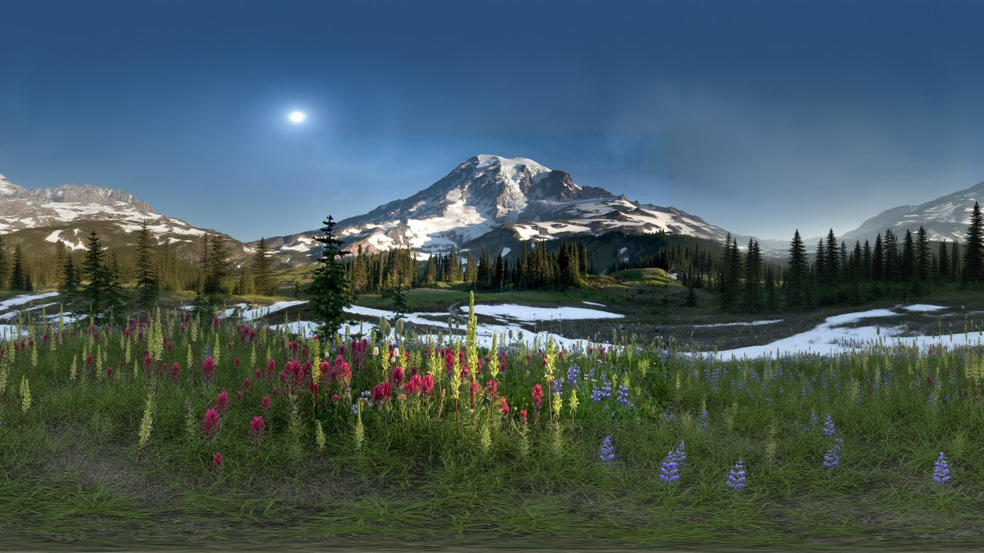
Jumping Into the Frame
Reconstructing interactive, physically-grounded 3D environments from a single image
Joshua Ford Advisor: Marie-Paule Cani

Slide 2
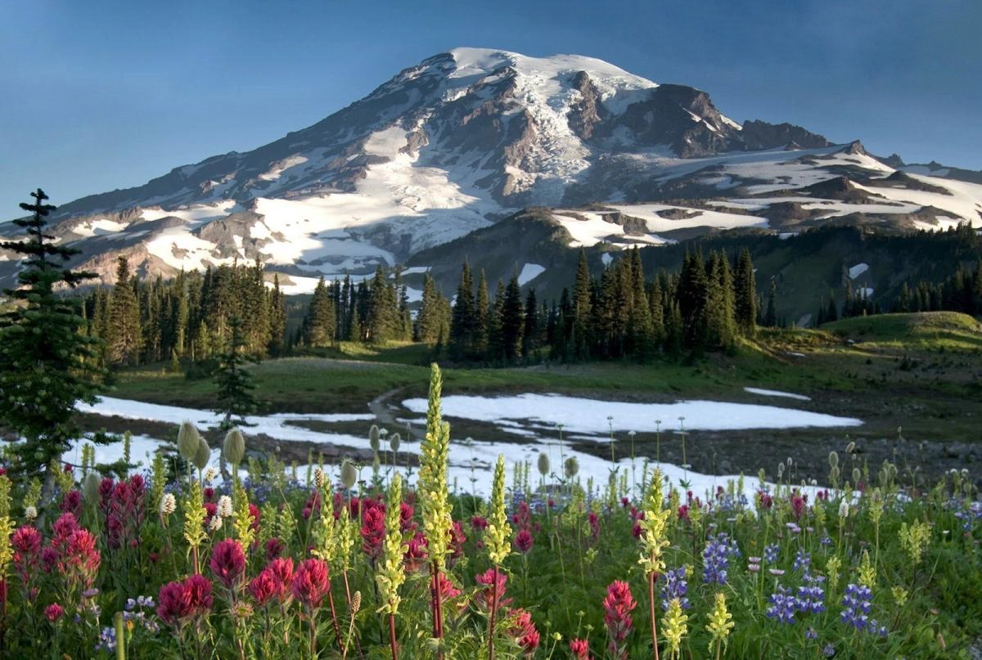
MOTIVATION
A photograph is not a place
— One view, infinitely many scenes. The problem is underconstrained.
— People read a photograph as a place anyway: ground past the frame, the far side of a rock, individual flowers.
— Photographs are abundant. 3D authoring is not.
— The goal is somewhere you can jump in, not a picture you can orbit.
One photograph — roughly a sixth of the sphere.
Interactive
objects animate and collide
Decomposed
entities, not painted texture
Plausible
beyond what was observed
Performant
stereo at headset frame rates
Introduction
2

Slide 3
THE CHALLENGE
Four problems that compound
Extreme ill-posedness
Five sixths of the sphere is never observed. Nor is anything behind an object.
Compounding error
Depth, then geometry, then materials, then objects. Each inherits every earlier error.
Heterogeneous content
A mountainside, a tree, a meadow, the sea. Four representations, one coordinate frame, one light.
Interactivity budget
Stereo at headset frame rates — binding hardest on exactly the parts that move.
Introduction
3

Slide 4
RELATED WORK
Prior work stops at viewable
Single-image panoramas
CubeDiff · DreamCube · PanoDreamer · LayerPano3D
WHERE WE DIFFER
They optimise fidelity near the original camera. We optimise physical decomposition — typed entities, not one geometry proxy:
· a collidable terrain mesh
· individually placed object meshes
· an instanced ground-cover population
· an animated water surface
The panorama is an intermediate representation, not the deliverable.
Single-image 3D scenes
SphericalDreamer · SonoWorld · 360Anything · WorldGen
Terrain, texture, arrangement
Pixels2Peaks · Earthbender · WorldBrush · Landlab · pattern texturing · point processes
Perception and reconstruction
Depth Anything 3 · SAM 2 · Grounding DINO · CLIP · SAM 3D · ObjectClear · LuxDiT · LTX-2
Related work
4

Slide 5
DESIGN PRINCIPLE
Reconstruct each part by its physical role
A scene is not one thing. Ground, objects, ground cover, water and sky differ in how they are built, textured, and how they behave.
Terrain
one height field, meshed at variable density, collidable
Objects
clustered by appearance, reconstructed once, instanced
Ground cover
scattered by density over a semantic and colour mask
Water
a separate levelled surface with an animated shader
Sky
skybox and image-based lighting source
Motion
a rigged sway, or a rigid body handed to physics
One representation for all of them means accepting that representation's limits.
Overview
5

Slide 6
42 STAGES, 38 ACTIVE IN THE DEFAULT CONFIGURATION
The pipeline
Terrain
Height field
Constrained reconstruction
Mesh + texture
THREE PANORAMA VARIANTS
Objects
Detection + typing
Appearance clustering
3D assets
Original
Ground cover
Spatial statistics
Population synthesis
Single photograph
Object-removed
Scene assembly
Sky-inpainted
Water
Region extraction
Levelled surface
streamed to the client as a .frame archive
Sky
Lighting estimation
Skybox
Geometry from the object-removed panorama; semantics from the original.
The server streams assets as they finish. The Unity client carries the shading, the wind and the physics.
Motion
Video generation
Motion extraction
Rigging
Overview
6

Slide 7
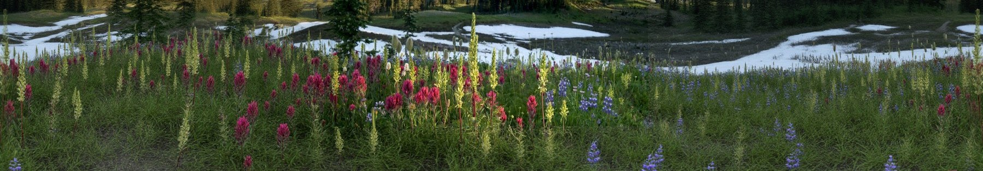
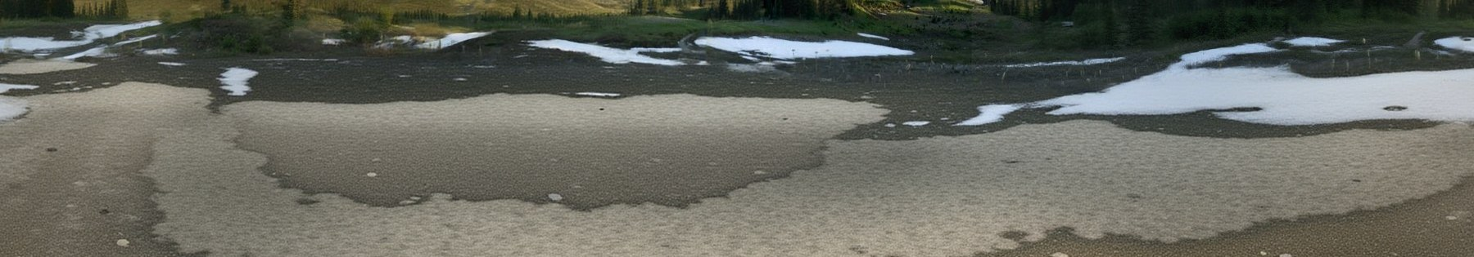
THE PANORAMIC SUBSTRATE
Three panoramas, because they answer different questions
Original
The only variant where the real objects remain. Every semantic stage reads it.
Object-removed
Depth through an occluder puts the flower canopy, not the ground, at the bottom of the height field.
Original (top) and object-removed (bottom): the meadow and the trees are gone with their shadows, exposing the ground behind them.
Sky-inpainted
Skybox and image-based lighting.
~83%
of the sphere is generated
3
panoramas kept in parallel
2×
region typing is run twice
The panoramic data
7

Slide 8
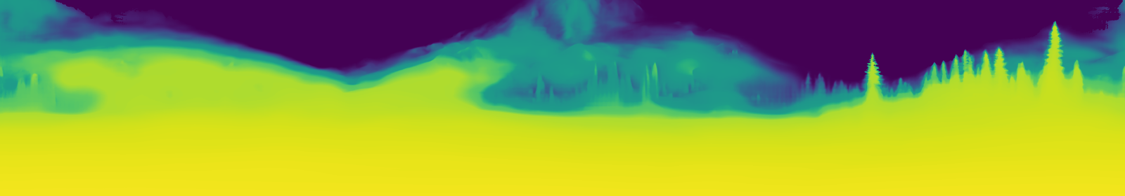
METRIC CALIBRATION
Relative depth, made metric — and made to fit
FITTING THE RESPONSE CURVE
FITTING THE TERRAIN BUDGET
— Panoramic depth is relative. The photograph's own metric depth calibrates it.
— 14 quantile bins, median knots, forced monotonic.
— Past the fitted range, extrapolate in log-depth — capped at 20×. Uncapped it invented tens of kilometres.
— Everything has to fit D_{max} = 100 m.
— A uniform rescale broke Rainier: 6.5×, and the camera ended up buried in its own terrain.
— So compress only the far end. The near field stays metric.
Calibrated panoramic depth, near field bright. Past the treeline the raw prediction has saturated and the whole range collapses into a narrow band. Sky is masked out rather than assigned a depth.
The panoramic data
8

Slide 9
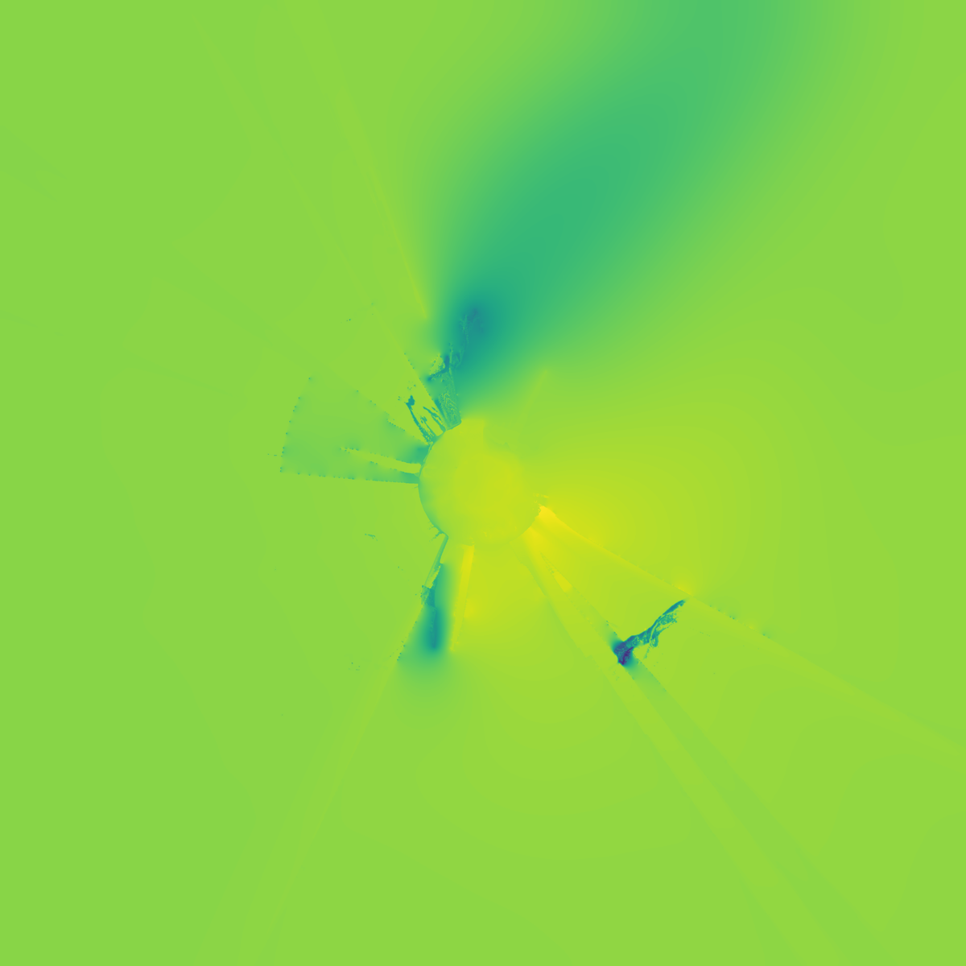
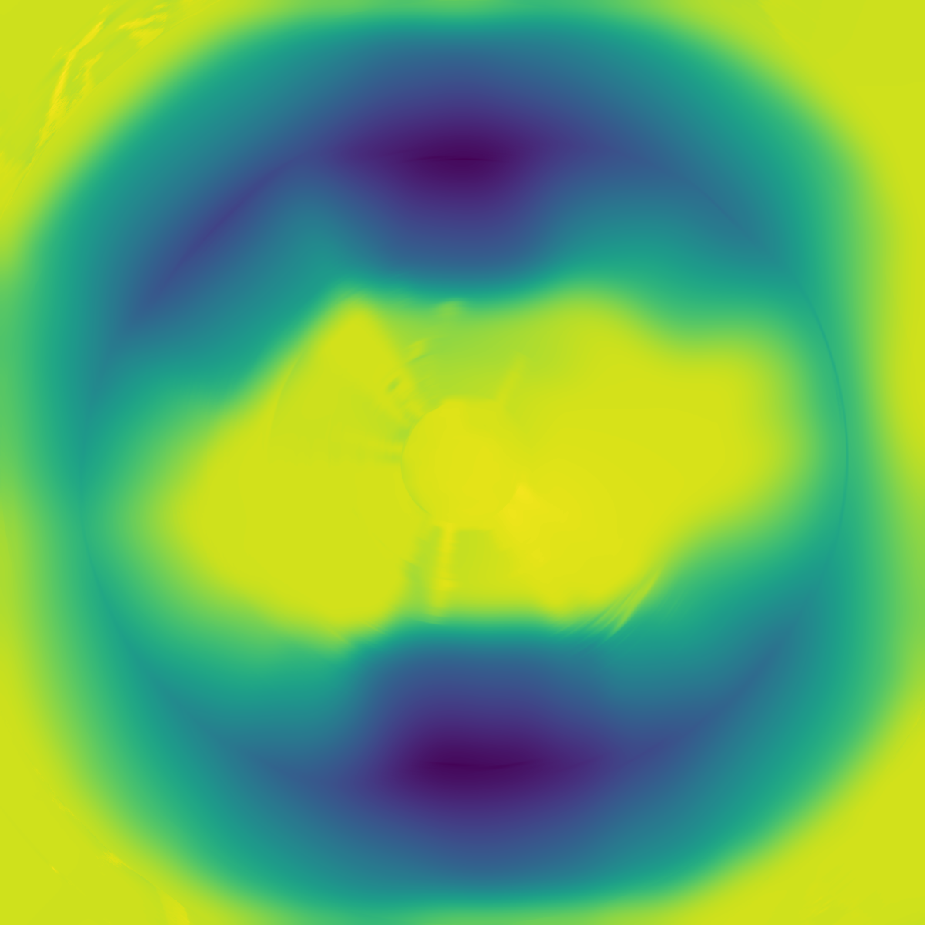
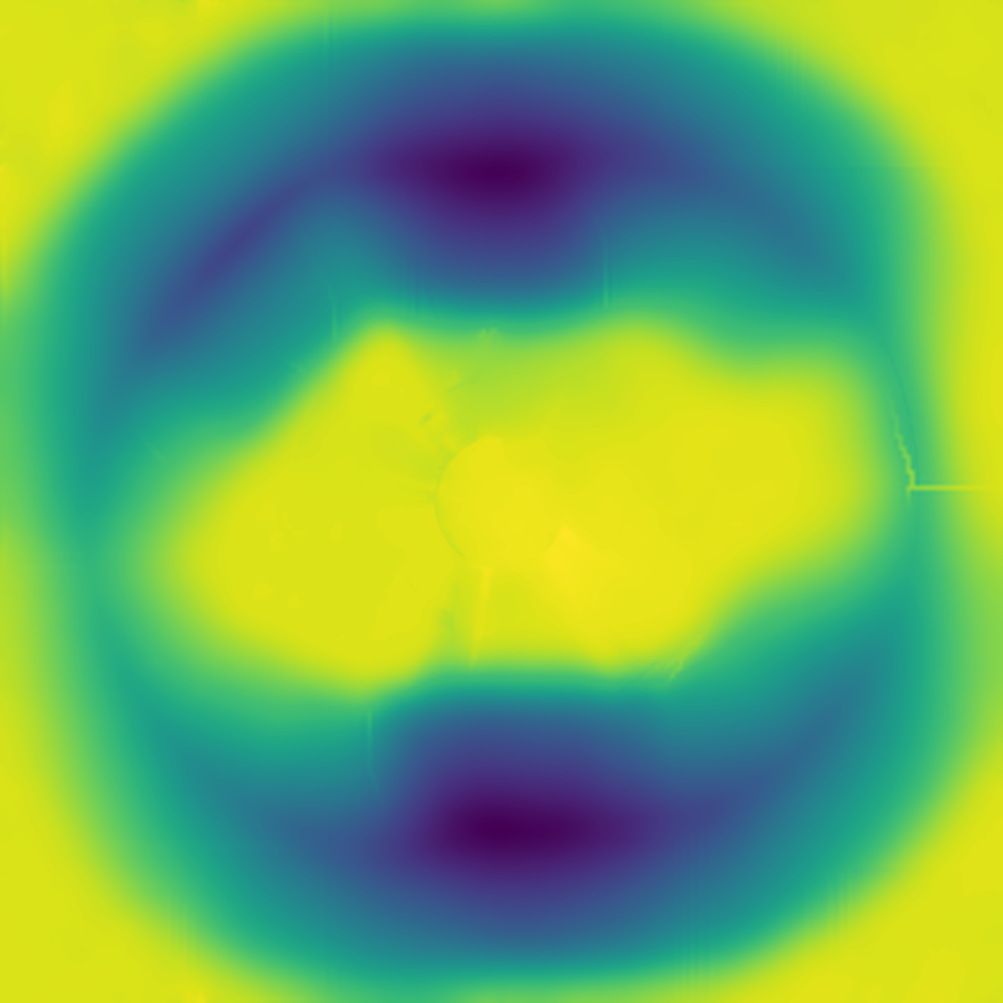
TERRAIN GEOMETRY
Measured ground is never modified
— A 4096² grid over 200 m.
— Every cell keeps the panorama pixel it was seen through.
— The solve never moves a measured cell.
Projected observations
7% of the grid, around the camera.
Harmonic completion
Measured cells are boundary conditions.
Erosion refinement
Only where nothing was observed.
DE-SPOKING
Per-column depth bias becomes a radial streak — inside the observed data, where the solve cannot touch it. A tangential high-pass removes only the angular component: elevation profile unchanged, cliff mask bit-identical, mean change 0.19 m.
Terrain
9

Slide 10
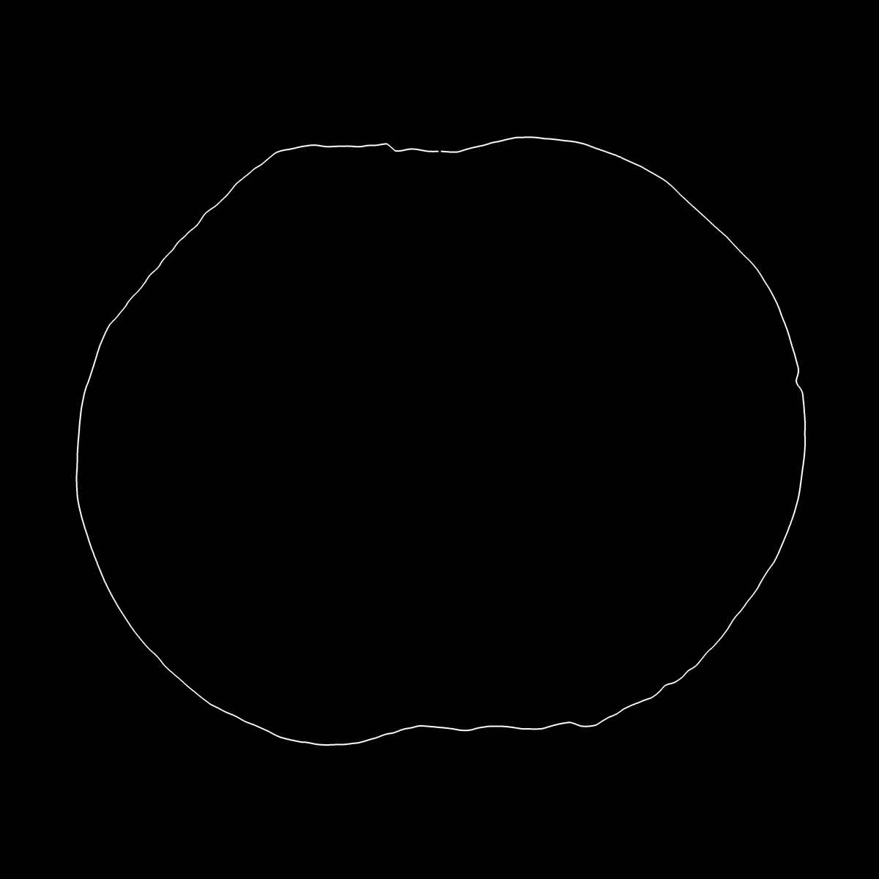
TERRAIN — THE LOAD-BEARING ASSUMPTION
The sky boundary is assumed to be the crest of ground
— Beyond depth range there is no measurement. The silhouette is the only signal left.
— Each column's first non-sky pixel becomes an elevation, placed at a fixed radius.
— A mountain kilometres away is brought close and shrunk: shape is preserved, distance is not.
— Erosion strength follows the same silhouette's jaggedness.
The extracted sky silhouette, top-down over the 200 m grid.
The assumption: that boundary is the crest of ground. It holds for Rainier and Shark Fin. It breaks Paris — slide 18.
Terrain
10

Slide 11
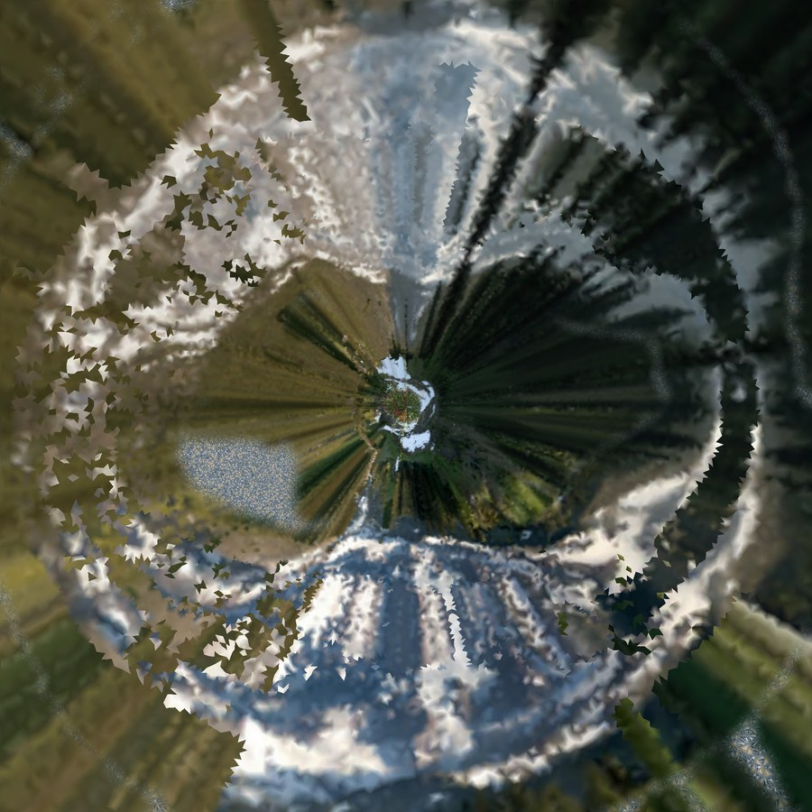
TERRAIN APPEARANCE
Projection smears the ground; patterns do not
WHY PROJECTION FAILS
A LAYERED SPLAT MATERIAL
— Grazing incidence. At 80 m one panorama row covers 12 m of ground.
— Upright content. A 0.5 m flower smears into a streak metres long — a radial pinwheel from above.
— Real photographic colour only where projection is trustworthy.
— Otherwise real material patches, cut from the panorama and assembled over the mesh's triangles.
— Generated tiles only where no real reference exists.
The baked terrain layer, top-down in texture space.
Tiles are prompted as an overhead flat lay under diffuse light. The tile is an albedo the client will light — shading baked into it would be applied twice.
Terrain appearance
11

Slide 12
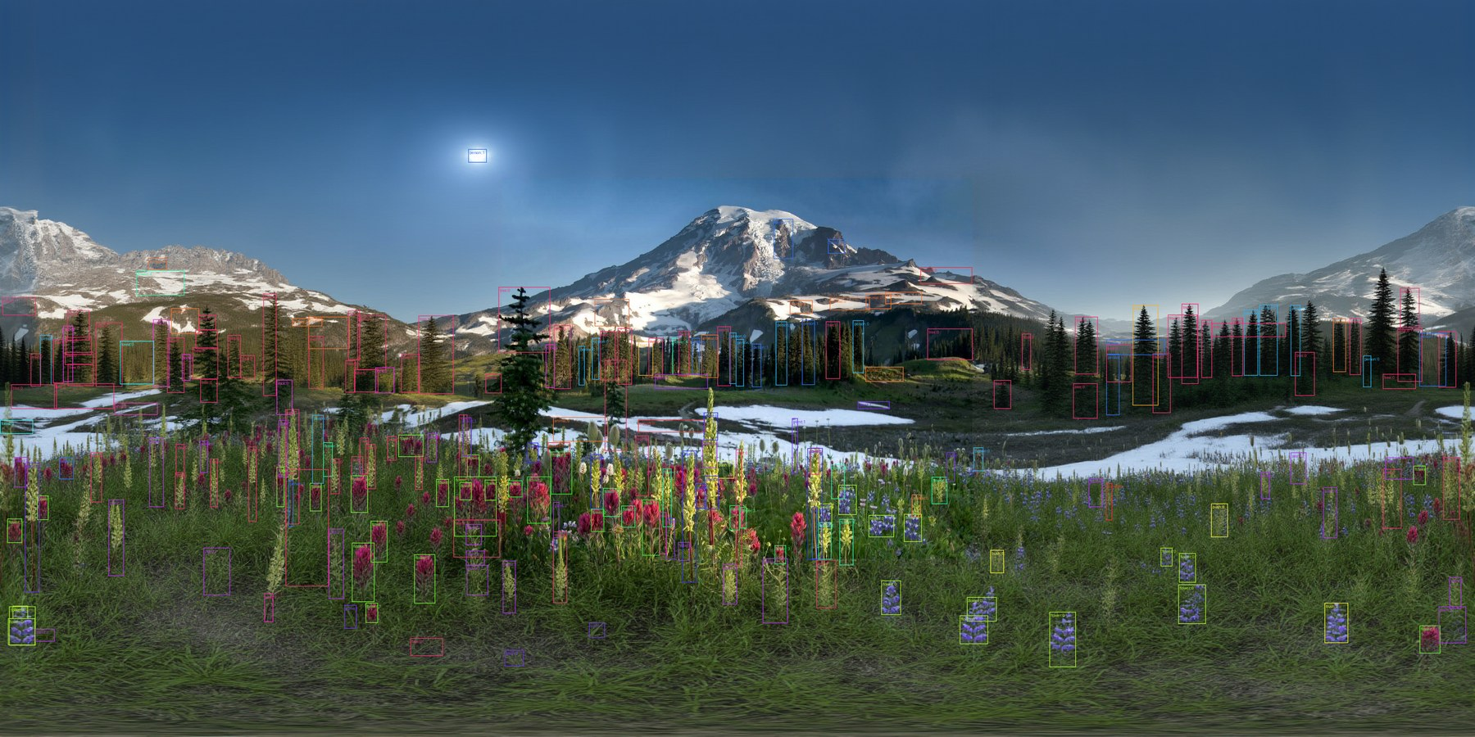
OBJECT DECOMPOSITION
CLIP proposes; an independent model disposes
— SAM 2 on the panorama, tiled and merged.
— CLIP proposes a label; Grounding DINO has to find it in the crop.
— CLIP always ranks — with no real signal, something still wins.
— Sub-clustered by DINOv2 appearance: flower colours, tree species.
— Buckets are bounded. An unbounded cut gave 302 groups.
Detections after appearance clustering, coloured by bucket. Segmentation runs on the panorama, so detections cover the full 360°.
One mesh per (class, bucket), instanced at every member — reconstruction is paid per bucket, not per instance.
Objects
12

Slide 13
LEVEL OF DETAIL
Resolvability decides the representation
1 Mesh
reconstructed once per group, instanced — when it renders large enough to resolve as geometry
2 Crossed card
three planes, twelve triangles; holds a silhouette from any angle, and inherits the sway rig
3 Billboard
one camera-facing quad. Last resort: in stereo it reads flat and swings with the head
— Crop chosen by resolution, not score: too few pixels returns a different object — a flat sheet.
— Representation chosen by projected angular size, not distance.
WHY CARDS EXIST, AND ONLY FOR VEGETATION
SAM 3D returns a conifer at 3.50:1 against detections at 0.12:1 — a 28× disagreement. 70 of 75 instances fall back to cards.
128
meshes
9,303
cards
33
billboards
2.48 M
triangles, from 4.47 M
Objects
13

Slide 14
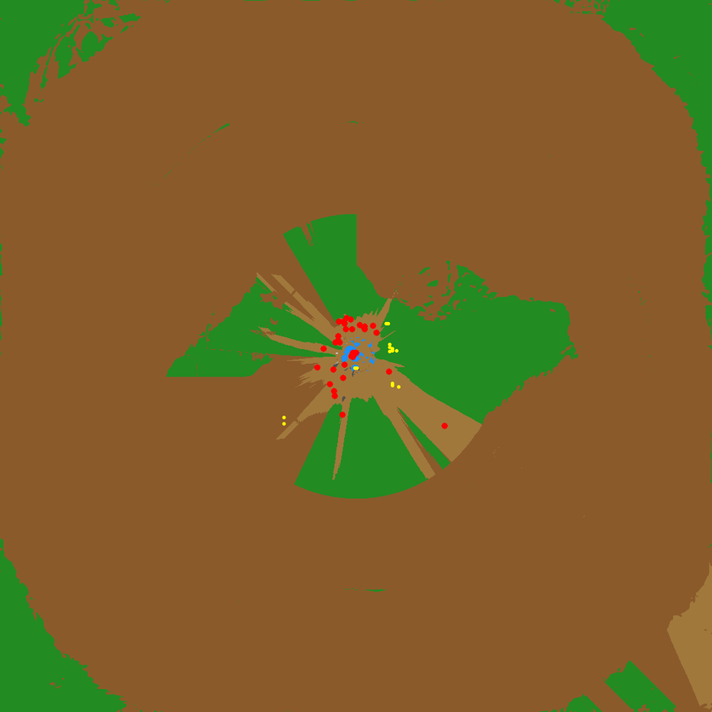
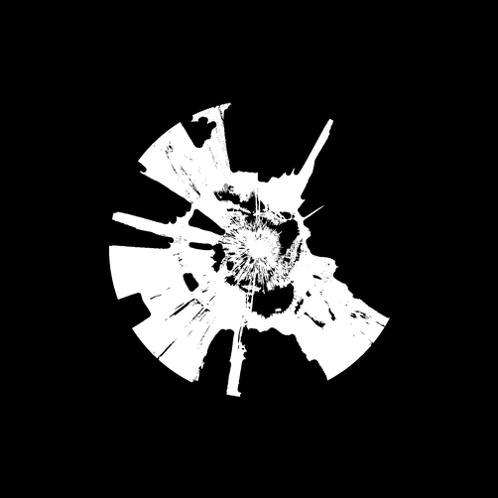
POPULATION SYNTHESIS
A detector finds tens of flowers in a meadow of thousands
Place only what was detected and the eye sees the sampling pattern, not the meadow.
Population synthesis
Where else would this class be? Match the measured pair-correlation over the rest of the admissible region.
Ground cover
What is the ground made of? A mask, not instances — read from the original panorama, which still has its meadow.
Synthesised tree population.
Ground-cover mask (zoomed).
COLOUR SETTLES WHAT THE LABEL SET CANNOT
One ground class folds meadow together with snowfield. The excess-green of each cell's own panorama pixel separates them — then the same measurement weights the density.
Population synthesis
14

Slide 15
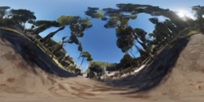
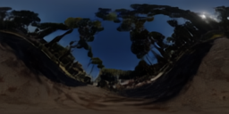

LIGHTING
Estimate the light, then take it out of everything
— LuxDiT recovers an HDR environment and a dominant direction. The client uses both.
— Every crop already carries the light of the day it was taken. Relighting it doubles the illumination.
— IntrinsicDiffusion de-lights crops, so what the client relights is material colour.
— That is also what makes assets portable — synthesis puts them anywhere.
Tone-mapped
Log scale
The log view exposes the range the client samples: the sun is a compact lobe well above the sky around it.
AND THE SKY ITSELF
The sky-inpainted panorama is skybox and image-based lighting source — one artefact doing two jobs.
Lighting and animation
15

Slide 16
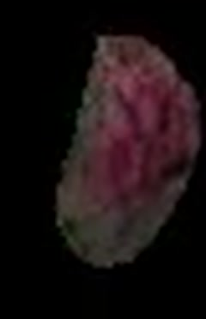



ANIMATION
Motion is measured; the wind is authored
— LTX-2 video, camera locked off — so drift is the object moving, not the camera.
— Drift under 60% of its own bounding-box diagonal means stationary.
— Stationary gets a three-bone rig. Timing is per instance, the skeleton is shared: a meadow stays one draw.
— Anything else is a rigid body — velocity and acceleration handed to physics.
0 s
1.2 s
2.3 s
3.9 s
One tracked flower through the generated video. It tilts and recovers while staying in place — the signal that types it as anchored.
ONE SHARED WIND FIELD
One global field, not per-object oscillators. A gust crosses the meadow and everything in its path answers in turn.
Still authored. Deriving it from the video is future work.
Lighting and animation
16

Slide 17
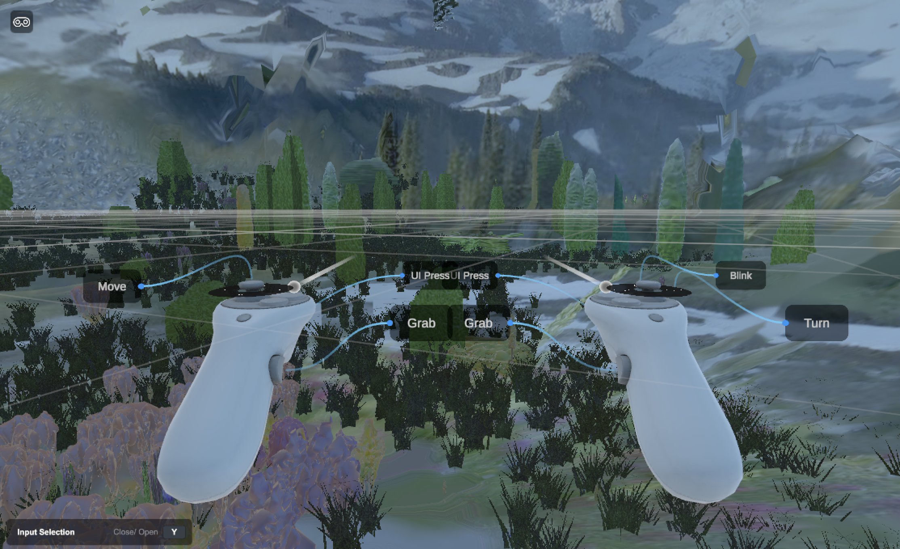
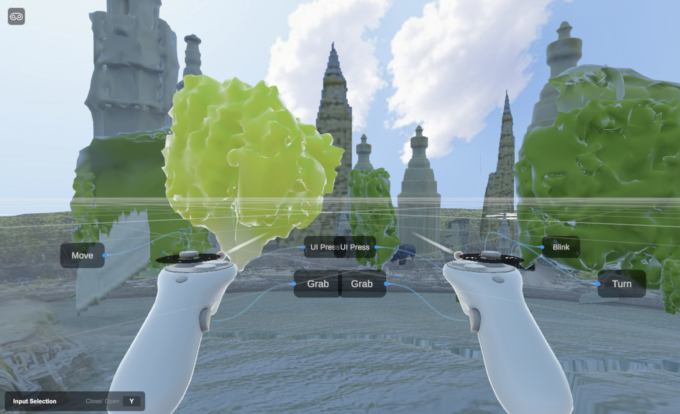
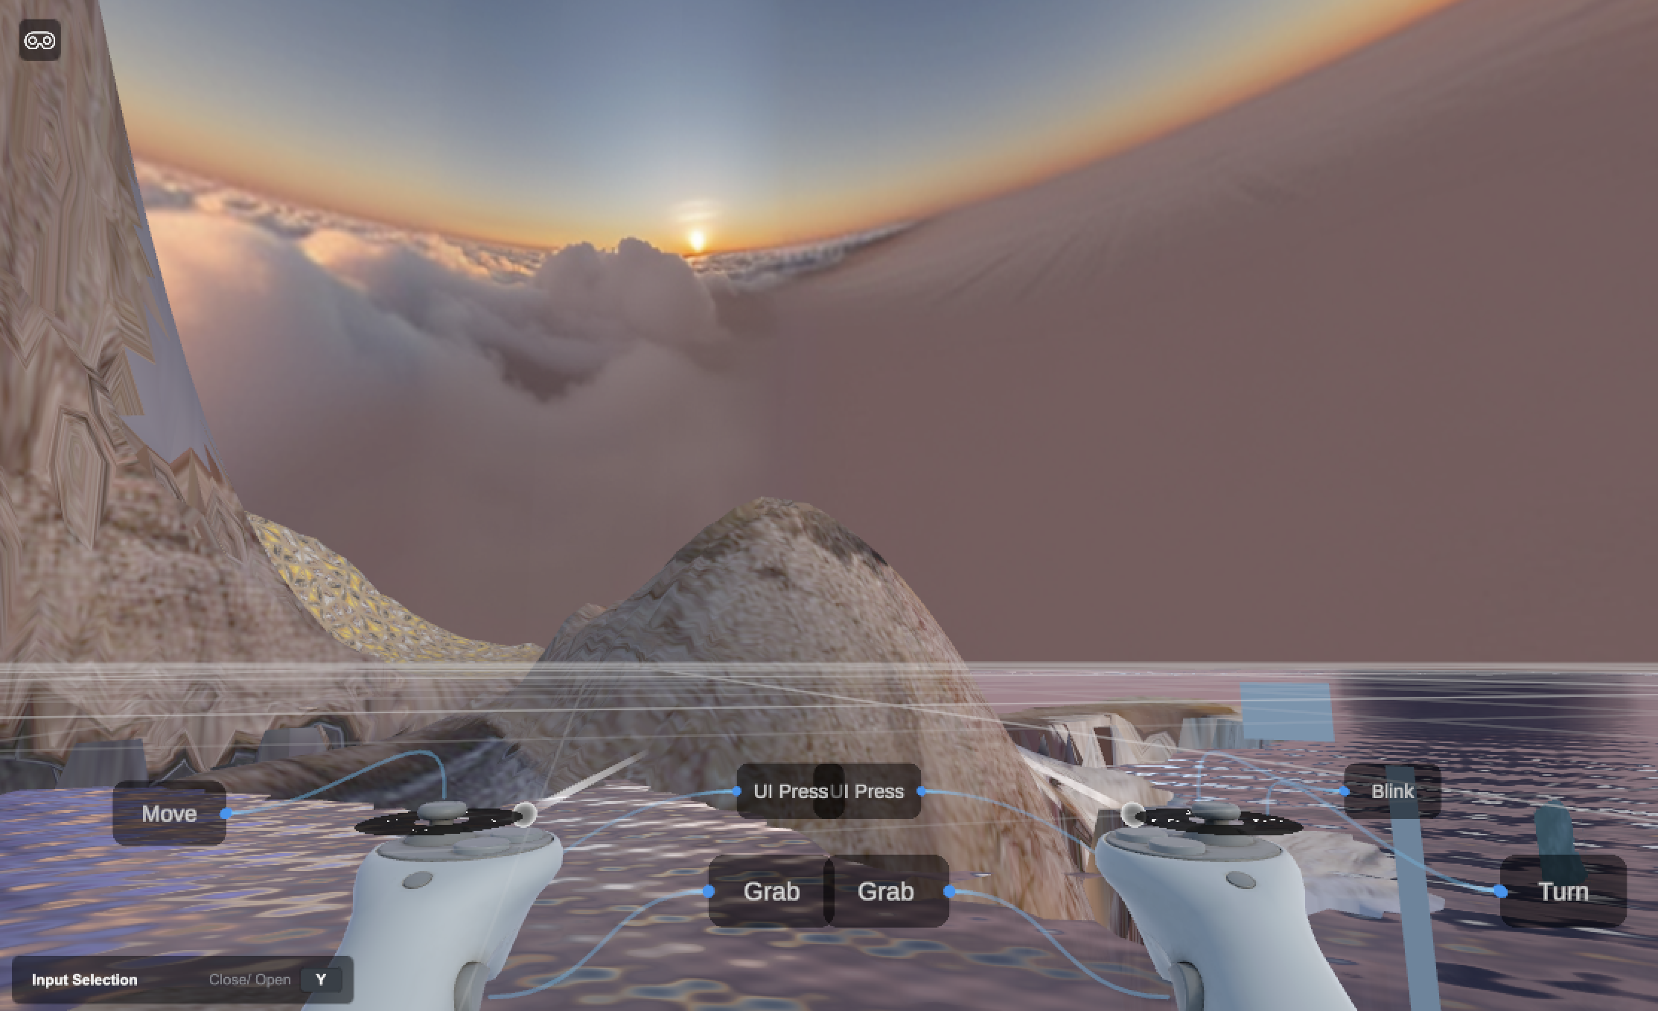
RESULTS
Three captures, chosen to break different assumptions
No ground-truth 3D exists, so evaluation is diagnostic: instrument, measure, and localise each defect to a stage.
Mount Rainier
alpine meadow, dense vegetation, snow
128 / 9,303 / 33 mesh / card / billboard
+35 m relief added
Breaks on: Conifer reconstruction
Paris
flat urban river scene, architecture
27 / 4 / 56 mesh / card / billboard
+78 m relief added
Breaks on: Skyline read as landform
Shark Fin Cove
coastal cliffs, open water, sea stacks
0 / 1 / 42 mesh / card / billboard
+81 m relief added
Breaks on: Detections are rock fragments
Results
17

Slide 18
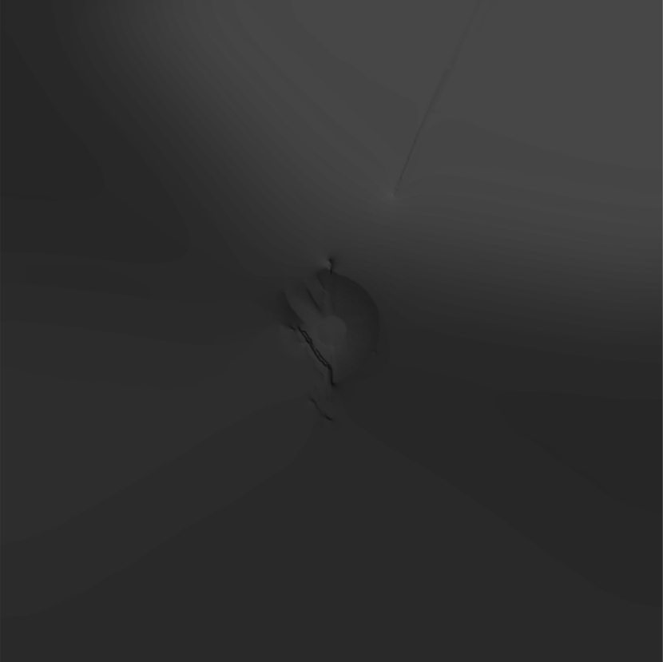
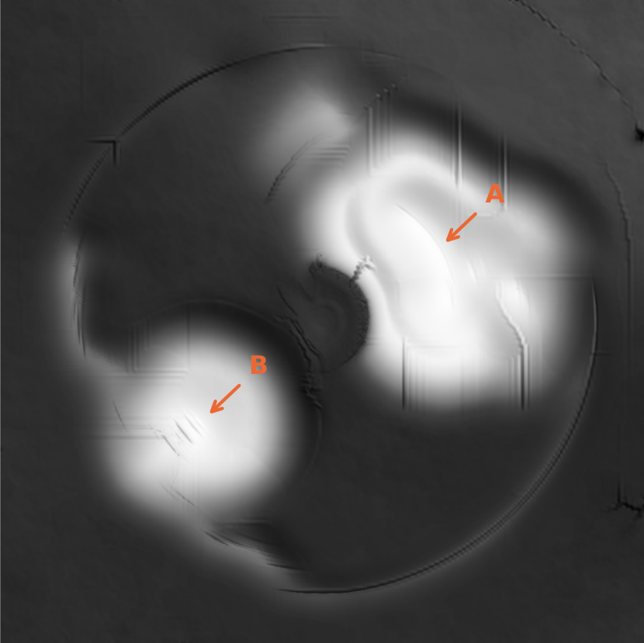
RESULTS
Every failure localises to an assumption, not a model
PARIS HEIGHT FIELD
Skyline read as landform
Terrain-typed silhouette columns: Paris 0%, Rainier 98%, Shark Fin 100%. Not one column of Paris's horizon is a landform.
Confident misclassification on texture
49 detections at median confidence 0.95. A rock typed person, captioned “a piece of pizza with bacon on it”.
Measured: −6.0 to −0.2 m, correctly flat. After ridge anchoring: −13.1 to +70.9 m. Hill A is the right-bank treeline, B the cathedral. One shared shading scale.
Water followed the terrain beneath it
One 11,872 m² body of sea spanning 73.5 m of elevation. The ocean draped up the cliffs.
Far-field texel density
67.8% of Shark Fin's terrain over 0.5 m per texel, against 20.9%. Within 25 m the captures are indistinguishable.
A defect can surface far from its cause: size compression starts in depth calibration and shows up eight stages later.
Results
18

Slide 19
REMEDIATION
Make the premise testable, not the threshold tunable
Each fix makes an implicit premise testable from evidence already computed — and is measured on every capture, not just the one that motivated it.
MEASURE
PREMISE MADE TESTABLE
MEASURED EFFECT
Silhouette composition gate
The sky boundary is the crest of ground
0% / 98% / 100%. Suppressed on Paris only; others bit-identical.
Per-crop region plausibility
This class can occupy the region its box sits in
Removes 9 / 4 / 12 detections. No false positives.
Caption–scene plausibility
The caption describes something this scene can contain
A further 2 / 9 / 16. Needs four conjunctive conditions.
Water surface levelling
The ground beneath water is flat
Shark Fin 73.5 m spread down to 0.00 m; shoreline step 0.14 m.
Projected-size level of detail
Distance predicts resolvability
Rainier 545 meshes down to 296; 4.47 M triangles to 2.48 M.
Resolution-based crop selection
The best-scoring crop is the best reconstruction input
Crop area up 1.0–9.2×. 205 of 471 instances had been degenerate.
Geometric UV-fold repair
Adjacent grid cells observed adjacent panorama rows
5,624 triangles collapsed on Rainier (7.0%). Face count unchanged.
Occluder-footprint inpainting
What foreground removal left behind is ground
Fabricated fill below the horizon: 23.9% down to 17.1%.
Results
19

Slide 20
CONCLUSIONS
Learned models answer what; classical methods decide how
— Learned and classical, roughly two to one by stage count.
— Generative models supply what was never observed. Nothing classical can.
— They do not supply a collidable surface, a samplable density, or a mesh with a skeleton in it.
— 12 of 38 active stages use no learned model — and those are the ones producing behaviour.
— The surviving defects are assumption failures, not model failures.
FUTURE WORK
Explicit scene classification so no stage assumes a scene type
Confidence propagation so the system can say where it is guessing
Thin-structure reconstruction species-aware priors for vegetation
Joint refinement depth, geometry and placement together
Perceptual evaluation a user study — our clearest gap
The boundaries are legible and measurable. Addressing them means making implicit commitments explicit.
Conclusions and future work
20

Slide 21
REFERENCES
Work this builds on
PANORAMA AND SCENE GENERATION
SEGMENTATION, DETECTION, RECOGNITION
TERRAIN, TEXTURE AND ARRANGEMENT
Kalischek et al. 2025 — CubeDiff
Huang et al. 2025 — DreamCube
Paliwal et al. 2025 — PanoDreamer
Yang et al. 2025 — LayerPano3D
Xie 2025 — WorldGen
Schnepf et al. 2026 — SphericalDreamer
Jin et al. 2026 — SonoWorld
Wu et al. 2026 — 360Anything
Ravi et al. 2025 — SAM 2
Liu et al. 2024 — Grounding DINO
Radford et al. 2021 — CLIP
Li et al. 2022 — BLIP
Xiao et al. 2024 — Florence-2
Zhang et al. 2024 — Recognize Anything
Huang et al. 2024 — Tag2Text
Huang et al. 2025 — RAM++
Xie et al. 2021 — SegFormer
Zheng et al. 2024 — BiRefNet
Oquab et al. 2024 — DINOv2
Jain et al. 2026 — Pixels2Peaks
Génevaux et al. 2015 — Terrain from feature primitives
Barazandeh et al. 2025 — Earthbender
Emilien et al. 2015 — WorldBrush
Barnhart 2020; Hobley 2017; Hutton 2020 — Landlab
Neyret & Cani 1999 — Pattern-based texturing
Geyer & Møller 1994 — Spatial point processes
Hurtut et al. 2009 — Element arrangement by example
DEPTH ESTIMATION
OBJECT RECONSTRUCTION AND INPAINTING
Lin et al. 2025 — Depth Anything 3
Lin et al. 2025 — Depth Any Panoramas
SAM 3D Team 2025 — SAM 3D
Huang et al. 2025 — SPAR3D
Xiang et al. 2025 — TRELLIS
Suvorov et al. 2022 — LaMa
Li et al. 2022 — MAT
Yu et al. 2023 — Inpaint Anything
Zhao et al. 2026 — ObjectClear
Lee et al. 2024 — Tree-D Fusion
LIGHTING AND VIDEO
IMAGE SYNTHESIS
Liang et al. 2025 — LuxDiT
Luo et al. 2024 — IntrinsicDiffusion
Lightricks 2026 — LTX-2
Esser et al. 2024 — Rectified flow transformers
Rombach et al. 2022 — Latent diffusion
Conde et al. 2022 — Swin2SR
Full bibliography — 46 entries — in the report.
References
21

