Slide 1
Assignment-1
For an organization of your choice, choose a set of business processes. Design star / snow flake schemas for analyzing these processes. Create a fact constellation schema by combining them. Extract data from different data sources, apply suitable transformations and load into destination tables using an ETL tool. For Example: Business Origination: Sales, Order, Marketing Process.

Slide 2
ETL
ETL is defined as a process that extracts the data from different RDBMS source systems, then transforms the data (like applying calculations, concatenations, etc.) and finally loads the data into the Data Warehouse system. ETL full-form is Extract, Transform and Load.

Slide 3
Why do you need ETL?
It helps companies to analyze their business data for taking critical business decisions.
Transactional databases cannot answer complex business questions that can be answered by ETL.
A Data Warehouse provides a common data repository
ETL provides a method of moving the data from various sources into a data warehouse.
As data sources change, the Data Warehouse will automatically update.
Well-designed and documented ETL system is almost essential to the success of a Data Warehouse project.
Allow verification of data transformation, aggregation and calculations rules.
ETL process allows sample data comparison between the source and the target system.
ETL process can perform complex transformations and requires the extra area to store the data.
ETL helps to Migrate data into a Data Warehouse. Convert to the various formats and types to adhere to one consistent system.

Slide 4
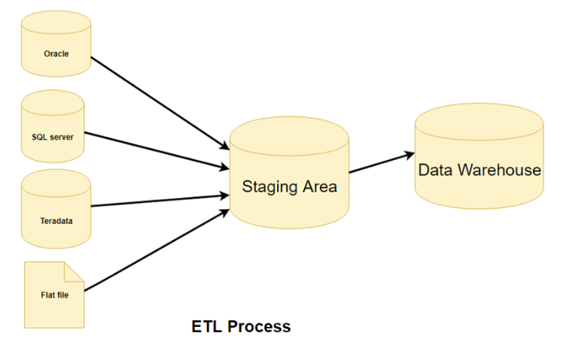

Slide 5
Step 1) Extraction
In this step, data is extracted from the source system into the staging area. Transformations if any are done in staging area so that performance of source system in not degraded. Also, if corrupted data is copied directly from the source into Data warehouse database, rollback will be a challenge. Staging area gives an opportunity to validate extracted data before it moves into the Data warehouse.
Data warehouse needs to integrate systems that have different

Slide 6
DBMS, Hardware, Operating Systems and Communication Protocols. Sources could include legacy applications like Mainframes, customized applications, Point of contact devices like ATM, Call switches, text files, spreadsheets, ERP, data from vendors, partners amongst others.
Hence one needs a logical data map before data is extracted and loaded physically. This data map describes the relationship between sources and target data.
Three Data Extraction methods:
Full Extraction
Partial Extraction- without update notification.
Partial Extraction- with update notification

Slide 7
Some validations are done during Extraction:
Reconcile records with the source data
Make sure that no spam/unwanted data loaded
Data type check
Remove all types of duplicate/fragmented data
Check whether all the keys are in place or not

Slide 8
Step 2) Transformation
Data extracted from source server is raw and not usable in its original form. Therefore it needs to be cleansed, mapped and transformed. In fact, this is the key step where ETL process adds value and changes data such that insightful BI reports can be generated.
In this step, you apply a set of functions on extracted data. Data that does not require any transformation is called as direct move or pass through data.
In transformation step, you can perform customized operations on data. For instance, if the user wants sum-of-sales revenue which is not in the database.

Slide 9
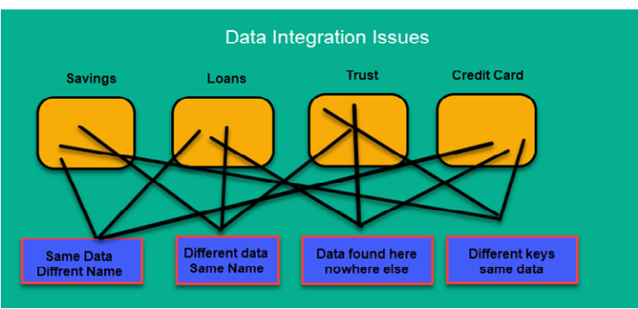

Slide 10
Following are Data Integrity Problems:
Different spelling of the same person like Jon, John, etc.
There are multiple ways to denote company name like Google, Google Inc.
Use of different names like Cleaveland, Cleveland.
There may be a case that different account numbers are generated by various applications for the same customer.
In some data required files remains blank
Invalid product collected at POS as manual entry can lead to mistakes.

Slide 11
Validations are done during this stage
Filtering – Select only certain columns to load
Using rules and lookup tables for Data standardization
Character Set Conversion and encoding handling
Conversion of Units of Measurements like Date Time Conversion, currency conversions, numerical conversions, etc.
Data threshold validation check. For example, age cannot be more than two digits.
Data flow validation from the staging area to the intermediate tables.
Required fields should not be left blank.
Cleaning ( for example, mapping NULL to 0 or Gender Male to "M" and Female to "F" etc.)
Split a column into multiples and merging multiple columns into a single column.
Transposing rows and columns,
Use lookups to merge data
Using any complex data validation (e.g., if the first two columns in a row are empty then it automatically reject the row from processing)

Slide 12
Step 3) Loading
Loading data into the target datawarehouse database is the last step of the ETL process. In a typical Data warehouse, huge volume of data needs to be loaded in a relatively short period (nights). Hence, load process should be optimized for performance.
In case of load failure, recover mechanisms should be configured to restart from the point of failure without data integrity loss. Data Warehouse admins need to monitor, resume, cancel loads as per prevailing server performance.
Types of Loading:
Initial Load — populating all the Data Warehouse tables
Incremental Load — applying ongoing changes as when needed periodically.
Full Refresh —erasing the contents of one or more tables and reloading with fresh data.

Slide 13
Load verification
Ensure that the key field data is neither missing nor null.
Test modeling views based on the target tables.
Check that combined values and calculated measures.
Data checks in dimension table as well as history table.
Check the BI reports on the loaded fact and dimension table.

Slide 14
ETL tools
There are many Data Warehousing tools are available in the market. Here, are some most prominent one:
1. MarkLogic:
MarkLogic is a data warehousing solution which makes data integration easier and faster using an array of enterprise features. It can query different types of data like documents, relationships, and metadata.
http://developer.marklogic.com/products
2. Oracle:
Oracle is the industry-leading database. It offers a wide range of choice of Data Warehouse solutions for both on-premises and in the cloud. It helps to optimize customer experiences by increasing operational efficiency.
https://www.oracle.com/index.html

Slide 15
ETL tools Contd.
3. Amazon RedShift:
Amazon Redshift is Datawarehouse tool. It is a simple and cost-effective tool to analyze all types of data using standard SQL and existing BI tools. It also allows running complex queries against petabytes of structured data.
https://aws.amazon.com/redshift/?nc2=h_m1
4] CloverETL
5] Jedox
6] Pentaho
7] Talend
8] Informatica PowerCenter
9] Microsoft SQL Server SSIS
10] Panoply etc.

Slide 16
The star schema and the snowflake schema are ways to organize data marts or entire data warehouses using relational databases.
Both of them use dimension tables to describe data aggregated in a fact table.
So we can expect to find some type of sales model inside the data warehouse of nearly every company. Let‟s take one more look at the sales model in both the star and snowflake schemas.

Slide 17
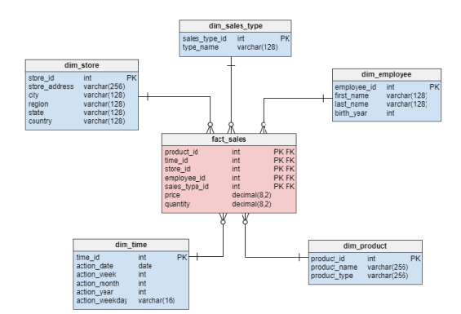

Slide 18
Characteristics of Star Schema:
Every dimension in a star schema is represented with the only one-dimension table.
The dimension table should contain the set of attributes.
The dimension table is joined to the fact table using a foreign key
The dimension table are not joined to each other Fact table would contain key and measure
The Star schema is easy to understand and provides optimal disk usage.
The dimension tables are not normalized. For instance, in the above figure, Country_ID does not have Country lookup table as an OLTP design would have. • The schema is widely supported by BI Tools

Slide 19
A Snowflake Schema is an extension of a Star Schema, and it adds additional dimensions.
It is called snowflake because its diagram resembles a Snowflake.
The dimension tables are normalized which splits data into additional tables.
In the following example, Country is further normalized into an individual table.

Slide 20
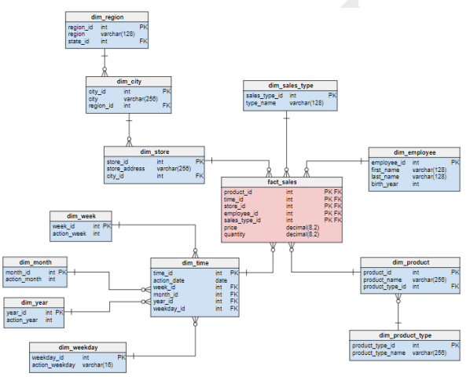

Slide 21
Rapidminer Assignment-1 Access Sample Dataset
How to Create Local Repository Click on icon near repository ->Create Repository or Folder
1. Go to operator Section-> Click on Retrieve and Drag into design menu-> Visit Parameter Section Click on Folder Option-> Sample->Click on Titanic ->Ok
For Show Result
2.Connect the output port to res ie result port->Click on RUN button see result.
Row=Record Column=Attribute/varriable

Slide 22
Assignment-2 Importing Data
1. Down Customer Churn dataset from google
Churn rate (sometimes called attrition rate), in its broadest sense, is a measure of the number of individuals or items moving out of a collective group over a specific period.
Loyality- Existing Customer
Company want to find Who is going to be Churn & Who is going to be Loyal

Slide 23
1. Visit Repository Section-> Select my first prediction->Create sub Folder Data in same.-> Create sub folder process in same.
2. Click on Add Data/Import data tab -> browse data from Computer->Next->Load data it look like Spreadsheet->it shows all data selected.->if you want see result type b,c in cell range->See the Result-> Next->Click on last transaction-> see all option
Eg. Churn- polynomial
3. Click on Change role->Select label->on

Slide 24
It shown Churn Column in green color mean special role.
Other Attribute are Regular Attribute
Now Select my First Prediction->Data Folder-Give name Customer Data->Finish
Rapidminer Loaded this data in result view
To Retrive data Drag and drop Customer Data from repository to design view

Slide 25
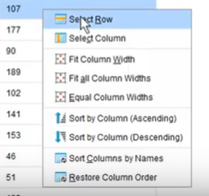
Assignment 3 – Visualizing data
See the Example dataset (Retrieve Customer data)
Click on any cell perform the operation

Slide 26

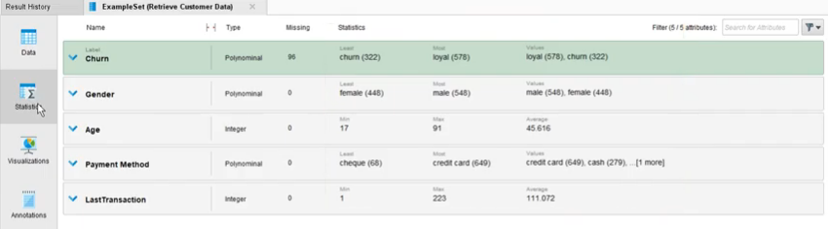
Click on Filter Option see the different stat

Slide 27

Now Click on Age->Click on hyperlink-> See the Result
Select Xaxis-Age vs Yaxis as transaction add the same see both graph
Select different chart style
Change color
Export images by click on export menu in right corner->File Print

Slide 28
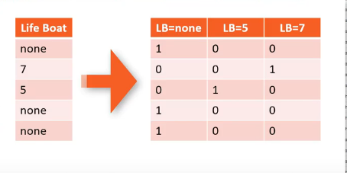
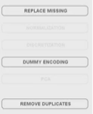
Assignment 4
Perform various Operation
Load Titanic Dataset
See no of rows and column
See the Structure and unstructured data
Like name or ticket no while cabin is unstrct.
See cleanse section-> Select life boat column

Slide 29
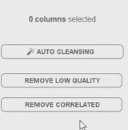
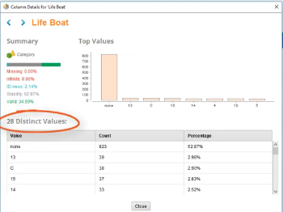

Click on any cell->Right Click->See details->Click on dummy encoding Apply
Click on icon see the description

Slide 30
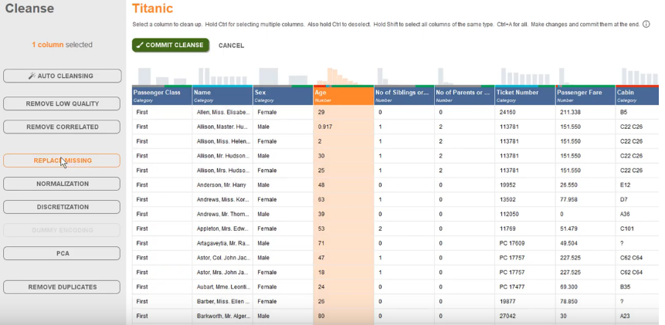
Select Attribute see the Possible Operation shown

Slide 31

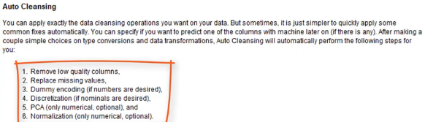
See the Steps in help
Click on Auto Cleansing->Next->Next ->Finish->see row Column value now
Click on Model

Slide 32
Home Work
Merging Data
Pivoting Data
Data Preparation
https://www.youtube.com/watch?v=Gg01mmR3j-g&list=PLssWC2d9JhOZLbQNZ80uOxLypglgWqbJA

