Slide 1
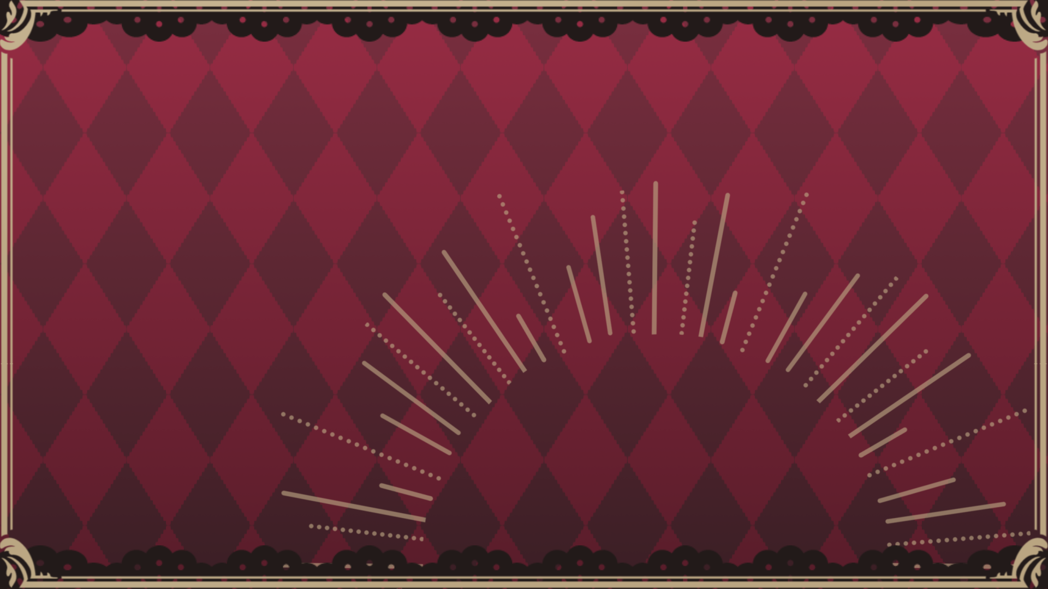
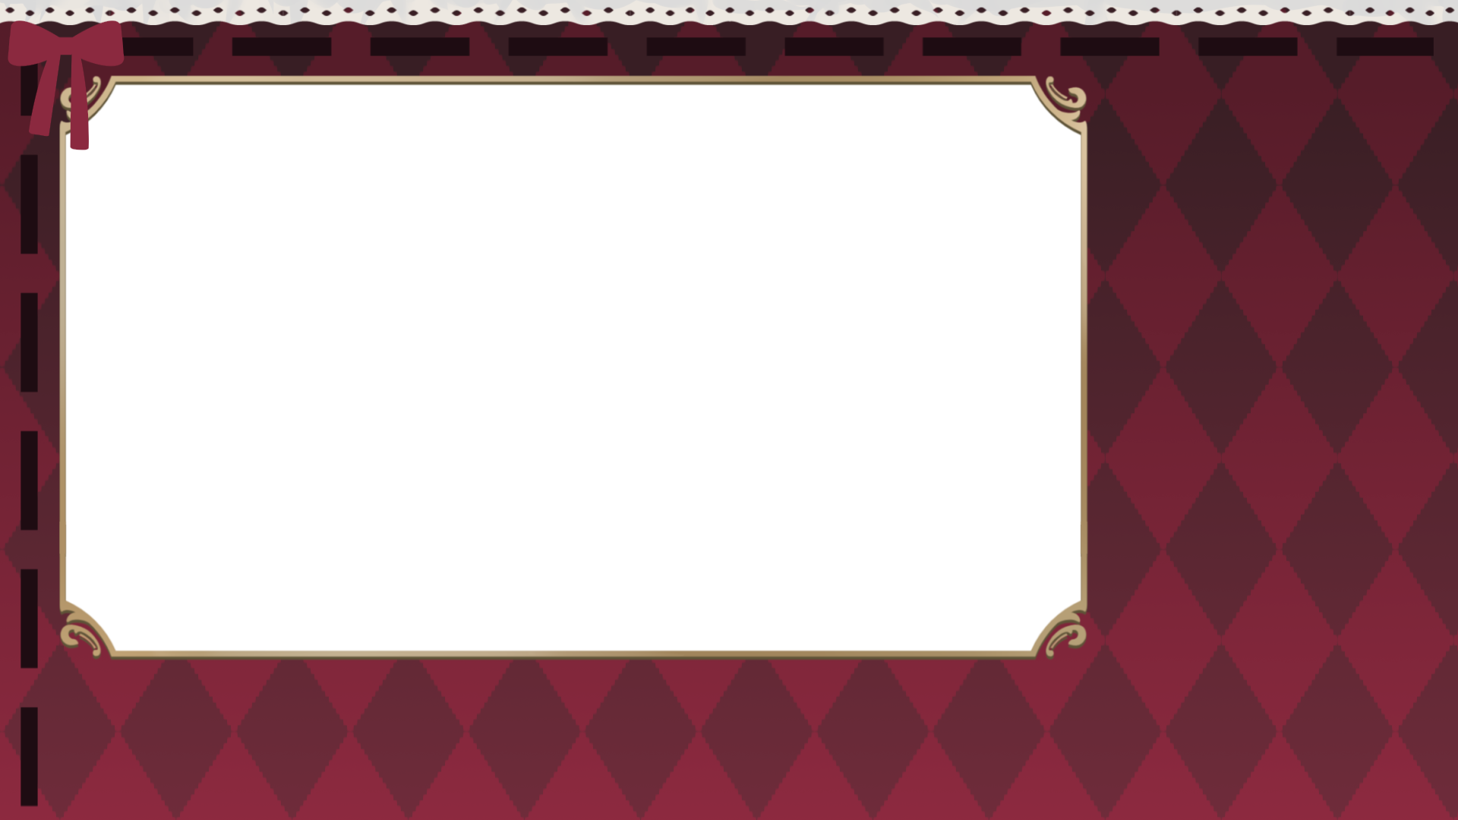
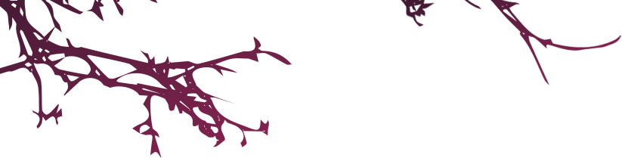
自我介紹

Slide 2
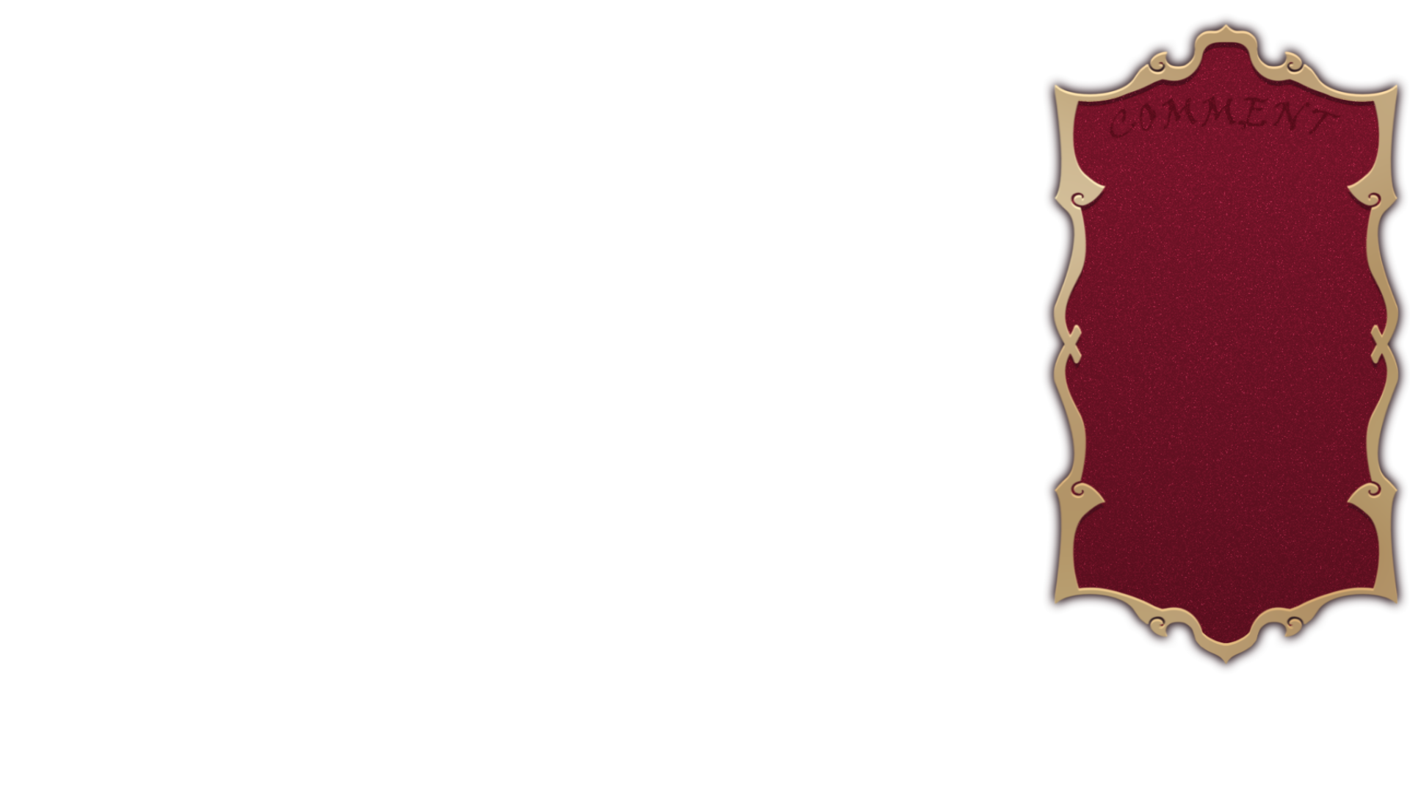
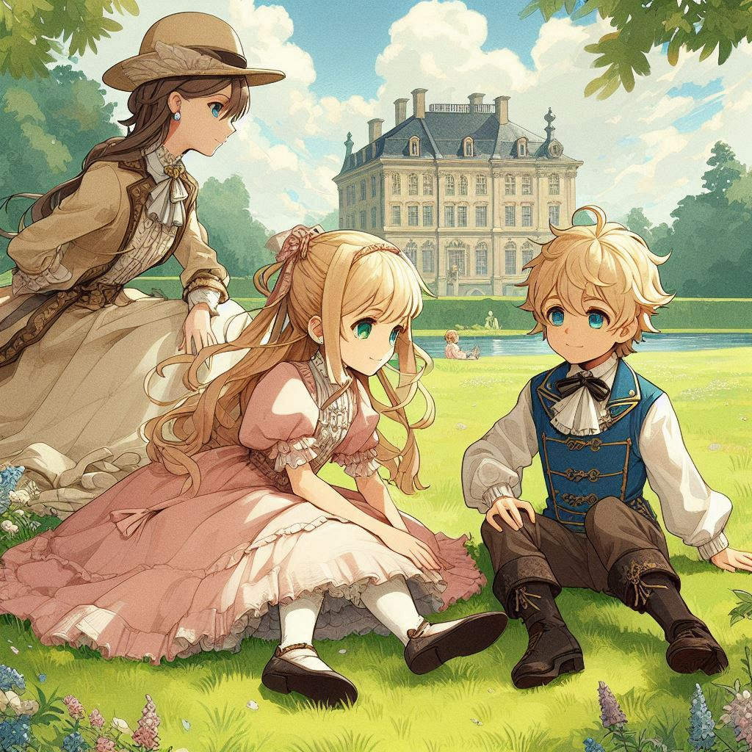

目標
Notes:
a girl and a boy, they are similar, around childhood age, both with blonde hair, are playing on a grassy field, accompanied by their mother nearby. They are dressed in Western European classical attire, with a European noble palace in the background, creating an aristocratic ambiance. The scene feels peaceful and harmonious, with a painting style that combines thick strokes and anime elements.lighter color.

Slide 3
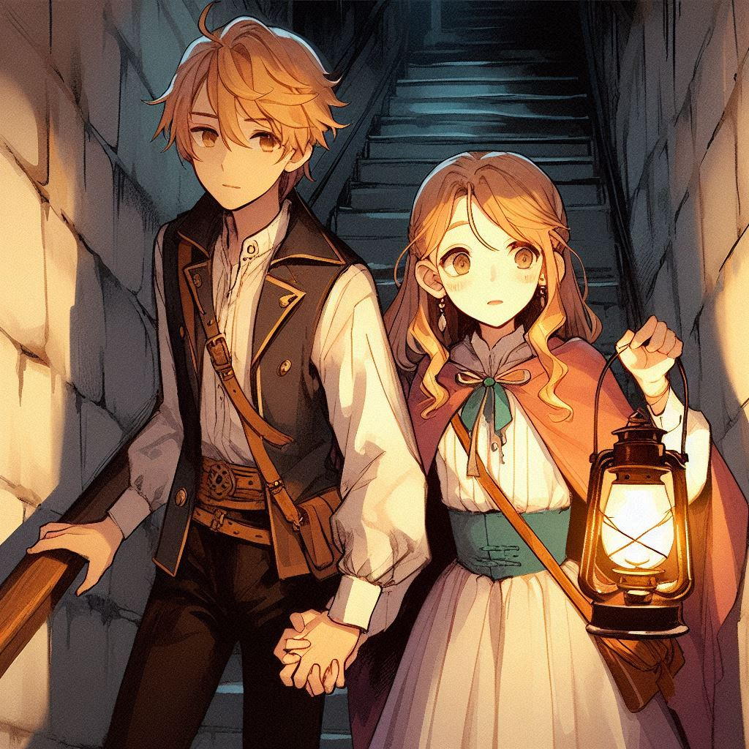
阻礙
Notes:
A boy and a girl, similar in age, both in their teenage years at 15, with matching golden hair. The girl holds the boy's hand, leading him down a dimly lit basement staircase. She walks ahead, carrying a lantern in her other hand, her expression filled with curiosity about what might be in the basement. They are dressed in classic Western European noble attire, and the illustration style combines thick, expressive brushstrokes with anime elements.with a European noble palace .The girl walks in front of the boy

Slide 4
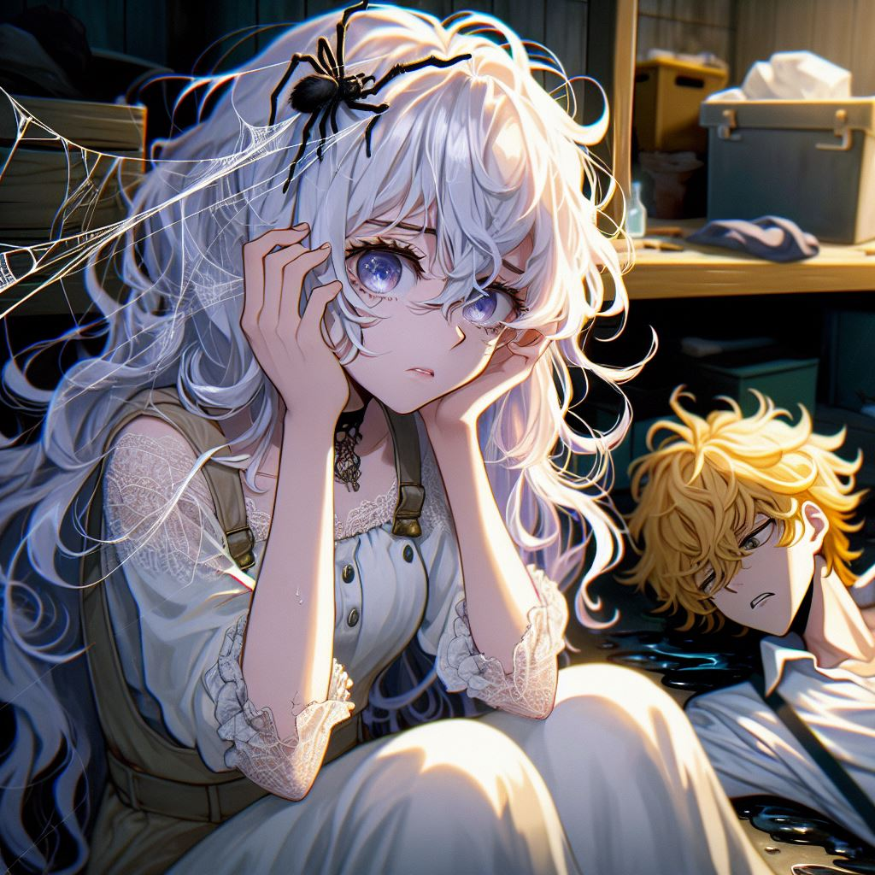
努力
Notes:
“一個有著長長波浪狀白髮的少女，大約15歲，表情緊張，雙手捧著臉。蜘蛛絲粘在她的臉上，旁邊躺著一個金髮的少年，睡在地上。地上有深色的水。他們在一個地下室裡，裡面充滿了設備和工具，場景有些神秘。外面是夜晚。整個場景具有動漫風格，畫風稍微厚重，但色彩飽和度較低。”

Slide 5
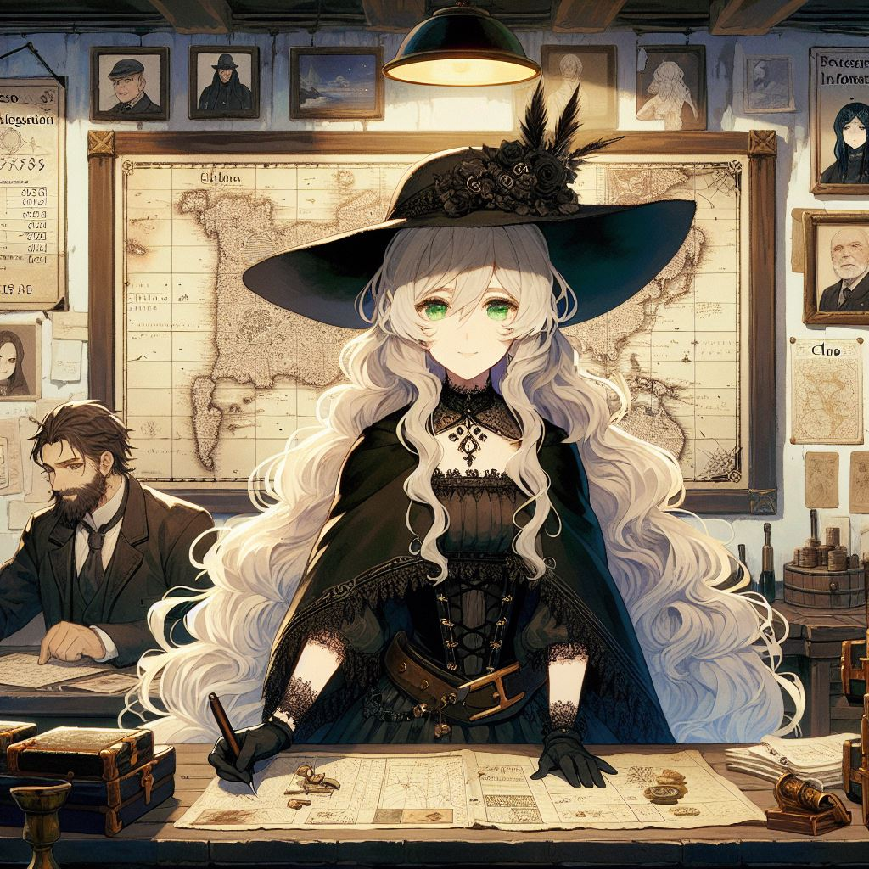
結果
Notes:
Eve is in an underground information shop she runs, with the background featuring two people writing investigation notes. On the walls hangs a fictional parchment map along with some clue records and photographs of individuals. The overall setting combines elements of a fantastical magical world with classical European style. The art style should be anime, incorporating thick paint techniques, with a subdued color palette. Eve is the main focus of the image. She has long, wavy white hair, a large black hat, and a black gown with lace decorations. Her eye color is green, and her clothing features spider motifs.

Slide 6
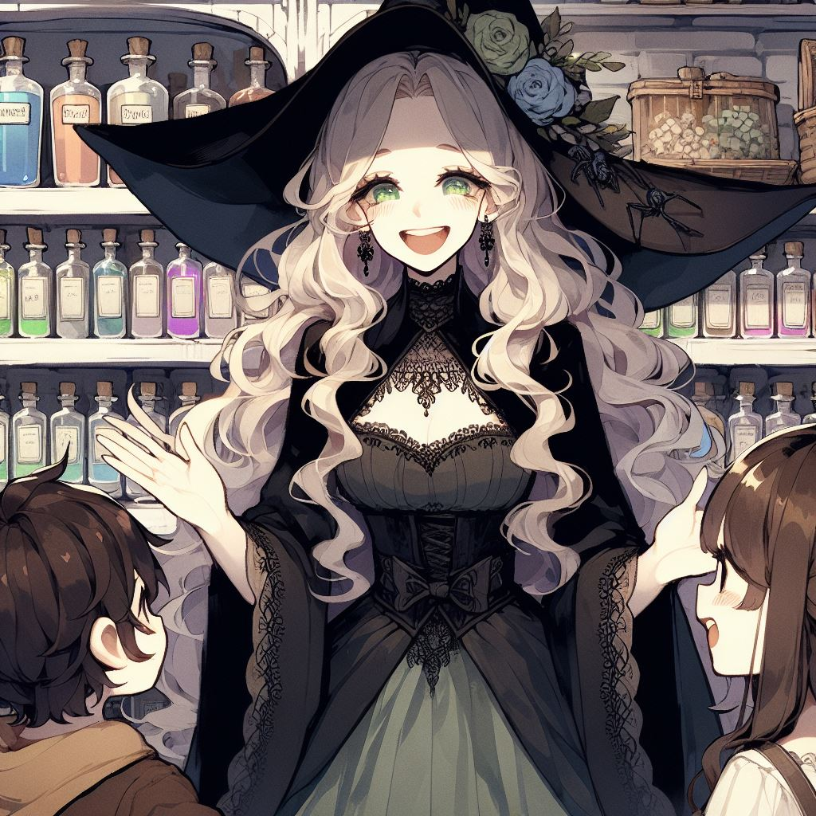
意外
Notes:
畫一張伊芙與小孩們快樂相視的圖片，背景是一肩魔法藥水鋪

Slide 7
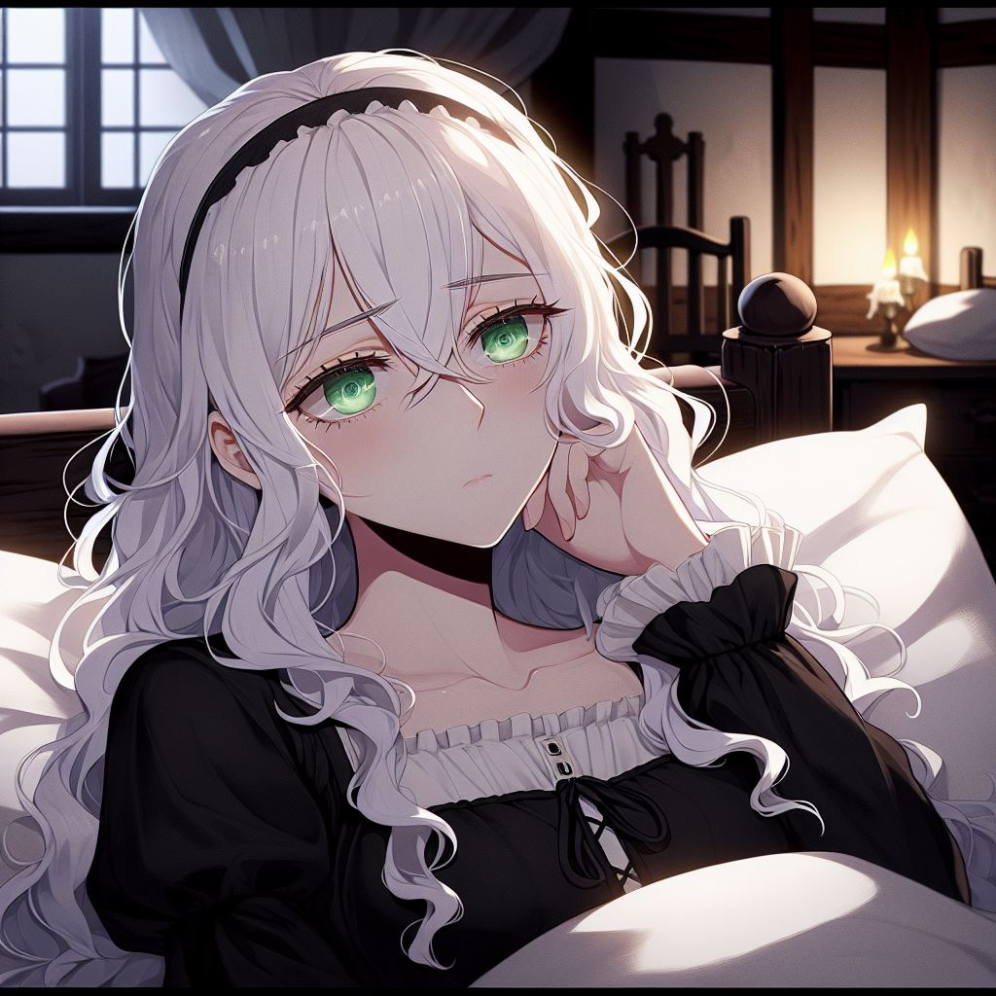
轉彎
Notes:
一个长着白色卷发的女人，绿眼睛，膚色是白色，穿着黑色歐式服裝，晚上躺在床上，未入睡，面露沉思的表情。房间的风格是欧式小屋，光线微弱。图像为日本动漫风格，采用厚涂技法，但色彩饱和度较低，眼神沒有高光，看向窗外，很困擾的樣子

Slide 8
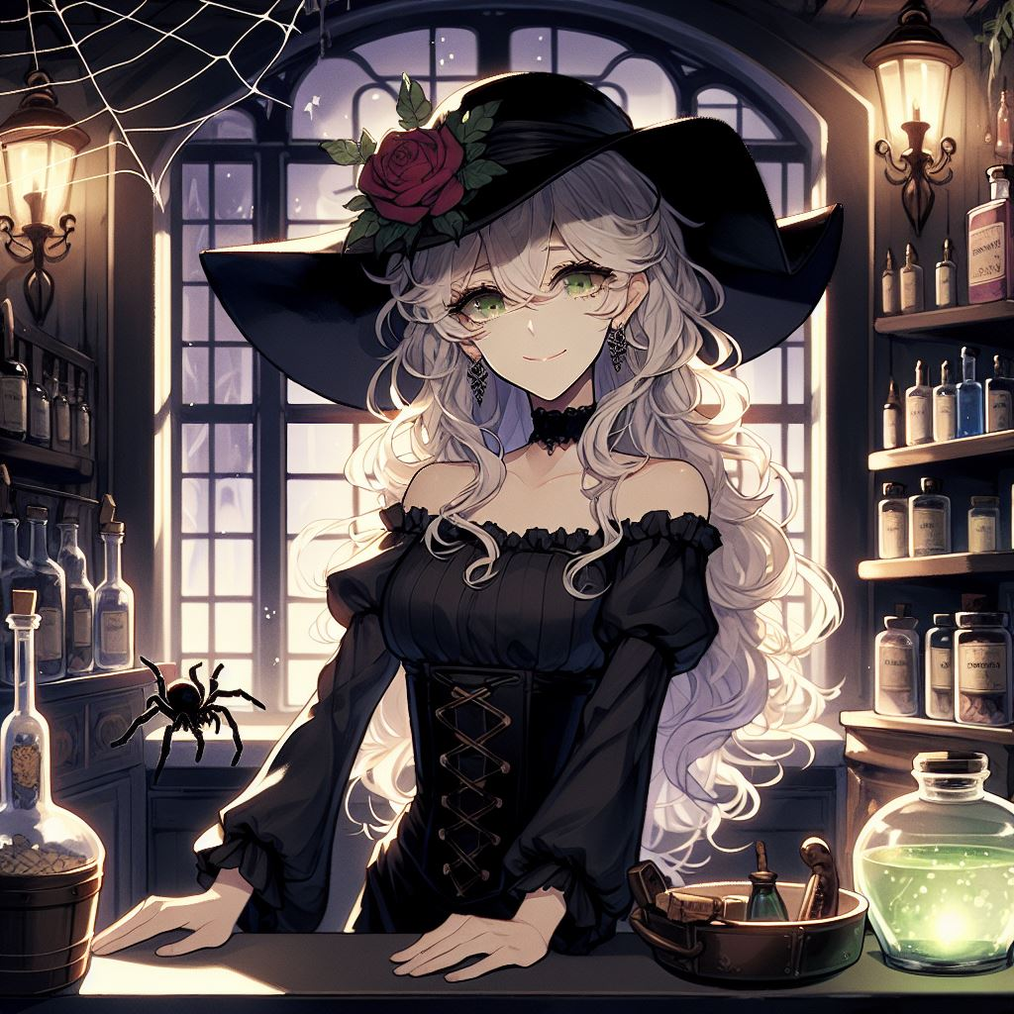
結局
Notes:
幫我畫一張她在魔法藥水鋪的樣子，她站在櫃檯，店內的燈光昏暗，光影感重，她對著鏡頭微笑，表示歡迎，旁邊有蜘蛛及蜘蛛網,要日式動漫風格，但場景是歐式的

