Slide 1
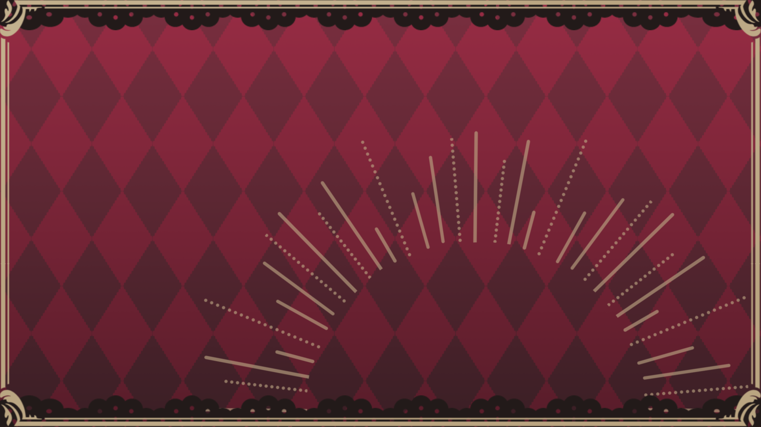
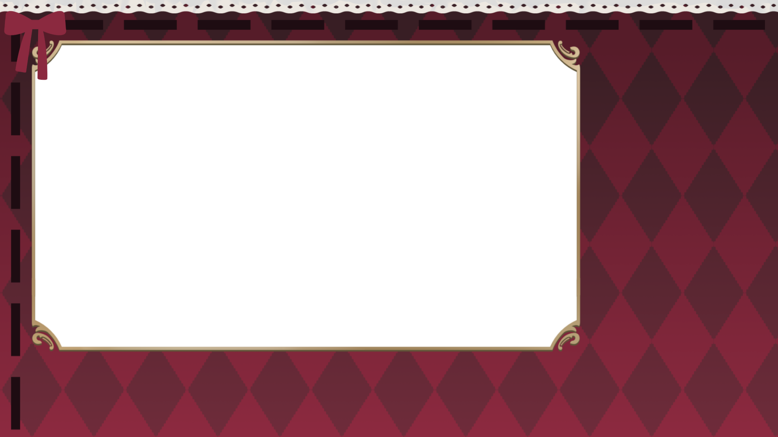
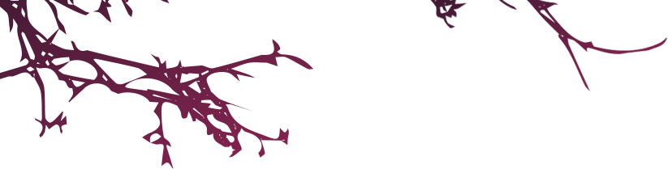
開店的序章

Slide 2
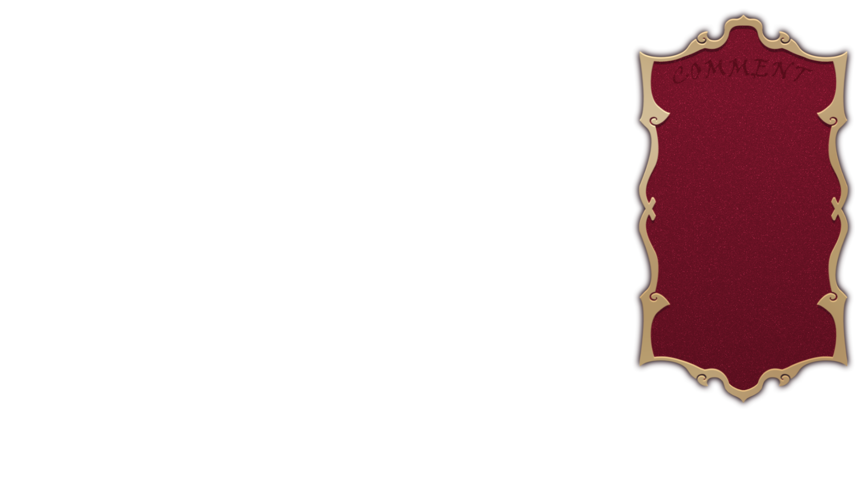
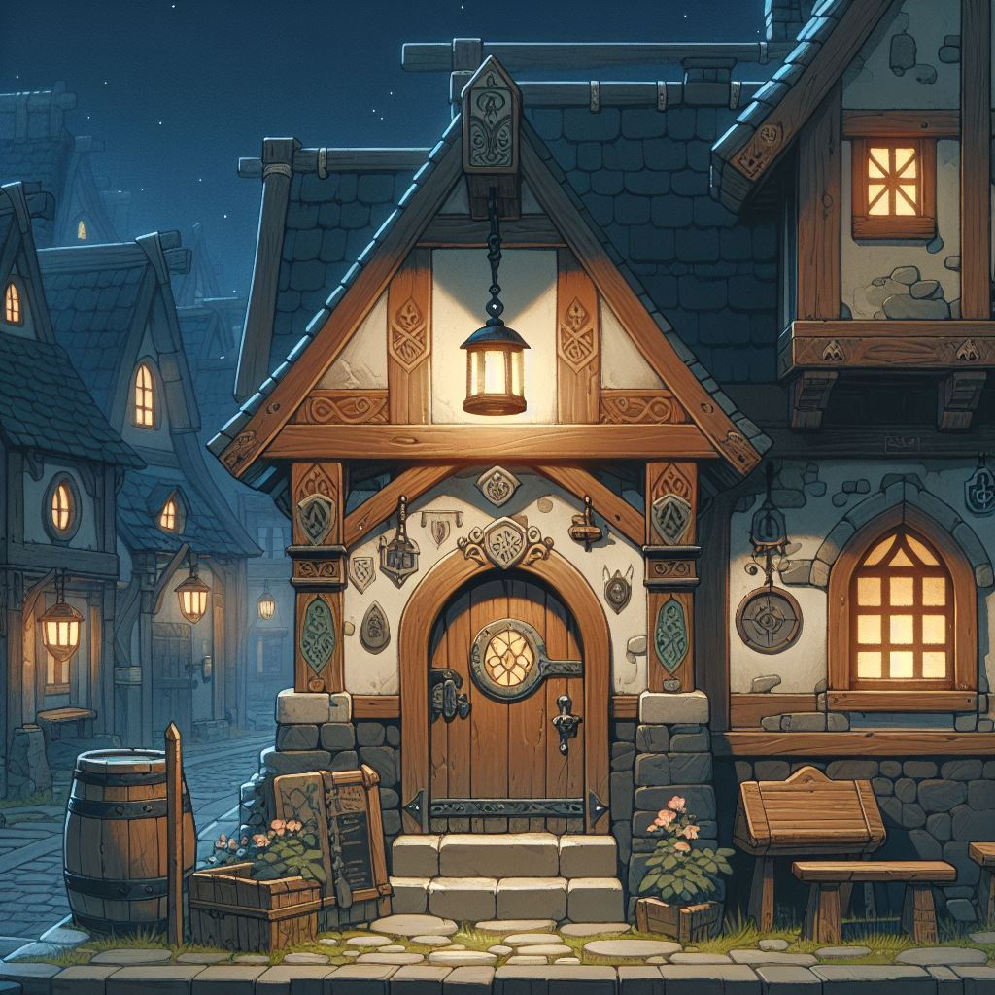
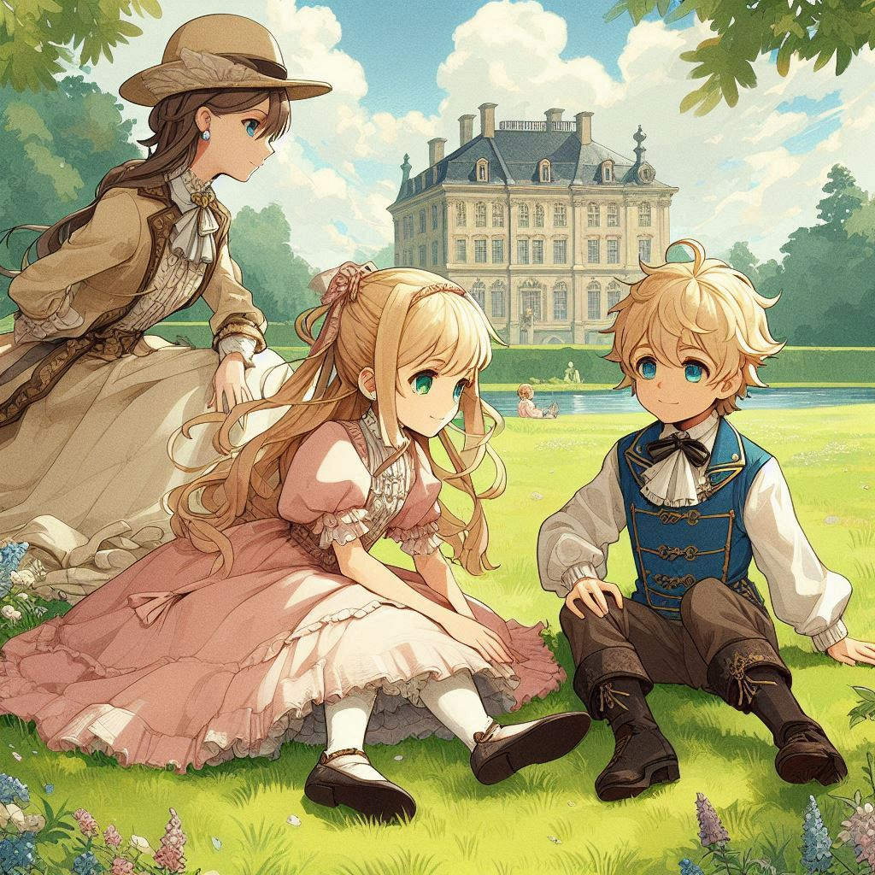

目標
Notes:
The entrance to a fantasy-style tavern in another world at night, with a warm yellow light glowing above the door. The building has a rustic, enchanted look with wooden details, stone walls, and magical symbols subtly integrated into the design. The scene has a mysterious, inviting atmosphere, with surrounding dark streets and a slight mist, all rendered in Japanese anime style with thick paint and low saturation.

Slide 3
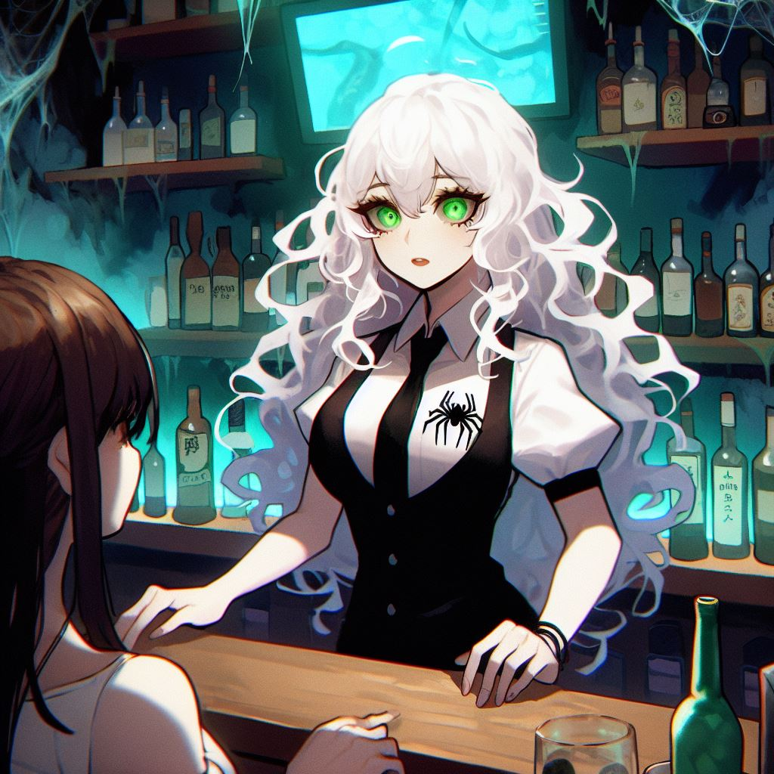
阻礙
Notes:
一位女士擁有白色長捲髮，綠色瞳孔，蒼白的肌膚，服飾上有蜘蛛的象徵，他是一個酒保，站在吧檯內置身在異世界的酒吧中，他試圖跟面前的客人講話，但那位客人沒有理他，只是喝著酒，風格是日式動漫風，有點厚塗，彩度較低

Slide 4
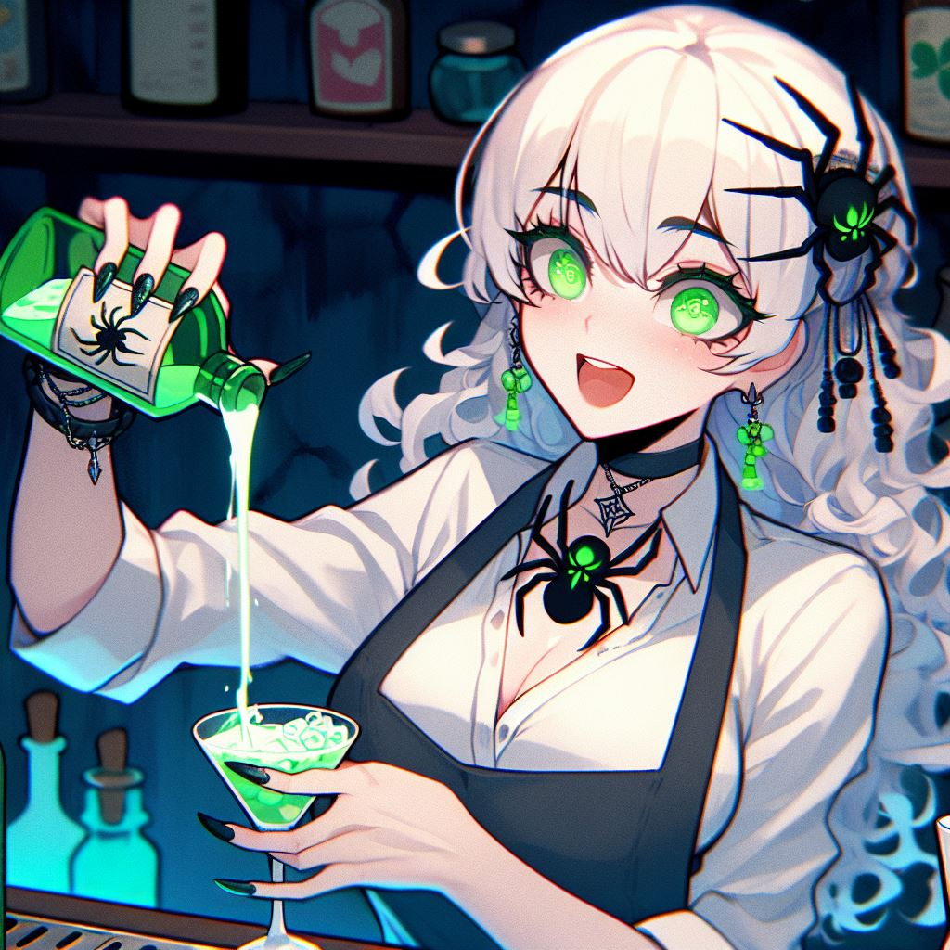
努力
Notes:
同樣是這位酒保，也是一樣的場景再酒吧中，她正拿著綠色的小瓶液體倒入調酒裡，並且興奮的看著調酒

Slide 5
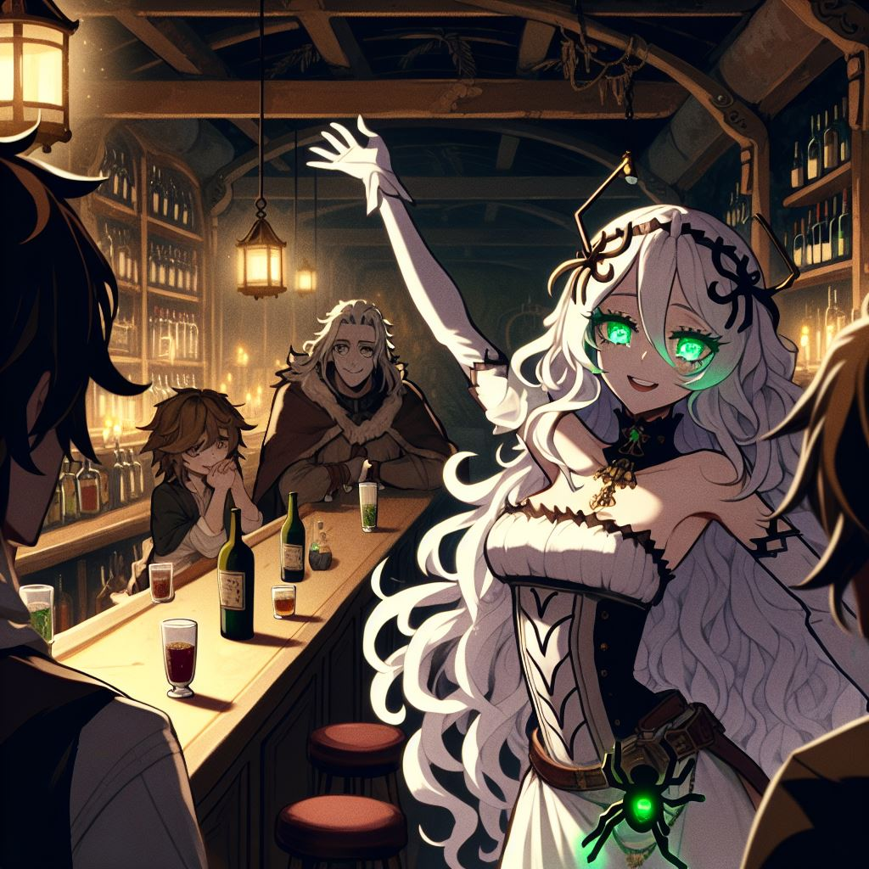
結果
Notes:
一位女士擁有白色長捲髮，綠色瞳孔，蒼白的肌膚，服飾上有蜘蛛的象徵，他是一個酒保，站在吧檯內置身在異世界的酒吧中，有點樸實歐式的風格，旁邊有幾位客人在喝酒，看起來酒醉了，酒保看著客人，露出得逞的微笑，動漫風格，酒吧的燈光昏暗，

Slide 6
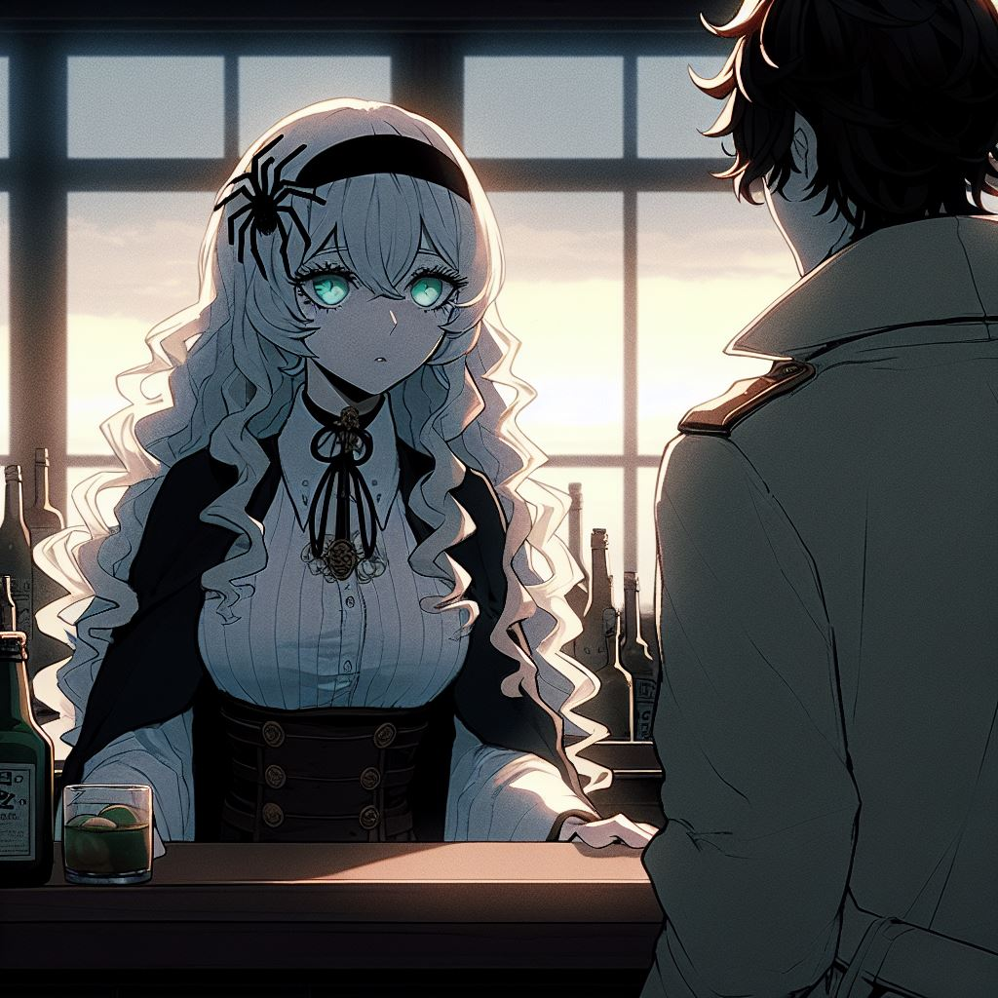
意外
Notes:
A woman with long white curly hair, green pupils, pale skin, and a spider symbol on her clothing. She is a bartender standing behind the bar in a bar, looking expressionlessly at the boss. A man in a coat stands next to her, he is the bar owner, wearing a top hat, with a serious expression, the boss looks like he is talking. The background is still inside the bar, but it is already dawn outside, and there is no one else except the two of them. The art style is anime style, with low saturation.

Slide 7
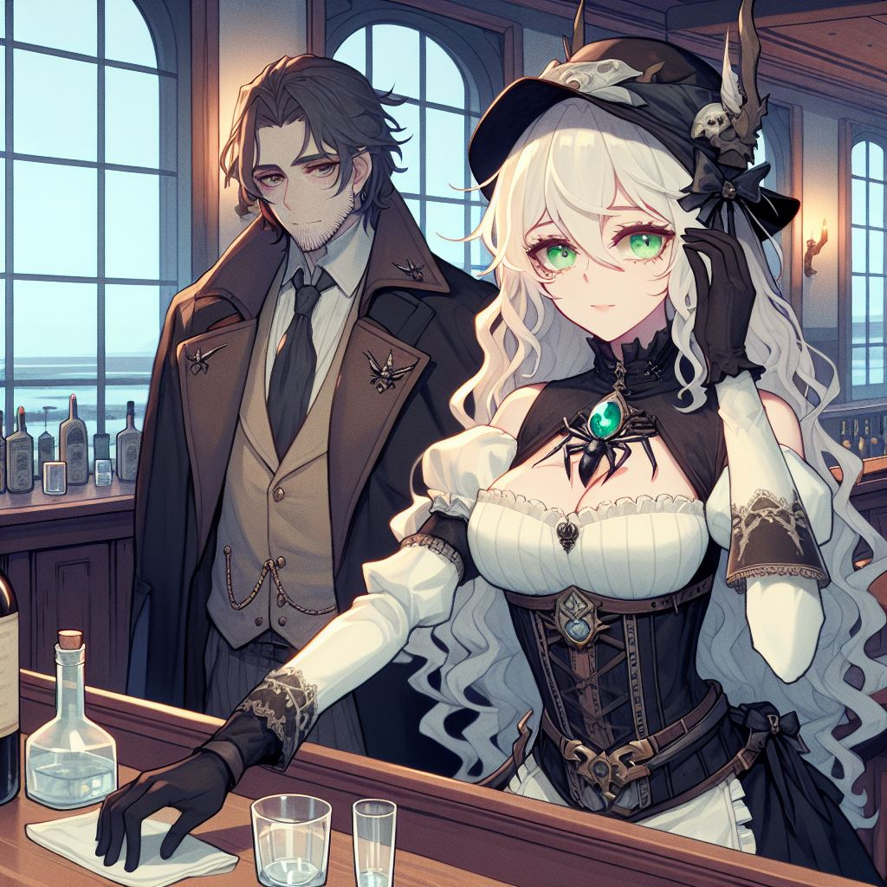
轉彎
Notes:
一位女士擁有白色長捲髮，綠色瞳孔，蒼白的肌膚，服飾上有蜘蛛的象徵，他是一個酒保，站在吧檯內置身在異世界的酒吧中，這位女酒保在擦拭杯子。有一位身穿大衣的男子站在他旁邊，他是酒吧老闆，帶著高角帽，面露嚴肅，背景仍然是酒館內，只是外面已是清晨，除了他們兩人沒有其他人了，畫風是動漫風格，彩度不要太高

Slide 8
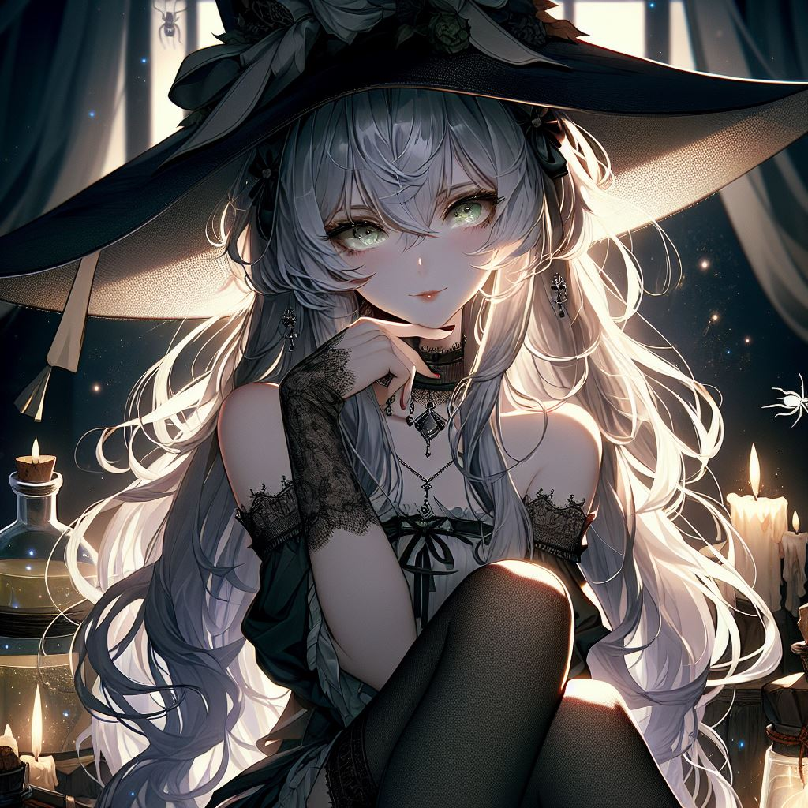
結局
Notes:
"A 2D anime-style dark fantasy artwork featuring a mysterious woman around 30 years old with long, wavy gray-white hair and piercing green eyes. She has pale skin with a slight brownish undertone. She is wearing a large, stylish hat and has a mischievous expression. One hand rests under her chin as she gazes toward a distant light source. Her legs are wrapped in fabric, and she wears a gothic-inspired outfit with intricate lace designs. The background is filled with a magical atmosphere, including glowing potion bottles, candles, and other mystical objects. The lighting is dramatic, with strong contrasts between light and shadow, creating a moody, mysterious setting filled with gothic elements. She also has side-swept bangs that frame her face."

