Slide 1
TNC AI Task B – Deep Learning w/ CNTK
2017/12/15
CNTK Task Team

Slide 2
Task B CNTK – Project Team
Dong Li | dongl@microsoft.com
Feifei Peng | kelloggpeng@live.cn
Haizhou Wang | haiwa@microsoft.com
Shu Peng | shpeng@microsoft.com
Wenlong Ni | wen@microsoft.com
Yuan Li | yuanli@microsoft.com
Yushan Cao | yucca@microsoft.com
Zhimin Yao | zhiya@microsoft.com

Slide 3
Task B CNTK – Project Status 2017/12/15
Train the model - TNC_TransferLearning.py Requires GPU
Load a pre-trained network ResNet18_ImageNet_CNTK.model
Replace the last layer w/ a dense layer
Feed the training set into the network
Minimize loss function
Saved the model (network and weights) to TNC_ResNet18_ImageNet_CNTK.model
Evaluate the model – tnc_label_evaluate.py Can run on CPU-only
Load the saved model from TNC_ResNet18_ImageNet_CNTK.model (our trained model)
Feed one image file into the model
Save predictions to EvalOutput.txt file
Published Web API and the model to Azure App Service
Created a ASP.Net Web API (REST API) wrapper for the model
http://tncanimallabel.azurewebsites.net/api/labels

Slide 4
Task B CNTK – Project Status 2017/12/15
Train the model
TNC_TransferLearning.py
TNC_ResNet18_ImageNet_CNTK.model
Save the network and
learned parameters
to a CNTK model file
TNC Label REST API
Publish the web API
(including the model) to
Azure App Service
ASP.NET Web API
for
TNC_ResNet18_ImageNet_CNTK.model
Local GPUs
CPU-Only
Azure App Service

Slide 5
Task B CNTK – Project Status 2017/12/15
Data preparation - CreateTrainingTestDataSet.py
Splitting training and test data set with given parameters
Training data ratio for every class = 0.80 (default 0.80, 80% for training, 20% for test)
Minimum data per class (default = 20, create duplicated data)
Maximum data per class (default = -1, no limitation)
Generating statistic information
Create 4 data sets: Full class, No-Empty class, Binary class and GoldenMonkey
Training with larger data sets
Data set: \\shpeng440\TNC_RawData\TNC-512.zip
Meta data: \\shpeng440\TNC_RawData\MetaData
Script please get from GitHub
Shared pretrained model with Eric

Slide 6
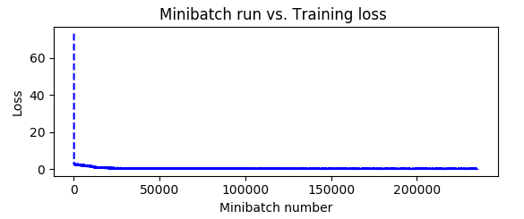
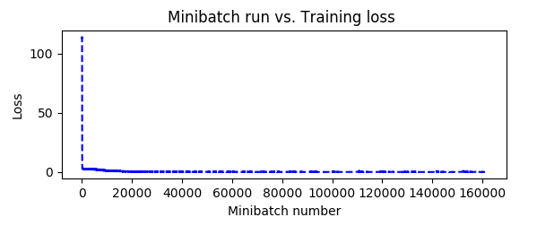
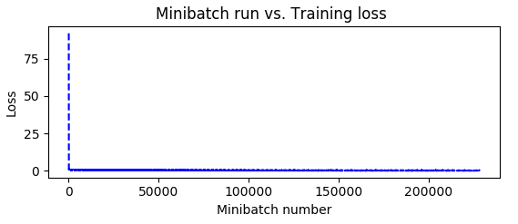
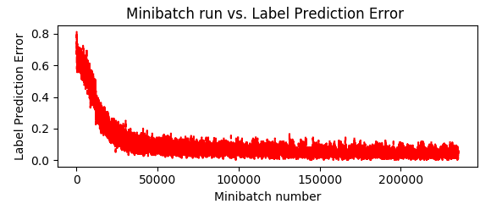
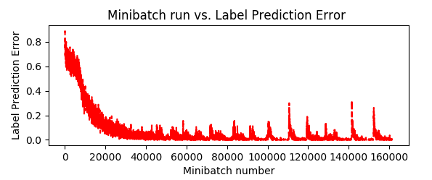
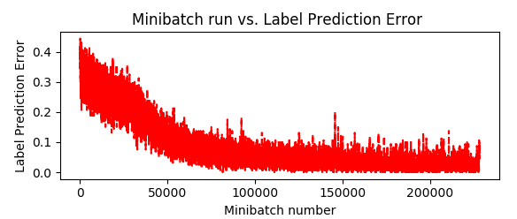
Task B CNTK – Project Status 2017/12/15
Test | Class # | max_epochs | mb_size | lr_per_mb | momentum_per_mb | l2_reg_weight | _image_height | _image_width | _num_channels | training size | test size | correct(rate)
Full Class | 46 | 200 | 5 | [0.2]*10 + [0.1] | 0.9 | 0.0005 | 682 | 512 | 3 | 5888 | 1487 | 37.32%
No Empty | 45 | 200 | 5 | [0.2]*10 + [0.1] | 0.9 | 0.0005 | 682 | 512 | 3 | 4036 | 1024 | 41.99%
Bi-Class | 2 | 200 | 5 | [0.2]*10 + [0.1] | 0.9 | 0.0005 | 682 | 512 | 3 | 5705 | 1427 | 64.89%
First rounds of training/test with
Full 46 Classes
No-Empty (45) Classes
Empty-NoneEmpty (2) Classes

Slide 7
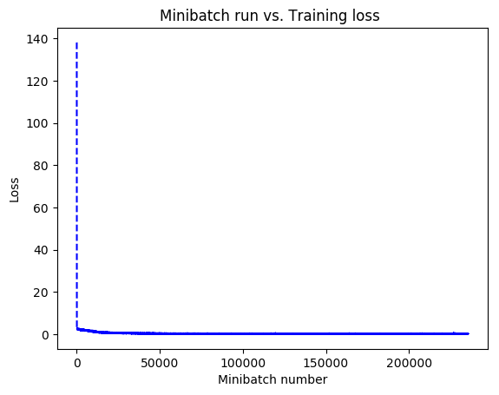
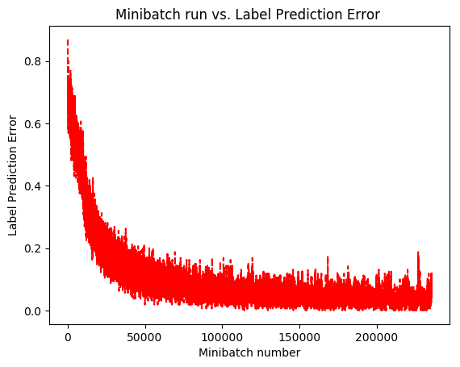
Task B CNTK – Project Status 2017/12/15
2nd Round of test – reassigned ID
302 out of 1487 predictions were correct 20%
Confusion matrix (next page)

Slide 8
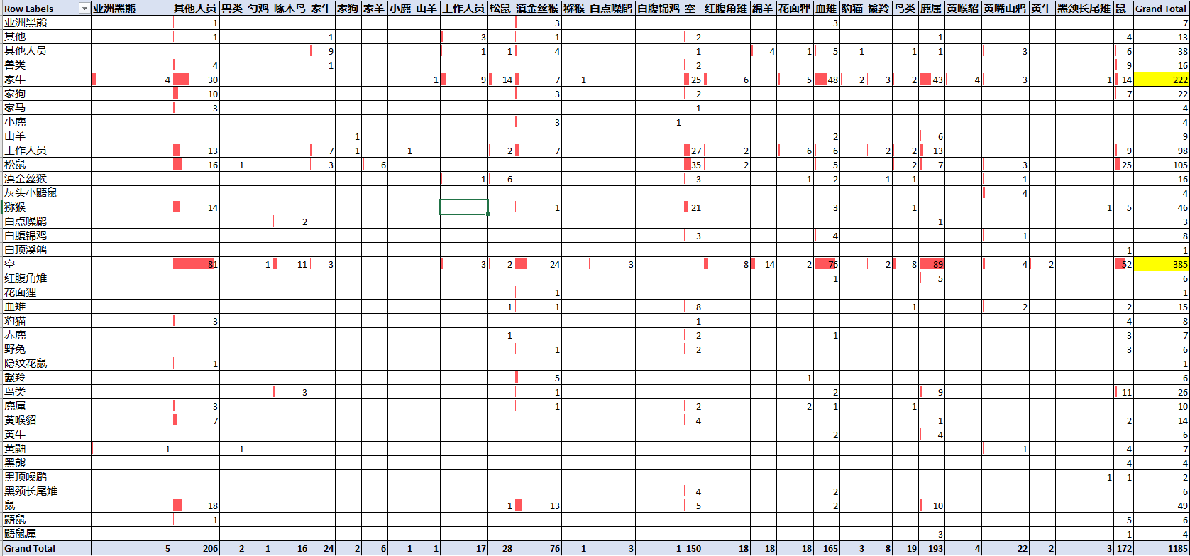
Task B CNTK – Project Status 2017/12/15
Analysis
\\shpeng440\TNC_RawData\Test\Output_201712141816\ResultAnalysis.xlsx

Slide 9
Task B CNTK – Project Status 2017/12/15
Missing by location/camera
Standard labeling
Prefer all in one column
Standard name
灰头小鼯鼠 vs. 鼯鼠 vs. 鼯鼠属?
工作人员vs.其他人员 vs. 其他?

