Slide 1
TNC AI Task B – Deep Learning w/ CNTK
2017/12/01
CNTK Task Team

Slide 2
Task B CNTK – Project Team
Dong Li | dongl@microsoft.com
Feifei Peng | kelloggpeng@live.cn
Haizhou Wang | haiwa@microsoft.com
Shu Peng | shpeng@microsoft.com
Wenlong Ni | wen@microsoft.com
Yuan Li | yuanli@microsoft.com
Yushan Cao | yucca@microsoft.com
Zhimin Yao | zhiya@microsoft.com

Slide 3
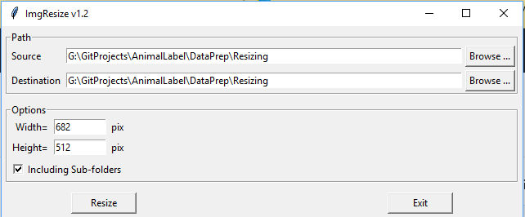
Task B CNTK – Project Status 2017/12/01
GitHub project is setup for Task B Team
tncchina/AnimalLabel
2 forked branches
Setup monitor service to notify the change in main branch
First batch of picture is ready
3257 pictures
890 video clips
Developed a tool to resize images
OpenCV-Python
Resized to customized size
Batch process (support sub-folders)
Transfer-Learning Experiments
(Details in next slide)

Slide 4
Transfer-Learning Experiments
Comparing the correction rate between two ImageNet pre-trained models
ResNet18_ImageNet_CNTK
ResNet152_ImageNet_CNTK
1620 pictures (682x512) as training data
700 pictures as test data
Repeated entire training set with same parameters
mb_size = 5
lr_per_mb = [0.2]*10 + [0.1]
momentum_per_mb = 0.9
l2_reg_weight = 0.0005

Slide 5
Task B CNTK – Project Status 2017/12/01
Transfer Learning - ResNet18_ImageNet_CNTK.model
AnimalLabel\CNTK\TransferLearning\TransferLearningP.py -- 200 Epochs
Training:
Finished Epoch[190 of 200]: [Training] loss = 0.001067 * 1620, metric = 0.00% * 1620 50.732s ( 31.9 samples/s);
Finished Epoch[191 of 200]: [Training] loss = 0.001030 * 1620, metric = 0.00% * 1620 50.699s ( 32.0 samples/s);
Finished Epoch[192 of 200]: [Training] loss = 0.001287 * 1620, metric = 0.00% * 1620 50.828s ( 31.9 samples/s);
Finished Epoch[193 of 200]: [Training] loss = 0.001108 * 1620, metric = 0.00% * 1620 50.743s ( 31.9 samples/s);
Finished Epoch[194 of 200]: [Training] loss = 0.001319 * 1620, metric = 0.00% * 1620 50.799s ( 31.9 samples/s);
Finished Epoch[195 of 200]: [Training] loss = 0.000983 * 1620, metric = 0.00% * 1620 50.836s ( 31.9 samples/s);
Finished Epoch[196 of 200]: [Training] loss = 0.001235 * 1620, metric = 0.00% * 1620 50.832s ( 31.9 samples/s);
Finished Epoch[197 of 200]: [Training] loss = 0.001270 * 1620, metric = 0.00% * 1620 50.756s ( 31.9 samples/s);
Finished Epoch[198 of 200]: [Training] loss = 0.001086 * 1620, metric = 0.00% * 1620 50.900s ( 31.8 samples/s);
Finished Epoch[199 of 200]: [Training] loss = 0.001071 * 1620, metric = 0.00% * 1620 50.830s ( 31.9 samples/s);
Finished Epoch[200 of 200]: [Training] loss = 0.001311 * 1620, metric = 0.00% * 1620 50.860s ( 31.9 samples/s);
Test:
600 out of 700 predictions were correct 0.8571428571428571.

Slide 6
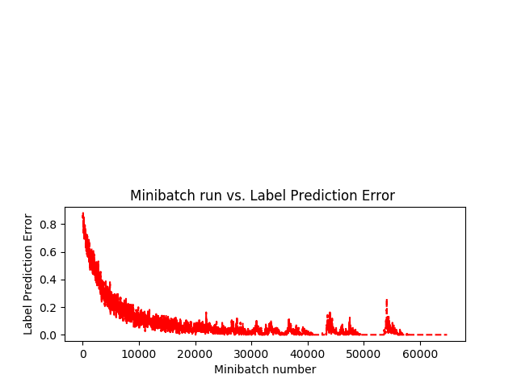
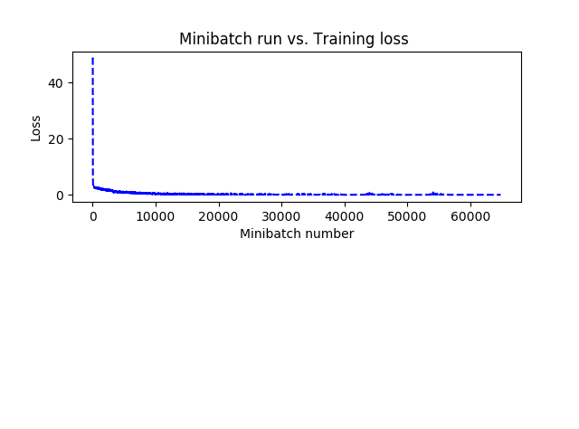
Task B CNTK – Project Status 2017/12/01
Transfer Learning - ResNet18_ImageNet_CNTK.model

Slide 8
Task B CNTK – Project Status 2017/12/01
CNTK learning parameters
epochs: one epoch feeds the entire training set into the network one time.
max_epoch: how many times the training set gets fed into the network
E.g. max_epoch = 100 the training set gets fed into the network 100 times.
mb_size: mini-batch size.
Refer to Stochastic Gradient Descent and Mini Batch Gradient Descent for detailed explanation
Basically, it is the number of training samples (TNC images files in our case) the network uses to compute the cost function each time.
lr_per_mb: learning rate per mini batch.
Refer to Learning Rate for detailed explanation

Slide 9
Task B CNTK – Project Status 2017/12/01
CNTK learning parameters
momentum_per_mb: momentum per mini batch
Refer to SGD with Momentum for detailed explanation
L2_reg_weight: Regularization
Refer to Regularized Linear Regression and Regularized Logistic Regression for more details.

Slide 10
Task B CNTK – Project Plan Week of 12/04
Downloading 2nd bath of pictures
Testing pretrained model with different scenarios
Empty – Non-empty detection
Using balance dataset
Amount classes next Page
Between Training and Testing sets
Different model
Different size
Open question:
Integration with other team?
Figure out if pre-trained model could be running on CPU?
Otherwise we need $ GPU card for this project

Slide 11
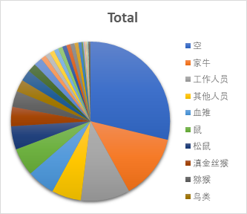
Task B CNTK – Project Plan Week of 12/04
Row Labels | Count of File Name
空 | 937
家牛 | 430
工作人员 | 325
其他人员 | 195
血雉 | 185
鼠 | 184
松鼠 | 154
滇金丝猴 | 128
猕猴 | 105
鸟类 | 80
家狗 | 74
黄喉貂 | 58
兽类 | 56
黑颈长尾雉 | 34
黄鼬 | 33
赤麂 | 32
山羊 | 30
白腹锦鸡 | 29
野兔 | 28
豹猫 | 27
其他 | 27
鬣羚 | 26
亚洲黑熊 | 21
黑顶噪鹛 | 9
隐纹花鼠 | 8
红腹角雉 | 8
黑熊 | 6
豪猪 | 5
小麂 | 5
黄嘴山鸦 | 5
长尾地鸫 | 3
家马 | 3
眼纹噪鹛 | 3
灰头小鼯鼠 | 2
未知 | 2
Grand Total | 3257
Unbalanced data across classes in the first batch

