Slide 1
TNC AI Task B – Deep Learning w/ CNTK
2017 October 30
CNTK Task Team (Feifie, Haizhou, Shu Peng, Yushan)

Slide 2
Task B CNTK – Project Plan
Goal of Nov./17’
Build a deep learning network on CNTK, to classify if there is an wild animal in the TNC photos, by end of Nov/2017.
How we do it
Week of 10/30 (Learn)
Get advises from experts (Prof. XiaoDong He or others) on what/which deep learning network to start with
Understand how to load the TNC photos into CNTK.
Need to have CNTK set up properly on machine.
Week of 11/6 (Build)
Implement a deep learning network with CNTK, based on the advise we get from the experts.
Get the deep learning network up and running with CNTK

Slide 3
Task B CNTK – Project Plan
How we do it
Week of 11/13 (Train and Validate)
Train the deep learning network with the training set available
Evaluate if the minimum of cost function we can get to is acceptable
Validate the deep learning network and the learned weights with the test data. Evaluate the accuracy of the deep learning network and its weights.
Week of 11/20 (Train and Validate)
Continue to tune the deep learning network to see if we can improve its accuracy.
Visualize the key measurements, by plotting cost function, error rates etc.
Week of 11/27 (Report-out)
Task B summary report

Slide 4
Task B CNTK – What we will need to learn
What we will learn in Nov/2017, also what’s required to deliver our goal
A fundamental understanding of deep learning network and computer vision
What deep learning network to use for wild animal classification
Hands-on experience building and training the deep learning network in CNTK
Data pre-processing in CNTK
Building fully-connected deep learning network in CNTK
Tuning different parameters (e.g. learning rate, gradient decent, padding etc.) in CNTK
How to evaluate the performance of the deep learning network in CNTK
Plotting cost function, error rates
Analyze correlation between cost function, error rates, parameters etc.
Last but not least – Python
Yes, we will code in Python with CNTK
If you already have experience in the above areas, put your skills in use and bring the team along with you!
If you are new to the above areas, learn together as a team. Building something new to you is the fun here!

Slide 5
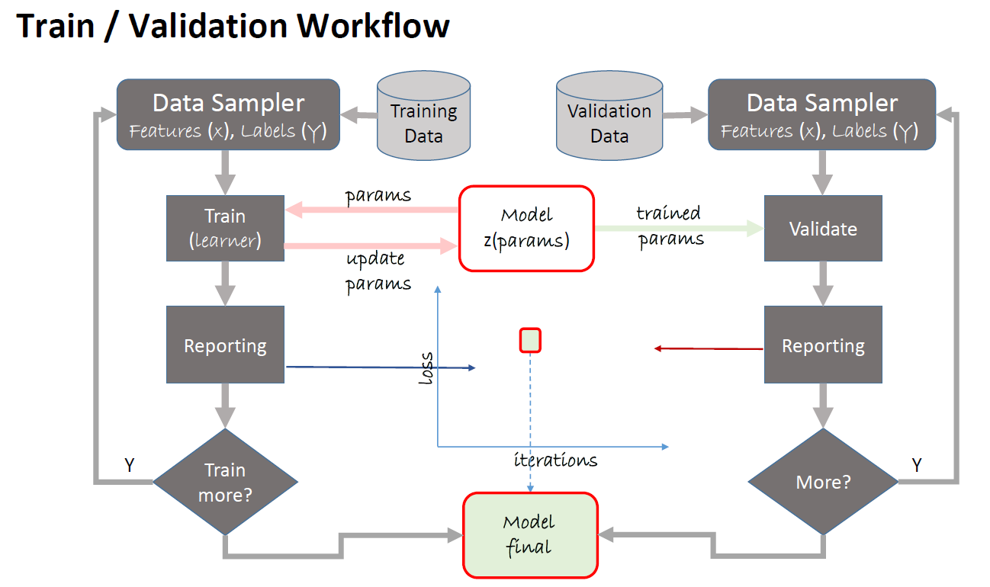
Task B CNTK – Week 1 (10/30) Progress &Learning
Deep Learning Explained (edX dat236)

Slide 6
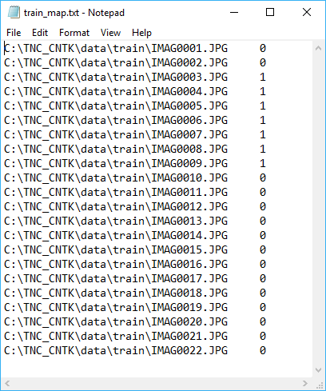
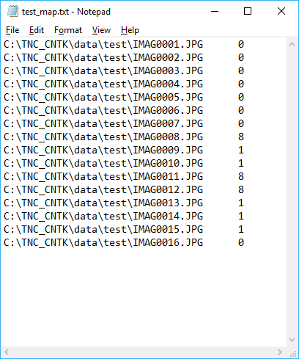
Task B CNTK – Week 1 (10/30) Progress & Learning
We got the plumbing going
Modified code in CNTK 201: Part B - Image Understanding
TNC_WildAnimalAI.py
Why we chose CNTK 201 to start with
It uses ImageDeserializer to read the image files
Other tutorials use CTFDeserializer to read small image files (e.g. 32 x 32 pixels)
TNC image files are pretty big: 4000 x 3000. CTFDeserializer doesn’t seem to fit.
More reading: BrainScript and Python: Understanding and Extending Readers
ImageDeserializer requires a simple map file, which lists the image file names and their labels.
Train_map.txt test_map.txt

Slide 7
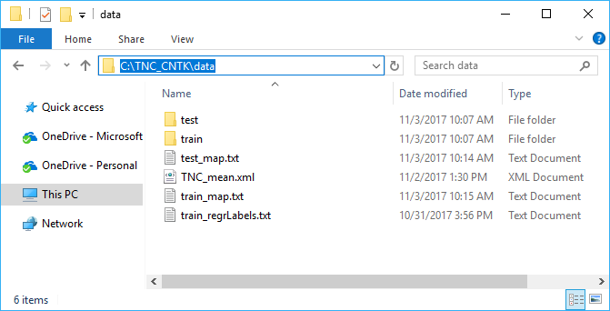
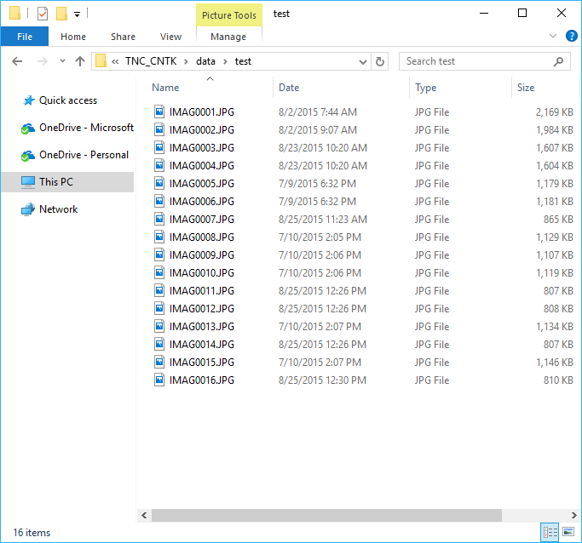
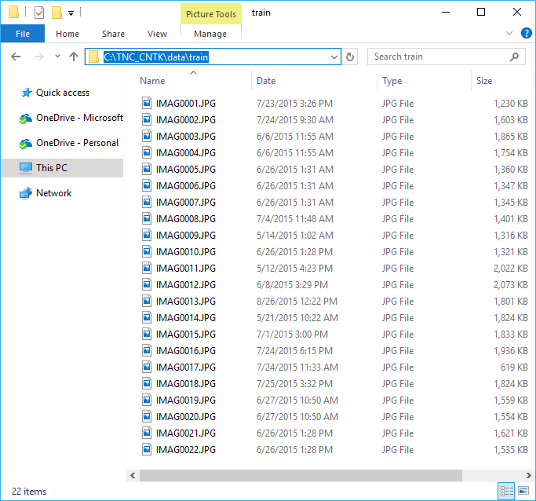
Task B CNTK – Week 1 (10/30) Progress & Learning
Folder Structure

Slide 8
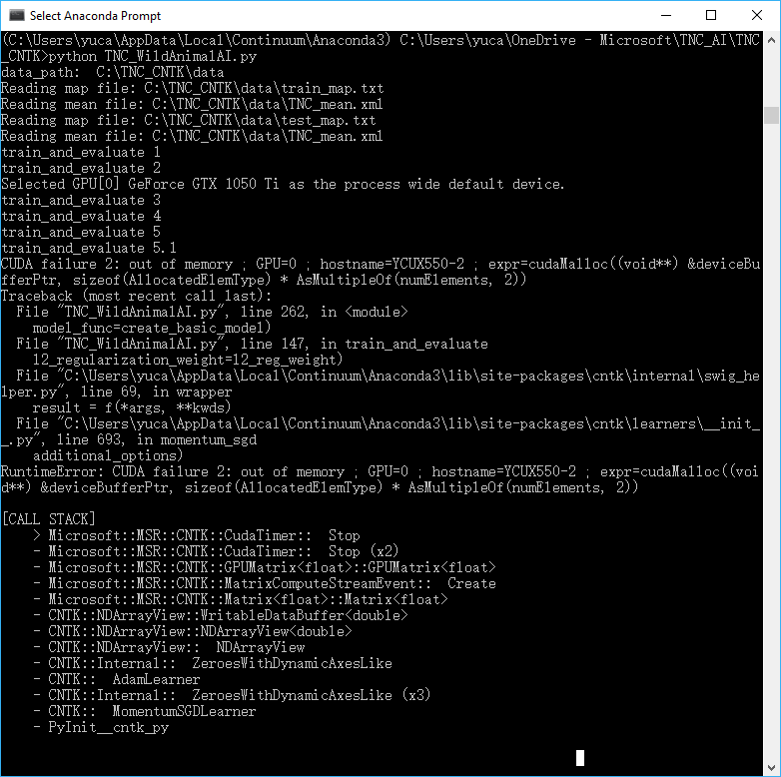
Task B CNTK – Week 1 (10/30) Progress & Learning
Blockers ☹ TNC_WildAnimalAI.py errors out
On machine with GPU
On machine without GPUs
Was able to finish without error
But…
Only fed 22 training samples (22 image files) into the network
The network is a very simple one, one that is probably not sophisticated enough for our problem
And it takes 2.5 hours to complete on i7/16GB RAM (no GPU)
We need to get this run on GPUs
Other challenges
TNC image files are way bigger than the tutorial ones
TNC: 4000 x 3000 (12M) Tutorial ones: 32 x 32 (1,024)
Has to reduce Minbatch size down to 1, otherwise will get error

Slide 9
Thoughts on learning & where to start
We all want to learn something new in the project.
When we all have a day-job to do, our single biggest challenge with learning is time, how much time we can make for this.
Good to use quick and easy ways to get started in a brand new area where we haven’t had experience.
Let’s share with the team any quick and easy ways we know and can think of.
Goal is to get started as quickly as possible, not to become an expert.
Once we get started, we will be able to learn more and deeper pretty fast as we go.

Slide 10
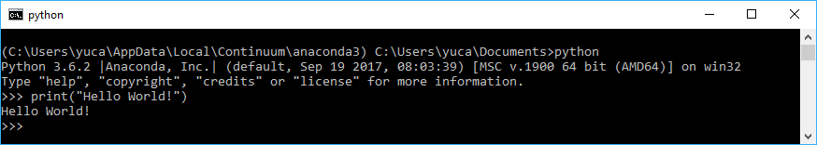
Task B CNTK - learning & where to start
Week of 10/30
Write your first “Hello World!” in Python in 10 mins
Skip this if you’ve coded in Python
Install Anaconda 3.6 on your computer.
Pls do NOT install the standard Python runtime from Python.org
The standard Python runtime does not come with additional packages such as numpy, matplotlib that are required by CNTK
In your Anaconda Prompt, type in the following commands
That is it! You’ve just written and run your first Python script, in 10 mins!!

Slide 11
Task B CNTK - learning & where to start
Week of 10/30
Set up CNTK on your machine
Skip this if you already have CNTK set up on your machine
Detail instructions are here. If you don’t have time to read through the instruction, the following are the steps for you:
You should already have installed Anaconda3 4.3.1 on your computer. If not, please install it. Pls do NOT install any newer Anacoda3 distributions. Anaconda 3.5 and 3.6 have compatibility issues with CNTK 2.2 Pls do NOT install the standard Python runtime from Python.org. The standard Python runtime does not come with additional packages such as numpy, matplotlib that are required by CNTK. Having two Python runtimes on the same the machine will only confuse ourselves.
In your Anaconda Prompt windows, type in:
Python
pip install https://cntk.ai/PythonWheel/CPU-Only/cntk-2.2-cp36-cp36m-win_amd64.whl
This should install CNTK into the Anaconda environment for you.

Slide 12
Task B CNTK - learning & where to start
Week of 10/30
Got an idea on quick and easy way to learn? Add a slide and share it here!

