Slide 1

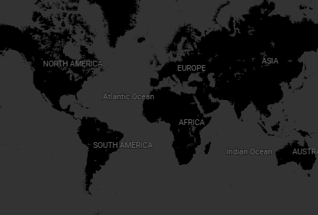





Power BI Desktop
Shows Added by Date
Shows by Rating
2,000
3K
1,500
2K
1,000
1K
500
0K
R
PG
NR
G
UR
TV-MA
TV-14
TV-PG
PG-13
TV-Y7
TV-Y
TV-G
(空⽩)
NC-17
0
2014
2016
Movie
2018
TV Show
2020
TV-Y7-FV
Movie
TV Show
Top 10 Genres
Countries Available
International Mo…
Dramas Comedies
International TV … Documentaries
Action & Advent…
TV Dramas Independent Mo… Children & Famil… Romantic Movies
2.8K
2.4K
1.7K
1.4K
0.9K
0.9K
0.8K
0.8K
0.6K
0.6K
© 2026 Miiccrrossofftt Corrporrattiion

Slide 2
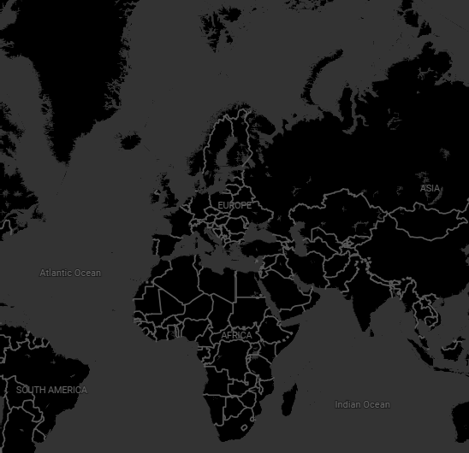
Power BI Desktop
Movie/TV Show
Release Year
2016
Rating
TV-MA
#Selfie 69

After a painful breakup, a trio of party-loving friends makes a bet: who can get married in three days.
Countries Available
category

Comedies
Dramas
International Movies
director

Cristina Jacob
cast
Alex Calin Crina Semciuc Flavia Hojda
Maia Morgenstern Maria Dinulescu Mihaela Mihut Olimpia Melinte

© 2026 Miiccrrossofftt Corrporrattiion

