Slide 1
Ngigx

Slide 2
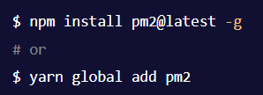

PM2 PRODUCTION PROCESS MANAGER FOR NODE.JS
PM2 is a daemon process manager that will help you manage and keep your application online. Getting started with PM2 is straightforward, it is offered as a simple and intuitive CLI, installable via NPM.
Installation
Start an app

Slide 3

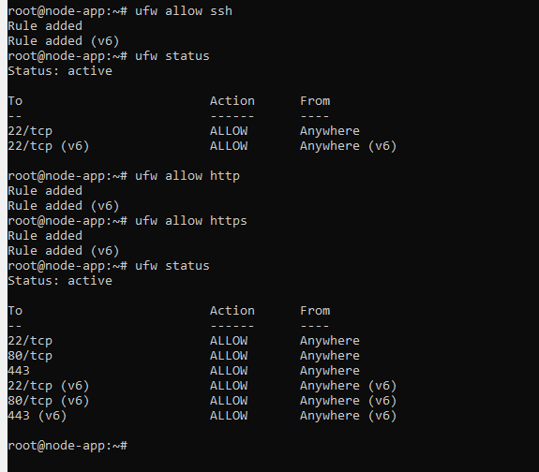
https://gist.github.com/bradtraversy/cd90d1ed3c462fe3bddd11bf8953a896

Slide 4
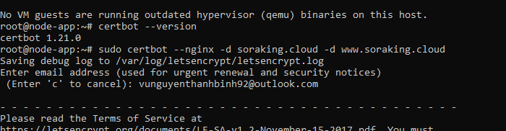
https://www.nginx.com/blog/using-free-ssltls-certificates-from-lets-encrypt-with-nginx/

Slide 5
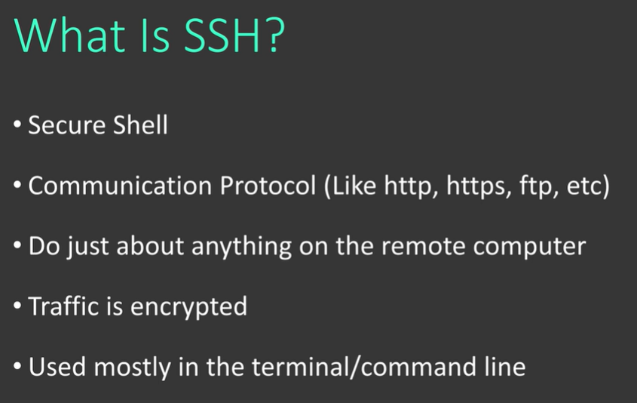

Slide 6
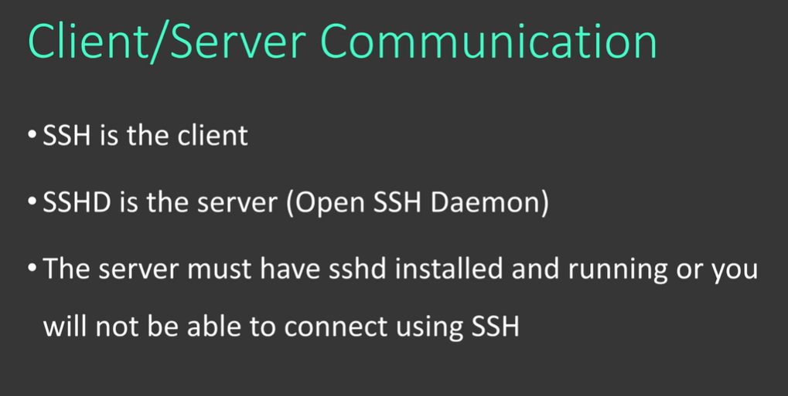

Slide 7
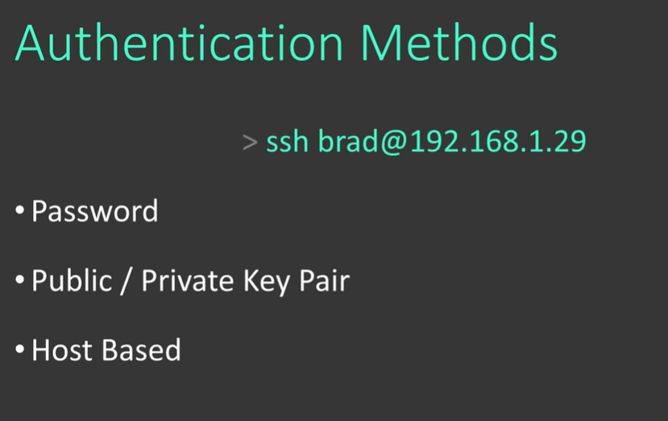

Slide 8
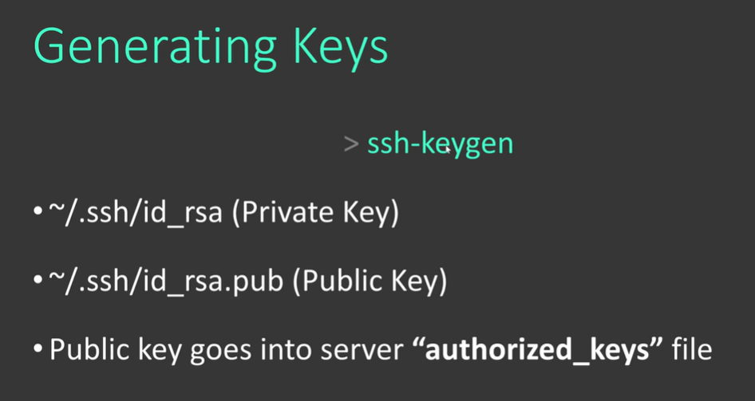

Slide 9
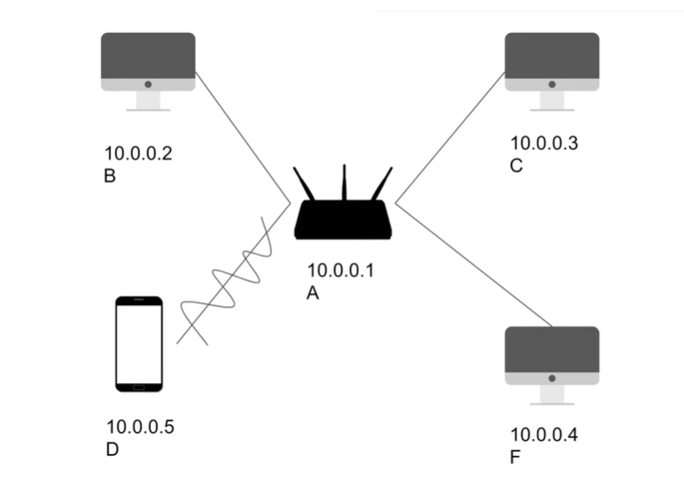
The OSI Model

