Slide 1

UNC13A-SSO (Splicing Switch Oligonucleotide) - Statistical consideration-
Yushuf Sharker
February 10th, 2024

Slide 2
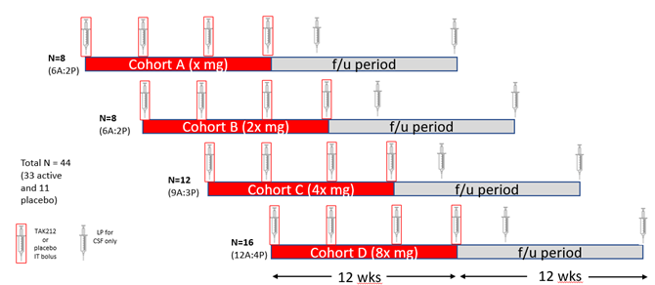
UNC 13A Study Design
Study Type: First in Human ePOC
Target Population: Adults with ALS of age between 18-62
Study Design: Randomized, Double-Blind, Placebo-Controlled MAD (SAD) study
Objective: Safety and tolerability and efficacy evaluation for Go/No-Go.
Open Label Extension
The open label extension (OLE) portion of the Ph1/2 will have similar objectives to the main study but will be a separate study with its own protocol. Only patients completing the Ph1/2 will be invited to roll into the OLE. The original treatment group assignment will remain blinded to the participants and investigators.
Notes:
Tofersen target population: Amyotrophic lateral sclerosis (ALS) in adults who have a mutation in the superoxide dismutase 1 (SOD1) gene.
All ALS except SOD1
Tofersen as well as the other drugs are in the marker, in this situation, does the palcebol controlled trial ethical?
Data monitoring plan is still absent

Slide 3
Endpoints UNC13A Phase 1/2
Primary Endpoints
Incidence of Adverse Events (AE) and Serious Adverse Events (SAE)
Incidence of abnormalities in clinical labs, vital signs, physical and neurological assessments, ECGs, C-SSRS
Secondary Endpoints
PK measures, including CSF, plasma, and urine levels of UNC13A-SSO
Antidrug Antibody (ADA) incidence in serum and its impact on PK, Pharmacodynamics (PD), and safety
Exploratory Endpoints
Change from baseline in
CSF normal UNC13A mRNA/protein or UNC13A downstream molecule
CSF and plasma neurofilament light chain (NfL) levels
ALSFRS-R
ALSAQ40, EQ5D5L, Clinical Global Impression (CGI), Patient Global Impression (PGI)
Exploratory Plasma NfL will be used for Go/No-Go evaluation and ALSFRS-R is the FDA/EMA recommended endpoint for ALS pivotal studies

Slide 4
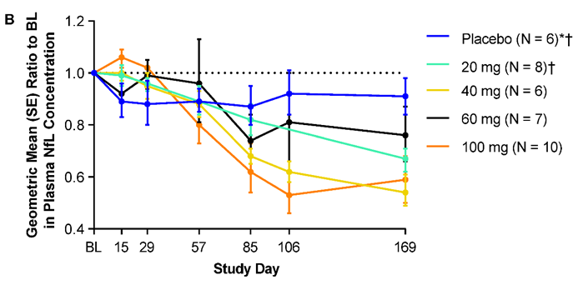
Change NfL observed in Tofersen Studies
Study | Mean | SD | Scale | n | Sample | Time
Tofersen P2/3* | 127.3 | 94.4 | Pg/ml | 21 | P | B
Tofersen P2/3* | 4.6 | 0.66 | Log | 21 | P | B
Tofersen P2/3 | 37 | 29.5 | Pg/ml | 15 | P | B
Tofersen P2/3 | 3.4 | 0.7 | Log | 15 | P | B
Tofersen P1/2* | 4.3 | NA | Log | 12 | P | B
BIIB078 | 107.7 | 77.3 | Pg/ml | 27 | P | B
BIIB078 | 5.94 | 0.28 | Log | 27 | P | B
Phase 2/3 Study
Faster-progression subgroup:
Treated group: Reduced by 60%
Placebo group: Increased by 20%
Difference: 80% reduction in the treated group compared to the placebo group
Adjusted geometric mean ratio to placebo: (1-.8/1.2) = 0.33 (95% CI: 0.25, 0.45)
Slower-progression subgroup:
Treated group: Reduced by 40%
Placebo group: Increased by 19%
Difference: 59% reduction in the treated group compared to the placebo group
Adjusted geometric mean ratio to placebo: (1-.0.59/1.19) = 0.52 (95% CI: 0.43, 0.63)
Nfl Mean and SD in original scale and log scale for placebo subjects at baseline.
* Faster progression group, P: Placebo, B: Baseline
Change in NfL for different dose levels at day 169 in tofersen phase 1/2 study
A reduction of 30% reduction with for most effective dose cohort is reasonable assumption for sample size evaluation. We used SD = 0.11 following Tofersen Phase 1/2.

Slide 5
Sample size and Justification UNC13A Phase 1/2
48 subjects are planned for the various dose cohorts. The cohort specific sample size are given in the table. 4 additional subject will be considered to account for dropout
Sample size was set with a goal to balance
The sample size is determined to following after tofersen Phase 1/2
The study anticipates a 30% reduction in NfL from baseline in the treated group versus control, with equal SD of 0.11 for both groups.
Power analysis (Cohen’s d = -3.2/0.11, alpha = 0.1) shows >90% power to detect NfL reduction for all cohorts.
Cohort | Treatment | Placebo | Total
A (Lowest) | 6 | 2 | 8
B (second) | 6 | 2 | 8
C (Third) | 12 | 4 | 16
D (Highest) | 12 | 4 | 16
Total | 36 | 12 | 48

Slide 6
Sample size and Justification UNC13A Phase 1/2
SD threshold for a desired effect size
With the sample size 12 in treated and 12 in placebo, the study can detect a reduction of 30% in NfL geometric mean ration until the SD <0.4. For sample size of treatment 6, the threshold is 0.33
With SD of 0.11, the study can detect minimum differences of 10% and 11% for treated N_t = 12 and 6, respectively (Table 1).
If we observe and extreme SD=0.7 in log NfL, as tofersen, The study can detect the difference of 30% with power 48% with N_t = 12 and 39% for N_t = 6. With SD = 0.7, the study would require to observe >46% reduction to have >80% power
N_{t} | SD | Reduction Threshold (%)
12 | 0.11 | 10
6 | 0.11 | 11
12 | 0.3 | 23
6 | 0.3 | 28
12 | 0.6 | 41
6 | 0.6 | 48
12 | 0.7 | 46
6 | 0.7 | 53
N_{t} | Reductions | SD Thresholds
12 | 10 | 0.12
6 | 10 | 0.10
12 | 15 | 0.18
6 | 15 | 0.15
12 | 20 | 0.25
6 | 20 | 0.2
12 | 30 | 0.4
6 | 30 | 0.33
Table: 1 Minimum detectable threshold of reduction for which arms can detect the difference with >80% power for different standard deviation (SD).
Table 2:Minimum SD threshold for which study can detect the different levels of reduction with >80% power

Slide 7
Go/No-Go Decision Metric
Assumptions:
A true reduction of 30% will be observed in NfL in the treated group compared to the placebo in log percent change from baseline is highly clinically significant.
The true reduction <15% we will not move forward
Simple Bayesian Decision rule, credibility of 95%
Sample size:
N_{p} = 12, N_{t1} = N_{t2} = 6, N_{t3} = N_{t4} = 12 for 4 different dose cohort, a total of 48
Equal Standard deviations for both treatment and placebo
SD considered 0.11 and 0.7 in log scale
Decision Thresholds:
Go Criteria: P(Δμ< −0.16)> 0.7
No-Go Criteria: P(Δμ< −0.16) <0.1
Definition of Δμ:
Δμ is defined as the median (treatment ratio of NfL level at follow-up to baseline) divided by the median (placebo ratio of NfL level at follow-up to baseline) in log scale.
Translation to Original Scale:
Go Criteria Δμ< −0.16 implies a 15% reduction with a probability after observed data is >70% for a ‘go’ decision.
Study level expectation:
With SD = 0.11, If the study observes < 10% reduction, the QDM will recommend no-go,
If the study observes more than >18% reduction, QDM will trigger to go.
QDM Recommend ‘consider’ in between

Slide 8
GNG Operating Characteristics
Several SD and sample size and reduction situations are evaluated for the decision using the proposed QDM.
SD | Nt | Reduction (%) | Go Probability (%) | No-Go Probability (%) | Consider (Gray Zone) Probability (%)
0.11 | 6 | 10 | 5.3 | 42.4 | 52.3
0.11 | 12 | 10 | 3.1 | 52.2 | 44.7
0.11 | 6 | 20 | 73.3 | 0.8 | 26.0
0.11 | 12 | 20 | 81.0 | 0.36 | 18.6
0.11 | 6 | 30 | 99.9 | 0 | 0.1
0.11 | 12 | 30 | 100 | 0 | 0
0.7 | 6 | 10 | 24.3 | 13.4 | 62.3
0.7 | 6 | 10 | 24.3 | 13.4 | 62.3
0.7 | 12 | 10 | 23.1 | 14.2 | 62.7
0.7 | 6 | 20 | 36.5 | 7.2 | 56.3
0.7 | 12 | 20 | 38.1 | 6.7 | 55.3
0.7 | 6 | 30 | 51.9 | 3.2 | 44.9
Interpretation:
If the true reduction due to the drug is 30% If we observed SD of0 0.11 and sample size N_{t} = N_{P} = 12, The QDM would recommend a ‘go’ decision 100%
If the study observes the same reduction with the sample size with SD = 0.7 (higher SD), the QDM would recommend 'go' with probability of 56% and 'Consider' with probability 42%
Decisions are sensitive to the observed standard deviations and sample sizes.

Slide 9
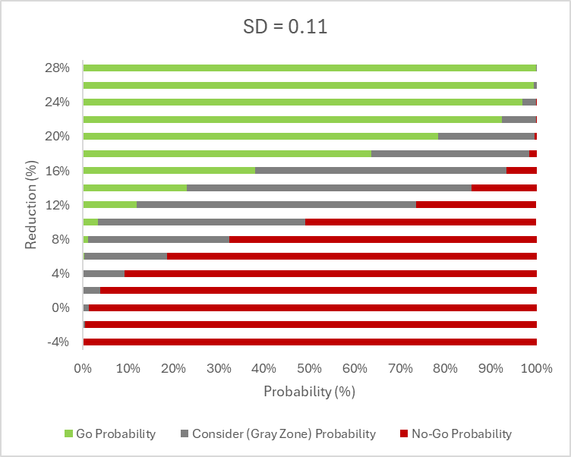
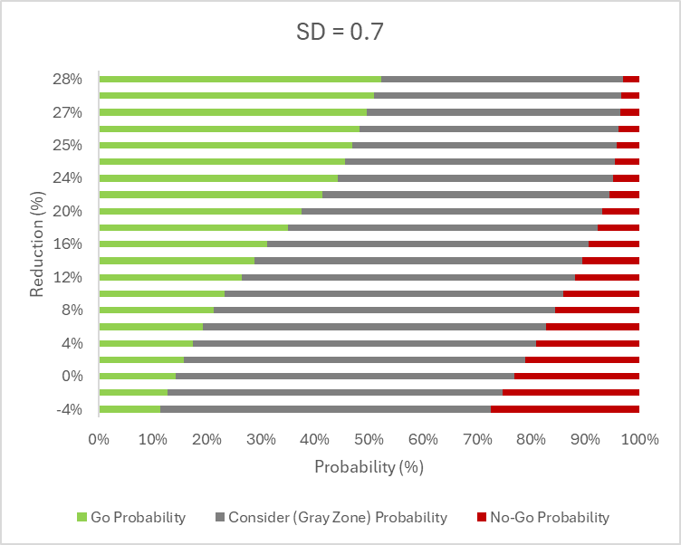
GNG Operating Characteristics
Quantitative Decision Metric Threshold
Operating characteristics of the proposed QDM for two different standard deviation 0.11 and 0.7. The sample size and the other considerations was the same. X axis indicates the difference in change from baseline between treatment and placebo arms in log scale.
A higher SD widens the gray zone, necessitating a larger observed difference (more than 28%) for a go decision with the QDM.

Slide 10
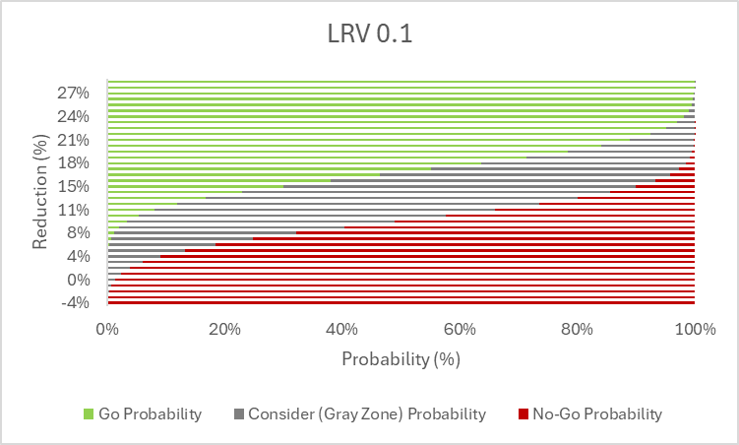
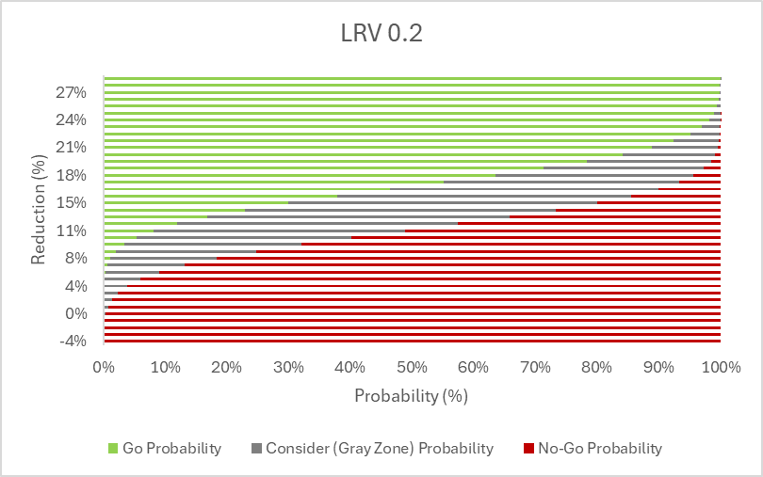
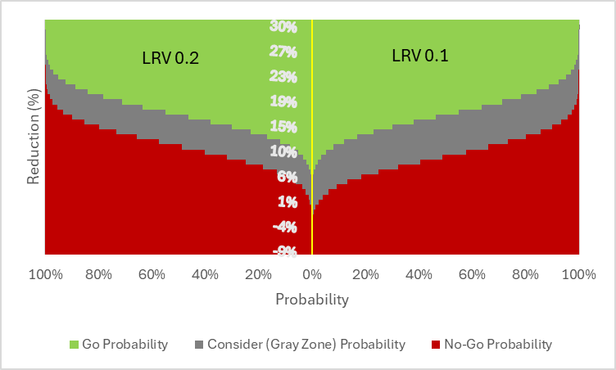
GNG Operating Characteristics
LRV 0.1 or 0.2
The level of risk we will accept for continuing a compound that is below our dignity line for development
The gray zone becomes wider in lower LRV that results the QDM prone to ‘go’ the go decision with lower true reduction.

Slide 11
Statistical Analysis Plan
Safety and PK/PD are the primary endpoints. Efficacy is evaluated by changes from baseline in NfL (week-16 or any time), ALSFRS-R, SVC, muscle strength, and speech up to week-24. Exploratory measures include morbidity, time to all-cause death, tracheostomy dependence, ALSAQ40, EQ5D5L, CGI, and PGI.
Placebo participants will be combined across dose cohorts for analyses. The combined placebo group will be used to compare the dose cohorts
Measurement will be summarized using descriptive statistics and figures by dose level.
Log-transformed analysis for NfL. Report NfL as geometric mean ratio to placebo.
Point estimates with 95% confidence intervals will be reported.
No adjustment for multiplicity; no inferential conclusions.
Subgroup Analysis may include Faster progressive subgroup vs. slower for all endpoints. This may include analysis based on UNC13A SNP data.

Slide 12
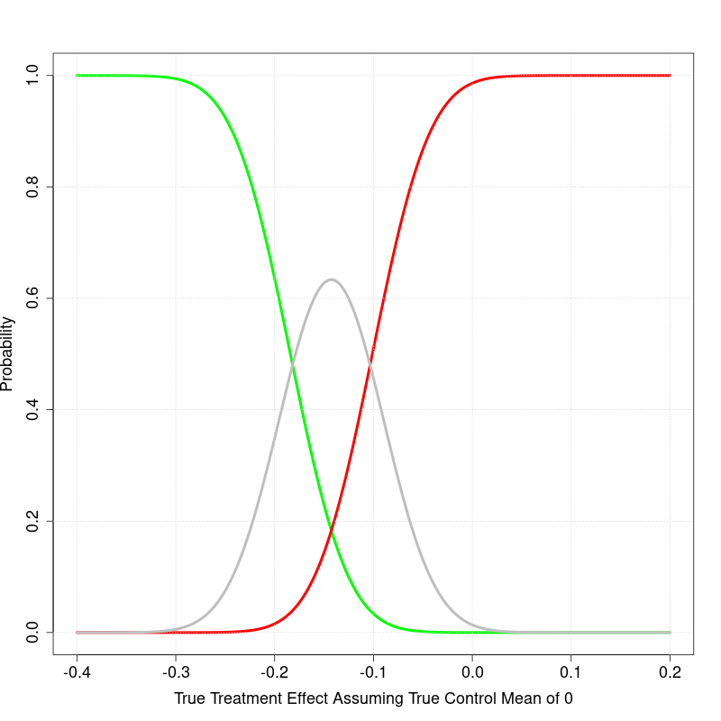
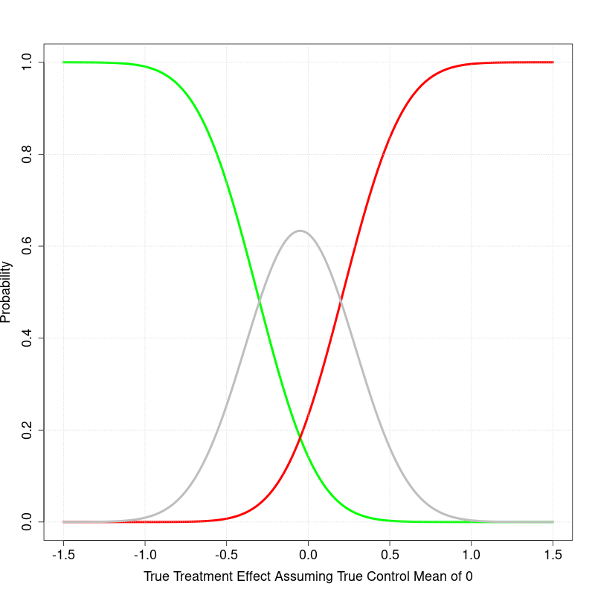
GNG Operating Characteristics
Quantitative Decision Metric Threshold
Operating characteristics of the proposed QDM for two different standard deviation 0.11 and 0.7. The sample size and the other considerations was the same. X axis indicates the difference in change from baseline between treatment and placebo arms in log scale.
Higher SD would lead to a wider gray zone and require higher difference to observe to have go decision with the QDM
SD = 0.11
SD = 0.7

Slide 13
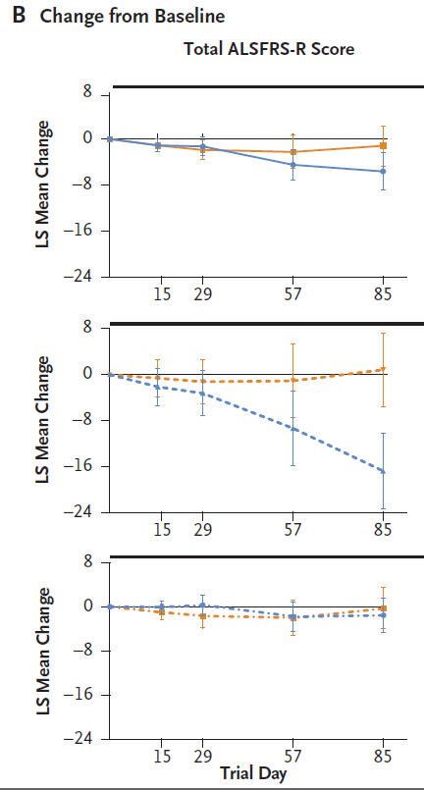
Tofersen ALSFRS-R score in Phase 1/2
Overall, ALSFRS-R points change from the baseline level was meaningful on day 57 and onward
D57 = −4.50 (−7.21 to −1.78)
D85 = −5.63 (−8.90 to −2.36)
Reduction was faster in the faster progressive group. The slower progressive group change was less detectable withing the timeframe of day 85

Slide 14
Go/No-Go Quantitative decision criteria
Hypothesis
UNC13A splicing correction will restore UNC13A protein levels, restore neuronal function and slow/halt motor neuron degeneration in ALS
Surrogate biomarker
NfL (Accelerated approval of Tofersen used the biomarker for approval))
30% lowering the NfL level is clinically meaningful (Ref Tofersen). Thus, current target levels of NfL reduction desired in our Ph1/2 study are a 30% reduction and a 30% increase would represent an undesirable outcome
“Conversely, a recent Ph1/2 study of another IT ASO directly against the C9orf72 RNA in ALS patients with C9orf72 mutations demonstrated target engagement but at the highest dose tested trended towards worsening of clinical outcome measures and an NfL increase of over 30%. Thus, current target levels of NfL reduction desired in our Ph1/2 study are a 30% reduction and a 30% increase would represent an undesirable outcome.”
Justification: Prior market research indicated that achieving an improvement of >40% in the ALSFRS-R (minimal acceptable level) would be differentiating and that an improvement of >50% in the ALSFRS-R (target preferred level) would be considered transformative as this would translate to considerable preservation of independent function.
Evaluation time
The evaluation time point is 4-12 weeks following the last dose to the baseline
The doses level would the highest safe dose
The median ratio of Nfl level at the follow-up to the baseline for the treatment arm will be compared to that of pooled placebo subjects across the cohorts

Slide 15
Log Scale Vs Original Scale NfL from Tofersen study
What level of reduction is expected if we to observe a 30% reduction in the log scale in the change from baseline?
NfL/Study | Mean | SD | GM | Median | Scale | n | Sample | Time
Tofersen P2/3* | 127.3 | 94.4 | 92.7 | 92.7 | Pg/ml | 21 | P | B
Tofersen P2/3* | 4.6 | 0.66 |  |  | Log | 21 | P | B
Tofersen P2/3 | 37 | 29.5 | 28.4 | 28.4 | Pg/ml | 15 | P | B
Tofersen P2/3 | 3.4 | 0.7 |  |  | Log | 15 | P | B
Tofersen P1/2*| | 4.3 |  |  |  | Log | 12 | P | B
Tofersen P2/3* | 146.2 | 82.6 | 121.8 | 121.8 | Pg/ml | 39 | T | B
Tofersen P2/3* | 5 | 0.06 |  |  | Log | 39 | T | B
Tofersen P2/3 | 47.6 | 41.8 | 33.2 | 33.2 | Pg/ml | 33 | T | B
Tofersen P2/3 | 3.9 | 0.14 |  |  | Log | 33 | T | B

Slide 16
Tofersen Phase 2/3 SAP
The joint rank test used in the VALOR trial is summarized as follows:
Purpose: To account for both functional decline and survival in the analysis of the change in the ALS Functional Rating Scale-Revised (ALSFRS-R) score.
Method:
Each participant's change in ALSFRS-R score from baseline to week 28 is compared with that of every other participant.
Participants receive a score of 1 if their outcome is better, -1 if worse, and 0 if the same as the participant being compared.
Participants who died are ranked lowest based on their time to death, with progressively lower ranks given to those who died sooner after the first dose.
Analysis:
The sum of individual scores for each participant (ranked score) is assessed using analysis of covariance (ANCOVA).
The ANCOVA model includes the trial group as a fixed effect and adjusts for covariates such as baseline disease duration, baseline ALSFRS-R score, and use of riluzole or edaravone.
Multiple imputation is used to account for missing data due to withdrawals not accounted for by death.
The joint rank test allows for a statistical test of the treatment effect while considering the truncation of data due to deaths.-

Slide 17
Tofersen Phase 2/3 Sample size calculation
Sample Size: 60 participants in the faster-progression primary analysis subgroup.
Randomization Ratio: 2:1 (tofersen to placebo).
Power: 84% power to detect a between-group difference.
Assumptions:
Change in ALSFRS-R score from baseline to week 28 of -4.8 in the tofersen group.
Change in ALSFRS-R score from baseline to week 28 of -24.7 in the placebo group.
Standard deviation of 20.39.
Survival of 90% in the tofersen group.
Survival of 82% in the placebo group.
Significance Level: Two-sided alpha level of 0.05.
These calculations were based on the joint rank test, which accounts for both functional decline and survival.

Slide 18
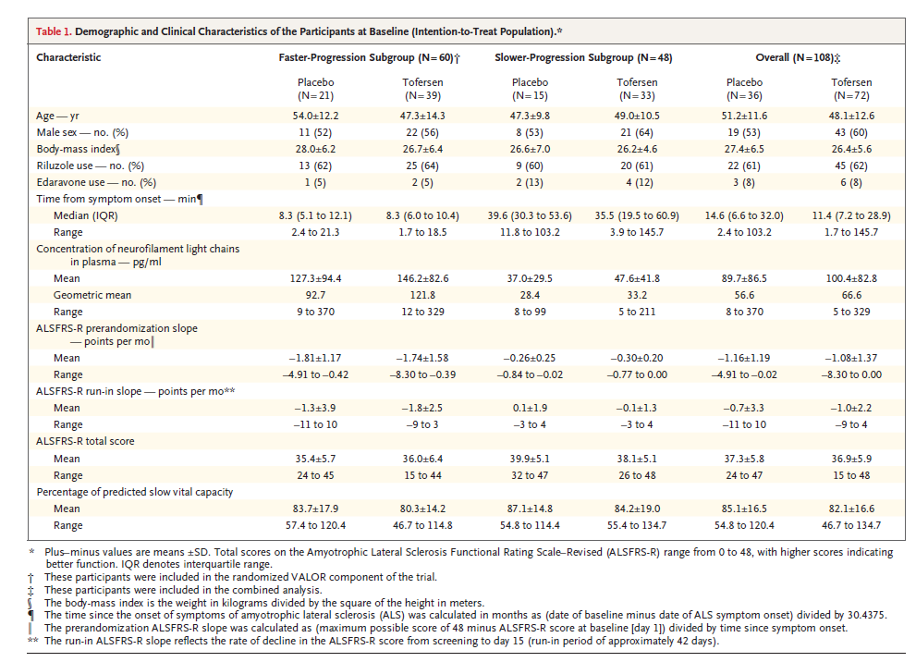
Tofersen Phase 2/3 NfL Results at baseline
End of the study
Faster-Progression Subgroup:
Placebo Group: The adjusted geometric mean ratio to baseline for NfL concentration was 1.20.
Tofersen Group: The adjusted geometric mean ratio to baseline for NfL concentration was 0.40.
Between-Group Difference: The geometric mean ratio for tofersen vs. placebo was 0.33 (95% CI, 0.25 to 0.45).
Approximated SD: (.45-.25)/2*1.96 = 0.051

Slide 19
Tofersen Phase 2/3 NfL Results
Adjusted geometric mean ratio to VALOR baseline: 1.20
Geometric mean ratio: tofersen vs. placebo (95% CI): 0.33 (0.25 to 0.45)
This indicates that the concentration of NfL in plasma increased by 20% from baseline in the placebo group.
In the faster-progression subgroup, the concentration of neurofilament light chains in plasma was reduced by 60% in participants who received tofersen, whereas it increased by 20% in those who received placebo.
The faster-progression subgroup in the VALOR trial was defined based on the following criteria:
SOD1 Mutation Type: Specific types of SOD1 mutations associated with faster disease progression.
Pre-randomization ALSFRS-R Slope: The estimated slope of the ALS Functional Rating Scale-Revised (ALSFRS-R) score calculated from the time of symptom onset until screening.
A total of 60 of the 108 participants made up the faster-progression subgroup

Slide 20
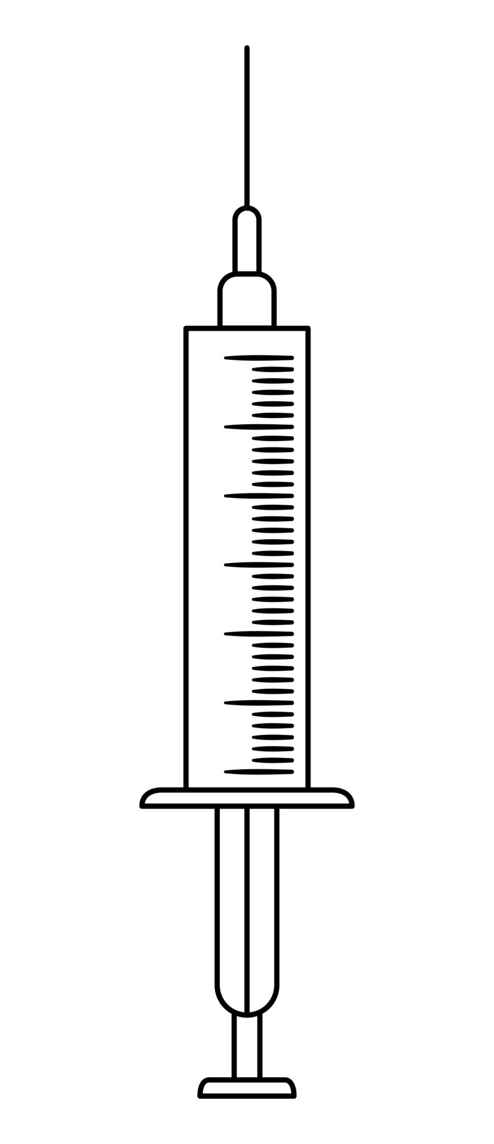
Ph1/2 Study Schematic (DRAFT)
Open label extension
(earliest start could be the end of chronic tox, in-life results, timing TBD)
N=8
(6A:2P)
Cohort A (x mg)
f/u period
N=8
(6A:2P)
Cohort B (2x mg)
f/u period
Total N = 48 (36 active and 12 placebo)
N=16
(12A:4P)
Cohort C (4x mg)
f/u period
Drug or placebo
IT bolus
LP for CSF only
N=16
(12A:4P)
Cohort D (8x mg)
f/u period
12 wks
12 wks
Start of each cohort with sentinel dosing (1 active, 1 placebo)
24 hr safety data review of sentinels prior to allowing dosing of remaining within cohort
After sentinels, no more than one patient can be dosed in a day
Dose escalation
All patients in previous cohort have reached 7 days post 2nd dose (4 wks post baseline) for safety review
Once safety confirmed, sentinel dosing for next cohort can start
Adaptive elements: Emerging PK and PD could lead to adaptions of dose level, dose frequency, and sample size in cohort 3 and 4
However, dose level will not exceed 2x to prior dose level and dose frequency will not be more frequent than monthly
Utilization of an external DSMB

Slide 21
FTE for Biostatistician
Dec 2024 - Jun 2025 (Phase 1/2)
Involvement:
Review literature
Write and disseminate the concept note
Perform simulation and power analysis
Contribute to Concept Sheet and CDP
FTE Required: 70% of a biostatistician
Jul 2026 - Sep 2026
Involvement:
Develop Protocol and SAP
Collaborate with statistical programmers for randomization, ADAM, SDTM database, and TLFs setup
FTE Required: 75% of a biostatistician
Oct 2026 Onwards
Involvement:
Data quality monitoring
Amend protocol and SAP if needed
Collaborate with programmers for database unlock, finalize ADAM, SDTM, and TLF
Analyze data for GNG and CRS
Work with the study team for clinical study report and regulatory submission
Develop Phase 2/3 trial
FTE Required: 100% of a biostatistician

Slide 22
Biostatistics Support
Biostatistics
Phase 1/2
Concept Development:
Review literature
Write and disseminate the concept note
Perform simulation and power analysis
Contribute to Concept Sheet and CDP
Protocol and SAP:
Draft protocol and SAP
Collaboration:
Work with statisticians on randomization, ADAM, and SDTM database setup and TLFs
Monitor data quality
Coordinate with programmers for database unlock and finalize ADAM, SDTM, and TLF
Analyze data for GNG and CRS
Clinical study report and regulatory submission
Phase 2/3
Concept Note Development:
Review literature
Write and disseminate the concept note
Perform simulation and power analysis
Analyze Pro-Act Data for natural history insights
Perform necessary simulation modeling, sample size estimation
Protocol and SAP Drafting:
Draft protocol and SAP
Collaboration:
Work with statistical programmers on randomization, ADAM, SDTM, and TLFs setup
Partner with programmers or CRO for data quality monitoring
Coordinate with stat programmers for database lock and finalization of ADAM, SDTM, and TLF
Engage with study team for clinical study report and regulatory submission

Slide 23
Study Overview, Tofersen Phase 1/2
Population
Adults with amyotrophic lateral sclerosis (ALS) due to SOD1 mutations.
Study Design
Phase 1-2, randomized, double-blind, placebo-controlled, SAD dose finding study. Conducted at 18 sites in the US, Canada, and four Western European countries.
Endpoint
Primary: Safety and pharmacokinetics.
Secondary: Change from baseline in cerebrospinal fluid (CSF) SOD1 concentration at day 85.
Exploratory: Change from baseline in ALSFTS-R score, Clinical function, respiratory function, and muscle strength.
Sample Size Estimation
12 participants per dose cohort (9 tofersen, 3 placebo), 48 in total for 80-99% power to detect differences
Assumptions: A 25% reduction in the CSF SOD1 protein concentration with a pooled standard deviation of 0.11 (natural log)
Duration
Up to 31 weeks: 7-week screening, 12-week intervention, 12-week follow-up.
Key Estimates
Difference in CSF SOD1 concentration change at day 85:
100 mg: -33 percentage points (95% CI, -47 to -16)
The study observed that concentrations of neurofilament light chains decreased in participants who received 100 mg of tofersen, while ALSFRS-R scores showed a potential slowing in decline, suggesting a possible relationship of NfL and ALSFRS-R

Slide 24
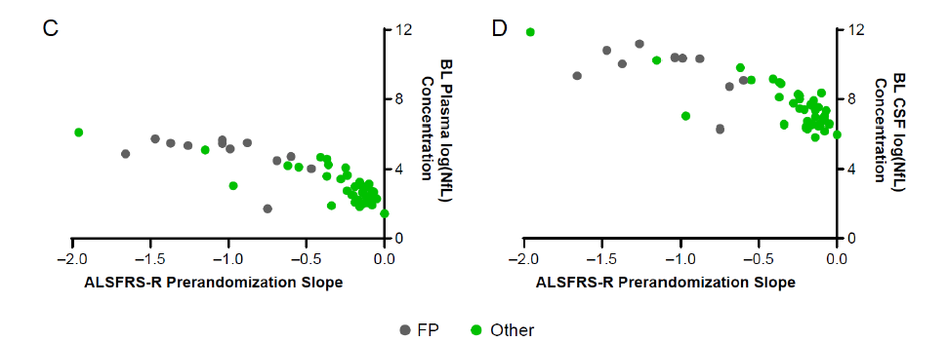
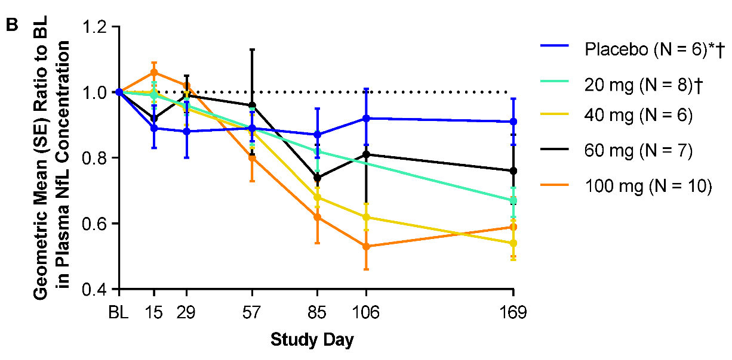
NfL Endpoint in Tofersen Phase 1/2 Results
The baseline neurofilament concentrations were at least 3.5 times as high in the fast-progression subgroup as in the other subgroup. The concentrations of phosphorylated neurofilament heavy chains and neurofilament light chains in plasma and CSF were largely unchanged during the intervention period among the 12 participants in the placebo group at day 85, whereas among the 10 participants who received 100 mg of tofersen, the concentrations decreased from baseline to day 85. Changes in the plasma and CSF concentrations of phosphorylated neurofilament heavy chains and neurofilament light chains from day 85 to day 169 are shown in Figures S13 and S14.
Fast-progression subgroup characteristics:
$SOD_{1}$ mutation linked to fast-progressing disease (mean duration ≤3 years)
Pre-randomization decrease in ALSFRS-R score of ≥0.2 points per month

