Slide 1

UNC13A-SSO (Splicing Switch Oligonucleotide) - Proposal for portfolio entry -
Yushuf Sharker
November 26, 2024

Slide 2
Study design
Objective and endpoints
Sample size assumptions
Backed up by tofersen
Sample size and justification
Risk of violation of assumption
GNG
Statistical analysis plan
Questions

Slide 4
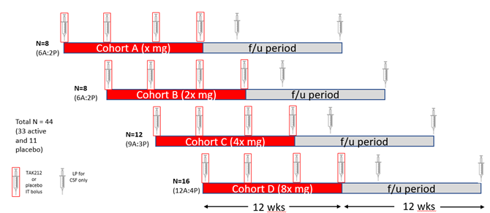
UNC 13A study design
Study Type: First in Human ePOC
Target Population: Adults aged 18 or older with ALS
Study Design: Randomized, Double-Blind, Placebo-Controlled MAD study
Objective: Safety and tolerability
Data Monitoring: The progression of the trial to the next dose-level cohort was based on a blinded review of safety and pharmacokinetic data from the preceding cohorts by the sponsor. The data reviewer may be blinded about patients' treatment group
Notes:
Tofersen target population: Amyotrophic lateral sclerosis (ALS) in adults who have a mutation in the superoxide dismutase 1 (SOD1) gene.
All ALS except SOD1
Tofersen as well as the other drugs are in the marker, in this situation, does the palcebol controlled trial ethical?
Data monitoring plan is still absent

Slide 5
Efficacy Endpoint UNC13A
The target product profile (TPP) includes the primary endpoint which measures the
Safety, PK
Neurofilament Light Chain (NfL) levels (Go/No-Go decision for ePOC)
Slowing in disease progression compared among treated group to Placebo Standard of care in the Amyotrophic Lateral Sclerosis Functional Rating Scale-revised (ALSFRS-R) score from baseline to Week 52.
Overall survival
Ventilator assistance free survival
Slow Vital Capacity (SVC) and
Quantitative muscle strength measures using handheld dynamometry and measuring survival during the long-term extension (LTE)
Tofersen
Primary Safety and PK.
The secondary outcome was the change from baseline in the cerebrospinal fluid (CSF) SOD1 concentration at day 85
Exploratory outcomes measured:
Changes in ALSFRS-R total score (12 items, 4 domains, each scored 0-4; higher scores = better function)
Percentage of predicted slow vital capacity
Handheld dynamometry megascore (strength in 16 muscle groups; z-score normalization, lower scores = worse function)
Neurofilament concentrations (phosphorylated neurofilament heavy chains and neurofilament light chains in post hoc analysis) (assay Quanterix and Plex Ella immunoassay)

Slide 6
Study Design and sample size
ePOC, POC and POM
The total estimated sample size is 44 across 4 dose level cohorts. Each cohort will have an overall ratio of 3 active to 1 placebo. The initial 2 dose level cohorts will have N=8 patients each and N=12 and N=16 in the two higher subsequent cohorts.
Tofersen:
The sample size assumptions were based on the expectation that a 25% reduction in the cerebrospinal fluid (CSF) SOD1 protein concentration would exceed both the assay variability and the longitudinal biovariability of CSF SOD1 as measured in humans. The calculation assumed a pooled standard deviation of 0.11 (natural log). It was estimated that 12 participants (9 to receive tofersen and 3 to receive placebo) in each of the four dose cohorts would be needed for the trial to have at least 80 to 99% power to detect differences in the reduction in the CSF SOD1 concentration (tofersen vs. placebo) between 12% and 25% at a 10% significance level.
To observe a 30% reduction in treated group the sample size is applicable for out study. With the assumption of 30% reduction and .11 SD (in natural log scale), the study would require 4 subjects in the placebo and 12 subjects in the treated arm that would provide >90% power to detect the difference with alpha = 10% two sided.

Slide 7
Study Design and sample size
ePOC, POC and POM
The total estimated sample size is 48 across 4 dose level cohorts. Each cohort will have an overall ratio of 3 active to 1 placebo. The initial 2 dose level cohorts will have N=8 patients each and N=12 and N=16 in the two higher subsequent cohorts.
Tofersen:
A 25% reduction in the CSF SOD1 protein concentration was estimated to exceed both the SOD1 assay variability and the longitudinal biovariability of CSF SOD1 as measured in humans. We calculated that 12 participants (9 to receive tofersen and 3 to receive placebo) in each of the four dose cohorts would be needed for the trial to have at least 80 to 99% power to detect differences in the reduction in the CSF SOD1 concentration (tofersen vs. placebo) between 12% and 25% at a 10% significance level. This sample-size calculation assumed a pooled standard deviation of 0.11 (natural log). The interim analysis that is described in the statistical analysis plan (available with the protocol) was conducted on all data up to the day 85 visit for 11 of the 12 participants in the 100-mg dose cohort to permit planning for the phase 3 trial (the 12th participant had not competed day 85 of the study). The results presented here reflect data from the final analysis.
To observe a 30% reduction in treated group the sample size is applicable for out study. With the assumption of 30% reduction and .11 SD (in natural log scale), the study would require 3 subjects in the placebo and 9 subjects in the treated arm that would provide 86% power to detect the difference with alpha = 10% two sided.

Slide 8
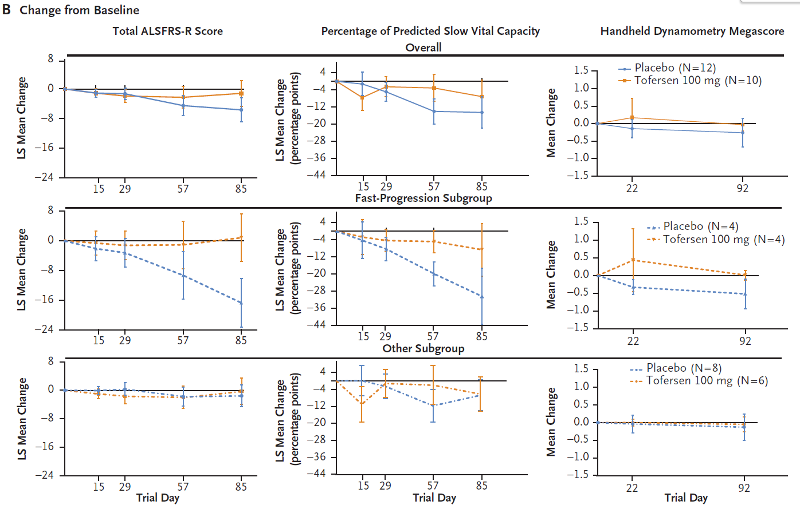
Efficacy Endpoint Tofersen
Endpoint measurements for placebo Phase 1/2
ALSFRS-R points change from based at d15 = -1.11 (-2.1—0.05),
d29 = −1.29 (−2.88 to 0.30)
d57 = −4.50 (−7.21 to −1.78)
d85 = −5.63 (−8.90 to −2.36)
handheld dynamometry megascore points
D22 = −0.14±0.27 (mean \pm sd), D92 = (−0.26±0.42)

Slide 9
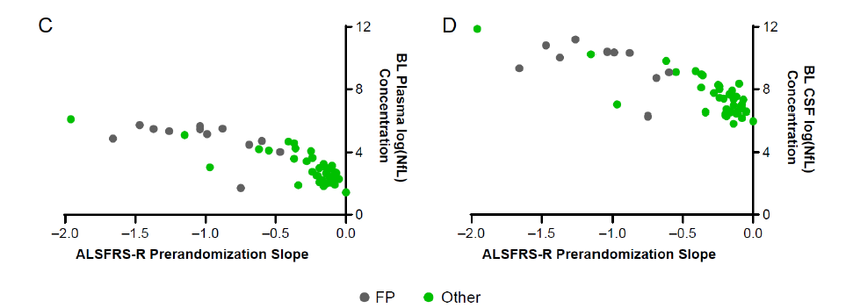
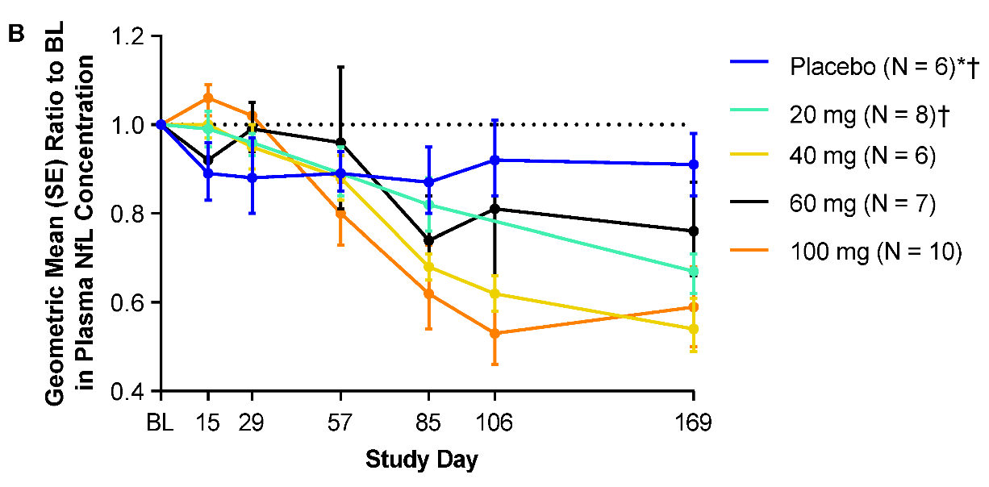
NfL Endpoint in Tofersen
The baseline neurofilament concentrations were at least 3.5 times as high in the fast-progression subgroup as in the other subgroup. The concentrations of phosphorylated neurofilament heavy chains and neurofilament light chains in plasma and CSF were largely unchanged during the intervention period among the 12 participants in the placebo group at day 85, whereas among the 10 participants who received 100 mg of tofersen, the concentrations decreased from baseline to day 85. Changes in the plasma and CSF concentrations of phosphorylated neurofilament heavy chains and neurofilament light chains from day 85 to day 169 are shown in Figures S13 and S14.
Fast-progression subgroup characteristics:
$SOD_{1}$ mutation linked to fast-progressing disease (mean duration ≤3 years)
Pre-randomization decrease in ALSFRS-R score of ≥0.2 points per month

Slide 10
Tofersen Phase 2/3
Study Design
we randomly assigned adults with SOD1 ALS in a 2:1 ratio to receive eight doses of tofersen (100 mg) or placebo over a period of 24 weeks.
Primary Endpoint
Change from baseline to week 28 in the total score on the ALS Functional Rating Scale–Revised (ALSFRS-R).
Secondary Endpoints
Changes in the total concentration of SOD1 protein in cerebrospinal fluid (CSF).
Changes in the concentration of neurofilament light chains in plasma.
Changes in slow vital capacity.
Changes in handheld dynamometry in 16 muscles.
change from baseline implies (ratio to baseline) to week 28

Slide 11
Tofersen Phase 2/3 Sample size calculation
Sample Size: 60 participants in the faster-progression primary analysis subgroup.
Randomization Ratio: 2:1 (tofersen to placebo).
Power: 84% power to detect a between-group difference.
Assumptions:
Change in ALSFRS-R score from baseline to week 28 of -4.8 in the tofersen group.
Change in ALSFRS-R score from baseline to week 28 of -24.7 in the placebo group.
Standard deviation of 20.39.
Survival of 90% in the tofersen group.
Survival of 82% in the placebo group.
Significance Level: Two-sided alpha level of 0.05.
These calculations were based on the joint rank test, which accounts for both functional decline and survival.

Slide 12
Tofersen Phase 2/3 SAP
The joint rank test used in the VALOR trial is summarized as follows:
Purpose: To account for both functional decline and survival in the analysis of the change in the ALS Functional Rating Scale-Revised (ALSFRS-R) score.
Method:
Each participant's change in ALSFRS-R score from baseline to week 28 is compared with that of every other participant.
Participants receive a score of 1 if their outcome is better, -1 if worse, and 0 if the same as the participant being compared.
Participants who died are ranked lowest based on their time to death, with progressively lower ranks given to those who died sooner after the first dose.
Analysis:
The sum of individual scores for each participant (ranked score) is assessed using analysis of covariance (ANCOVA).
The ANCOVA model includes the trial group as a fixed effect and adjusts for covariates such as baseline disease duration, baseline ALSFRS-R score, and use of riluzole or edaravone.
Multiple imputation is used to account for missing data due to withdrawals not accounted for by death.
The joint rank test allows for a statistical test of the treatment effect while considering the truncation of data due to deaths.-

Slide 13
Tofersen Phase 2/3 NfL Results
Adjusted geometric mean ratio to VALOR baseline: 1.20
Geometric mean ratio: tofersen vs. placebo (95% CI): 0.33 (0.25 to 0.45)
This indicates that the concentration of NfL in plasma increased by 20% from baseline in the placebo group.
In the faster-progression subgroup, the concentration of neurofilament light chains in plasma was reduced by 60% in participants who received tofersen, whereas it increased by 20% in those who received placebo.
The faster-progression subgroup in the VALOR trial was defined based on the following criteria:
SOD1 Mutation Type: Specific types of SOD1 mutations associated with faster disease progression.
Pre-randomization ALSFRS-R Slope: The estimated slope of the ALS Functional Rating Scale-Revised (ALSFRS-R) score calculated from the time of symptom onset until screening.
A total of 60 of the 108 participants made up the faster-progression subgroup

Slide 14
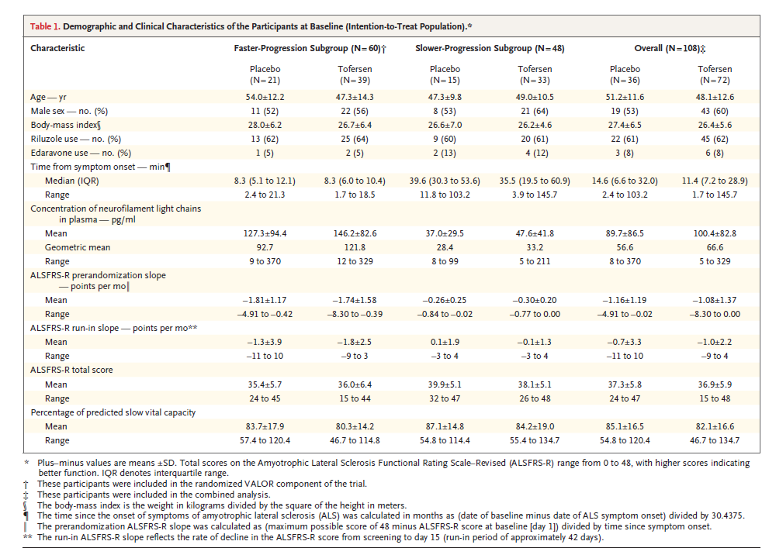
Tofersen Phase 2/3 NfL Results at baseline
End of the study
Faster-Progression Subgroup:
Placebo Group: The adjusted geometric mean ratio to baseline for NfL concentration was 1.20.
Tofersen Group: The adjusted geometric mean ratio to baseline for NfL concentration was 0.40.
Between-Group Difference: The geometric mean ratio for tofersen vs. placebo was 0.33 (95% CI, 0.25 to 0.45).
Approximated SD: (.45-.25)/2*1.96 = 0.051

Slide 15
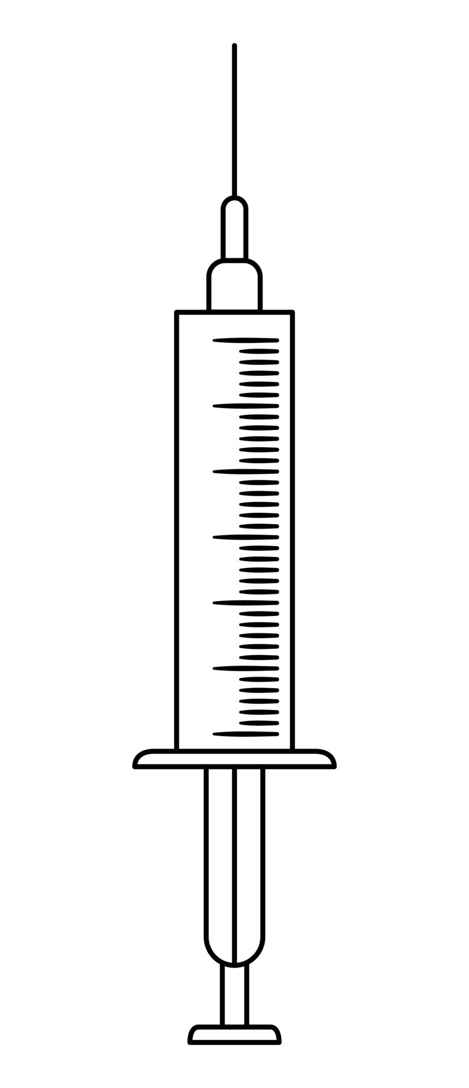
Ph1/2 Study Schematic (DRAFT)
Open label extension
(earliest start could be the end of chronic tox, in-life results, timing TBD)
N=8
(6A:2P)
Cohort A (x mg)
f/u period
N=8
(6A:2P)
Cohort B (2x mg)
f/u period
Total N = 48 (36 active and 12 placebo)
N=16
(12A:4P)
Cohort C (4x mg)
f/u period
Drug or placebo
IT bolus
LP for CSF only
N=16
(12A:4P)
Cohort D (8x mg)
f/u period
12 wks
12 wks
Start of each cohort with sentinel dosing (1 active, 1 placebo)
24 hr safety data review of sentinels prior to allowing dosing of remaining within cohort
After sentinels, no more than one patient can be dosed in a day
Dose escalation
All patients in previous cohort have reached 7 days post 2nd dose (4 wks post baseline) for safety review
Once safety confirmed, sentinel dosing for next cohort can start
Adaptive elements: Emerging PK and PD could lead to adaptions of dose level, dose frequency, and sample size in cohort 3 and 4
However, dose level will not exceed 2x to prior dose level and dose frequency will not be more frequent than monthly
Utilization of an external DSMB

Slide 16
Sample Size

Slide 17
Go/No-Go Quantitative decision criteria
Hypothesis
UNC13A splicing correction will restore UNC13A protein levels, restore neuronal function and slow/halt motor neuron degeneration in ALS
Surrogate biomarker
NfL (Accelerated approval of Tofersen used the biomarker for approval))
30% lowering the NfL level is clinically meaningful (Ref Tofersen). Thus, current target levels of NfL reduction desired in our Ph1/2 study are a 30% reduction and a 30% increase would represent an undesirable outcome
“Conversely, a recent Ph1/2 study of another IT ASO directly against the C9orf72 RNA in ALS patients with C9orf72 mutations demonstrated target engagement but at the highest dose tested trended towards worsening of clinical outcome measures and an NfL increase of over 30%. Thus, current target levels of NfL reduction desired in our Ph1/2 study are a 30% reduction and a 30% increase would represent an undesirable outcome.”
Justification: Prior market research indicated that achieving an improvement of >40% in the ALSFRS-R (minimal acceptable level) would be differentiating and that an improvement of >50% in the ALSFRS-R (target preferred level) would be considered transformative as this would translate to considerable preservation of independent function.
Evaluation time
The evaluation time point is 4-12 weeks following the last dose to the baseline
The doses level would the highest safe dose
The median ratio of Nfl level at the follow-up to the baseline for the treatment arm will be compared to that of pooled placebo subjects across the cohorts

Slide 18
Go/No-Go Decision Metric
NfL Increase from baseline | 30% | 20% | 10% | 0% | -10% | -20% | -30% | -40% | -50% | -60% | -70% | -80%
Treatment Placebo Ratio
0.1
0.2
0.3
0.4
0.5
0.6
0.7
0.8
0.9
1
1.5
2
2.5
3
 | Ylog | Yoriginal | reduction in Log scale | Reduction in original Scale
Min | 2 | 7 | 30% | 45.1%
Max | 6 | 403.4 | 30% | 83.5%

Slide 19
ePOC: Substantial Efficacy
Substantial efficacy in a specified indication at an interim point within a POC trial, indicating reasonable probability of meeting pre-defined POC efficacy level in the study as originally defined
Are the following key elements of the Takeda EPOC study design optimal?
Bayesian go/no go criteria, informative vs. non-informative prior, sample size and the assumptions

Slide 20
ePOC: Deliverables
What would be the ideal level of effect for go
What would be the probability of getting the effect for different levels of observation.
Is 30% reduction good enough for making gng decision
Questions:
30% in the original scale or log scale
From baseline or from placebo
30% reduction in the change from baseline
Change in treated /Change in placebo = >.3

Slide 21
Log Scale Vs Original Scale NfL from Tofersen study
What level of reduction is expected if we to observe a 30% reduction in the log scale in the change from baseline?

Slide 22
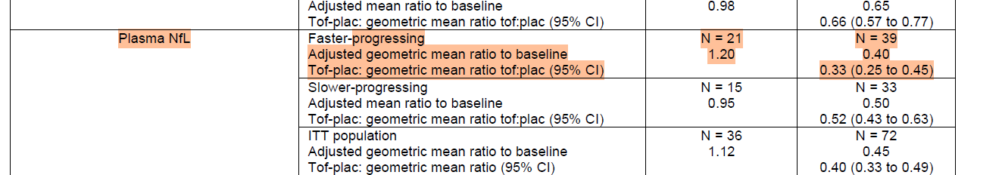
Reduction in change from basline in log scale
Faster-progression subgroup:
Treated group: Reduced by 60%
Placebo group: Increased by 20%
Difference: 80% reduction in the treated group compared to the placebo group
Slower-progression subgroup:
Treated group: Reduced by 40%
Placebo group: Increased by 19%
Difference: 59% reduction in the treated group compared to the placebo group

Slide 23
Log Scale Vs Original Scale NfL
What level of reduction is expected if we to observe a 30% reduction in the log scale?
 | Baseline Nfl In log scale | Baseline Nfl scale | Percent reduction in log scale | Percent reduction in original scale
Min | 2 | 7 | 30% | 45.1%
Max | 6 | 403.4 | 30% | 83.5%
Reduction in original scale depends on baseline
If we observed as low as 7 level of baseline, still we have 45% reduction if we observed a 30% reduction in the log scale

Slide 24
Log Scale Vs Original Scale NfL
What level of reduction is expected if we to observe a 30% reduction in the log scale in the change from baseline?

Slide 25
Log Scale Vs Original Scale NfL
What level of reduction is expected if we to observe a 30% reduction in the log scale?
 | Baseline Nfl In log scale | Baseline Nfl In log scale | Percent reduction in log scale | Percent reduction in original scale
Min | 2 | 7 | 30% | 45.1%
Max | 6 | 403.4 | 30% | 83.5%
Observed placebo at baseline mean 3.6 (0.145)
20% increase yields 3.6*1.2 = 4.3 change from baseline delta at followup = 0.72
For treated group change from baseline expected (30% reduction) = 0.50. We are interested to observe less than or equal 0.5
Difference in change = -.22 (expected to be less than -.22)

Slide 26
Log Scale Vs Original Scale NfL
Assuming Same SD of 0.145 in log scale, 5 placebo and 16 treated.5
Go Criteria: P(Δμ < -0.22 ) > 0.7
No-Go Criteria: P(Δμ < -0.22 ) < 0.1
We must observe the difference in change from baseline < -0.35 for Go
If we observe the difference in change from basely > -0.16
Assumed mu_c | Assumed mu_t | Assumed sigma_c | Assumed sigma_t | Go Probability | No-Go Probability | Consider (Gray Zone) Probability
0.7 | 0.3 | 0.2 | 0.2 | 89.11% | 0.12% | 10.77%
0.7 | 0.4 | 0.2 | 0.2 | 60.11% | 1.96% | 37.93%
0.7 | 0.5 | 0.2 | 0.2 | 23.59% | 13.87% | 62.55%
0.7 | 0.6 | 0.2 | 0.2 | 4.50% | 45.60% | 49.90%
0.7 | 0.6 | 0.2 | 0.2 | 4.50% | 45.60% | 49.90%
0.7 | 0.6 | 0.2 | 0.2 | 4.50% | 45.60% | 49.90%

Slide 27
Biostatistics Support
Biostatistics
Phase 1/2
Concept Development:
Review literature
Write and disseminate the concept note
Perform simulation and power analysis
Contribute to Concept Sheet and CDP
Protocol and SAP:
Draft protocol and SAP
Collaboration:
Work with statisticians on randomization, ADAM, and SDTM database setup and TLFs
Monitor data quality
Coordinate with programmers for database unlock and finalize ADAM, SDTM, and TLF
Analyze data for GNG and CRS
Clinical study report and regulatory submission
Phase 2/3
Concept Note Development:
Review literature
Write and disseminate the concept note
Perform simulation and power analysis
Analyze Pro-Act Data for natural history insights
Perform necessary simulation modeling, sample size estimation
Protocol and SAP Drafting:
Draft protocol and SAP
Collaboration:
Work with statistical programmers on randomization, ADAM, SDTM, and TLFs setup
Partner with programmers or CRO for data quality monitoring
Coordinate with stat programmers for database lock and finalization of ADAM, SDTM, and TLF
Engage with study team for clinical study report and regulatory submission

Slide 28
FTE for Biostatistician
Dec 2024 - Jun 2025 (Phase 1/2)
Involvement:
Review literature
Write and disseminate the concept note
Perform simulation and power analysis
Contribute to Concept Sheet and CDP
FTE Required: 70% of a biostatistician
Jul 2026 - Sep 2026
Involvement:
Develop Protocol and SAP
Collaborate with statistical programmers for randomization, ADAM, SDTM database, and TLFs setup
FTE Required: 75% of a biostatistician
Oct 2026 Onwards
Involvement:
Data quality monitoring
Amend protocol and SAP if needed
Collaborate with programmers for database unlock, finalize ADAM, SDTM, and TLF
Analyze data for GNG and CRS
Work with the study team for clinical study report and regulatory submission
Develop Phase 2/3 trial
FTE Required: 100% of a biostatistician

Slide 29
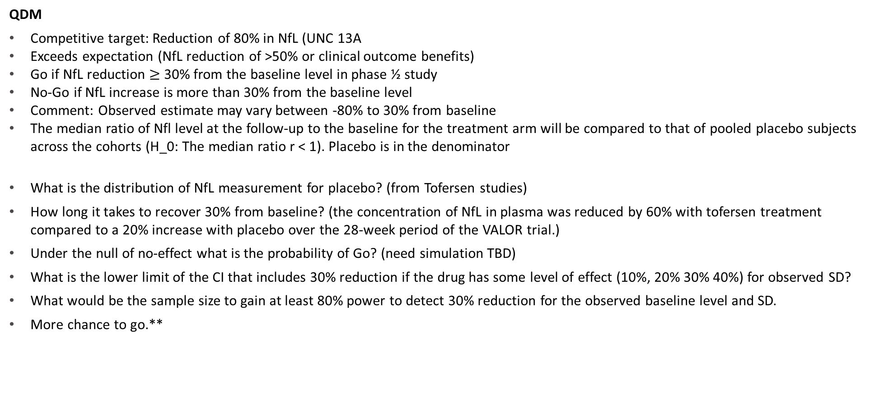
Go/No-Go Quantitative decision criteria
QDM
Competitive target: Reduction of 80% in NfL (UNC 13A
Exceeds expectation (NfL reduction of >50% or clinical outcome benefits)
Go if NfL reduction $≥$ 30% from the baseline level in phase ½ study
No-Go if NfL increase is more than 30% from the baseline level
Comment: Observed estimate may vary between -80% to 30% from baseline
The median ratio of Nfl level at the follow-up to the baseline for the treatment arm will be compared to that of pooled placebo subjects across the cohorts (H_0: The median ratio r < 1). Placebo is in the denominator
What is the distribution of NfL measurement for placebo? (from Tofersen studies)
How long it takes to recover 30% from baseline? (the concentration of NfL in plasma was reduced by 60% with tofersen treatment compared to a 20% increase with placebo over the 28-week period of the VALOR trial.)
Under the null of no-effect what is the probability of Go? (need simulation TBD)
What is the lower limit of the CI that includes 30% reduction if the drug has some level of effect (10%, 20% 30% 40%) for observed SD?
What would be the sample size to gain at least 80% power to detect 30% reduction for the observed baseline level and SD.
More chance to go.**

