Slide 1

UNC13A-SSO (Splicing Switch Oligonucleotide) ePOC - Statistical consideration-
Yushuf Sharker
February 10th, 2024

Slide 2
Discussion Points
Study Design: Is it adequate to meet the objectives?
Endpoints: Are they well-defined and sufficient for efficacy and Go/No-Go (GNG) decisions?
Assumptions: Are the reduction assumptions reasonable?
Sample Size: Is it sufficient to confidently achieve the study objectives?
Go/No-Go Criteria: Are the thresholds and SD acceptable? Are the assumptions for GNG reasonable?
Statistical Analysis Plan: Any comments or suggestions?

Slide 3
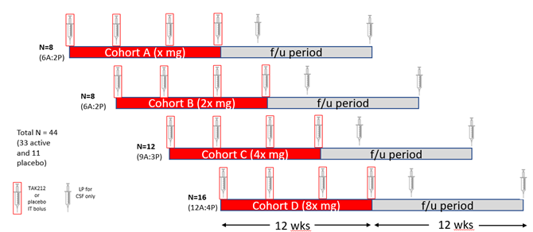
UNC 13A Study Design Phase 1/2
Study Type: First in Human ePOC among adults with ALS of age between 18-62
Study Design: Randomized, Double-Blind, Placebo-Controlled, Dose Finding
Dosing: Four dose cohort. Each cohort will be randomized to a specific dose level or placebo with allocation ratio 3:1
Objective: Safety, PK/PD and efficacy evaluation for Go/No-Go.
Notes:
Tofersen target population: Amyotrophic lateral sclerosis (ALS) in adults who have a mutation in the superoxide dismutase 1 (SOD1) gene.
All ALS except SOD1
Tofersen as well as the other drugs are in the marker, in this situation, does the palcebol controlled trial ethical?
Data monitoring plan is still absent

Slide 4
Endpoints UNC13A-SSO Phase 1/2
Primary Endpoints
Incidence of Adverse Events (AE) and Serious Adverse Events (SAE)
Incidence of abnormalities in clinical labs, vital signs, physical and neurological assessments, ECGs, C-SSRS
Secondary Endpoints
PK measures, including CSF, plasma, and urine
Antidrug Antibody (ADA) incidence in serum and its impact on PK, Pharmacodynamics (PD), and safety
Exploratory Endpoints
Change from baseline in
CSF normal UNC13A mRNA/protein or UNC13A downstream molecule
CSF and plasma neurofilament light chain (NfL)
ALSFRS-R
ALSAQ40, EQ5D5L, Clinical Global Impression (CGI), Patient Global Impression (PGI)
Exploratory Plasma NfL will be used for Go/No-Go evaluation and ALSFRS-R is the FDA/EMA recommended endpoint for ALS pivotal studies

Slide 5
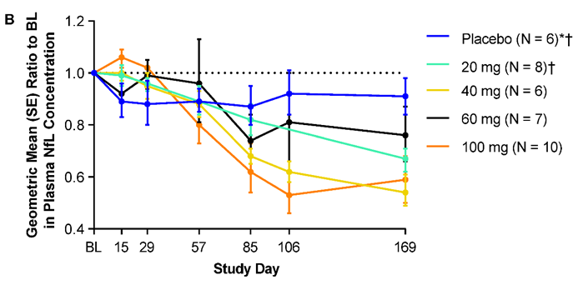
Change in NfL in Literature
Phase 2/3 Study
Faster-progression subgroup:
Treated group: Reduced by 60%
Placebo group: Increased by 20%
Adjusted geometric mean (GM) ratio to placebo: (1-.8/1.2) = 0.33 (95% CI: 0.25, 0.45)
Slower-progression subgroup:
Treated group: Reduced by 40%
Placebo group: Increased by 19%
Adjusted GM ratio to placebo: (1-0.59/1.19) = 0.52 (95% CI: 0.43, 0.63)
Tofersen Phase 1/2
All progression group: GM ratio to placebo ~ 0.25 (100 ml Group)
Sample size and assumptions: Enrolled 48 subjects, allocation ratio of 3:1 to Treated: placebo. Assumptions involved 25% reduction in GM ratio to placebo with pooled Standard Deviation (SD) = 0.11.
UNC13A-SSO
A reduction of 30% in GM ratio to placebo is a reasonable assumption for sample size evaluation with pooled SD = 0.11
Study | Mean | SD | Scale | n | Group | Time
Tofersen P2/3* | 127.3 | 94.4 | Pg/ml | 21 | P | B
Tofersen P2/3* | 4.6 | 0.66 | Log | 21 | P | B
Tofersen P2/3 | 37 | 29.5 | Pg/ml | 15 | P | B
Tofersen P2/3 | 3.4 | 0.7 | Log | 15 | P | B
Tofersen P1/2* | 4.3 | NA | Log | 12 | P | B
BIIB078‡ | 107.7 | 77.3 | Pg/ml | 27 | P | B
BIIB078 | 5.94 | 0.28 | Log | 27 | P | B
Nfl Mean and SD in original scale and log scale for placebo subjects at baseline.
* Faster progression group, P: Placebo, B: Baseline ‡ Source: Berg et al., Lancet Neurology
Change in NfL for different dose levels at day 169 in tofersen phase 1/2 study

Slide 6
Sample Size and Justification UNC13A-SSO Phase 1/2
A total of 48 subjects are planned for the various dose cohorts. The cohort specific sample size are given in the table.
To account for 10% dropout, 4 additional subject will be considered
The combined placebo group will be used to compare the dose cohorts. For example, For dose cohort A, 6 treated subjects will be compared with 12 placebo subject and the same for the other cohorts.
With the assumed level of 30% reduction and pooled SD of 0.11, alpha = 0.1, The study could detect the reduction with >90% power for all dose cohorts. The power of the study is sensitive to SD and the assumed percent reduction
Cohort | Treatment | Placebo | Total | # Placebo for comparison
A (Lowest) | 6 | 2 | 8 | 12
B (Second) | 6 | 2 | 8 | 12
C (Third) | 12 | 4 | 16 | 12
D (Highest) | 12 | 4 | 16 | 12
Total | 36 | 12 | 48

Slide 7
Sample Size and Justification UNC13A-SSO Phase 1/2
Reduction and SD thresholds: Sensitivity Analysis (Alpha = 0.1)
With pooled SD = 0.11 and sample size N_{T} = 12 and 6, the study detect minimum reduction of 10% and 11% respectively with at least 80% power. Higher SD would require to observe a higher level of reduction to be detected with >80% power (Table 1).
With the sample size N_{T} = 12 and 6, the study can detect a reduction of 30% with >80% power if the SD <0.4 and 0.33 respectively
N_{T} | SD | Reduction Threshold (%)
12 | 0.11 | 10
6 | 0.11 | 11
12 | 0.30 | 23
6 | 0.30 | 28
12 | 0.60 | 41
6 | 0.60 | 48
12 | 0.70 | 46
6 | 0.70 | 53
N_{T} | Reductions (%) | SD Thresholds
12 | 10 | 0.12
6 | 10 | 0.10
12 | 15 | 0.18
6 | 15 | 0.15
12 | 20 | 0.25
6 | 20 | 0.20
12 | 30 | 0.40
6 | 30 | 0.33
Table: 1 Minimum detectable threshold of reduction for which arms can detect the difference with >80% power for different SDs.
Table 2: Minimum SD threshold for which study can detect the different levels of reduction with >80% power

Slide 8
Go/No-Go Decision Metric
Decision Thresholds:
Go Criteria: P(Δμ< −0.16)> 0.7
No-Go Criteria: P(Δμ< −0.16) <0.1
Definition of Δμ:
Δμ is defined as the difference in (change from baseline in log NfL level at Week 16 among treated) and (change from baseline in log NfL level at Week 16 among placebo).
Translation to Original Scale:
Go Criteria Δμ< −0.16 implies a 15% reduction with a probability after observed data is >70% for a ‘go’ decision.
Study level expectation:
If the study observes < 10% reduction, the QDM will recommend no-go,
If the study observes more than >18% reduction, QDM will trigger to go.
QDM Recommend ‘consider’ in between
Assumptions:
The true reduction of 30% in GM ratio to placebo is highly clinically significant. In log scale this is equivalent to Δμ = -0.35.
The true reduction <15% GM ratio to placebo, team needs extreme caution to move forward for development
Simple Bayesian Decision rule, credibility of 95%
Sample size:
N_{P} = 12, N_{T1} = N_{T2} = 6, N_{T3} = N_{T4} = 12 for 4 different dose cohort, a total of 48
Equal Standard deviations for both treatment and placebo
SD considered 0.11 and 0.7 in log scale

Slide 9
GNG Operating Characteristics
Several SD and sample size and reduction situations are evaluated for the decision using the proposed QDM.
SD | Nt | Reduction (%) | Go Probability (%) | No-Go Probability (%) | Consider (Gray Zone) Probability (%)
0.11 | 6 | 10 | 5.3 | 42.4 | 52.3
0.11 | 12 | 10 | 3.1 | 52.2 | 44.7
0.11 | 6 | 20 | 73.3 | 0.8 | 26.0
0.11 | 12 | 20 | 81.0 | 0.36 | 18.6
0.11 | 6 | 30 | 99.9 | 0 | 0.1
0.11 | 12 | 30 | 100 | 0 | 0
0.7 | 6 | 10 | 24.3 | 13.4 | 62.3
0.7 | 6 | 10 | 24.3 | 13.4 | 62.3
0.7 | 12 | 10 | 23.1 | 14.2 | 62.7
0.7 | 6 | 20 | 36.5 | 7.2 | 56.3
0.7 | 12 | 20 | 38.1 | 6.7 | 55.3
0.7 | 6 | 30 | 51.9 | 3.2 | 44.9
Interpretation:
If the true reduction is 30% If we observe SD of 0.11 or less with sample size N_{T} = N_{P} = 12, The QDM would recommend a ‘go’ decision with probability 100%
For the same reduction level and sample size with SD = 0.7 (higher SD), the QDM would recommend 'go' with probability of 56% and 'Consider' with probability 42%
Decisions are sensitive to the observed standard deviations and sample sizes.

Slide 10
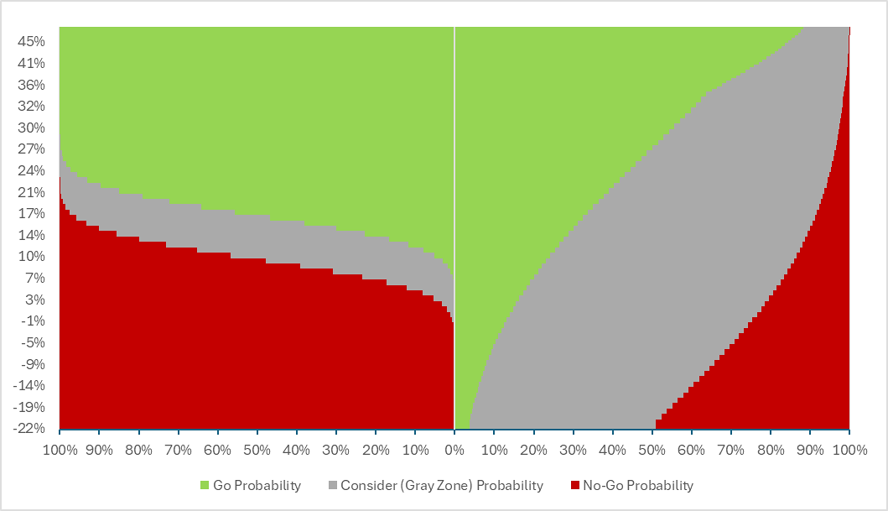
GNG Operating Characteristics
Operating characteristics of the proposed QDM for two different standard deviation 0.11 and 0.7.
If the true reduction is 18%, QDM with SD 0.11 will trigger ‘go’ whether with SD 0.7, QDM will recommend ‘consider’
If there is no reduction, higher SD would lead QDM to ‘consider’. Even it has some positive probability to go for it.
SD = 0.11
SD = 0.70
A higher SD widens the gray zone, necessitating a larger observed difference (more than 28%) for a go decision with the QDM.

Slide 11
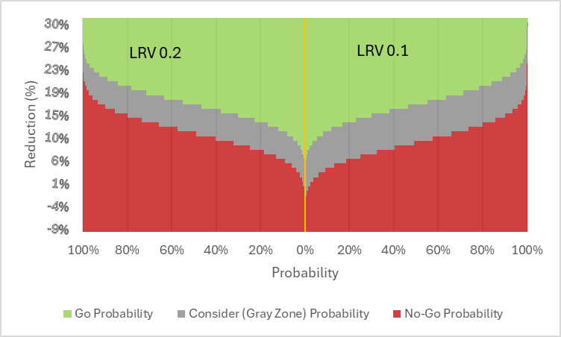
GNG Operating Characteristics
LRV 0.1 or 0.2
LRV is the level of risk we agree for continuing a compound that is below our threshold line for development
The impact of changing the level of risk from 0.2 to 0.1 has limited impact on probability of ‘go’
Reduced LRV increase the chance of ‘consider’ and reduced the probability of ‘no-go’ with lower true effect
For example, on the black horizontal line, the reduction is slightly greater than 10%, LRV recommends ‘No-Go’ however LRV 0.1 recommends ‘Consider’.
The gray zone becomes wider in lower LRV that results the QDM is prone to ‘go’ decision with lower true reduction.

Slide 12
Statistical Analysis Plan
Efficacy Evaluation and Go/No-Go: Changes from baseline in NfL (by week 16), ALSFRS-R, SVC, muscle strength, and speech (up to week 24).
Data Summary: Descriptive statistics and figures by dose level and follow-up time.
NfL Analysis: Log-transformed; reported as geometric mean ratio to placebo.
Reporting: Point estimates with 95% confidence intervals.
No Multiplicity Adjustment: Inferential conclusions are not drawn.
Subgroup Analysis: Based on progression speed and UNC13A SNP data.

Slide 13
Discussion Points
Study Design: Is it adequate to meet the objectives?
Endpoints: Are they well-defined and sufficient for efficacy and Go/No-Go (GNG) decisions?
Assumptions: Are the reduction assumptions reasonable?
Sample Size: Is it sufficient to confidently achieve the study objectives?
Go/No-Go Criteria: Are the thresholds for TTV, TLRV, ThetaTV, and SD acceptable? Are the assumptions for GNG reasonable?
Statistical Analysis Plan: Any comments or suggestions?

Slide 14
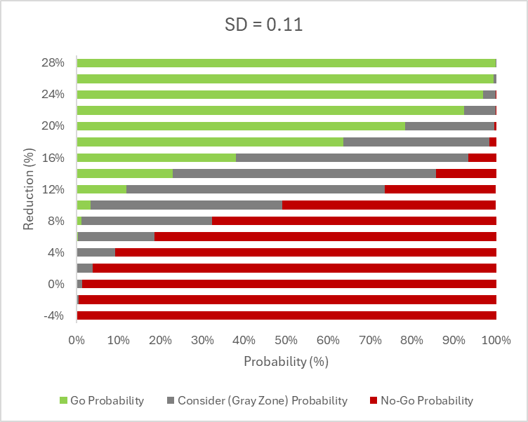
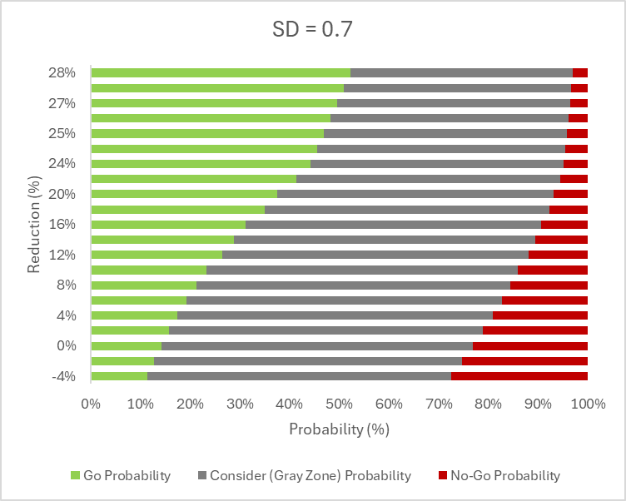
GNG Operating Characteristics
Operating characteristics of the proposed QDM for two different standard deviation 0.11 and 0.7.
A higher SD widens the gray zone, necessitating a larger observed difference (more than 28%) for a go decision with the QDM.

Slide 15
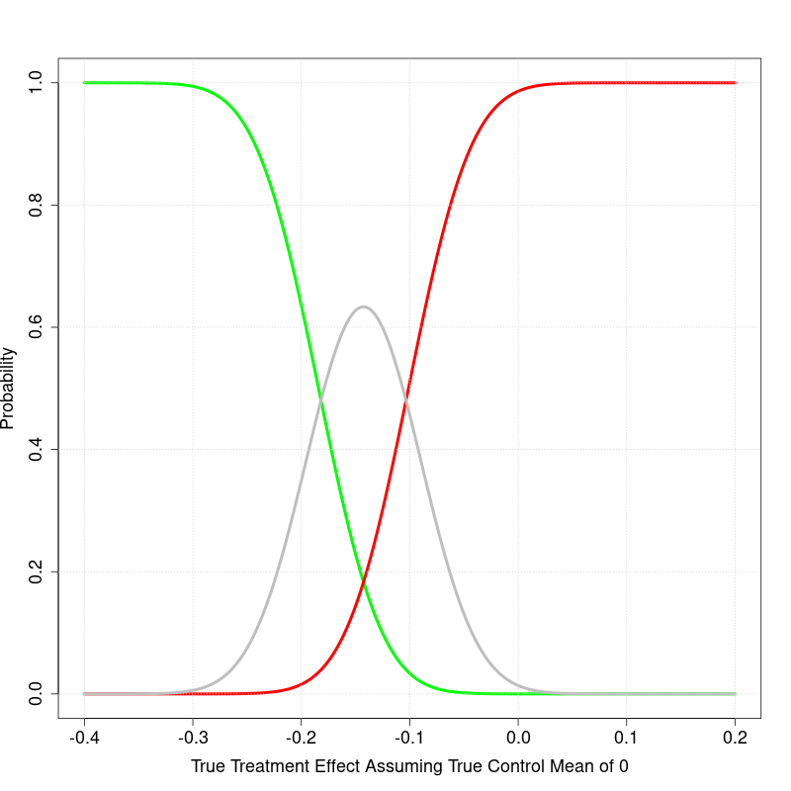
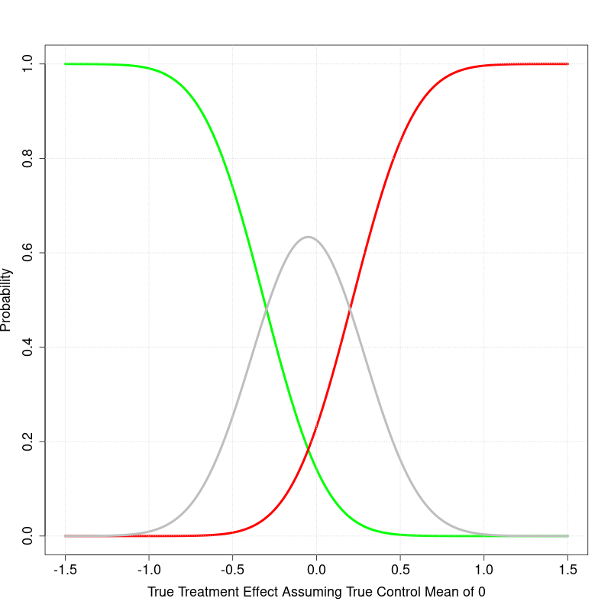
GNG Operating Characteristics
Quantitative Decision Metric Threshold
Operating characteristics of the proposed QDM for two different standard deviation 0.11 and 0.7. The sample size and the other considerations was the same. X axis indicates the difference in change from baseline between treatment and placebo arms in log scale.
Higher SD would lead to a wider gray zone and require higher difference to observe to have go decision with the QDM
SD = 0.11
SD = 0.7

Slide 16
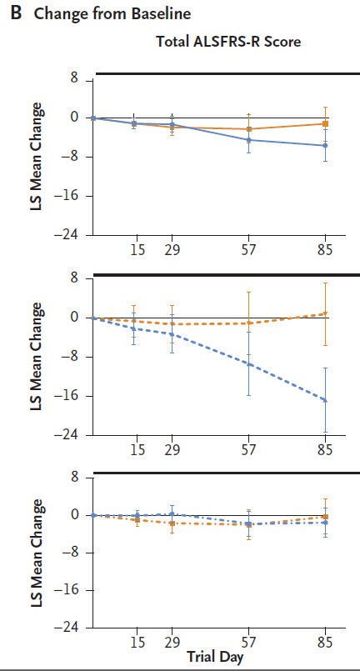
Tofersen ALSFRS-R score in Phase 1/2
Overall, ALSFRS-R points change from the baseline level was meaningful on day 57 and onward
D57 = −4.50 (−7.21 to −1.78)
D85 = −5.63 (−8.90 to −2.36)
Reduction was faster in the faster progressive group. The slower progressive group change was less detectable withing the timeframe of day 85

Slide 17
Go/No-Go Quantitative decision criteria
Hypothesis
UNC13A splicing correction will restore UNC13A protein levels, restore neuronal function and slow/halt motor neuron degeneration in ALS
Surrogate biomarker
NfL (Accelerated approval of Tofersen used the biomarker for approval))
30% lowering the NfL level is clinically meaningful (Ref Tofersen). Thus, current target levels of NfL reduction desired in our Ph1/2 study are a 30% reduction and a 30% increase would represent an undesirable outcome
“Conversely, a recent Ph1/2 study of another IT ASO directly against the C9orf72 RNA in ALS patients with C9orf72 mutations demonstrated target engagement but at the highest dose tested trended towards worsening of clinical outcome measures and an NfL increase of over 30%. Thus, current target levels of NfL reduction desired in our Ph1/2 study are a 30% reduction and a 30% increase would represent an undesirable outcome.”
Justification: Prior market research indicated that achieving an improvement of >40% in the ALSFRS-R (minimal acceptable level) would be differentiating and that an improvement of >50% in the ALSFRS-R (target preferred level) would be considered transformative as this would translate to considerable preservation of independent function.
Evaluation time
The evaluation time point is 4-12 weeks following the last dose to the baseline
The doses level would the highest safe dose
The median ratio of Nfl level at the follow-up to the baseline for the treatment arm will be compared to that of pooled placebo subjects across the cohorts

Slide 18
Log Scale Vs Original Scale NfL from Tofersen study
What level of reduction is expected if we to observe a 30% reduction in the log scale in the change from baseline?
NfL/Study | Mean | SD | GM | Median | Scale | n | Sample | Time
Tofersen P2/3* | 127.3 | 94.4 | 92.7 | 92.7 | Pg/ml | 21 | P | B
Tofersen P2/3* | 4.6 | 0.66 |  |  | Log | 21 | P | B
Tofersen P2/3 | 37 | 29.5 | 28.4 | 28.4 | Pg/ml | 15 | P | B
Tofersen P2/3 | 3.4 | 0.7 |  |  | Log | 15 | P | B
Tofersen P1/2*| | 4.3 |  |  |  | Log | 12 | P | B
Tofersen P2/3* | 146.2 | 82.6 | 121.8 | 121.8 | Pg/ml | 39 | T | B
Tofersen P2/3* | 5 | 0.06 |  |  | Log | 39 | T | B
Tofersen P2/3 | 47.6 | 41.8 | 33.2 | 33.2 | Pg/ml | 33 | T | B
Tofersen P2/3 | 3.9 | 0.14 |  |  | Log | 33 | T | B

Slide 19
Tofersen Phase 2/3 SAP
The joint rank test used in the VALOR trial is summarized as follows:
Purpose: To account for both functional decline and survival in the analysis of the change in the ALS Functional Rating Scale-Revised (ALSFRS-R) score.
Method:
Each participant's change in ALSFRS-R score from baseline to week 28 is compared with that of every other participant.
Participants receive a score of 1 if their outcome is better, -1 if worse, and 0 if the same as the participant being compared.
Participants who died are ranked lowest based on their time to death, with progressively lower ranks given to those who died sooner after the first dose.
Analysis:
The sum of individual scores for each participant (ranked score) is assessed using analysis of covariance (ANCOVA).
The ANCOVA model includes the trial group as a fixed effect and adjusts for covariates such as baseline disease duration, baseline ALSFRS-R score, and use of riluzole or edaravone.
Multiple imputation is used to account for missing data due to withdrawals not accounted for by death.
The joint rank test allows for a statistical test of the treatment effect while considering the truncation of data due to deaths.-

Slide 20
Tofersen Phase 2/3 Sample size calculation
Sample Size: 60 participants in the faster-progression primary analysis subgroup.
Randomization Ratio: 2:1 (tofersen to placebo).
Power: 84% power to detect a between-group difference.
Assumptions:
Change in ALSFRS-R score from baseline to week 28 of -4.8 in the tofersen group.
Change in ALSFRS-R score from baseline to week 28 of -24.7 in the placebo group.
Standard deviation of 20.39.
Survival of 90% in the tofersen group.
Survival of 82% in the placebo group.
Significance Level: Two-sided alpha level of 0.05.
These calculations were based on the joint rank test, which accounts for both functional decline and survival.

Slide 21
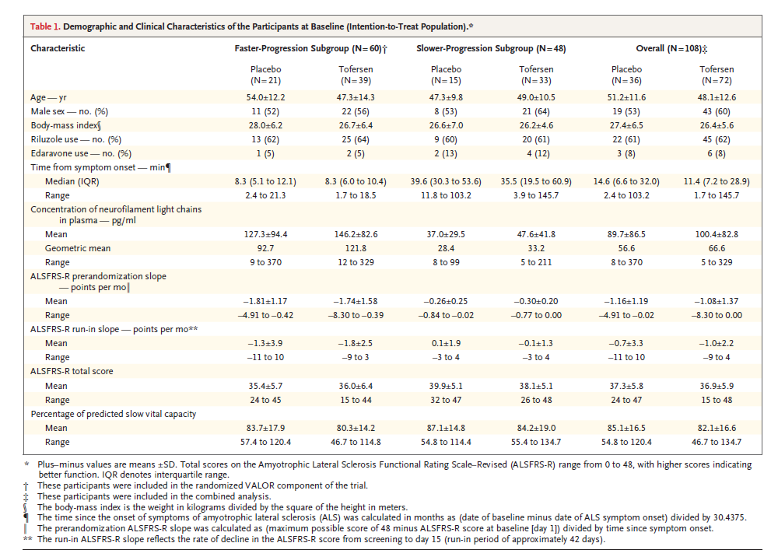
Tofersen Phase 2/3 NfL Results at baseline
End of the study
Faster-Progression Subgroup:
Placebo Group: The adjusted geometric mean ratio to baseline for NfL concentration was 1.20.
Tofersen Group: The adjusted geometric mean ratio to baseline for NfL concentration was 0.40.
Between-Group Difference: The geometric mean ratio for tofersen vs. placebo was 0.33 (95% CI, 0.25 to 0.45).
Approximated SD: (.45-.25)/2*1.96 = 0.051

Slide 22
Tofersen Phase 2/3 NfL Results
Adjusted geometric mean ratio to VALOR baseline: 1.20
Geometric mean ratio: tofersen vs. placebo (95% CI): 0.33 (0.25 to 0.45)
This indicates that the concentration of NfL in plasma increased by 20% from baseline in the placebo group.
In the faster-progression subgroup, the concentration of neurofilament light chains in plasma was reduced by 60% in participants who received tofersen, whereas it increased by 20% in those who received placebo.
The faster-progression subgroup in the VALOR trial was defined based on the following criteria:
SOD1 Mutation Type: Specific types of SOD1 mutations associated with faster disease progression.
Pre-randomization ALSFRS-R Slope: The estimated slope of the ALS Functional Rating Scale-Revised (ALSFRS-R) score calculated from the time of symptom onset until screening.
A total of 60 of the 108 participants made up the faster-progression subgroup

Slide 23
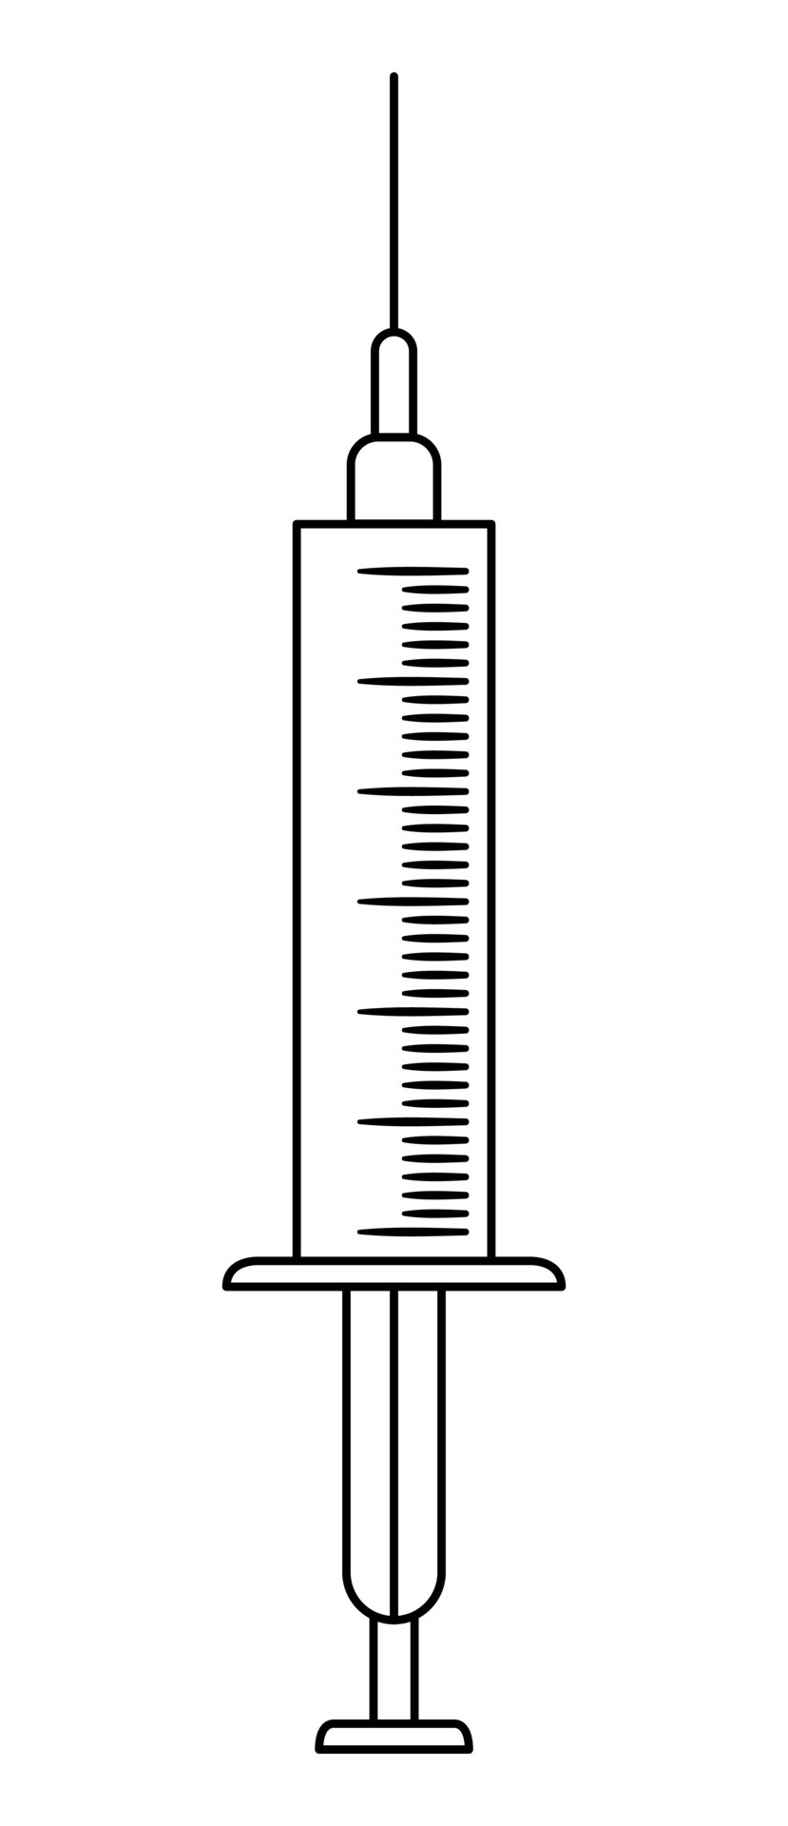
Ph1/2 Study Schematic (DRAFT)
Open label extension
(earliest start could be the end of chronic tox, in-life results, timing TBD)
N=8
(6A:2P)
Cohort A (x mg)
f/u period
N=8
(6A:2P)
Cohort B (2x mg)
f/u period
Total N = 48 (36 active and 12 placebo)
N=16
(12A:4P)
Cohort C (4x mg)
f/u period
Drug or placebo
IT bolus
LP for CSF only
N=16
(12A:4P)
Cohort D (8x mg)
f/u period
12 wks
12 wks
Start of each cohort with sentinel dosing (1 active, 1 placebo)
24 hr safety data review of sentinels prior to allowing dosing of remaining within cohort
After sentinels, no more than one patient can be dosed in a day
Dose escalation
All patients in previous cohort have reached 7 days post 2nd dose (4 wks post baseline) for safety review
Once safety confirmed, sentinel dosing for next cohort can start
Adaptive elements: Emerging PK and PD could lead to adaptions of dose level, dose frequency, and sample size in cohort 3 and 4
However, dose level will not exceed 2x to prior dose level and dose frequency will not be more frequent than monthly
Utilization of an external DSMB
Open Label Extension
Completed Subjects will be invited to participate The open label extension (OLE) portion of the Ph1/2. OLE will be a separate study with objectives similar to Phase 1/2. The original treatment group assignment will remain blinded to the participants and investigators.

Slide 24
FTE for Biostatistician
Dec 2024 - Jun 2025 (Phase 1/2)
Involvement:
Review literature
Write and disseminate the concept note
Perform simulation and power analysis
Contribute to Concept Sheet and CDP
FTE Required: 70% of a biostatistician
Jul 2026 - Sep 2026
Involvement:
Develop Protocol and SAP
Collaborate with statistical programmers for randomization, ADAM, SDTM database, and TLFs setup
FTE Required: 75% of a biostatistician
Oct 2026 Onwards
Involvement:
Data quality monitoring
Amend protocol and SAP if needed
Collaborate with programmers for database unlock, finalize ADAM, SDTM, and TLF
Analyze data for GNG and CRS
Work with the study team for clinical study report and regulatory submission
Develop Phase 2/3 trial
FTE Required: 100% of a biostatistician

Slide 25
Biostatistics Support
Biostatistics
Phase 1/2
Concept Development:
Review literature
Write and disseminate the concept note
Perform simulation and power analysis
Contribute to Concept Sheet and CDP
Protocol and SAP:
Draft protocol and SAP
Collaboration:
Work with statisticians on randomization, ADAM, and SDTM database setup and TLFs
Monitor data quality
Coordinate with programmers for database unlock and finalize ADAM, SDTM, and TLF
Analyze data for GNG and CRS
Clinical study report and regulatory submission
Phase 2/3
Concept Note Development:
Review literature
Write and disseminate the concept note
Perform simulation and power analysis
Analyze Pro-Act Data for natural history insights
Perform necessary simulation modeling, sample size estimation
Protocol and SAP Drafting:
Draft protocol and SAP
Collaboration:
Work with statistical programmers on randomization, ADAM, SDTM, and TLFs setup
Partner with programmers or CRO for data quality monitoring
Coordinate with stat programmers for database lock and finalization of ADAM, SDTM, and TLF
Engage with study team for clinical study report and regulatory submission

Slide 26
Study Overview, Tofersen Phase 1/2
Population
Adults with amyotrophic lateral sclerosis (ALS) due to SOD1 mutations.
Study Design
Phase 1-2, randomized, double-blind, placebo-controlled, SAD dose finding study. Conducted at 18 sites in the US, Canada, and four Western European countries.
Endpoint
Primary: Safety and pharmacokinetics.
Secondary: Change from baseline in cerebrospinal fluid (CSF) SOD1 concentration at day 85.
Exploratory: Change from baseline in ALSFTS-R score, Clinical function, respiratory function, and muscle strength.
Sample Size Estimation
12 participants per dose cohort (9 tofersen, 3 placebo), 48 in total for 80-99% power to detect differences
Assumptions: A 25% reduction in the CSF SOD1 protein concentration with a pooled standard deviation of 0.11 (natural log)
Duration
Up to 31 weeks: 7-week screening, 12-week intervention, 12-week follow-up.
Key Estimates
Difference in CSF SOD1 concentration change at day 85:
100 mg: -33 percentage points (95% CI, -47 to -16)
The study observed that concentrations of neurofilament light chains decreased in participants who received 100 mg of tofersen, while ALSFRS-R scores showed a potential slowing in decline, suggesting a possible relationship of NfL and ALSFRS-R

Slide 27
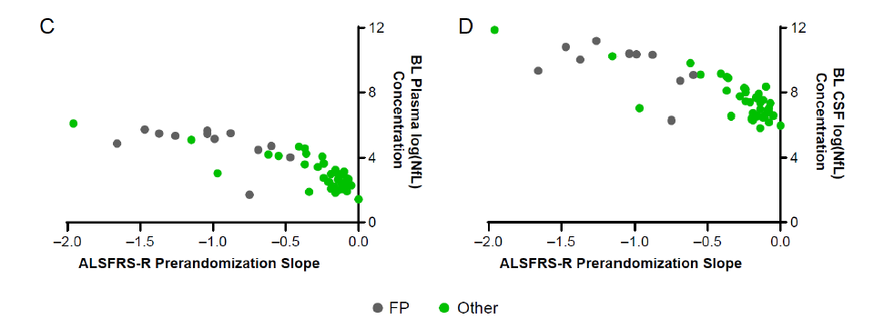
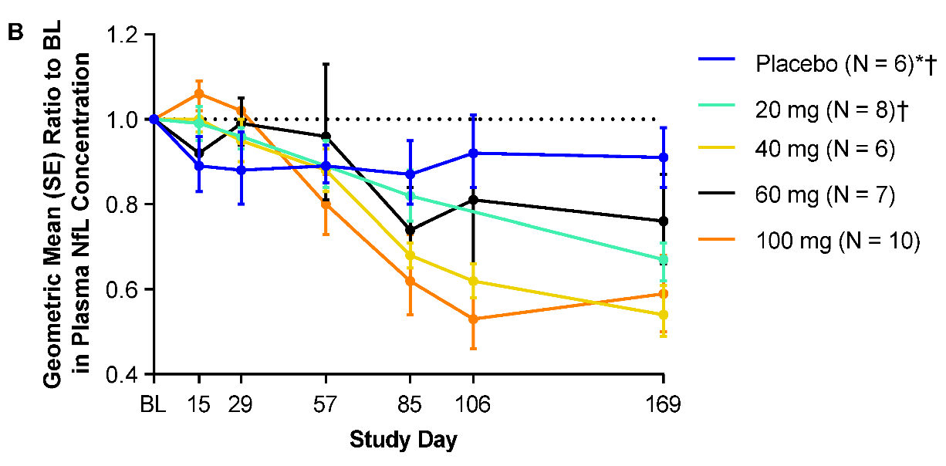
NfL Endpoint in Tofersen Phase 1/2 Results
The baseline neurofilament concentrations were at least 3.5 times as high in the fast-progression subgroup as in the other subgroup. The concentrations of phosphorylated neurofilament heavy chains and neurofilament light chains in plasma and CSF were largely unchanged during the intervention period among the 12 participants in the placebo group at day 85, whereas among the 10 participants who received 100 mg of tofersen, the concentrations decreased from baseline to day 85. Changes in the plasma and CSF concentrations of phosphorylated neurofilament heavy chains and neurofilament light chains from day 85 to day 169 are shown in Figures S13 and S14.
Fast-progression subgroup characteristics:
$SOD_{1}$ mutation linked to fast-progressing disease (mean duration ≤3 years)
Pre-randomization decrease in ALSFRS-R score of ≥0.2 points per month

