Slide 1
生物统计和生物信息引论
Lecture 11
生物医学问题中的复杂模型应用 I
王健桥
jianqw@mail.tsinghua.edu.cn

Slide 2
Outline
From sequence to protein structure
From DNA sequence to regulatory elements
Concepts in Large Language Model
Applications for Biological sequences
  AlphaFold3
  AlphaGenome
  ESM2

Slide 3
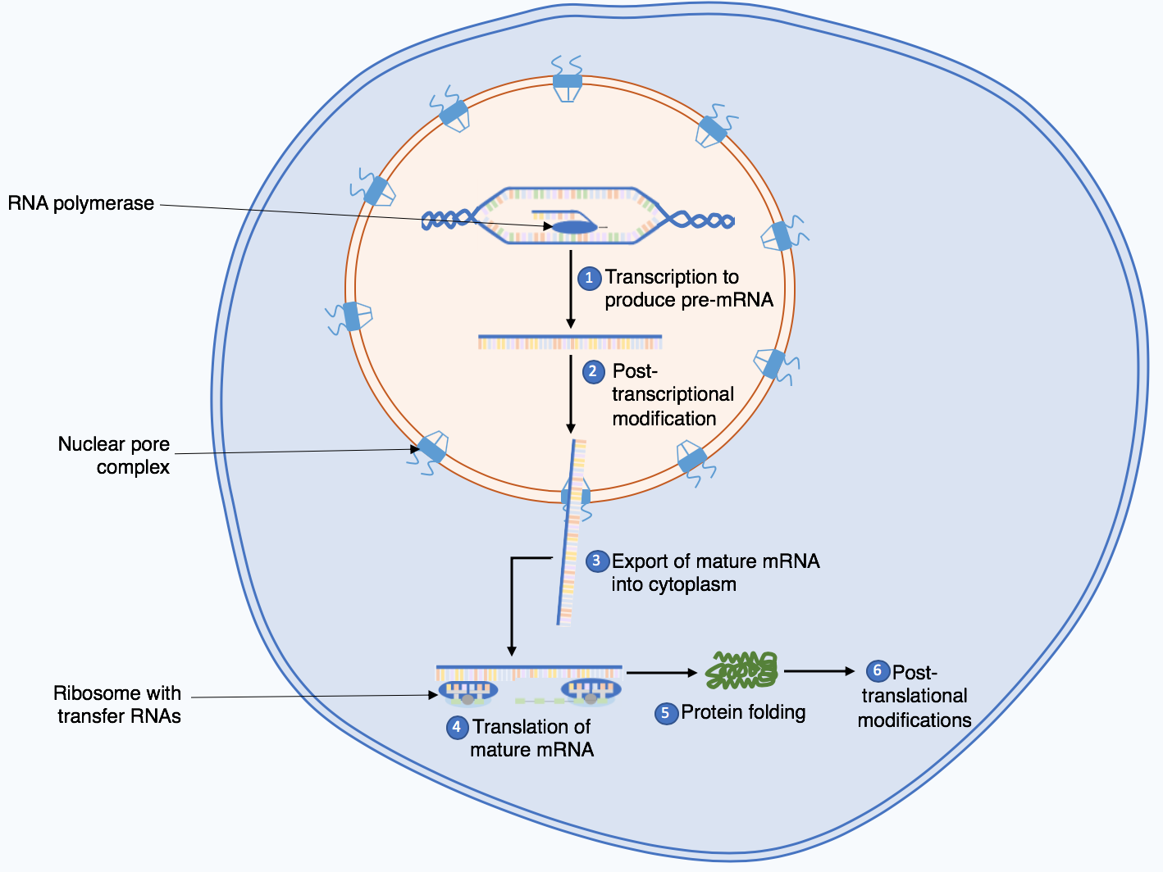
Recap: central dogma
Source: Wikipedia
Notes:
https://statomics.github.io/SGA/sequencing_intro.html

Slide 4
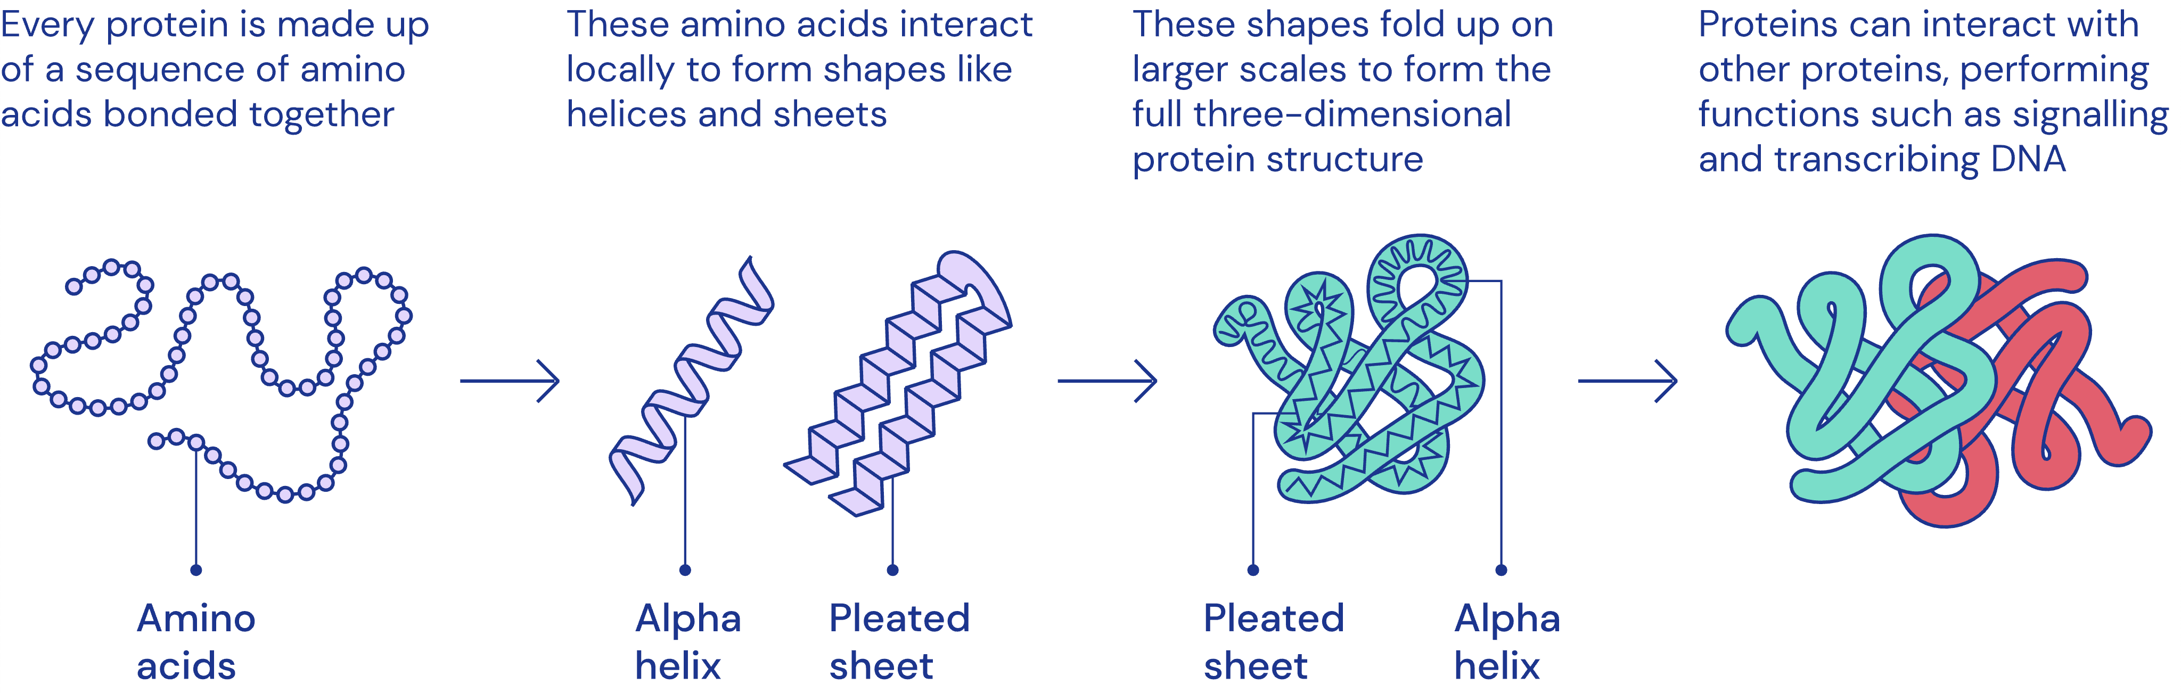
Protein: from sequence to structure
Proteins are made up of 20 types of amino acids.
Sequence determine 3D structure.
A protein can be represented as a 1D sequence or a 3D structure.
Source: https://deepmind.google/blog/alphafold-using-ai-for-scientific-discovery-2020/

Slide 5
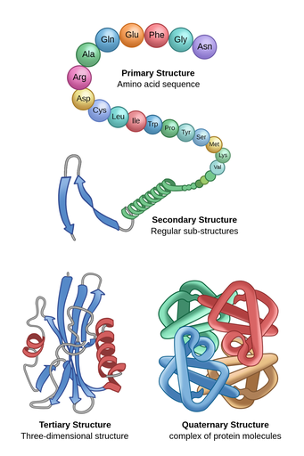
How the sequence folds to the 3D structure
1962 Nobel Prize in Chemistry: first atomic structures of proteins
1972 Nobel Prize in Chemistry: 3D shape of a protein is entirely determined by the sequence of its amino acids
How to determine the structure? Previous methods: find the structure that has low free energy

Slide 6
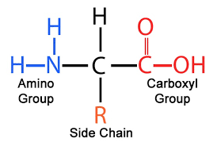
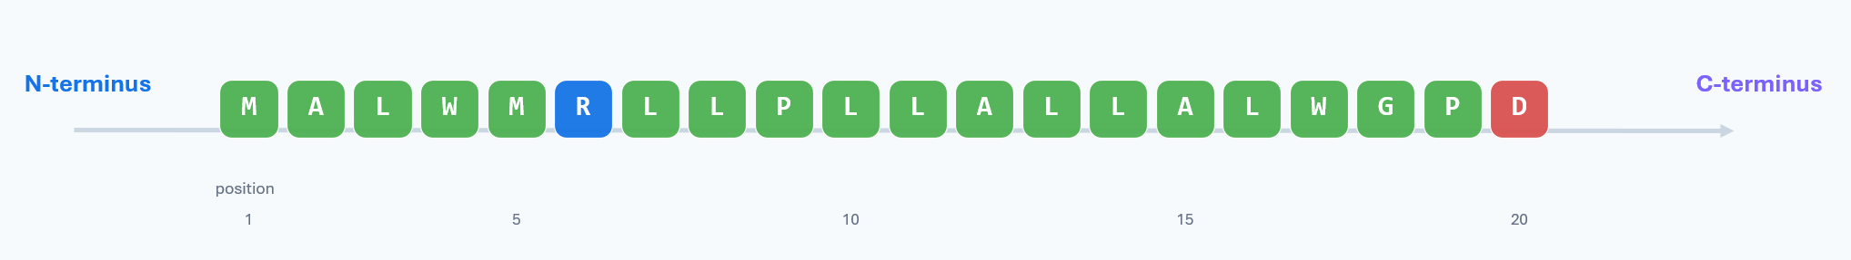
Protein Sequence data
Sequences: The raw strings of amino acids.
Residue ≠ free amino acid
Order matters
Coordinates matter
Inside a protein, each letter represents an amino-acid residue joined by peptide bonds.
Changing one letter or moving a segment can change folding, binding, processing, or disease risk.
Annotations usually refer to residue numbers, such as 25..54 or Cys31.

Slide 7
The protein “alphabet” carries chemistry
The one-letter code is compact, but each letter has chemical behavior that influences structure and function.
Hydrophobic
(疏水性)
A
V
L
I
M
F
W
P
G
often buried inside folded proteins
Polar
(极性)
S
T
N
Q
Y
C
form H-bonds; often surface-exposed
Acidic
(酸性)
D
E
negatively charged near neutral pH
Basic
（碱性）
K
R
H
positively charged; common cleavage signals
Typical interpretation
Hydrophobic stretches can indicate signal peptides or membrane regions; charged clusters can mark cleavage sites, active sites, or interaction patches.
Protein sequence data — student teaching deck
3
Notes:
Use this slide to connect symbols with chemistry. Students often memorize letters but miss why properties matter.
Clarify that the groups are simplified; exact behavior depends on pH, structural context, and neighboring residues.

Slide 8
7. Sequence comparison reveals variants
A single substitution can change chemical properties, folding, or interaction with another molecule.
Example: insulin residue 46, R → Q
Reference segment: residues 41–50
41
42
43
44
45
46
47
48
49
50
R = arginine
Basic, positively charged side chain. In this site, changing R can affect interaction and folding.
Reference
L
V
C
G
E
R
G
F
F
Y
Variant
L
V
C
G
E
Q
G
F
F
Y
Q = glutamine
Polar, uncharged side chain. Similar size, different charge: a subtle-looking but meaningful change.
Where is it? What property changed? Is the residue conserved? Is there experimental evidence?
8
Notes:
This slide demonstrates how alignments or variant tables are interpreted. Students should not stop at “letter changed”; they should translate the letter change into chemistry and position.
The UniProt record notes a variant at residue 46, R to Q, associated with MODY10 and reduced binding/biological activity/folding properties.

Slide 9
Multiple Sequence Alignment
Multiple sequence alignment (MSA) lies at the heart of comparative genomics, structural biology and evolutionary inference.
02
MSA 在做什么？把“相同来源的位置”排到同一列
未对齐的相似序列
MSA 之后
长度可能不同；插入或缺失的位置尚不清楚。
每一列表示一个可比较的同源位置；“-” 表示插入/缺失。
MKTLLVAIAAGIT
Seq1
M
K
T
L
L
V
A
I
A
A
-
-
-
G
I
T
Seq1
插入 gap
Seq2
M
K
T
L
-
V
A
I
A
A
Q
Q
Q
G
I
T
Seq2
MKTLVAIAAQQQGIT
让同源位置垂直对齐
Seq3
M
K
T
L
L
V
A
I
A
A
-
-
-
G
I
T
Seq3
MKTLLVAIAAGIT
gap 区域
关键概念
MSA 的列不是“第 k 个字符”，而是“第 k 个同源位置”。这点对于后续解释保守性、突变和结构约束非常重要。

Slide 10
一个简单的 MSA 例子：怎样读保守位点与替换
03
物种
1
5
10
15
20
Human
M
A
L
W
M
R
L
L
P
L
L
A
L
L
A
L
W
G
P
D
P
Mouse
M
A
L
W
M
R
L
L
P
L
L
A
L
L
V
L
W
G
P
D
P
Rat
M
A
L
W
M
R
L
L
P
L
L
A
L
L
A
L
W
G
P
E
P
Dog
M
A
L
W
M
R
L
L
P
L
L
A
L
L
A
L
W
G
P
E
P
保守性
*
*
*
*
*
*
*
*
*
*
*
*
*
*
:
*
*
*
*
:
*
怎么读？
例子中的变化
“*” 表示该列完全保守；“:” 表示发生了替换，但化学性质相近。保守列通常提示结构或功能约束。
A ↔ V 都是疏水氨基酸；D ↔ E 都是酸性氨基酸。这样的替换通常比疏水 ↔ 带电替换更温和。

Slide 11
保守性告诉我们：哪些位置可能承担结构或功能约束
04
M
A
L
W
M
R
L
L
P
L
L
A
L
L
A
L
W
G
P
D
P
读图逻辑
示例序列
MSA 将每个位置的“进化变异”转化为位置级特征：越保守，越可能被结构或功能约束。
conservation score
注意
长疏水片段
高度保守位点
可变 / gap 区域
保守 ≠ 一定功能关键；可变 ≠ 一定不重要。需要结合结构、表达、实验与物种采样共同判断。
可能提示 signal peptide
或 transmembrane region
更可能参与折叠核心、
活性位点或结合界面
常对应 flexible loop，
或物种特异性插入缺失
MSA · Multiple Sequence Alignment

Slide 12
共进化：MSA 还能暗示三维结构中的接触关系
05
如果两个位置在进化中“同步变化”，它们可能在空间上相互接触。
species
position i
position j
position i
position j
Sp1
A
············
K
i
j
··········
Sp2
V
············
R
共变信号
Sp3
I
············
H
如果 i 变，j 也系统性变化，
可能说明二者在 3D 中相互接触。
Sp4
L
············
Q
结构预测中的作用
与 AlphaFold 的关系
MSA 提供两类信号：单列保守性说明位置重要性；双列共变性提示残基之间可能接触。
AlphaFold2 等结构预测方法会把 MSA 中的演化信息编码成序列特征和 pairwise 特征，用于约束三维结构。
MSA · Multiple Sequence Alignment

Slide 13
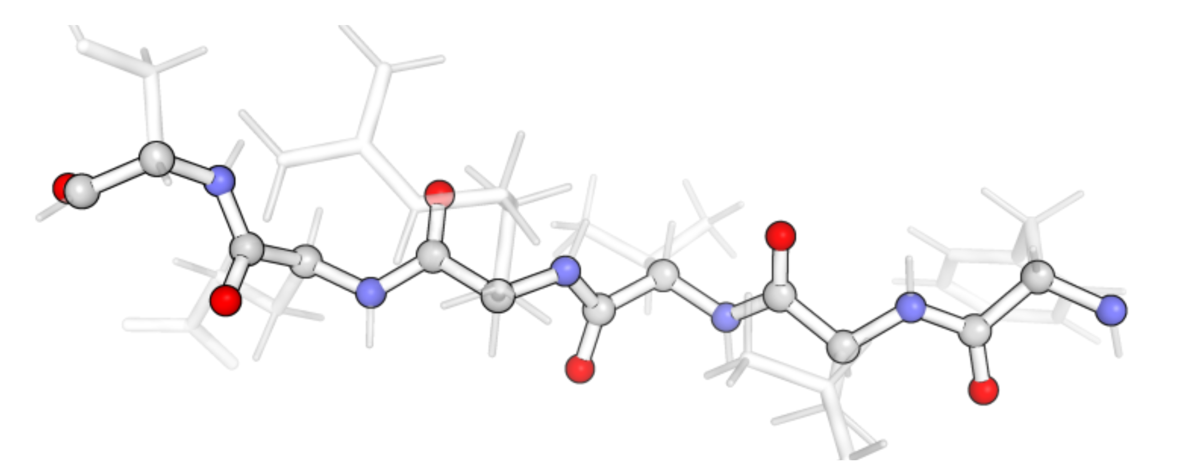
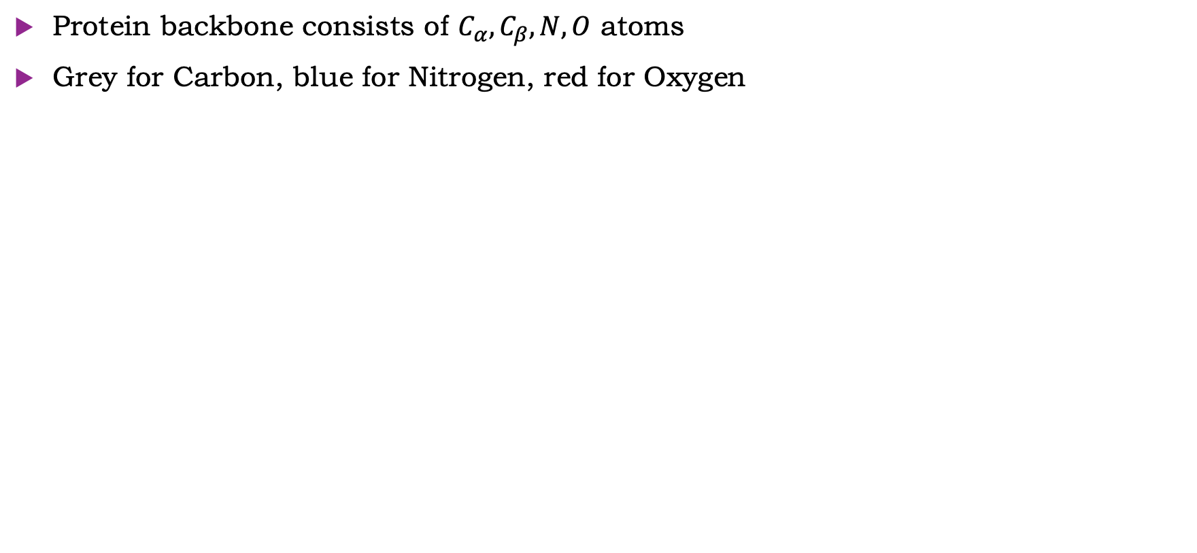
Protein Parameterization
Protein backbone consists of $C_{α}, C_{β}, N, O$ atoms
Grey for Carbon, blue for Nitrogen, red for Oxygen

Slide 14
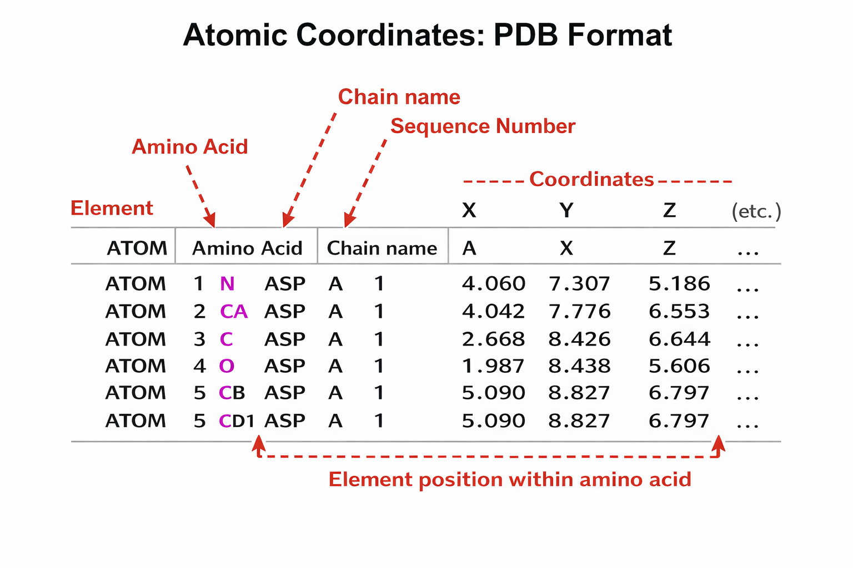
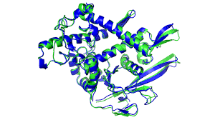
Protein 3D structure data
A pdb file mainly stores atom coordinates.
Multiple atoms make up an amino acid.
Multiple amino acids make up a chain.
X-ray or cryo-EM

Slide 15
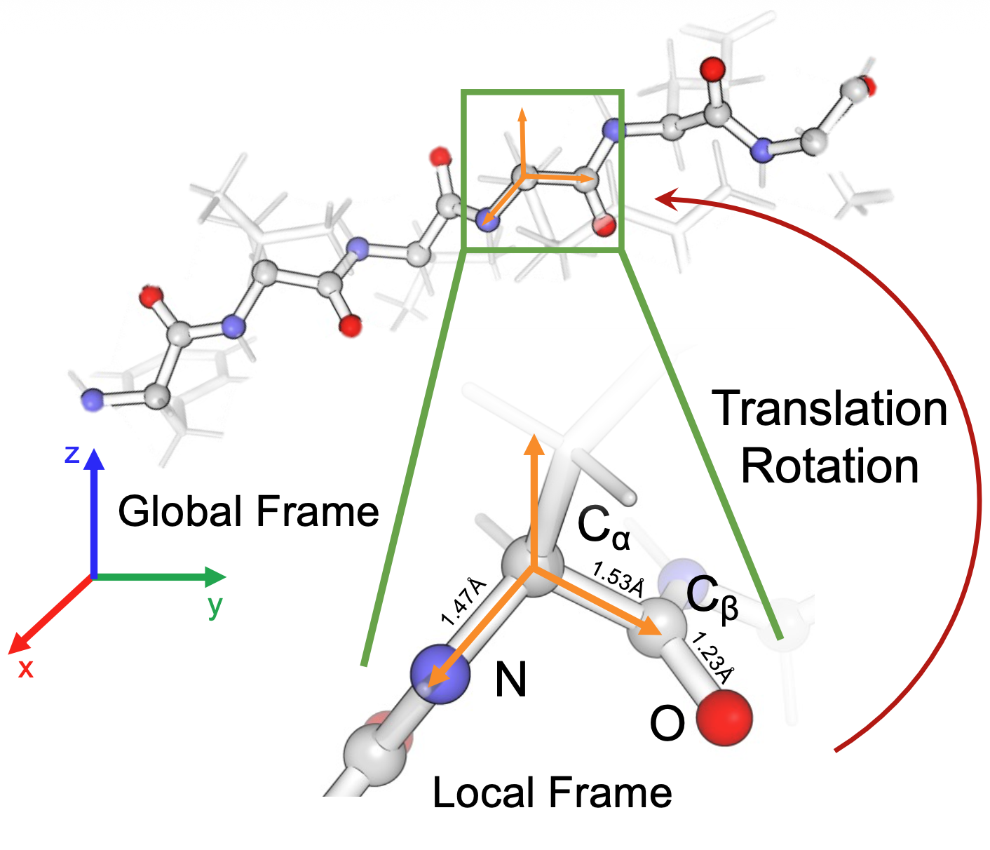
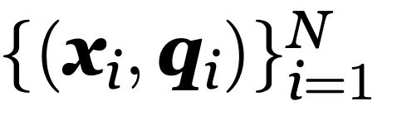
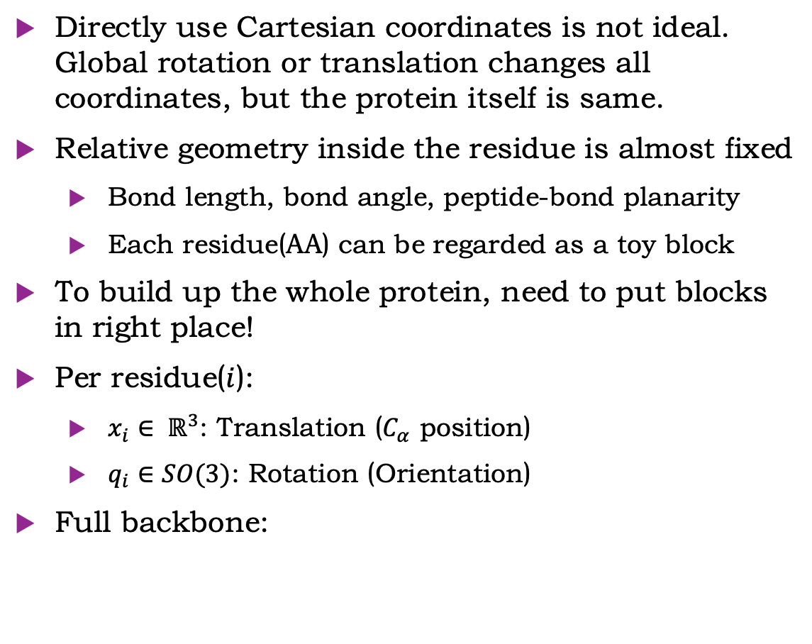
Protein Parameterization
Directly use Cartesian coordinates is not ideal. Global rotation or translation changes all coordinates, but the protein itself is same.
Relative geometry inside the residue is almost fixed
  Bond length, bond angle, peptide-bond planarity
  Each residue(AA) can be regarded as a toy block
To build up the whole protein, need to put blocks in right place!
Per residue($i$):
  $x_{i}∈ ℝ^{3}$: Translation ($C_{α}$ position)
  $q_{i}∈SO(3)$: Rotation (Orientation)
Full backbone:

Slide 16
Scientific goal
The goal is still to recover the 3D structure from a sequence
Spatial structure determines the biological function
The challenge is that we understand little about the underlying chemistry/physics mechanism
Previous methods： Calculate the lowest Energy Function in Protein Folding

Slide 17
The protein folding problem
Why this is more than a classification task
Amino acid
sequence
Physical and
evolutionary constraints
Folded 3D
structure
Biological
function
Input
M K T A Y I A K Q R ...
→
Output
3D coordinates, residue contacts, confidence scores
→
Use
mechanism, binding, design, disease interpretation
Teaching point: unlike MNIST, the target is not a label. The model must predict spatial geometry.
02
Notes:
Explain the problem in data terms. Input is a one-dimensional sequence of amino acid tokens; output is a three-dimensional object. This is why protein structure prediction is a structured prediction problem rather than a simple classification problem.

Slide 18
Existing efforts before modern deep learning
Different data sources, different assumptions, different bottlenecks
Approach
Main data used
What it contributes / limitation
Experimental structural biology
X-ray crystallography, NMR, cryo-EM
Directly determine structures; accurate but slow, costly, and not fully scalable.
Physics-based modeling
Energy functions and molecular simulation
Search for the lowest-energy conformation; conformational space is enormous.
Homology / template modeling
Known structures of related proteins
Works well with close templates; weaker for novel folds or distant homologs.
Co-evolution / contact prediction
Multiple sequence alignments
Correlated mutations suggest residue-residue contacts; needs many related sequences.
Deep learning / AlphaFold
Sequence, MSA, pair representations, geometry
Learns structural constraints from large data; still requires biological validation.
Bottom line: progress came from combining physical insight, evolutionary information, benchmarks, and statistical learning.
03
Notes:
Do not present pre-AlphaFold work as obsolete. Experimental structure determination remains the gold standard, and template modeling or co-evolutionary analysis are still conceptually important. The message is that each approach uses a different representation of the biological system.

Slide 19
AlphaFold

Slide 20
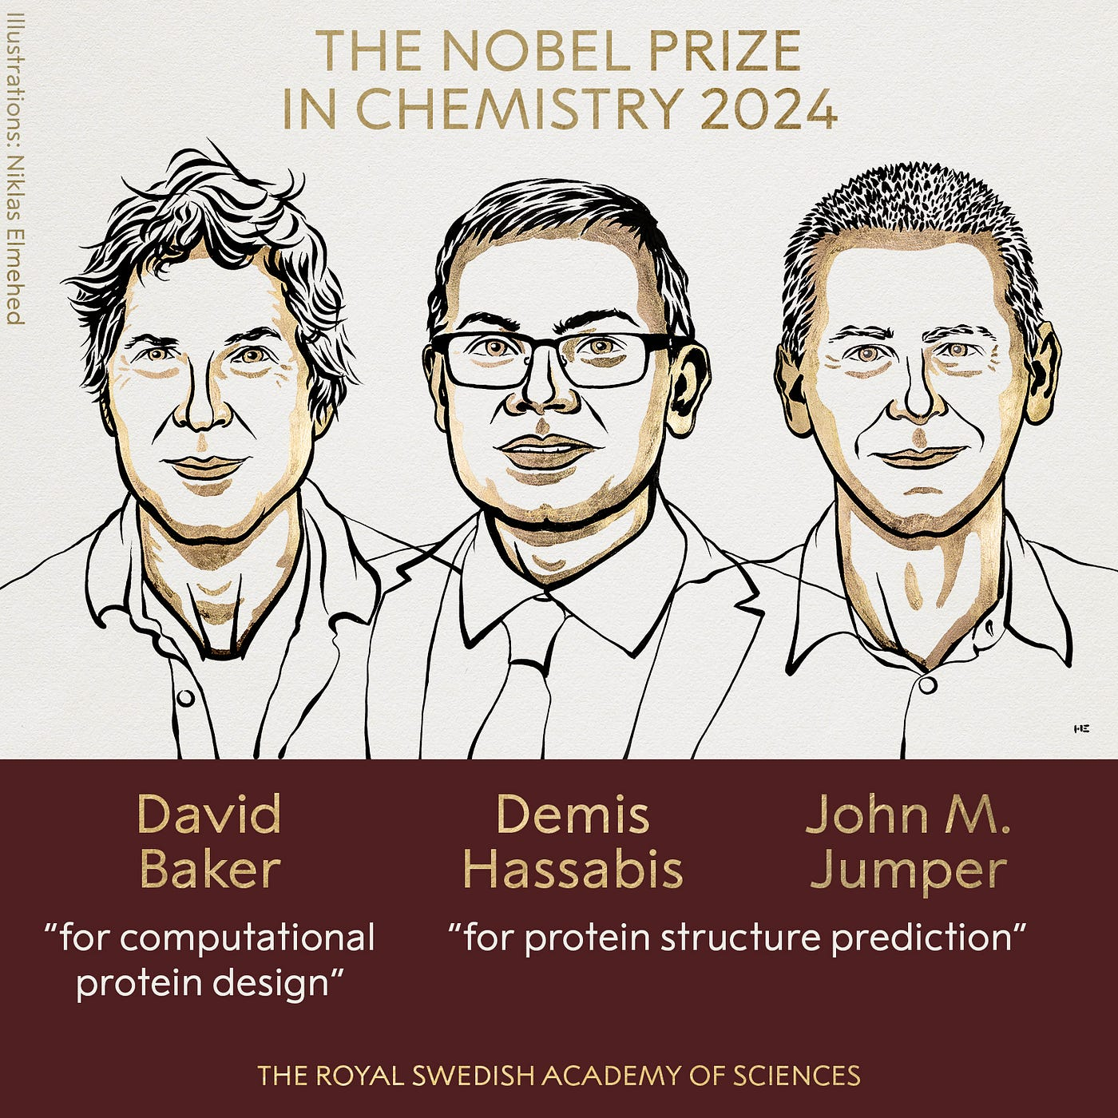
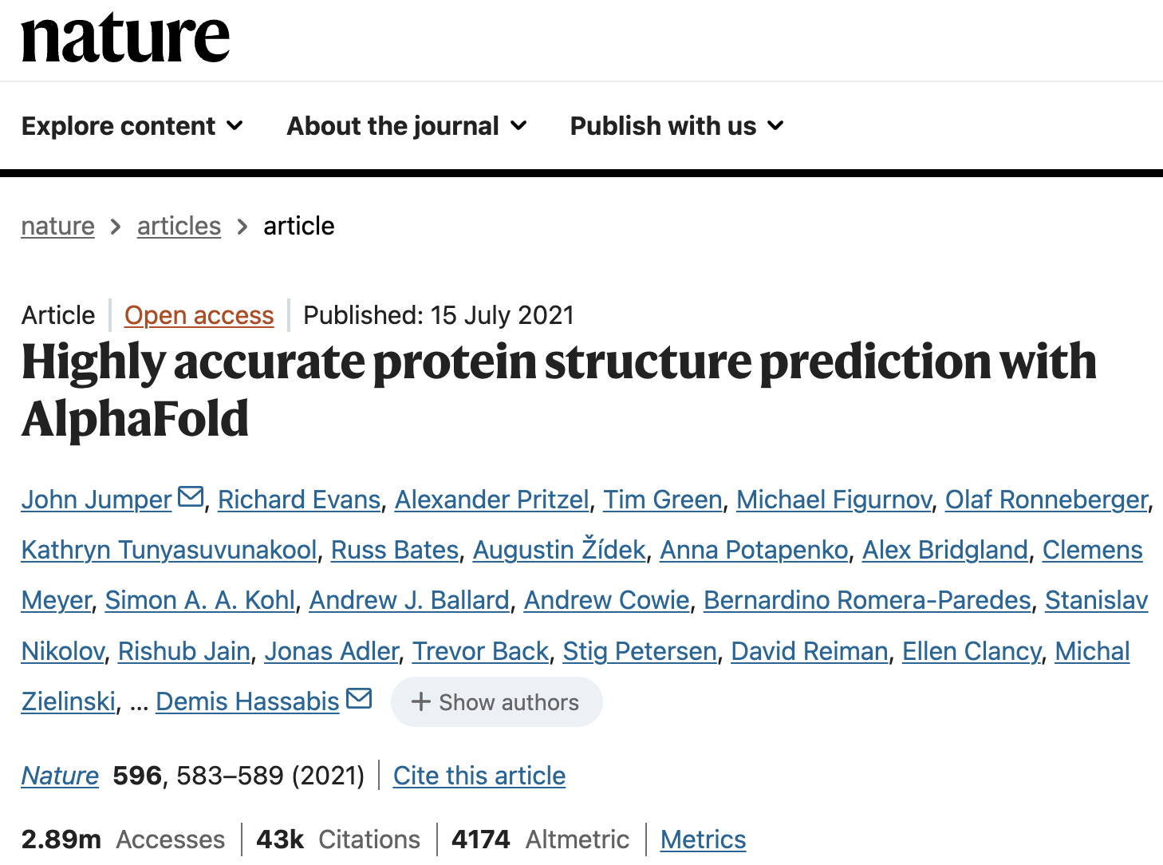

Slide 21
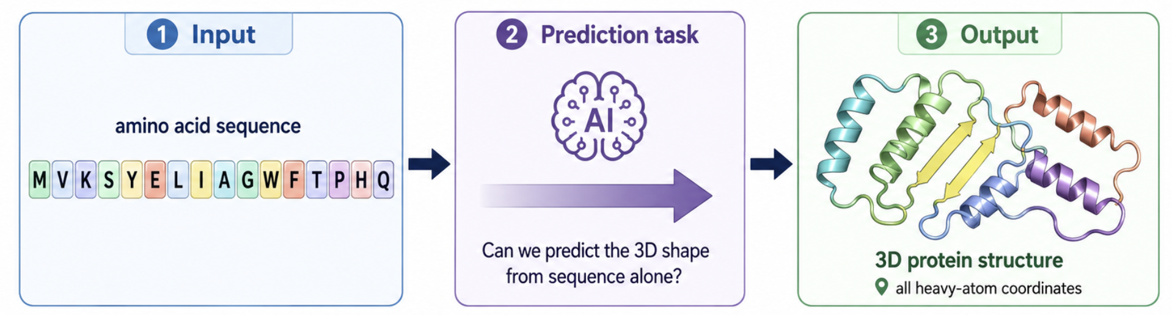
From sequence to structure
Alphafold2 predicts all heavy-atoms.
Translation and rotation for backbone,
4 torsion angles for side chain.

Slide 22
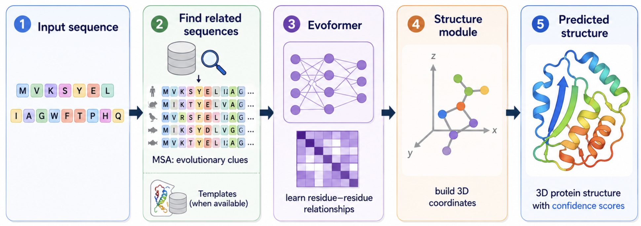
Model structure

Slide 23
Progress in Large Language Model
Before moving to the Alphafold, let’s talk about progress in LLM
Biological sequence models borrowed this idea: choose meaningful units, convert them to embeddings, and learn context-dependent representations.

Slide 24
Autoregressive models(GPT)

Slide 25
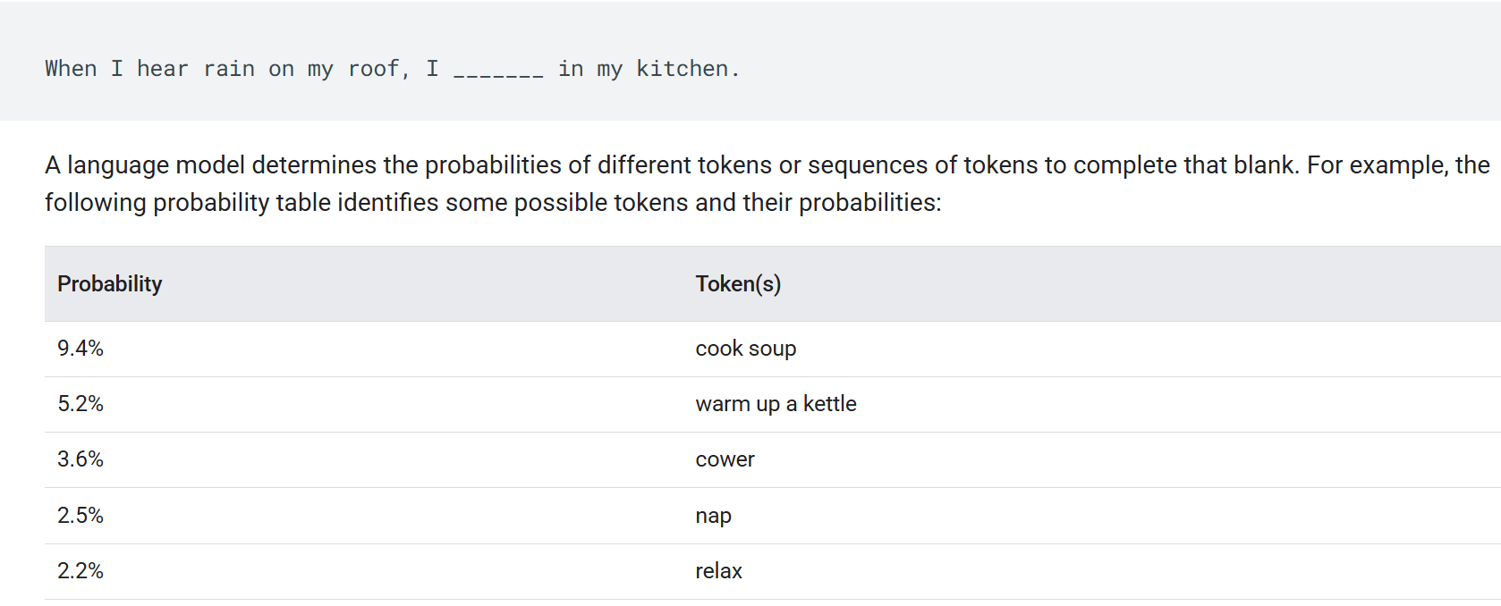
What is a language model

Slide 26
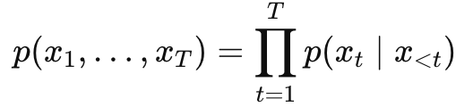
Auto Regressive
Autoregressive model: generate data token by token
Key idea: predict the next token from previous tokens
AR:
Just like how we talk. During training, model learns to predict next word(token). During inference, recursively predict next token.

Slide 27
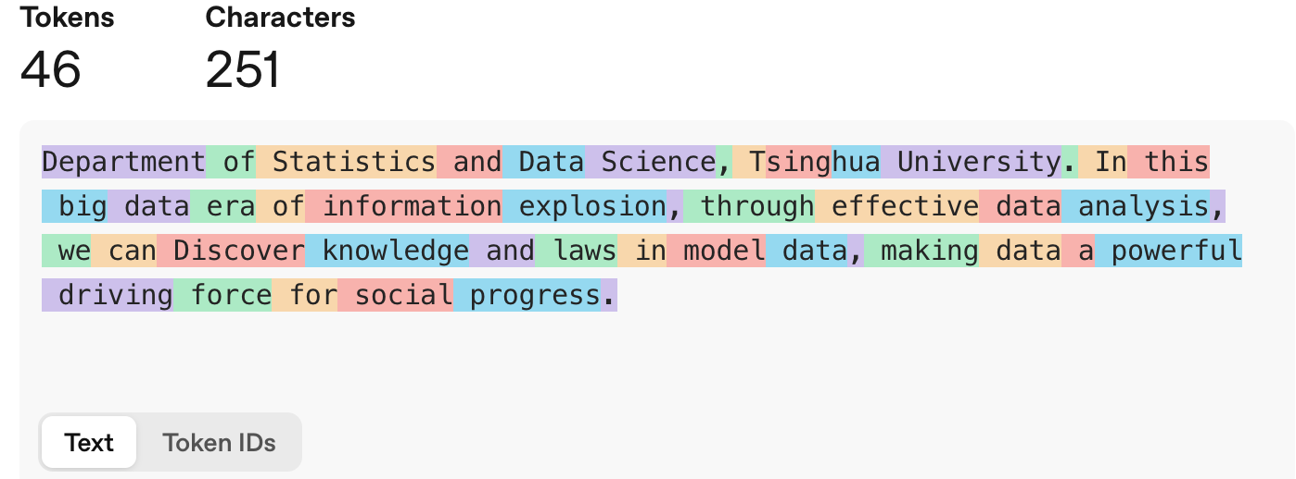
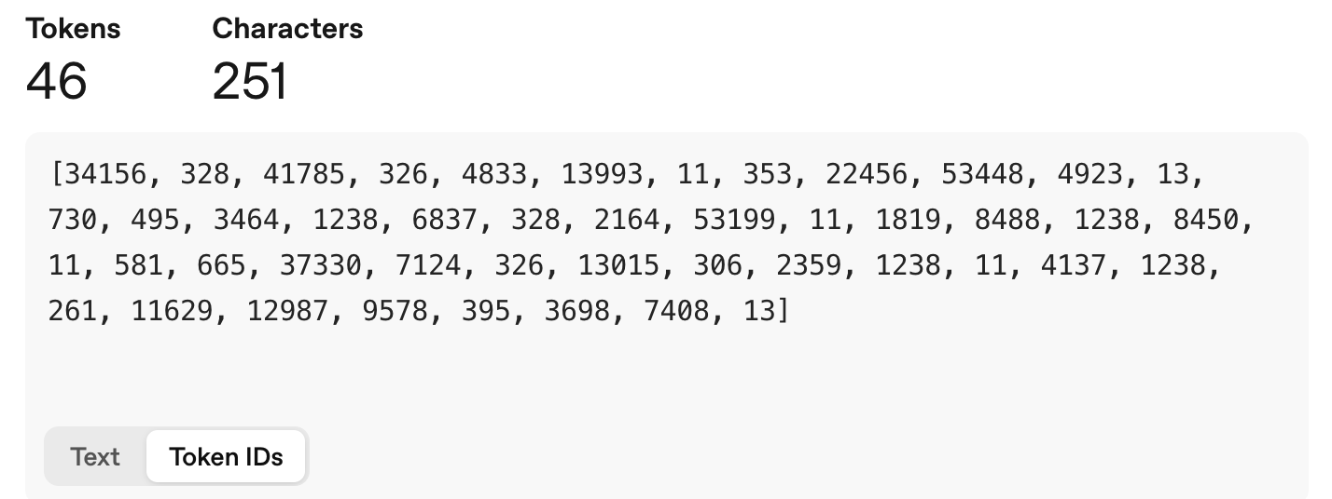
Token
A token is the basic unit processed by the model
  Text: words or subwords
  Protein: amino acids
  DNA / RNA: nucleotides
  Single-cell data: genes can be treated as token-like units
Tokenizer turns sentence into tokens:
  Try on https://platform.openai.com/tokenizer

Slide 28
Token
2. Tokenization in large language models
Word-level
Character-level
Subword / BPE
"biomedical applications"
"biology"
"biomedical applications"
biomedical
applications
b
i
o
l
o
g
y
bio
medical
app
lications
• simple
• large vocabulary
• bad for rare words
• small vocabulary
• long sequences
• harder long-context learning
• compact
• handles rare words
• learned from corpus statistics

Slide 29
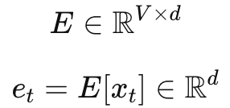
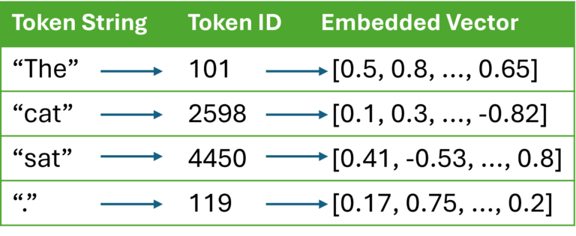
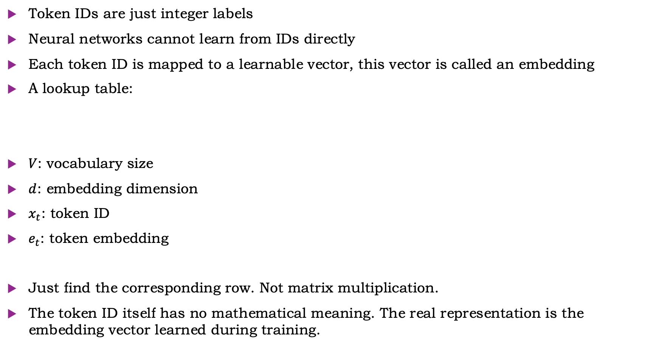
From token IDs to embeddings
Token IDs are just integer labels
Neural networks cannot learn from IDs directly
Each token ID is mapped to a learnable vector, this vector is called an embedding
A lookup table:
$V$: vocabulary size
$d$: embedding dimension
$x_{t}$: token ID
$e_{t}$: token embedding
Just find the corresponding row. Not matrix multiplication.
The token ID itself has no mathematical meaning. The real representation is the embedding vector learned during training.

Slide 30
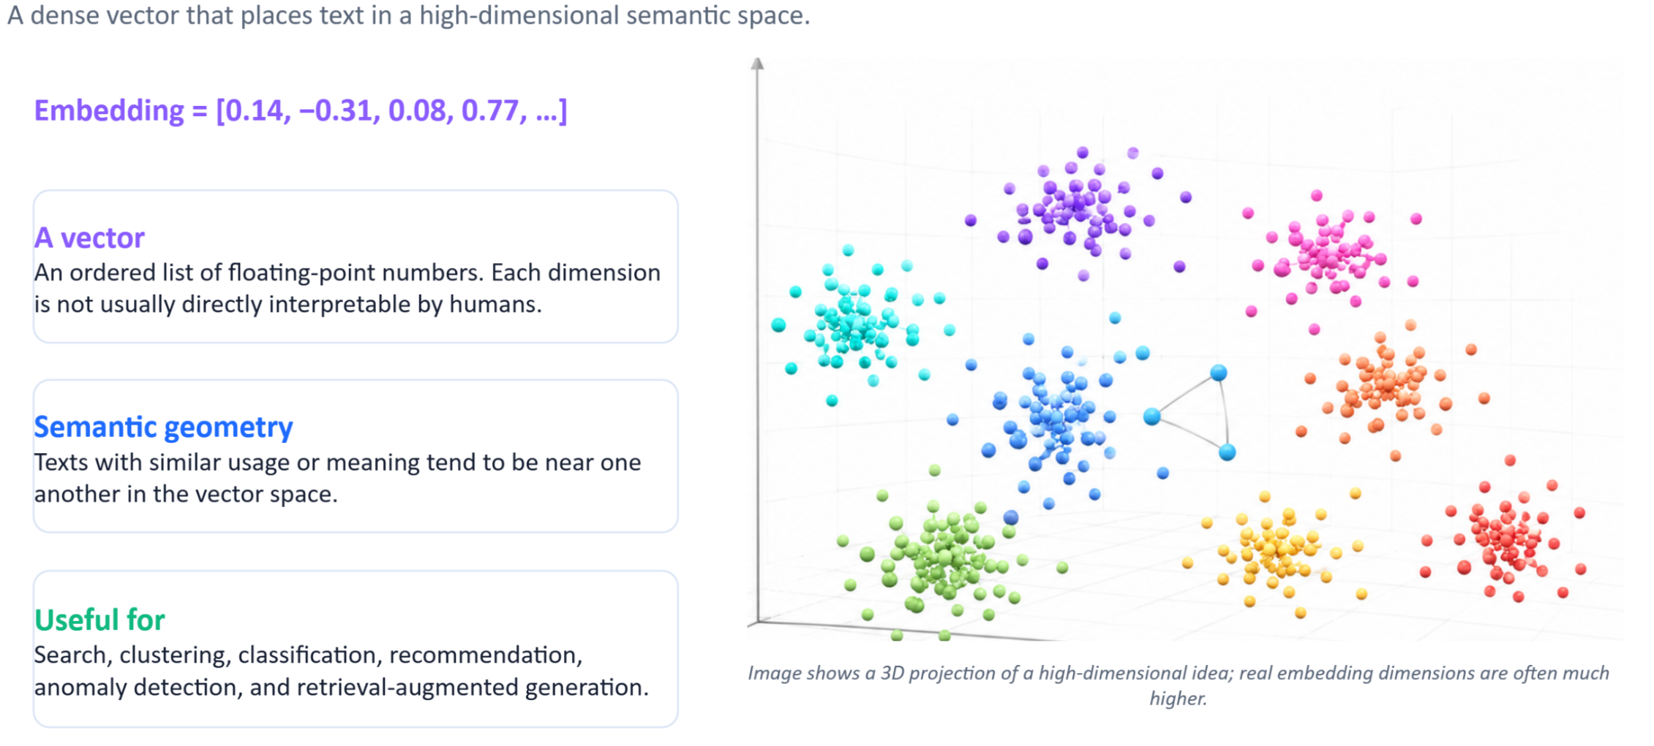
Embedding space

Slide 31
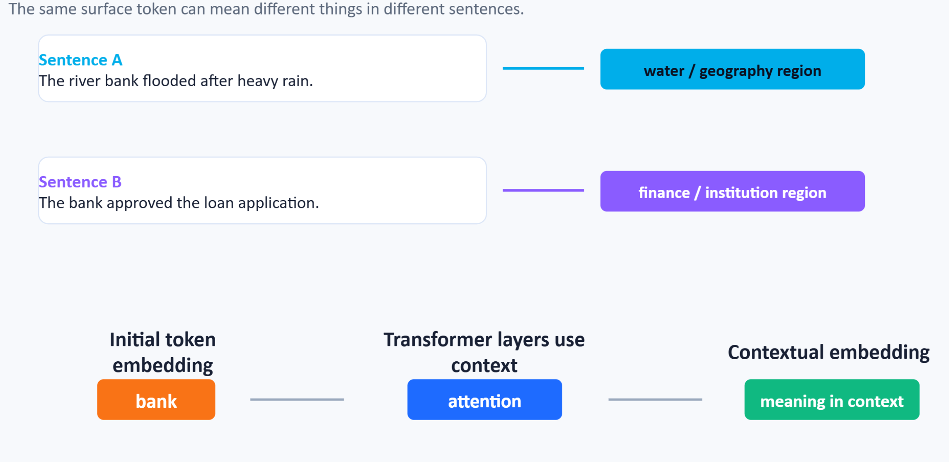
Context changes representation

Slide 32
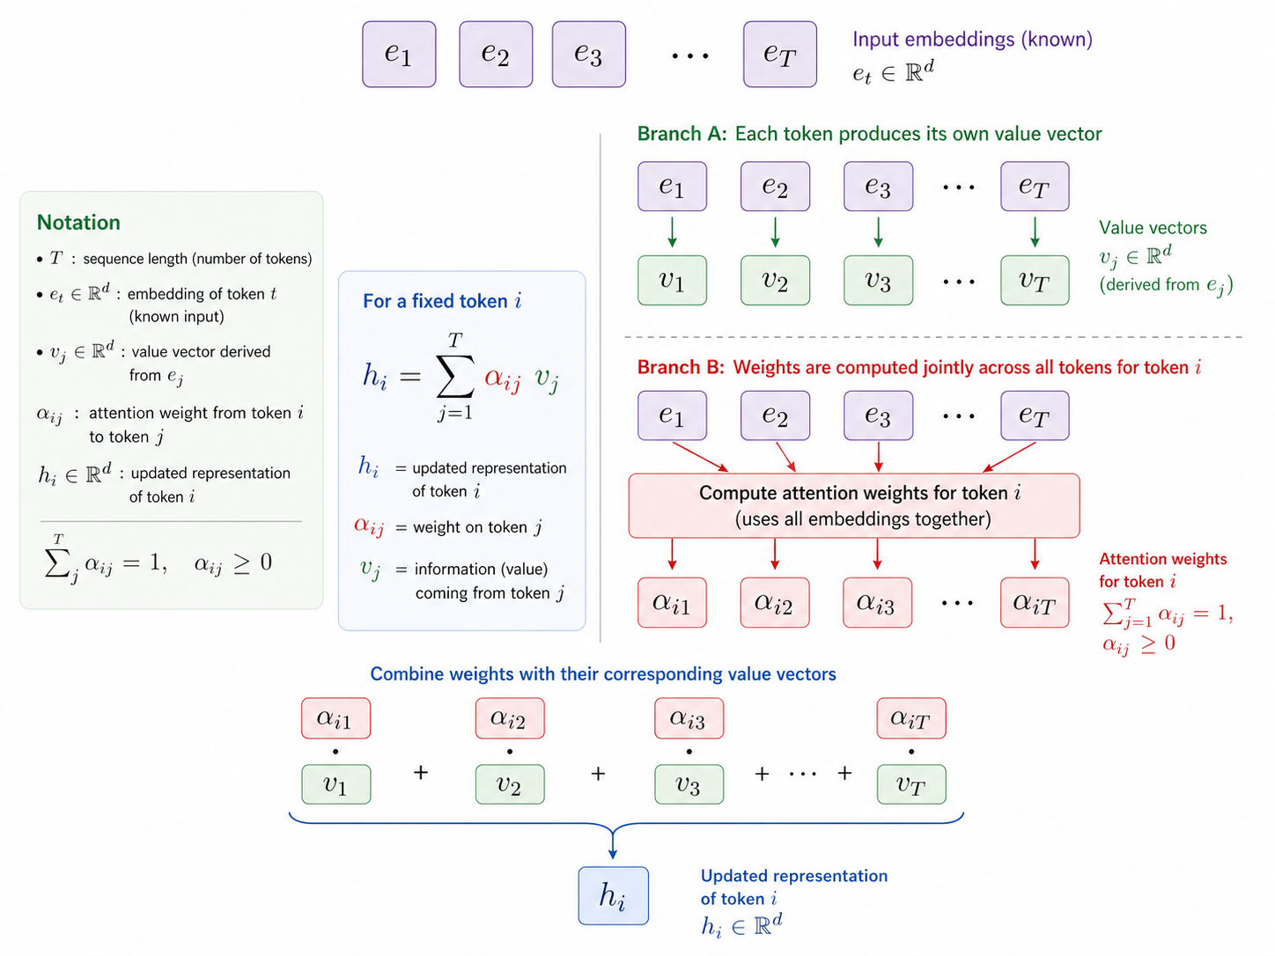
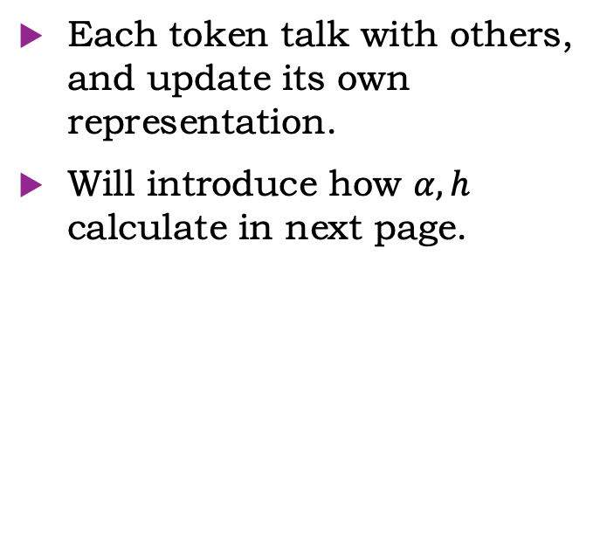
Key idea: weighted average
Each token talk with others, and update its own representation.
Will introduce how $α, h$ calculate in next page.

Slide 33
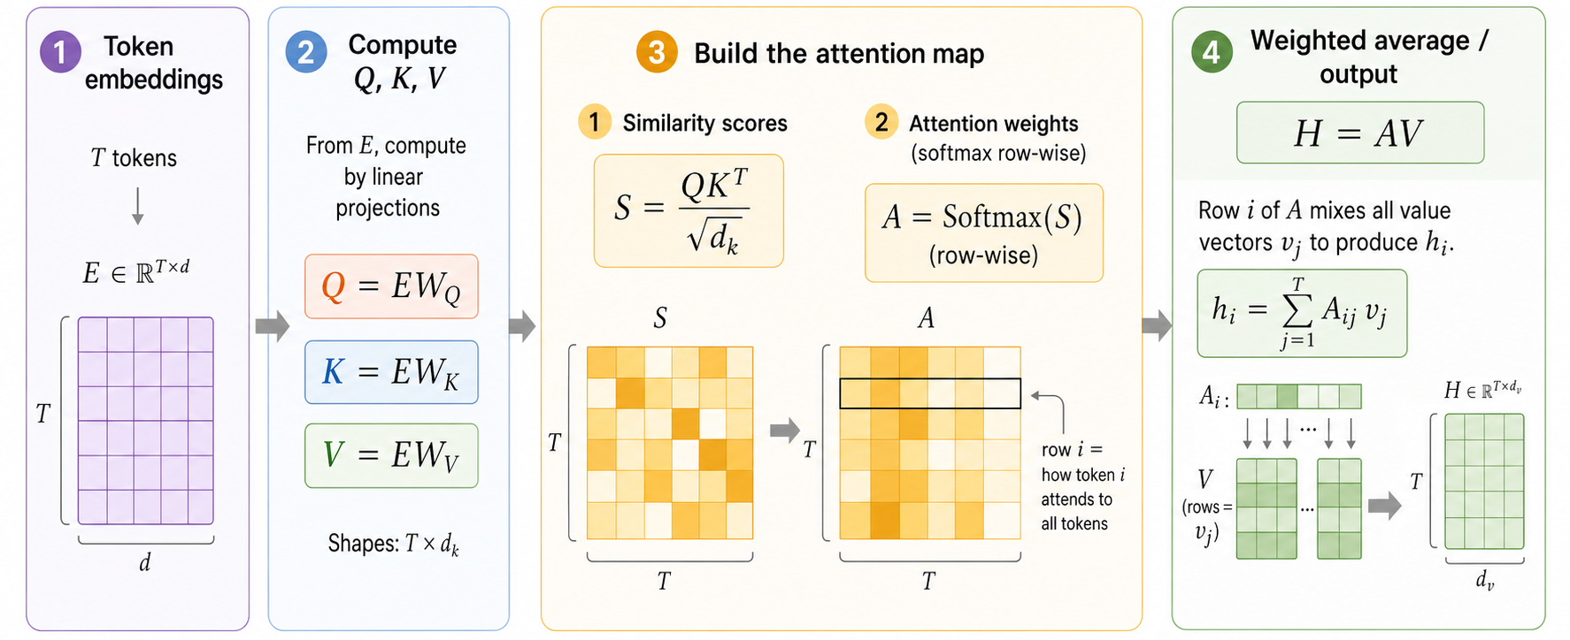
Attention

Slide 34
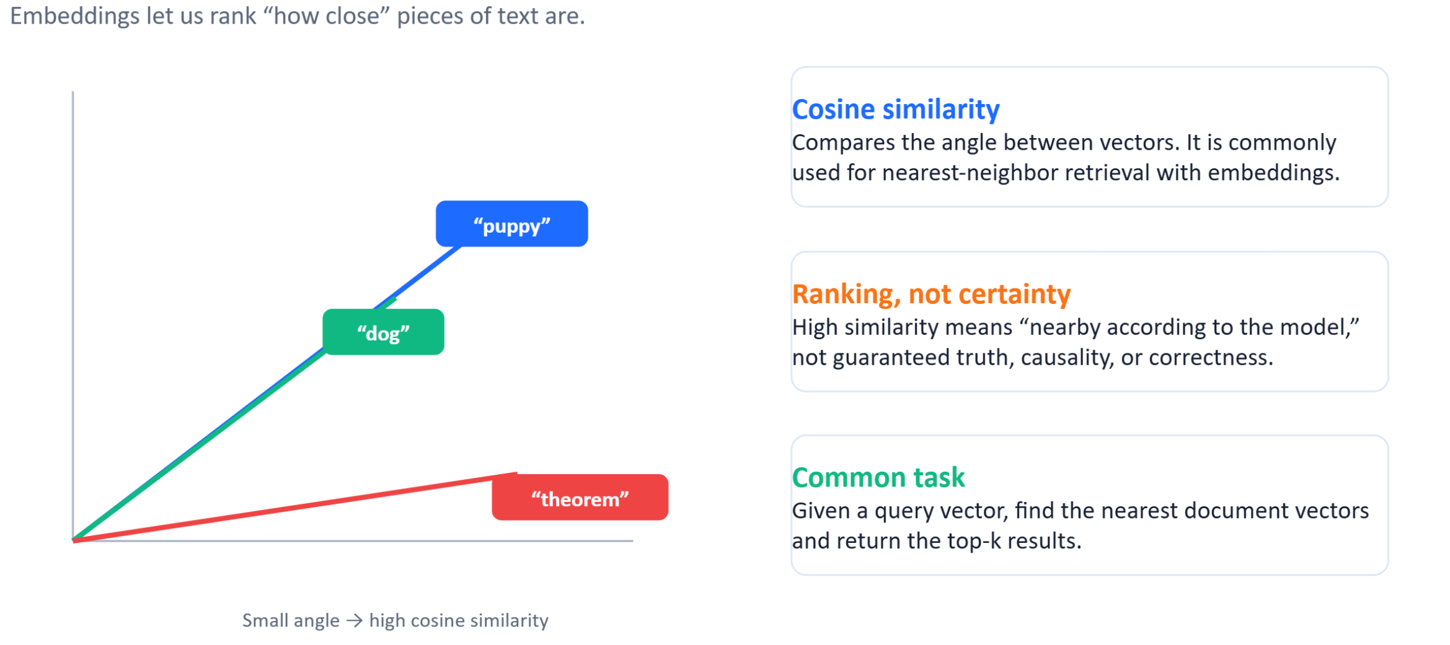
Measuring similarity

Slide 35
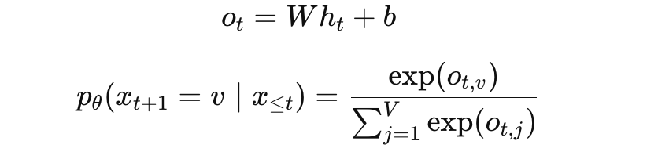
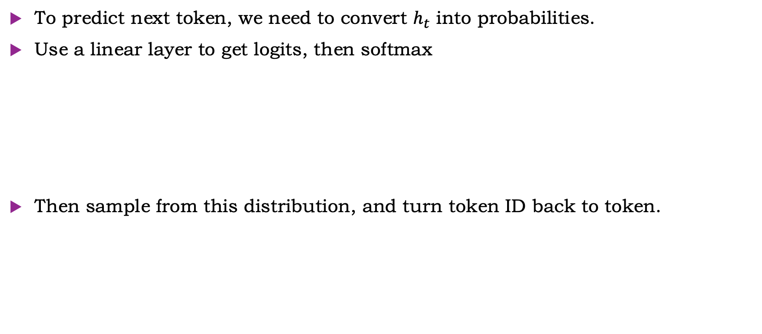
Prediction
To predict next token, we need to convert $h_{t}$ into probabilities.
Use a linear layer to get logits, then softmax
Then sample from this distribution, and turn token ID back to token.

Slide 36
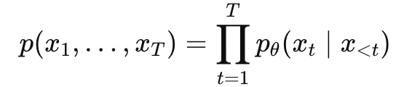
Autoregressive generation
Start from a prompt or start token
Predict the next-token distribution
Choose or sample the next token
Append it to the sequence
Repeat

Slide 37
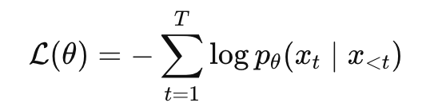
Training: Predict the Next Token
During training, the true sequence is known
The model predicts each next token
This is a classification task at every position
Use cross-entropy loss
Input context | Target
The | cell
The cell | expresses
The cell expresses | gene

Slide 38
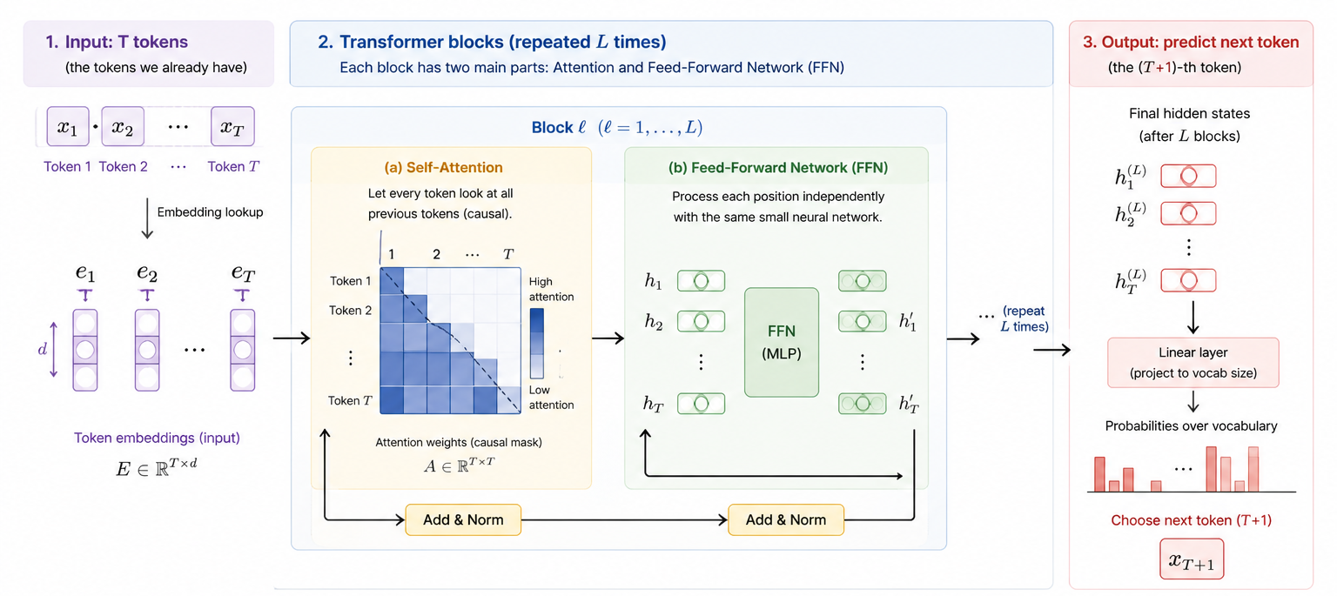
GPT
Generative: generates token sequences
Pre-trained: trained on large-scale data
Transformer: learns token-token interactions
Core is next token prediction (NTP)

Slide 39
Transfer from text to biology: analogy and caveat
The useful analogy
The important caveat
• Text is a sequence of tokens.
• DNA and proteins are also sequences of symbols.
• Context changes meaning: words in sentences, motifs in genomes, residues in proteins.
• Self-supervised learning can exploit massive unlabeled sequence datasets.
• Biological sequences are not human language.
• Syntax is constrained by chemistry, evolution, and experimental biology.
• Outputs may be structures, tracks, functions, or variant effects—not just words.
• Tokenization should respect biological resolution and task requirements.
Use this slide to prevent overclaiming: 'genome language' is a useful metaphor, not a complete theory.

Slide 40
Protein sequence tokenization
For proteins, the natural token is usually one amino acid residue.
Protein sequence: M K T A Y I A K Q R Q I S F V K ...
• Each token corresponds to a residue.
• Vocabulary is small: ~20 standard amino acids plus special/rare tokens.
• Embedding captures biochemical and evolutionary context.
M
K
T
A
Y
I
A
K
Protein tokenization is usually simpler, but structure prediction is geometrically harder.
Source: ProteinBERT encodes protein sequences as amino-acid token sequences with standard and special tokens.

Slide 41
Protein language models
Use self-supervised learning to learn residue-level and sequence-level representations.
Masked amino acid prediction
M
K
T
[MASK]
Y
I
A
K
Predict: A
Pretraining
Embeddings
Transfer
large protein sequence databases
per-residue and whole-protein vectors
structure, function, localization, variants
• Protein LMs such as ESM showed that structural and functional signals can emerge from large-scale unsupervised training on amino acid sequences.
Sources: Rives et al., 2021 ESM; ProteinBERT, 2022.

Slide 42
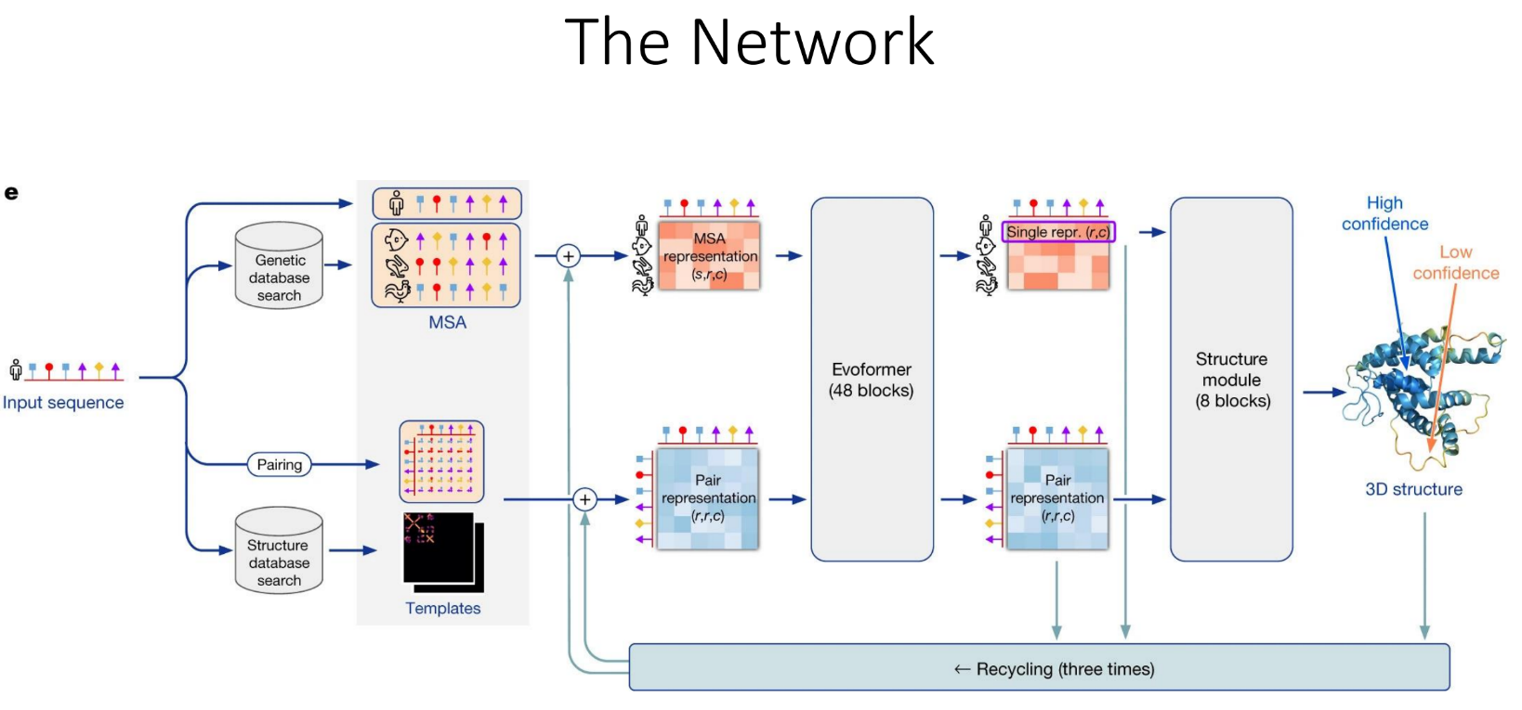
Protein tokenization vs AlphaFold
AlphaFold uses sequence representations, but it is not merely a text-style language model.
Amino acid
sequence
MSA / evolutionary
information
Residue-pair
representation
Structure
module
3D atomic
coordinates
Sources: AlphaFold 3 Nature paper; AlphaFold family uses rich residue and pair representations for structure prediction.

Slide 43
