Slide 1
生物统计和生物信息引论
Lecture 10
深度学习基础
王健桥
jianqw@mail.tsinghua.edu.cn

Slide 2
Motivation: Why AI in Biomedicine?
生物医学数据规模快速增长：医学影像、基因组、电子病历、可穿戴设备、实验数据
难以处理的多模态、非结构化数据
什么是多模态？
什么是非结构化数据？

Slide 3
Example: Multimodal AI for disease Prognosis
Input:
  Imaging: CT / pathology images
  Omics: Protein, metabolites
  Clinical records: Age, stage, treatment
  Clinical notes: Pathology reports
Output:
  Survival prediction
  Treatment response
  Disease subtype

Slide 4
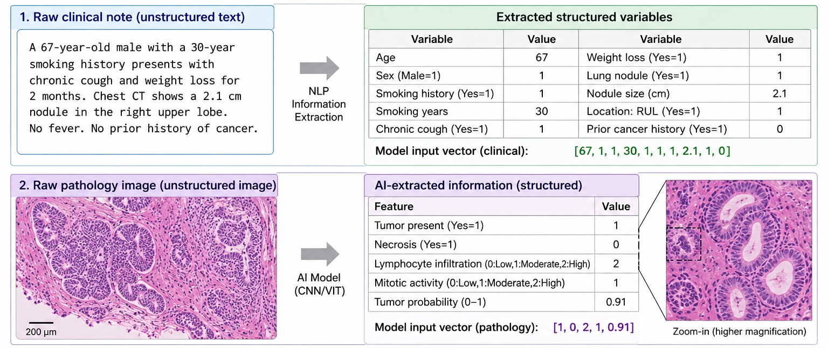
Structured data & Unstructured data
Structured data are easier to analyze, but may lose important information.
Raw biomedical data contain richer information, but also more noise and redundancy.
GPT image

Slide 5
Outline
Task and Data
Binary Logistic Regression
Multi-class Logistic Regression
Logistic Regression with MLP

Slide 6
Task and Data

Slide 7
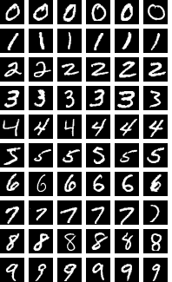
MNIST dataset
MNIST is a benchmark dataset of handwritten digits from 0 to 9.
It contains 70,000 grayscale images, each with size 28 × 28 pixels.
The task is a 10-class classification problem: given an image, predict which digit it represents.
MNIST is widely used to introduce machine learning, neural networks, and image classification because it is simple, clean, and easy to visualize.
Although it is relatively easy for modern models, it remains a useful starting point for understanding how models learn from image data.

Slide 8
Task: 10-class classification
Model
0,1,…,9
Input x: figures
Output y: labels

Slide 9
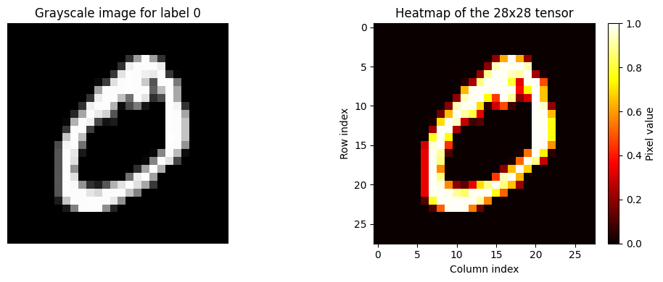
What does data look like
They are just 28*28 matrix, each element is between 0 and 1
A mapping
However, traditional methods cannot handle non-structural data.
We can flatten the figure as a 784-dim vector
代码：dl_intro/01_mnist_dataset_overview.ipynb

Slide 10
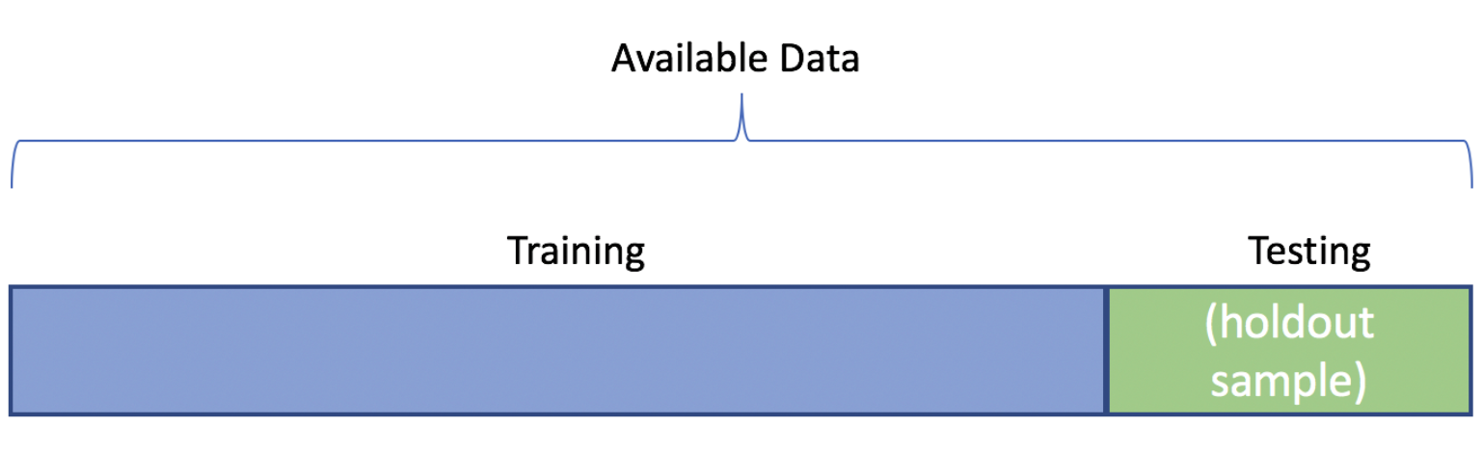
Training/Testing set split
We usually split all available data into training and testing set.
Training data is for model training
Testing data is for model performance testing
We don’t care if the model “remember everything”, but if the model can find rules and perform well on unseen data.

Slide 11
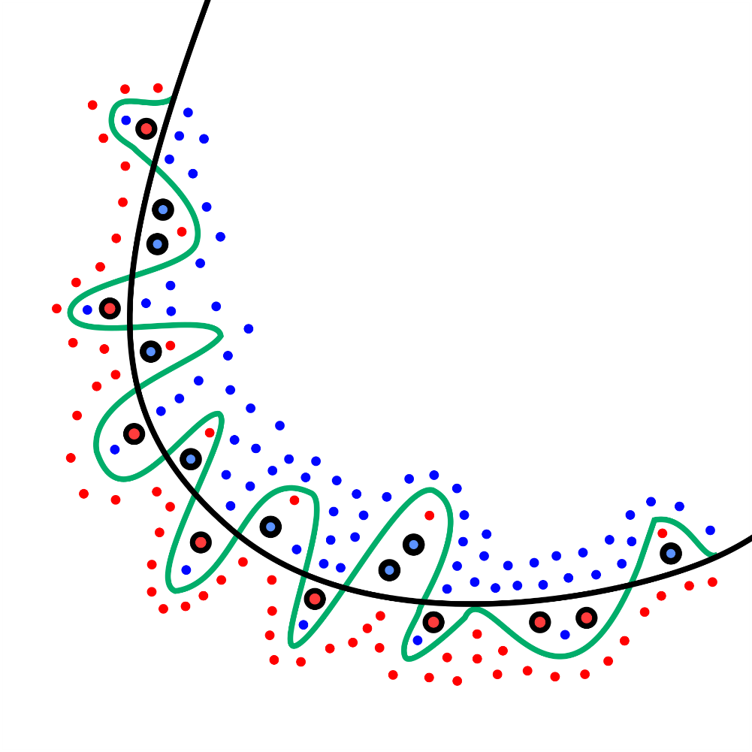
Overfitting
Overfitting = doing very well on training data, but poorly on new data
The model learns not only the pattern, but also noise and randomness
It may “memorize” the training examples instead of learning general rules
As a result, training error is low, while test error stays high
Our goal is not to fit the training set perfectly, but to generalize to unseen data

Slide 12
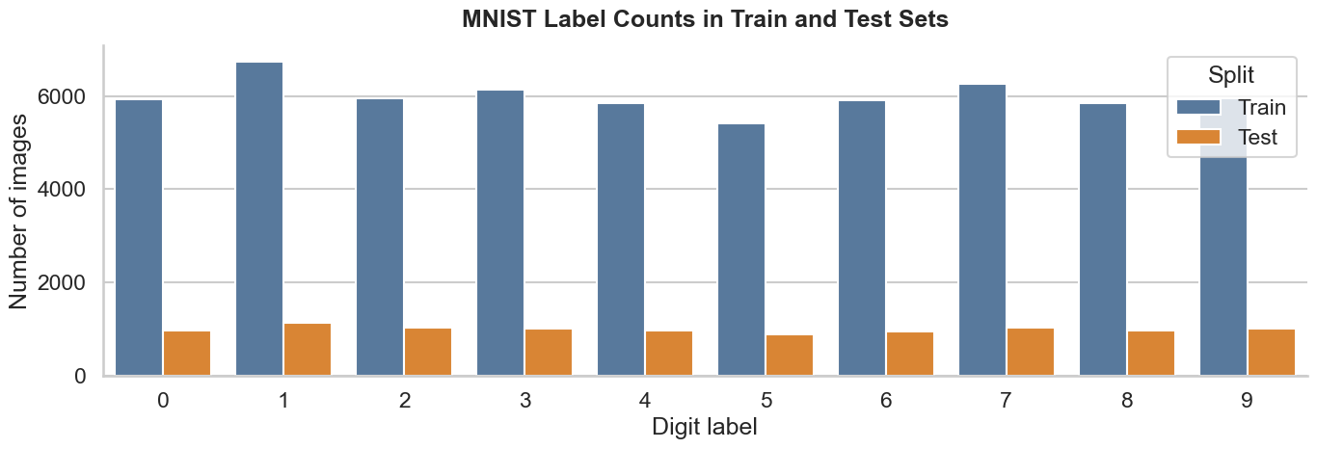
Split in MNIST
Train set for learning, test set for evaluation
Keep class proportions similar across splits
Balanced splits make performance comparison more reliable

Slide 13
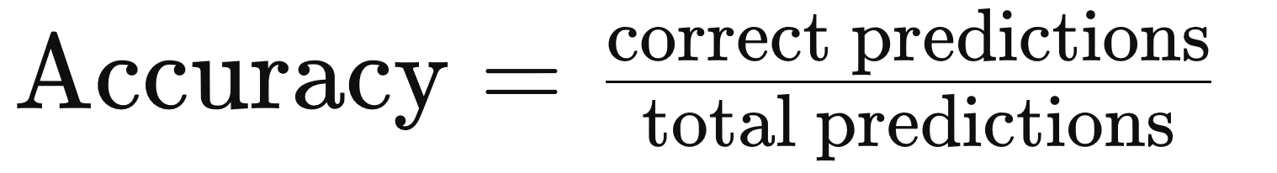
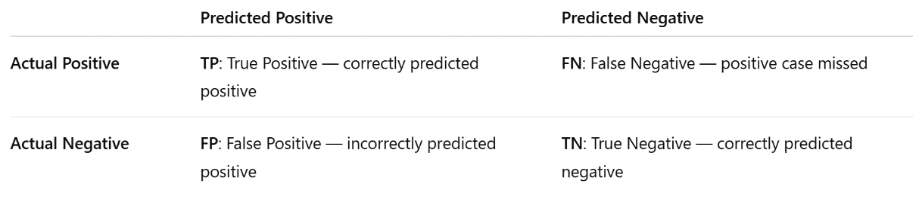
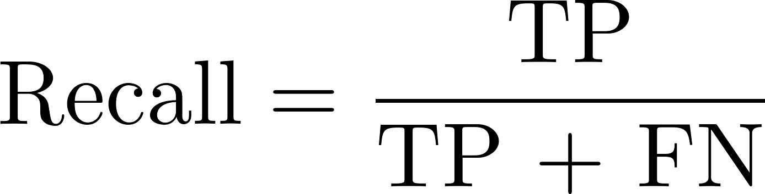
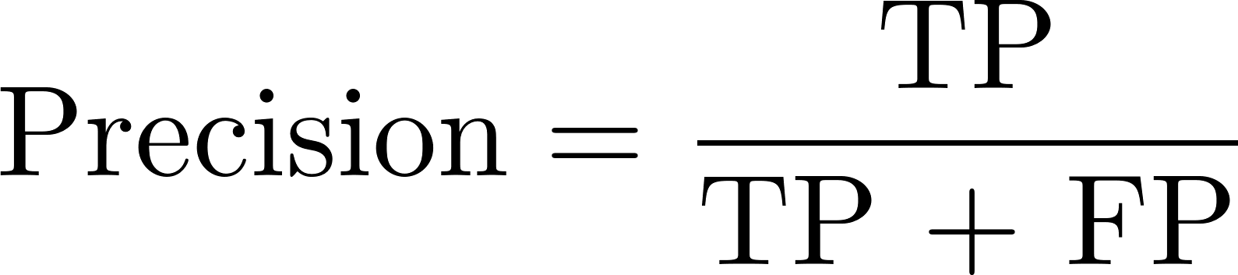
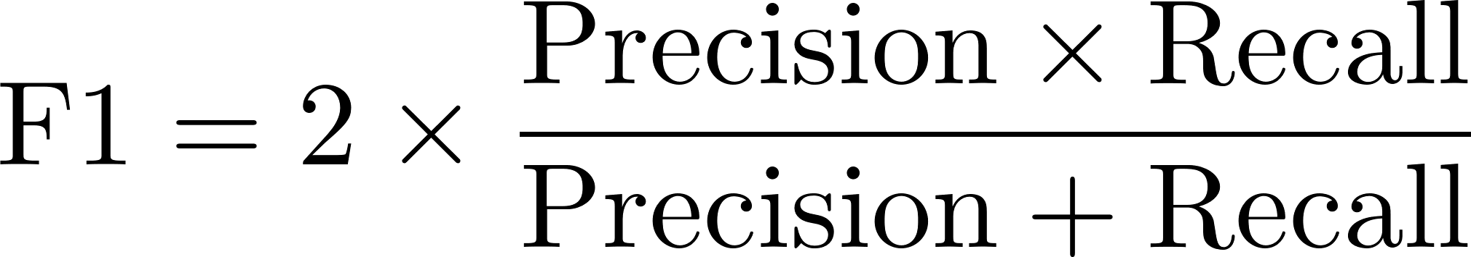
Metric
Accuracy measures how often the model is correct
Example: 9 correct out of 10 → accuracy = 90%
We usually care more about test accuracy than train accuracy
Other: recall （漏检少不少）, precision （预测准不准）, F1 …

Slide 14
Binary Logistic Regression

Slide 15



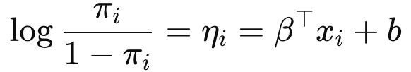
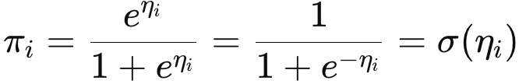
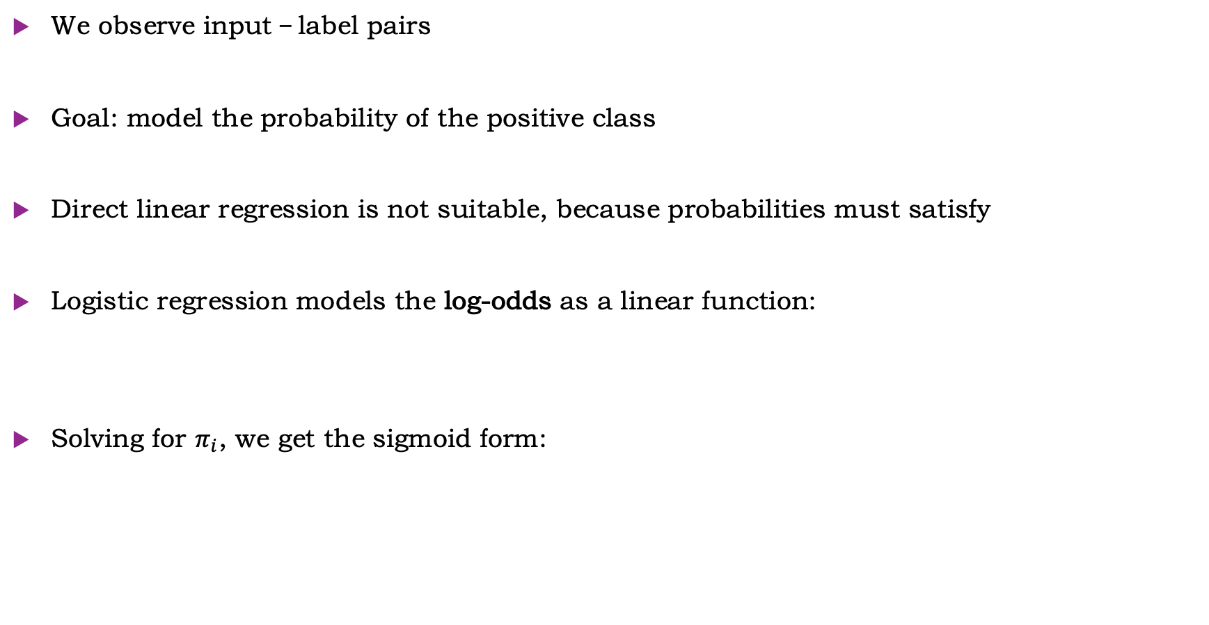
Recall: Binary Logistic Regression
We observe input–label pairs
Goal: model the probability of the positive class
Direct linear regression is not suitable, because probabilities must satisfy
Logistic regression models the log-odds as a linear function:
Solving for $π_{i}$, we get the sigmoid form:

Slide 16


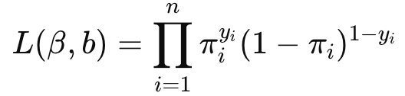
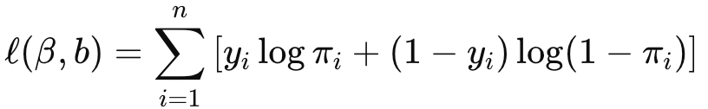

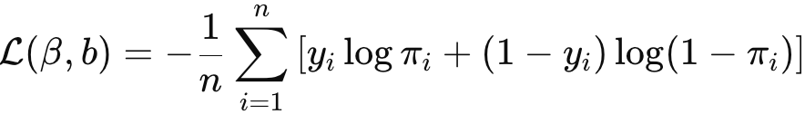
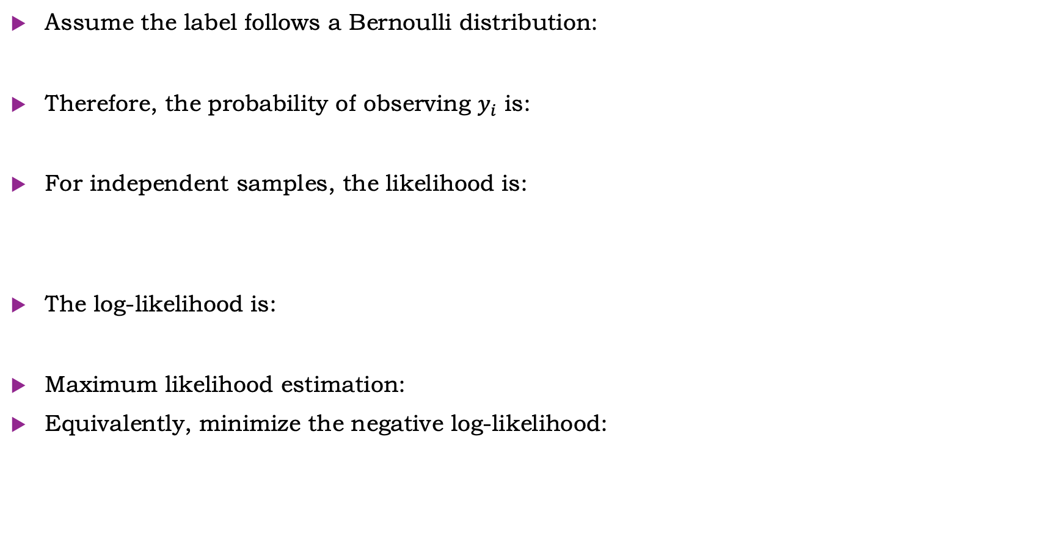
Recall: Binary Logistic Regression
Assume the label follows a Bernoulli distribution:
Therefore, the probability of observing $y_{i}$ is:
For independent samples, the likelihood is:
The log-likelihood is:
Maximum likelihood estimation:
Equivalently, minimize the negative log-likelihood:

Slide 17
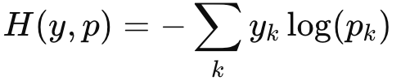
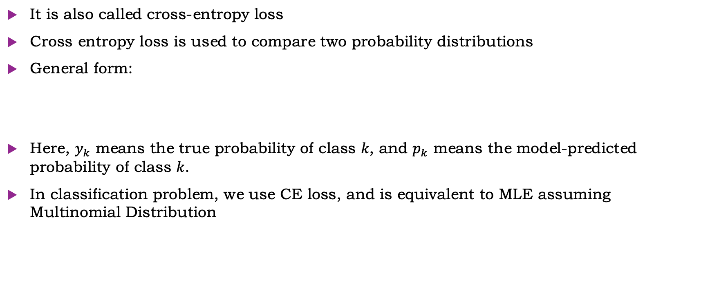
Cross-Entropy
It is also called cross-entropy loss
Cross entropy loss is used to compare two probability distributions
General form:
Here, $y_{k}$ means the true probability of class 𝑘, and $p_{k}$ means the model-predicted probability of class 𝑘.
In classification problem, we use CE loss, and is equivalent to MLE assuming Multinomial Distribution

Slide 18

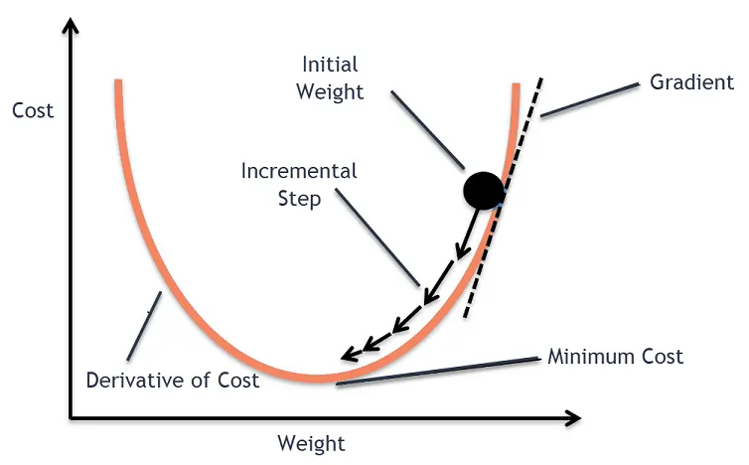
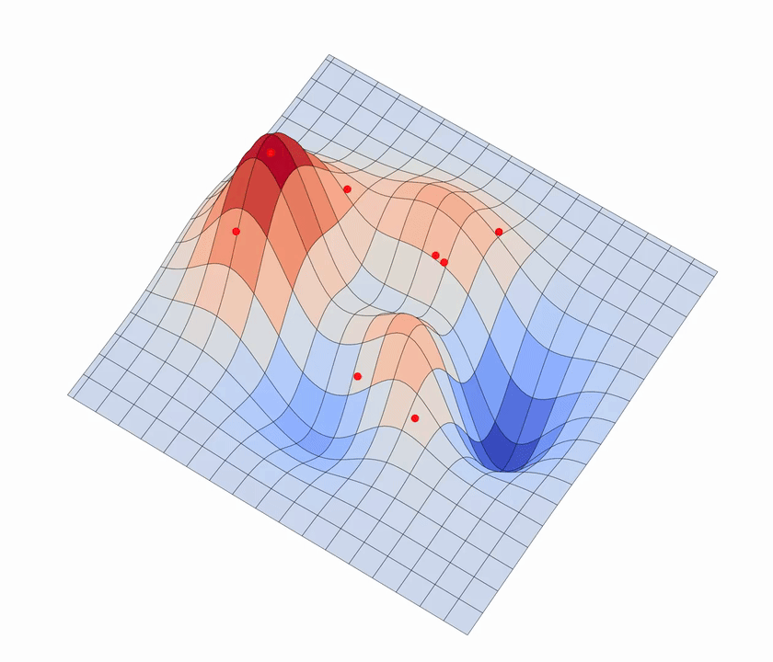
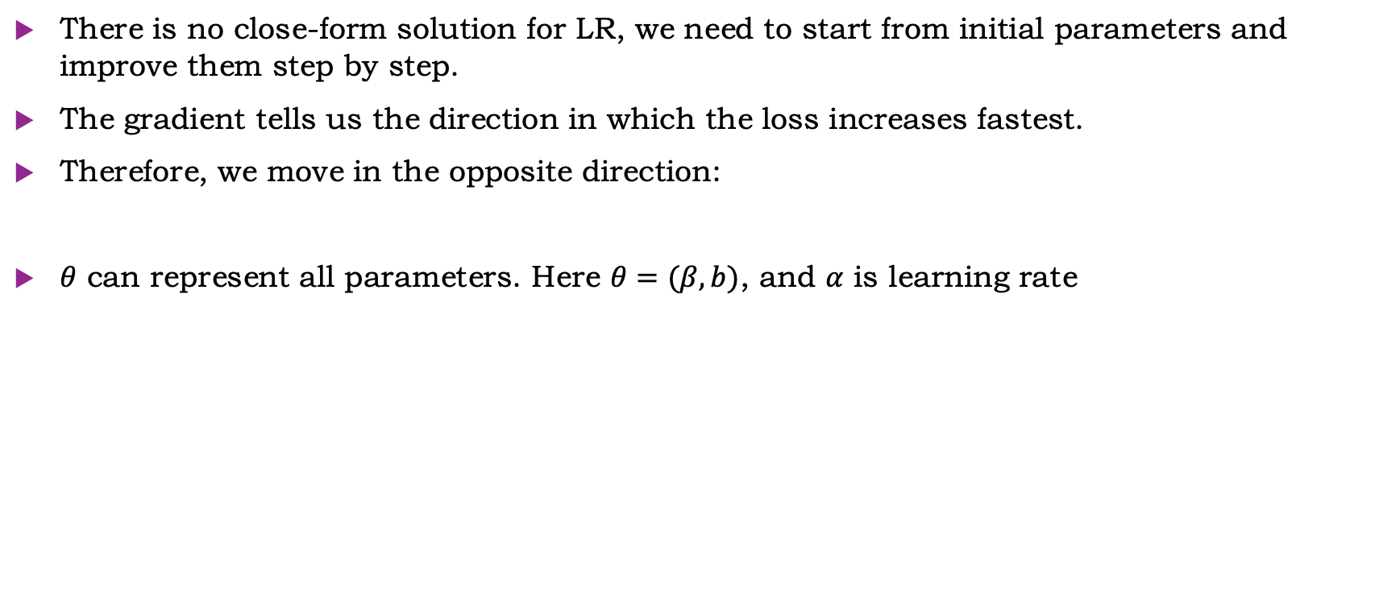
Optimization: Gradient Descent
There is no close-form solution for LR, we need to start from initial parameters and improve them step by step.
The gradient tells us the direction in which the loss increases fastest.
Therefore, we move in the opposite direction:
$θ$ can represent all parameters. Here $θ=(β, b)$, and $α$ is learning rate

Slide 19
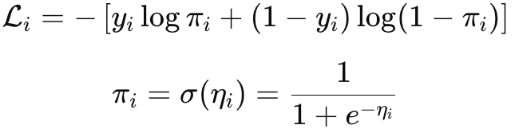
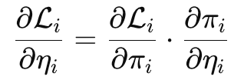
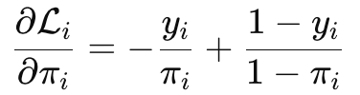
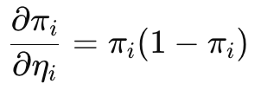
Gradient for Binary Logistic Regression
For one sample:
By chain rule:
Firstly,
Second,
Therefore,

Slide 20

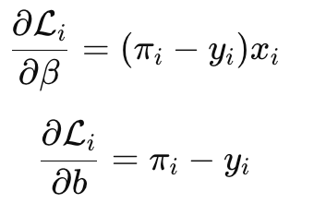

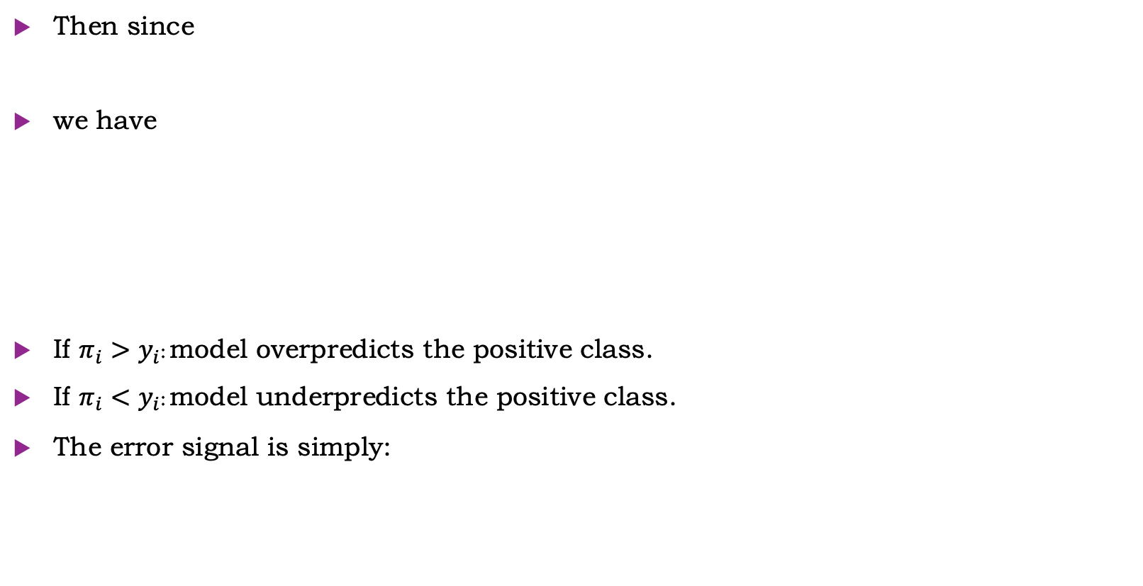
Gradient for Binary Logistic Regression
Then since
we have
If $π_{i}>y_{i}$: model overpredicts the positive class.
If $π_{i}<y_{i}$: model underpredicts the positive class.
The error signal is simply:

Slide 21
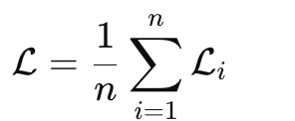
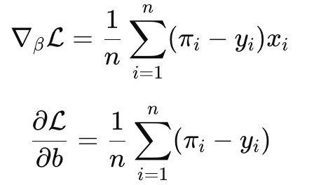
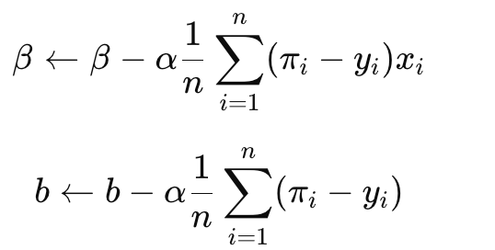
Gradient Descent
For all samples, the average loss is:
Therefore,
Gradient descent update:

Slide 22
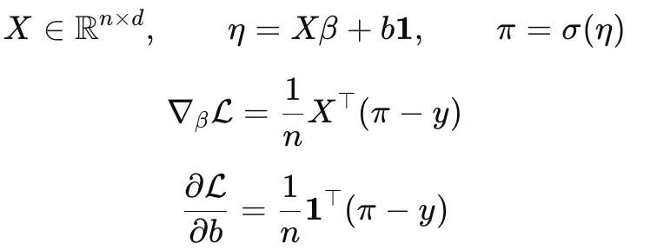
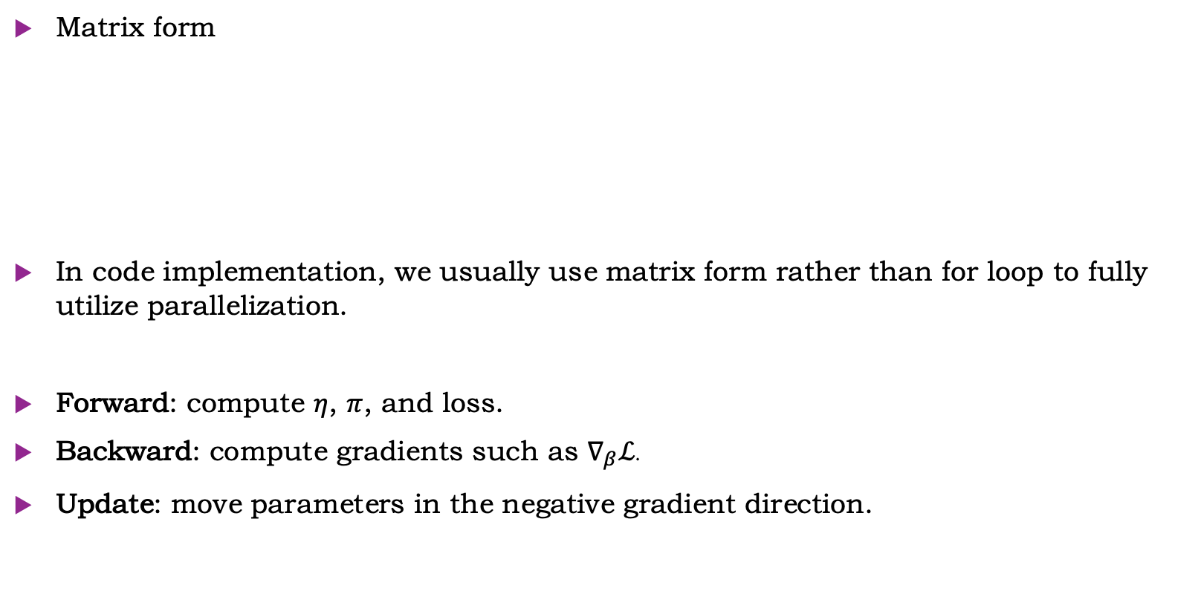
Gradient Descent
Matrix form
In code implementation, we usually use matrix form rather than for loop to fully utilize parallelization.
Forward: compute $η$, $π$, and loss.
Backward: compute gradients such as $∇_{β}ℒ$.
Update: move parameters in the negative gradient direction.

Slide 23
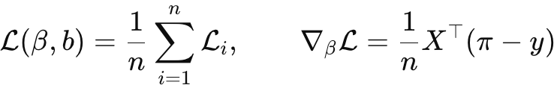

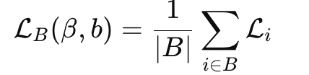
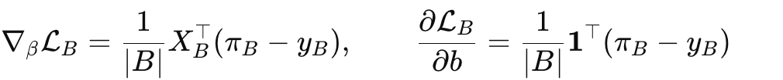

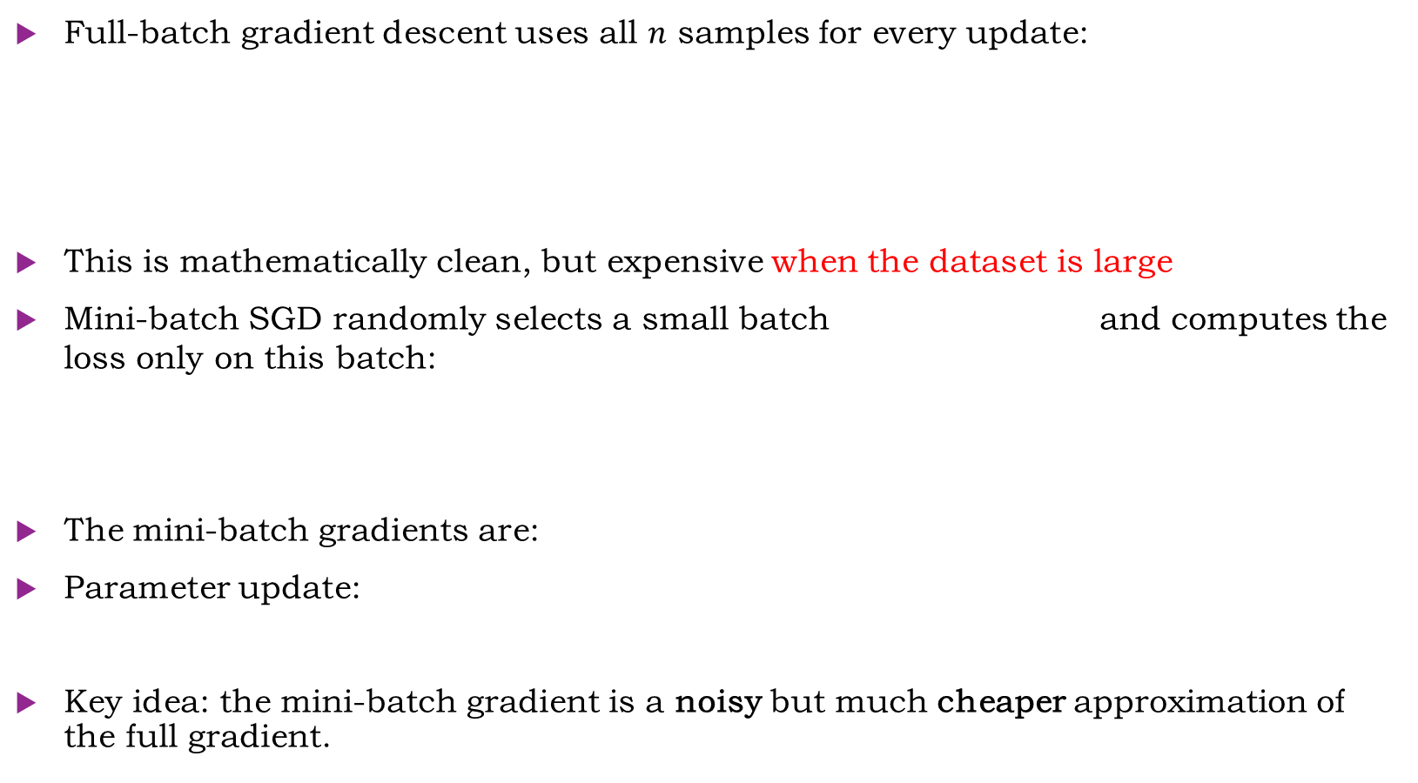
Stochastic Gradient Descent
Full-batch gradient descent uses all $n$ samples for every update:
This is mathematically clean, but expensive when the dataset is large
Mini-batch SGD randomly selects a small batch and computes the loss only on this batch:
The mini-batch gradients are:
Parameter update:
Key idea: the mini-batch gradient is a noisy but much cheaper approximation of the full gradient.

Slide 24
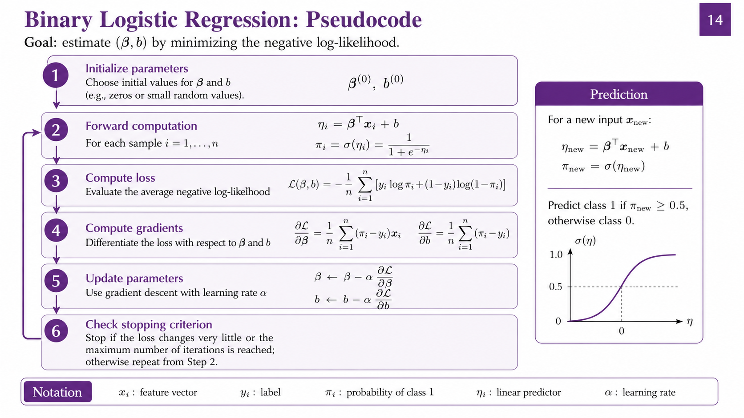


Slide 25


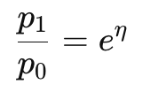

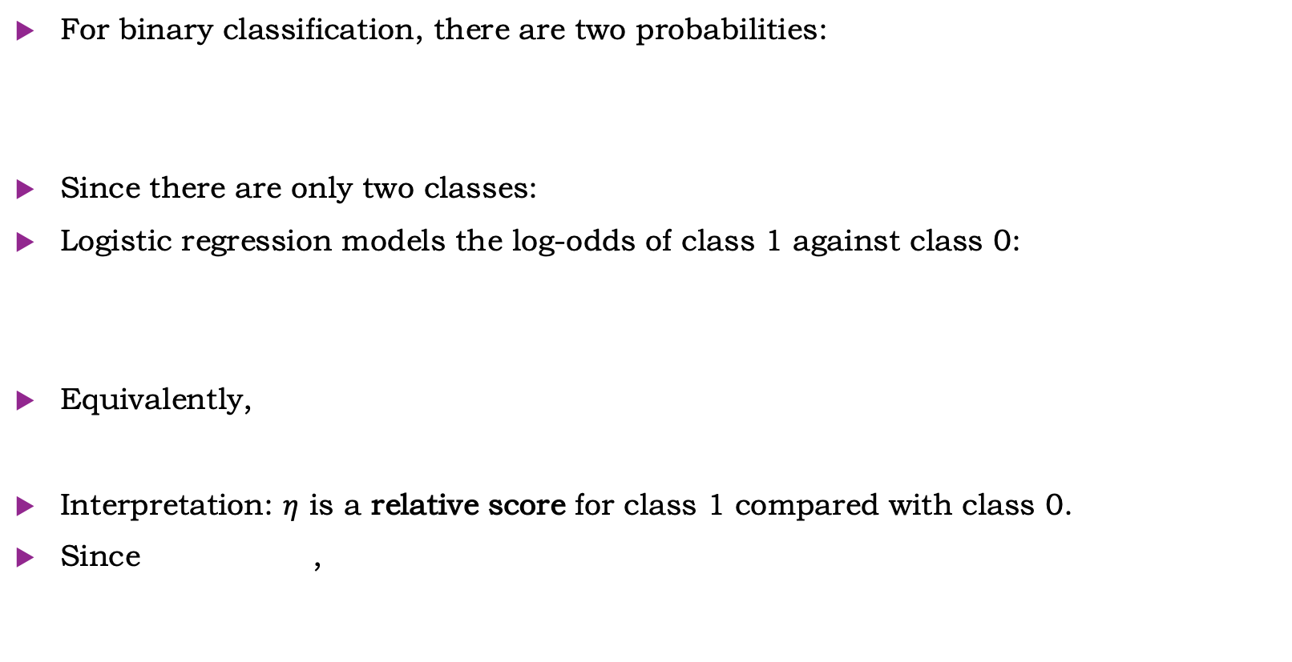
Binary Logistic Regression: Modeling Relative Odds
For binary classification, there are two probabilities:
Since there are only two classes:
Logistic regression models the log-odds of class 1 against class 0:
Equivalently,
Interpretation: $η$ is a relative score for class 1 compared with class 0.
Since ,

Slide 26

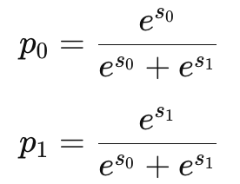

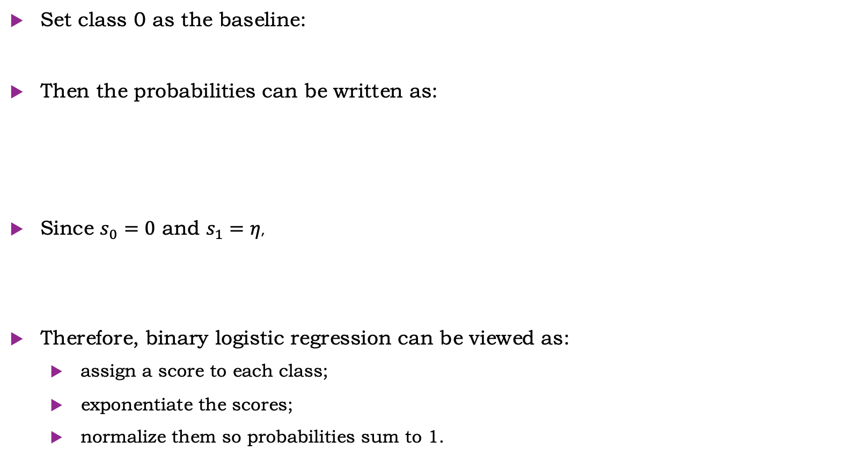
Two-class normalization
Set class 0 as the baseline:
Then the probabilities can be written as:
Since $s_{0}=0$ and $s_{1}=η$,
Therefore, binary logistic regression can be viewed as:
  assign a score to each class;
  exponentiate the scores;
  normalize them so probabilities sum to 1.

Slide 27
Multi-class Logistic Regression

Slide 28


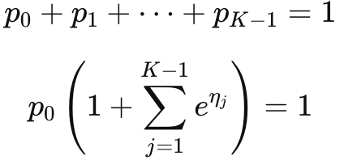
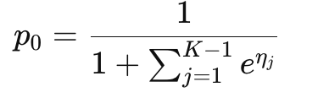
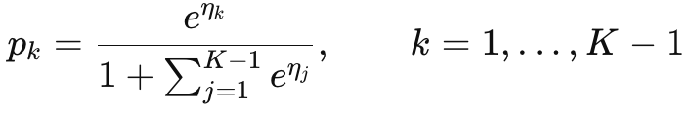
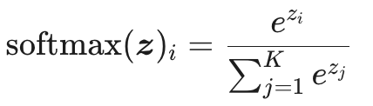
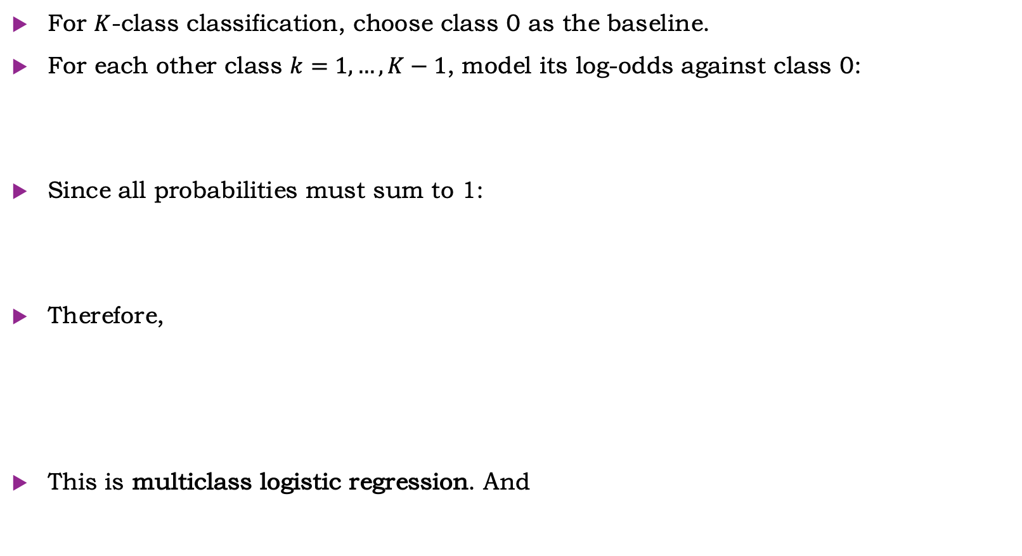
From Binary Logistic to Multiclass LR
For $K$-class classification, choose class 0 as the baseline.
For each other class $k=1,…,K−1$, model its log-odds against class 0:
Since all probabilities must sum to 1:
Therefore,
This is multiclass logistic regression. And

Slide 29




Softmax
Softmax function turns arbitrary inputs(logits) into probabilities
Logits are not probabilities:
  they can be negative;
  they can be larger than 1;
  they do not need to sum to 1.
Property:
Softmax: soft + max.
Hard max: argmax just choose the largest one.
For , argmax gives , , which is a hard decision
But softmax gives . The max logit still correspond to max probability, but also keep non-zero prob for other classes. So, it’s a soft version of max.
Code: dl_intro/02_softmax_cross_entropy.ipynb
Notes:
口头讲一下为啥叫做softmax

Slide 30
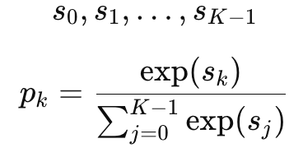
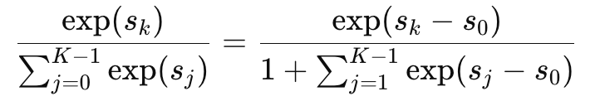


Identifiable Note
In neural networks, rather than chooses one baseline class, e.g. class 0, we usually predict $K$logits:
It’s equivalent, since
Therefore, the baseline formulation is recovered by setting:

Slide 31




Multi-class Logistic Regression
Task: predict a label from an input feature vector
Model: for each class k, compute a linear score
These 10 scores are converted into probabilities using the softmax function:
The predicted label is the class with the highest probability.
Training is done by minimizing cross-entropy loss over all classes.

Slide 32







Multinomial Likelihood
For one image $x_{i}$, the model predicts a probability vector:
Represent the true label as a one-hot vector:
The probability of observing this label is (one-trial multinomial):
For independent samples, the likelihood is:
The log-likelihood is:
Therefore, minimizing the negative log-likelihood gives cross-entropy loss:

Slide 33





Cross-Entropy: one-hot case
In our case, each image has one correct label, we present the true label as a one-hot vector. (categorize)
  E.g. if true digit is 3, then
Model prediction after softmax:
Calculate cross-entropy
Because only the correct class has $y_{k}=1$, the loss becomes:

Slide 34







Optimization
Forward Process:
Backward Process:
Update

Slide 35

GD and SGD
Full GD uses all training samples to compute one update
This is accurate, but slow for large datasets
SGD uses one sample or a mini-batch to estimate the gradient.
Each update is noisier, but much faster
Mini-batch SGD is the standard choice in deep learning

Slide 36



Use SGD: Pytorch Autograd
Computing gradients by hand is tedious for complex models.
PyTorch builds a computation graph during the forward pass.
loss.backward() applies the chain rule automatically.
Gradients are stored in each parameter’s .grad.
optimizer.step() uses these gradients to update parameters.
Autograd = automatic chain rule on the computation graph
Computation Graph(Forward)
Backward propagation

Slide 37


Slide 38

Results
Test accuracy: 0.9222 with 30 epochs (~30s on a Macbook M4 chip)
Try by yourself!
Code: dl_intro/03_logistic_regression_mnist_pytorch.ipynb

Slide 39

Recap: from image to prediction

Slide 40
Logistic Regression with MLP

Slide 41



Limitation of linear model
linear model already works reasonably well, but its errors reveal a limitation: it only uses additive first-order pixel evidence and cannot learn nonlinear feature combinations.
For each class:
The score is a weighted sum of individual pixels.
It uses first-order pixel evidence only.
It does not explicitly model interactions such as:

Slide 42

Why nonlinearity?
A linear model creates linear decision boundaries in feature space.
Some patterns cannot be separated well by a single linear rule.
Nonlinear models can bend the decision boundary.
More importantly, they can learn intermediate features: pixels -> strokes -> digits

Slide 43


Introduce nonlinearity： ReLU
ReLU means Rectified Linear Unit.
It keeps positive values and removes negative values:
Linear + Linear = Still Linear
Linear + ReLU + Linear = Nonlinear model
Of course, you can use other non-linear functions, e.g. Sigmoid, SiLU, tanh

Slide 44


From linear model to MLP
Linear classifier:
MLP(Multi Layer Perceptrons) adds a hidden layer:
The hidden layer learns intermediate features.
The output layer uses these features for classification.
Linear + activation + Linear = MLP!
Can have many layers. Must have an activation between two layers.
Gradient? Pytorch automatically do it for you.

Slide 45


2 Layer MLP

Slide 46

Performance
Test set accuracy: 0.9770
Code: dl_intro/04_mlp_mnist_pytorch.ipynb

Slide 47

Recap: a standard pipeline of machine learning

Slide 48
After class
Run all code by yourself !!
The only way to learn deep learning is read, understand, execute, modify the code by yourself.
It’s very interesting to tune the hyper-parameters and get a good result.
The fifth notebook talks about overfitting, which we didn’t mention in our class, but it’s very important.
The sixth notebook guide you to actually understand a Pytorch code.
If you want to learn more, follow guidance in README.md or ask TA.

