Slide 1
生物统计和生物信息引论
Lecture 9
Longitudinal Data Analysis
王健桥
jianqw@mail.tsinghua.edu.cn

Slide 2
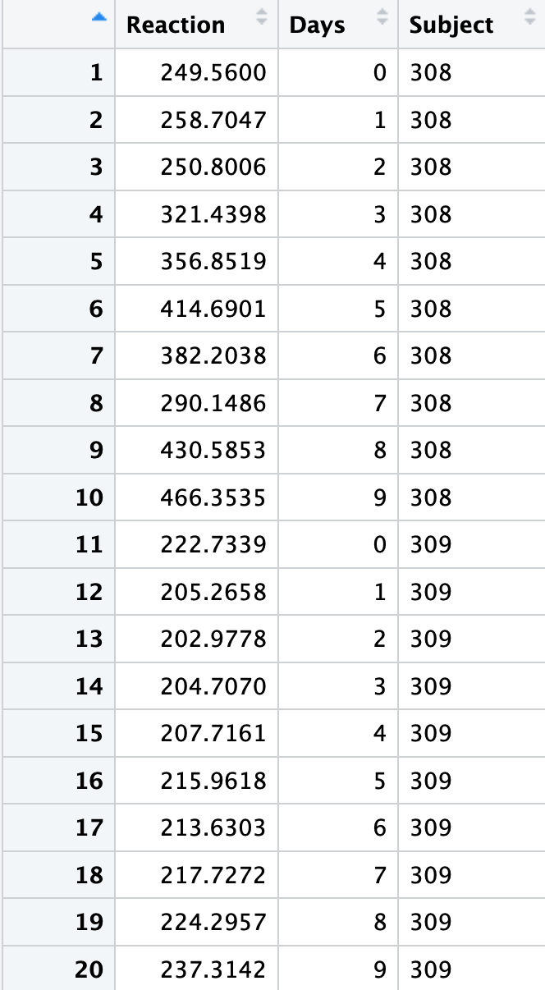
Example: Reaction Time in Sleep Study
lme4::sleepstudy in R
The average reaction times per day (in milliseconds) for subjects in a sleep deprivation study.
180 observations.
Reaction: Average reaction time (ms)
Days: Number of days of sleep deprivation
For details, ?lme4::sleepstudy in R

Slide 3
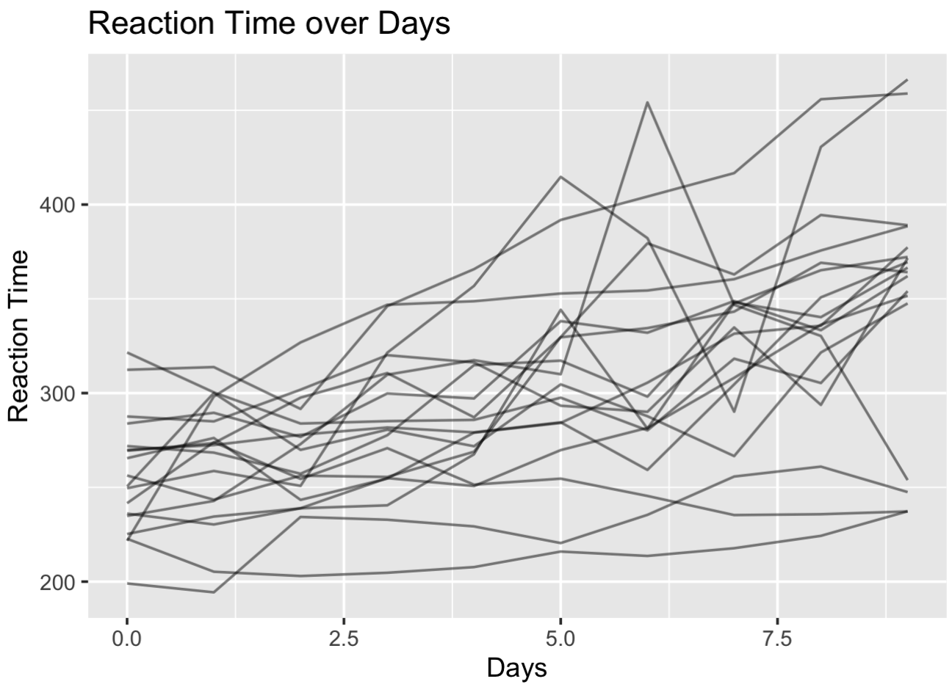
Example: Reaction Time in Sleep Study

Slide 4
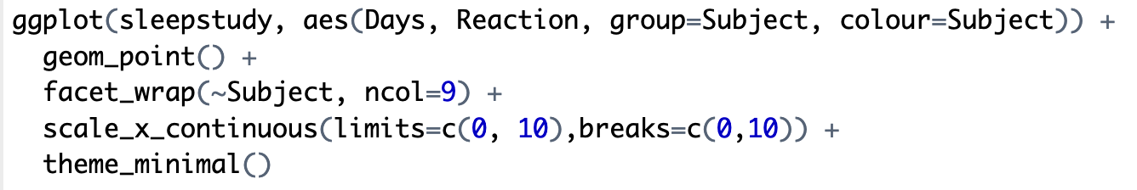
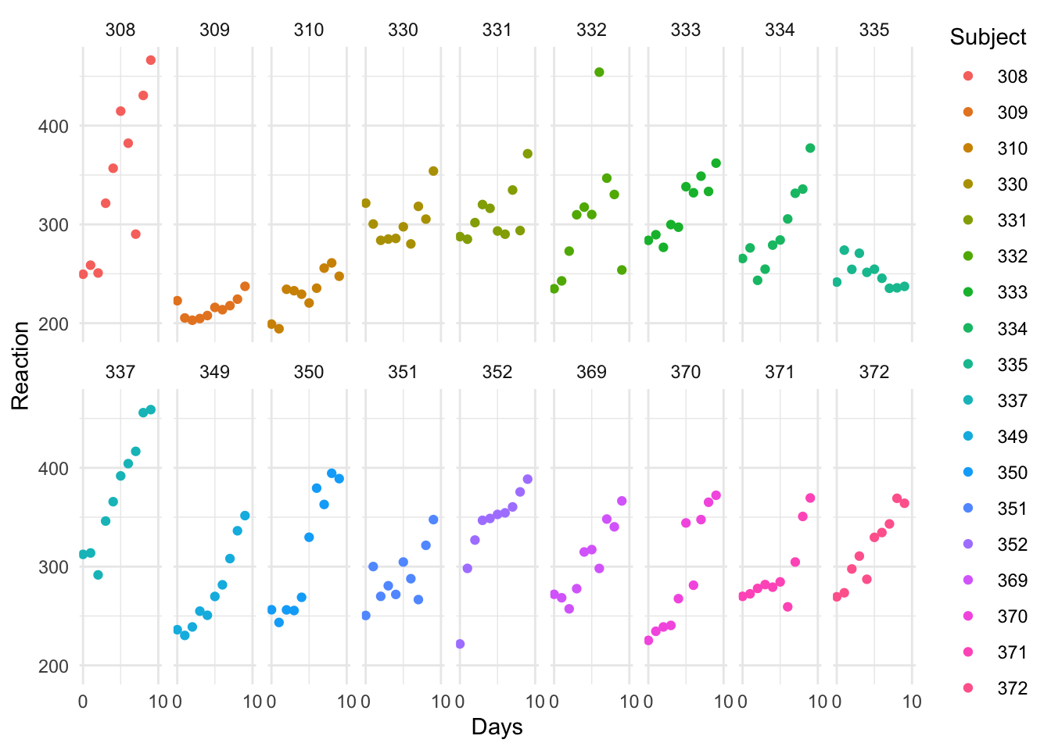
Another visualization

Slide 5
What is Longitudinal Data
Data collected on the same unit at multiple time points
Examples:
  Patient follow-up measurements
  Growth curves
  Economic data
Data structure
  $i=1,…,r$, $j=1,…,n_{i}$
  Outcomes $Y_{ij}$
  Covariates $X_{ij},Z_{ij}$

Slide 6
Key Features
Repeated measurements within subjects
Within-subject correlation
Between-subject heterogeneity
Time effect
Challenge:
  Observations from the same subject are dependent
  Different subjects may have different baselines and trends

Slide 7
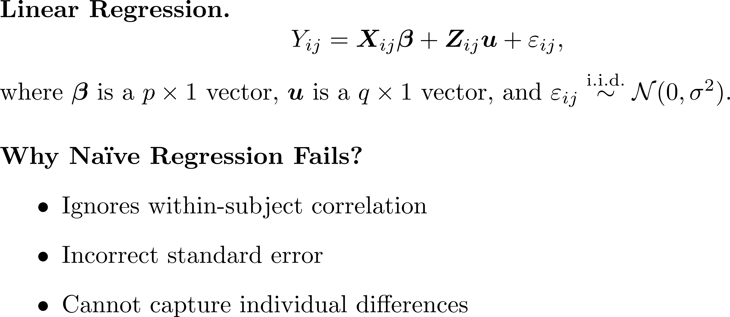
Naïve Approach: Linear Regression

Slide 8

Intercept only
What will happen when the records are imbalanced?

Slide 9
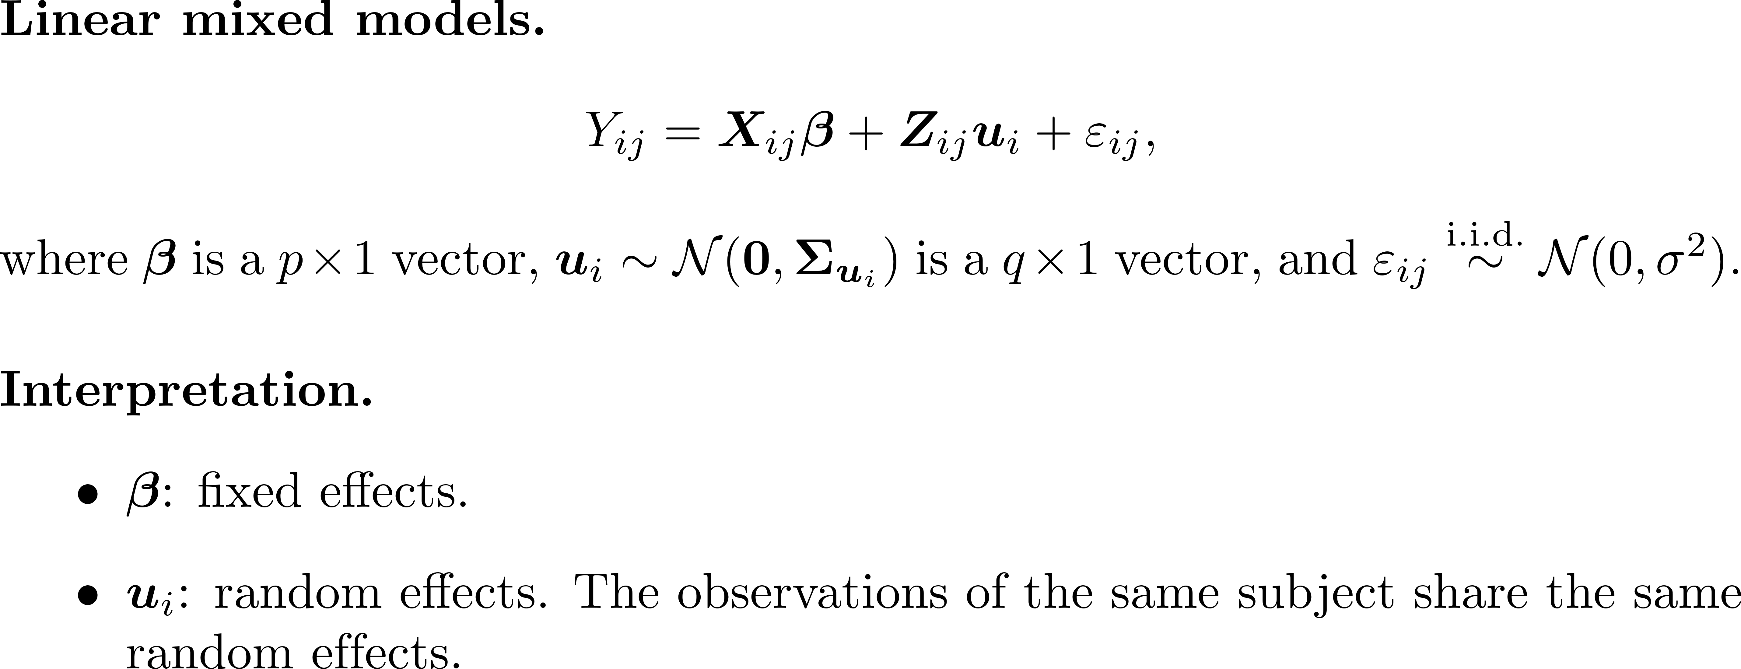
Linear Mixed Models

Slide 10
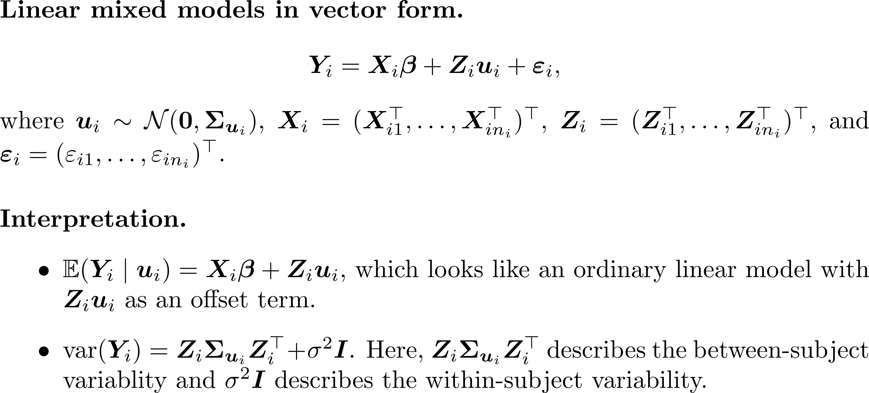
Linear Mixed Models

Slide 11
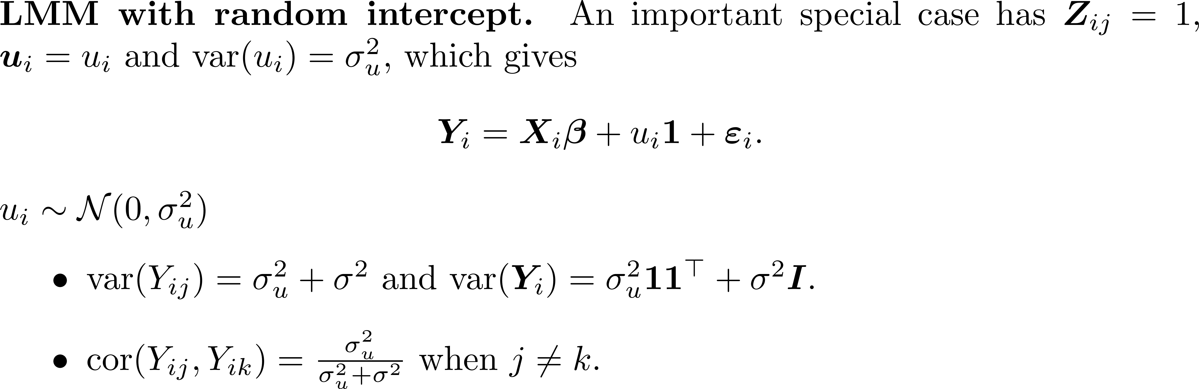
Random Intercept Linear Mixed Model

Slide 12

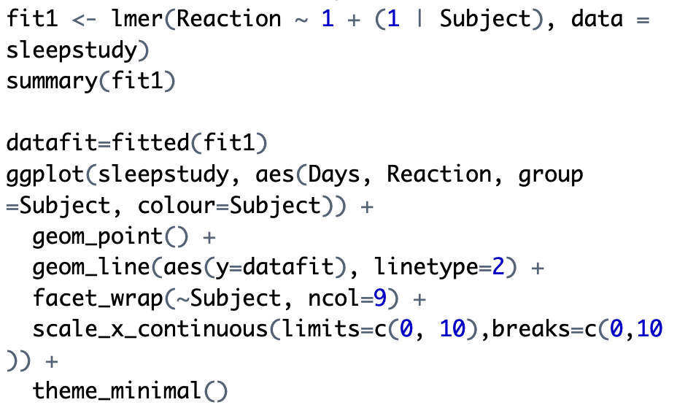
Example: Random Intercept (1)

Slide 13
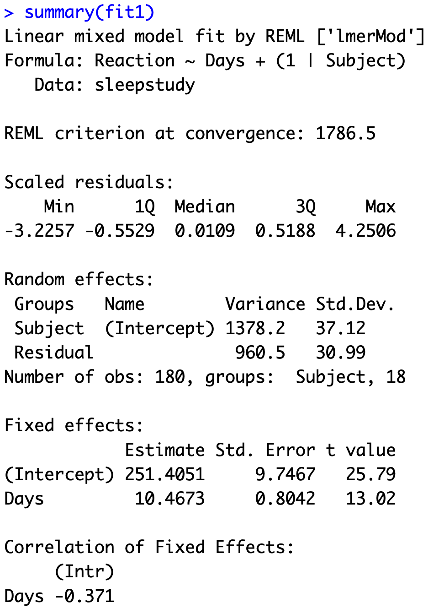
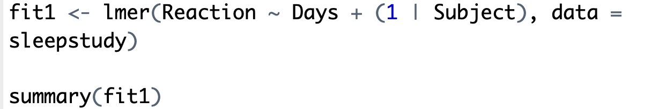
Example: Random Intercept (2)

Slide 14
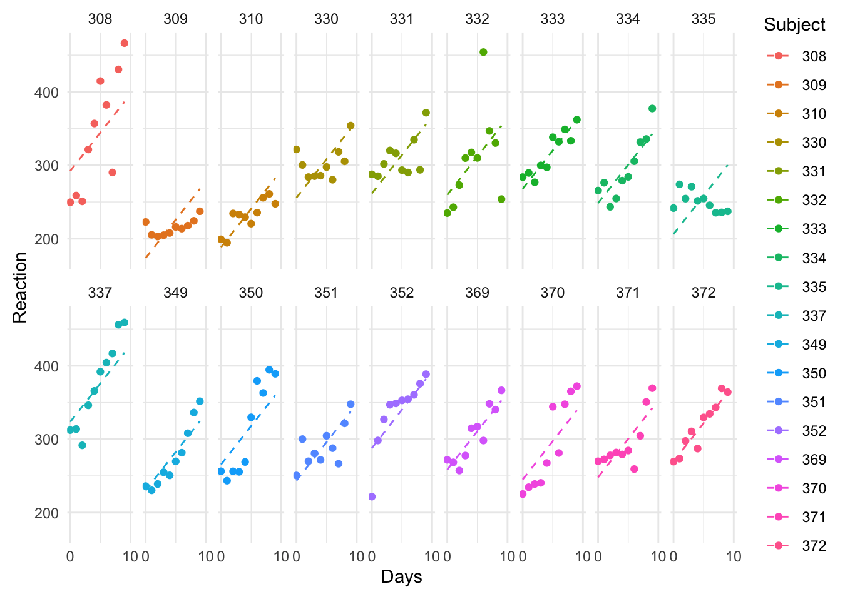
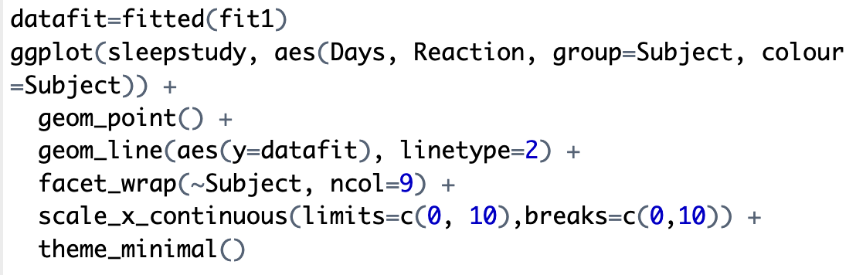
Example: Random Intercept (2)

Slide 15
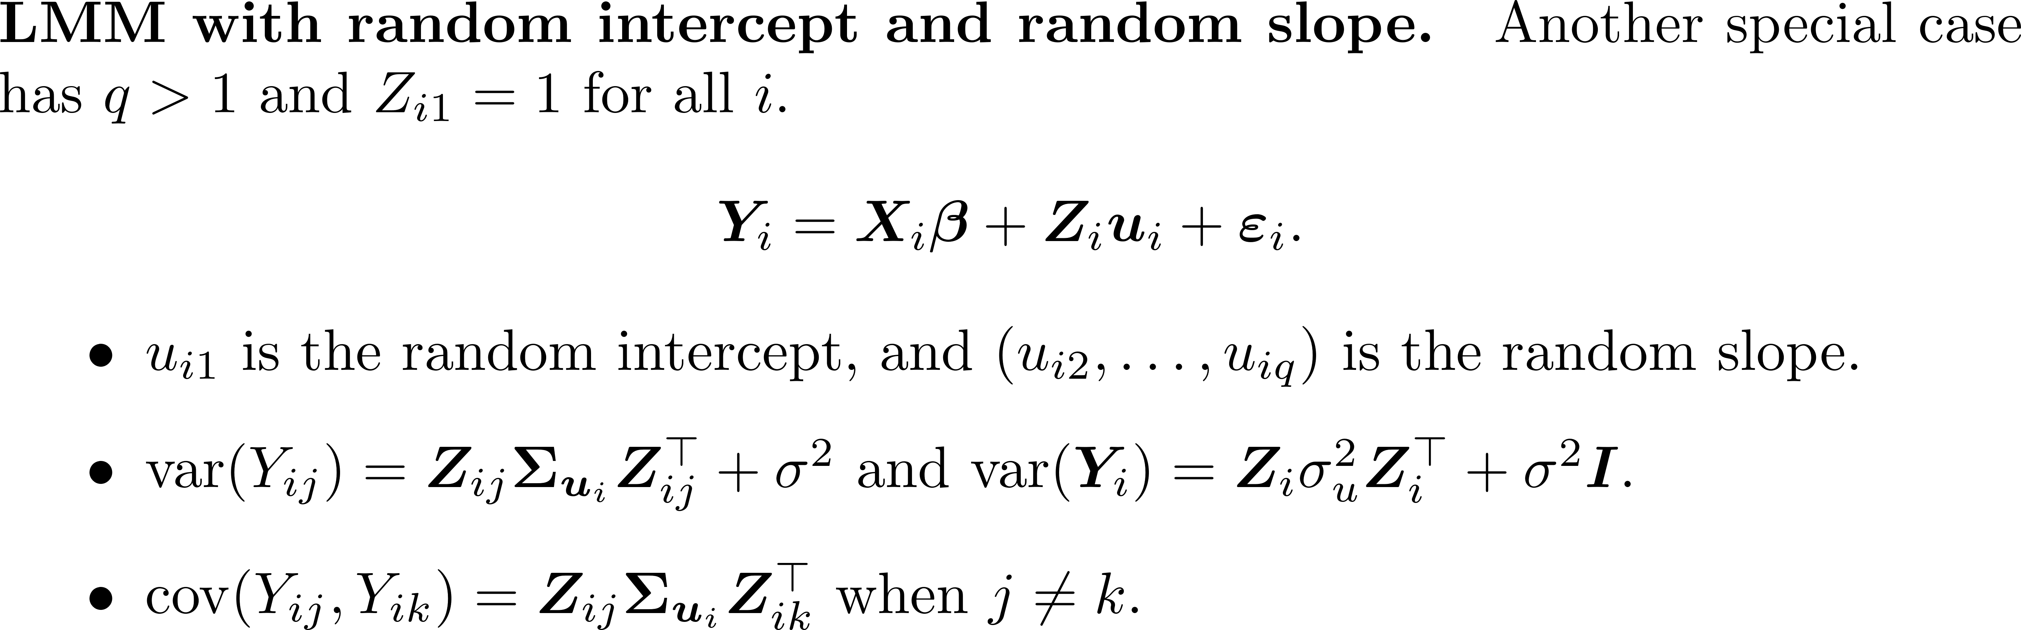
Random Intercept and Random Slope

Slide 16
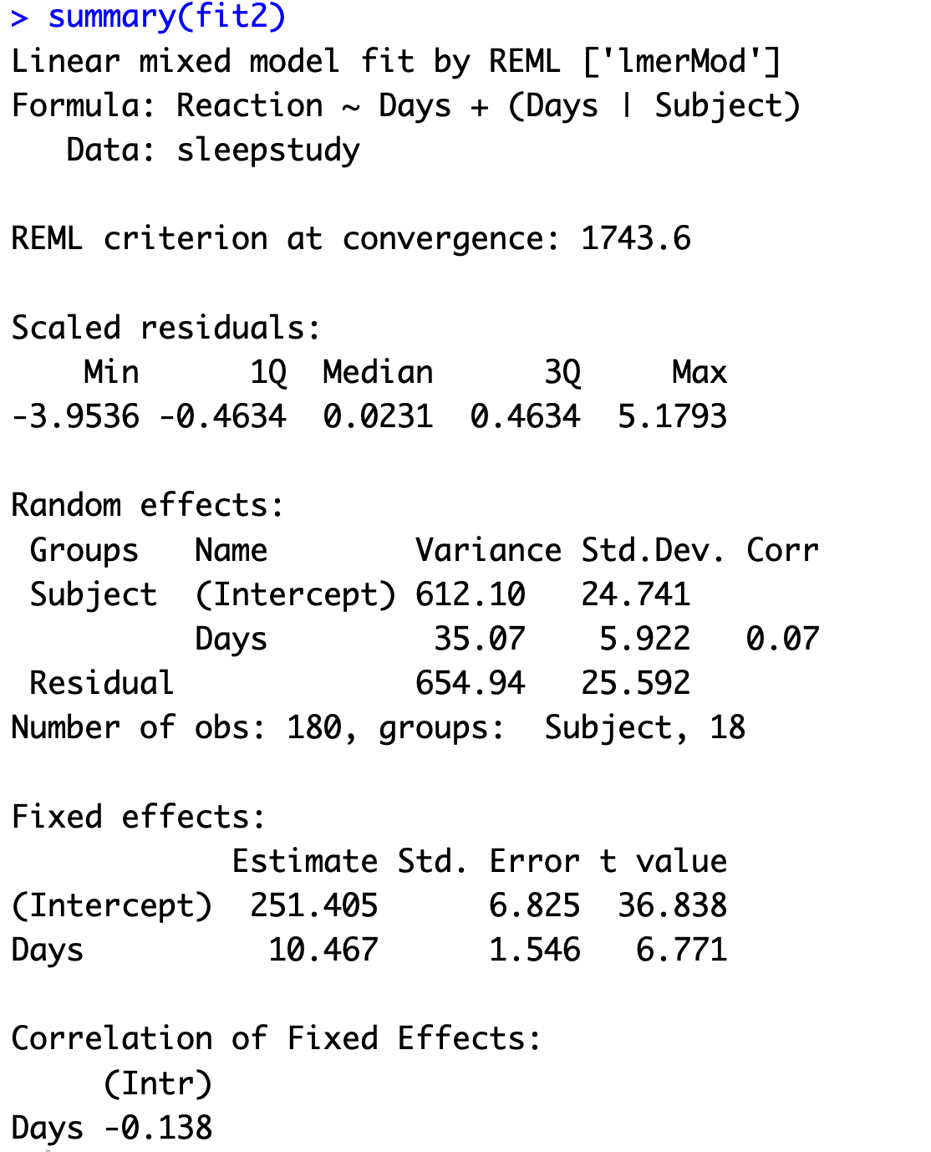
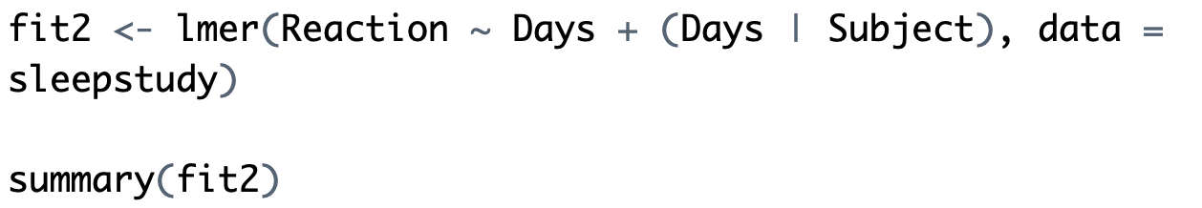
Example: Random Intercept and Slope

Slide 17
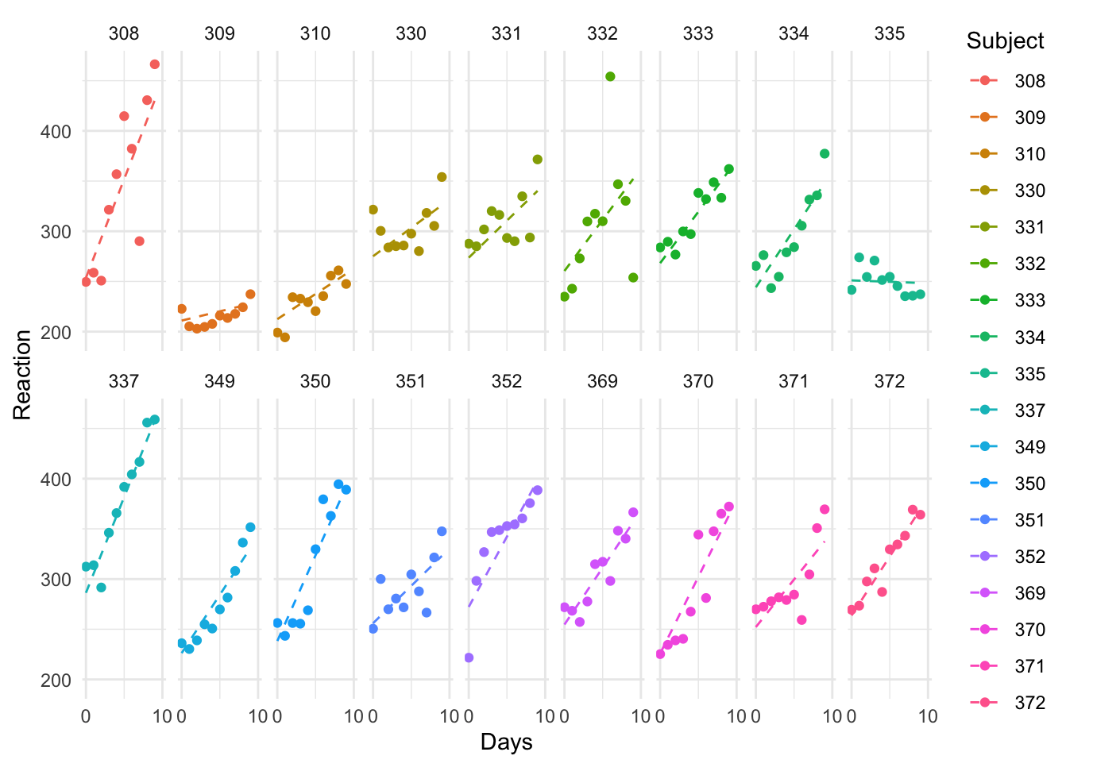
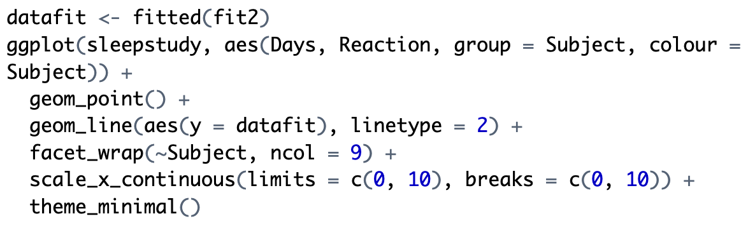
Example: Random Intercept and Slope

Slide 18
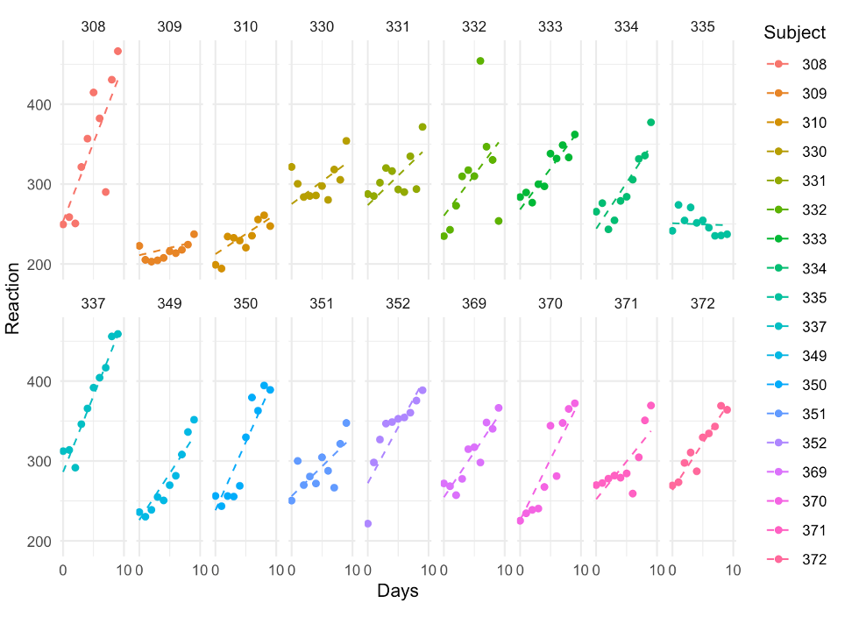
Comparing Two Models

Slide 19
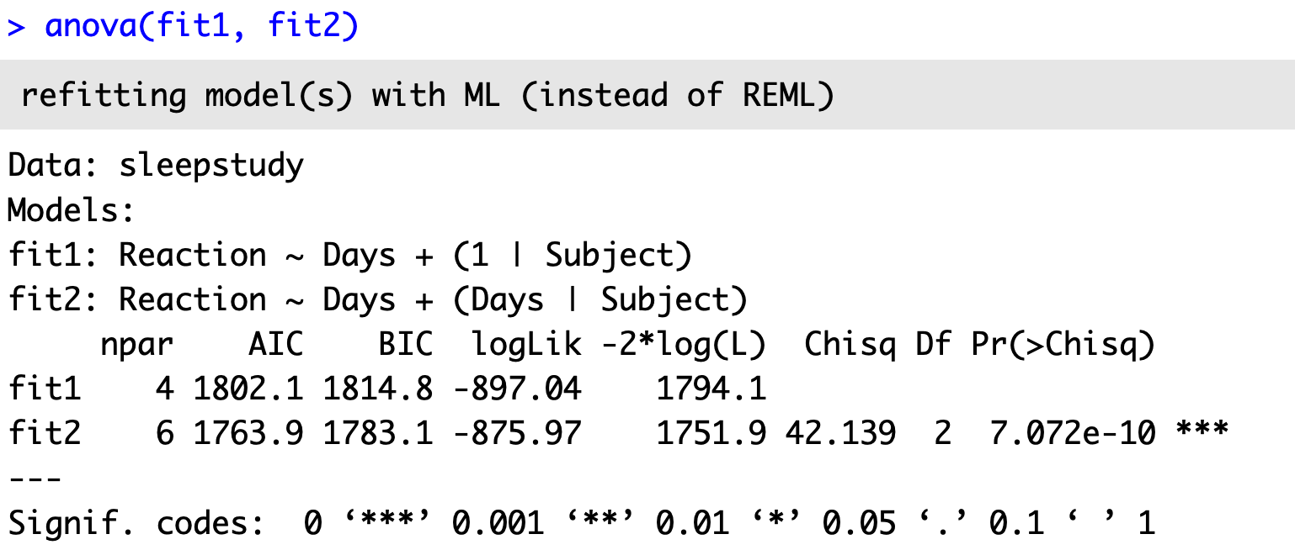
Comparing Two Models

Slide 20
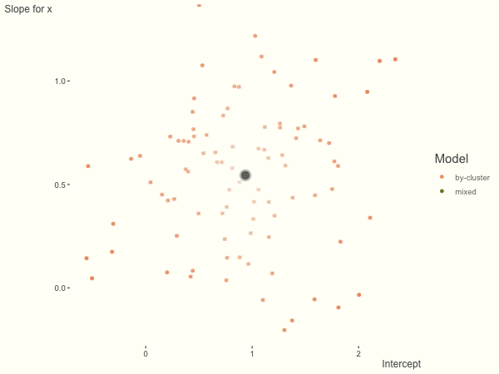
Comparing Mixed effects vs. No-pooling
Equivalent to computing individual correlations/regression for each person?
Not really: shrinkage by the distribution assumption
https://m-clark.github.io/posts/2019-05-14-shrinkage-in-mixed-models/

Slide 21
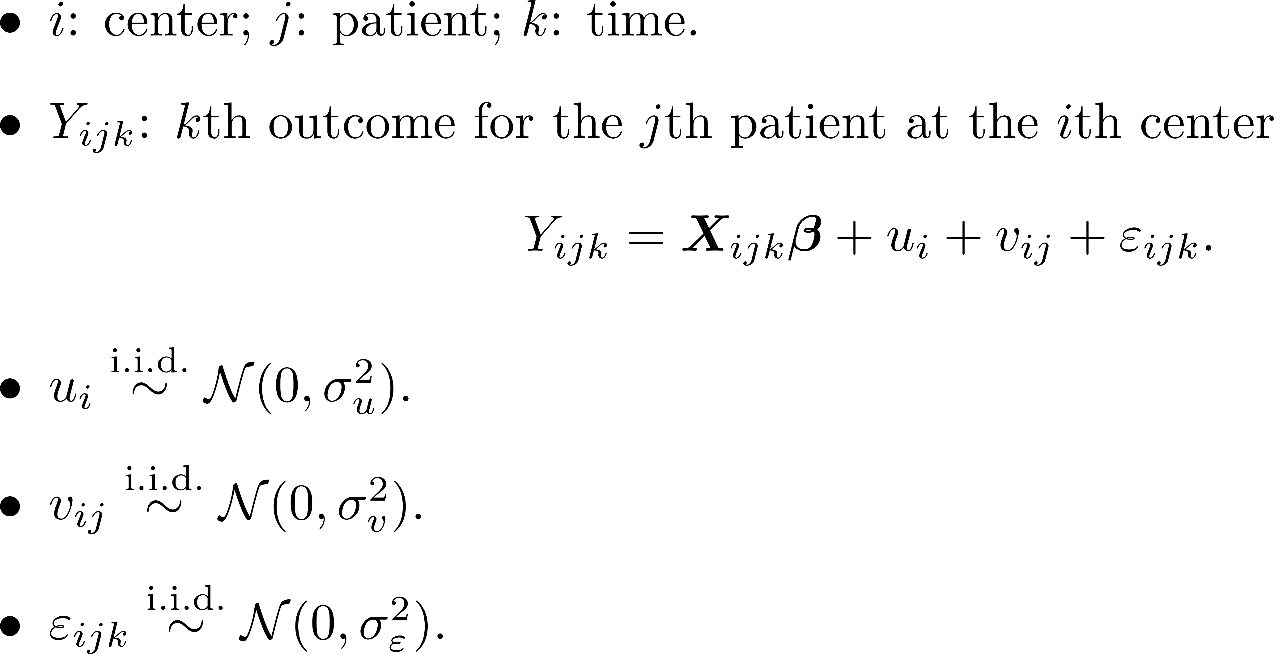
Hierarchical Model: Multilevel Model

Slide 22
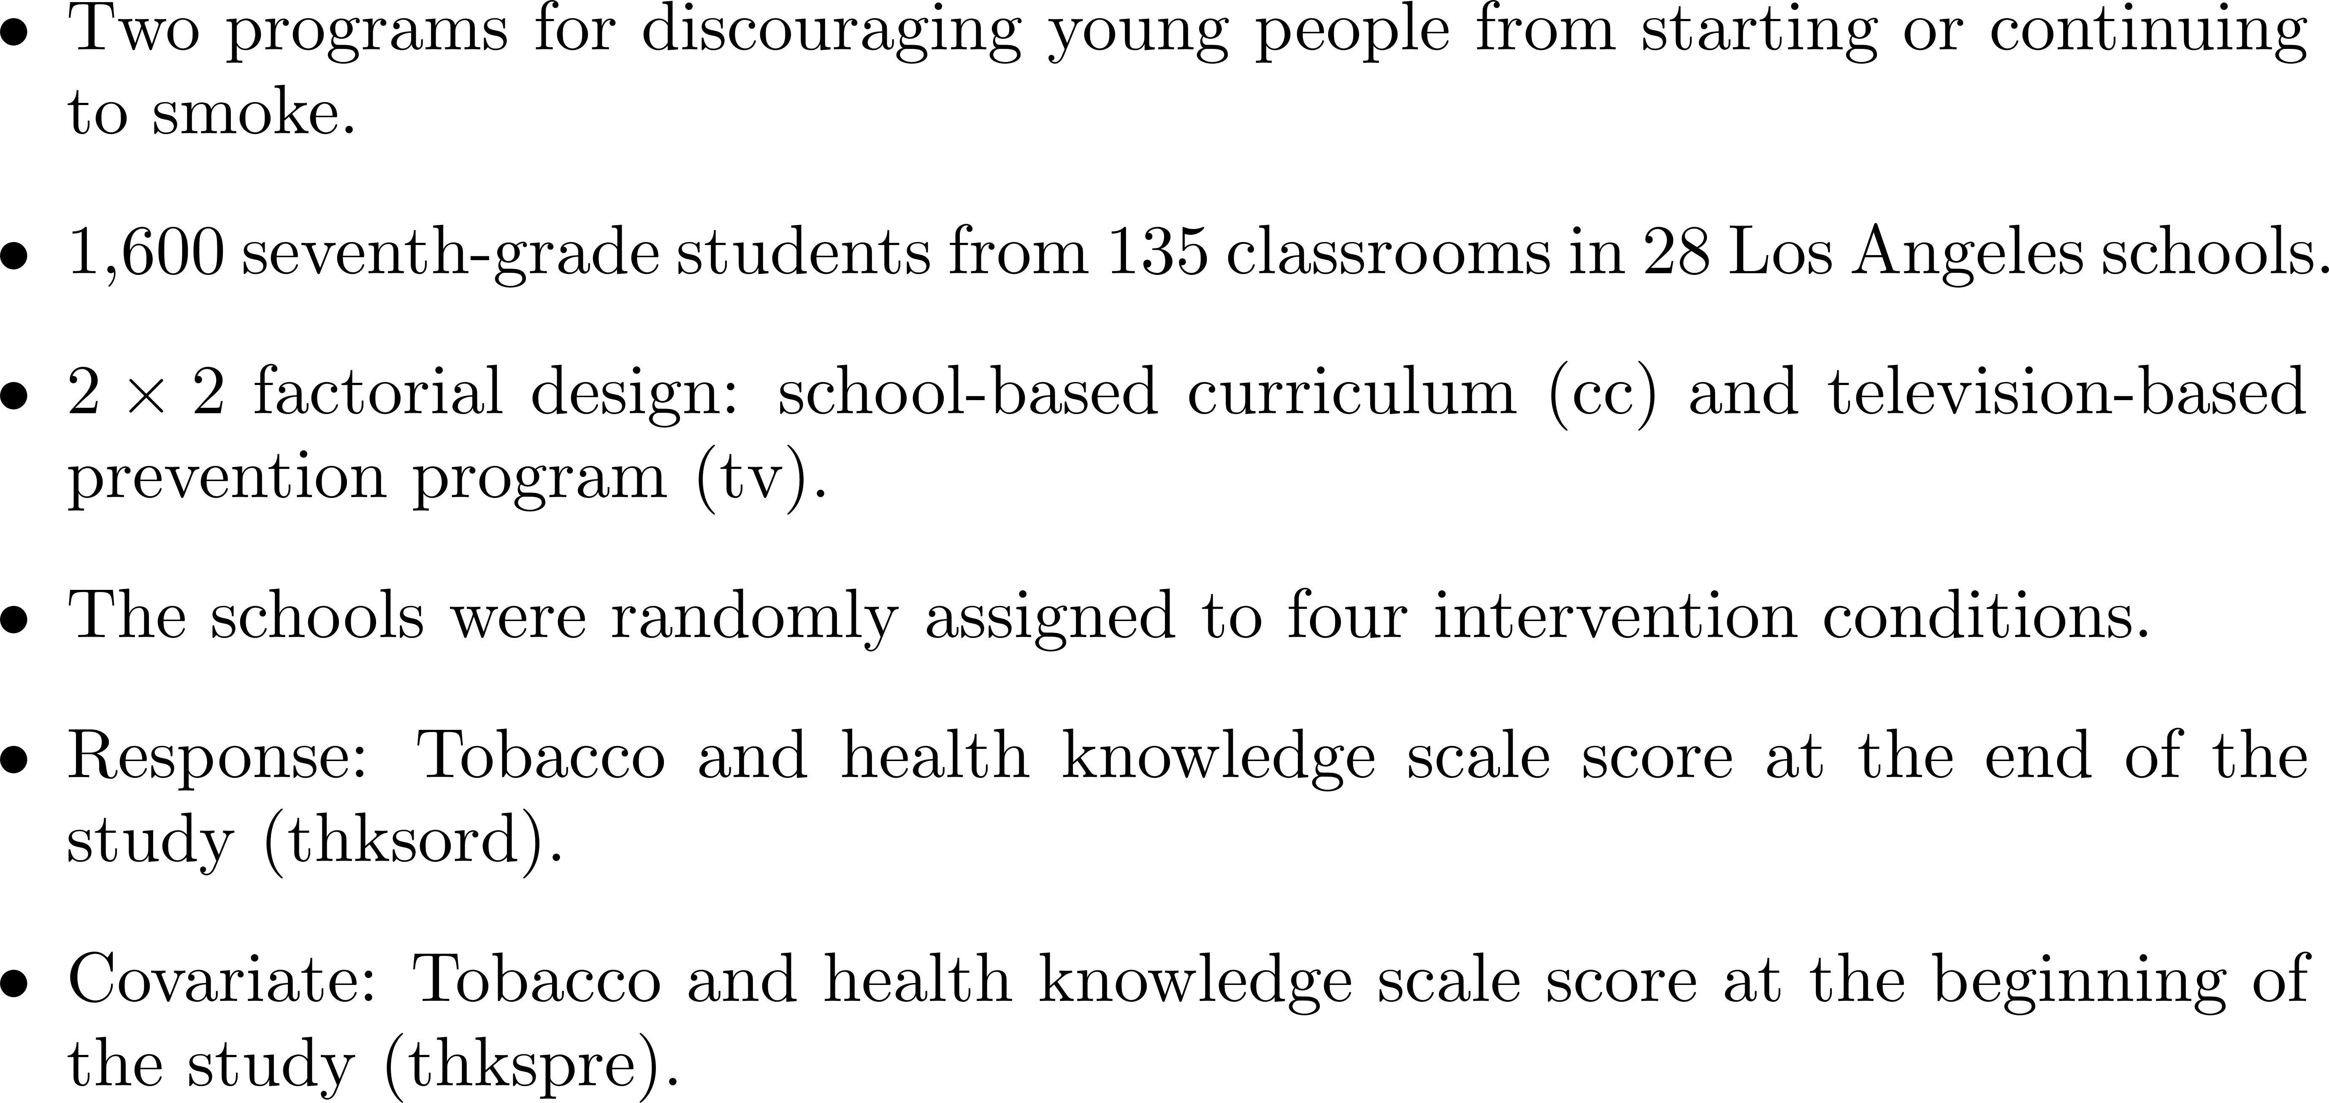
Example: Smoking Prevention and Cessation Study

Slide 23
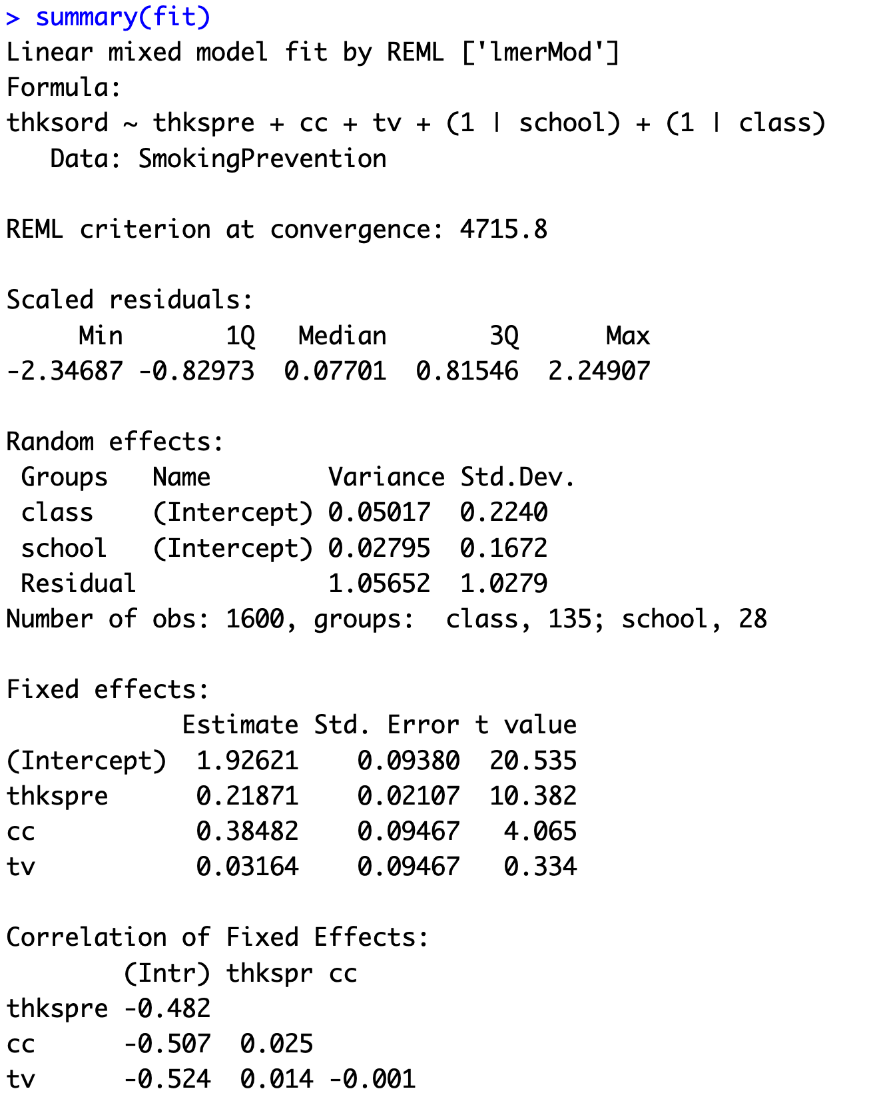
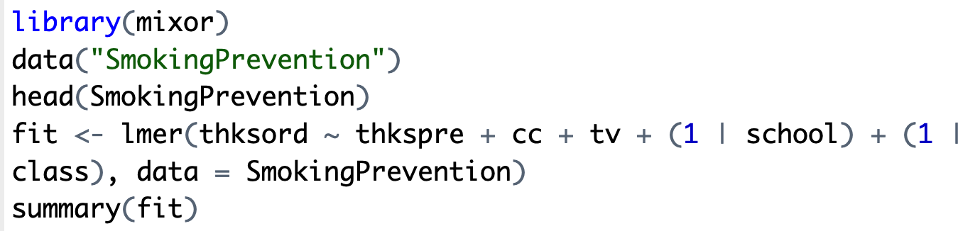
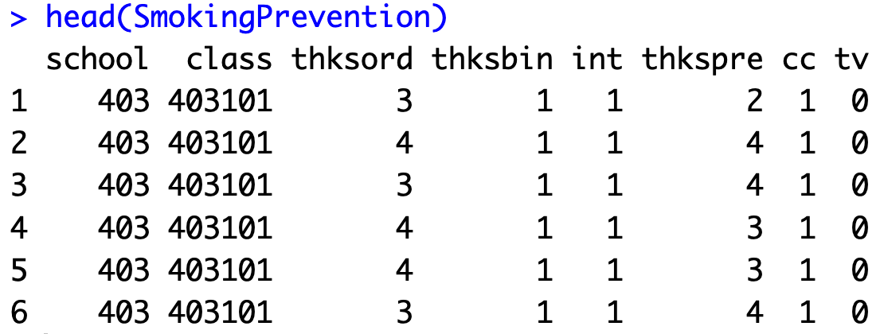
Example: Smoking Prevention and Cessation Study

Slide 24
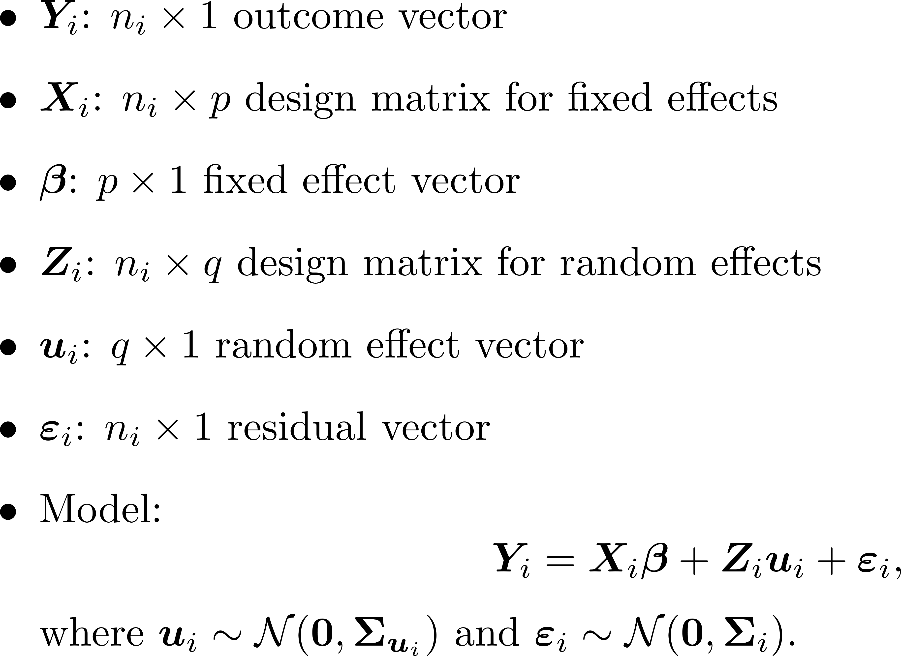
Matrix Notation for LMMs

Slide 25
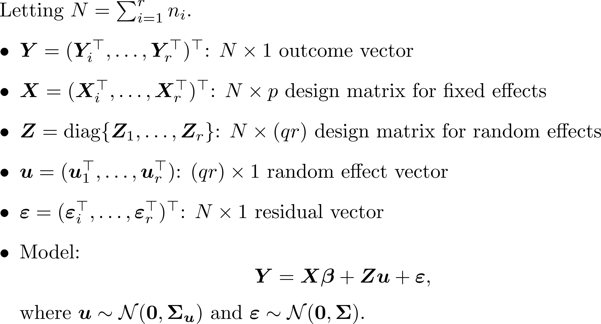
Matrix Notation for LMMs

Slide 26
Estimation of $β$

Slide 27
Inference of $β$, $H_{0}:Lβ=0$

Slide 28
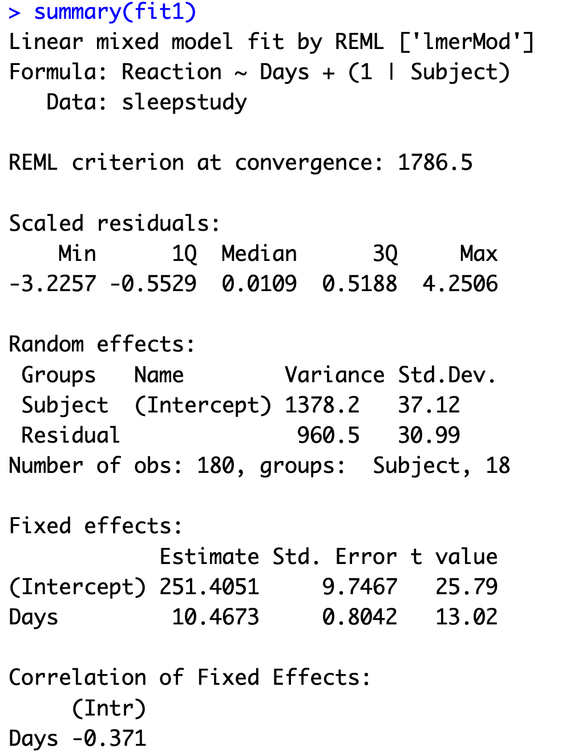
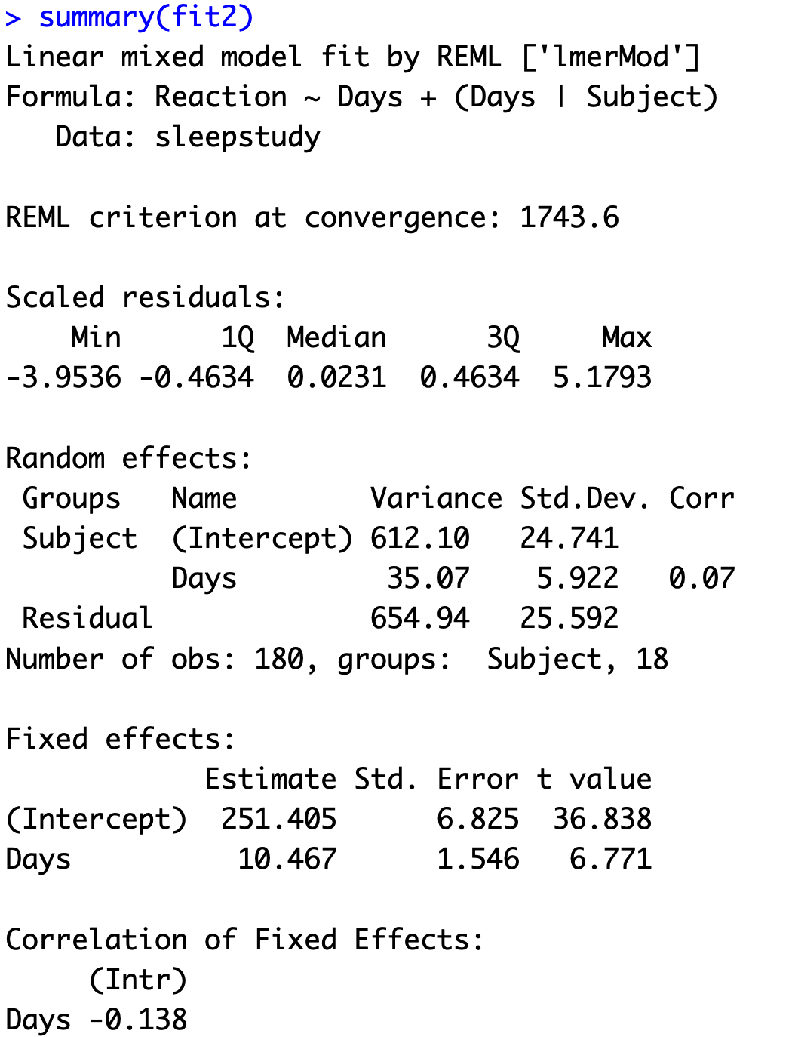
Recall the Results

Slide 29
Estimation of $V$

Slide 30
Disadvantages of ML estimation of $V$

Slide 31
Restrictive ML (REML) in Linear Regression

Slide 32
Restrictive ML (REML) in Linear Regression

Slide 33
REML in LMM

Slide 34
Comparing REML and ML

Slide 35
Estimation of $u_{i}$: BLUP

Slide 36
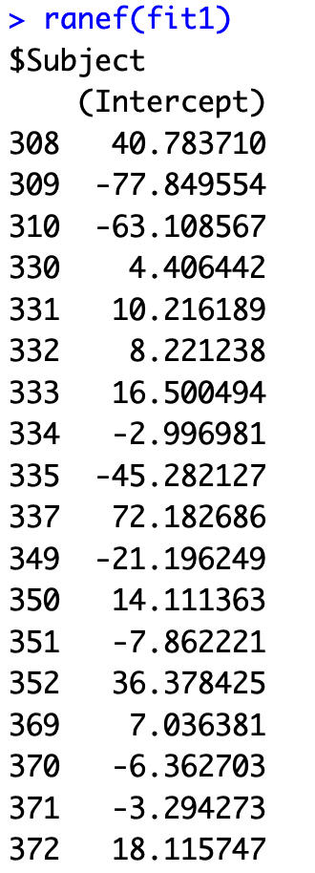
Example: Reaction Time in Sleep Study

Slide 37
BLUP and BLUE

Slide 38
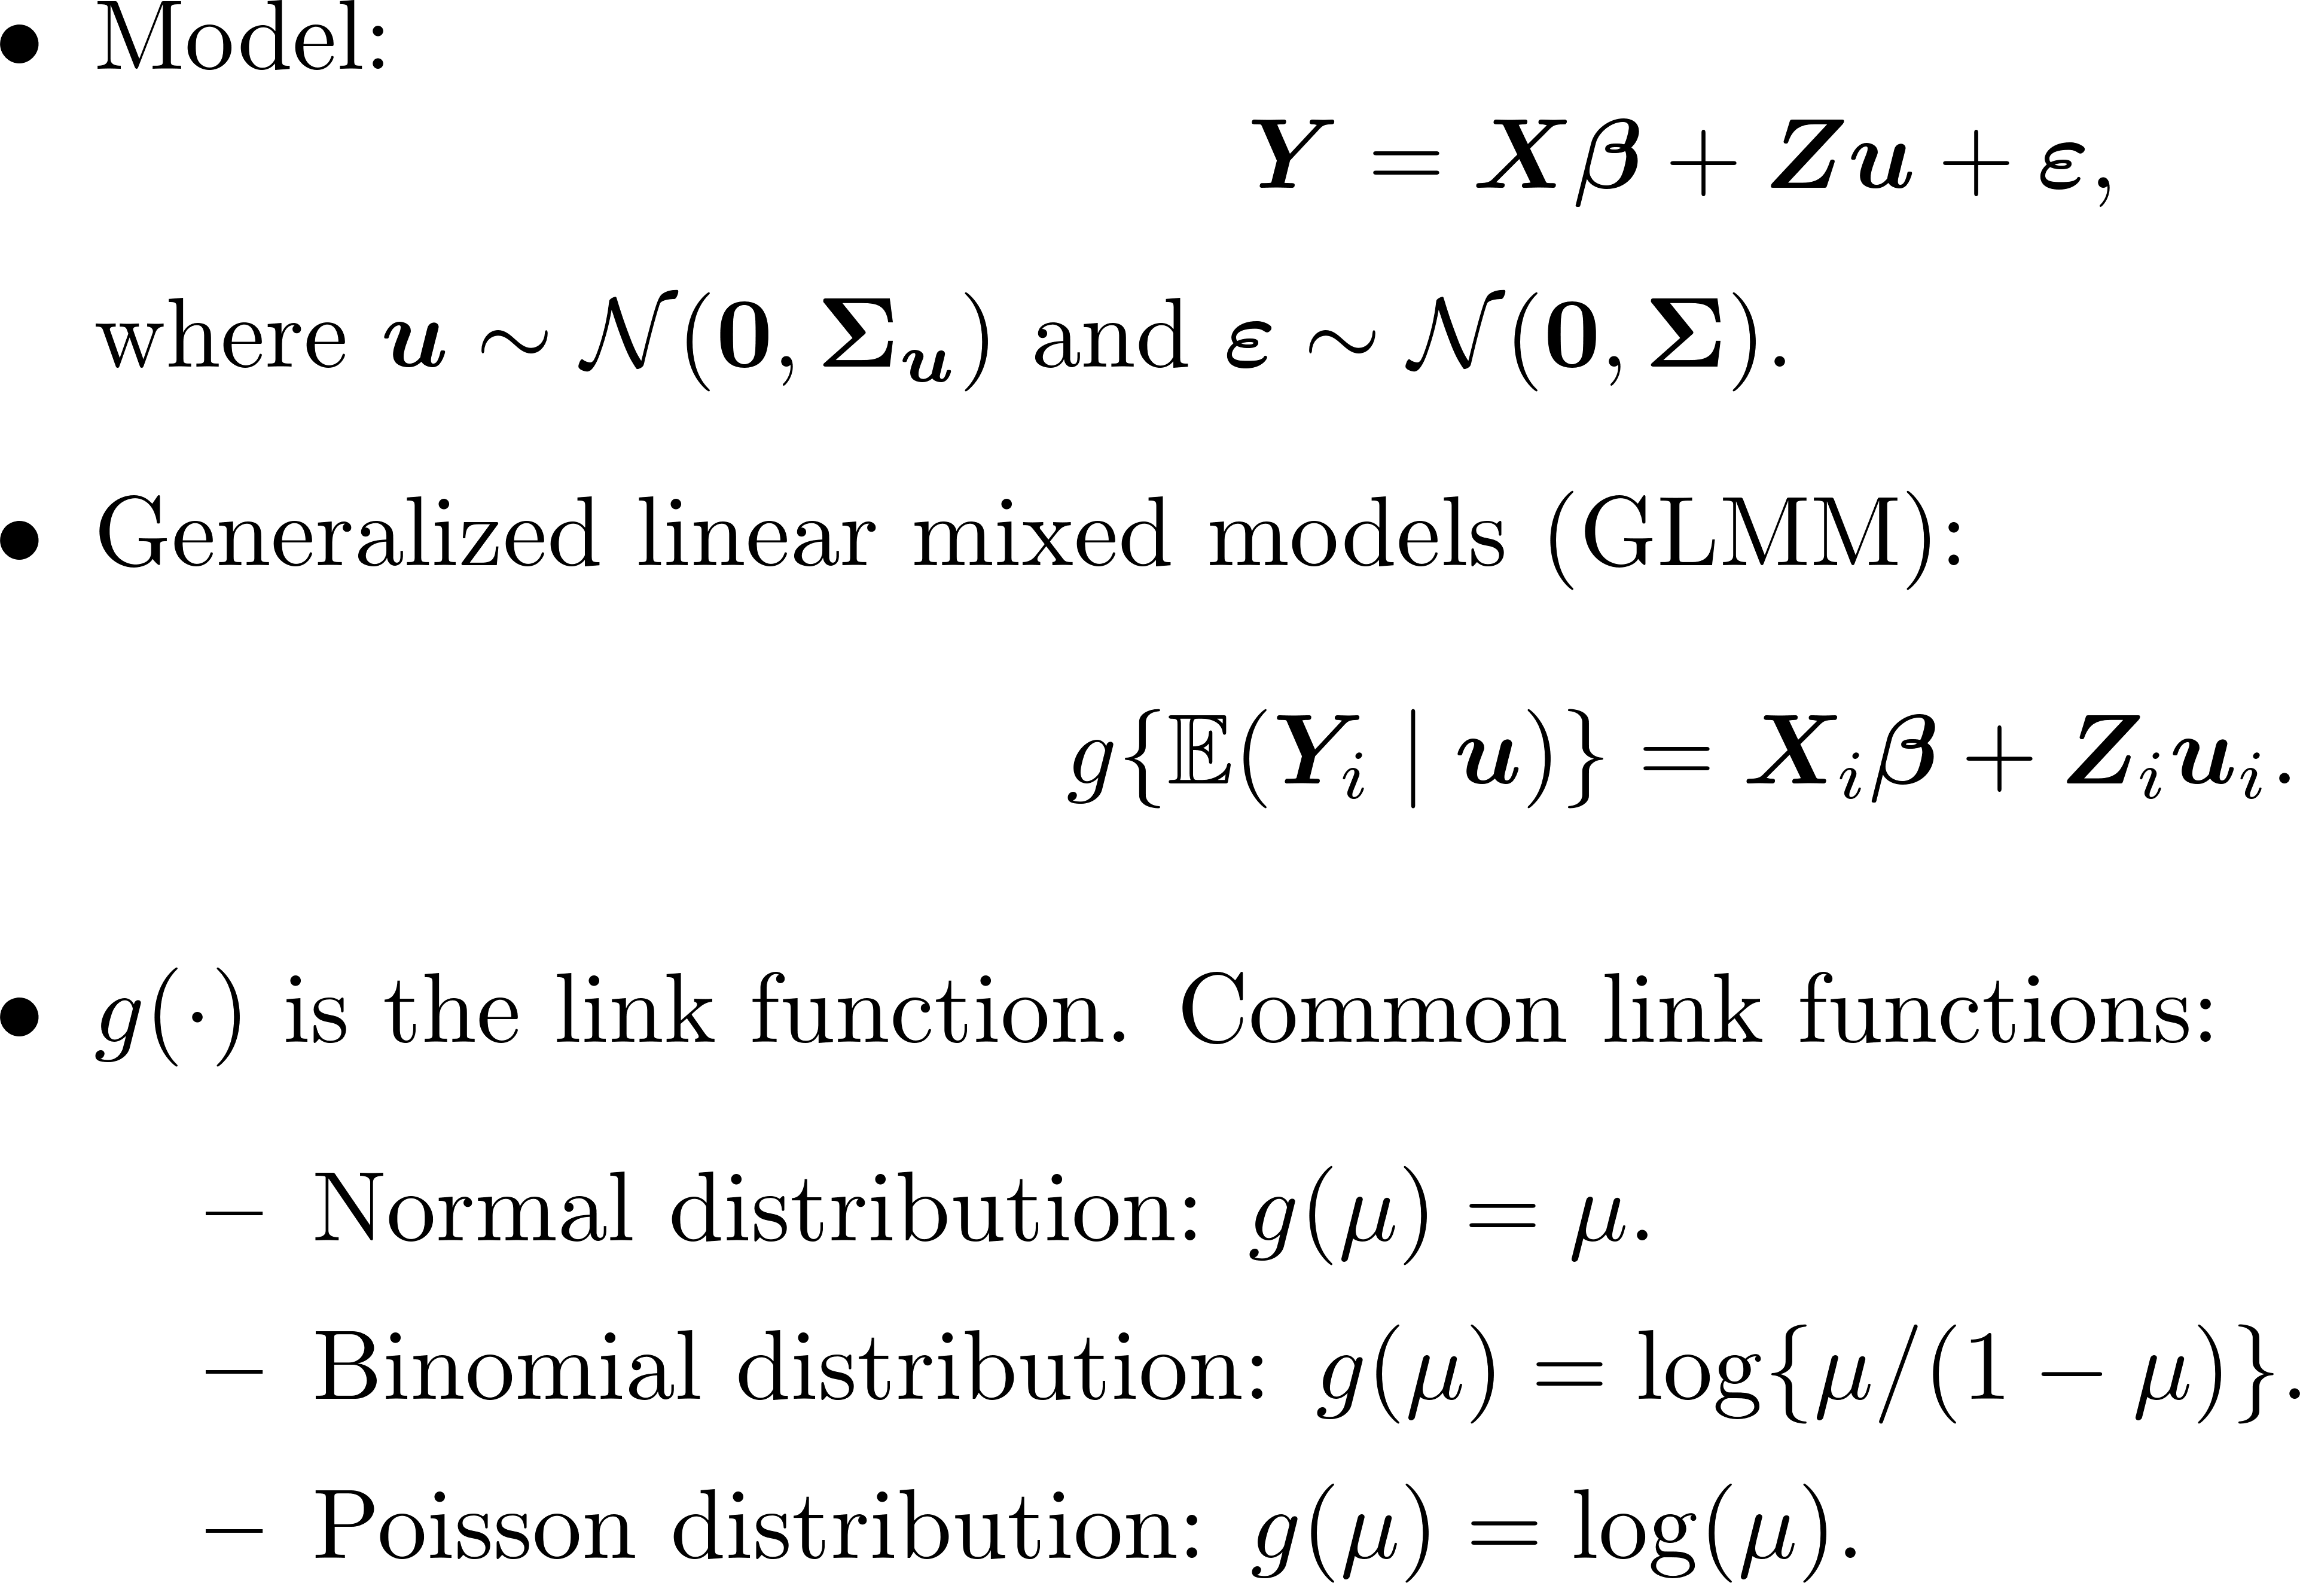
Generalized Linear Mixed Models

Slide 39
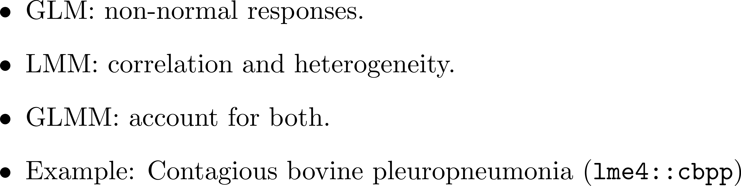
Why GLMM?

Slide 40
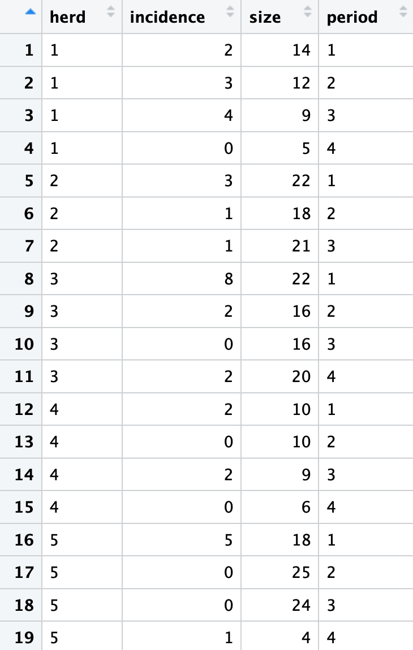
Example: CBPP
lme4::cbpp in R
Contagious bovine pleuropneumonia (CBPP) （牛传染性胸膜肺炎）
15 commercial herds in the Boji district of Ethiopia in Africa
Cluster: Herd
Period: 1–4
Incidence $Y_{i}$: Number of positive cases
Size $n_{i}$: Total number
$Y_{i}∼Bernoulli\left(p_{i}\right)$

Slide 41
Binary Data and Count Data

Slide 42
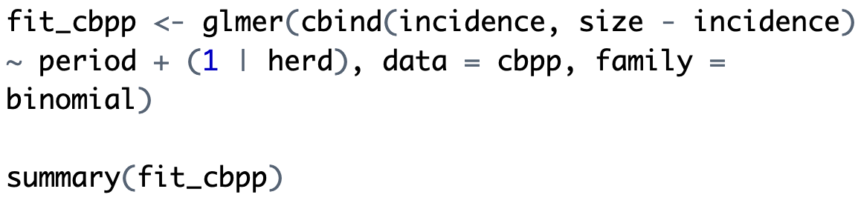
Logistic Mixed Model for CBPP

Slide 43
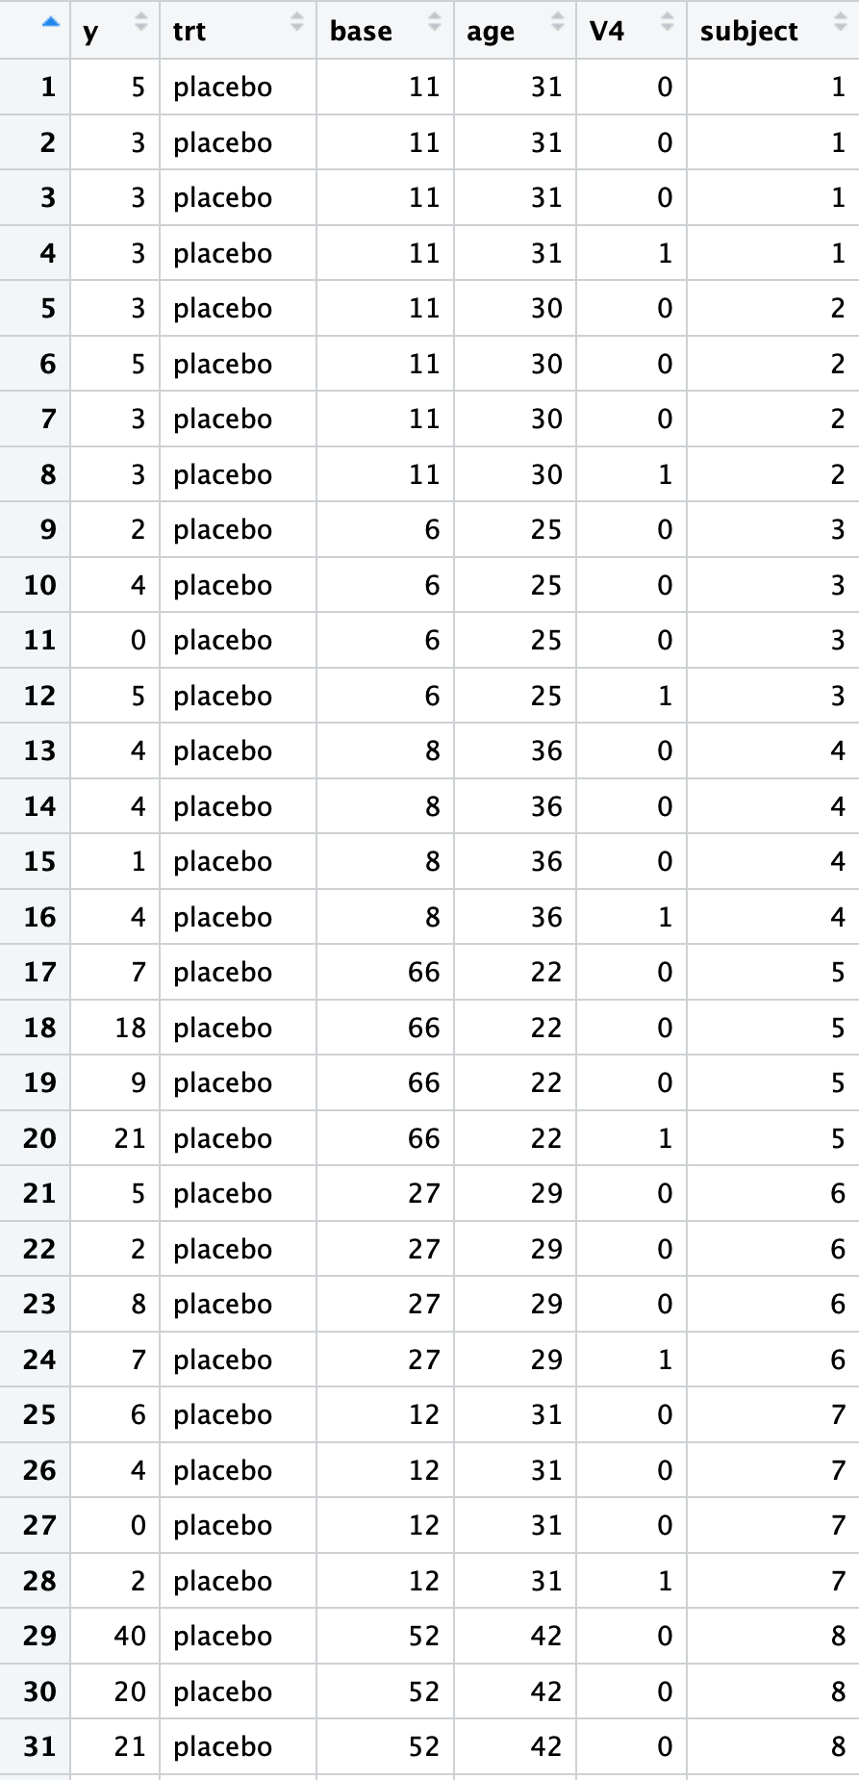
Example: Seizure Counts for Epileptics
MASS::epil in R
Seizure Counts for Epileptics（癫痫发作次数）
59 patients
y: the count for the 2-week period
trt: treatment/control
base: the counts in the baseline 8-week period
age: subject’s age, in years
V4: 0/1 indicator variable of period 4

Slide 44
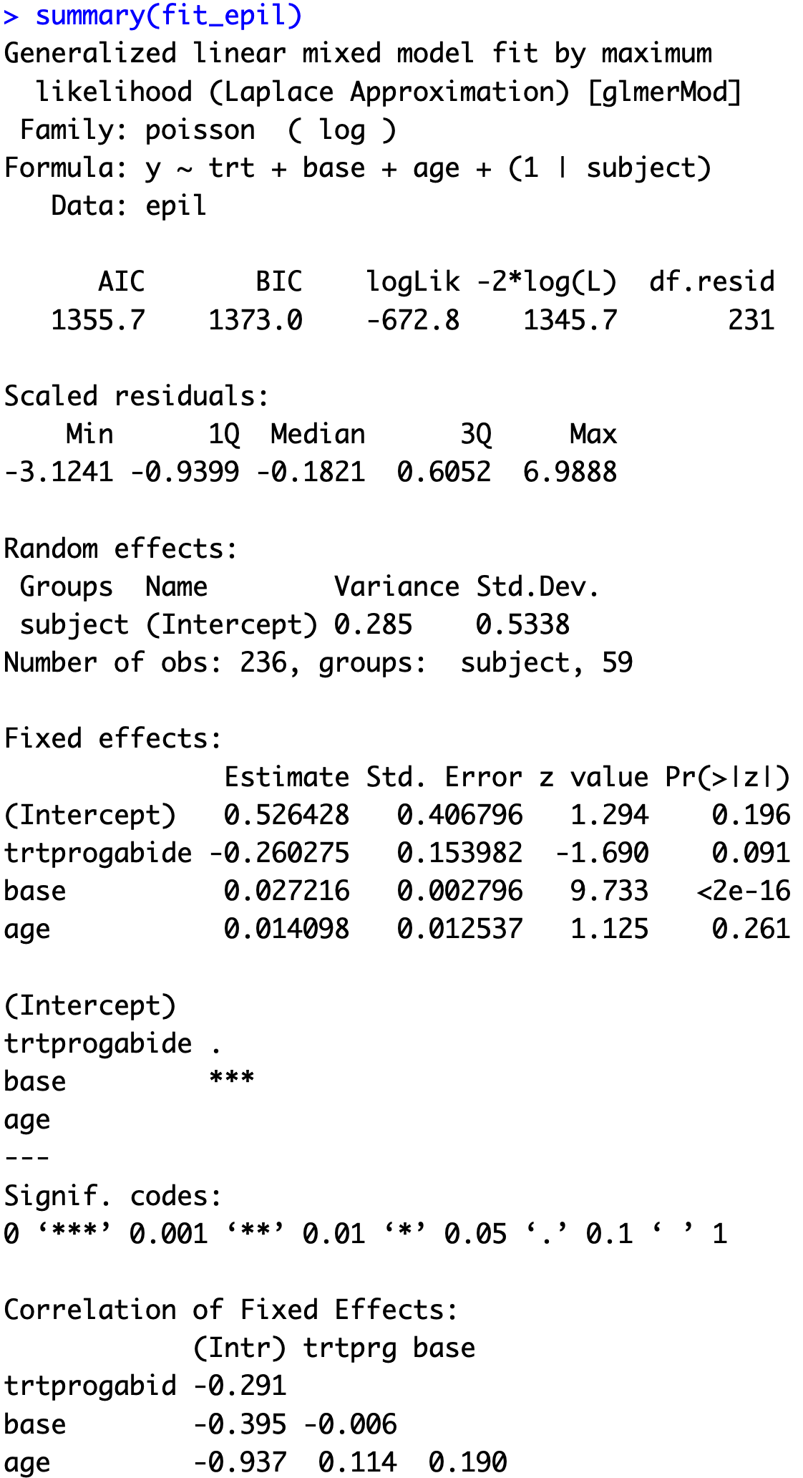
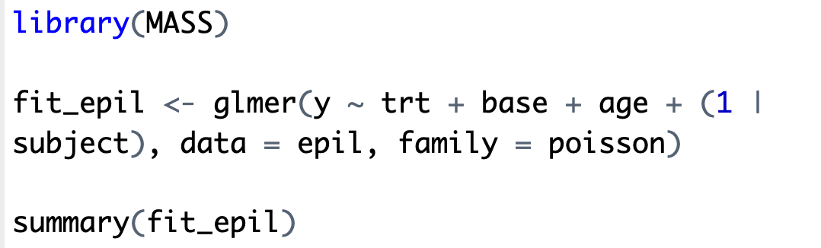
Poisson Mixed Model for epil

Slide 45
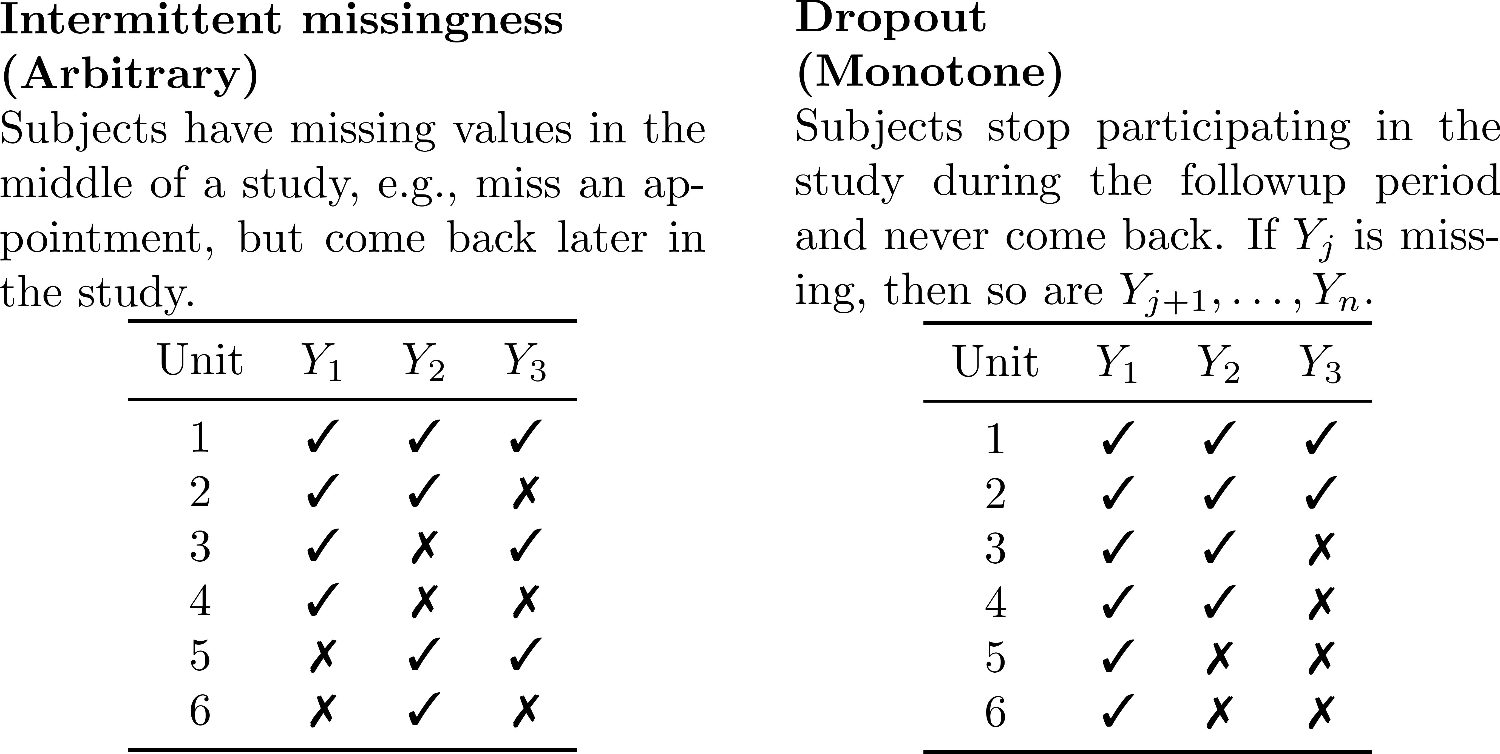
Introduction to Missing Data

Slide 46
Analysis of Missing Data
Missing data may cause biased estimates if handled incorrectly
The presence of bias and the degree of bias depend on the nature of the missing data process and the analysis methods.
Analysis of missing data in longitudinal studies requires specification of the missing data mechanism and often requires joint modeling of the outcome $Y$ and the missing data indicator $R$.

Slide 47
Example: Hedeker and Gibbons (1997)
Randomized psychiatric trial.
312 patients received drug therapies for schizophrenia; 101 patients received a placebo.
Measurements at week 0, 1, 3, 6.
Missing data primarily due to dropout.
Outcome: severity of illness (1=normal, …, 7=extremely ill); treated as continuous.

Slide 48
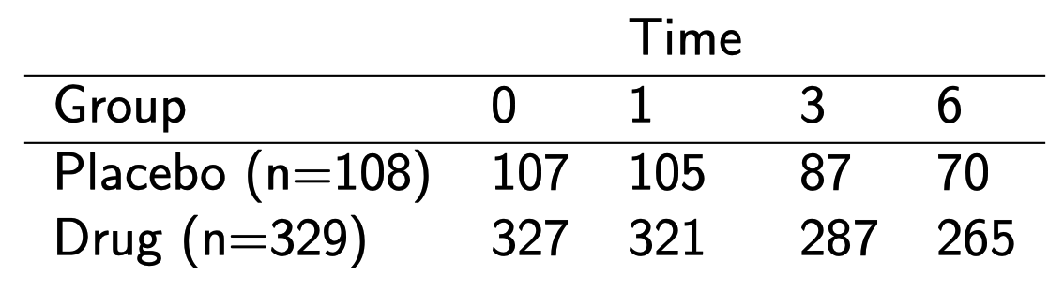
Example: Hedeker and Gibbons (1997)
Note: the drug group combines three treatments
Dropout rates:
  Placebo: 35%
  Drug: 20%

Slide 49
Missing Data Mechanisms
Missing Mechanisms (Little and Rubin, 2002)
  Missing Completely at Random (MCAR): Missingness does not depend on outcomes and covariates.
  Missing at Random (MAR): Missingness only depends on observed outcomes and covariates.
  Nonignorable/Informative/Not Missing at Random (NMAR): Missingness depends on unobserved outcomes or unobserved covariates.

Slide 50
Missing Data Mechanisms

Slide 51
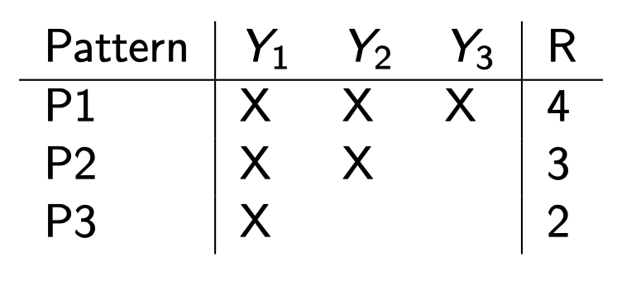
Likelihood-Based Mixed Models

Slide 52
Likelihood-Based Mixed Models

Slide 53
Summary
Definition and features of longitudinal data
Linear mixed models
  Random intercept
  Random intercept and random slope
  Hierarchical model
Inference for the parameters in linear mixed models
  Likelihood-based method
  Restricted maximum likelihood (REML)
  Best linear unbiased predictor (BLUP)
Generalized linear mixed models
Missing data

