Slide 2
Q: What are all the upgrade materials I need for Kaeya?

Slide 3
Q: What are the weapons I can use for this person?

Slide 4
Q: What characters are strong against this boss?

Slide 5
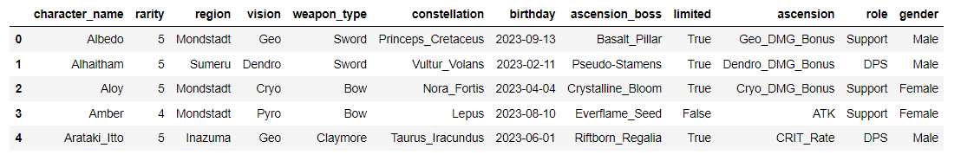
Characters.csv

Slide 6
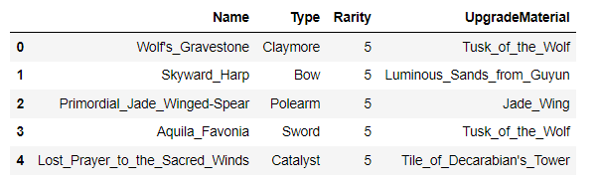
Weapons.csv

Slide 7
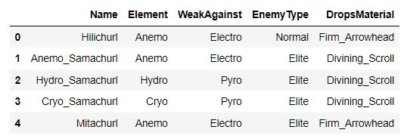
Enemies.csv

Slide 8
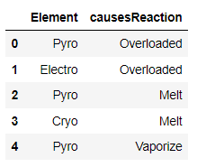
Reactions.csv

Slide 9
Dataset Creation

Slide 10
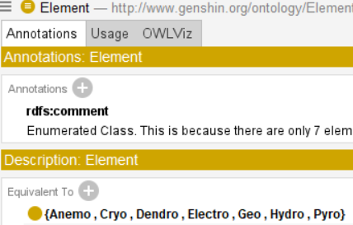

Slide 11
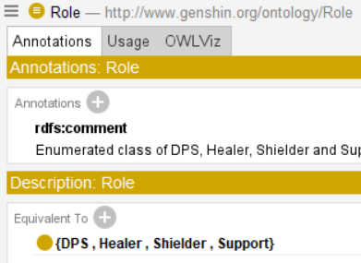

Slide 12
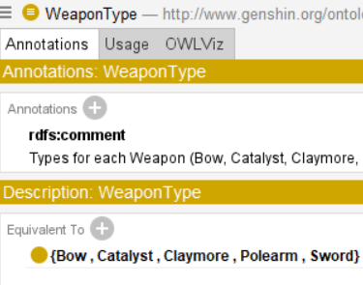

Slide 13
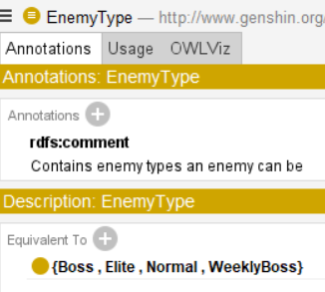

Slide 14
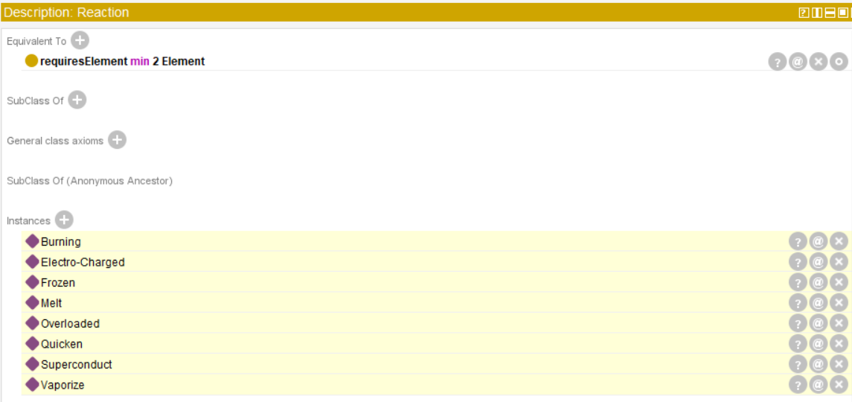

Slide 15
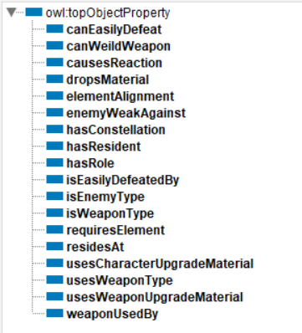
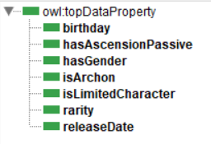

Slide 16
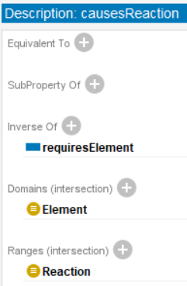

Slide 17
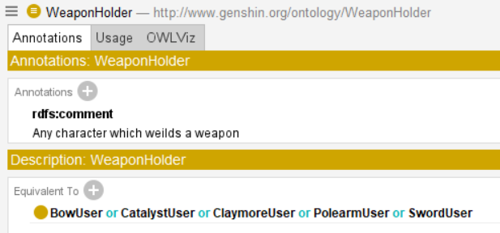

Slide 18

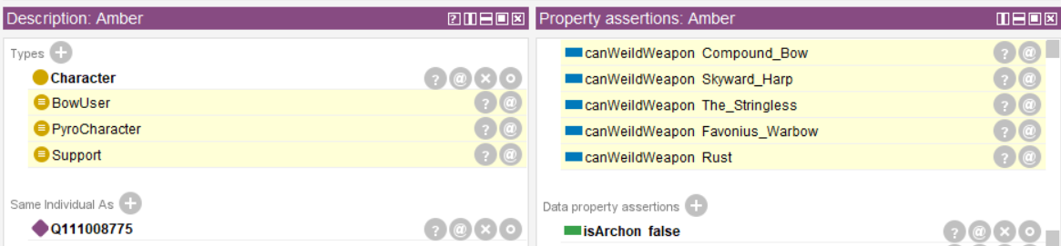
SWRL Rules
^^ 4 more SWRL rules like this one

Slide 19
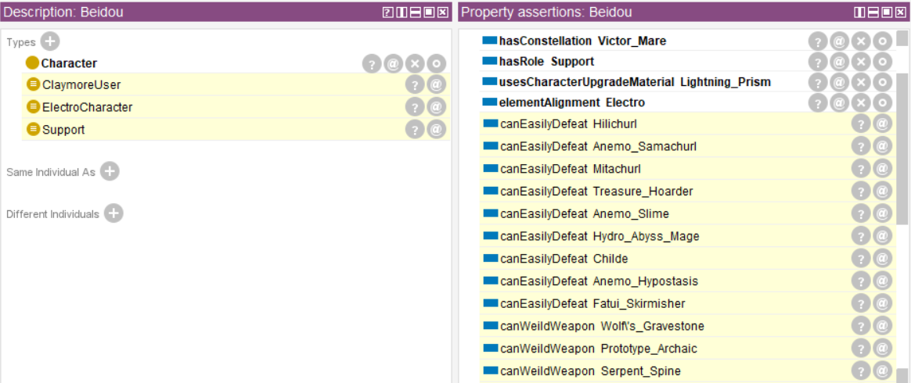
SWRL Rules

Slide 20
SWRL Rules
^^ 4 more like this one
Relation for characters that can easily defeat certain enemies

Slide 21
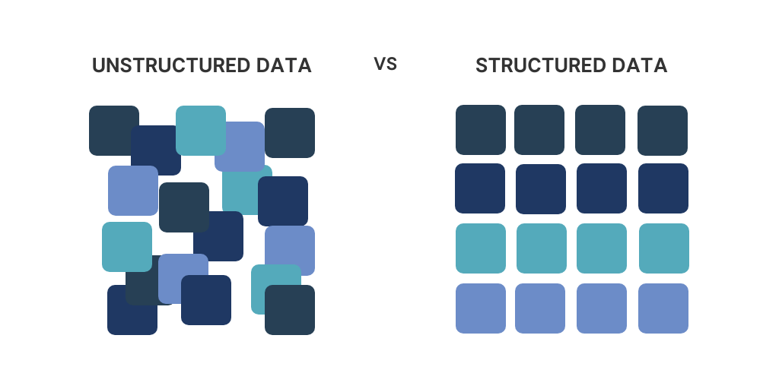
(Game, Community Wiki)
(Datasets)

