Slide 1
SOFTWARE DOCUMENTATION
ON
KEY PERFORMANCE INDICATORS
(KPI)
BY
ABDULROHEEM ABDULLATEEF

Slide 2
WHAT IS KEY PERFORMANCE INDICATORS (KPI)
Key performance indicators (KPIs) are those indicators that focus on
the aspects of organizational performance that are the most critical for
the current and future success of the organization

Slide 3
INTRODUCTION
Many companies are working with the wrong measures, many of which are incorrectly termed key performance indicators (KPIs). It is a myth to consider all performance measures to be KPIs. The confusion over whether measures are lead or lag indicators is addressed.

Slide 4
OVERVIEW
Key Performance Indicators are a series of measurements of how a business is progressing in the medium and long term. Operational managers use these indicators to find out how they are performing and what they can do to make the business operate better overall. Investors also use them when making decisions about a company's prospects for future success.

Slide 5
THE PROBLEM STATEMENT
Unclear or Unachievable KPI Goals Everybody should know the SMART method. Use it! This method helps you to clearly understand the impact of your KPIs. When you set up your KPIs, make sure that your statements are formulated clearly.
Challenge 1:

Slide 6
THE PROBLEM STATEMENT
Challenge 2:
Lack of Communication Another problem is that KPIs aren’t used or are completely ignored by employees. The reason for this is the lack of communication. Management needs to clearly communicate the benefits and the value of the KPIs as they relate to the business.

Slide 7
THE PROBLEM STATEMENT
Challenge 3:
No KPI Action Plan Setting up the right KPIs costs money, time and effort. To do it right and avoid overstraining monetary and non-monetary costs all at once, you need to break down the plan into smaller steps. Creating specific actions makes your goals clearer to others and helps them to grasp what needs to be done right away.

Slide 8
THE PROBLEM STATEMENT
Challenge 4:
Lack of Measuring KPIs You can only improve what you are measuring. But if you have no standardized way of measuring your KPIs, this is the point you’ll need to focus on. It’s key that you measure your KPIs on a regular basis in a way that doesn’t cost too much effort. Challenges That Keep You From Achieving Your KPIs

Slide 9
AIMS
1. Key result indicators (KRIs) give the board an overall summary of
how the organization is performing.
2. Result indicators (RIs) tell management how teams are combining
to produce results.
3. Performance indicators (PIs) tell management what teams are
delivering.
4. Key performance indicators (KPIs) tell management how the
organization is performing in their critical success factors and, by
monitoring them, management is able to increase performance
dramatically.

Slide 10
OBJECTIVES
To eliminate the manual appraisal calculation process
To help employee to move forward in right way in order to boost his/her career
To make sure each and every employee deserve the perfect amount of appraisal
Provide better understanding between employee and his organization
To calculate his/her performance
To make sure each and every employee should work well in order to gain a good appraisal
To have a good vibe while working in a team towards one another
Enhances a team to work together
Work well Earn well

Slide 11
ADMIN FUNCTIONAL REQUIREMENTS
Smooth running of the App is the primary function of the Admin being the overall boss of the portal.
Admin registers and supervises all the task on the portal.
The admin will validate and approve different users accounts.
He also validate and approve any users created on the portal.
Admin can create any department.
The Admin is also in the position to update, delete and remove totally of any registered employeethat does not work with the target of the organization being policy or illegal.
The admin manage and monitor the task of each employee generated from his/her department.
He gives real time accounting details through analysis and reports on the dashboard.

Slide 12
HEAD OF DEPARTMENT FUNCTIONAL REQUIREMENTS
Head of department is the one register each employee to each department.
The Head of department will validate and approve different users’ accounts.
The Head of department is also in the position to update, employee on his/her task being given with the organization policy or illegal.
The Head of department manage and monitor the employee at each department.
He gives real time accounting details through analysis and reports to admin

Slide 13
EMPLOYEE FUNCTIONAL REQUIREMENTS
The employee can register on the App which enable him or her to have full access to use App via login.
The employee can search for any department of interest on the App.
The employee can also search task of an organization being attach to him/her .

Slide 14
NON REQUIREMENT
TECHNICAL REQUIREMENT
SECURITY:
The app is protected from unauthorized access to the System . Users gain access through Email and password provided when registered and is expected of them not to disclose to third party.

Slide 15





APPLICATION ARCHITECTURE
High Level Architecture
INTERNET
EMPLOYER
EMPLOYEE
COMPANY COMPUTER
WEB

Slide 16
FUNCTIONAL REQUIMENT
Admin Functional Requirement
Can able to login/log out.
Can register an Head of department.
Can see an employee task being given.
Can delete an employee.
Can know the number of employee in the company.
Can see employee who is present in company.
Can add additional money to an employee who work very well.
Can also comment.

Slide 17
FUNCTIONAL REQUIMENT
Head of department Functional Requirement
Can able to login/log out.
Can see an employee task being given.
Can know the number of employee in the company.
Can see employee who is present in company.
Can also comment.

Slide 18
FUNCTIONAL REQUIMENT
CODE LEARNERS HUB
Employee Functional Requirement
Can able to login/log out.
Can able to see his/her task base on his/her work being done.
Can able to see his/her salary.
Can able to comment.
5. Can received an alert notification.

Slide 19
LOGIN
ADMIN FLOW CHART
VIEW DEPARTMENT
CAN SEE LIST OF HEAD OF DEPARTMENT
CAN SEE LIST OF ALL EMPLOYEE
CAN SEE EMPLOYEE TASK
COMMENT
LOGOUT

Slide 20
LOGIN
HEAD OF DEPARTMENT FLOW CHART
VIEW DEPARTMENT
CAN SEE LIST OF EMPLOYEE
ASSIGN EMPLOYEE LIST
CAN SEE EMPLOYEE TASK
COMMENT
LOGOUT

Slide 21
LOGIN
EMPLOYEE FLOW CHART
VIEW HIS/HER DEPARTMENT
CAN SEE HIS/HER TEAM MEMBER
CAN SEE HIS/HER PERFORMANCE
COMMENT
LOGOUT

Slide 22
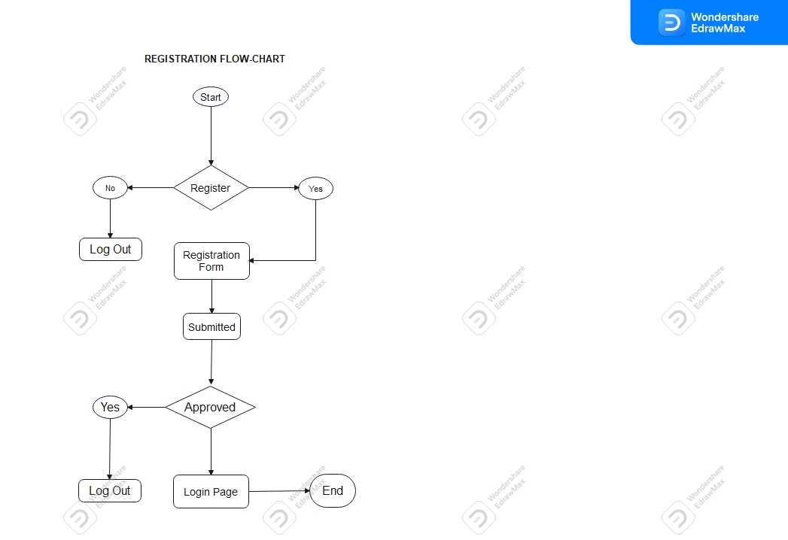

Slide 23


REGISTER/LOGIN
CODE LEARNERS HUB
ADMIN
ASSIGN TASK TO EMPLOYEE
VIEW
INDIVIDUAL
EMPLOYEE TASK
EMPLOYEE
ALLAWANCE
VIEW EMPLOYEE THAT COMPLETE THE TASK
VIEW TASK
VIEW NUMBER OF EMPLOYEE
COLLECT SALARY
EMPLOYEE
PROMOTION/TRANSFER
NOTICATION
COMMENT
LOGOUT
DELETE

Slide 24
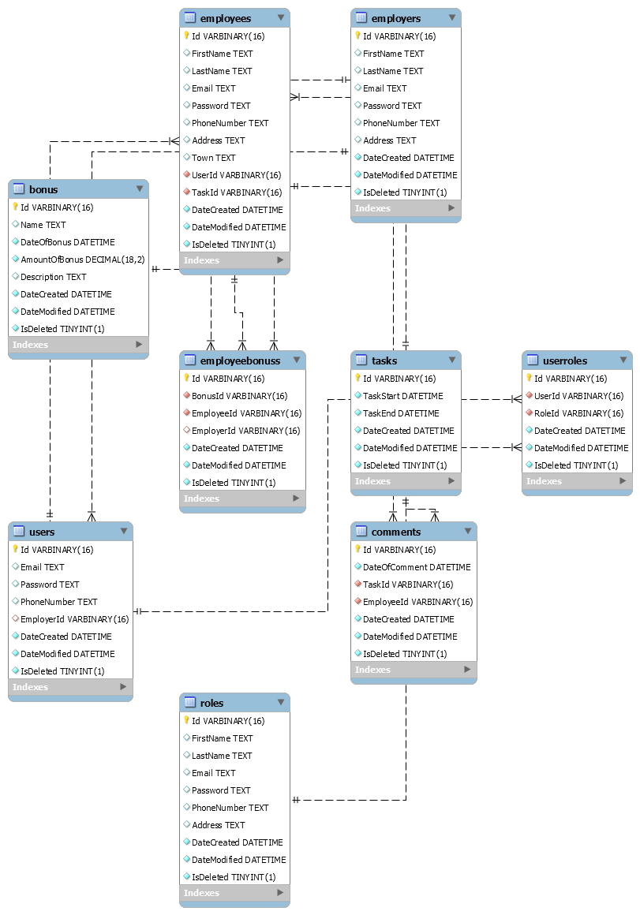
ENTITY RELATIONSHIP DIAGRAM

Slide 25
TO DO ON KPI PROJECT
View on individual employee kpi list
Each users dashboard views
Chat views
How to get individual employee kpi for month and year

