Slide 1
E-Thrift
Documentation on Thrift Management System

Slide 2
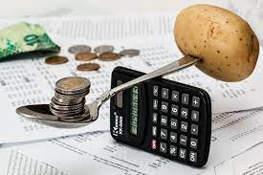
INTRODUCTION TO THRIFT
Thrift contribution which is also popularly known as ajo by the (Yoruba’s), esusu by the (Igbo) and Apache by the (Hausa’s) is a contributory thrift saving scheme among a group of people kind of saving scheme a group of people engage in.
Thrift is the money collected on a daily, weekly, and/or monthly basis by who is known as a thrift collector. Thrift collectors are typically male. Participants in the thrift must pay the thrift collector a participation fee depending on the rate to which they contribute money.
E-Thrift Collector software management system is an application that collect money from user in group or individual and the money will be return to each one of them one after the other.

Slide 3
PROBLEM STATEMENT
In current era, both thrift collectors and contributors have problem in getting in touch with each other thereby making the process strenuous for both parties.

Slide 4
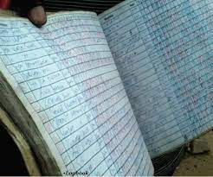
CURRENT SITUATION
INABILITY TO FIND A TRUST WORTHY THRIFT COLLECTOR
DIFFIULTY IN GETTING THE CONTRIBUTIONS FEE TO THE THRIFT COLLECTOR
CLASHES BETWEEN THE THRIFT COLLECTOR’S AND THEIR CUSTOMER AS A RESULT OF CALCULATION ERROR.
UNAVAILABLITY OF A DISCUSSION PLATFORM FOR UPDATING THE CONTRIBUTORS

Slide 5
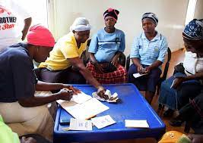
PROJECT OBJECTIVE
To develop an application that would help solve thrift calculation error.
To develop an application that would reduce thrift stress.
To develop an application that would help in keeping both thrift collectors and contributors updated.
To develop an easily accessible application for thrift collectors and their customer.

Slide 6
REQUIREMENT
FUNCTIONAL REQUIREMENT
NON FUNCTIONAL RERQUIREMENT

Slide 7
FUNCTIONAL REQUIREMENT
As a customer, I should be able to:
Register.
Login.
View all the package of thrift.
Select my packages.
Create package, if authorize by admin.
Change packages.

Slide 8
FUNCTIONAL REQUIREMENT FOR ADMIN
As an admin, I should be able to
Login to the app.
Approve register user.
Create packages.
View all customer in each packages.
Authorize new package created by customer.

Slide 9
Technical REQUIREMENT
Accessibility : The system will be accessible for all individual who have interest in the application.
Reliability : the system will be very reliable to its customer .
Network :The application requires internet connectivity to access some of its features.
INTEROPERABILITY: The system will be able to run on any operating system, be it web browser or technical devices.

Slide 10
LOW LEVEL DIAGRAM
LOW LEVEL
DIAGRAM

Slide 11
ACTIVITY FLOW
ACTIVITY FLOW
CHART

Slide 12
LOGIN FLOW CHART
Start
Enter to the website
Have an account
No
Register
Yes
Login
Submit
Email and password valid
Enter Email and password
Yes
Logged in to the system
Stop

Slide 13
PACKAGE APPROVAL FLOW CHART
Login
Click on Non-Approved Package
Select Package To Approve
Select Package
Create new package
View Package Information
Click Approve Button

Slide 14
Payment Flow Chart
Start
Login
Select Desired Package
Read terms and condition of the Package
Agree with the terms and condition
No
Decline
Yes
Pay for Package

Slide 15
ADMIN USE CASE DIAGRAM
Login
APPROVE PACKAGE
View Approved PACKAGE
View Non-Approved PACKAGE
View Customer

Slide 16
User USE CASE DIAGRAM
Register
Login
Check Packages
Join Packages
Create Packages

Slide 17
HIGH LEVEL DIAGRAM

Slide 18





USE CASE DIAGRAM
DATABASE
E-THRIFT MANAGEMENT SYSTEM

Slide 19
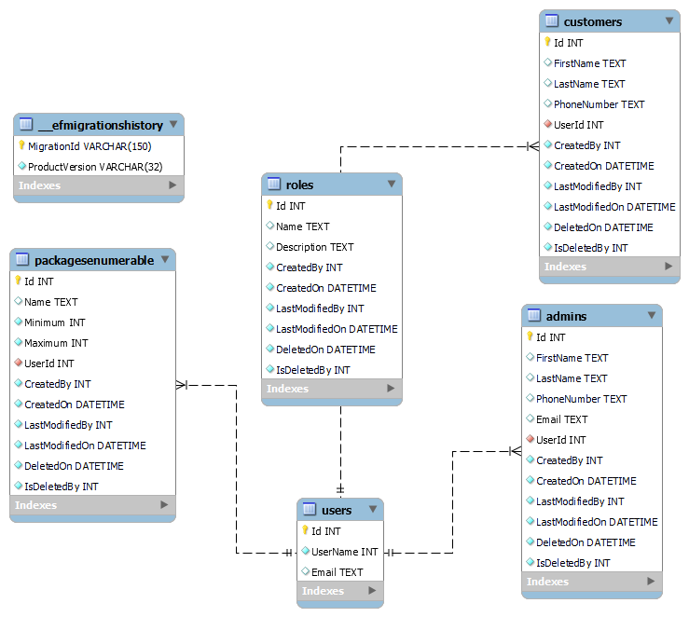

Slide 20
customer
Login
SignUp
SeeAllPackag
Create your own package
If package is completed
Generate number
JoinPackage . listen to terms and condition
Using paystack and the implemented number the number will be given to them one by one

