Slide 1
SOFTWARE DOCUMENTATION TITLE => HETISSENTIAL
© YUSUF MASROOR-AHMAD

Slide 2
INTRODUCTION
Hetissential is a software and internet based system that revolves round in locating health service within an area for emergency and non emergency purpose. Thus, it will be a health directory place. This Application will be a huge benefit to people who don’t know the Service Rendered by an health Center to locate and know the services provided by the health centers. Each of the location will be based on Google map service for ease location, such that health facility can be easily located.

Slide 3
PURPOSE
Hetissential purpose is to serve as intermediary Directory for users to Locate health Centers of their choice, to view the services provided by the health centers. Facilities and type of medical investigation carried out

Slide 4
SCOPE
Hetissential focuses on the state and wellbeing of the user in such a way that a user login in to the app and find nearest health center that suits the user view service offered by the health centers, know the hours of service, user can also contact or message on whatsapp for swift reply. Hetissential will also provide health education and health information service to it`s user .

Slide 5
OBJECTIVES
Hospital locator service
Pharmacy locator
Medical Equipment stores Locator
Health Education and Information Service
Accident and Emergency service Escalation
Ambulance service.

Slide 6
Admin Functional Requirement
Assigned Admin will sign up or Register into The app
He can Register Sub-Admin of the
Admin will be Responsible for The Regular Update of the of the Application
Admin will be able to delete or update health center details
Admin will be able to send mails to the users.
Admin can also connect user to their Respective health centers.

Slide 7
USER FUNCTIONAL REQUIREMENTS
User will Login into the system
User will Search for nearby health centers
User will view the service offered by each health centers
User can also make payment on reaching the health center or make a physical payment
Users can Sign up or Register into the application for further Interaction with the health centers

Slide 8
Software Requirements
INTERNET
PAYMENT GATEWAY
DATABASE
Multiplexing and de–multiplexing libraries.

Slide 9

User Use Case Diagram
Users
Start
Login
Search Nearby Health centers
View health Centers service
Get feed back from the admin
Can make Payment
Can Register or Sign up
END

Slide 10

ADMIN USE CASE DAIGRAM
START
Admin
Sign up or Register
Add Sub -Admin
Add New Features OR Updates on the Application
END
Delete or Update Health center Details
Logout

Slide 11




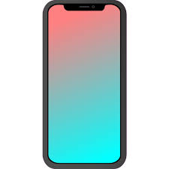
HIGH LEVEL DAIGRAM
Database
Users
Internet
Admin
Cloud
Health Center System
Mobile Responsiveness

Slide 12
Login Flow Chart Diagram
END
START
The process Start all over
The user is redirected to his page
No
A Login Page is Displayed
A Login Success Message is Displayed
Check if the login information Exist
yes
The user fills in the login page
The Process is delayed for verification
Submits the form

Slide 13
Flow Chart Diagram
START
Login
Search for Health Centers
Choose Health Center
View Service Rendered
End
Can Make Payment

Slide 14
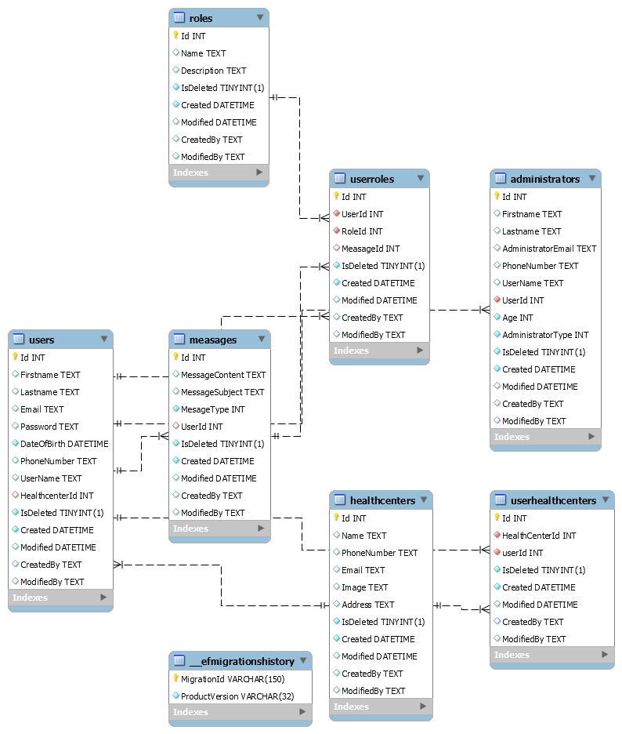
ENTITY RELATIONSHIP DIAGRAM

Slide 15
END

