Slide 1
The Logophilia An application built for The Love Of Words
CODELEARNERSHUB
Software Documentation And Analysis
© Saula Sheriffdeen Olamilekan

Slide 2
The Problem Statement
The English Language is a language used as a medium of communication in every sector of the world.
Thus, its importance is overwhelming to discuss, but the knowledge of this language is less accessible and its inaccessibility is a development of a social problem identified as “Communication Incompetency”. The emergence of technology has helped to solve this problem in its best way, but the existing tools to solve this problem are inaccessible due to the following reasons:
Inaccessibility to existing tools that seek to solve this problem, e.g. (Financial inaccessibility, Inaccessibility due to physical challenges)
Lack of user-consciousness (i.e.: non-user oriented but profit-oriented) known with applications that are existing for this solution.
CODELEARNERSHUB

Slide 3
Current State
The Application, The Logophilia: An Application Built For The Love Of Words identifies the problem of a defaulting ability of communication in the English Language, common amongst the human society, which is owned to the above reasons stated in the Slide 2 of this presentation, which this application seeks to solve.
CODELEARNERSHUB

Slide 4
Introduction
CODELEARNERSHUB

Slide 5
Application Overview
The Application, The Logophilia : An Application Built For The Love Of Words is a vocabulary development application, which is focused on the development of the fluency of communication in the English Language with target to eradicating the problem of Communication Incompetency.
CODELEARNERSHUB

Slide 6
Application Purpose
The Application, The Logophilia: An Application Built For The Love Of Words is developed with the sole purpose of building a platform for the discovery of individual ability of fluency in communication in the English Language.
CODELEARNERSHUB

Slide 7
Application Scope
The Logophilia focuses on achieving the purpose of vocabulary development of its users, and harnessing the love for the English Language, through the Dictionary feature it has with which users can look up for words new to them.
Additionally, The LoGophilia gives the platform for competition between its users, which enables the user in measuring the position and rate at which he or she has been able to develop through the platform.
CODELEARNERSHUB

Slide 8
OBJECTIVES
TO help reduce the rate of illiteracy.
To serve as a reference tool for stakeholders of education
To help in creating the passion for enhancing vocabulary development.
To exist as a platform that serves as a source of joy for students in quest for knowledge
CODELEARNERSHUB

Slide 9
OBJECTIVES
TO help in harnessing the confidence of users in the ability of fluency in communication in the English Language.
To provide a global platform where competitions are created to foster eagerness in learning and participation in healthy challenges.
CODELEARNERSHUB

Slide 10
Application Requirements
CODELEARNERSHUB

Slide 11
Functional Requirements
CODELEARNERSHUB

Slide 12
User’s Functional Requirements ( The User-Story)
The application user can register into the system
The application allows users to create and engage in educative discussions, created by such user or other users of the application.
The application allows its user to search words, via voice search and text search
The application features rendition of the search result of words in audio format and visible text forms
The application provides its users access to word games
The user has access to viewing the result of the quizzes and games partake in
CODELEARNERSHUB

Slide 13
User’s Functional Requirements ( The User-Story)
The user can search and learn about the language of origin (etymology) of words and history about them.
The user can participate in contests like Spelling Bee which rates a user with other users of the application
Can view the leaderboard of the competitions.
Can access words of the day
The user has access to documenting the words he discovers and access them.
Can meet and greet other users.
The user can Log Out Of The Application.
CODELEARNERSHUB

Slide 14
Admin’s Functional Requirements
The Application Main Administrator Can Register Into The System
He can register Sub-Administrators
He can create games
The application administrator has the responsibility of sending notifications of new games
The administrator and the Sub-Administrators can create competitions
He can update Application Users To partake in competitions
He can make the update of the Competition Leaderboards
He can regulate the Comment and Post Contents of users
He can Soft-delete users
CODELEARNERSHUB

Slide 15
Non-Functional Requirements
CODELEARNERSHUB

Slide 16
Technical Requirements
SECURITY
The application requires the E-mail of the user and the Password for Authentication (collecting information about the user) and Authorization (allowing the user to perform some actions in the system) of the user in the application through these required information that are registered by the user while registering into the system.
These user information are expected to be secured from external access .
NETWORK
The application requires internet connectivity for access to some of its features.
CODELEARNERSHUB

Slide 17
Technical Requirements
USER INFORMATION
The application sends mails and notifications to its users via their E-Mail Service Clients (e.g. Gmail) registered into the system.
Thus, the application requires that the information supplied are not falsified.
PROJECT DURATION
This project is scheduled to hold for the minimum duration of 21 days
CODELEARNERSHUB

Slide 18
future improvements
The application in its subsequent versions would include the following features:
Voice Search
Game Creation And Playing
Word Games
User Competitions
Social-Media Interaction Platform
CODELEARNERSHUB

Slide 19
APPLICATION ARCHITECTURE
CODELEARNERSHUB

Slide 20
High Level ARCHITECTURE
CODELEARNERSHUB

Slide 21






THE APPLICATION USER’S APPLICATION USAGE OBJECTIVES
This is a pictorial representation of the application features which the user has access to, in usage of the application.
CODELEARNERSHUB

Slide 22


User Search Cycle
The Application User
The logophilia
Interacts with the application through his mobile devices
Sees the search result in text or audio format
The Application takes the request and interacts with the Cloud (a store of information) to process the user request from which the result to the search is sourced
Receives the search result

Slide 23
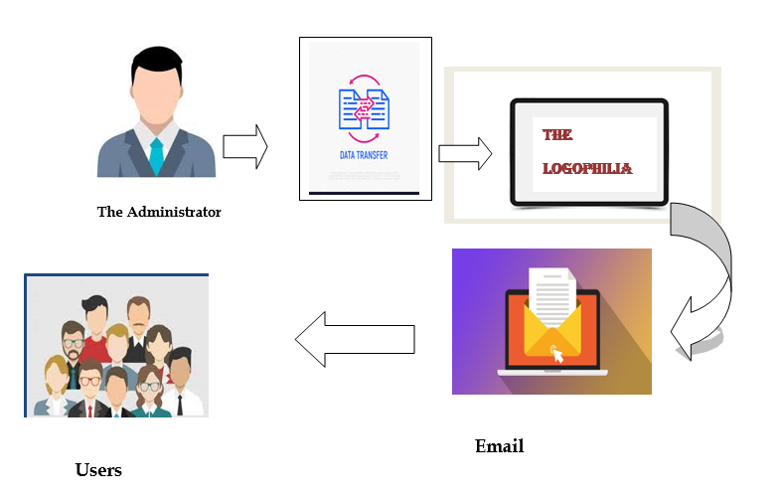
The Administrator Serves as a medium of information transfer between The Application And Its Users Via the Email Service
CODELEARNERSHUB

Slide 24
Low Level ARCHITECTURE
CODELEARNERSHUB

Slide 25
Register Into The Application
Can Join Discussions Created By Users
The user can meet and greet other users via its social-media interaction feature
Use Case Diagram
Can Learn About The Evolvement Of Words Through The Language Of Origin
Search For Words Via Text Search
The user has access to information from the application’s admin via E-mail
The user can document the vocabularies he learns and
Can access them
Can Access Words Of The Day
Create Educative Discussion
Can Log In And Log Out Of The Application
Learn how words are developed
Application User
CODELEARNERSHUB

Slide 26
Register Into The Application
Can Log In And Log Out Of The Application
Use Case Diagram
Can Update The Application’s Contest Leaderboard
Can Register Sub-Administrators
Can Only Soft-Delete Users Of The Application
Can Regulate The Contents Of The User Posts
He And Sub-Administrators are Responsible For Mailing The Users Of The Application About Contests
Application Administrator
CODELEARNERSHUB

Slide 27
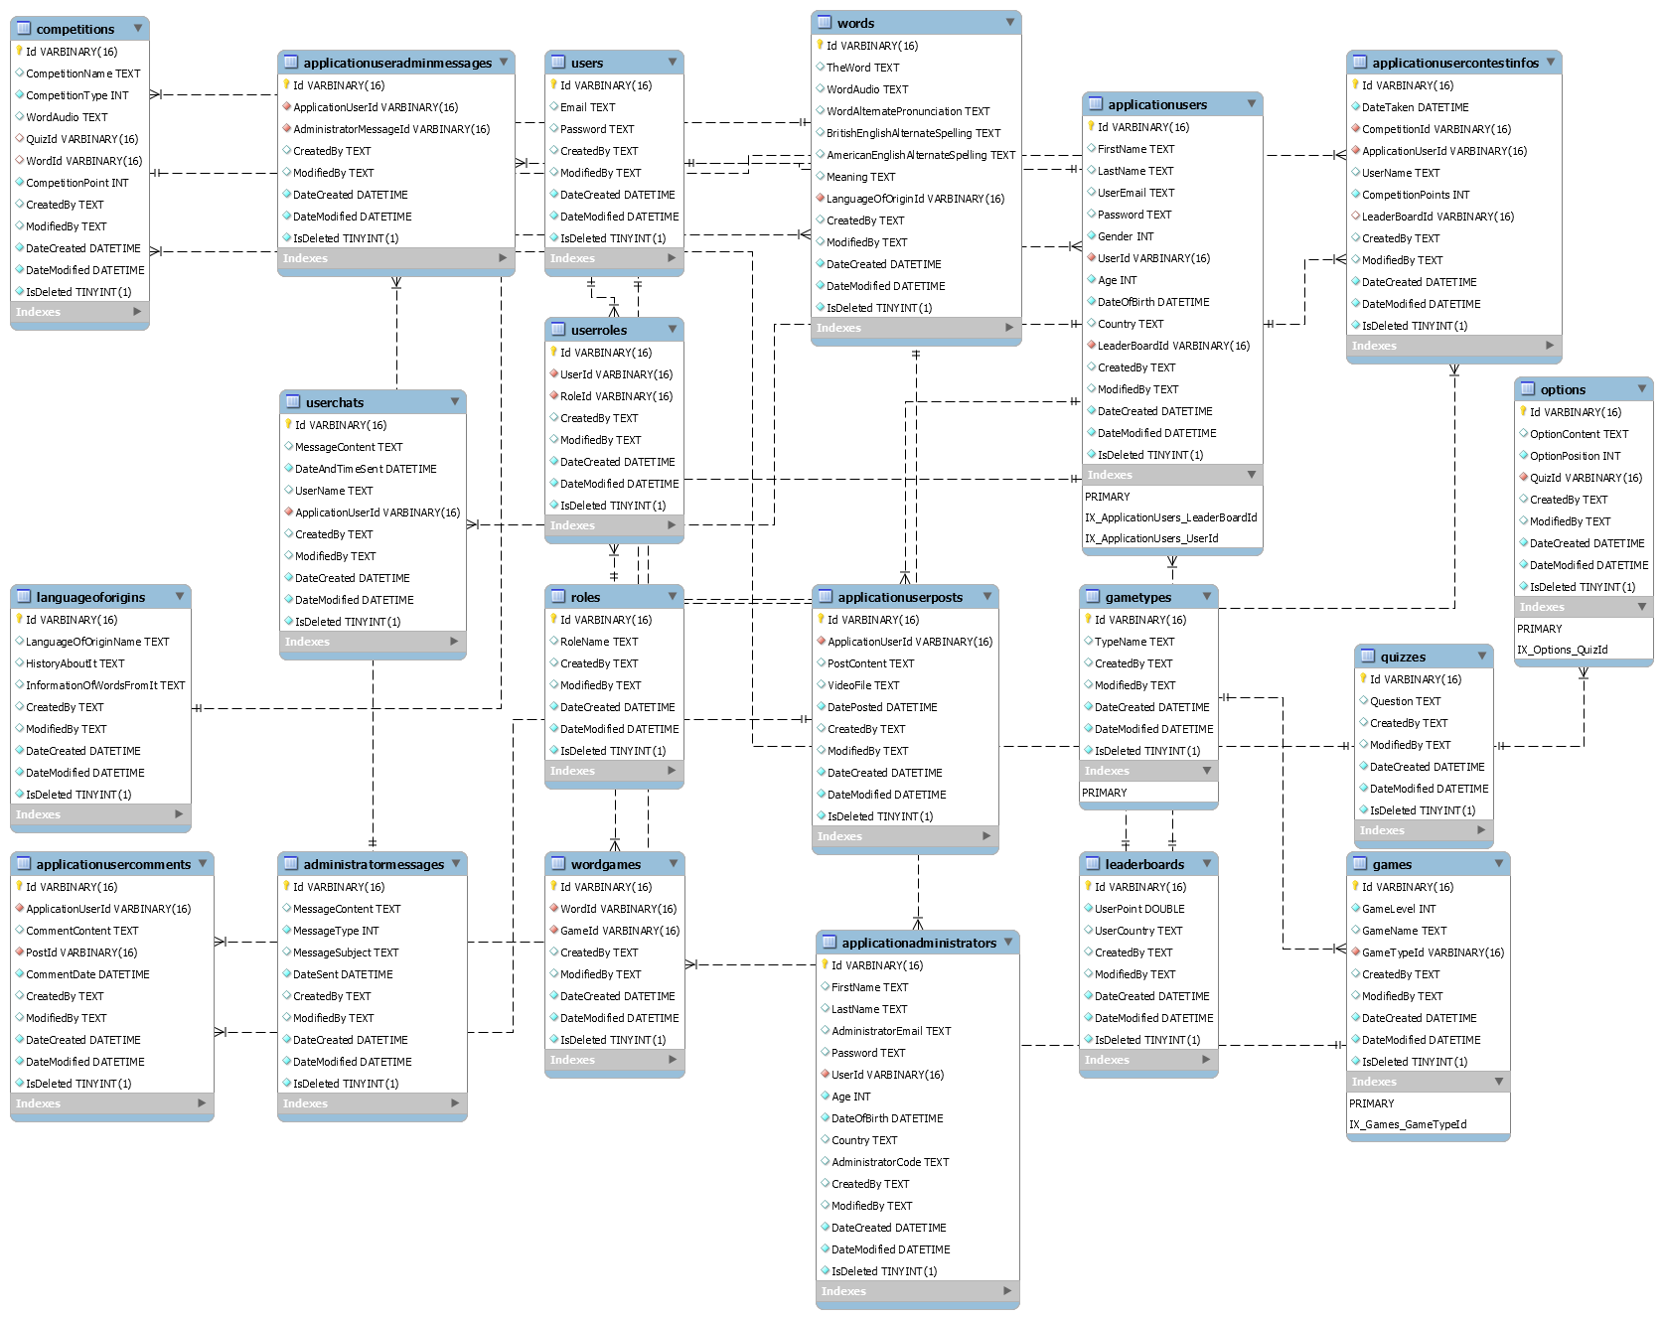
CODELEARNERSHUB
Entity Relationship Diagram

Slide 28
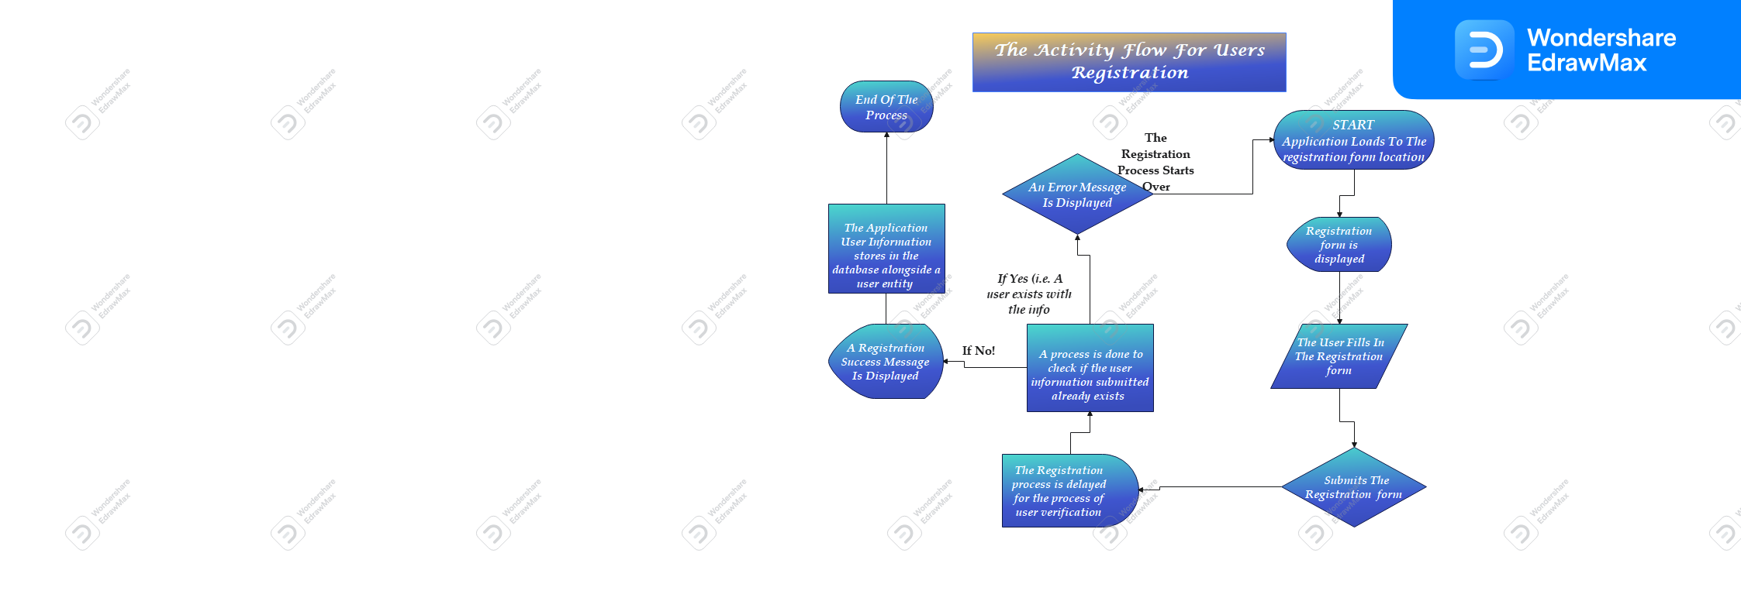
CODELEARNERSHUB
CODELEARNERSHUB

Slide 29
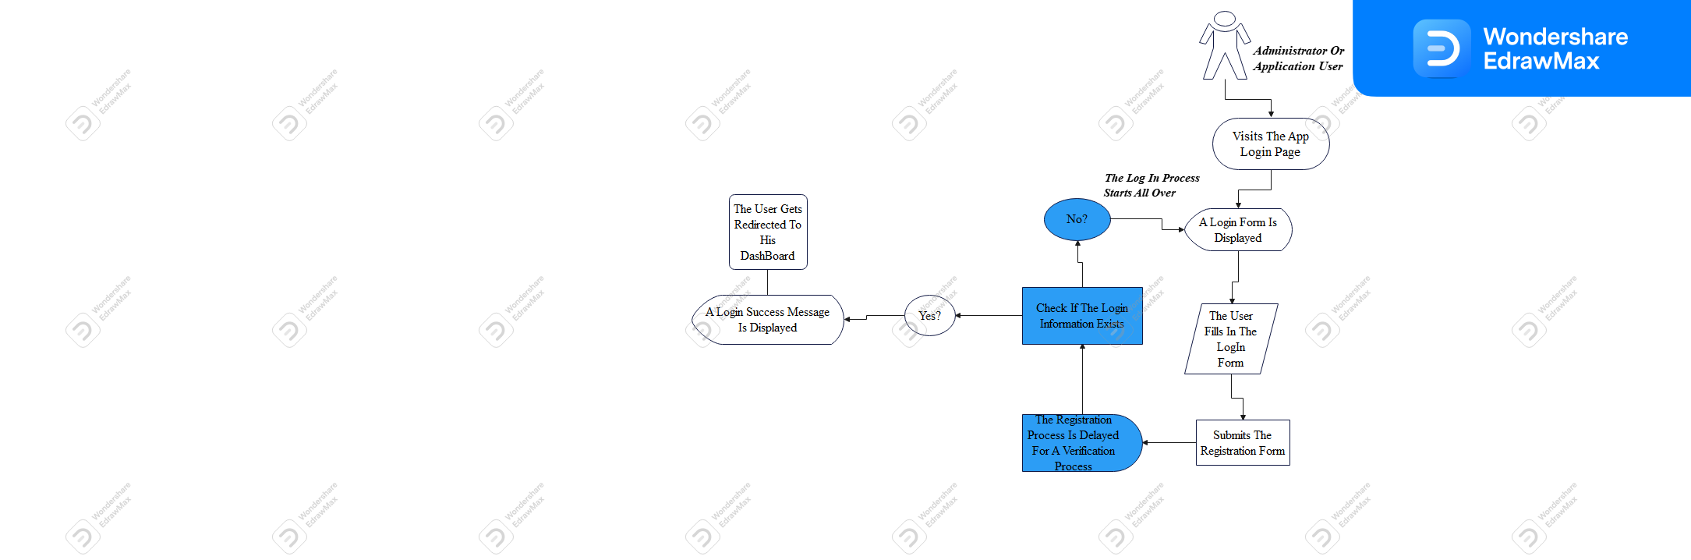
Application User And Administrator Log-in Activity Flow
CODELEARNERSHUB

Slide 30
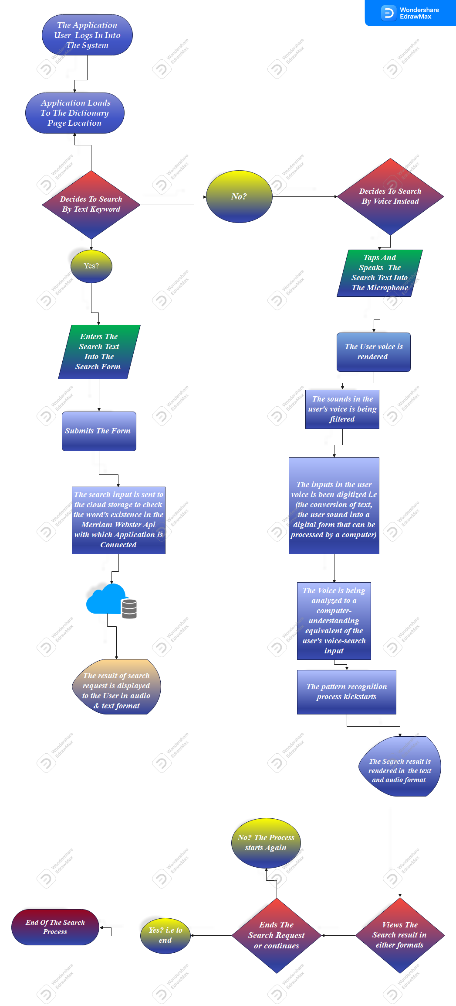
Word Search Activity Flow
CODELEARNERSHUB

