Slide 1
Project Status Update: Customer Portal v2
Synthetic data · evaluation only
合成数据

Slide 2
Project Status Update: Customer Portal v2
Owner: Omar Haddad
Overall status: Red
Budget: USD 288,000
Budget spent: 68%
合成数据

Slide 3
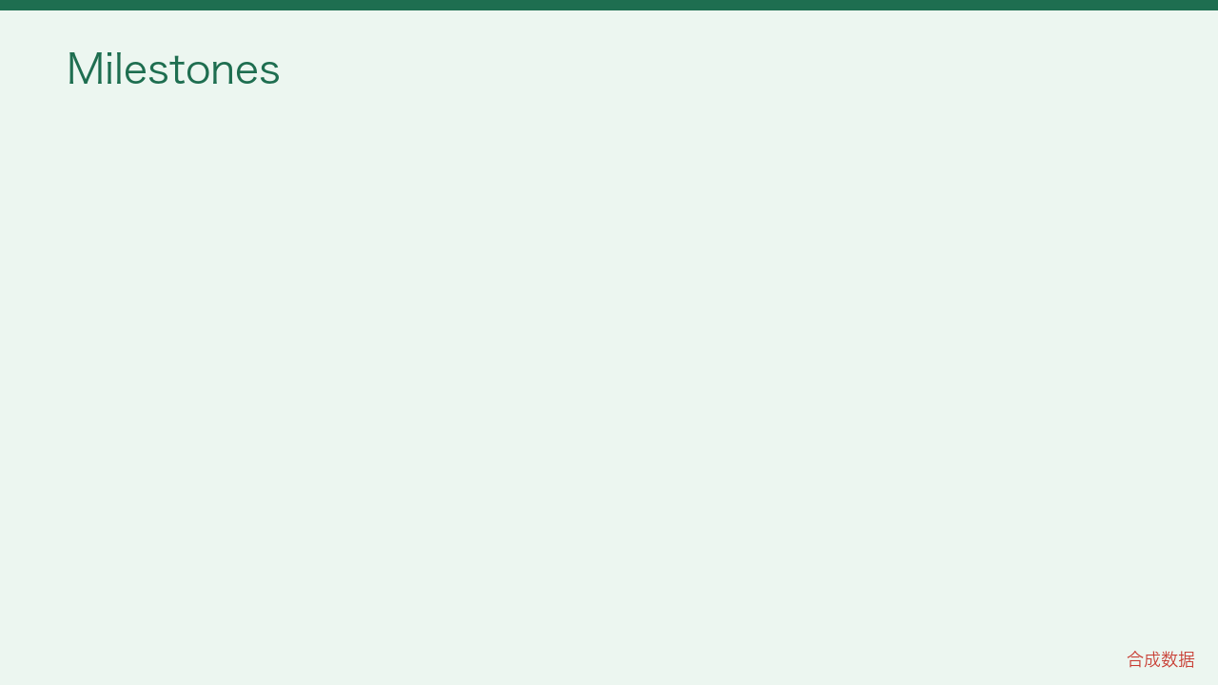

Slide 4
Table
Milestone State
Design sign-off done
Pilot at 2 sites in progress
Full rollout planned
合成数据

Slide 5
Top risk
Vendor delivery slipped by 10 days
合成数据

Slide 6
Next report
Next update due on 2026-06-25. Synthetic report for evaluation only.
合成数据

