Slide 1
Project Status Update: Website Redesign
Synthetic data · evaluation only
合成数据

Slide 2
Project Status Update: Website Redesign
Owner: Lucas Meyer
Overall status: Red
Budget: USD 271,000
Budget spent: 39%
合成数据

Slide 3


Slide 4
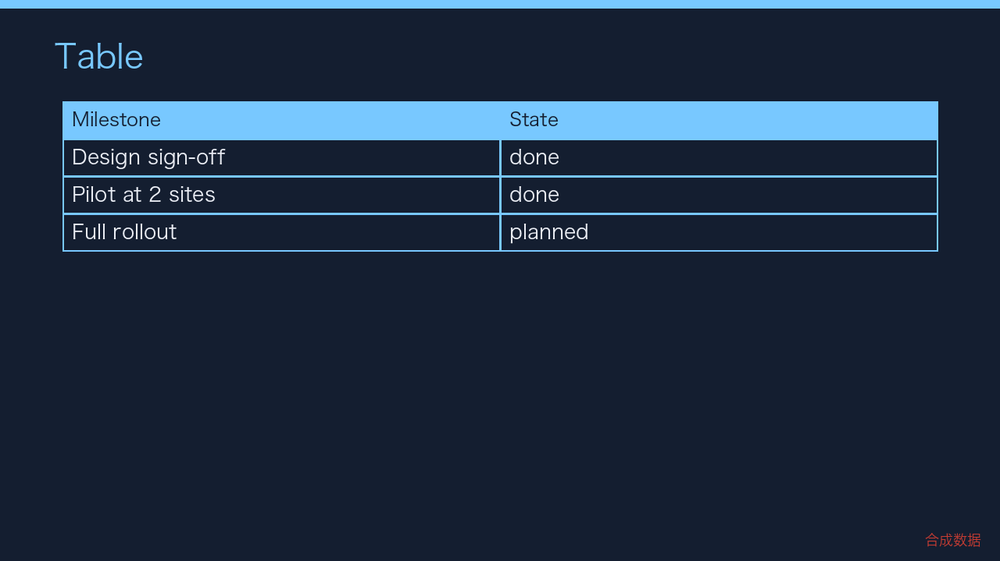

Slide 5
Top risk
Integration API rate limits
合成数据

Slide 6
Next report
Next update due on 2026-04-10. Synthetic report for evaluation only.
合成数据

