Slide 1

PHILIPPINE HISTORY
BACHELOR OF SCIENCE IN INFORMATION TECHNOLOGY
SYSTEMS PLUS COMPUTER COLLEGE- CALOOCAN CAMPUS
SYSTEMS PLUS COMPUTER COLLEGE - CALOOCAN

Slide 2
THE PROPAGANDA MOVEMENT AND THE KATIPUNAN
SYSTEMS PLUS COMPUTER COLLEGE - CALOOCAN

Slide 3
THE PROPAGANDA MOVEMENT AND ITS OBJECTIVES
The Propaganda Movement which began in 1872. It was a peaceful campaign for reforms geared towards changing the political and social order in the country under Spanish rule.
SYSTEMS PLUS COMPUTER COLLEGE - CALOOCAN

Slide 4
Among the reforms sought by the reformists who came from the ranks of Filipino ilustrados were the following:
Equality of Filipinos and Spaniards before the law;
Assimilation of the Philippines as a regular province of Spain;
Restoration of Philippine representation in the Spanish Cortes;
Filipinization or secularization of Philippine parishes; and
Individual liberties for the Filipino people, such as freedom of speech, freedom of the press, and freedom of redress of grievances.
SYSTEMS PLUS COMPUTER COLLEGE - CALOOCAN

Slide 5
THE FILIPINO PROPAGANDISTS
Most of the propagandists came from middle class and wealthy families who were sent abroad to obtain European education.
They are idealistic and principled men whose concern was on seeing changes in the Philippines.
SYSTEMS PLUS COMPUTER COLLEGE - CALOOCAN

Slide 6
THE FILIPINO PROPAGANDISTS
Notable among these propagandists were the following:
Jose Rizal
Graciano Lopez-Jaena
Marcelo H. del Pilar
Antonio Luna
Juan Luna
Mariano Ponce
Pedro Paterno
Pedro Serrano Laktaw
Jose Ma. Panganiban
Jose Alejandrino
Isabelo delos Reyes, and
Dominador Gomez.
SYSTEMS PLUS COMPUTER COLLEGE - CALOOCAN

Slide 7
Nonetheless, three among them came to be called the Triumvirate of the Propaganda Movement (Rizal, Lopez-Jaena, and Del Pilar.)
SYSTEMS PLUS COMPUTER COLLEGE - CALOOCAN

Slide 8
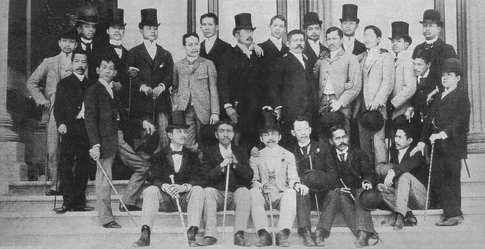
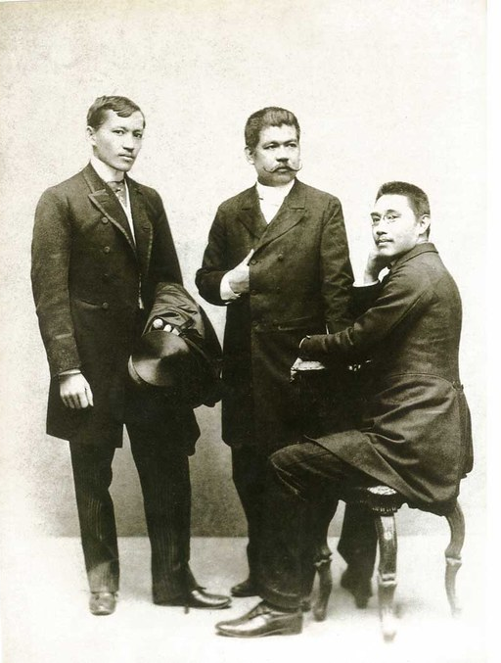
THE FILIPINO PROPAGANDISTS
SYSTEMS PLUS COMPUTER COLLEGE - CALOOCAN

Slide 9
JOSE RIZAL: THE NOVELIST
Jose Rizal was the most highly educated among the Filipino propagandists.
He obtained his secondary education at Ateneo.
It was in this school where he learn the values of fairness, justice and reason which, in effect, led him to focus his lifetime work toward the quest for justice, equality and dignity.
SYSTEMS PLUS COMPUTER COLLEGE - CALOOCAN

Slide 10
At the age of 18, he was able to prove that the Filipinos were comparable with the Spaniards in mental ability by winning the grand prize in a literary contest with his entry, A la Juventud Filipina or To the Filipino Youth. It was in this poem, where Rizal called the Philippines mi patria or my fatherland.
SYSTEMS PLUS COMPUTER COLLEGE - CALOOCAN

Slide 11
His allegorical play entitled El Consejo delos Dioses was chosen as the best entry in the competition of 1880. The jury, however, upon discovering that the author was a Filipino, decided to grant the grand prize to a Spaniard.
Two of his famous literary works written when he was already 26 years old were the Noli Me Tangere and the El Filibusterismo.
SYSTEMS PLUS COMPUTER COLLEGE - CALOOCAN

Slide 12
The Noli Me Tangere was considered the Charter of Filipino nationalism.
It calls on the Filipinos to regain their self-confidence, appreciate their self-worth, assert themselves as co-equal of the Spaniards.
SYSTEMS PLUS COMPUTER COLLEGE - CALOOCAN

Slide 13
In contrast with the Noli, El Filibusterismo was Rizal's anatomy of a revolution that failed.
His message in the Fili is very clear: that the present system of government under corrupt officials, dominated by the friars can lead to the downfall of Spain.
Rizal through this novel warned the Spanish authorities that since the Filipinos had desired assimilation for a long time, Spain had to grant it. If not, then the people may eventually prefer to die rather than endure the miseries any longer.
SYSTEMS PLUS COMPUTER COLLEGE - CALOOCAN

Slide 14
Because Rizal became an exponent, the friars did everything to have him tried on charges of treason and sedition, condemned and consequently sentenced to die on December 30, 1896, at Bagumbayan.
SYSTEMS PLUS COMPUTER COLLEGE - CALOOCAN

Slide 15
GRACIANO LOPEZ JAENA: THE ORATOR
Graciano was born on December 18, 1856, in Jaro, Iloilo. He studied at the Seminary of Jaro in preparation for priesthood. Although grounded in religious teachings, he still demonstrated the ability to resist arbitrary authority and control.
As a keen observer, he became aware of the disgraceful conditions of the country and the sad situation of the Filipino people.
SYSTEMS PLUS COMPUTER COLLEGE - CALOOCAN

Slide 16
Owing to his extraordinary talent for writing, he was able to write his criticism of the friars in his tale entitled Fray Botod.
In this piece of literature, he pictured an immoral and ignorant, big-bellied friar named Botod who enriched himself by exploiting the masses. The friars, therefore, became the object of ridicule and contempt by the people.
SYSTEMS PLUS COMPUTER COLLEGE - CALOOCAN

Slide 17
Graciano, therefore, got the ire of the friars, who were about to have him arrested. Thus, he secretly left the Philippines in order to escape persecution and enrolled in medicine at the University of Valencia in Spain.
He died of tuberculosis on January 20, 1896 in Barcelona, Spain.
SYSTEMS PLUS COMPUTER COLLEGE - CALOOCAN

Slide 18
MARCELO H. DEL PILAR: THE JOURNALIST
Marcelo del Pilar was born in Bulakan on August 30, 1850.
He was a co-equal of Rizal in intellectual capacity considering that he was lawyer, journalist and a political analyst.
He had his pre-college education at the Colegio de San Jose. He obtained his law degree at the University of Santo Tomas in 1880.
SYSTEMS PLUS COMPUTER COLLEGE - CALOOCAN

Slide 19
Aware of the abuses of the Spaniards in his own locality, Del Pilar campaigned against the misdeeds and excesses of the Spanish friars and the civil officials.
He founded the Diariong Tagalog, where he published articles attacking the Spanish authorities and the friars and exposed all injustices committed by the colonial government.
SYSTEMS PLUS COMPUTER COLLEGE - CALOOCAN

Slide 20
He went to Europe to escape persecution and to join the Filipino expatriates in their campaign for reforms. Unfortunately, however, Del Pilar died on July 4, 1896 because of tuberculosis.
SYSTEMS PLUS COMPUTER COLLEGE - CALOOCAN

Slide 21
THE LA SOLIDARIDAD
La Solidaridad was actually the organization established by Filipino expatriates in Barcelona.
This society founded on December 31, 1888, came to be known as the Associacion La Solidaridad, which pledged to work for reforms from the Spanish government.
SYSTEMS PLUS COMPUTER COLLEGE - CALOOCAN

Slide 22
The officers of Associacion La Solidaridad were the following:
President - Galiciano Apacible
Vice-President - Graciano Lopez-Jaena
Secretary - Manuel Sta. Maria
Treasurer - Mariano Ponce
Accountant - Jose Ma. Panganiban
SYSTEMS PLUS COMPUTER COLLEGE - CALOOCAN

Slide 23
Although Rizal was not an officer of the Associacion La Solidaridad, he was unanimously chosen as its honorary president. This implies that at this point in time, Rizal was already the recognized leader of the Filipino colony in Barcelona.
SYSTEMS PLUS COMPUTER COLLEGE - CALOOCAN

Slide 24
The aims of Associacion La Solidaridad were the following:
To work peacefully for political and social reforms;
To portray the disgraceful conditions of the Philippines.
To advocate liberal ideas and progress; and
To champion the legitimate aspirations of the Filipino people to life, democracy, and happiness.
SYSTEMS PLUS COMPUTER COLLEGE - CALOOCAN

Slide 25
To prevent the Spaniards from discovering the true identity of the contributors to the organization, Filipino reformists used pseudonyms.
Marcelo del Pilar - Plaridel
Jose Rizal - Laon Laan/Dimasalang
Mariano Ponce - Kalipulako or Tigbalang
Antonio Luna - Taga-Ilog
Jose Ma. Panganiban - Jomapa
SYSTEMS PLUS COMPUTER COLLEGE - CALOOCAN

Slide 26
ASOCIACION HISPANO-FILIPINO
To secure reforms for the Philippines, Filipino propagandists and their Spanish allies established the Asociacion Hispano-Filipino or the Hispano-Filipino Association in Madrid on January 12, 1889.
The officers of this association were the following:
President - Don Miguel Morayta
Vice-President - Gen. Felipe De la Corte
Secretary - Dominador Gomez
SYSTEMS PLUS COMPUTER COLLEGE - CALOOCAN

Slide 27
The association was composed of Filipino expatriates and prominent scholars in Spain.
The work of the association was divided into sections, with Marcelo del Pilar taking charge of the political section, Mariano Ponce for the literary section, and Tomas Arejola for the recreation section.
SYSTEMS PLUS COMPUTER COLLEGE - CALOOCAN

Slide 28
THE LA LIGA FILIPINA
While in Hong Kong, Rizal laid down the basis of the La Liga Filipina or the Philippine League, which he planned to establish in the Philippines upon his return. He, then, drafted the constitution of the league, with the assistance of Jose Ma. Basa.
The motto of this league was Unus Instar Omnium or one is equal to all.
SYSTEMS PLUS COMPUTER COLLEGE - CALOOCAN

Slide 29
Based on its constitution, the La Liga sought to achieve the following aims and objectives:
The unification of the whole archipelago into a vigorous, compact body;
Mutual protection in every want and necessity;
Defense against all forms of violence and injustice;
Stimulation of instruction, agriculture, and commerce; and
The undertaking of study and application of reforms.
SYSTEMS PLUS COMPUTER COLLEGE - CALOOCAN

Slide 30
Membership in the La Liga, however, depended on passing certain tests. Once accepted, the member should pay a monthly due of ten centavos.
Aside from this financial obligation, he would be duty-bound to give preferential treatment to members of the organization in all his actions.
While he had these obligations to his fellow members, he was expected to recruit a member, contribute a piece of work or an observation to the Liga.
SYSTEMS PLUS COMPUTER COLLEGE - CALOOCAN

Slide 31
Membership, however, entitled one to the following privileges: financial and moral assistance from the organization, an assurance that fellow members would support him in his business or profession as long as he did the same to others.
Full support from the La Liga in case of trouble or injustice
SYSTEMS PLUS COMPUTER COLLEGE - CALOOCAN

Slide 32
On July 3, 1892, Rizal founded the La Liga Filipina on Calle Ilaya, Tondo, in the home of Doroteo Ongjuco.
The elected officers of the La Liga were the following:
President - Ambrosio Salvador
Fiscal - Agustin de la Rosa
Treasurer - Bonifacio Arevalo
Secretary - Deodato Arellano
SYSTEMS PLUS COMPUTER COLLEGE - CALOOCAN

Slide 33
Three days after the founding of La Liga, Rizal was arrested by order of Governor-General Despujol and deported to Dapitan on July 15, 1892, and he remained in exiled in that place before the outbreak of the Revolution of 1896.
With his deportation to Dapitan the La Liga Filipina died its natural death and subsequently split into two branches. The rightist wing came to be called Cuerpos de Compromisarios, while the leftist wing came to be known as the Katipunan.
SYSTEMS PLUS COMPUTER COLLEGE - CALOOCAN

Slide 34
THE FAILURE OF THE PROPAGANDA MOVEMENT
The reformists did not succeed in accomplishing the platforms of the Propaganda Movement.
This can be attributed to the following reasons:
Spain was very much preoccupied with her own internal problems and did not have time to consider the colonial problems aired by the propagandists through the La Solidaridad.
SYSTEMS PLUS COMPUTER COLLEGE - CALOOCAN

Slide 35
2) The friars countered all attacks of the reformists through their newspaper in the Philippines entitled La Politica de Espana en Filipinas.
3) Petty quarrels among the reformists made them disunited
4) Lack of finances to support the propaganda activities in Europe led to the failure of the movement.
SYSTEMS PLUS COMPUTER COLLEGE - CALOOCAN

Slide 36
BONIFACIO AND THE KATIPUNAN
When Dr. Jose Rizal was arrested and deported to Dapitan, it was already very clear that the Propaganda Movement had failed.
Bonifacio, a member of La Liga Filipina, realized the uselessness of peaceful struggle. He no longer dreamed of mere reforms for the country and became more interested in liberating the people from Spanish cruelty.
SYSTEMS PLUS COMPUTER COLLEGE - CALOOCAN

Slide 37
He founded the Katipunan securing the independence and freedom of the country by force of arms
The official name of this society was Kataastaasan, Kagalanggalangan Katipunan ng mga Anak ng Bayan.
SYSTEMS PLUS COMPUTER COLLEGE - CALOOCAN

Slide 38
ANDRES BONIFACIO
Andres Bonifacio was born on November 30, 1863, to Santiago Bonifacio and Catalina de Castro.
Orphaned at an early age, the siblings made canes and paper fans to meet their necessities.
At a young age, he married a certain Monica. The marriage did not last long as she died of leprosy.
SYSTEMS PLUS COMPUTER COLLEGE - CALOOCAN

Slide 39
In 1892, he met Gregoria de Jesus of Kalookan, who became his second wife.
Andres and Gregoria were married twice. Members of the Katipunan attended this ceremony.
That evening Gregoria de Jesus became a member of the women's chapter of the Katipunan; she was conferred the title, Lakambini ng Katipunan.
SYSTEMS PLUS COMPUTER COLLEGE - CALOOCAN

Slide 40
Although he never finished high school, Andres Bonifacio was a very intelligent and smart man. He knew Spanish and spoke a little English. He read foreign novels, as well as books about revolution, politics, law, and religion.
These books opened his mind to the idea of effecting change through radical or violent means.
SYSTEMS PLUS COMPUTER COLLEGE - CALOOCAN

Slide 41
From his continued reading of various books, he realized that common people had rights and that freedom was a valuable thing to have. Inspired by these new ideas, Andres began to dream that a better life was possible for his countrymen.
SYSTEMS PLUS COMPUTER COLLEGE - CALOOCAN

Slide 42
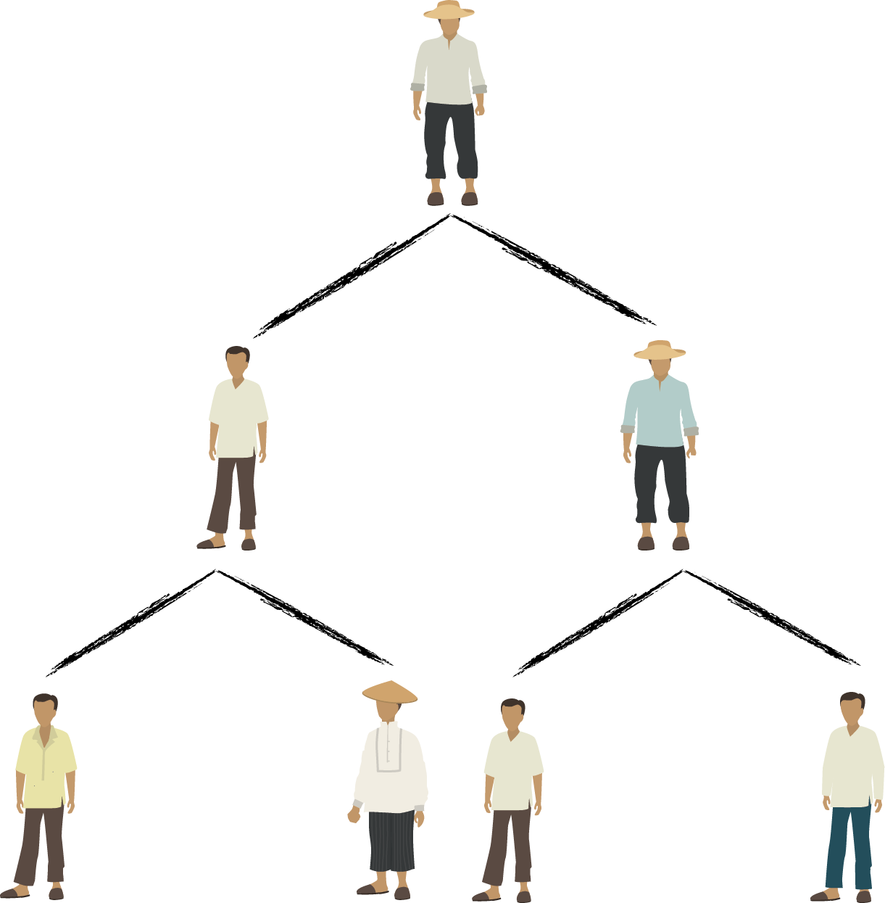
RECRUITMENT AND MEMBERSHIP
To keep the Katipunan from being discovered by the Spaniards, new members were enlisted through the triangle method.
Through this scheme, a recruiter would ask two members to join but the recruits themselves would not know each other.
SYSTEMS PLUS COMPUTER COLLEGE - CALOOCAN

Slide 43
Since the triangle method was quite slow in expanding the membership of the organization, this system was given up.
All Katipuneros could now recruit as many members as they could after October 1892,
SYSTEMS PLUS COMPUTER COLLEGE - CALOOCAN

Slide 44
There were a number of tests that an applicant for membership in the Katipunan had to overcome to prove his sincerity and courage.
Wearing a black robe, the new recruit was led blindfolded into a darkly lit room and required to answer the following questions:
"In what condition did the Spaniards find the Filipino people when they came?"
"In what condition do they find themselves now?"; and
What hope do the Filipino people have for the future?"
SYSTEMS PLUS COMPUTER COLLEGE - CALOOCAN

Slide 45
This was followed by other tests for the would-be-Katipunero.
The final test was the sandugo or blood compact. The recruit was asked to make a small cut on his left forearm with a sharp knife.
He then signed the Katipunan oath in his own blood. Afterwards, the new member chose a symbolic name for himself.
SYSTEMS PLUS COMPUTER COLLEGE - CALOOCAN

Slide 46
Over the next four years, the founders of the Katipunan succeeded in recruiting new members to the society.
By the time it was discovered, the estimated strength of the Katipunan was from 100,000 to 400,000 members.
Aside from Manila, the Katipunan also established sizeable chapters in Batangas, Laguna, Cavite, Bulacan, Pampanga, Tarlac and Nueva Ecija.
SYSTEMS PLUS COMPUTER COLLEGE - CALOOCAN

Slide 47
There were also women who became members of the Katipunan. They were limited to the wives, daughters, or close relatives of the Katipuneros.
The women's chapter of the Katipunan was formed in July 1893. Only about thirty females were known to have joined this secret society
During Katipunan meetings, they carried revolvers or daggers.
They usually served as lookouts in the outer sala while the men held their secret meetings in the backroom.
SYSTEMS PLUS COMPUTER COLLEGE - CALOOCAN

Slide 48
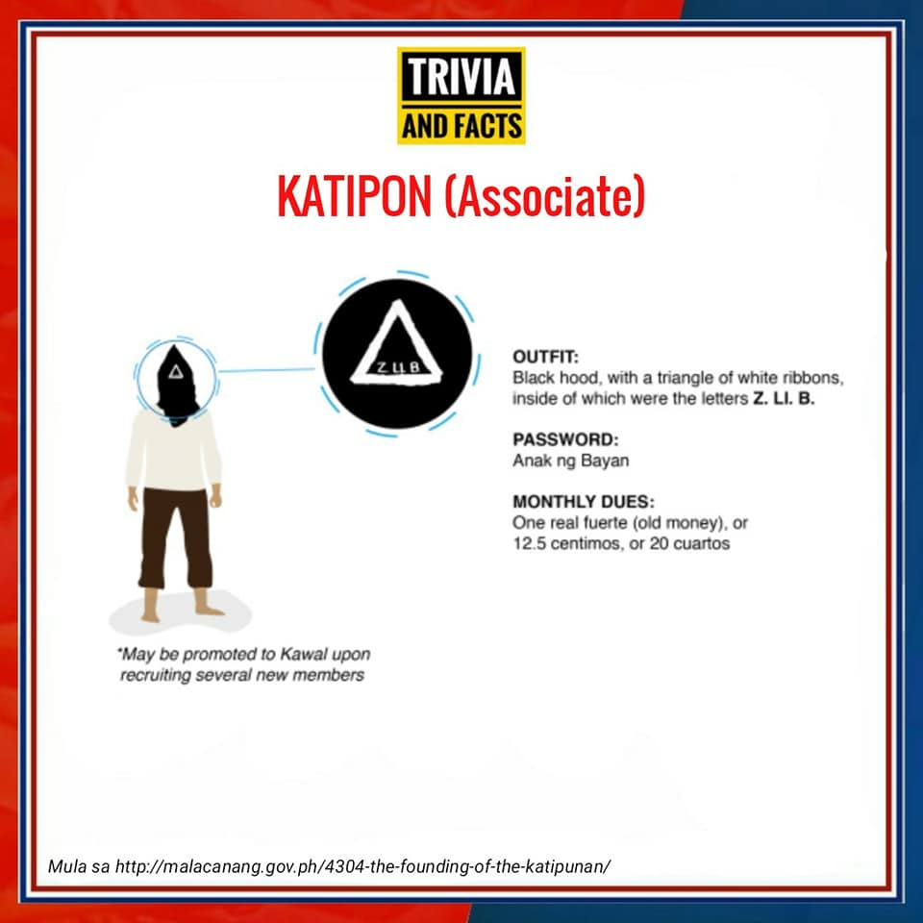
There were three grades of membership in the Katipunan.
The first grade was called Katipon.
The katipon wore a black hood with a triangle formed by white ribbons and letters during Katipunan meetings.
His password was Anak ng Bayan or Son of the People.
SYSTEMS PLUS COMPUTER COLLEGE - CALOOCAN

Slide 49
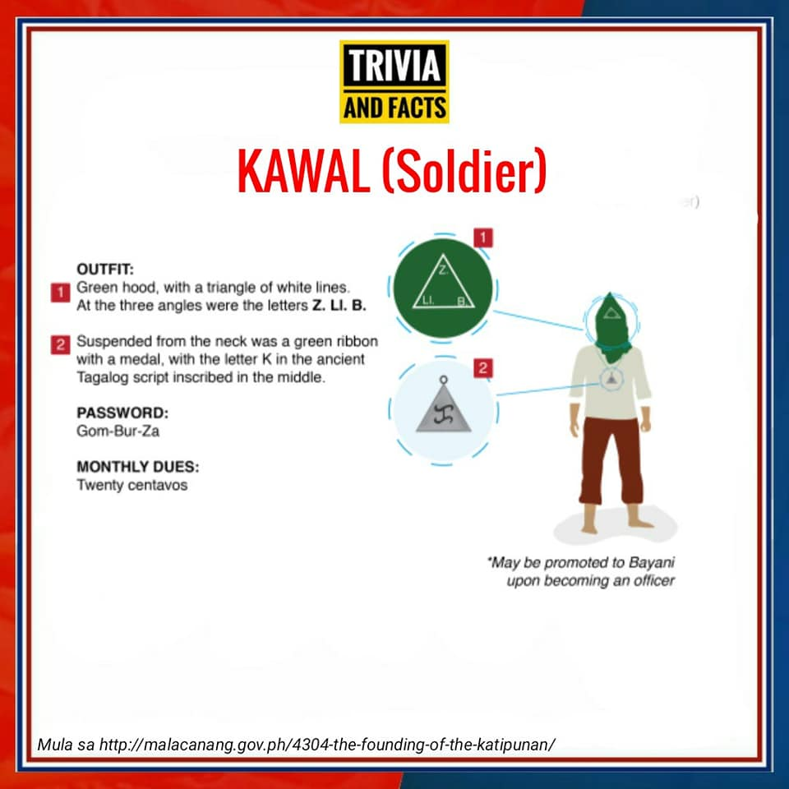
The second grade was called Kawal.
He wore a green hood and triangle consisting of white lines.
Around his neck was a green ribbon with a medal on which the Malayan letter K was inscribed.
His password was GOMBURZA.
SYSTEMS PLUS COMPUTER COLLEGE - CALOOCAN

Slide 50
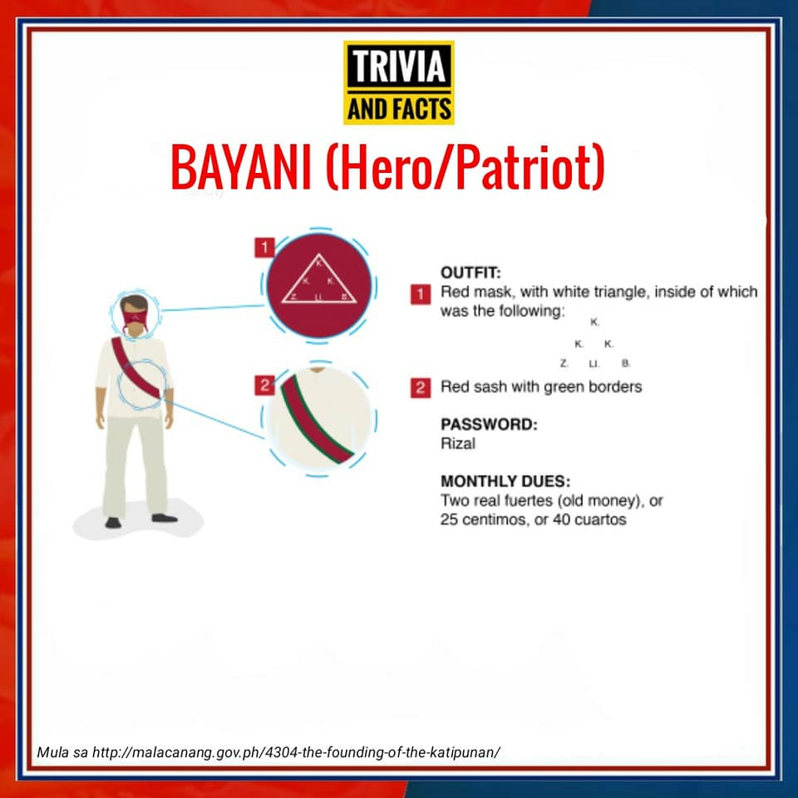
The highest grade of membership in the Katipunan was called Bayani.
He wore a red mask and a sash with green borders during Katipunan assemblies.
His password was RIZAL.
SYSTEMS PLUS COMPUTER COLLEGE - CALOOCAN

Slide 51
EMILIO JACINTO AND THE KATIPUNAN
While Andres Bonifacio was called the Father of the Philippine Revolution, Emilio Jacinto was called the Brains of the Katipunan.
He attended San Juan de Letran College, and later transferred to the University of Santo Tomas to study law.
SYSTEMS PLUS COMPUTER COLLEGE - CALOOCAN

Slide 52
He did not, however, finish his college education and, at the age of 20, joined the Katipunan. He became the advisor on fiscal matters and secretary to Andres Bonifacio.
Jacinto also wrote for the Katipunan newspaper called Kalayaan. He wrote in the newspaper under the pen name Dimasilaw, and used the alias Pingkian in the Katipunan.
SYSTEMS PLUS COMPUTER COLLEGE - CALOOCAN

Slide 53
After Bonifacio's death, Jacinto continued fighting the Spaniards, though he never joined the forces of General Emilio Aguinaldo.
He contracted malaria and died on April 16, 1899, in Majayjay, Laguna, at the age of 23. His remains were later transferred to the Manila North Cemetery.
SYSTEMS PLUS COMPUTER COLLEGE - CALOOCAN

Slide 54
THE DISCOVERY OF THE KATIPUNAN
Teodoro Patiño, a worker at the Diario de Manila printing press, revealed the existence of the society to his sister, Honoraria, in early August of 1896.
She was so upset by what she learned, Honoraria, relayed the information to Teresa de Jesus, the Mother Superior of the orphanage in Mandaluyong.
Teresa suggested that they seek the advice of Father Mariano Gil, the parish priest of Tondo.
SYSTEMS PLUS COMPUTER COLLEGE - CALOOCAN

Slide 55
After Patiños alleged confession to Fr. Mariano Gil, the Spanish Civil Guards raided the premises of Diario de Manila on August 18, 1896, and arrested De la Cruz, who was found in possession of a dagger used in Katipunan initiation rites and a list of Katipunan members.
Consequently, the printing press was closed and hundreds of suspected KKK members were arrested
Patiño's alleged betrayal has become the standard version of how the revolution broke out in 1896.
SYSTEMS PLUS COMPUTER COLLEGE - CALOOCAN

