Slide 1
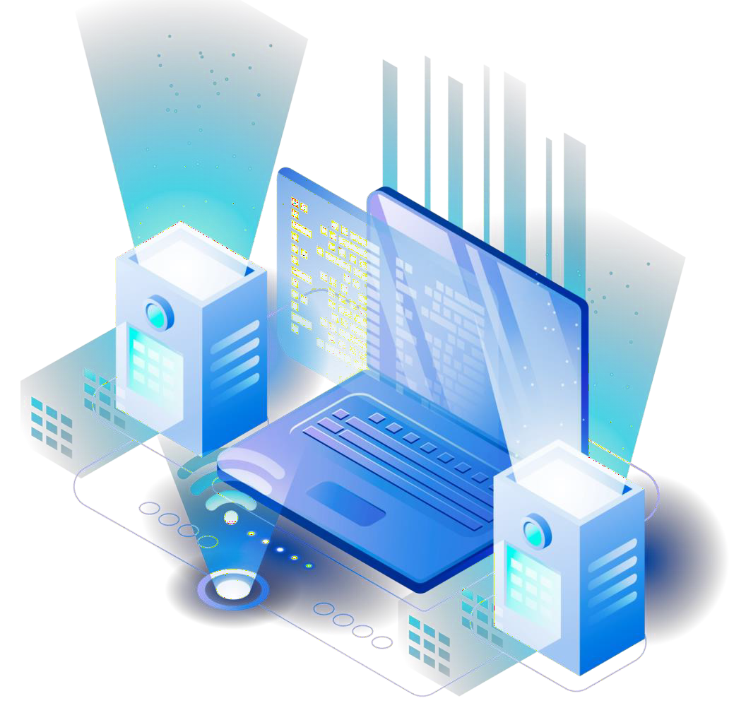
HIGH AVAILABILTY AND DISASTER RECOVERY
Presented by:
Rodel Florenz Siongco

Slide 2
Table of contents
01
04
07
High Availability
Big Data Management and Analytics
Need of Cloud Management
02
05
07
Purpose of High Availability
Benefits of Big Data Management
Benefits
03
06
07
Ways to Achieve High Availability
Cloud Database Management
Features

Slide 3
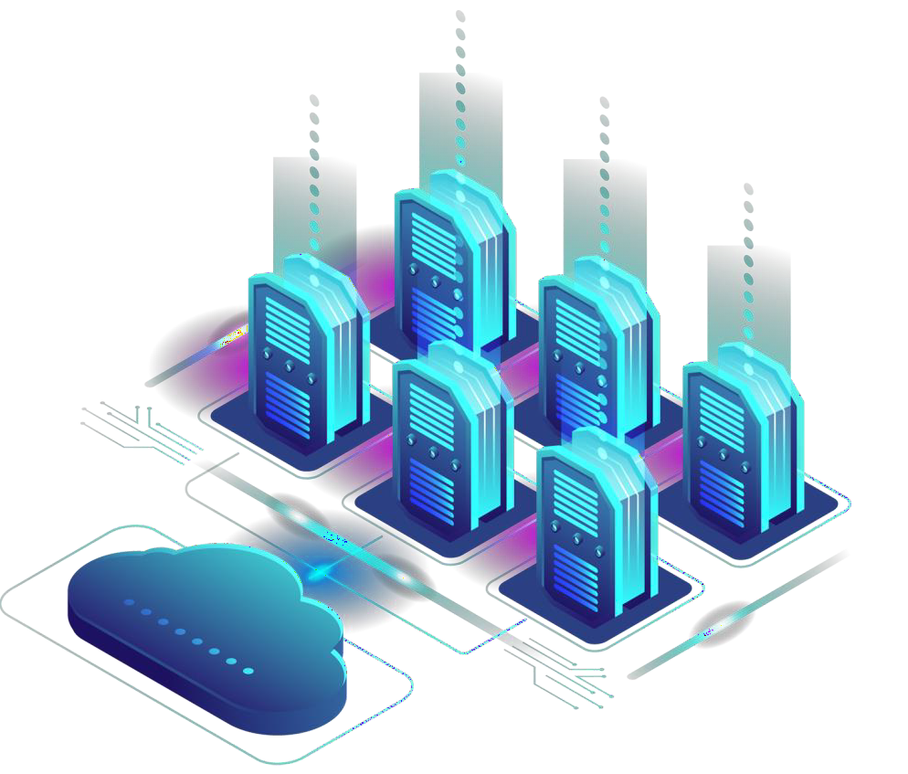
HIGH AVAILABILTY
High availability describes as systems' ability to carry on as usual for a pre-determined period of time in the event that one or more of it’s components malfunction. The agreed upon operational performance level is attained by a highly available system by eliminating single sources of failure.
High availability systems are used in industries and situations where system availability is crucial. Real-world high availability include those needed for telecommunication network, healthcare system, military controls, autonomous cars, and industrial operation.

Slide 4
What are the purpose of high availability?
Eliminates Any Single Point of Failure A single point of failure is a part that, should it malfunction, would bring the system to a stop. A single server used by business to execute it’s applications.
Implement Automatic Failure Detection
Any flaws or malfunctions must be identified and addressed immediately. Ideally, the system will have automation built in so that it can take care of the issue by itself. Integrated techniques should also be used to prevent common cause failures, which occur when two or more systems or components malfunction simultaneously, usually for the same reason.
Ensure No Data Loss In the event that data protections are not in place, data loss may occur from a component failure. The components required to prevent or reduce data loss during system failure.

Slide 5
What are the purpose of high availability?
Build In Reliable Failover
If a system component fails, a similar component must be immediately available to take over for the failed component. For this reason, the system must include redundant components and ensure reliable failover, which is the process of switching from one component to another without losing data or affecting performance or operations.

Slide 6
Ways to achieve high availability
Design The System With High Availability In Mind - The goal of designing an High Availability system is to create one that meets performance and availability requirements, while minimizing cost and complexity. Single points of failure should be eliminated with redundancy.
Test The Failover Process - Once the system is up and running, the failover process should be checked to ensure that workloads can be switched over to the backup component in case of failure. Applications should be tested and retested as time goes on, with a testing schedule put in place.
Monitor The System -The system's performance and operations should be tracked using metrics and observation. Any variance from the norm must be logged and evaluated to determine how the system was affected and what adjustments are required.

Slide 7
Ways to achieve high availability
Deploy The Hardware - Hardware should be resilient and performant, while balancing quality with cost-effectiveness. Hot-swappable and hot-pluggable hardware is particularly useful in HA systems because the equipment doesn't have to be powered down when swapped out or when components are plugged in or unplugged.
Evaluate - The data gathered from monitoring should be analyzed to find ways to improve the system. This process should be ongoing to ensure availability as conditions change and the system evolves.

Slide 8
BIG DATA MANAGEMENT AND ANALYTICS
Big data management is the organization, administration and governance of large volumes of both structured and unstructured data. Ensuring a high degree of data quality and accessibility for big data analytics and business intelligence applications is the aim of big data management.
Analytics is a branch of computer science that looks for useful patterns in data using machine learning, statistics, and math. Sorting through enormous data sets to find, analyze, and disseminate fresh information is the process of analytics, or data analytics.

Slide 9
BIG DATA MANAGEMENT AND ANALYTICS
It is the process of extracting insights from data, while data management is the process of collecting, storing, organizing, and securing data. Data management provides the foundation for data analytics.

Slide 10
What are the benefits of big data management?
Competitive Advantages - With quality data and correct management practices, organizations can have advanced analytics capabilities that give them an advantage over their competitors that don't have the same standards for big data management.
Improved Accuracy - Putting in place a framework for managing large amounts of data guarantees that the information is well-organized, error-free, and cleaned. More accurate data analytics outcomes are achieved with well-organized and trustworthy data.

Slide 11
What are the benefits of big data management?
Cost Savings - Effective big data management boosts productivity while cutting costs for businesses by optimizing resource allocation and minimizing latency and downtime.
Personalized Marketing - Organizations are able to offer more individualized customer service and marketing strategies when they use high-quality data to obtain insights about their customers.

Slide 12
CLOUD DATABASE MANAGEMENT
A cloud database is one that is designed to manage, organize, and store data inside of an organization. It can operate in a public or private cloud environment. It is a cloud computing platform that is used to build and access a database service. It has all the advantages of cloud computing together with many of the uses of a traditional database. To implement the database, users install software on a cloud infrastructure.

Slide 13
CLOUD DATABASE MANAGEMENT
Cloud databases utilize the hybrid cloud idea to gather, transport, replicate, and push all of an organization's data to the edge. To send database requests anywhere in the world, users no longer need to install the reliant middleware. They have the ability to link apps straight to their database.

Slide 14
Why do we need to use cloud database management?
Control Options - Users can opt for a virtual machine image managed like a traditional database or a provider’s DBaaS.
Database Technology - SQL databases are difficult to scale but common. NoSQL databases scale more easily but do not work with some applications.
Security - Most cloud database providers encrypt data and provide other security measures.
Maintenance - When using a virtual machine image, IT staffers should understand how to maintain the underlying infrastructure.

Slide 15
What are the benefits of cloud database management?
Disaster Recovery - Data is protected by backups stored on remote servers in the event of a natural disaster, equipment malfunction, or power outage.
Ease of Access - Using an API or web interface provided by a vendor, users can access cloud databases from any location.
Scalability - To adapt to changing needs, cloud databases can increase their storage capacity at runtime. Businesses only pay for the services they receive.

Slide 16
What are the features of cloud database management?
A database service built and accessed through a cloud platform.
Enables enterprise users to host databases without buying dedicated hardware.
Can be managed by the user or offered as a service and managed by a provider.
Can support relational databases (including MySQL and PostgreSQL) and NoSQL databases (including MongoDB and Apache CouchDB).
Accessed through a web interface or vendor-provided application programming interface (API)

