Slide 1
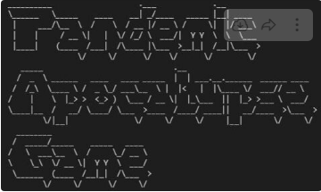
Pandemic Apocalypse Game
Retrospective
Kat, Nigel - Photo

Slide 2
The Project
Team
Project
Nigel Martin
Yussuf Ismail
Jarrod Ferreiro
Kathleen Newman
A text based adventure game in Python that goes through various scenarios. It is based in the scene of a zombie apocalypse. Zombies are attacking the user and the user has to go on an adventure and follow a map to complete the game.
Kat

Slide 3
Allocations
Nigel Martin
Yussuf Ismail
Jarrod Ferreiro
Kat Newman
Coded the yellow section
Coding Review
Merged code sections
Tested Code
Designed flowchart
Coded the Green section
Coded the blue section
ASCII Generators
Coding suggestions
Managed Trello
Coded the purple section
Suggestions about ASCII art
Created the map
Kat

Slide 4
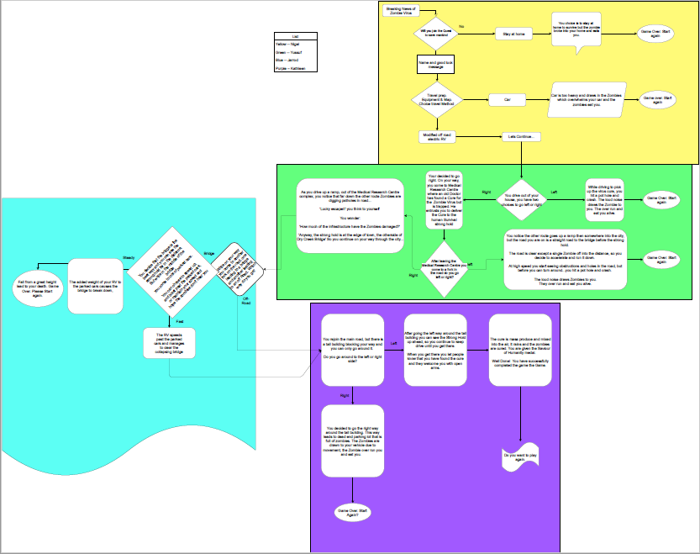
Flowchart
Yussuf

Slide 5
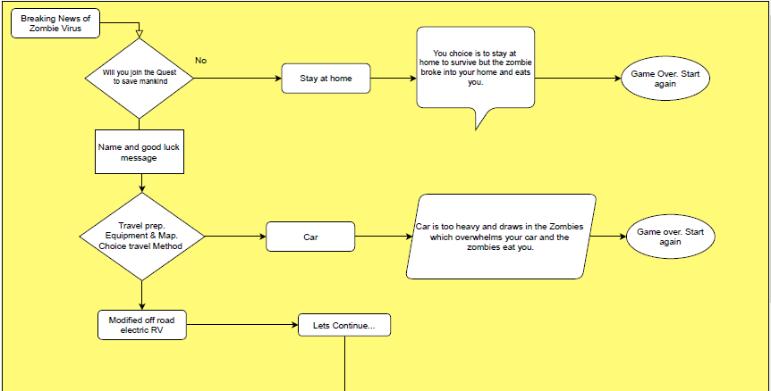
Flowchart - Nigel Martin
Yussuf

Slide 6
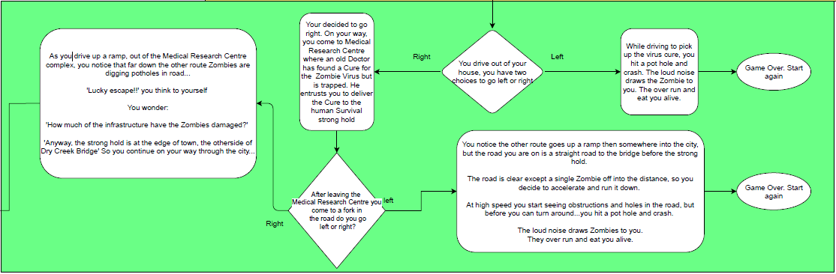
Flowchart - Yussuf Ismail
Yussuf

Slide 7
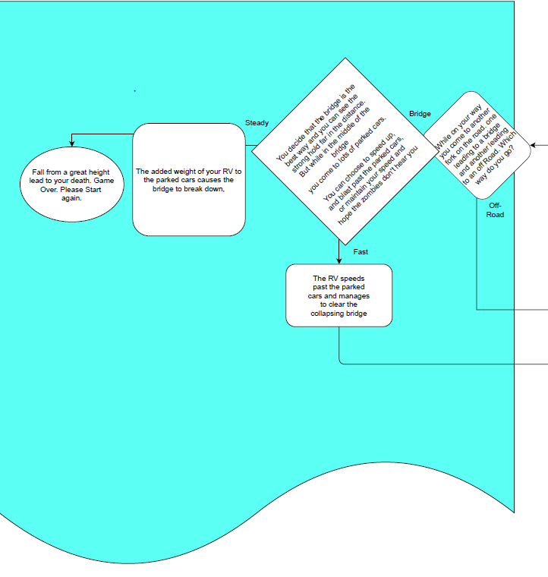
Flowchart - Jarrod Ferreiro
Yussuf

Slide 8
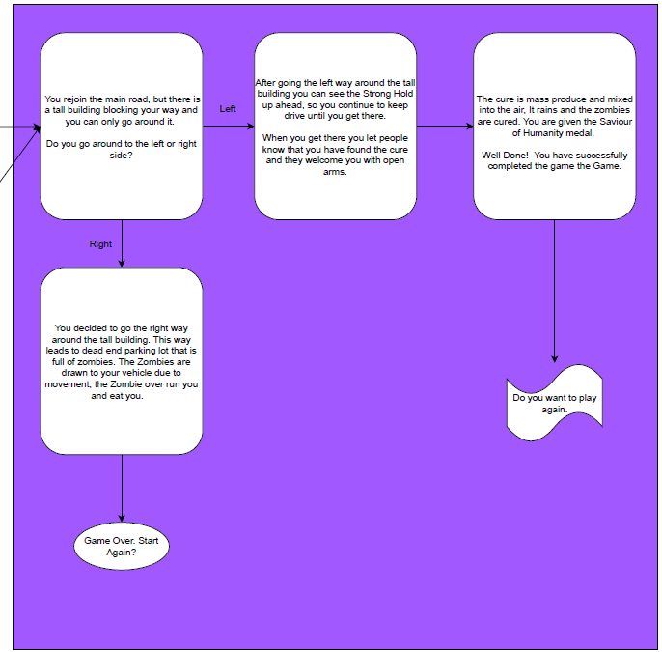
Flowchart - Kat Newman
Yussuf

Slide 9
Project Retrospective Checklist
Discuss how you researched, planned and coded the game, including individual team member roles and responsibilities, what went well, what you would do differently next time. We looked up a page on reddit and thought of an idea. We had zombies, pandemic and apocalypse on our minds. We planned with a flow chart and using Trello. Coding research was done online.
Discussing project management generally as well as coding is important for this presentation. Think about the workflow of using Python in this project- i.e. all the tools, technologies and techniques used, both technical and non-technical. We used Trello for Project Management and Visual Studio Code with built in Python extensions and Python SDK.
Kat, Nigel, Yussuf

Slide 10
Project Retrospective Checklist
For this project we used Python in the backend (terminal only). What would you imagine the challenges/difference would be if we were to incorporate frontend development (HTML/CSS) in this project? The challenges would be that it would take more time, many more lines of code and having to learn web development. Even if the web development was straightforward, we would still have needed to design graphical interfaces, characters and game imagery.
What would the advantages and disadvantages be of dedicating more time to the frontend? With an HTML/CSS frontend we could have had a much easier time with graphics and audio, as the browser would give us much easier access/support. However this would have added greater complexity to the code, and we haven’t started HTML or CSS training on this course yet. Also, ultimately nothing runs without a stable and completed backend implementation.
Kat, Yussuf, Nigel

Slide 11
Project Retrospective Checklist
The usefulness of Trello and Slack. What are the drawbacks/limitations of using Slack and Trello? Trello was easy to use and allowed us to implement Kanban for our project. Slack was used for team communication, sharing project files, ASCII pictures and code. Trello and Slack gave us an added advantage compared to traditional paper methods of project development. Not a limitation of Slack and Trello specifically, but our remote project development meant the face to face dynamic and ease of communication was lost through the formality required in using Trello and Slack.
Efficiency of the team and project management. We were very efficient considering we had time constraints. We all agreed on what cards we were working on and the status of our work.
Kat, Nigel, Yussuf

Slide 12
Project Retrospective Checklist
Were stand-ups helpful? Yes, it was helpful. It gave us views on different scenarios. It also gave us an opportunity to see the different types of solutions to specific problems. We discussed different issues relating to the code and ASCII pictures.
Was Kanban planning effective?
We didn’t use Trello to its full potential, however Kanban was an effective methodology. We implemented a simplistic Kanban workflow and simplified keeping track of the project's progress. Effectively, the volume of work was inadequate to demonstrate the capabilities of the Kanban board.
Kat, Nigel, Yussuf

Slide 13
Project Retrospective Checklist
Was testing effective? What was the purpose of the tests you carried out?
Testing was very effective except for one bug that was introduced due to the method used for questions and answer recognition (qa). We tested to remove bugs and improve quality overall.
How would the game project be different if working independently? Think particularly in terms of workflow and communication/collaborative tools and techniques used and discuss the advantages and disadvantages?
Maybe we would have been willing to take more risks for personal growth, rather than focusing on getting the project finished and manageable. But the deadlines would have to be relaxed to get the most potential out of each of us. Working remotely certainly hampered our creative choices and badly reflected on group confidence.
Kat, Jarrod Ferreiro

Slide 14
Implementation

Slide 15
Allocate project roles depending on team strengths
Decide on Game detail
Game enhancements
discussion
Merge Code, Testing
Packaging, Game Review
Evaluate Game sections of the project
Separate to Develop Game sections
Nigel

Slide 16
Yellow code Section
nigel.py
Green code Section
yussuf.py
Blue code Section
jarrod.py
Purple code Section
kat.py
Miscellaneous function shared library
cn_game_extras.py
Main control structure
cn_game.py
Used by all code sections
Nigel

Slide 17
Yussuf divided his flowcharted game narrative into four sections and allocated us our tasks. Once each programmer had completed their game section, the functions were linked into a whole using the python import feature.
Yellow code Section
nigel.py
Purple code Section
kat.py
Green code Section
yussuf.py
Blue code Section
jarrod.py
from cn_game_extras import qa_until, type_print
from nigel import play_yellow_section
from yussuf import play_green_section
from jarrod import play_blue_section
from kat import play_purple_section
Main control structure
cn_game.py
The imported functions were then called to “PLAY“ each section of the game. If the player died a function returned False and if they lived it returned True.
if player_is_alive == True :
player_is_alive = play_yellow_section( player_name)
Nigel

Slide 18
Shared functions were placed in single file: cn_game_extras.py and imported by the various code sections.
This ensured everyone used the same utilities and also facilitated simple global game changes, such as changing the default type_print speed.
Miscellaneous function shared library
cn_game_extras.py
def qa( question, true_options, false_options) :
def qa_until( question, valid_answers) :
def type_print( message, speed=0.01, pause=0.5):
NB: The qa function returning a true or false, the qa_until function returning a list index and if..elif..else ADDED to the text and storyline, is all that was required to implement all sections of the game.
Used by all code sections
Further sections based on Yussuf’s extended storyline were started, but not completed by the deadline. As well as Jarrod’s idea to add combat capabilities which was great, but the original storyline didn’t require it.
Nigel

Slide 19
Potential Improvements
If we had spent more time working on the flow chart, and had been more willing to take design risks at the start. Pandemic Apocalypse would have been a much richer title.
We all underestimated how knowledgeable Nigel was as a coding veteran, and our own ability to learn coding methods on our own.
The highlights however were numerous. Each team member received and completed their tasks quickly without being given deadlines or time scales.
No one complained about their roles or workloads in comparison to other members even if the workload wasn’t to their strengths.
Everyone was able to explain and communicate how they completed their piece of the project.
How to make a better Apocalypse!
The initial flow chart was always supposed to be temporary, we didn’t really have a real Project Leader so the plan wasn’t refined until end of project.
No one in the team had a strong enough opinion to make any changes happen, most of the text and choices were verbatim from the initial flow chart.
New ideas were instantly absorbed into the project.
The entire team did add to the project in unique ways to each individual, but with no PL teamwork was fractured and disjointed.
The ambition and the project suffered as a result.
Jarrod Ferreiro

