Slide 1

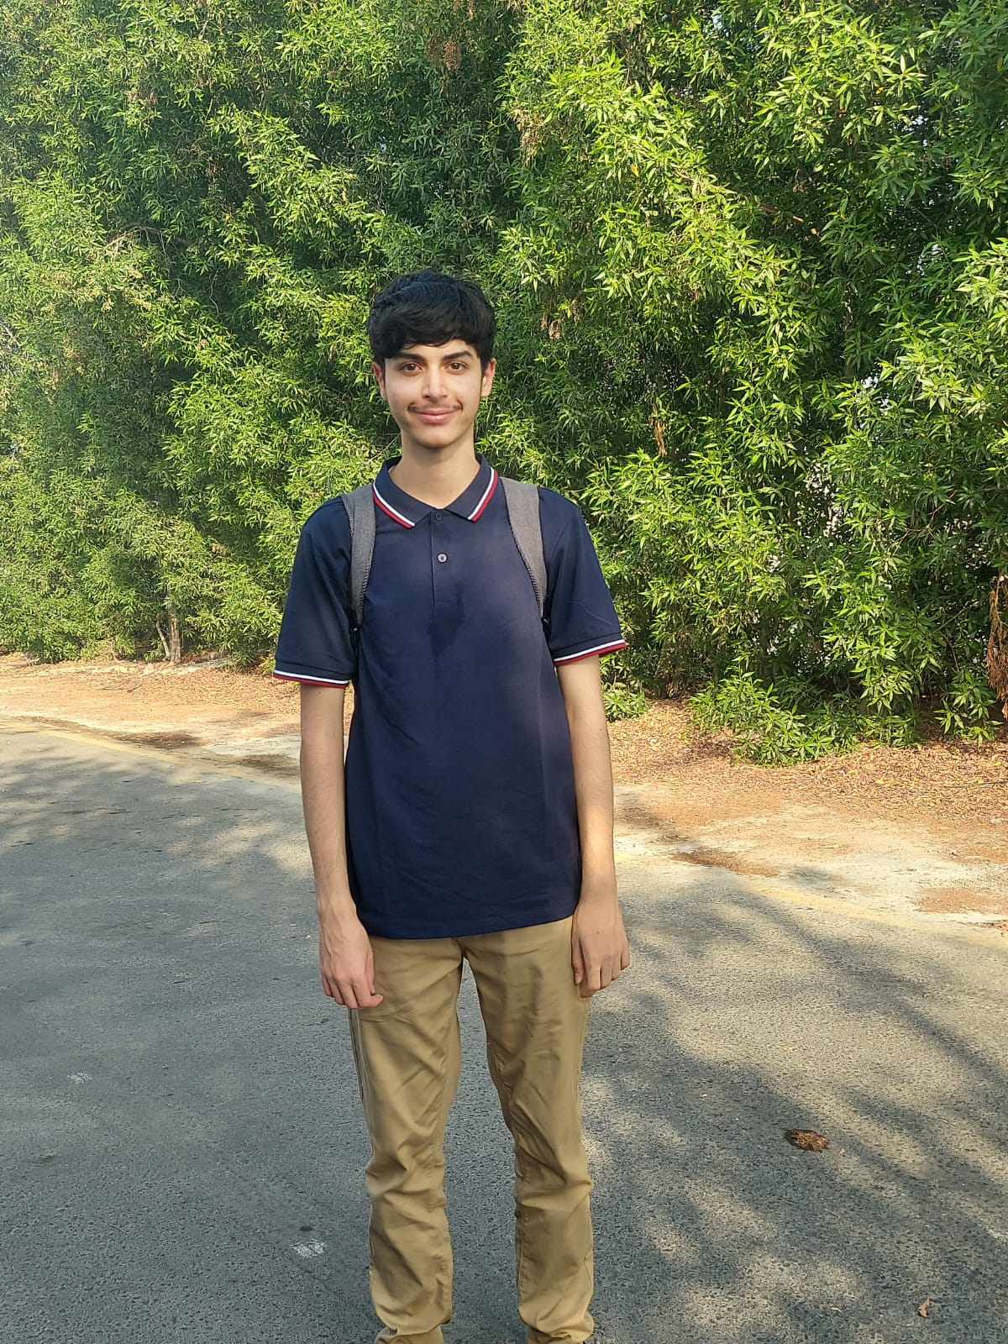
TEAM
01
Our team
Yusuf Karanib
Raed Mardoum
Early-career AI and cloud developer based in the UAE, with a background in game development and business studies in Canada.
Computer Engineering student at AUS, specialising in AI and machine learning. General experience in web development, computer graphics and object-oriented programming.
Project lead and demo
Validation and city test
Explains the problem, data and result. Runs the live demonstration.
Explains the validation results and how planners could test the idea.
Notes:
1 - Yusuf - 0:00 to 0:35
> Hello, we're Team Milkaholics. I'm Yusuf Karanib, an early-career AI and cloud developer based in the UAE. I lead the project and will show the data and result. Raed Mardoum is a Computer Engineering student at AUS, specialising in AI and machine learning. He will explain the validation and our proposed city test.
Raed biography supplied by Yusuf on 26 October 2026. The confirmed organiser email of 26 October requires the team introduction first.

Slide 2

PRIORITY MAP
RIYADH HEATREADY
Where should planners
inspect first?
Satellite and population data for southeast Riyadh
WHAT IT GIVES
A ranked map of 1 km areas that may need an early site visit
Team Milkaholics
Yusuf Karanib and Raed Mardoum
Notes:
2 - Yusuf - 0:35 to 0:50
> Our project is Riyadh HeatReady. We worked on one question: if a planning team can visit only a few areas, where should it start?

Slide 3
PROBLEM AND ANSWER
03
The problem and our answer
168.3 km²
1 km
Planners
Inspect first
AREA WE STUDIED
SIZE OF EACH CELL
WHO THIS IS FOR
WHAT THE TOOL SHOWS
PROBLEM
OUR IDEA
Planners may need to compare separate maps for growth, heat, population and vegetation before choosing where to visit.
HeatReady combines those maps and ranks 1 km areas. It gives planners a place to start, not a final decision.
Notes:
3 - Yusuf - 0:50 to 1:20
> We focused on 168 square kilometres in southeast Riyadh. A planner may need to compare separate maps of growth, surface heat, population and vegetation before choosing where to visit. HeatReady brings these together and ranks one-kilometre areas. The result gives the team a starting point for inspection. Local staff still decide what the area needs after checking conditions on the ground.

Slide 4

THE ANSWER
04
Where planners should inspect first
3.74 km²
14 / 67
78.7
CONFIRMED GROWTH SIGNAL
HIGH / ELIGIBLE CELLS
TOP SCORE: R05C10
The same result is available as a map, a table and GIS files.
Notes:
4 - Yusuf - 1:20 to 2:45
> Here is the result. Our stricter checks retained 3.74 square kilometres of possible built-up growth. Sixty-seven cells met the ranking rules, and fourteen received the High label. R05C10 came first at about 78.7 points. The chart shows how heat, population, growth and vegetation each contribute to a score.
Open `outputs/dashboard.html`, already at Decision output. Keep the demonstration to about 25-30 seconds.
> This is the working report. Here is the ranked map, and here is the table with R05C10 at the top. The repository also contains the results as a spreadsheet table and GIS files.
Return to slide 4.
> A high score is a reason to inspect an area early. The inspection determines what action makes sense there.

Slide 5

DATA AND METHOD
05
The data behind the answer
Sentinel-2
Shows vegetation and surface colour
Sentinel-1
Radar check for built structures
Annual land cover
Flags possible growth from 2018 to 2023
Landsat 8
Measures land surface temperature
WorldPop
Estimates where people live
Planet Tanager
Tests a desert classification problem
Annual maps flag growth. Optical and radar data check it. Heat, population and vegetation set the score.
Notes:
5 - Yusuf - 2:45 to 3:45
> Each dataset had a job. Annual land-cover maps flagged possible growth from 2018 to 2023. Sentinel-2 optical data and Sentinel-1 radar checked whether those places looked built-up in 2025 and had become more built-like since 2018. That narrowed 13.82 square kilometres to 3.74.
> Landsat supplied surface temperature. WorldPop supplied estimated population, and Sentinel-2 supplied vegetation. We ranked the cells using 40 percent heat, 30 percent population, 20 percent growth and 10 percent low vegetation. Those weights are starting choices for the proof of concept. Tanager added a separate check on desert confusion. Raed will explain what the tests tell us.
Change to slide 6 and let Raed begin.

Slide 6

VALIDATION EVIDENCE
06
How well the model matched the reference
0.88
0.78
0.89
The model matched a separate satellite reference well. This is not the same as field accuracy.
F1 AGREEMENT
INTERSECTION OVER UNION
BALANCED ACCURACY
MAIN LIMITATIONS
Surface temperature is not air temperature or personal heat exposure.
WorldPop is an estimate, not a current population or worker count.
Bright desert and roofs can still confuse the model.
A real user still needs to review the score weights.
Notes:
6 - Raed - 3:45 to 4:45
> Thank you, Yusuf. I'm Raed Mardoum. We tested the built-up model on the eastern part of the area, away from its training data. Against ESA WorldCover, it reached F1 of 0.88, overlap of 0.78 and balanced accuracy of 0.89.
> Those numbers show agreement with a satellite reference. Field checks are still needed. They also test the built-up model, rather than the usefulness of the final ranking. Surface temperature differs from air temperature, and WorldPop is an estimate. Desert surfaces can still confuse the model. These are reasons to check the suggested areas locally.

Slide 7

DIFFERENCE
07
Why we used more than one signal
THREE CHECKS
Annual maps suggest where growth may have happened.
Optical and radar data check the same places.
Each final score keeps its four parts visible.
The Tanager check showed that one built-up index can confuse bright desert with buildings.
WHY IT HELPS
A planner gets one ranked list and can still see the evidence behind each area.
Notes:
7 - Raed - 4:45 to 5:30
> We used more than one source because bright desert can resemble built land. Annual maps flag possible change, and optical and radar measurements check those places. In our Tanager comparison, likely-unbuilt ground had a higher median built-up index than established buildings. That shows why one threshold can mislead us here. The final score also shows its four parts, so a planner can see why an area ranks highly.

Slide 8
NEXT STEP
08
How we would test it with planners
1
2
3
4
Talk to users
Check the top five
Fix the score
Test again
Ask planners and GIS staff how they choose inspection areas today.
Compare the ranking with local plans and visits to the area.
Adjust the weights and add local information that we are missing.
Run the same process in another part of Riyadh.
THE TEST
Does HeatReady save time without sending staff to the wrong places?
Notes:
8 - Raed - 5:30 to 6:15
> Next, we would ask planners and GIS staff how they choose inspection areas today. They would check our top five against local plans and visits to the area. We would record useful findings, false alarms and the time taken. Then we would adjust the weights and add missing local information, such as worker exposure. Finally, we would repeat the test in another part of Riyadh. That would tell us whether HeatReady saves staff time and gives them useful places to inspect. Thank you. We're ready for your questions.

Slide 9
APPENDIX
09
Data sources and dates
Source | Dates used | Role | Access / licence
Sentinel-2 L2A | 11 May 2018; 10 May 2021; 9 May 2025 | Optical features, masks, vegetation | Copernicus open access
Sentinel-1 RTC | 10 May 2018; 6 May 2021; 9 May 2025 | Radar structure | Microsoft PC; CC BY 4.0
IO/Esri annual LULC | 2018-2023 | Trend + candidate endpoint change | CC BY 4.0
Landsat 8 C2 L2 | 10 May 2025 | Land-surface temperature | US public domain
ESA WorldCover | 2021 | Spatial holdout reference | CC BY 4.0
WorldPop Global2 | 2025 | Modelled population | CC BY 4.0
Planet Tanager | 15 May 2025 | Spectral context + sensitivity test | Open urban archive; CC BY 4.0
Item IDs, processing steps and licences are documented in the repository. Satellite 813 imagery was not used.
Notes:
Appendix only. Open if a judge asks for exact source dates, roles or licences.

Slide 10
APPENDIX
10
Validation evidence and limits
RESULTS
The east-side holdout was compared with WorldCover.
F1 0.88, IoU 0.78 and balanced accuracy 0.89.
The test contains 36,156 reference pixels.
LIMITS
Field accuracy.
Air temperature or health outcomes.
Municipal approval or user acceptance.
Next: field and user review of the top-ranked cells.
Training area: west Tuning area: middle Test area: east
Notes:
Appendix only. Use for questions about leakage, train-test geography, annual trend uncertainty or the difference between satellite agreement and field accuracy.

