Slide 1

SATELLITE-DERIVED PRIORITY MAP
RIYADH
HeatReady
From satellite evidence to a clear municipal inspection priority
ONE DECISION
Which 1 km zones should a planning and heat-resilience team inspect first?
Milkaholics • Urban Expansion, Land Use Change & Heat Risk • United Arab Emirates
Notes:
0:00–0:20 | Yusuf. Good afternoon. We are Team Milkaholics, and this is Riyadh HeatReady. It uses satellite evidence to rank one-kilometre zones in southeastern Riyadh where recent growth, hotter surfaces and modelled population overlap. Our question is simple: where should a municipal team inspect first?

Slide 2
TEAM CAPABILITY
02
Two clear owners for one testable decision
YK
Yusuf Karanib
RM
Raed Mardoum
Project Lead and Data/Method Presenter
Validation, Workflow and Impact Lead
Project responsibility
Finals responsibility
•
Coordinates the final submission and live demonstration.
•
Explains validation evidence, limitations and safe interpretation.
•
Explains the problem, EO data, method, score and live demonstration.
•
Explains innovation, expected impact and the municipal pilot plan.
Finals focus: EO workflow, data processing and reproducibility.
Finals focus: validation interpretation, decision workflow and pilot design.
MILKAHOLICS • ARAB YOUTH SPACE HACKATHON: 813 CHALLENGE
Notes:
0:20–0:55 | Yusuf. I am Yusuf Karanib, the project lead and data and method presenter. I will explain the problem, satellite sources, analysis, priority score and working output. Raed Mardoum is our validation, workflow and impact lead. He will explain what the metrics do and do not prove, what makes the solution different, and how we would test it with a municipality. We have separated these responsibilities so each of us can answer the judges directly.

Slide 3
PROBLEM, USER AND NEED
03
The problem is not missing maps — it is a fragmented decision
168.30 km²
1 km
1 user
1 action
SOUTHEASTERN RIYADH STUDY AREA
TRANSPARENT SCREENING CELLS
MUNICIPAL PLANNING + HEAT TEAM
INSPECT LOCALLY BEFORE INTERVENTION
CURRENT PAIN
TESTABLE MVP
Growth, heat, population and vegetation sit in separate layers. A planner still needs a short, explainable list of places to inspect.
A ranked layer, dashboard and GIS files that show the score and its evidence — without automatically selecting a cooling intervention.
Honest gap: no municipal user interview has happened yet. The workflow and value must be tested during incubation.
MILKAHOLICS • ARAB YOUTH SPACE HACKATHON: 813 CHALLENGE
Notes:
0:55–1:50 | Yusuf. The study area covers 168.30 square kilometres along southeastern Riyadh's urban-industrial fringe; it does not represent the whole city. The intended user is a municipal planning and heat-resilience team. Today, growth, surface heat, population and vegetation can sit in separate layers. A planner still has to compare them before deciding where to inspect. Our MVP turns these layers into a ranked list of 1-kilometre cells. The action is not 'build trees here' or 'install a cool roof here.' The action is 'inspect this zone first, then compare it with local plans and field conditions.' We have not interviewed a municipality yet, so this workflow and its value are hypotheses that must be tested.

Slide 4

SPACE DATA AND ANALYTICS
04
Six open sources, one conservative chain
Sentinel-2
Optical reflectance, vegetation and built features
Sentinel-1
Radar structure to reduce bright-desert confusion
Annual LULC
Six maps propose 2018–2023 built-up change
Landsat 8
Quality-masked 2025 land-surface temperature
WorldPop
Modelled 2025 population exposure
Planet Tanager
426-band material context and failure-mode test
Annual change proposes growth → separate 2025 optical + radar evidence confirms it → heat, population and vegetation rank eligible cells.
MILKAHOLICS • ARAB YOUTH SPACE HACKATHON: 813 CHALLENGE
Notes:
1:50–3:10 | Yusuf. Each open source has one job. Sentinel-2 provides optical reflectance, vegetation information and built-up features. Sentinel-1 adds radar structure, which helps because bright desert can look built-up in optical data. Six annual land-cover maps propose built-up change from 2018 to 2023. Landsat 8 provides quality-masked land-surface temperature for 10 May 2025. WorldPop provides modelled 2025 population. Planet Tanager provides a 426-band spectral view for a material-context and failure-mode check. The chain is deliberately conservative. Annual change first proposes 13.82 square kilometres of possible growth. We retain only pixels for which separate 2025 Sentinel-2 and Sentinel-1 evidence also supports a built-up interpretation, leaving a 3.74 square-kilometre confirmed-growth signal. Eligible one-kilometre cells are then ranked with a transparent score: 40 percent heat, 30 percent population, 20 percent confirmed growth and 10 percent lack of vegetation. These weights are PoC assumptions, not official municipal policy.

Slide 5

WORKING OUTPUT
05
A ranked map plus separate GIS-ready files
3.74 km²
14 / 67
78.7
CONFIRMED GROWTH SIGNAL
HIGH / ELIGIBLE CELLS
TOP SCORE: R05C10
Demo path: open the static dashboard → show the decision map and top-five table → explain R05C10 → mention the separate CSV, GeoJSON and GeoTIFF files.
MILKAHOLICS • ARAB YOUTH SPACE HACKATHON: 813 CHALLENGE
Notes:
3:10–4:45 | Yusuf. [On slide 5] The result is a decision map and a component chart. Sixty-seven cells contain confirmed growth, and fourteen are labelled High priority. R05C10 ranks first with a score of about 78.7. Its score does not come from one hidden prediction; the chart shows the heat, population, growth and vegetation components. [Open outputs/dashboard.html and stay at Decision output.] This dashboard is a self-contained static report, not an interactive application. Here are the headline metrics, the decision map and the top-five table. The stricter rule retained 3.74 square kilometres of confirmed growth, and the top row is R05C10. The repository also contains separate CSV, GeoJSON and GeoTIFF files so a planner can review the same result in a spreadsheet or GIS. [Return to slide 5.] This output is a screening result. It cannot choose an intervention by itself; every high-ranked zone still needs local inspection. Raed will now explain what our validation proves, what the method adds, and how we would test it with a municipality.

Slide 6

SCIENTIFIC VALIDITY
06
Measured agreement, explicit assumptions, bounded claims
0.88
0.78
0.89
These compare the model with a spatially separate WorldCover reference. They are not field accuracy.
F1 AGREEMENT
INTERSECTION OVER UNION
BALANCED ACCURACY
LIMITS JUDGES SHOULD HEAR
•
Land-surface temperature is not air temperature or personal heat exposure.
•
WorldPop is modelled; it is not a live census or worker count.
•
Bright desert and roofs can still confuse classification.
•
Score weights are PoC assumptions that a real user must review.
MILKAHOLICS • ARAB YOUTH SPACE HACKATHON: 813 CHALLENGE
Notes:
4:45–5:55 | Raed. To test the built-up model, we trained in the western part of the study area, tuned in a separate middle strip and tested in the east against ESA WorldCover. The east-side holdout reached an F1 score of 0.88, an intersection over union of 0.78 and balanced accuracy of 0.89. F1 balances missed built-up pixels and false alarms. Intersection over union measures overlap. Balanced accuracy gives equal weight to built and unbuilt classes. These numbers show agreement with another satellite product; they are not field accuracy. Landsat measures land-surface temperature, not air temperature or personal heat exposure. WorldPop is modelled and may miss worker exposure. Bright desert and roofs can still confuse classification. The score weights are assumptions that a real user must review. Because of these limits, HeatReady supports inspection rather than making an automatic decision.

Slide 7

INNOVATION AND DIFFERENTIATION
07
The value is the evidence chain — not a black-box score
WHAT IS DIFFERENT
•
Annual maps propose change; independent optical and radar evidence confirms it.
•
Tanager tests why a simple high-NDBI-means-built rule can fail in bright desert.
•
Every ranked cell keeps visible score components and GIS-ready evidence.
Careful claim: one Tanager date adds material context. It does not prove change or identify specific materials.
POTENTIAL IMPACT
Reduce time spent comparing separate datasets and create a repeatable way to select field-inspection priorities. This is a hypothesis until real users test it.
MILKAHOLICS • ARAB YOUTH SPACE HACKATHON: 813 CHALLENGE
Notes:
5:55–6:55 | Raed. What makes this different is not a new index. It is the evidence chain and the visible decision logic. Annual maps propose change, while separate optical and radar evidence confirm it. We also tested a common shortcut: treating high NDBI as built-up. In the Tanager scene, likely-unbuilt desert had a higher median narrow-band NDBI than established built land. That is a warning that one threshold can fail in this environment. Tanager provides material context from one date; it does not prove change or identify a specific material. Every ranked cell keeps its component scores and GIS evidence. The potential impact is faster, more repeatable screening, but we cannot claim time savings or municipal value until real users test it.

Slide 8
DEVELOPMENT POTENTIAL
08
Turn the PoC into a measured municipal pilot
1
2
3
4
Interview
Validate
Adapt
Scale
Confirm the decision, current workflow and acceptable false alarms with at least three real users.
Inspect the top five zones, record useful results and false alarms, and compare with local plans.
Agree on weights, add worker exposure and city-plan constraints, then rerun the ranking.
Test a repeatable update in another Riyadh area before any operational deployment claim.
THE FINAL ASK
Support one municipal pilot that tests whether HeatReady helps a real team choose where to inspect first — with measurable false alarms, user feedback and updated weights.
MILKAHOLICS • ARAB YOUTH SPACE HACKATHON: 813 CHALLENGE
Notes:
6:55–7:55 | Raed. The next stage should be a measured pilot, not a deployment claim. First, we would interview at least three planners, GIS staff or heat-resilience stakeholders and confirm their real decision and acceptable false alarms. Second, they would review the top five zones against local plans and field observations, marking useful results and false alarms. Third, we would adjust the weights and add missing local information, including worker exposure and city-plan constraints. Finally, we would test the same update process in another Riyadh area and measure analyst time, operating cost and repeatability. Our request is support for one municipal pilot that tests whether HeatReady helps a real team choose where to inspect first. Thank you; we welcome your questions.

Slide 9
APPENDIX
09
Exact data roles and dates
Source | Dates used | Role | Access / licence
Sentinel-2 L2A | 11 May 2018; 10 May 2021; 9 May 2025 | Optical features, masks, vegetation | Copernicus open access
Sentinel-1 RTC | 10 May 2018; 6 May 2021; 9 May 2025 | Radar structure | Microsoft PC; CC BY 4.0
IO/Esri annual LULC | 2018–2023 | Trend + candidate endpoint change | CC BY 4.0
Landsat 8 C2 L2 | 10 May 2025 | Land-surface temperature | US public domain
ESA WorldCover | 2021 | Spatial holdout reference | CC BY 4.0
WorldPop Global2 | 2025 | Modelled population | CC BY 4.0
Planet Tanager | 15 May 2025 | Spectral context + sensitivity test | Open urban archive; CC BY 4.0
Exact item IDs, URLs, processing and attribution are in config.json and docs/DATA_AND_LICENSES.md. The PoC does not use Satellite 813 or restricted imagery.
APPENDIX • MILKAHOLICS • ARAB YOUTH SPACE HACKATHON: 813 CHALLENGE
Notes:
Appendix only. Open if a judge asks for exact source dates, roles or licences.

Slide 10
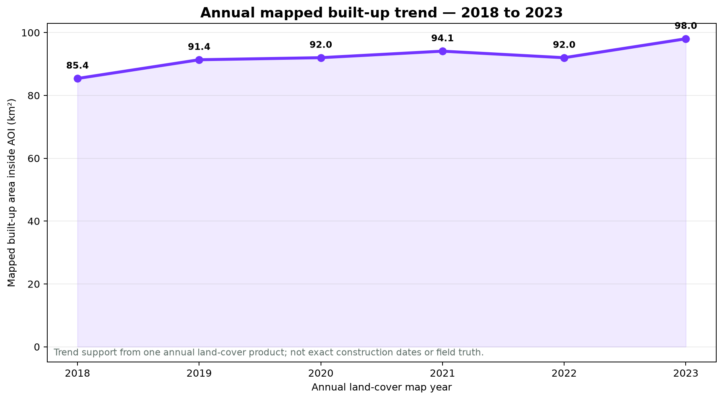
APPENDIX
10
What the validation can — and cannot — prove
VALIDATION LOGIC
•
West strip trains; middle strip tunes; east strip tests against WorldCover.
•
The test set is spatially separate and contains more than 10,000 reference pixels.
•
The annual time series supports trend interpretation; the 2022 dip shows why it is not construction truth.
•
No field survey, air-temperature model, health outcome or municipal acceptance test is claimed.
Operational validation must measure useful inspections and false alarms with a real user.
APPENDIX • MILKAHOLICS • ARAB YOUTH SPACE HACKATHON: 813 CHALLENGE
Notes:
Appendix only. Use for questions about leakage, train-test geography, annual trend uncertainty or the difference between satellite agreement and field accuracy.

Slide 11
APPENDIX
11
Fast answers judges may ask for
Why 1 km cells?
Why these weights?
They match the population layer and support early area screening; they do not select an individual building.
They are transparent PoC assumptions: 40% heat, 30% population, 20% growth, 10% lack of vegetation. A real user must review them.
Why not use NDBI alone?
Can judges reproduce it?
Bright desert can look built-like. Tanager and the optical-radar model show why multiple evidence sources are safer.
Yes. The public repository has pinned requirements, a run-all sample notebook, example input/output and the full source pipeline.
What happens if the score is wrong?
What is next?
No automatic action follows. The cost is wasted inspection time, so the pilot measures false alarms before operational use.
User interviews, top-five field checks, local constraints, updated weights and a repeatable test in another Riyadh area.
APPENDIX • MILKAHOLICS • ARAB YOUTH SPACE HACKATHON: 813 CHALLENGE
Notes:
Appendix only. Yusuf handles the problem, data, method, scoring calculation, demo and reproducibility. Raed handles validation meaning, limitations, innovation, user impact, false alarms and the pilot plan.

