Slide 1
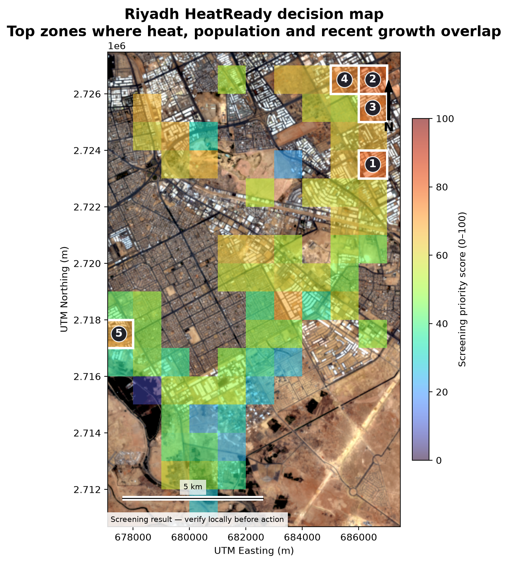
SATELLITE-DERIVED PRIORITY MAP
RIYADH
HeatReady
A growth-to-heat priority map for southeastern Riyadh
One clear decision
Which 1 km zones should a municipal planning and heat-resilience team inspect first?
Milkaholics • Urban Expansion, Land Use Change & Heat Risk • United Arab Emirates
Notes:
Sources: Project output outputs/decision_map.png; official challenge and submission guide https://spaceacademy-hackathons.space.gov.ae/guides/poc-submission-guide.html

Slide 2
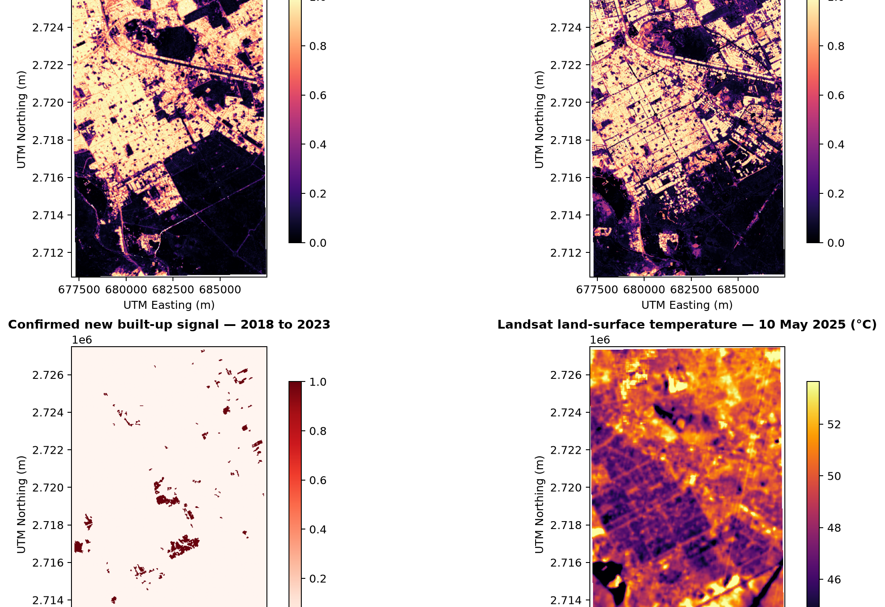
PROBLEM
02
Growth and heat are visible - but the decision is fragmented
168.30
km² study area
Planners may need to compare separate growth, heat, population, and vegetation layers before choosing where to inspect.
Affected group
Residents and workers in fast-changing, hot urban-fringe zones.
MILKAHOLICS • ARAB YOUTH SPACE HACKATHON: 813 CHALLENGE
Notes:
Sources: project outputs/results_summary.json and outputs/analysis_overview.png. The affected group is a problem hypothesis, not a measured health-outcome claim.

Slide 3
BUSINESS USE CASE
03
One user. One decision. One testable PoC.
USER
DECISION
ACTION
Municipal planning + heat-resilience team
Where should we inspect first?
Local review before intervention
Reviews zones, local plans, infrastructure, and field conditions.
Output: ranked 1 km cells with the evidence behind each score.
Shade, trees, cool roofs, or pavements are options to assess - not automatic recommendations.
HONEST GAP
No municipal user interview has happened yet. The current workflow and value are hypotheses to test during incubation.
MILKAHOLICS • ARAB YOUTH SPACE HACKATHON: 813 CHALLENGE
Notes:
Sources: README.md business use case; official guide requirement to identify the end user and decision. No user validation is claimed.

Slide 4
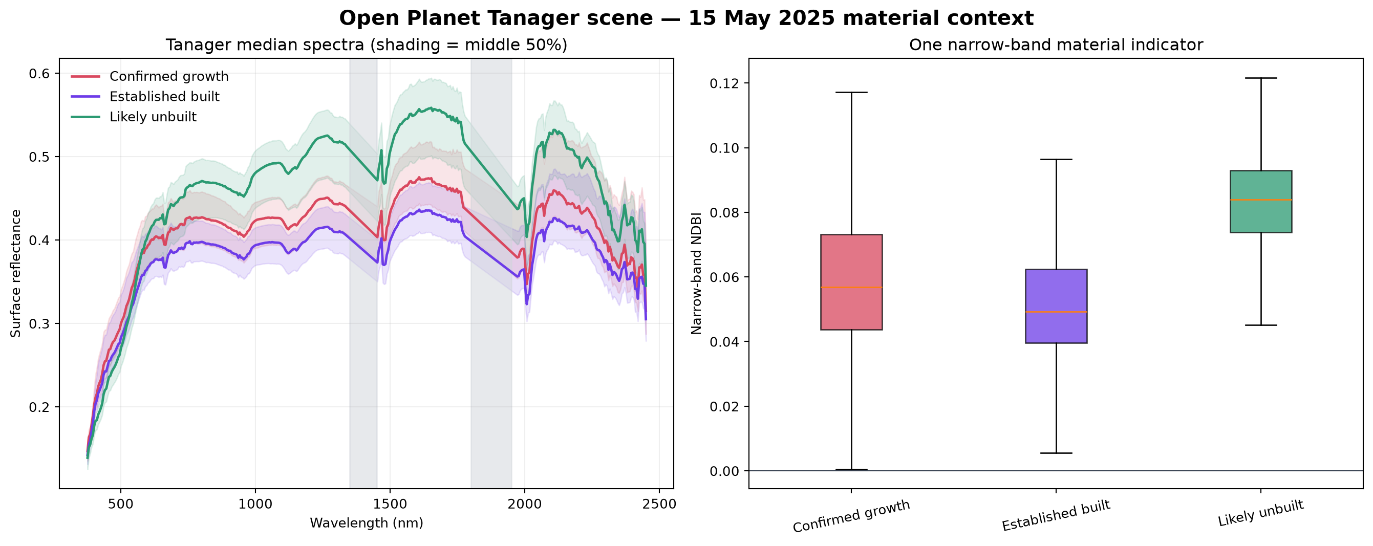
SPACE DATA
04
Every source has one job - and the result depends on EO
Sentinel-2
Optical reflectance, quality mask, vegetation + built features
Sentinel-1
Radar structure to reduce bright-desert confusion
Annual LULC
Six mapped years propose 2018-2023 growth
Landsat 8
2025 land-surface temperature
WorldPop
Modelled 2025 population exposure
Hyperspectral role
Tanager improves the analysis by testing a known desert failure mode. Likely-unbuilt surfaces had higher median narrow-band NDBI than established-built surfaces.
Planet Tanager
426-band 2025 spectra: material context + failure-mode test
MILKAHOLICS • ARAB YOUTH SPACE HACKATHON: 813 CHALLENGE
Notes:
Sources: docs/DATA_AND_LICENSES.md; Copernicus https://dataspace.copernicus.eu/terms-and-conditions; Landsat https://www.usgs.gov/faqs/are-landsat-data-cloud-still-considered-be-within-public-domain; WorldCover https://esa-worldcover.org/en/data-access; WorldPop https://hub.worldpop.org/geodata/summary?id=79157; Planet Tanager STAC https://www.planet.com/data/stac/tanager-core-imagery/urban/collection.json; project output outputs/tanager_material_analysis.png.

Slide 5
TECHNICAL APPROACH
05
A conservative chain from open scenes to inspection priority
1
2
3
4
5
Align + mask
Learn built signal
Propose change
Confirm growth
Rank 1 km cells
Exact scenes
30 m grid
quality filters
Sentinel-2 + SAR
west train
middle tune
Six annual maps
2018 → 2023
Keep change only if
2025 fusion agrees
40% heat
30% people
20% growth
10% lack green
Validation design
The east side is held out for testing against WorldCover. The final growth layer must pass two independent tests: annual change + optical-radar confirmation.
MILKAHOLICS • ARAB YOUTH SPACE HACKATHON: 813 CHALLENGE
Notes:
Sources: docs/METHODOLOGY.md; src/run_analysis.py; outputs/validation_metrics.json. The validation reference is satellite-derived, not field truth.

Slide 6
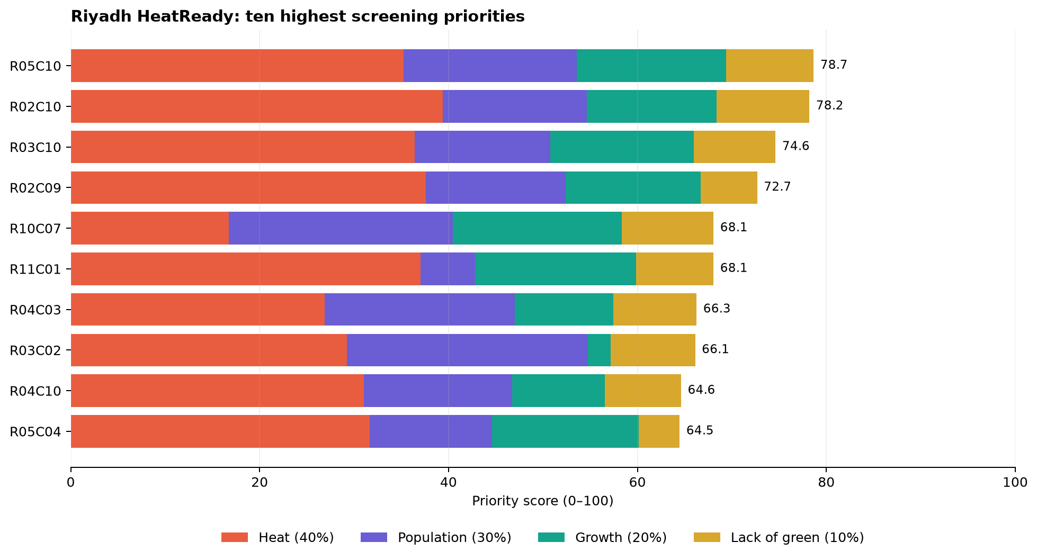
WORKING OUTPUT
06
Six data sources become one ranked inspection list
3.74 km²
14 / 67
78.7
confirmed growth signal
High / eligible cells
top score: R05C10
Screening result - verify locally before action
MILKAHOLICS • ARAB YOUTH SPACE HACKATHON: 813 CHALLENGE
Notes:
Sources: outputs/decision_map.png, results/example_priority_output.png, outputs/results_summary.json, and the executed notebooks/02_main_analysis.ipynb. Values are PoC results, not official city statistics.

Slide 7
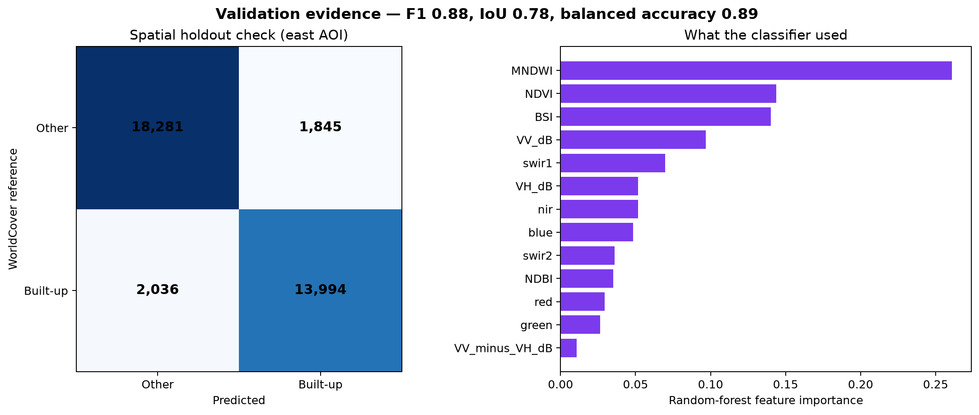
VALIDATION + LIMITS
07
Strong satellite agreement - with clear boundaries on the claim
0.88
0.78
F1 agreement
intersection over union
Four limits to remember
1 WorldCover agreement is not field accuracy.
2 Surface temperature is not air temperature.
3 WorldPop is modelled, not a census.
4 Bright desert can still confuse built surfaces.
The 2022 mapped-area dip is useful evidence of uncertainty - not something to hide.
MILKAHOLICS • ARAB YOUTH SPACE HACKATHON: 813 CHALLENGE
Notes:
Sources: outputs/validation.png and outputs/validation_metrics.json; ESA WorldCover https://esa-worldcover.org/en/data-access. Metrics are agreement with a satellite-derived reference in a spatial holdout, not independent field validation.

Slide 8
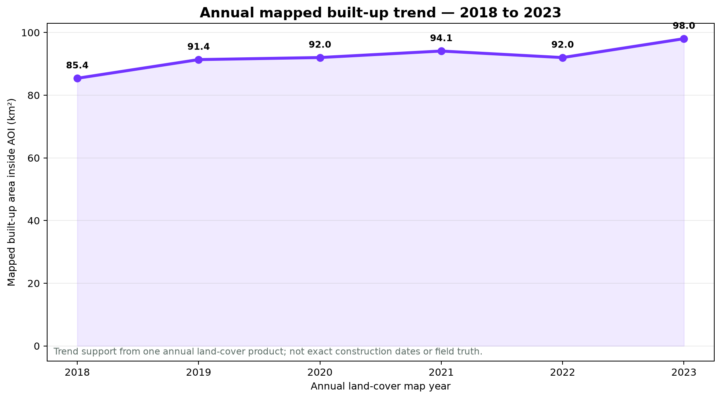
IMPACT
08
A repeatable screen can focus scarce local inspection time
PILOT HYPOTHESIS
Inspect the top five zones
A planning team compares the ranking with local plans and field conditions, then records useful hits, false alarms, and time saved.
Deliverable
Refreshable dashboard + CSV + GeoJSON + GeoTIFF
85.39
98.03
1 area
km² mapped in 2018
km² mapped in 2023
tested; not all Riyadh
MILKAHOLICS • ARAB YOUTH SPACE HACKATHON: 813 CHALLENGE
Notes:
Sources: outputs/annual_built_area_timeseries.png and outputs/results_summary.json. Impact and product adoption are hypotheses; no municipality, customer, time saving, revenue, or deployment is claimed.

Slide 9
INCUBATION PATH
09
Turn a credible screen into a user-validated municipal tool
01
Interview
3+ planners, GIS staff, or heat stakeholders
02
Agree
User decision, weights, thresholds, and success measure
03
Validate
Field-check top zones and label false alarms
04
Enrich
City plans, worker exposure, and higher-resolution data
05
Repeat
Run another Riyadh area and test update cost
Goal: prove usefulness with real users - then scale the data and product.
MILKAHOLICS • ARAB YOUTH SPACE HACKATHON: 813 CHALLENGE
Notes:
Sources: official submission guide https://spaceacademy-hackathons.space.gov.ae/guides/poc-submission-guide.html and project docs/PROJECT_BRIEF.md. No user-validation bonus is claimed in the current PoC.

