Slide 1

SATELLITE-DERIVED PRIORITY MAP
RIYADH
HeatReady
From satellite evidence to a clear municipal inspection priority
ONE DECISION
Which 1 km zones should a planning and heat-resilience team inspect first?
Milkaholics • Urban Expansion, Land Use Change & Heat Risk • United Arab Emirates
Notes:
0:00–0:20 | Yusuf. Riyadh HeatReady uses satellite data to rank 1 km zones in southeastern Riyadh where recent growth, hotter land surfaces and modelled population overlap. The decision is simple: where should a municipal team inspect first?

Slide 2
TEAM CAPABILITY
02
Two clear owners for one testable decision
YK
Yusuf Karanib
RM
Raed Mardoum
Project Lead and Data/Method Presenter
Validation, Workflow and Impact Lead
Project responsibility
Finals responsibility
•
Coordinates the final submission and live demonstration.
•
Explains validation evidence, limitations and safe interpretation.
•
Explains the problem, EO data, method, score and live demonstration.
•
Explains innovation, expected impact and the municipal pilot plan.
Project expertise: EO workflow, data processing and reproducibility.
Project responsibility: validation interpretation, decision workflow and pilot design.
MILKAHOLICS • ARAB YOUTH SPACE HACKATHON: 813 CHALLENGE
Notes:
0:20–0:55 | Yusuf. Introduce both team members by finals responsibility, without adding unverified education or employment. Yusuf presents slides 1–5: problem, data, method and demo. Raed presents slides 6–8: validation and limitations, innovation and impact, and the pilot plan. Planned speaking time is 4 minutes 45 seconds for Yusuf and 3 minutes 10 seconds for Raed.

Slide 3
PROBLEM, USER AND NEED
03
The problem is not missing maps — it is a fragmented decision
168.30 km²
1 km
1 user
1 action
SOUTHEASTERN RIYADH STUDY AREA
TRANSPARENT SCREENING CELLS
MUNICIPAL PLANNING + HEAT TEAM
INSPECT LOCALLY BEFORE INTERVENTION
CURRENT PAIN
TESTABLE MVP
Growth, heat, population and vegetation sit in separate layers. A planner still needs a short, explainable list of places to inspect.
A ranked layer, dashboard and GIS files that show the score and its evidence — without automatically selecting a cooling intervention.
Honest gap: no municipal user interview has happened yet. The workflow and value must be tested during incubation.
MILKAHOLICS • ARAB YOUTH SPACE HACKATHON: 813 CHALLENGE
Notes:
0:55–1:50 | Yusuf. The study covers 168.30 square kilometres in southeastern Riyadh, not the whole city. The intended user is a municipal planning and heat-resilience team. The MVP ranks 1 km zones for inspection. It does not prescribe trees, roofs or pavements automatically. No user interview is claimed.

Slide 4

SPACE DATA AND ANALYTICS
04
Six open sources, one conservative chain
Sentinel-2
Optical reflectance, vegetation and built features
Sentinel-1
Radar structure to reduce bright-desert confusion
Annual LULC
Six maps propose 2018–2023 built-up change
Landsat 8
Quality-masked 2025 land-surface temperature
WorldPop
Modelled 2025 population exposure
Planet Tanager
426-band material context and failure-mode test
Annual change proposes growth → separate 2025 optical + radar evidence confirms it → heat, population and vegetation rank eligible cells.
MILKAHOLICS • ARAB YOUTH SPACE HACKATHON: 813 CHALLENGE
Notes:
1:50–3:10 | Yusuf. Each source has one job. Annual land cover proposes endpoint growth. A separate Sentinel-2 and Sentinel-1 model confirms pixels that still look built-up in 2025. Landsat adds land-surface temperature, WorldPop adds modelled exposure, and Sentinel-2 adds vegetation. Tanager tests a desert failure mode. The score is 40 percent heat, 30 percent population, 20 percent confirmed growth and 10 percent lack of vegetation.

Slide 5

WORKING OUTPUT
05
A ranked map a planner can inspect and export
3.74 km²
14 / 67
78.7
CONFIRMED GROWTH SIGNAL
HIGH / ELIGIBLE CELLS
TOP SCORE: R05C10
Demo path: open dashboard → select top zone → inspect heat, population, growth and green components → export CSV/GeoJSON/GeoTIFF.
MILKAHOLICS • ARAB YOUTH SPACE HACKATHON: 813 CHALLENGE
Notes:
3:10–4:45 | Yusuf. Demonstrate the dashboard. The stricter rule retained 3.74 square kilometres of confirmed growth. Fourteen of 67 eligible cells are High priority. R05C10 is first at about 78.7. Show that each bar exposes the score components. The map is a screening result, so a local check must happen before action. Handoff: Raed will now explain what the validation proves, what makes the approach different and how we would test it with a municipality.

Slide 6

SCIENTIFIC VALIDITY
06
Measured agreement, explicit assumptions, bounded claims
0.88
0.78
0.89
These compare the model with a spatially separate WorldCover reference. They are not field accuracy.
F1 AGREEMENT
INTERSECTION OVER UNION
BALANCED ACCURACY
LIMITS JUDGES SHOULD HEAR
•
Land-surface temperature is not air temperature or personal heat exposure.
•
WorldPop is modelled; it is not a live census or worker count.
•
Bright desert and roofs can still confuse classification.
•
Score weights are PoC assumptions that a real user must review.
MILKAHOLICS • ARAB YOUTH SPACE HACKATHON: 813 CHALLENGE
Notes:
4:45–5:55 | Raed. The spatial east-side holdout reached F1 0.88, IoU 0.78 and balanced accuracy 0.89 against WorldCover. These numbers measure agreement with another satellite product, not field accuracy. Land-surface temperature is not air temperature. WorldPop is modelled. Bright desert remains difficult, and a municipal user must review the score weights. These limits are why the output supports inspection rather than automatic action.

Slide 7

INNOVATION AND DIFFERENTIATION
07
The value is the evidence chain — not a black-box score
WHAT IS DIFFERENT
•
Annual maps propose change; independent optical and radar evidence confirms it.
•
Tanager tests why a simple high-NDBI-means-built rule can fail in bright desert.
•
Every ranked cell keeps visible score components and GIS-ready evidence.
Careful claim: one Tanager date adds material context. It does not prove change or identify specific materials.
POTENTIAL IMPACT
Reduce time spent comparing separate datasets and create a repeatable way to select field-inspection priorities. This is a hypothesis until real users test it.
MILKAHOLICS • ARAB YOUTH SPACE HACKATHON: 813 CHALLENGE
Notes:
5:55–6:55 | Raed. The innovation is the conservative, explainable chain. Annual change proposes growth, while separate optical and radar evidence confirms it. Tanager showed why one simple NDBI threshold can fail in bright desert. Every zone keeps visible score components and GIS evidence. The possible impact is faster, repeatable screening, but we cannot claim that benefit until real users test it.

Slide 8
DEVELOPMENT POTENTIAL
08
Turn the PoC into a measured municipal pilot
1
2
3
4
Interview
Validate
Adapt
Scale
Confirm the decision, current workflow and acceptable false alarms with at least three real users.
Inspect the top five zones, record useful results and false alarms, and compare with local plans.
Agree on weights, add worker exposure and city-plan constraints, then rerun the ranking.
Test a repeatable update in another Riyadh area before any operational deployment claim.
THE FINAL ASK
Support one municipal pilot that tests whether HeatReady helps a real team choose where to inspect first — with measurable false alarms, user feedback and updated weights.
MILKAHOLICS • ARAB YOUTH SPACE HACKATHON: 813 CHALLENGE
Notes:
6:55–7:55 | Raed. The next stage is a measured pilot, not a deployment claim. First interview users and confirm the workflow. Then inspect the top five zones and record useful results and false alarms. Adjust weights and add local constraints. Finally test a repeatable update in another Riyadh area. Our ask is support for one municipal pilot that measures whether the ranking improves screening.

Slide 9
APPENDIX
09
Exact data roles and dates
Source | Dates used | Role | Access / licence
Sentinel-2 L2A | 11 May 2018; 10 May 2021; 9 May 2025 | Optical features, masks, vegetation | Copernicus open access
Sentinel-1 RTC | 10 May 2018; 6 May 2021; 9 May 2025 | Radar structure | Microsoft PC; CC BY 4.0
IO/Esri annual LULC | 2018–2023 | Trend + candidate endpoint change | CC BY 4.0
Landsat 8 C2 L2 | 10 May 2025 | Land-surface temperature | US public domain
ESA WorldCover | 2021 | Spatial holdout reference | CC BY 4.0
WorldPop Global2 | 2025 | Modelled population | CC BY 4.0
Planet Tanager | 15 May 2025 | Spectral context + sensitivity test | Open urban archive; CC BY 4.0
Exact item IDs, URLs, processing and attribution are in config.json and docs/DATA_AND_LICENSES.md. The PoC does not use Satellite 813 or restricted imagery.
APPENDIX • MILKAHOLICS • ARAB YOUTH SPACE HACKATHON: 813 CHALLENGE
Notes:
Appendix only. Open if a judge asks for exact source dates, roles or licences.

Slide 10
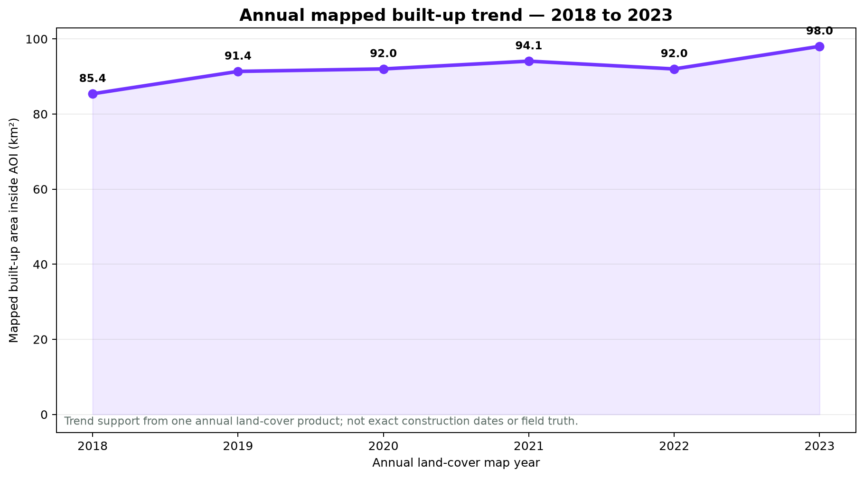
APPENDIX
10
What the validation can — and cannot — prove
VALIDATION LOGIC
•
West strip trains; middle strip tunes; east strip tests against WorldCover.
•
The test set is spatially separate and contains more than 10,000 reference pixels.
•
The annual time series supports trend interpretation; the 2022 dip shows why it is not construction truth.
•
No field survey, air-temperature model, health outcome or municipal acceptance test is claimed.
Operational validation must measure useful inspections and false alarms with a real user.
APPENDIX • MILKAHOLICS • ARAB YOUTH SPACE HACKATHON: 813 CHALLENGE
Notes:
Appendix only. Use for questions about leakage, train-test geography, annual trend uncertainty or the difference between satellite agreement and field accuracy.

Slide 11
APPENDIX
11
Fast answers judges may ask for
Why 1 km cells?
Why these weights?
They match the population layer and support early area screening; they do not select an individual building.
They are transparent PoC assumptions: 40% heat, 30% population, 20% growth, 10% lack of vegetation. A real user must review them.
Why not use NDBI alone?
Can judges reproduce it?
Bright desert can look built-like. Tanager and the optical-radar model show why multiple evidence sources are safer.
Yes. The public repository has pinned requirements, a run-all sample notebook, example input/output and the full source pipeline.
What happens if the score is wrong?
What is next?
No automatic action follows. The cost is wasted inspection time, so the pilot measures false alarms before operational use.
User interviews, top-five field checks, local constraints, updated weights and a repeatable test in another Riyadh area.
APPENDIX • MILKAHOLICS • ARAB YOUTH SPACE HACKATHON: 813 CHALLENGE
Notes:
Appendix only. Yusuf handles the problem, data, method, scoring calculation, demo and reproducibility. Raed handles validation meaning, limitations, innovation, user impact, false alarms and the pilot plan.

