Slide 1
Cyclistic Bikes
Presented By: Yusuf Serdar Aytekin
Last Updated: July 14th, 2023

Slide 2
Cyclistic Bikes
Purpose Statement (What are we talking about?)
Description of The Data Source
Cleaning Process of The Data
Story (the analysis of data)
Conclusion

Slide 3
Purpose Statement
My task is to find correlations between the annual members and casual members in how and when they use their bikes.
By doing this, we can understand why casual riders would buy a membership so that we can convert them into annual members.

Slide 4
Description of The Data Source
I used 12 months of the previous year (2022) of Cyclistic trip data.
All of them include ride_id, date, and station information up to 12 features.

Slide 5
Cleaning Process of The Data
First of all, I imported pandas and sqlite3 libraries for the data process.
Next, I dropped the null values and converted the started_at and ended_at features into Date Time.
I created features ride_length and day_of_week.
I cleaned the data frames by dropping the rows having ride length zero and interchanging the incorrect date values.
I created SQL tables for each month using sqlite3.
Finally, I grouped all the months by seasons and concatenated them to create year data frame.

Slide 6
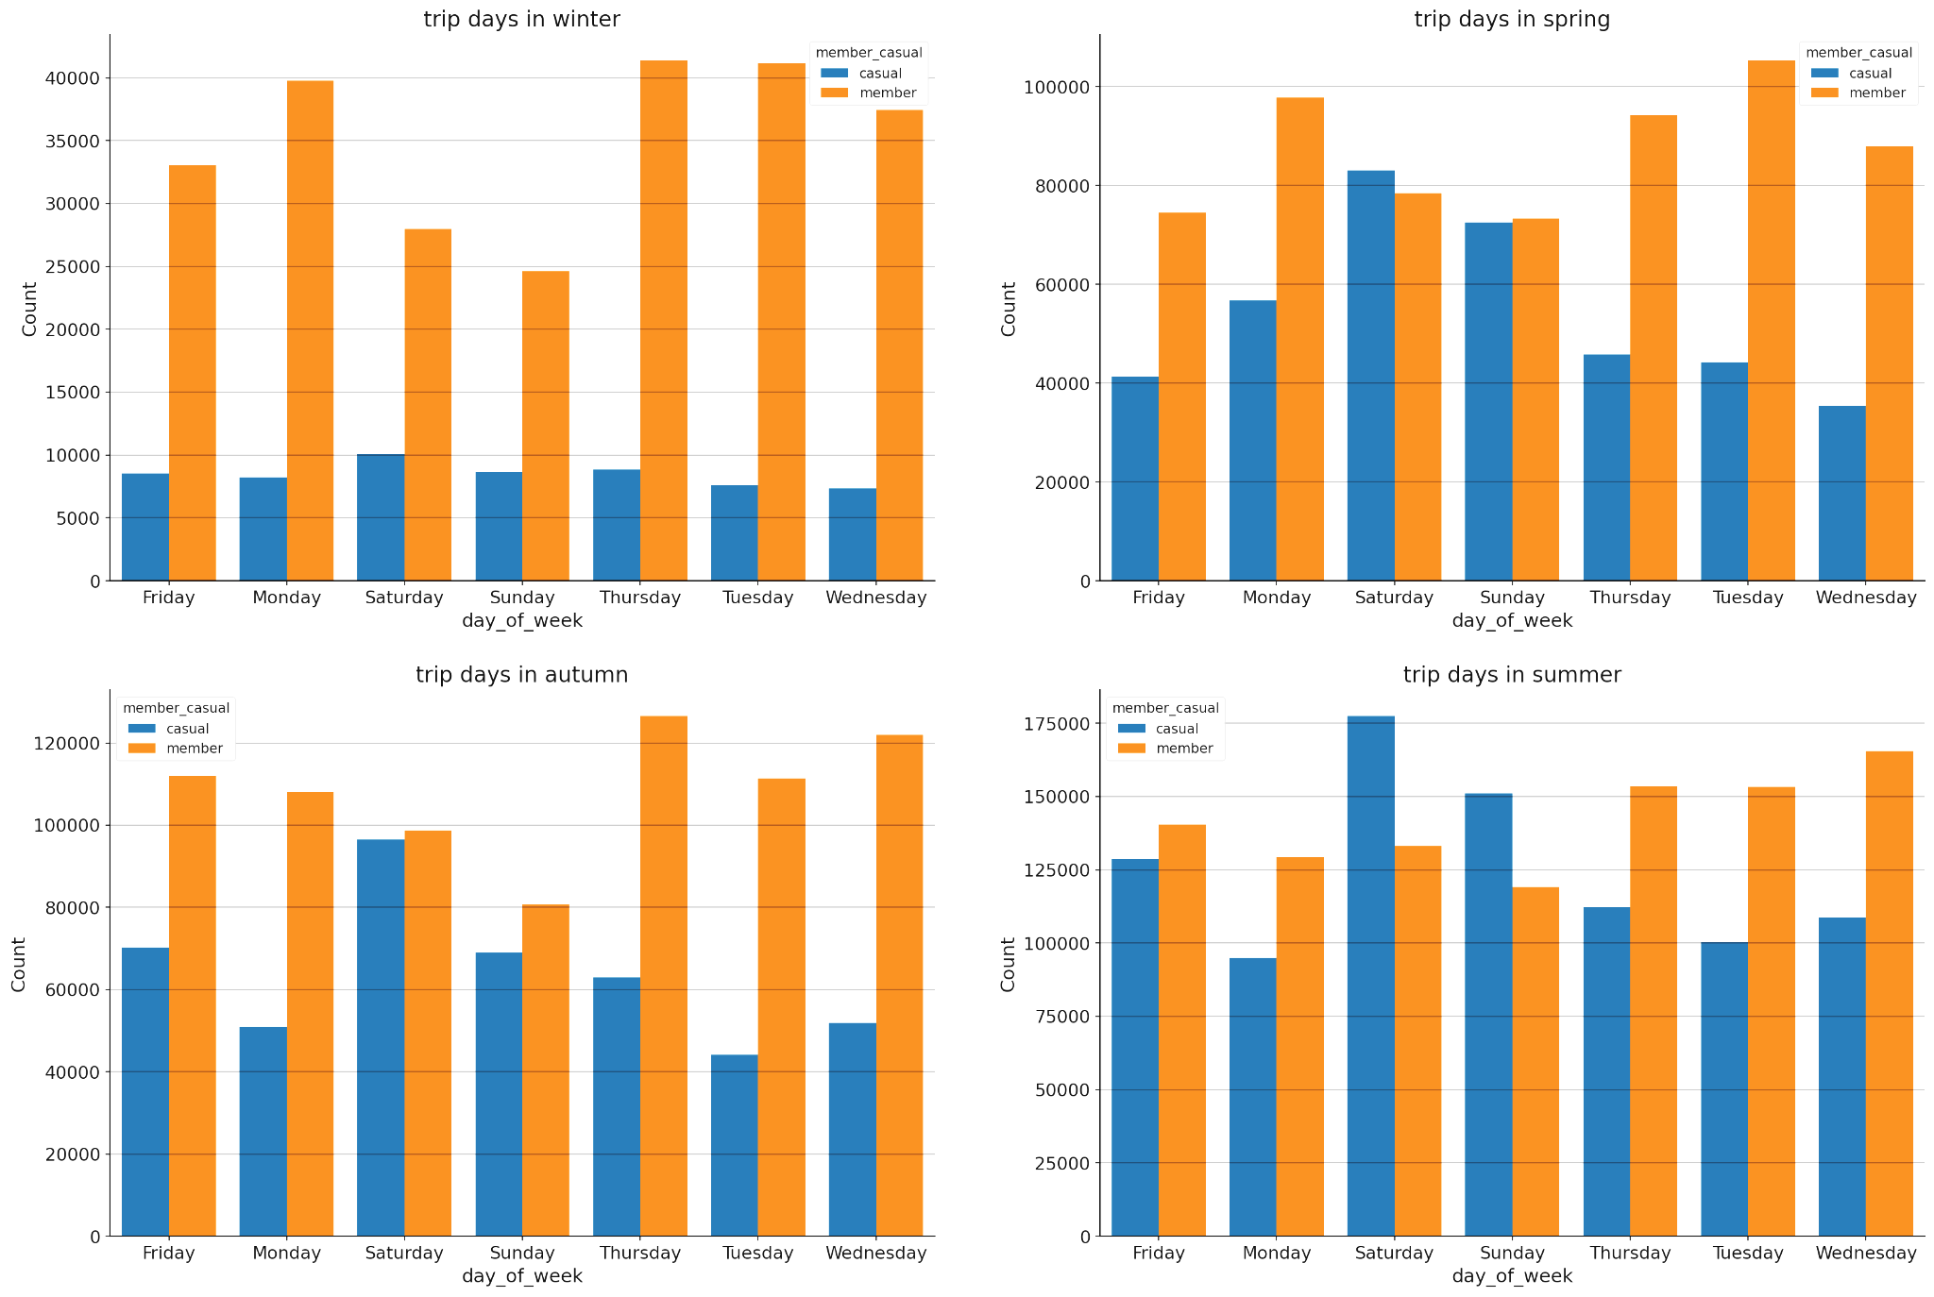
Story
Preferred Days of Members
Casual members prefer to ride on weekends.
Annual members generally prefer to ride on weekdays.

Slide 7
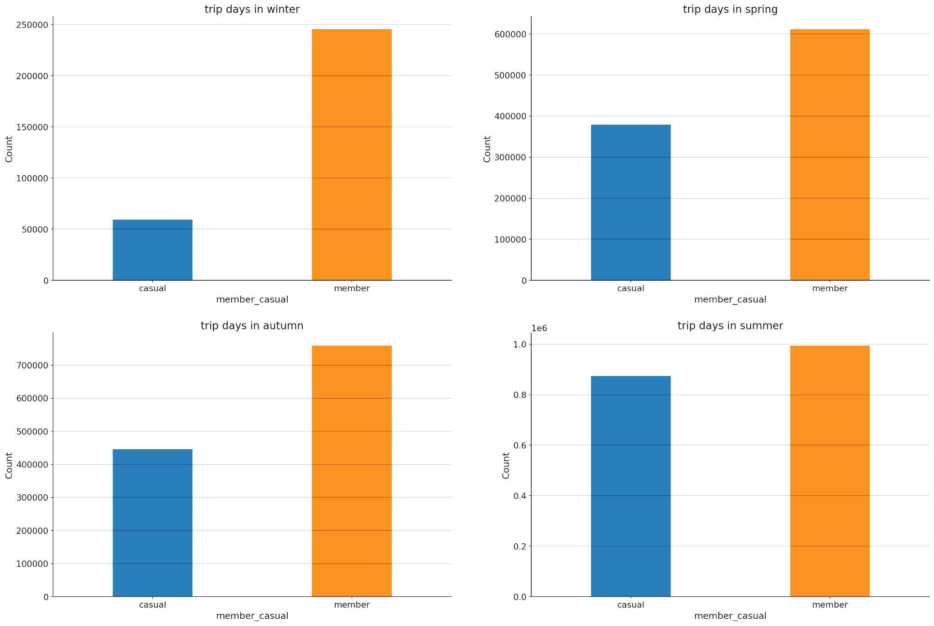
Number of Members in Each Season
Casual members generally prefer riding in Summer.
Annual members don’t have a preference.

Slide 8
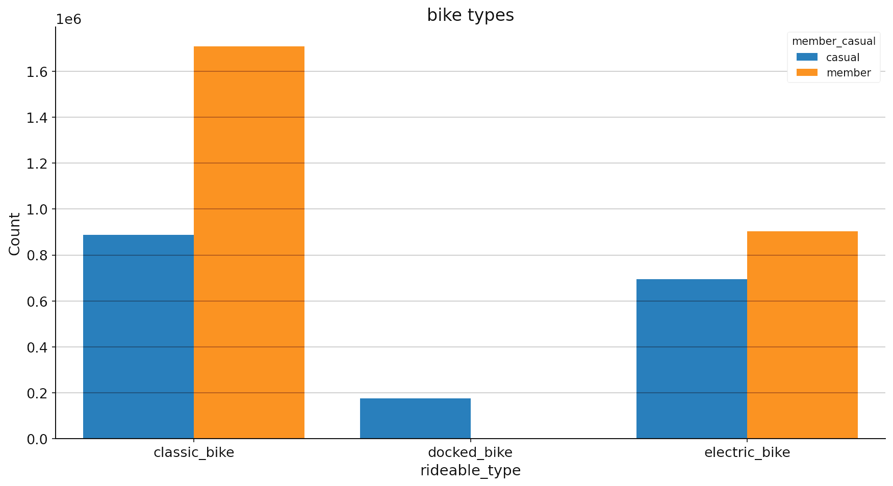
Bike Types - Members
None of the annual members use docked bikes.
Annual members generally use classic bikes.

Slide 9
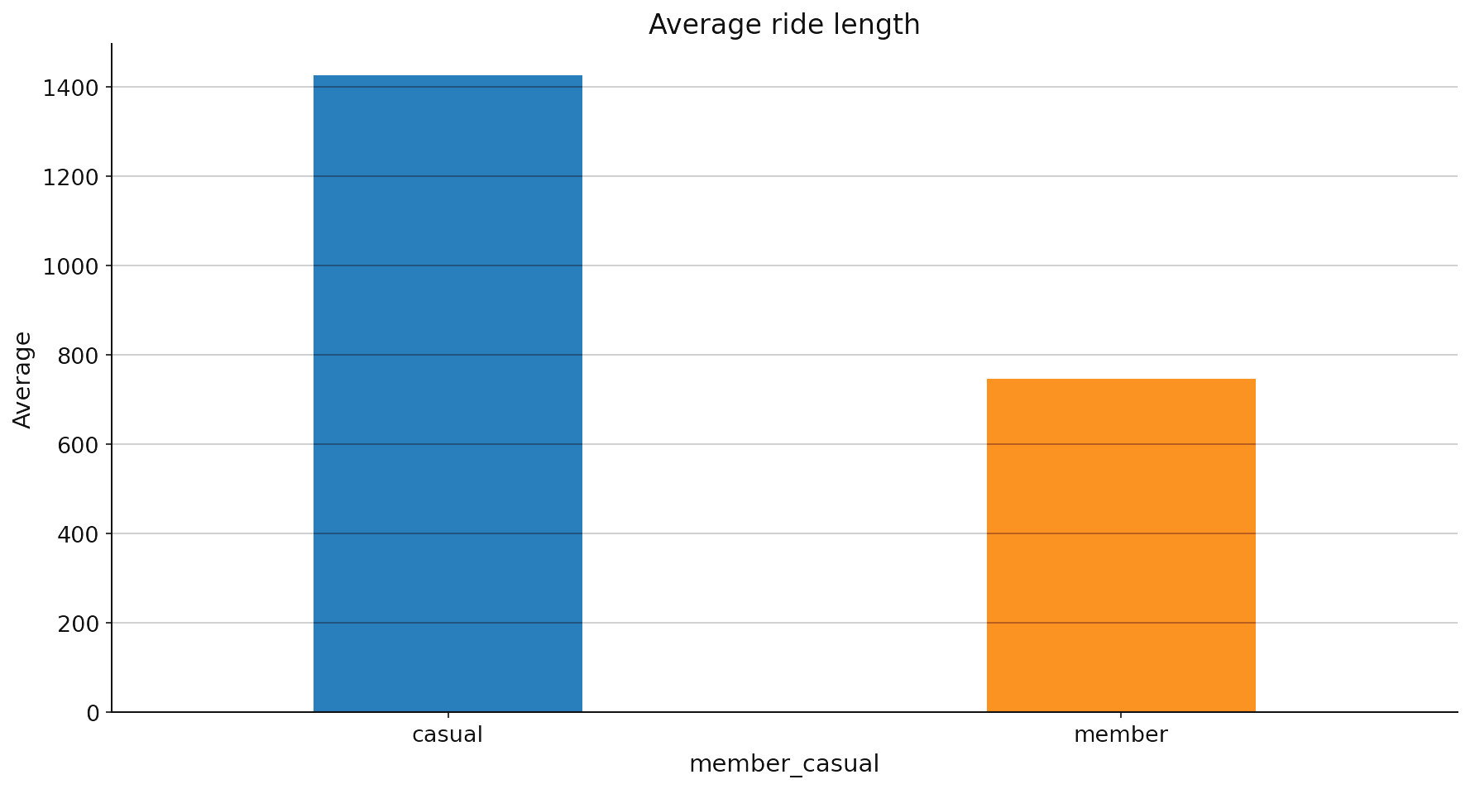
Average Ride Length of The Members
The average ride length of casual members is generally higher than that of annual members.

Slide 10
Conclusion

Slide 11
Conclusion
We should find better alternative bike types to docked bikes.
We should investigate further why casual members generally prefer riding on weekends.
We may organise events or other projects for annual members in summer to attract casual members.

Slide 12
Thank You

