Slide 1
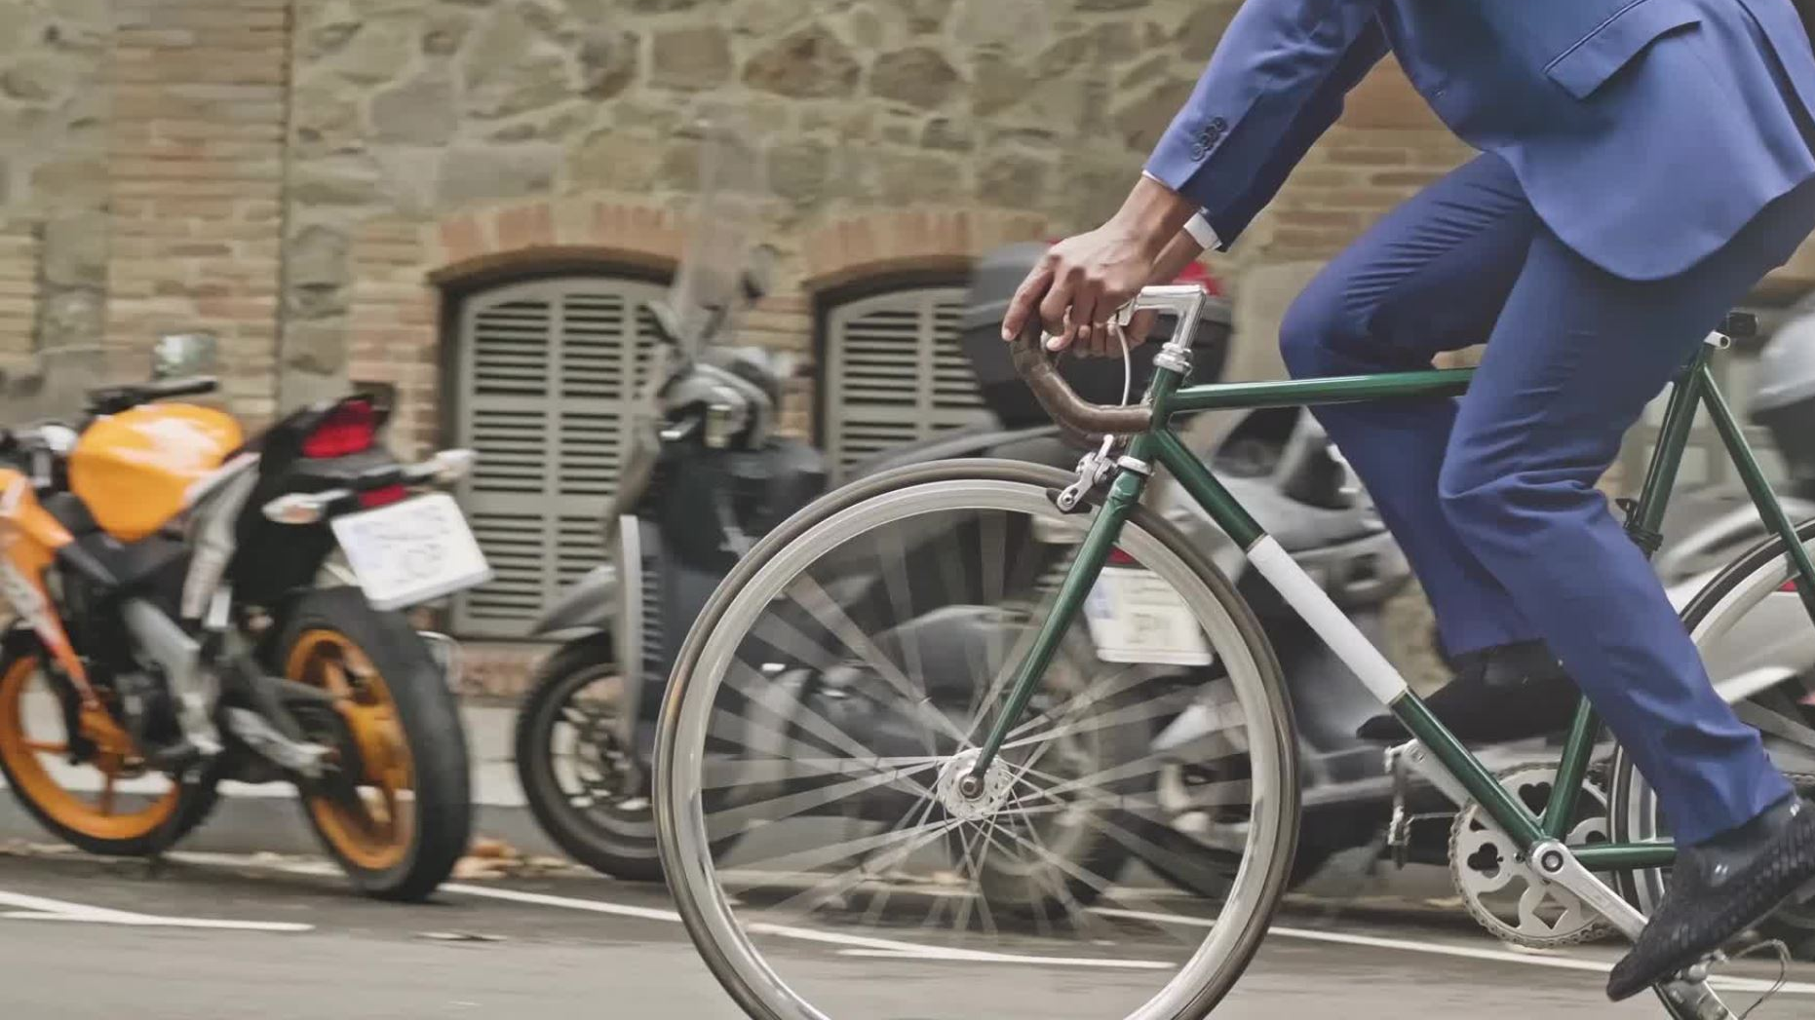
Cyclistic Bikes
Presented by: Yusuf Serdar Aytekin
Last Updated: September 9th, 2024

Slide 2
Cyclistic bikes
Purpose Statement (What are we talking about?)
Description of the Data Source
Cleaning Process of the Data
Story (the analysis of the data)
Conclusion

Slide 3
Purpose statement
The objective is to identify correlations between annual and casual members in terms of how and when they use their bikes.
This will enable us to understand why casual cyclists would buy a membership and how we can convert them into annual members.

Slide 4

Description of the data source
The data set comprised 12 months of cyclistic trip data from the previous year (2022).
Each entry included the ride ID, date, and station information, along with up to 12 features.

Slide 5

Cleaning Process of The Data
First of all, I imported pandas and sqlite3 libraries for the data process.
Next, I dropped the null values and converted the started_at and ended_at features into Date Time.
I created features ride_length and day_of_week.
I cleaned the data frames by dropping the rows having ride length zero and interchanging the incorrect date values.
I created SQL tables for each month using sqlite3.
Finally, I grouped all the months by seasons and concatenated them to create year data frame.

Slide 6
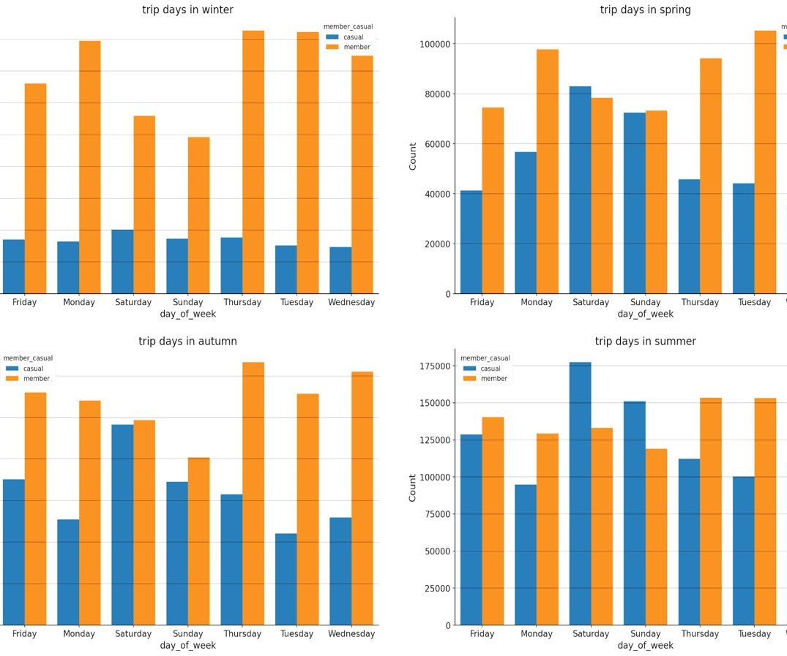
Story
Preferred Days of Members
Casual members prefer to ride on weekends.
Annual members generally prefer to ride on weekdays.

Slide 7
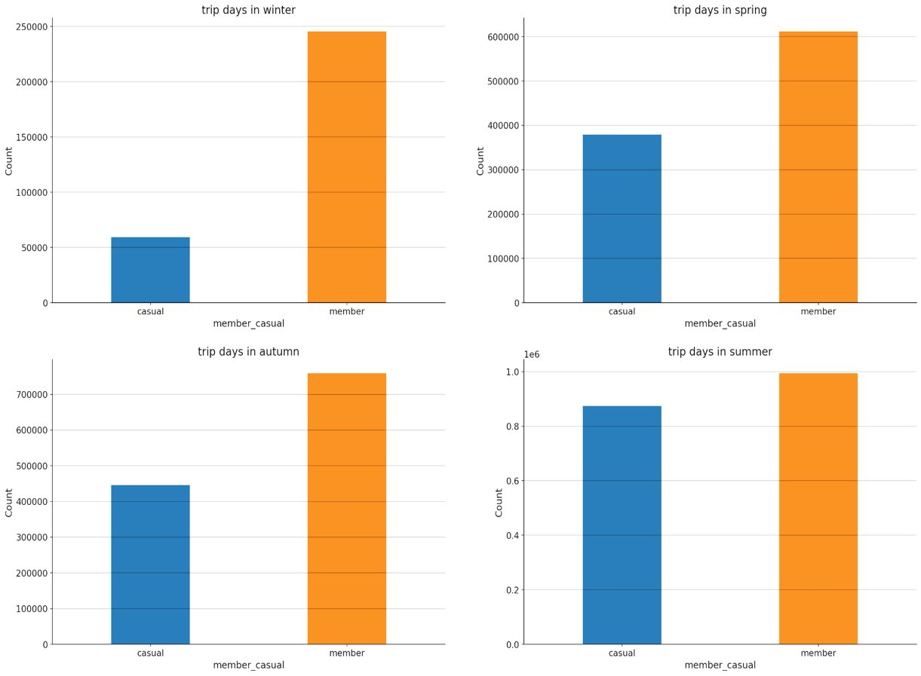
Number of Members in Each Season
Casual members generally prefer riding in Summer.
Annual members don’t have a preference.

Slide 8
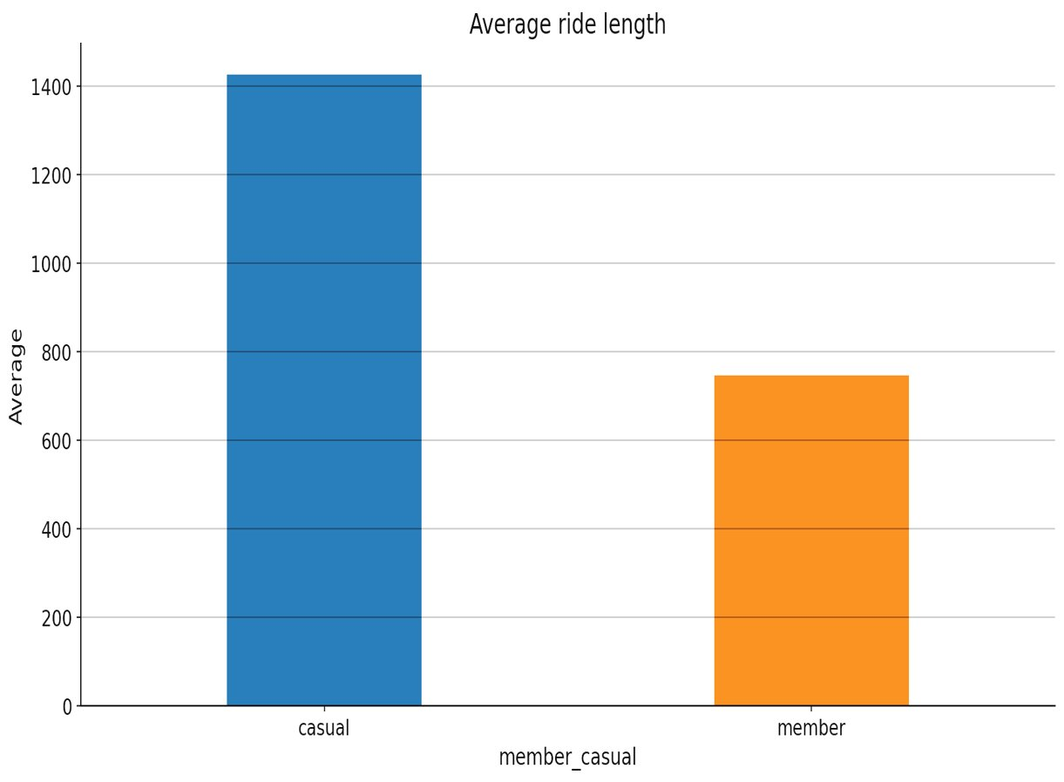
Average Ride Length of The Members
The average ride length of casual members is generally higher than that of annual members.

Slide 9

Conclusion

Slide 10

Conclusion
We should find better alternative bike types to docked bikes.
We should investigate further why casual members generally prefer riding on weekends.
We may organise events or other projects for annual members in summer to attract casual members.

