Slide 1

Weekly achievements
01
02
Git & Github
Python Frameworks: Flask & FastAPI
03
04
MLFLOW
Data Visualization with Power BI
05
Time series

Slide 2


Git & Github
Git
Github
A tool/program that controls system helps you track changes in your code, move between versions, and collaborate with others
A platform/website that hosts Git repositories in the cloud Makes it easy to share code, collaborate, review pull requests, and manage projects online.

Slide 3

Choosing Your API Framework: Flask vs. FastAPI
Flask: Simplicity & Flexibility
FastAPI: Performance & Productivity
A lightweight micro-framework, ideal for smaller applications or when you need granular control. It's easy to get started and offers high customization, though it requires more external libraries for advanced features.
Built on Starlette and Pydantic, FastAPI delivers excellent performance with asynchronous capabilities and automatic data validation/serialization. It's perfect for building robust, high-speed APIs for time-series data.

Slide 4
MLFLOW
MLflow is an open-source platform that helps you manage the machine learning lifecycle :
1-Tracking :
Record experiments (which model you used, parameters you tried, and metrics (accuracy and how you evaluate your model)).
2-Projects :
Organize your ML code in a standard way.
Makes it easy for others to run your project with the same environment.
3-Models :
Standard format to save models.
Easy to deploy on REST API, Docker, or cloud platforms.
4-Model Registry :
A central store for models.
Gives models versions and status.

Slide 5
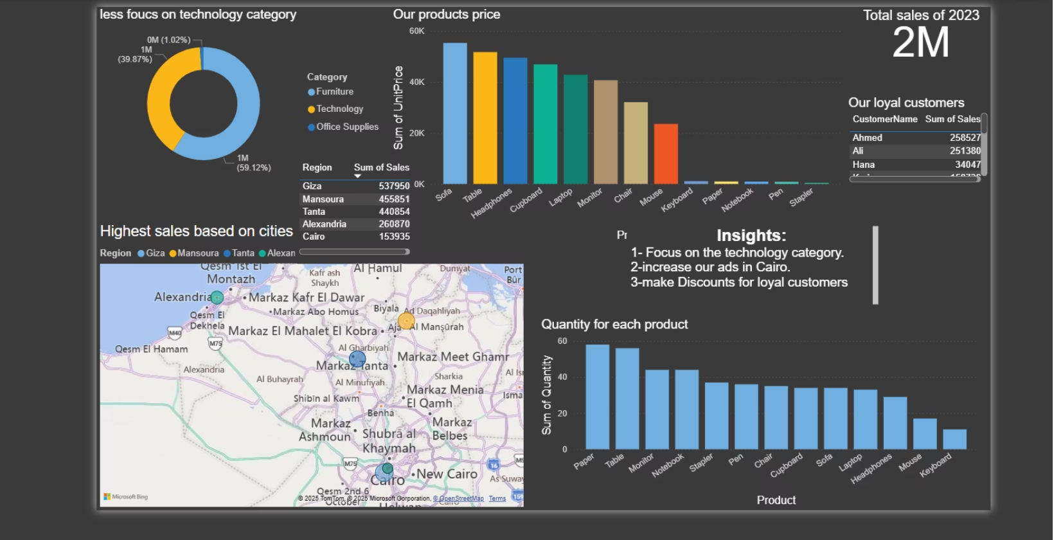
Insights with Power BI
Power BI is a business intelligence tool by Microsoft
It helps you in :
Connect to data (Excel, SQL, CSV, APIs, etc.)
Clean & transform data
Visualize data with charts, dashboards, reports
Share insights with others (online or mobile)
Benefits of Power BI :
Useful for data analysis & decision making.
Interactive dashboards.
Connects to many data sources.
Easy drag-and-drop interface.

Slide 6

Time-Series Data & AI
"The true value of time-series data isn't just in what it tells us about the past, but how it empowers us to shape the future with AI-driven predictions."
Why Time Series Is Special :
Data is sequential (order matters).
Past values can affect future values.
Often has patterns (trend , seasonality, noise)

Slide 7
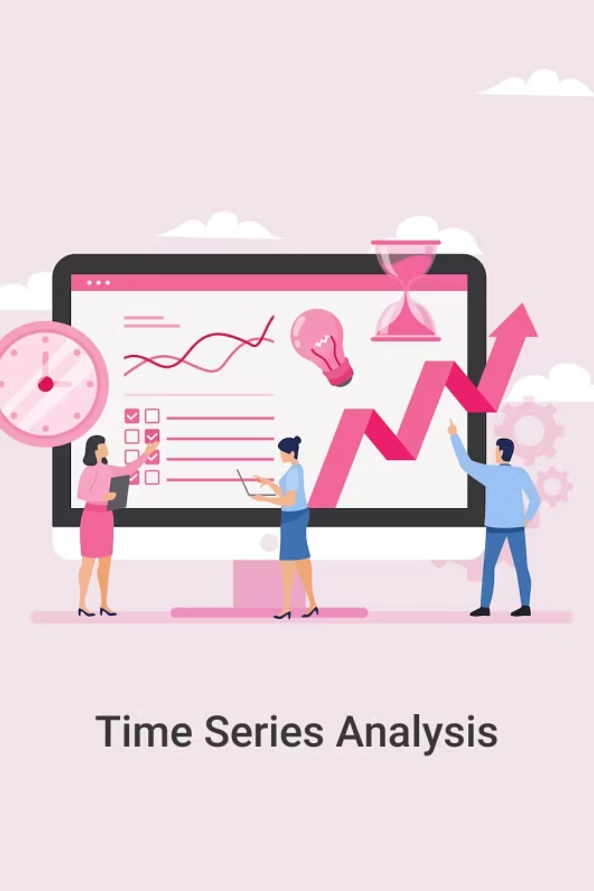
Uses of Time Series :
Forecasting sales for next month.
Predicting weather.
Stock market analysis.

Slide 8

THANK YOU for reading

