Slide 1
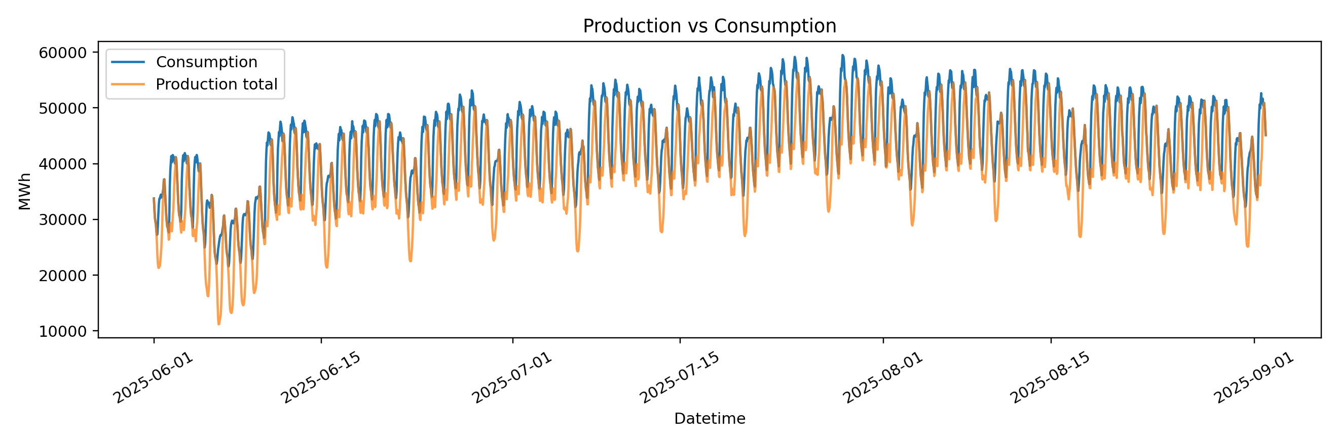
Electricity Consumption Forecasting
Decision Tree and XGBoost for hourly load prediction
MEE344 Machine Learning – Term Project
Group Members: Yusuf Ali Demirkıran 200029900
Fatih Umut Sadıkoğlu 200030322
Batuhan Çanga Y23LELE001
Doğukan Akhan 200027062
Bahadır Çetin 200026717
Dataset window: 1 Jun 2025 - 1 Sep 2025
Target: hourly electricity consumption (Tuketim)

Slide 2
Problem Definition
A supervised regression task with explicit forecasting constraints
Input information
available before time t
Feature engineering
calendar + lags + rolling
Decision Tree /
XGBoost Regressor
Prediction
Tuketim_t
We predict hourly electricity consumption. The target is continuous, so the task is regression.
Same-hour production is excluded from the main model because it would not be known before forecasting that hour.
The model uses past consumption, past production and known calendar information.
MEE344 Machine Learning Term Project | 2

Slide 3
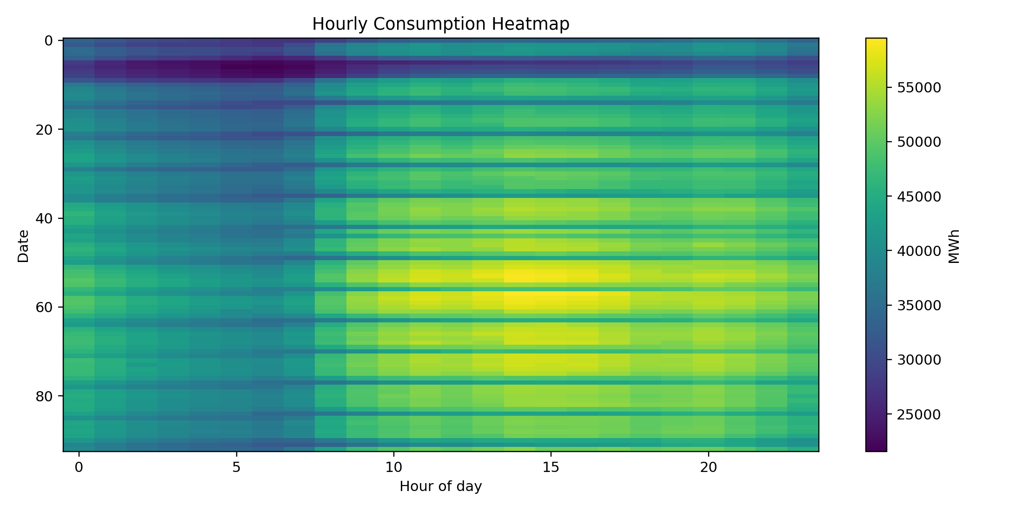
Dataset Overview
Two hourly CSV files are merged by timestamp
2232
2232
2064
309
37
raw production rows
raw consumption rows
modeled samples
test samples
features used
Item
Status
Time range
2025-06-01 00:00 to 2025-09-01 23:00
Frequency
Hourly, no gaps detected
Merge key
datetime
Target
Tuketim (MWh)
Constant columns removed
Nafta, LNG
MEE344 Machine Learning Term Project | 3

Slide 4
Preprocessing Decisions
Data cleaning was kept explicit and reproducible
Parse Turkish number formats
33.758,78 -> 33758.78
Create datetime
from Tarih + Saat
Merge production + consumption
by timestamp
Remove constant columns
Nafta, LNG
No raw missing values were found. Missing rows introduced by lag/rolling features are dropped after feature construction.
No nominal categorical variables were present. Date/time strings are encoded as numeric calendar and cyclic features.
No standardization is applied: Decision Tree and XGBoost are tree-based methods and do not require feature scaling.
MEE344 Machine Learning Term Project | 4

Slide 5
Exploratory Analysis: System Load
Consumption and production are correlated but not identical
Observation
Implication
Production total is not equal to consumption
Do not treat Toplam as target substitute
Consumption follows daily demand cycles
Use calendar features
Lag autocorrelation is strong
Use lag and rolling features
Key modeling choice: same-time production values are excluded from the main forecast to avoid feature availability leakage.
MEE344 Machine Learning Term Project | 5

Slide 6
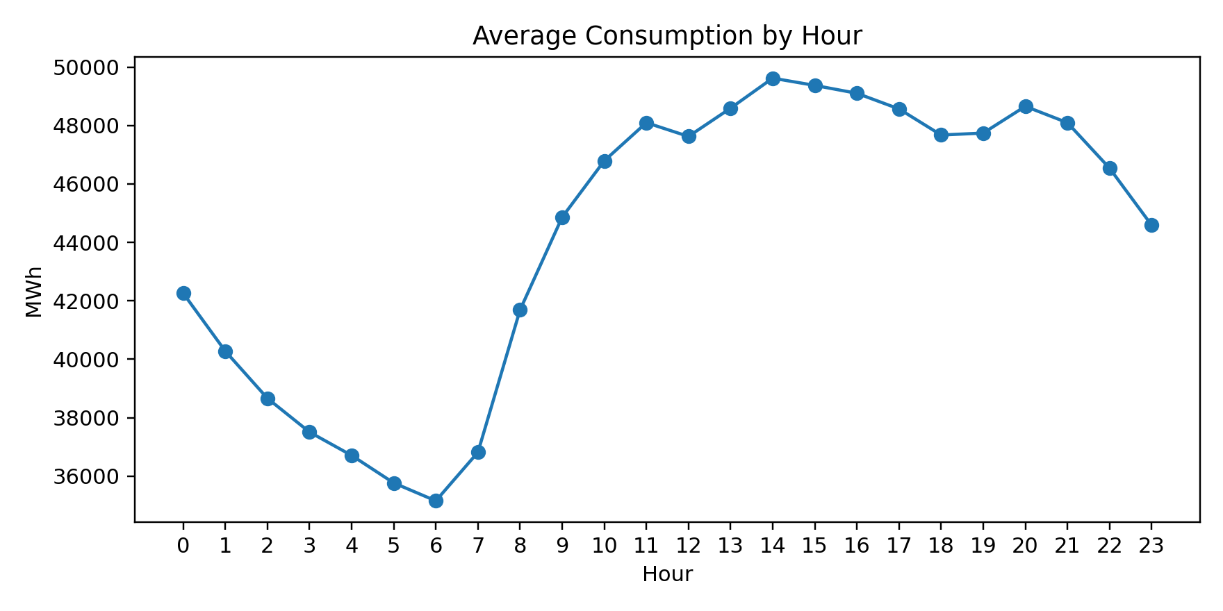
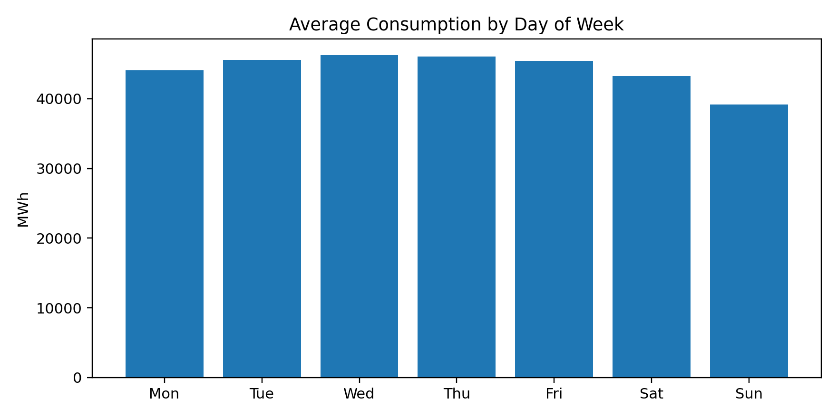
Exploratory Analysis: Temporal Patterns
Hourly and weekly structure justify calendar features
Average consumption rises after early morning and remains high during daytime/evening.
Weekends, especially Sunday, show lower average consumption than weekdays.
MEE344 Machine Learning Term Project | 6

Slide 7
Feature Engineering
Rows represent prediction time t; features use t-1 or earlier
Calendar at t
hour, day, weekend
sin/cos encodings
Consumption history
lag 1, 24, 168
rolling mean/std
Production history
Toplam_lags
source_lag_1
Target
Tuketim_t
Lag 1: previous hour. Lag 24: same hour yesterday. Lag 168: same hour last week.
Rolling features are computed as shift(1).rolling(...), so the target row is never included.
MEE344 Machine Learning Term Project | 7

Slide 8
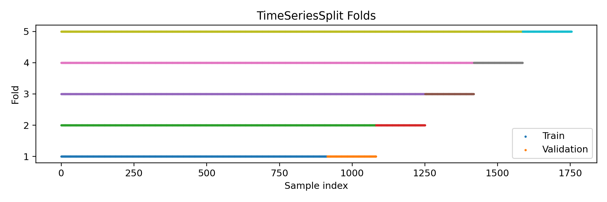
Validation Methodology
The test period is untouched until final evaluation
Split
Purpose
Earlier 85%
train + validation region
Last 15%
final test set
TimeSeriesSplit
hyperparameter tuning
Metrics
RMSE, MAE, R2
Random split is avoided because it can train on future samples and validate on past samples. TimeSeriesSplit preserves chronological order.
MEE344 Machine Learning Term Project | 8

Slide 9
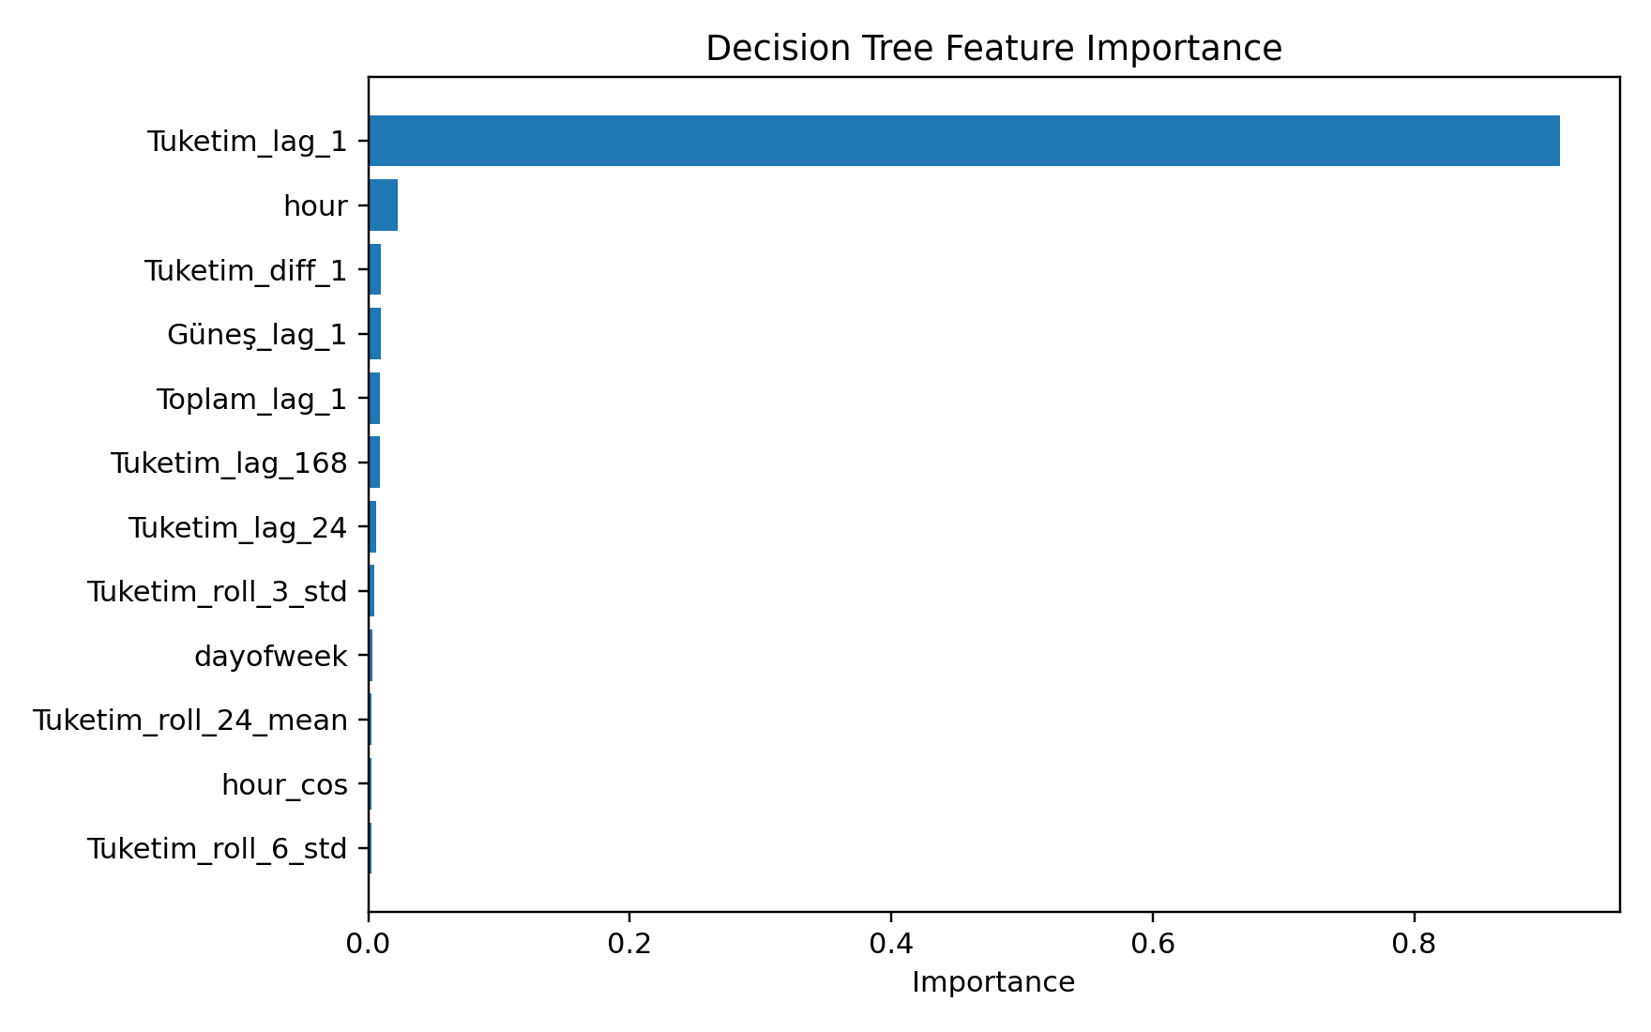
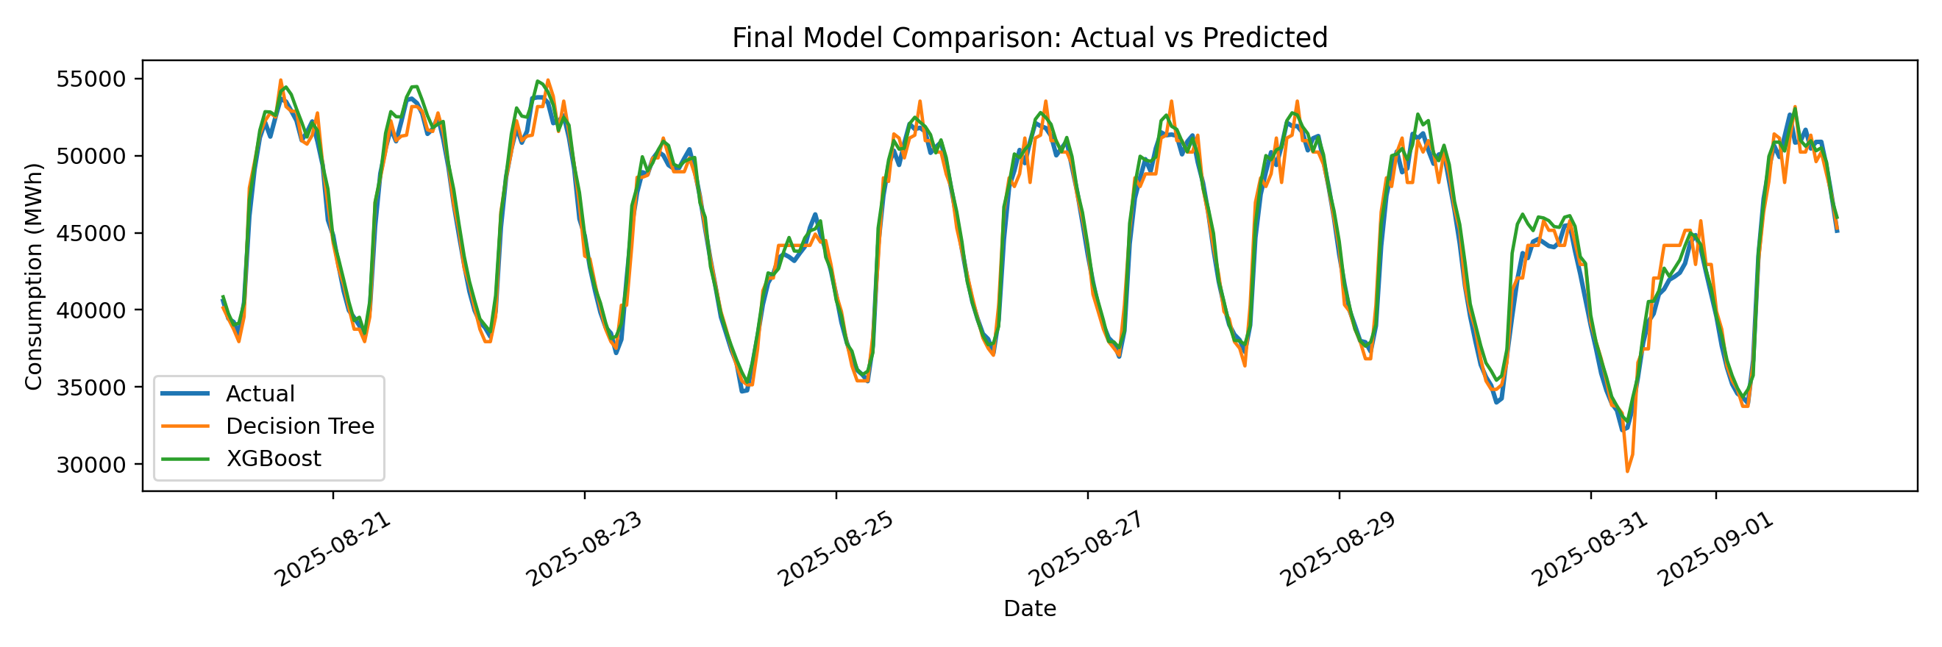
Model 1: Decision Tree Regressor
Interpretable baseline with controlled complexity
Baseline tree
default settings
Grid search
max_depth, leaf size
TimeSeriesSplit
5 validation folds
Final test
RMSE, MAE, R2
MEE344 Machine Learning Term Project | 9

Slide 10
Decision Tree Results
Tuning reduces complexity but only slightly improves RMSE
Model
RMSE
MAE
R2
Baseline
1011.92
739.69
0.9688
Tuned
1004.10
759.15
0.9693
Best tuned configuration: max_depth=10, min_samples_leaf=5, min_samples_split=2.
The model is interpretable, but it is still a single tree; boosted trees are expected to generalize better.
MEE344 Machine Learning Term Project | 10

Slide 11
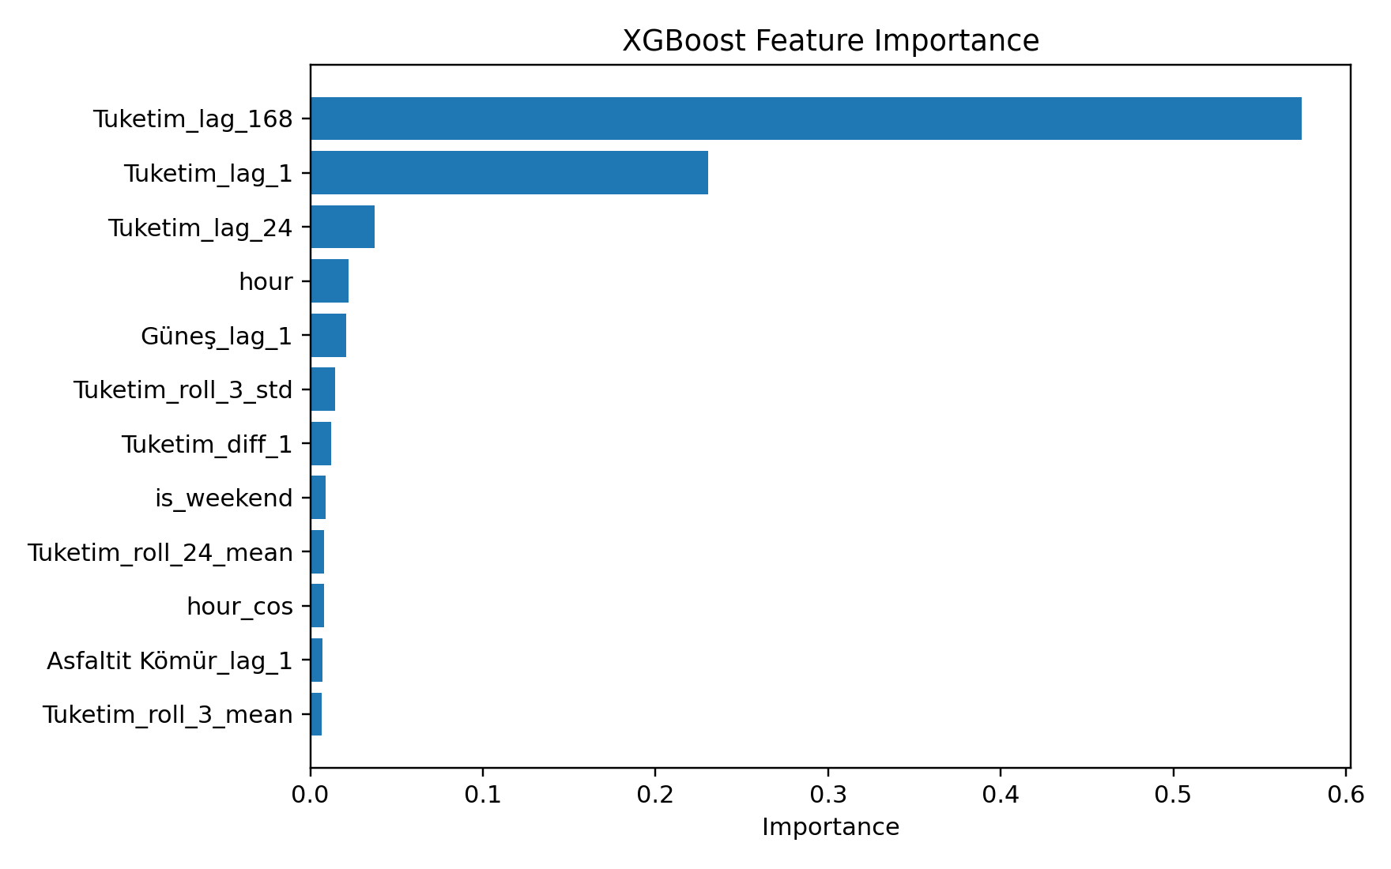
Model 2: XGBoost Regressor
Boosted tree ensemble for stronger nonlinear prediction
Sequential trees
correct previous errors
Small candidate search
learning rate, depth, trees
Same TimeSeriesSplit
no random CV
Same test set
fair comparison
Final tuned parameters: 200 trees, depth 3, learning rate 0.03, subsample 0.9, colsample 0.9.
MEE344 Machine Learning Term Project | 11

Slide 12
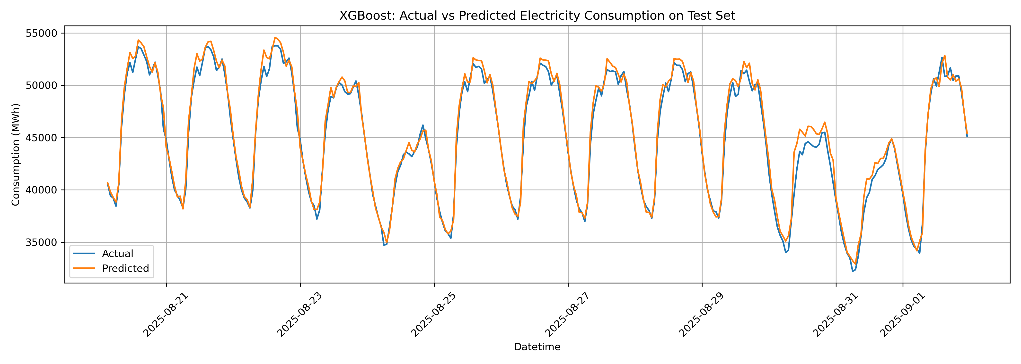
XGBoost Results
XGBoost achieves the lowest final test error
Model
RMSE
MAE
R2
Baseline
852.22
647.50
0.9779
Tuned
784.41
591.91
0.981
The tuned XGBoost model improves over the tuned Decision Tree by about 21.9% RMSE.
The remaining errors likely correspond to rapid local changes not captured by weather or holiday variables.
MEE344 Machine Learning Term Project | 12

Slide 13
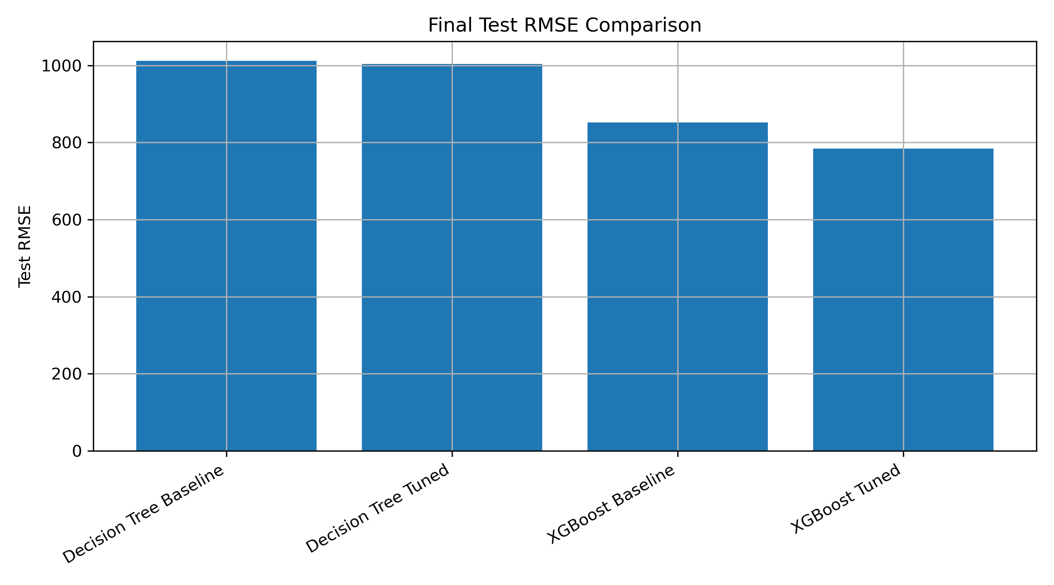
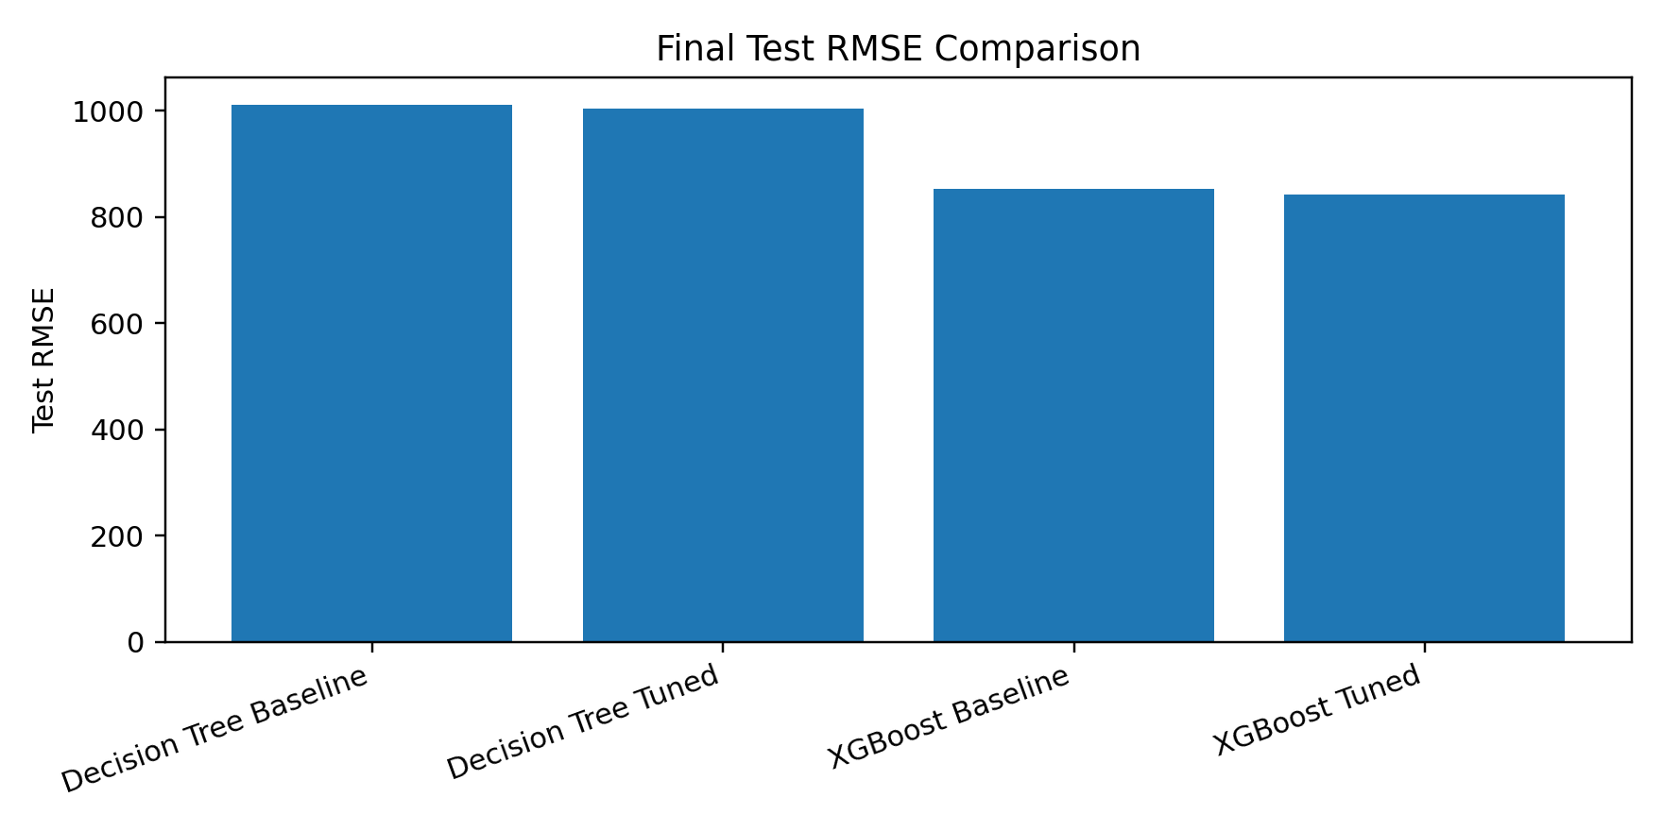
Final Model Comparison
Both models perform well; XGBoost is strongest
Model
RMSE
MAE
R2
Decision Tree Tuned
1004.10
759.15
0.9693
XGBoost Tuned
784.41
591.91
0.981
21.9%
0.981
RMSE reduction
Best R2
Final conclusion: XGBoost is selected as the better model under the same leakage-safe feature set and test period.
MEE344 Machine Learning Term Project | 13

Slide 14
Insights and Interpretation
The strongest signals are recent consumption and system state
Lagged consumption features confirm strong short-term and daily dependence in electricity demand.
Lagged production features provide recent system-state information, but are kept lagged to avoid availability leakage.
MEE344 Machine Learning Term Project | 14

Slide 15
Conclusion and Discussion
What the model results imply and where the setup is limited
Final conclusion
XGBoost is selected as the best model under the same leakage-safe feature set and final test period.
RMSE: 784.41 MAE: 591.91 R²: 0.981
Compared with the tuned Decision Tree, XGBoost reduces RMSE by about 21.9%.
Interpretation
The dominant features are lagged consumption values, especially the weekly lag and previous-hour load.
This matches electricity demand behavior: recent load and weekly routines carry strong predictive information.
Lagged production contributes as recent system-state information, not as same-hour leakage.
Limitations
The dataset covers only the summer period from June to September 2025.
Weather, public holidays, electricity prices and industrial activity are not included.
Sudden demand changes remain harder to predict with only lagged historical features.
Main takeaway: a leakage-safe time-series setup with lagged features gives a realistic forecasting task; boosted trees improve accuracy while preserving interpretable feature importance.
MEE344 Machine Learning Term Project | 15

