Slide 1
PAPER PRESENTATION
ICRNNA
Improved automatic modulation recognition using deep learning with additive attention
El-Haryqy, Kharbouche, Ouamna, Madini, Zouine · Ibn Tofail University, Morocco · Results in Engineering 26 (2025) 104783
Look
Read in order
Weigh
Decide
Yusuf Bilal Cetinkaya · Moshe Kam's research group · NJIT · October 2026
1
Notes:
Today I present the paper our detector comes from: ICRNNA, from a group in Morocco, published in 2025. I'll keep it simple: what it does, how it works, what it reports, and whether it holds up.

Slide 2
THE PAPER
The paper in one sentence
A neural network looks at 128 samples of a radio signal and says which of 11 modulations sent it.
63.24%
our detector
right on RML2016.10a: the best of the 12 models they compare
is built on this design
2
Notes:
The paper in one sentence: a neural network looks at 128 samples of a radio signal and says which of 11 modulations sent it. They report 63.24 percent right on this dataset, the best of the twelve models they compare. Our own detector is built on this design.

Slide 3
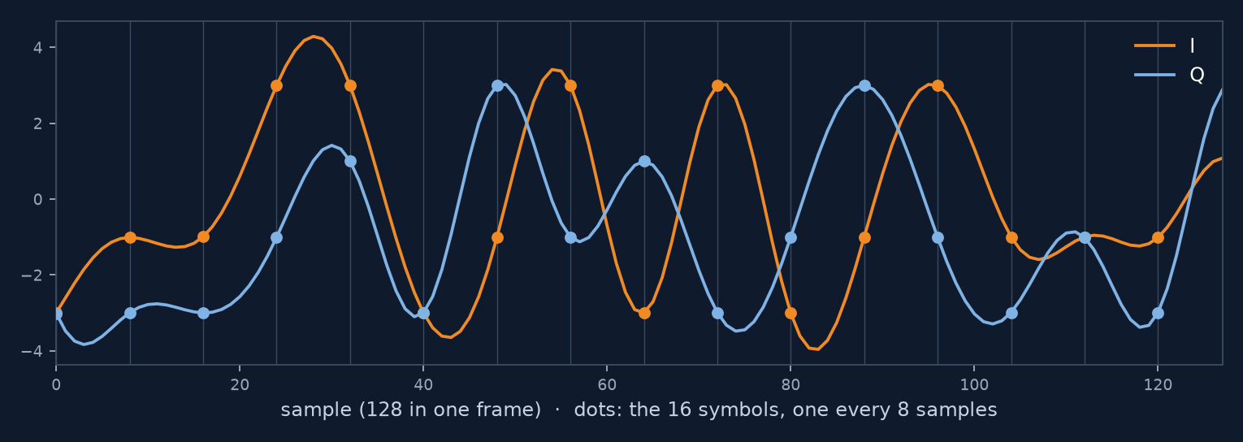
THE PAPER · DATA
The data: what the model sees
11
20
220,000
modulation types
SNR labels, −20 to 18 dB
frames
one frame: I (orange), Q (blue)
2 × 128
Each frame: 128 samples of I and 128 of Q.
That array is the only input.
RML2016.10a, the same dataset we use.
3
Notes:
The data is the same dataset we use, RML2016.10a: eleven modulation types, twenty noise levels, 220,000 frames. Each frame is 128 samples of I and 128 of Q. That is the only input; the network sees nothing else.

Slide 4
THE PAPER · THE MODEL
How it works: four steps
1
2
3
4
Look at short pieces
Read them in order
Weigh the pieces
Decide
CNN
LSTM, both directions
attention
dense layers
short filters slide along the signal
carries a memory from piece to piece
a weighted average of all the pieces
11 scores; the largest one wins
In: 128 samples (I and Q). Out: 11 scores. 794,188 numbers learned, 83% of them in step 2.
Step 2, reading the pieces in order, is the heart of it.
4
Notes:
How does it work? Four steps. One: it looks at short pieces of the signal, with small filters that slide along it. Two: it reads those pieces in order, forwards and backwards, carrying a memory from piece to piece. Three: it weighs the pieces and takes a weighted average. Four: it gives eleven scores, one per modulation, and the largest wins. Most of the network, 83 percent, is in step two. That is the heart of it.

Slide 5
THE PAPER
How they trained and tested it
70%
15%
15%
154,000
33,000
33,000
frames with the right answer: it learns from these
frames to decide when to stop learning
frames kept aside: every result is counted on these
It stopped by itself after 58 passes over the data, when it stopped improving. Done once.
The test frames are never used for learning.
5
Notes:
How was it trained and tested? The frames are split three ways. 154,000 frames, with the right answer, to learn from. 33,000 to decide when to stop learning. And 33,000 kept aside, never used for learning: every result is counted on those. It stopped by itself after 58 passes over the data, and they did it once.

Slide 6
THE PAPER · TABLE 3
Their main table: first by half a point
63.24 vs 62.73: the runner-up is half a point behind.
6
Notes:
Their main result. ICRNNA is first, at 63.24 percent. The next model is half a point behind. The well-known older ones are two to three points behind.

Slide 7
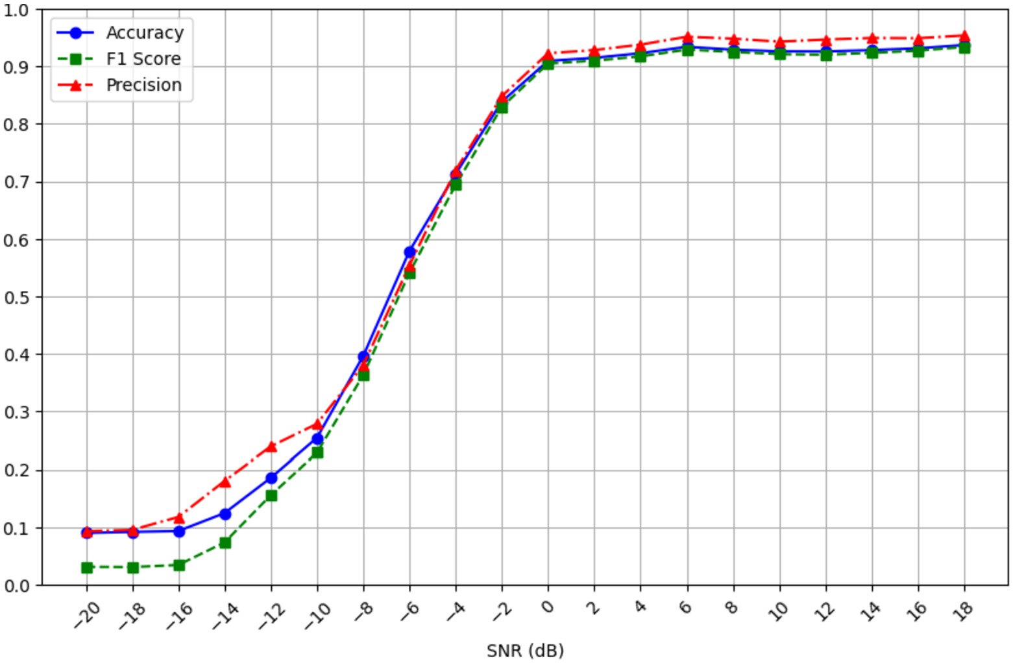
THE PAPER · FIG. 8
Accuracy against SNR
9%
at −20 dB: chance
(1 in 11)
~93%
from 0 dB up
Figure from El-Haryqy et al. 2025 (CC BY-NC 4.0)
7
Notes:
Accuracy against noise. At the noisiest level it is right 9 percent of the time, which is guessing among eleven. It improves quickly between minus 10 and 0 dB, and from 0 dB up it is right about 93 percent of the time.

Slide 8
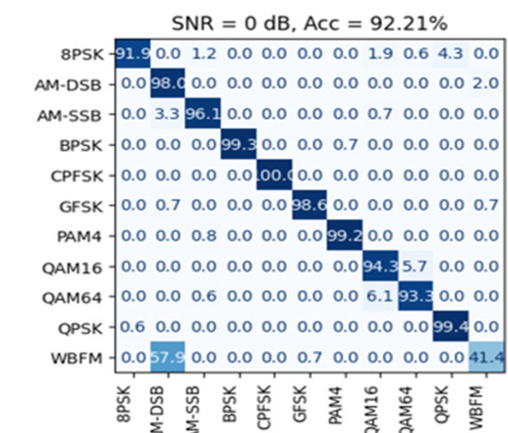
THE PAPER · FIG. 11
Where it still fails, at 0 dB
57.9%
of WBFM called AM-DSB
~6%
QAM16 ↔ QAM64, each way
Figure from El-Haryqy et al. 2025 (CC BY-NC 4.0)
The same two problems we see in our runs.
8
Notes:
Where does it still make mistakes, at 0 dB? Two places. WBFM is called AM-DSB more than half the time. And QAM16 and QAM64 are mixed up, about 6 percent each way. These are the same two problems we see in our own runs.

Slide 9
THE PAPER · TABLE 6
Which step matters?
+0.4
points added by step 3 (weighing)
0.1
points between step 2 alone and all four
Step 2, reading in order, does almost all the work.
9
Notes:
Which step matters? They removed steps one at a time. Step one alone: 59.9. Step two alone: 63.1. All four: 63.2. So step two, reading in order, does almost all the work; the other steps add a fraction of a point.

Slide 10
THEIR CODE
Their code, and what it gives
Apr 2025
62.71%
the paper, without code
their code, run by us once (more runs going)
paper: 63.24%
Aug 2026
their code on GitHub (no trained network)
Their own code, run once: 0.53 points below their paper.
10
Notes:
The paper came out without code. In August this year the authors put their code on GitHub, but not the trained network itself. We ran their code ourselves, once so far. It gives 62.71 percent, against their published 63.24: 0.5 points lower. Training behaved like theirs: it stopped by itself at epoch 61, with validation accuracy at 63.6, as in their paper. Half a point is the size of the run-to-run variation we see, so the next two runs will tell us whether this is just that.

Slide 11
OUR CHECK
Is their number real?
63.24%
63.21%
the paper
our rebuild, from the paper's text alone
It needed longer training than the paper's 58 passes: our best was at pass 107.
Yes: the result can be reproduced.
11
Notes:
Is their number real? Before their code existed, I rebuilt the network from the paper's description alone. It gets 63.21 percent, against their 63.24. So yes, the result can be reproduced. It needed longer training than their 58 passes; ours was best at pass 107.

Slide 12
OUR CHECK
How much better is it, really?
We trained five published models the same way: same data, same split, 3 repeats each.
model | right, all noise levels | right, 10 dB and above
ICRNNA (2025) | 62.2% | 91.5%
LSTM2 (2018) | 61.4% | 91.5%
MCLDNN (2020) | 61.4% | 91.1%
PET-CGDNN (2021) | 61.0% | 90.6%
VT-CNN2 (2016) | 56.1% | 82.0%
First, but only by about one point.
12
Notes:
How much better is it, really? We trained five published models the same way: same data, same split, three repeats each. ICRNNA is first, but only by about one point. At 10 dB and above, the best four are all about 91 percent.

Slide 13
In short
1
A neural network in four steps; step 2, reading in order, does most of the work.
2
Its 63.24% is real: we get 63.21% from the paper alone.
3
It is about one point better than older models, not a big jump.
For us: a solid detector to build on.
13
Notes:
To sum up. It is a neural network in four steps, and step two, reading in order, does most of the work. Its 63.24 percent is real: we get 63.21 from the paper alone. And it is about one point better than older models, not a big jump. For us, it is a solid detector to build on. Thank you. I have more detail on each step if you'd like.

Slide 14
BACKUP
Details, if asked
Each step of the model, the training recipe, their code, and what we checked in their tables.
14
Notes:
Backup slides with the details, if you want to go deeper.

Slide 15
THE PAPER · MODEL
The model at a glance
frame
CNN
BiLSTM
Attention
Dense
output
2 × 128
64 × 128
64 × 256
256
128 → 64
11
size of what comes out
One frame in, eleven probabilities out. The largest is the answer.
Redrawn from their Fig. 2; sizes from their code.
15
Notes:
Here is the whole model. A frame of 2 by 128 goes in. Four blocks process it. Eleven probabilities come out, one per modulation, and the largest is the answer. Below each block I wrote the size of what comes out of it, so you can follow one frame through. I'll now take the blocks one at a time.

Slide 16
THE PAPER · CNN
Block 1: short learned filters
1
64 filters, 3 taps
2 × 128 → 128 × 64
samples →
2
128 filters, 3 taps
→ 128 × 128
one output per sample, per filter
pool: larger of each pair
illustration
3
→ 64 × 128
Like an FIR filter whose taps are learned instead of designed.
Each of the 64 steps sums up about 6 samples: less than one symbol.
16
Notes:
Block one: two convolution layers. A convolution here is a short filter, three samples long, slid along the frame, like an FIR filter whose taps are learned instead of designed. The first layer has 64 such filters, the second 128. So every time step is now described by 128 numbers. Then a pooling step keeps the larger of each pair of neighbours, so 128 time steps become 64. Each of the 64 steps summarizes about 6 samples, less than one symbol.

Slide 17
THE PAPER · BiLSTM
Block 2: reading the steps in order
forwards, with a memory
step 1
step 2
step 3
step …
step 63
step 64
backwards, a second LSTM
2 layers, 128 numbers each way
→ 64 × 256
83%
of the model's numbers are here
After this block, every step knows the whole frame.
17
Notes:
Block two: two bidirectional LSTM layers. An LSTM reads the 64 steps in order, one at a time, and carries a memory from step to step. Bidirectional means a second LSTM reads the same steps backwards. So at every step, the output knows what came before and what comes after: 128 numbers from each direction, 256 in total. This block holds 83 percent of the model's numbers.

Slide 18
THE PAPER · ATTENTION
Block 3: a learned weighted average
score = v · tanh(W₁q + W₂k)
weights = softmax(score)
output = Σ weightₜ · stepₜ
a weight for each of the 64 steps; they add up to 1
“Improved” (from their code):
illustration
a learned scale on the scores · dropout 0.1 on the weights · normalization of the output
64 steps in, one vector of 256 out: the frame's summary.
18
Notes:
Block three: attention. Each of the 64 steps gets a score from a small learned network. A softmax turns the scores into weights that add up to one. The output is the weighted average of the 64 steps: one vector of 256 numbers for the whole frame. The paper calls it improved because of three additions. From their code we now know exactly what they are: a learned scale on the scores, dropout on the weights, and a normalization of the result.

Slide 19
THE PAPER · DENSE
Block 4: the decision
8PSK
AM-DSB
BiLSTM 83%
AM-SSB
BPSK
Attention 8%
CPFSK
Dense 5%
GFSK
PAM4
CNN 3%
QAM16
QAM64
QPSK
WBFM
794,188 numbers in total
256 → 128 → 64 → 11 probabilities; the largest wins (illustration)
Most of the model is the LSTM.
19
Notes:
Block four: the decision. Two ordinary layers, 128 and 64 numbers, and then 11 outputs. A softmax turns them into probabilities, and the largest one is the answer. In total the model has 794 thousand numbers. The pie shows where they are: almost all in the LSTM.

Slide 20
THE PAPER · TABLE 2 AND THEIR CODE
How it is trained
DATA
LOOP
STOPPING
70% learn: 154,000 frames
15% watch: 33,000
15% test: 33,000
batches of 32 frames
4,813 steps per epoch
loss: cross-entropy
Adam, learning rate 0.001
loss flat 5 epochs: rate × 0.2
loss flat 6 epochs: stop
at most 100 epochs
58
where it stopped
Trained once: one split, one run.
20
Notes:
How it is trained. Seventy percent of the frames to learn from, fifteen to watch, fifteen to test. Batches of 32 frames; the loss is cross-entropy; the optimizer is Adam with learning rate 0.001. When the validation loss stops improving for 5 epochs, the learning rate is cut by five. When it stops improving for 6 epochs, training stops and the best weights are restored. The paper's table says 58 epochs. From their code we now know that 58 is where this stopping rule fired, not a number they chose. They trained once.

Slide 21
PART 2 · THEIR CODE
What their code tells us
1
The model is the one in the paper
same layers, 794,188 numbers (paper: 0.79 M)
2
“58 epochs” was not a choice
training stops by itself when it stops improving; for them, at 58
3
They trained it once
one split of the data, one run, one number
One run gives one number: how much would it move?
21
Notes:
What does their code tell us? Three things. First, the model in the code is the model in the paper: same layers, 794 thousand numbers. Second, the 58 epochs in the paper were not a choice: the training stops by itself when it stops improving, and for them that happened at 58. Third, they trained it once: one split of the data, one run, one number. And one run leaves a question: how much would that number move if you ran it again?

Slide 22
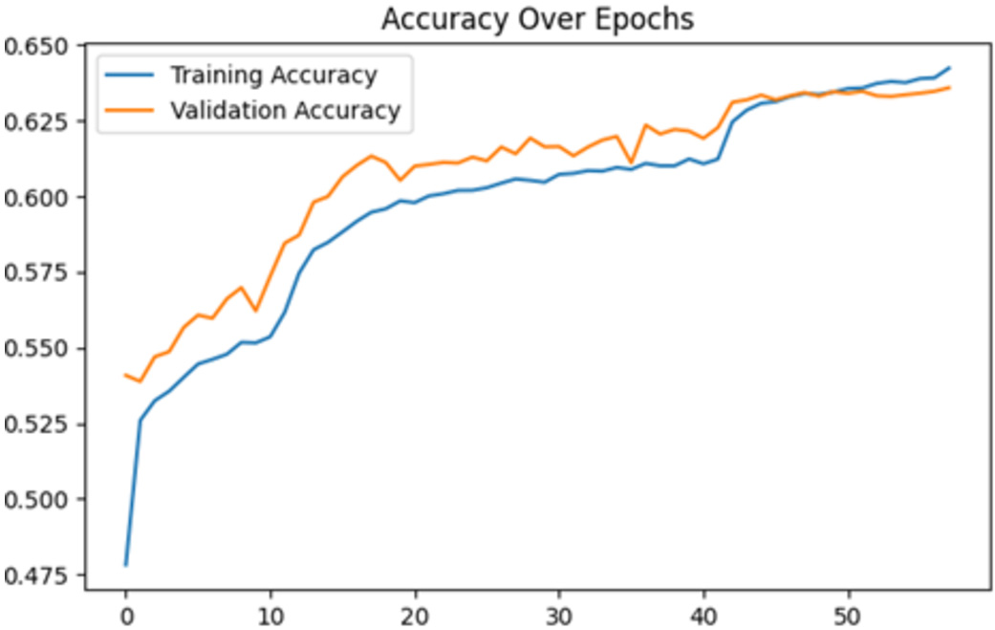
OUR CHECK
What “58 epochs” means
61.75%
our rebuild at a fixed 58 epochs (3 runs)
63.21%
the same, left to run: best at epoch 107
Their Fig. 7: accuracy still rising at 58
Figure from El-Haryqy et al. 2025 (CC BY-NC 4.0)
Their rule stopped on the loss; the accuracy was still climbing.
22
Notes:
One detail about the 58 epochs. Their stopping rule watches the validation loss, and the loss had flattened. But the validation accuracy, in their own figure on the right, is still rising at 58. When I trained our rebuild for a fixed 58 epochs, I got 61.75 percent. Letting it continue, it peaked at epoch 107 at 63.21. So their number is real, but it sits where the accuracy was still climbing.

Slide 23
OUR CHECK
We rebuilt it; their code agrees
Apr 2025
Aug 2026
Sep 2026
paper, no code
their code on GitHub, no weights
our rebuild from the paper alone
63.21%
MATCHED THEIR CODE
MISSED
one pooling step
normalization after each LSTM
dropout on attention weights
size: 794,827 vs 794,188
exact attention form and its learned scale
input normalization
gradient clipping
our rebuild, trained to the end (paper: 63.24%)
Their 63.24% is reproducible from the paper alone.
23
Notes:
Before we knew any code existed, I rebuilt the model from the paper's text alone. Its size matched: 794,827 numbers. In August the authors released their code, and it confirms our reading: one pooling step, normalization after each LSTM, dropout on the attention weights. We missed a few details: the exact form of the attention, the input normalization, and gradient clipping. Trained until it stopped improving, our rebuild reached 63.21 percent, against their 63.24.

Slide 24
OUR CHECK
Three claims their own tables don't support
“Best at low SNR”
Table 5: beaten at −10, −8 and −6 dB
1
“Full model has the highest precision”
Table 6: LSTM alone is higher, 0.768 vs 0.754
2
“MCLDNN: 406 million parameters”
It has 406,199: 0.41 million
3
ICRNNA is about twice MCLDNN's size, not smaller.
24
Notes:
Reading their tables closely, three statements in the text don't match their own numbers. Best at low SNR: in their Table 5, other models are higher at minus 10, minus 8 and minus 6 dB. Highest precision: in Table 6, the LSTM-only model is higher. And MCLDNN is listed with 406 million parameters; it has 406 thousand. So ICRNNA is about twice the size of MCLDNN, not smaller.

Slide 25
OUR CHECK
What the paper doesn't tell us
1
One run
no spread; our seeds vary by up to a point
+9 dB
2
Baselines
retrained on the same split, or copied from their papers?
more signal in QAM16 than in QPSK, both labelled 0 dB (measured in the file)
3
SNR label
taken as the true SNR
A half-point lead from one run may not be real.
25
Notes:
And three things the paper doesn't tell us. It reports one training run, with no spread; across seeds we see up to a point of variation, so a half-point lead may not be real. It doesn't say whether the other models were retrained or copied from their papers. And it treats the SNR label as a true SNR; in this data, at label 0 dB, QAM16 has about 9 dB more signal than QPSK.

