Slide 1
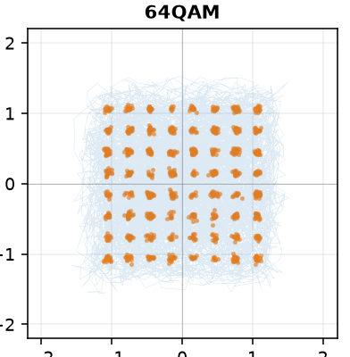
Why a modulation classifier fails across transmitters
— measured by intervention, and closed
RadioML 2018.01A · ICRNNA backbone · progress report, September 2026
Yusuf Bilal Çetinkaya
Notes:
Every number in this deck is read from a results file in the repository; nothing is quoted from the earlier backbone.

Slide 2
The problem
Reproducing the benchmark is solved. What happens when the transmitter changes is not.
Train on RadioML. Test on I/Q generated by an independent transmitter model. Same five modulations, same SNRs, same sample rate.
The questions this project answers
1
How large is the drop, and where does it land?
0.999
0.805
2
What property of the signal causes it — shown by intervention, not correlation?
in-domain accuracy
on the other transmitter
3
Can it be removed without paying for it in-domain?
16QAM alone: 0.056 — it is read as 64QAM
4
Where does a modulation the model never saw go?
2
Notes:
The contribution is the attribution method, not an accuracy number. The 0.999 to 0.805 drop is the starting measurement, on five shared classes, five seeds.

Slide 3
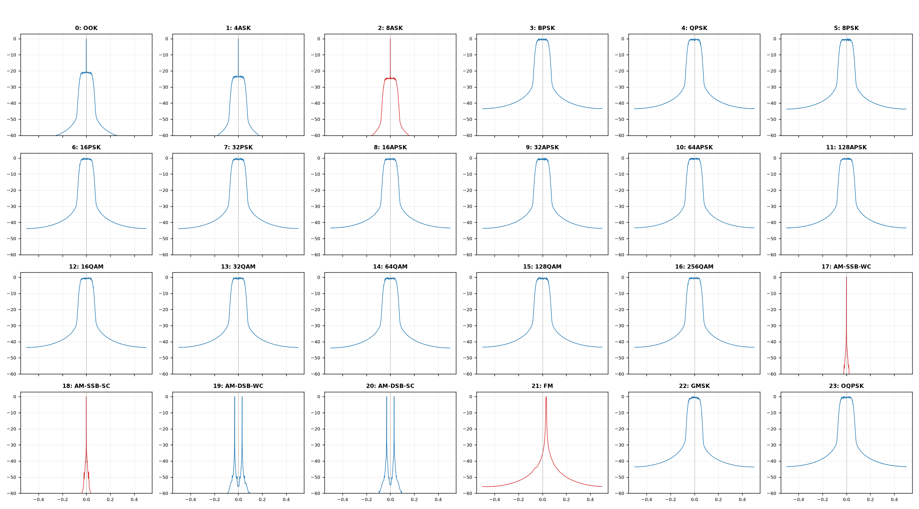
Dataset: RadioML 2018.01A
One dataset, by decision. Every class shares the same spectral envelope — that turns out to matter.
24
modulation classes — ASK, PSK, APSK, QAM, analog
1,024
I/Q samples per frame, used at native length
26
SNR levels, −20 to +30 dB in 2 dB steps
4,096
frames per (class, SNR) cell; 2.5 M frames, 21 GB
RML2016.10a stays in the record for one purpose: the paper-faithful build reaches 63.21% against the published 63.24% on it — the pipeline's only tie to a published number.
Mean power spectrum per class at 30 dB. Blue = symmetric, red = single-sideband.
3
Notes:
Decided with Moshe on 16 September: new work goes on 2018 only. The 2016 results are not retracted.

Slide 4
Input, output, model, protocol
Defined once here, and unchanged for every result that follows.
INPUT
MODEL
OUTPUT
one I/Q frame
2 × 1,024 float32
unit average power
ICRNNA · 786k params
conv front end → BiLSTM →
additive attention
one of K class labels
K = 24, or 4 for the
decision table
Protocol
A run counts as converged only if
70 / 15 / 15 split, stratified over every (class, SNR) cell
Early stopping, LR schedule and checkpoint choice read validation only; the test set is touched once
Batch 256, Adam 1e-3, ReduceLROnPlateau, patience 20 under an epoch ceiling
Three seeds per configuration; results written after every seed and resumed, never overwritten
best_epoch + patience ≤ ceiling
Otherwise the number is a floor, not a measurement. Every result here passes this test; where a first run did not, it was rerun under a higher ceiling and the rerun is what is shown. Convergence turned out to be set by gradient updates, not epochs — and to depend on the method, not only the data.
4
Notes:
The backbone is transcribed from a peer's reproduction and differs from the published ICRNNA in five places; it is not called 'the published architecture'. The faithful build is a separate file and does reproduce the paper.

Slide 5
First, does the backbone classify?
Not the contribution — but the cross-domain numbers must start from a competent classifier.
87.2%
24 classes, SNR ≥ 10 dB (±1.4)
100.0%
4 classes, SNR ≥ 10 dB
Overall across all 26 levels: 0.570 on 24 classes, 0.747 on 4. Chance is 0.042 and 0.25; the curve sits there below −12 dB and saturates from +8.
5
Notes:
Deep residual networks on the whole dataset are reported near 95% above 8 dB; this is 512 of 4096 frames per cell with a 786k recurrent model. Closing that gap is not the goal.

Slide 6
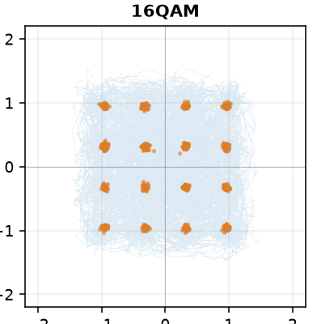
The decision table
Four modulations in, 40,656 decisions above 10 dB, three seeds pooled — how often did we say what?
transmitted \ decided | BPSK | QPSK | 16QAM | 64QAM | recall
BPSK | 10,164 | 0 | 0 | 0 | 100.0%
QPSK | 0 | 10,164 | 0 | 0 | 100.0%
16QAM | 0 | 0 | 10,164 | 0 | 100.0%
64QAM | 0 | 0 | 2 | 10,162 | 100.0%
40,654 of 40,656 correct. Both errors are 64QAM decided as 16QAM. Rows sum to 10,164: 308 test frames per (class, SNR) cell × 11 levels × 3 seeds.
16QAM and 64QAM at 20 dB: the pair that carries almost every error in this project
Converged
Peaks at epochs 46, 48, 66 under a 150 ceiling. Two of the three seeds are bit-identical to the earlier 60-epoch run — the lower ceiling had only denied them the proof.
6
Notes:
This is the table asked for on 15 September. The same table on RML2016 (128-sample frames) still confuses the QAM pair 7–11% at high SNR; at 1,024 samples that confusion is gone. The frame is the difference.

Slide 7
Where the decisions go, by SNR
A perfect table at high SNR says nothing. The informative tables are lower down.
transmitted \ decided | BPSK | QPSK | 16QAM | 64QAM | recall
BPSK | 924 | 0 | 0 | 0 | 100.0%
QPSK | 0 | 924 | 0 | 0 | 100.0%
16QAM | 0 | 9 | 519 | 396 | 56.2%
64QAM | 0 | 6 | 349 | 569 | 61.6%
At 0 dB: 2,936 of 3,696 (79.4%). PSK is perfect; the QAM pair is a coin flip against each other.
Two stages, two thresholds
PSK-versus-QAM closes between −4 and 0 dB; which-QAM closes between 0 and +6
Below the first threshold the unreadable classes do not scatter — they sink: at −8 dB, 16QAM is read as QPSK 68% of the time and 64QAM 72%; 16QAM's own recall is below chance
The accuracy curve averages both stages into one number per level
7
Notes:
924 decisions per row at each single level; a 1% cell is nine frames. Both matrices are from the converged run.

Slide 8
The gap, and what closes it
Five shared classes, five seeds each, every cell converged. In-domain never moves; cross-domain does.
0.805 → 0.989
no method → spectral whitening
comparison | Δ cross-domain | verdict
literature augmentation vs none | 0.002 | does not address it
whitening vs none | +0.183 | closes it
whitening + augmentation vs whitening | +0.006 | not a measurement (1 s.d.)
Rotation, conjugate flip and additive noise — the augmentation set the literature cites — move the gap by 0.002. Whatever they are good for, this failure mode is not it.
8
Notes:
Stopping epochs by method: none 51/41/48/36/38, augmentation 89/48/83/65/82, whitening 26/26/33/43/25, both 66/37/53/37/50. Whitening converges about 2.4× faster than augmentation — it removes a nuisance dimension, augmentation adds one.

Slide 9
What causes it — by intervention, not correlation
Four explanations tested and refuted. One intervention that moves the prediction.
×
Occupied bandwidth
Phase-preserving magnitude substitution
matching it did not recover 16QAM
✓
Constellation density
Take a frame from the failing domain. Keep its phase spectrum exactly. Substitute only the magnitude spectrum of the training domain. Nothing else changes — not the symbols, not the timing, not the channel.
×
density is not what the model reads
×
Symbol-timing regularity
The prediction follows the magnitude spectrum.
RadioML has no symbol-rate spectral line; driving it down changed nothing
That is an intervention on the signal, not an observation of the representation, so it supports a causal claim. The cause is the transmitter's spectral envelope — chiefly its pulse-shaping roll-off.
×
Channel impairments
CFO, multipath, IQ imbalance removed one at a time — little changed
Signal-level, classifier-independent; the accuracies attached to these interventions are pending re-measurement on the current backbone.
9
Notes:
The working story for most of the project was shortcut learning — the model reads modulation order off the envelope. Two experiments killed it: handing 16QAM frames a 64QAM envelope left the prediction at 16QAM. The envelope does not carry the class; removing it still helps. That is stated as unresolved.

Slide 10
The fix: remove the envelope
X / smooth(|X|)^α — divide each frame's spectrum by a smoothed estimate of its own magnitude envelope.
Monotone, saturating by 0.75
α = 1.0 is at least as good as 0.75 (0.993 vs 0.988) and seven times more stable across seeds (±0.001 vs ±0.007). The recovery is carried by 16QAM at every step: α switches one confusion off rather than lifting everything a little.
Costs nothing in-domain
In-domain accuracy stays at 0.999 with whitening on. The gap falls from +0.193 to +0.011, so the recovery is not bought by trading away benchmark performance.
10
Notes:
The middle of the sweep is where seeds disagree: α = 0.5 has a spread of 0.019 on cross-domain accuracy against 0.001–0.007 at either end. Half-removing the envelope leaves a model that sometimes learns to read through it.

Slide 11
Where an unseen modulation lands
Train on 23 classes, probe with the 24th. Families fixed before the run; now measured on the current backbone.
16 of 24
The eight misses
Across five architectures
held out | sink | share | second
BPSK | OQPSK | 62% | QPSK 33%
16APSK | 16QAM | 100% | —
32APSK | 32QAM | 82% | 128APSK 13%
64APSK | 32QAM | 44% | 128APSK 37%
16QAM | 64APSK | 42% | 128APSK 31%
FM | GMSK | 100% | —
GMSK | 8PSK | 74% | FM 18%
OQPSK | 16QAM | 75% | 64QAM 10%
held-out classes sink into their own family · chance 3.5
All 24 runs converged. Best epochs 7 to 43 under a 60 ceiling, patience 10. 10 of the 24 sinks take more than 95% of the probes — the model does not scatter, it decides.
Merging APSK with QAM — both amplitude-and-phase constellations — would make it 20 of 24. That reading is post hoc, so the number quoted is 16.
Orange: an APSK ↔ QAM pair. Four of the eight misses are that pair; two more are FM ↔ GMSK, both constant-envelope. The misses are structured — the hand taxonomy, not the model, is what they disagree with.
Chance is 0.8 of 6. 8ASK, 32PSK, 128APSK sink to the same class on all five; the two misses on every architecture are FM and OQPSK, the two hard cases the rule put in on purpose. 1 of 30 runs unconverged (Transformer | 32PSK) — its sink stands.
11
Notes:
The ICRNNA column of the control is a bit-identical training to the corresponding rows of the 24-class run: same best epoch, same in-distribution accuracy to every digit. The probe frames are an independent draw and move the shares by at most 0.3 points.

Slide 12
Three things this rerun took away
Kept in the record, not deleted. Each was believed on the earlier backbone and did not survive re-measurement.
−
−
!
"Partial whitening beats full"
"The model reads the class off the envelope"
"The 60-epoch ceiling was safe"
Our one concrete disagreement with WhiteNet, from one seed per point on the old backbone. Five seeds on the current one: α = 1.0 ≥ 0.75. Withdrawn; on this task we agree with WhiteNet.
Handing 16QAM frames a 64QAM envelope left the prediction at 16QAM. The envelope does not carry the class, yet removing it still helps. The mechanism is stated as unresolved.
It was not: cells peaked at 82–89. Rerun with room, every flagged cell came back bit-identical or within a point — the ceiling had cost nothing, but that could only be shown by paying for the rerun.
12
Notes:
Negative results are part of the argument. Whitening itself is not novel either: WhiteNet arrived at the same operation on real over-the-air captures; what survives here is the attribution method and the sink finding.

Slide 13
Caveats, stated rather than buried
!
Both domains are synthetic
!
The model is not the published architecture
RadioML is simulated and so is the second transmitter. Until an over-the-air capture exists this is a study of a mechanism, not a measurement of a deployment. The single largest weakness.
It is transcribed from a peer's reproduction and differs from the paper in five places. The paper-faithful build is separate — it reproduces the paper's 63.24% (63.21%), but only trained to convergence, 107 epochs against the paper's 58.
!
Half the sink checks are still on the old backbone
!
Three seeds is thin on 24 classes
The 24-class leave-one-out and the architecture control are re-measured. The embedding check, the discriminating control, label permutation and family recovery are not yet.
Seed spread reaches 0.021; a difference under about 0.03 between two configurations is not yet a difference.
13

Slide 14
Next
Just landed
The sink thread on the current backbone: 16 of 24 held-out classes sink into their own family, and the same-family sink survives on all five architectures. Both runs converged.
Next
Port or drop the domain-adversarial baseline (dann.py); then the cumulant classifier on the same four classes at 0 dB as an independent check that the QAM coin flip is the signal's limit, not the model's.
Growing
This deck is the running record; new results are appended, withdrawn claims stay.
Repository: YusufBilo78/amc · every figure regenerates from the committed .npz files
14

