Slide 1
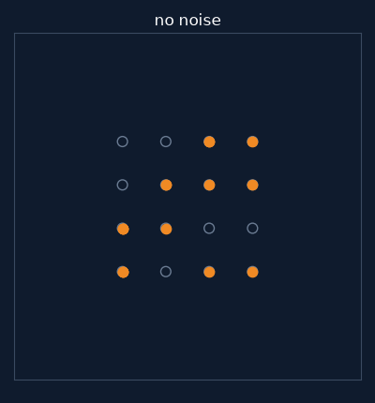
AMC · DATA FUSION LAB
Telling four radio signals apart
What our detector does, step by step
BPSK · QPSK · QAM16 · QAM64
16 symbols of one QAM16 frame, as the noise grows
Prepared for Dr. Moshe Kam's research group · NJIT · October 2026
1
Notes:
Today I will show what our detector does, step by step, on the four signals you asked about: BPSK, QPSK, QAM16 and QAM64. On the right is one QAM16 frame: sixteen symbols, and you can watch them spread out as the noise grows. Everything is on the RML2016.10a dataset, the one the group uses.

Slide 2
WHAT IT IS
model_zoo.backbone(4)
What does the detector do?
It is given 128 samples of a radio signal and says which of four modulations sent them.
1
Look at short pieces
2
Read the pieces in order
3
Decide
2 convolution layers
BiLSTM, forwards and backwards
attention + 2 dense layers
Each piece: 12 samples, about 1.5 symbols. The frame becomes 32 pieces.
Each piece now knows about the whole frame.
Weighted average of the 32 pieces → 4 scores. The largest score wins.
25,792 numbers learned
659,968 numbers learned
99,716 numbers learned
785,476 numbers learned in total. Most of them, 84%, are in step 2. Nothing in it is random once trained: the same frame always gets the same answer.
2
Notes:
The detector is given 128 samples of a radio signal and has to say which of the four it is. It works in three steps. First it looks at short pieces of the frame, about one and a half symbols each, so the frame becomes 32 pieces. Second, it reads those pieces in order, forwards and backwards, so that each piece knows about the whole frame. Third, it takes a weighted average of the 32 pieces and turns it into four scores; the largest score is the answer. In total it has 785 thousand numbers that it learns, and 84 percent of them are in the second step. Once trained, nothing in it is random: the same frame always gets the same answer.

Slide 3
WHERE IT CAME FROM
colab/icrnna_faithful_2016.py
Who designed it, and who wrote the code?
A paper
A colleague's code
Our code
El-Haryqy et al., Results in Engineering, 2025. Model name: ICRNNA. Reported 63.24% on 11 classes.
Their re-implementation of the paper. Our code is copied from it.
Differs from the paper in 5 small places (filter size, pooling, normalisation, dropout, one layer fewer).
Is the paper's number real?
Written with an AI assistant
I rebuilt the model from the paper alone and trained it until it stopped improving:
The code, the plots and these slides were written with Claude Code (Anthropic). Every number comes from running that code on a GPU. The choices of what to test are mine.
63.21% against the paper's 63.24%
3
Notes:
Where it came from. The design is from a 2025 paper; the model is called ICRNNA. A colleague re-implemented that paper, and our code is copied from their version, which differs from the paper in five small places. To check that the paper's number is real, I rebuilt the model from the paper alone and trained it until it stopped improving: 63.21 percent against the paper's 63.24. And to be clear about the tools: the code, the plots and these slides were written with Claude Code, an AI coding assistant. Every number comes from running that code on a GPU, and what to test was my choice. [Say here who the colleague is and how the work before September was done.]

Slide 4
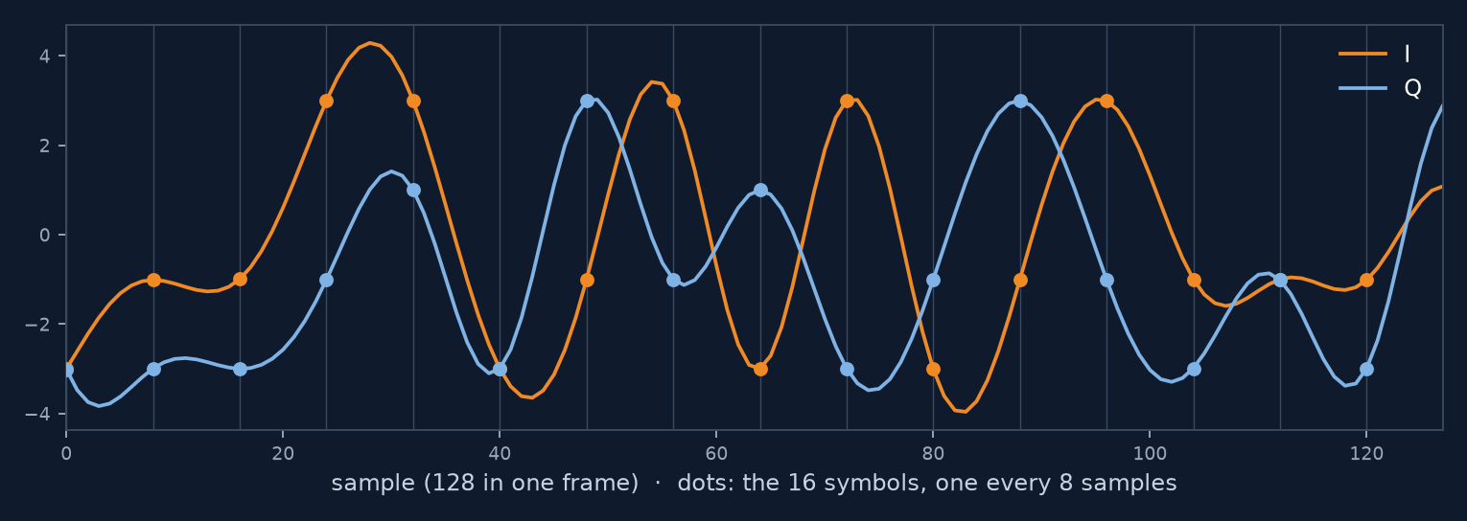
THE BIG PICTURE
train_backbone.py --classes BPSK,QPSK,QAM16,QAM64
What we gave it, and what came out
INPUT
DETECTOR
OUTPUT
1
Learn on 70% of the frames
94.2%
99.6%
right, at 10 dB and above
BPSK and QPSK right at 10 dB
2
Tune on 15%: when to stop
Data: RML2016.10a (DeepSig, simulated)
4 kinds × 20 noise levels × 1,000 frames
One frame: 128 samples = 16 symbols
25%
42,000
3
Test on 15% it never saw
at −20 dB: a guess
test decisions at 10 dB and above
Repeated 14 times, a different split each time.
How we check it: every number is counted on test frames the detector never saw while learning.
4
Notes:
This is the whole experiment on one slide. Input: the RML2016.10a dataset, made by DeepSig in a simulator: four kinds of signal, twenty noise levels, a thousand frames each. One frame is 128 samples, which is 16 symbols. The detector learns on 70 percent of the frames, uses 15 percent to decide when to stop learning, and is tested on the last 15 percent, which it never saw. I repeated this 14 times with a different split each time. Output: at 10 dB and above it is right 94.2 percent of the time, over 42,000 test decisions. BPSK and QPSK are right 99.6 percent of the time. At minus 20 dB it is at 25 percent, which with four choices is a guess.

Slide 5
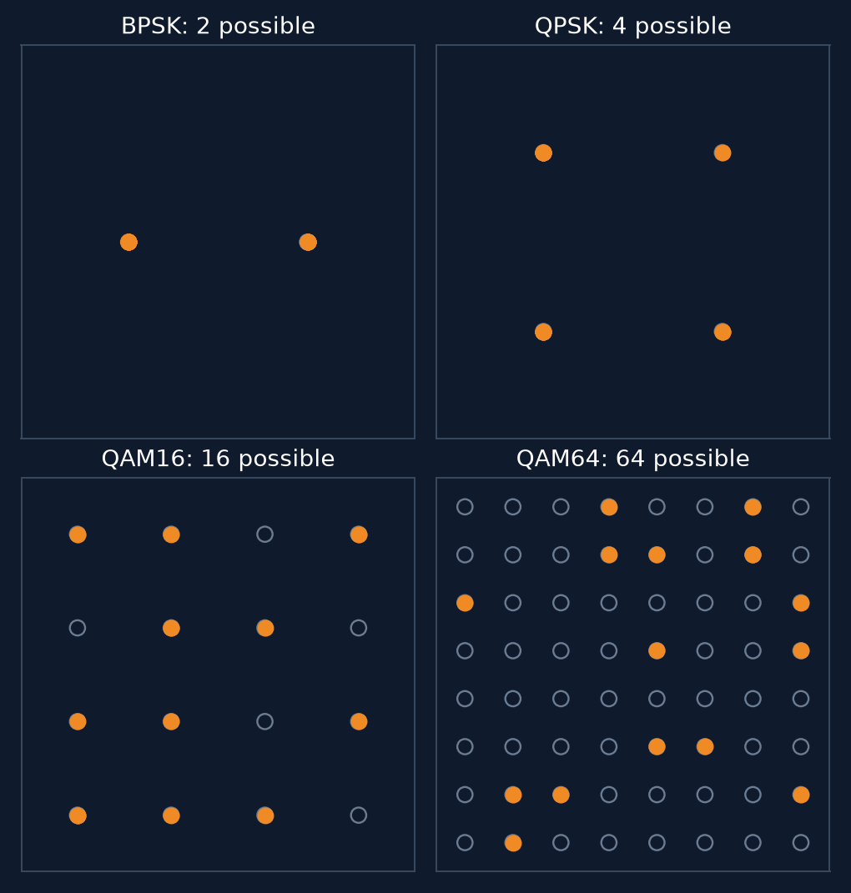
STEP 1 · THE INPUT
128 samples = 16 symbols
What one frame looks like
One frame of QAM16, drawn without noise. Orange: the in-phase part (I); blue: the quadrature part (Q). A symbol every 8 samples (the dots); each dot sits on −3, −1, 1 or 3. That is what makes it QAM16.
16 symbols cannot show all 64 points of QAM64. So a QAM64 frame can look like QAM16 even with no noise at all.
16 symbols of one frame (orange) on all the points each kind can use (circles).
Pictures drawn by us to explain; the data are DeepSig's.
5
Notes:
Step one: what the detector actually sees. This is one QAM16 frame, drawn without noise. The orange line is the in-phase part, the blue line the quadrature part. Every 8 samples there is one symbol, the dots, and each dot sits on minus 3, minus 1, 1 or 3. That pattern is what makes it QAM16. On the right are the 16 symbols of one frame for each kind, drawn on all the points that kind can use. QAM64 has 64 points, but a frame only has 16 symbols, so it can show at most 16 of them. A QAM64 frame can look like QAM16 even with no noise at all. Keep that in mind.

Slide 6
STEP 2 · THE NOISE
tools/measure_rml2016_snr.py
What does “10 dB” mean in this data?
Who made it
I measured the noise in the file itself:
DeepSig, in a simulator (GNU Radio). Not recorded from a real radio.
1.9 dB
+15 dB
What the label sets
of real change for every 1 dB of label
more signal in QAM64 than in BPSK or QPSK, at the same label
One number in their code: the noise amplitude = 10^(−label/10).
What else is added
Carrier offset, clock offset, fading and echoes (multipath) — at every noise level, even the best.
How: the signal sits in the middle of the spectrum; outside it there is only noise, so its level there gives the noise power. Checked first on frames of known noise (within 0.5 dB).
“10 dB” is a setting, not a measurement, and it means a different amount of noise for each kind of signal.
6
Notes:
Step two: the noise. You asked what 10 dB is the ratio of. The dataset was made by DeepSig in a simulator. In their code, the label sets exactly one number: the noise amplitude, 10 to the minus label over 10. Besides noise, every frame also gets a carrier offset, a clock offset, fading and echoes, at every noise level, even the best one. I did not want to rely on their code, so I measured the noise in the file itself: the signal sits in the middle of the spectrum, and outside it there is only noise. Two findings. One dB of label is about 1.9 dB of real change, so the label moves twice as fast as its name. And at the same label, QAM64 frames have about 15 dB more signal than BPSK and QPSK frames. So 10 dB here is a setting, not a measurement, and it means a different noise level for each kind of signal.

Slide 7
RESULT
tools/single_snr.py
The answer at one noise level: 10 dB
8,400 test frames: 14 repeats × 4 kinds × 150. Rows: what was sent. Columns: what the detector said.
sent \ said | BPSK | QPSK | QAM16 | QAM64 | recall
BPSK | 2,092 | 3 | 0 | 5 | 99.6%
QPSK | 6 | 2,091 | 2 | 1 | 99.6%
QAM16 | 4 | 19 | 1,808 | 269 | 86.1%
QAM64 | 8 | 5 | 126 | 1,961 | 93.4%
precision | 99.1% | 98.7% | 93.4% | 87.7%
448
wrong out of 8,400
395
of them are QAM16 and QAM64 mixed up
Recall = of the frames that were this kind, how many it named right (a row).
Precision = of the frames it gave this name, how many were right (a column).
BPSK and QPSK are essentially solved. Almost every mistake is QAM16 against QAM64.
7
Notes:
The answer at one noise level, 10 dB. 8,400 test frames. Each row is what was sent, each column what the detector said. Recall is a row: of the frames that were QPSK, how many it called QPSK. Precision is a column: of the frames it called QPSK, how many really were. BPSK and QPSK are at 99.6 percent. 448 frames out of 8,400 are wrong, and 395 of those are QAM16 and QAM64 mixed up.

Slide 8
STEP BY STEP · LESS SIGNAL
tools/single_snr.py
Turn the noise up: when does it break?
Wrong answers out of 8,400 test frames at each label.
10 → 2 dB
about 450–490 wrong every time: the same box
below 0 dB
it breaks: QPSK starts going to the QAMs first
From 10 dB down to 2 dB nothing changes. The mistakes there are not caused by noise.
8
Notes:
Then, as you asked, turn the noise up. These bars are the number of wrong answers out of 8,400 at each label. From 10 dB down to 2 dB it stays at about 450 to 490: the same box every time. Below 0 dB it starts to break, and QPSK is the first to slip, into the QAMs. So the mistakes we have at 10 dB are not caused by noise.

Slide 9
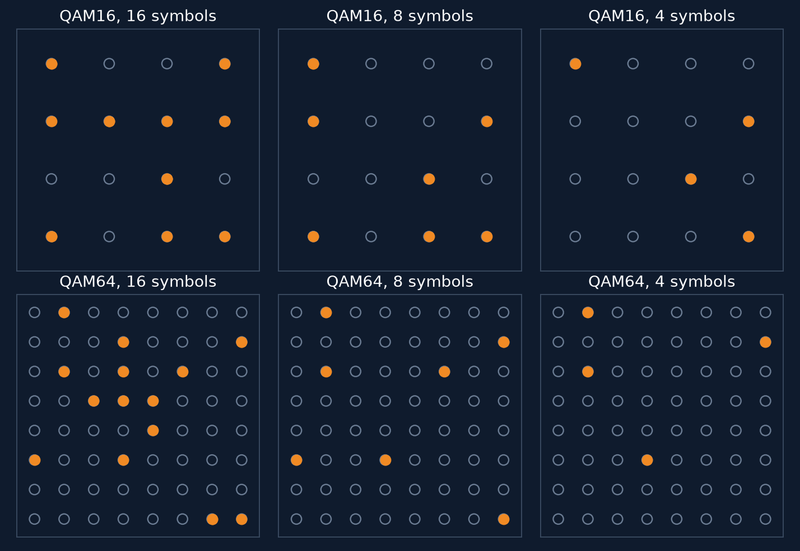
COMPARING FRAME LENGTHS
train_backbone.py --frame-len 64 / 32
16, 8 or 4 symbols: what does it need?
5.7%
16 symbols
15.5%
8 symbols
25.2%
4 symbols
wrong, from +2 dB up
Fewer symbols, fewer points of the grid shown: QAM64 and QAM16 start to look alike.
More signal does not fix it. More symbols does. Noise decides where the curve falls; the number of symbols decides how low it can go.
9
Notes:
So what does cause them? Frame length. I cut every frame to 64 samples, which is 8 symbols, and to 32 samples, 4 symbols, and trained again. The curves fall at about the same noise level, but they flatten at different heights: 5.7 percent wrong with 16 symbols, 15.5 with 8, 25.2 with 4. On the right: with fewer symbols you see fewer points of the grid, and QAM16 and QAM64 become harder to tell apart. More signal does not fix this; more symbols does.

Slide 10
SOMETHING WE FOUND
tools/single_snr.py
With no signal at all, it still answers
52.2%
24.8%
How they are counted
Recall
= right ÷ frames sent of that kind
Precision
= right ÷ frames it called that kind
Recall alone can look good while the detector is only guessing.
vs
QPSK recall at −20 dB
QPSK precision at −20 dB
looks like it recognises QPSK
it is guessing: 1 in 4
Why? It must name one of the four. With nothing to go on it says BPSK or QPSK 98.8% of the time, and which of the two changes from one training run to the next.
Every chart now shows precision next to recall, and how many decisions sit behind each point.
10
Notes:
One thing we found. At minus 20 dB there is no signal at all, but the detector still has to name one of the four. QPSK recall there is 52 percent, which looks like it recognises QPSK. It does not: of all the frames it calls QPSK, only 25 percent are QPSK, which is a guess. It sends almost everything, 98.8 percent, to BPSK or QPSK, and which of the two changes from one training run to the next. That is why every chart now shows precision next to recall, and how many decisions each point is based on.

Slide 11
In short
1
BPSK and QPSK are essentially solved. The mistakes are QAM16 against QAM64.
2
Those mistakes come from having only 16 symbols, not from noise: with 8 or 4 symbols they grow 2.7 and 4.3 times.
3
“10 dB” in this data is a setting, not a measurement, and it means a different noise level for each kind of signal.
QAM16 and QAM64 with 16, 8 and 4 symbols
Next: switch off the carrier offset, fading and echoes one at a time, and see which one the QAM mistakes belong to.
11
Notes:
To sum up. BPSK and QPSK are essentially solved; the mistakes are QAM16 against QAM64. Those mistakes come from having only 16 symbols, not from noise: with 8 or 4 symbols they grow 2.7 and 4.3 times. And 10 dB in this dataset is a setting, not a measurement. Next, I want to switch off the carrier offset, the fading and the echoes one at a time and see which one the QAM mistakes belong to. Thank you.

