Slide 1
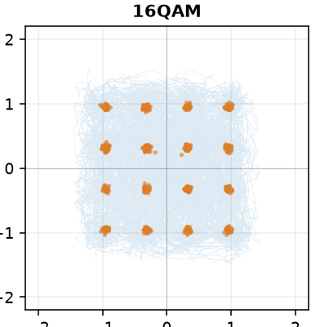
Opening the four-class box
What you asked on 22 September, answered on RML2016.10a
BPSK · QPSK · QAM16 · QAM64 · 128-sample frames · ICRNNA · 14 seeds
Yusuf Bilal Çetinkaya · September 2026
1
Notes:
Last week you asked me to open the box, define the noise, and go one SNR at a time on the four-class problem, and not to make it more complicated than that. This is that, on RML2016.10a, the dataset the group works on. Everything is measured on one model, and every number comes from a file in the repository.

Slide 2
What you asked for last week
Six items, one slide each. Everything on 2016, so it compares with the group's work.
you asked | slide | status
Open the box: what the detector is, where it came from, who wrote it | 3–5 | done
Define the noise: what “10 dB” is the ratio of, who made it | 6–7 | done
One SNR at a time: the matrix at 10, then 6, then about 3 dB | 8–9 | done
State the frame length, then shorten it | 10–11 | done
Every graph says how many decisions are behind each point; recall defined, precision shown | 8, 12 | done
Don't make it more complicated than the four-class box — break it | all | done
2
Notes:
These are the six things you asked for, and the slide where each is answered. Items one to five are done. The sixth, don't make it more complicated, is how the deck is built: four classes, one model, one dataset. There is one slide near the end on the domain-gap work, because it contradicted 2018 and I want you to know that.

Slide 3
The box, end to end
One frame in, one of four labels out. Every block, its output shape and how many numbers it learns.
input
conv 1
conv 2
BiLSTM
attention
classifier
decision
I and Q,
128 samples
= 16 symbols
64 filters × 5 samples
+ max-pool 2
128 filters × 3
+ max-pool 2
2 layers, 128 per
direction, reads the
32 steps both ways
weighted average
of the 32 steps
dense 128
+ dense 4
largest score
wins
2 × 128
64 × 64
128 × 32
32 × 256
256
4 scores
1 label
no weights
832 weights
24,960 weights
659,968 weights
66,048 weights
33,668 weights
no weights
785,476
84%
Each of the 32 LSTM steps sees 12 input samples, 1.5 symbols. The same weights run at 64 and 32 samples; only the number of steps changes (16, 8). Each frame is scaled to unit power before it goes in, so the level carries nothing.
numbers learned in total
of them in the LSTM: this is mostly a recurrent network
3
Notes:
The box, end to end. In: one frame, 128 complex samples, as a 2 by 128 array of I and Q. On this dataset that is 16 symbols. Each frame is scaled to unit power first, so the model cannot read the level. Two convolution layers turn it into 32 short feature vectors, each describing about one and a half symbols. A two-layer bidirectional LSTM reads those 32 forwards and backwards, so each one knows about the whole frame. Attention takes a learned weighted average of the 32, which gives one vector for the frame. A small classifier turns that into four scores, and the decision is the largest score. 785 thousand numbers are learned; 84 percent of them are in the LSTM. The same weights work at 64 and 32 samples, only the number of LSTM steps changes, and that is what makes the frame-length test clean.

Slide 4
Where it came from, and who wrote what
The model is a colleague's reproduction of a paper. The code around it was written with an AI assistant.
The architecture
Written with an AI assistant
ICRNNA — El-Haryqy et al., Results in Engineering 26 (2025) 104783. Our code is transcribed from a colleague's reproduction, not from the paper, and differs in five places: first kernel 5 vs 3; two pools vs one; one BatchNorm after the LSTM vs one per layer; no attention dropout or LayerNorm; one dense layer vs two.
Claude Code (Anthropic) wrote most of the code, the Colab runners, the table and figure tools, this deck and most of the write-up. Every commit it wrote is marked in git.
Not from it: the dataset (DeepSig), the architecture (the paper, the colleague), the numbers — measured by running the code on Colab GPUs, several rerun bit-identical — and the decisions.
What I asked, what came back — e.g.: “shorten the frame to 64, then 32” → a frame-length option and three runs; “why is the faithful build 1.5 points low?” → the convergence check that found 58 epochs too few.
A separate build written from the paper itself, on 11 classes:
 | accuracy
paper, Table 3 | 63.24%
faithful build, paper's 58 epochs | 61.75%
faithful build, to convergence (epoch 107) | 63.21%
Full account: DETECTOR.md in the repository.
4
Notes:
Where it came from. The architecture is ICRNNA, El-Haryqy and colleagues, Results in Engineering 2025. Our code is not written from the paper; it is transcribed from a colleague's reproduction, and it differs from the paper in five places, listed. So I never call it the published architecture. To check the paper independently I built a faithful version from the paper itself. At the paper's own 58 epochs it reaches 61.75 against 63.24. Trained until early stopping ends it, which is epoch 107, it reaches 63.21. So the paper's number is real and our pipeline reads the data correctly. And you asked who wrote what. The code, the tools, this deck and most of the write-up were written with Claude Code, Anthropic's coding assistant. Every commit it wrote is marked in git. The dataset, the architecture, the numbers and the decisions did not come from it: the numbers come from running the code on a GPU, and several were rerun and came back bit-identical. [Say here, in your own words, how the work before 9 September was done and who the colleague is.]

Slide 5
How it was trained, and how it decides
The test set is read once. The decision is deterministic, and it always picks one of the four.
data | RML2016.10a, 4 classes × 20 SNR levels × 1,000 frames
split | per (class, SNR): 70% train, 15% validation, 15% test
training | AdamW, lr 1e-3, batch 256, cross-entropy; lr ×0.2 when validation stalls
stopping | 20 epochs without validation gain; ceiling 100; best-validation weights kept
repeats | 14 seeds: new split, new initialisation each
converged? | all 14: best epochs 16–46, every one stopped early
Same frame 10,000 times
→ the same answer 10,000 times. At test time nothing is random. The meaningful test is 10,000 different frames, and that is what every table here counts.
No “I don't know”
The largest of four scores always wins, even at −20 dB where the frame carries nothing. Where those frames go is slide 12.
5
Notes:
How it was trained, and how it decides. The split is per class and per SNR: 70 percent train, 15 validation, 15 test. Early stopping, the learning-rate schedule and the choice of checkpoint read only validation; the test set is touched once. 14 seeds, and every one of them stopped by early stopping, not by the ceiling. On the decision: the model is deterministic. The same frame 10,000 times gives the same answer 10,000 times. So the meaningful test is 10,000 different frames, and every table in this deck counts exactly that. And there is no 'I don't know': every frame gets one of the four labels, even at minus 20 dB. That is where the sink on slide 12 comes from.

Slide 6
Who made the noise
DeepSig, in GNU Radio, synthetic. The paper gives no parameters; these are from their published generator.
stage | setting | what it means
modulator | root-raised cosine, 8 samples / symbol, roll-off 0.35 | 200 kHz sampling, 25 kbaud; a frame is 0.64 ms, 16 symbols
clock offset | random walk, clipped at 50 Hz | sample-rate drift
carrier offset | random walk, clipped at 500 Hz | up to 115° of rotation across one frame
fading | Rician, K = 4, Doppler 1 Hz | one random complex gain per frame
multipath | 3 paths: delays 0, 0.9, 1.7 samples; gains 1, 0.8, 0.3 | 0.2 symbol of delay spread
noise | white Gaussian, noise_amp = 10^(−label/10) | the only thing the SNR label sets
!
Noise is one of five impairments
Carrier offset, clock offset, fading and multipath are present at every SNR, including +18 dB. Errors at high SNR cannot be blamed on noise.
Source: O'Shea & West, GRCon 2016; github.com/radioML/dataset, generate_RML2016.10a.py.
6
Notes:
Who made the noise. DeepSig, in GNU Radio, entirely synthetic. The paper names the channel block and gives no parameters at all, so these come from the generator code they published. The important point is on the right: noise is only one of five impairments. Carrier offset, clock offset, Rician fading and three-path multipath are there at every SNR, including plus 18. And the SNR label sets exactly one number: the noise amplitude, 10 to the minus label over 10.

Slide 7
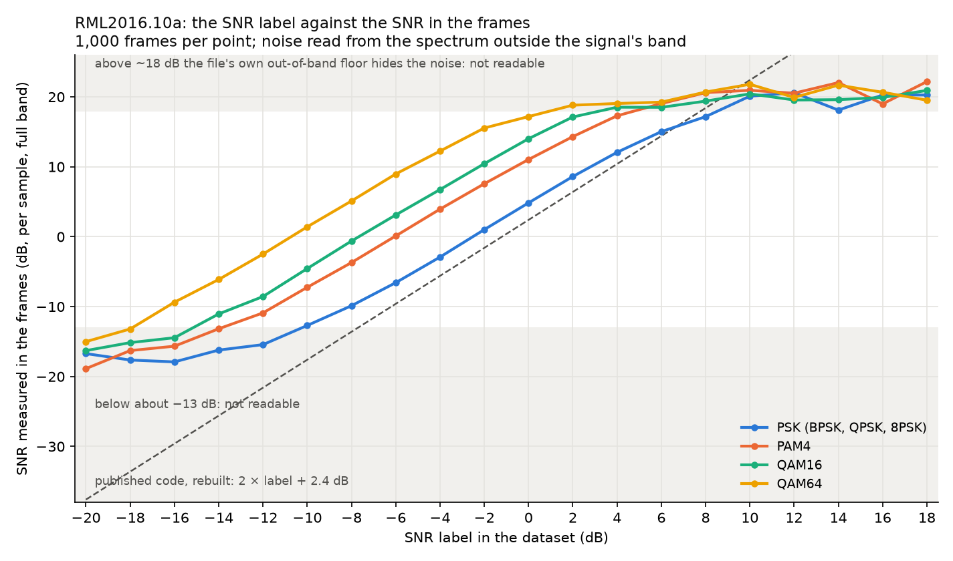
What “10 dB” is the ratio of
Measured in the frames of the file itself, not taken from the code.
1.87–1.89 dB
of measured SNR per dB of label (PSK): the label sets a noise amplitude, so it moves twice as fast as its name
Same label, different SNR — above PSK:
 | measured | unscaled points
PAM4 | +6.6 dB | +7.0 dB
QAM16 | +9.5 dB | +10.0 dB
QAM64 | +15.2 dB | +16.2 dB
At a label of −6 dB a QAM64 frame is at about +9 dB, a QPSK frame at about -6 dB. Readable only from about −13 to +18 dB; outside that the flat parts are the method's limit.
7
Notes:
So what is 10 dB the ratio of? Because that setting is an amplitude, the label moves the noise twice as fast as its name. I did not want to take the code's word for it, so I measured the SNR in the frames of the file itself, from the noise level outside the signal's band. For PSK the measured SNR rises 1.9 dB per dB of label. Confirmed. The second finding I did not expect: the classes do not share an SNR. At the same label, QAM16 frames have 9.5 dB more SNR than PSK and QAM64 15 dB more. That is exactly what you get if the constellations went out unscaled, with the noise the same for all. So at a label of minus 6, a QAM64 frame is at about plus 9 dB and a QPSK frame at about minus 6. The answer to your question: 10 dB in this dataset is a setting, not a ratio, and it means a different ratio for each class. The method reads between about minus 13 and plus 18 dB; outside that, the flat parts are the method's limit.

Slide 8
The box at one SNR: 10 dB
8,400 decisions — 14 seeds × 4 classes × 150 test frames. Rows: what was sent. Columns: what was decided.
sent \ decided | BPSK | QPSK | QAM16 | QAM64 | recall
BPSK | 2,092 | 3 | 0 | 5 | 99.6%
QPSK | 6 | 2,091 | 2 | 1 | 99.6%
QAM16 | 4 | 19 | 1,808 | 269 | 86.1%
QAM64 | 8 | 5 | 126 | 1,961 | 93.4%
precision | 99.1% of 2,110 | 98.7% of 2,118 | 93.4% of 1,936 | 87.7% of 2,236
448
wrong of 8,400 (5.3%)
395
of them are QAM16 ↔ QAM64
recall = the row: of the frames that were this class, how many were called it.
precision = the column: of the frames called this class, how many were it.
BPSK and QPSK: 99.6% recall. The errors are one pair.
8
Notes:
The box at one SNR: 10 dB label. 8,400 decisions: 14 seeds, 150 test frames per class. Rows are what was sent, columns what was decided. Recall is the row: of the frames that were this class, how many were called it. Precision is the column: of the frames called this class, how many were it. BPSK and QPSK are at 99.6 percent. Almost every error is QAM16 against QAM64: 395 of the 448.

Slide 9
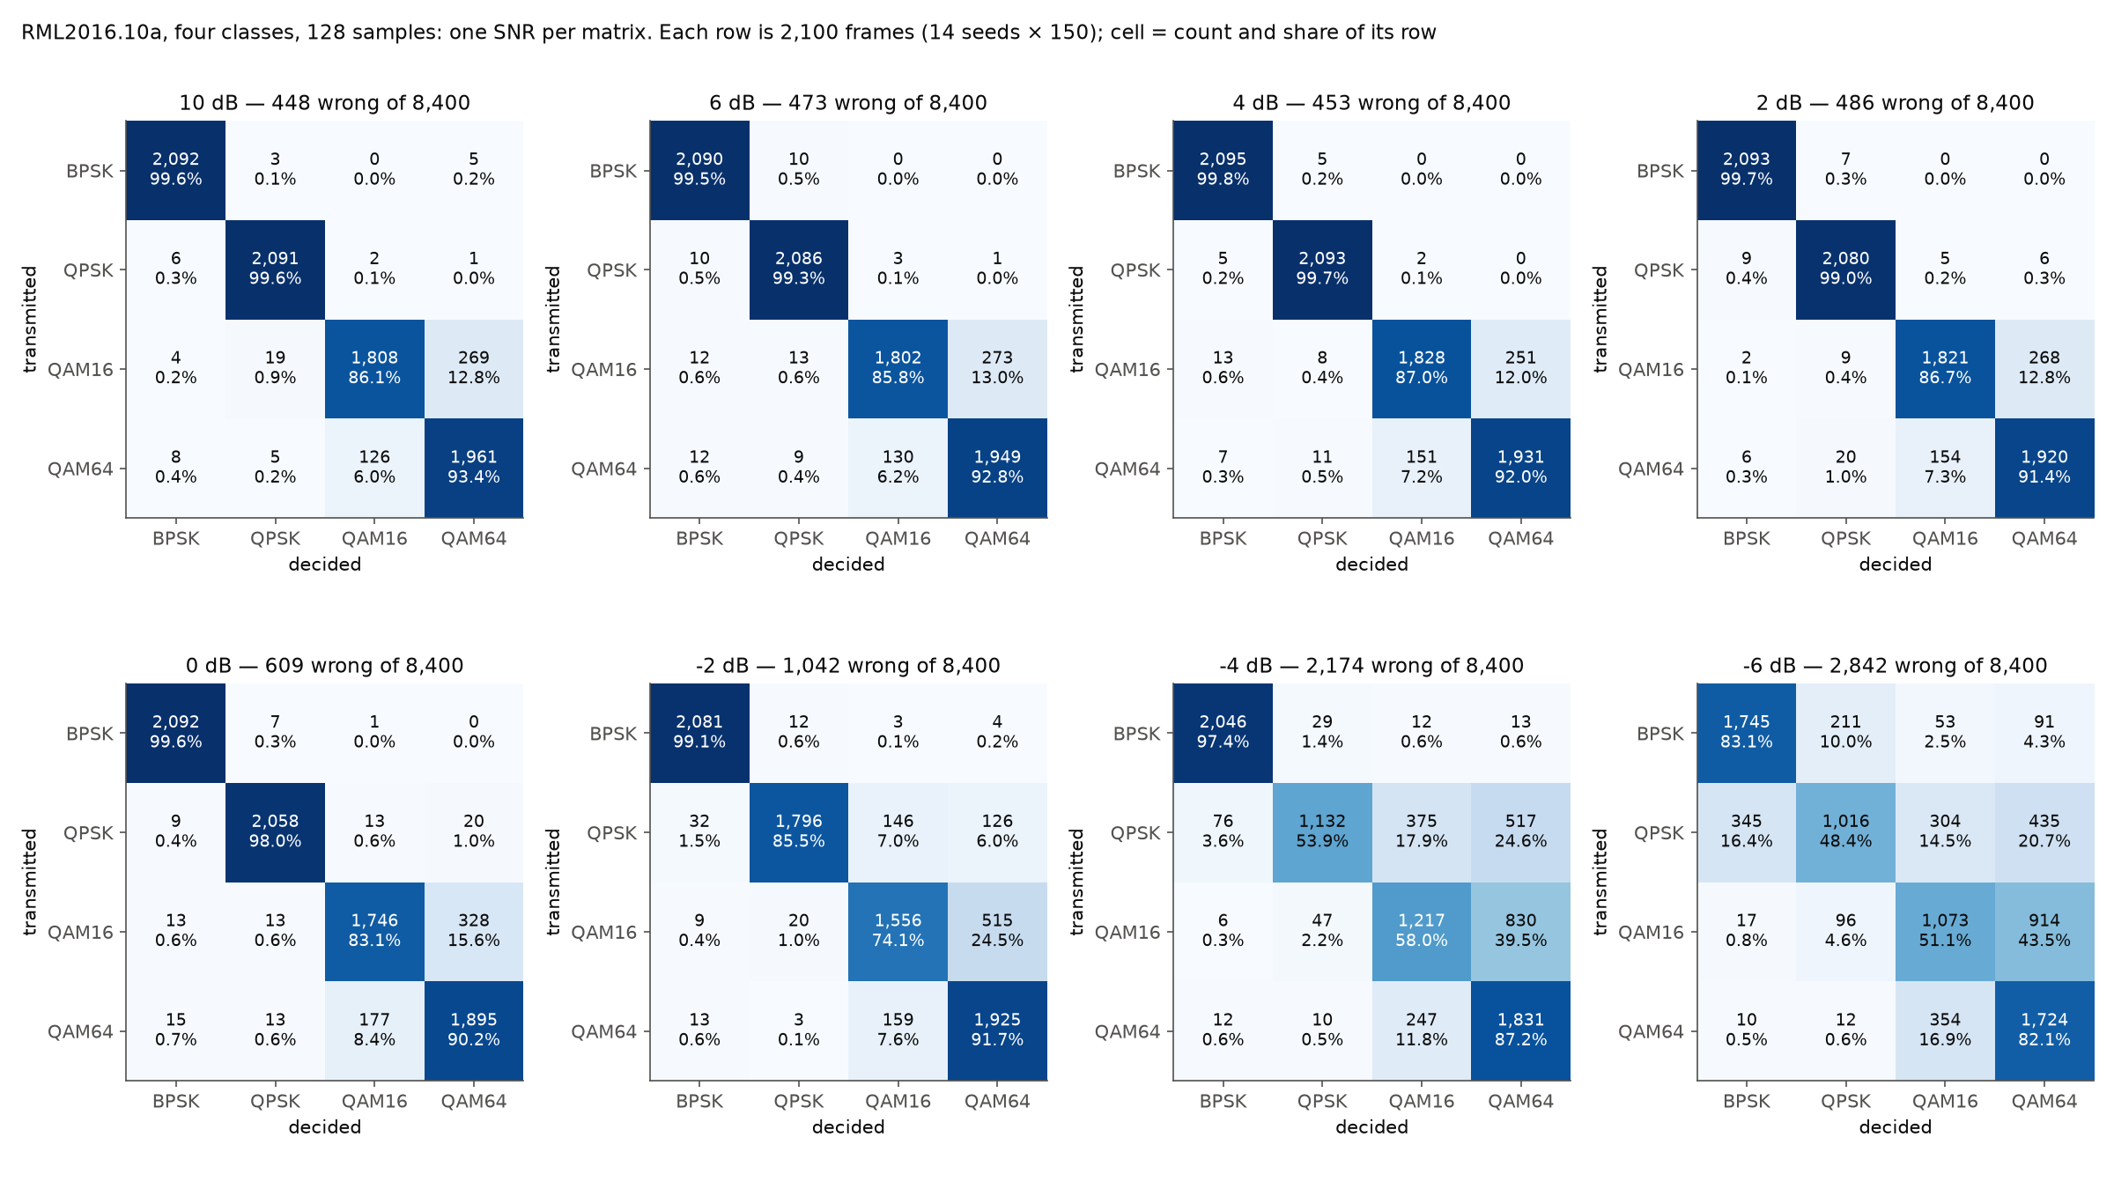
Then lower: nothing changes until 0 dB
Each matrix 8,400 decisions; each cell count and share of its row.
label | wrong of 8,400
+10 dB | 448
+6 dB | 473
+4 dB | 453
+2 dB | 486
0 dB | 609
-2 dB | 1,042
-4 dB | 2,174
-6 dB | 2,842
10 → 2 dB: the same box. Below 0 dB QPSK leaks into both QAMs first; BPSK holds longest.
9
Notes:
Then lower, as you asked: 10, 6, 4, 2. The counts are 448, 473, 453, 486 wrong out of 8,400. Nothing changes. The box does not start to break until the label goes under 0 dB: 609 at 0, 1,042 at minus 2, 2,174 at minus 4. Below that, QPSK leaks into both QAMs first and QAM16 drains into QAM64; BPSK holds longest.

Slide 10
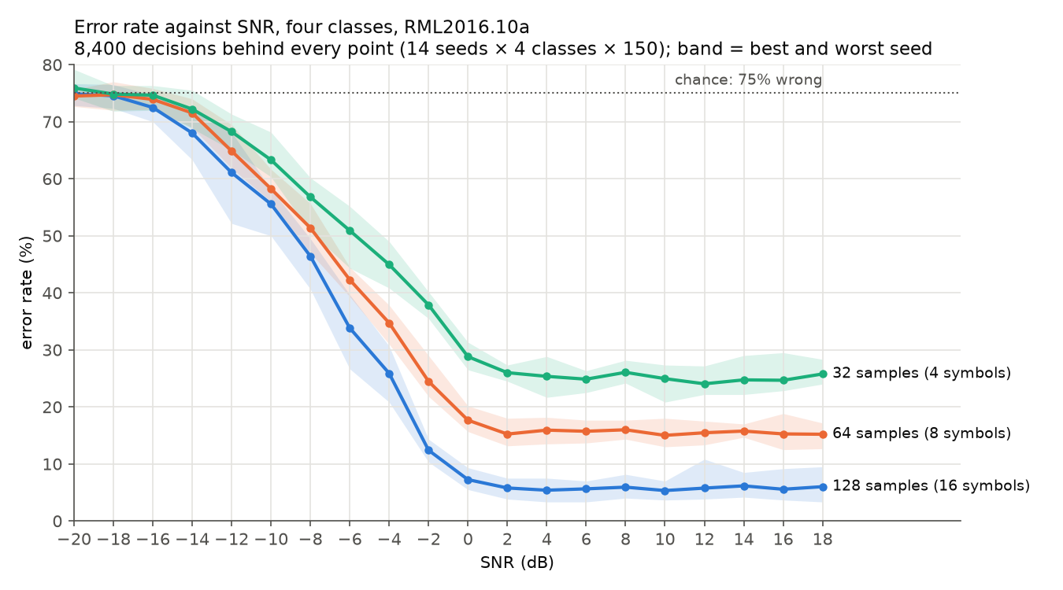
Error rate against SNR — and against frame length
SNR decides where the curve falls. The number of symbols decides how low it can go.
5.7%
error floor from +2 dB up, 128 samples = 16 symbols
15.5%
error floor from +2 dB up, 64 samples = 8 symbols
25.2%
error floor from +2 dB up, 32 samples = 4 symbols
Above 10 dB: 2,421 / 6,443 / 10,431 wrong of 42,000.
10
Notes:
Error rate against SNR, and against frame length, which you also asked for. 8,400 decisions behind every point; the band is the best and worst of 14 seeds. SNR decides where the curve falls. Frame length decides how low it can go: from plus 2 dB up, the error rate is flat at 5.7 percent with 128 samples, 15.5 with 64 and 25.2 with 32. As you predicted: shorter frames, more errors, and more SNR does not buy them back.

Slide 11
What shorter frames break
Recall above 10 dB, 10,500 frames per class per length.
87 → 66 → 46%
QAM16 recall at 16 → 8 → 4 symbols: at 4 it is a coin flip
809
QPSK frames called BPSK at 4 symbols: if all four land on one diagonal, the frame looks like BPSK
These QAM frames are measured at 17 dB SNR or more (slide 7). The errors are the symbol count, not the noise.
11
Notes:
What the shorter frames break. At 128 samples, 16 symbols, QAM16 recall is 87 percent. At 8 symbols, 66. At 4 symbols, 46: a coin flip. BPSK does not move. QPSK only drops at 4 symbols, and it drops into BPSK, which is what four symbols predict: if all four fall on one diagonal of the QPSK constellation, the frame looks like BPSK. With the SNR measurement from slide 7, the QAM frames here are above 17 dB. So these errors are not noise; they are the number of symbols in the frame.

Slide 12
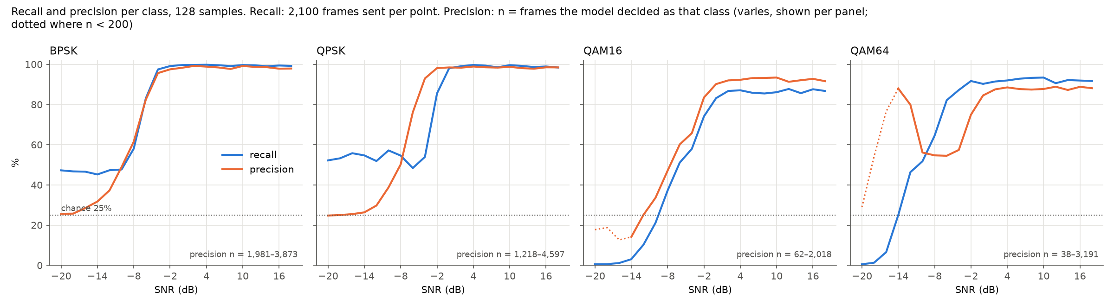
Recall, precision, and where empty frames go
Recall: 2,100 frames sent per point. Precision: n = frames decided as that class, shown per panel.
98.8%
26% / 25%
12–86%
of all −20 dB decisions go to BPSK or QPSK
BPSK / QPSK precision at −20 dB: chance, with four classes
BPSK's share of that, seed to seed: which of the two is arbitrary
12
Notes:
Every graph now says how many decisions are behind each point, and shows precision next to recall. This is why. At minus 20 dB, BPSK and QPSK recall are near 50 percent, which looks like recognition. It is not: 98.8 percent of all decisions go to those two, and their precision is 25 percent, which is chance with four classes. The model sends frames with no information to the PSK classes, and which of the two is arbitrary: from seed to seed the BPSK share runs from 12 to 86 percent. That is the rising curve you pointed at last week. It is the sink, and precision is what shows it.

Slide 13
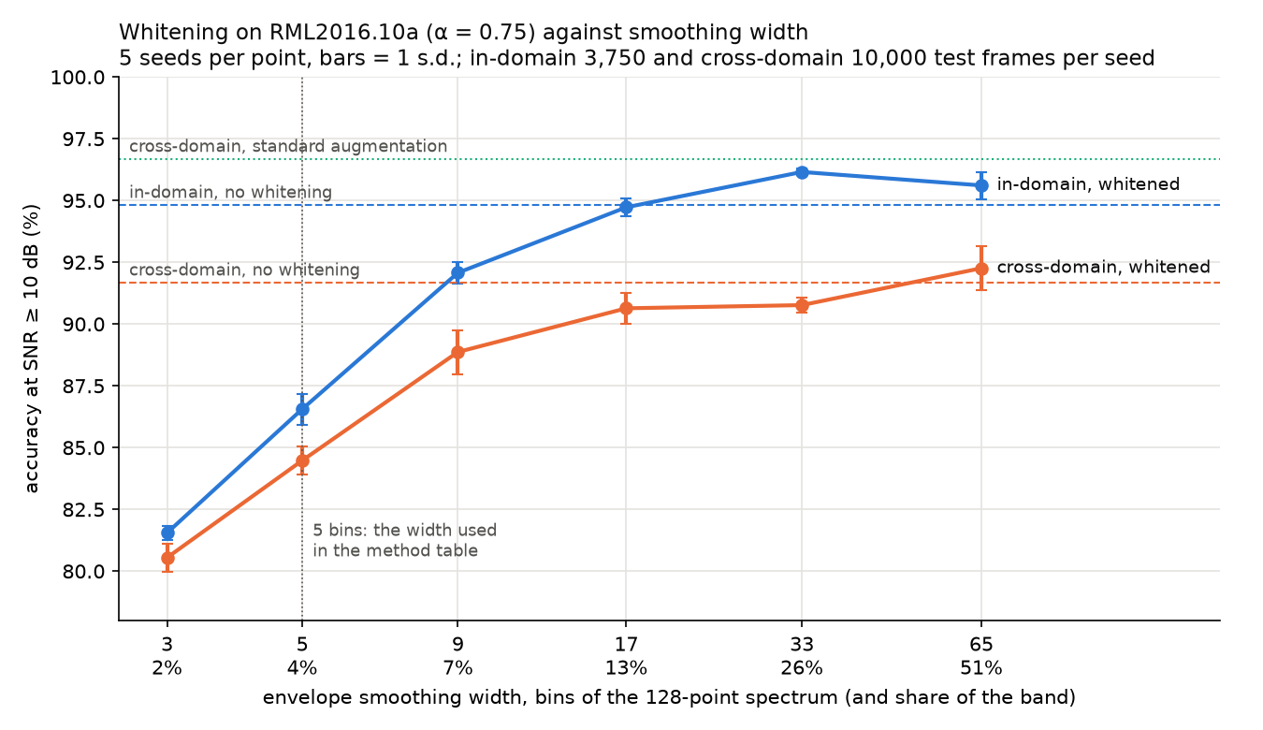
Beyond the box: the 2018 result does not transfer
Train on RML2016.10a, test on our own generator. 5 shared classes, 14 seeds, accuracy at ≥ 10 dB.
method | in-domain | cross-domain
none | 0.948 | 0.920
standard augmentation | 0.969 | 0.968
whitening (5-bin envelope) | 0.864 | 0.843
whitening + augmentation | 0.931 | 0.913
The gap is small here (0.028) and the standard augmentation set closes it. On 2018 the gap was 0.19 and whitening closed it.
Whitening's 8-point cost was the envelope estimate: 128 points smoothed over 5 bins. Over 33 bins it is +1.3 points in-domain — but cross-domain it never clearly beats doing nothing.
13
Notes:
One slide beyond the box, because it changes what I told you about 2018. On 2018 spectral whitening closed the domain gap. On 2016 it does not. The gap is small to start with, 0.028, and the standard augmentation set closes it. Whitening at first cost 8 points in-domain. I measured why: at 128 samples the spectral envelope is estimated from too few bins. Smoothing over more bins removes the cost entirely, and at 33 bins it is even 1.3 points better than nothing, but it still does not close the cross-domain gap. So the 2018 claim holds only for 2018, and I say so.

Slide 14
Caveats
!
Both domains are synthetic
!
Not the published architecture
RML2016.10a is simulated, and so is our second transmitter. No over-the-air capture has been classified yet.
A colleague's reproduction with five differences. The faithful build is separate and matches the paper at convergence.
!
The SNR label is not one SNR
!
One dataset, one model
At one label QAM64 frames carry about 15 dB more SNR than PSK. Classes cannot be compared at one label.
14 seeds each, all converged. A second architecture on the same box has not been run.
14
Notes:
The caveats. Both domains are synthetic. The model is not the published architecture. The SNR label means a different SNR per class, so no comparison across classes at one label. And the four-class results are 14 seeds on one dataset and one model.

Slide 15
Next: break the box one knob at a time
Done
Frame length (128 / 64 / 32) and SNR (one level at a time). The high-SNR errors are the QAM pair, and they follow the symbol count.
Next
The generator is now rebuilt in GNU Radio. Switch off carrier offset, fading and multipath one at a time, same four classes, same 128 samples, and see which impairment the high-SNR QAM errors belong to.
Then
The same box on a real capture, when lab access allows.
Repository: YusufBilo78/amc · DETECTOR.md · NOISE_2016.md · SNR_2016.md
15
Notes:
Next, keeping to the four-class box, and breaking it one knob at a time. Frame length and SNR are done. The generator is in our hands, so the next knobs are the other four impairments: turn off carrier offset, fading and multipath one by one, at the same frame length, and see which one the high-SNR QAM errors belong to. Then the same box on a real capture, when lab access allows.

