Slide 1
PAPER PRESENTATION
ICRNNA
Improved automatic modulation recognition using deep learning with additive attention
El-Haryqy, Kharbouche, Ouamna, Madini, Zouine · Ibn Tofail University, Morocco · Results in Engineering 26 (2025) 104783
Look
Read in order
Weigh
Decide
Yusuf Bilal Cetinkaya · Moshe Kam's research group · NJIT · October 2026
1
Notes:
Today I present the paper our classifier comes from: ICRNNA, from a group in Morocco, published in 2025. I'll keep it simple: what it does, how it works, what it reports, and whether it holds up.

Slide 2
THE PAPER
The paper in one sentence
A neural network looks at 128 samples of a radio signal and says which of 11 modulations sent it.
63.24%
my classifier
right on RML2016.10a: the best of the 12 models they compare
is built on this design
2
Notes:
The paper in one sentence: a neural network looks at 128 samples of a radio signal and says which of 11 modulations sent it. They report 63.24 percent right on this dataset, the best of the twelve models they compare. My own classifier is built on this design.

Slide 3
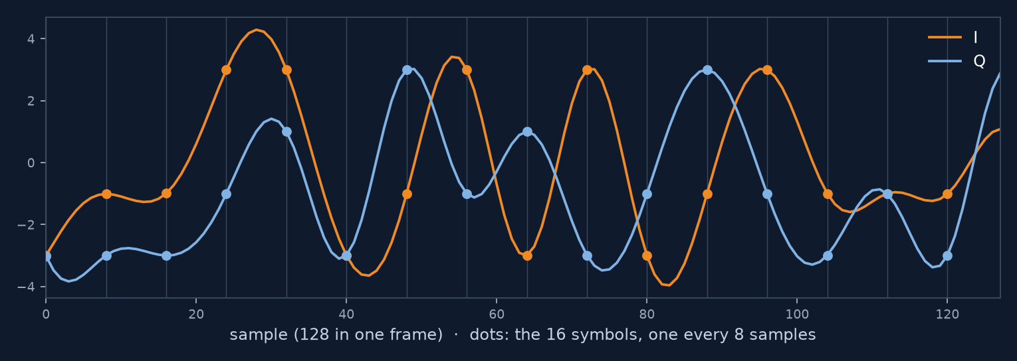
THE PAPER · DATA
The data: what the model sees
11
20
220,000
modulation types:
8 digital, 3 analog
SNR labels, −20 to 18 dB,
in steps of 2 dB
frames: 1,000 per type
at each SNR
one frame: I (orange), Q (blue)
2 × 128
Each frame: 128 samples of I and 128 of Q.
That array is the only input.
RML2016.10a, the same dataset we use.
3
Notes:
The data is the same dataset we use, RML2016.10a: eleven modulation types, eight digital and three analog. Twenty noise levels, from minus 20 to plus 18 dB in steps of 2, and 1,000 frames of each type at each level: 220,000 frames. Each frame is 128 samples of I and 128 of Q. That is the only input; the network sees nothing else.

Slide 4
THE PAPER · THE MODEL
How it works: four steps
1
2
3
4
Look at short pieces
Read them in order
Weigh the pieces
Decide
CNN
LSTM, both directions
attention
dense layers
short filters slide along the signal
carries a memory from piece to piece
a weighted average of all the pieces
11 confidence scores, one per type; the largest wins
In: 128 samples (I and Q). Out: 11 scores. 794,188 numbers learned, 83% of them in step 2.
Step 2, reading the pieces in order, is the heart of it.
4
Notes:
How does it work? Four steps. One: it looks at short pieces of the signal, with small filters that slide along it. Two: it reads those pieces in order, forwards and backwards, carrying a memory from piece to piece. Three: it weighs the pieces and takes a weighted average. Four: it gives eleven confidence scores, one per modulation, and the largest wins. Most of the network, 83 percent, is in step two. That is the heart of it.

Slide 5
THE PAPER · THE MODEL
Step 2 up close: what is an LSTM?
It reads the 64 pieces one at a time and carries a memory of 128 numbers from piece to piece. At every piece, three gates act like valves:
1
Keep
2
Write
3
Show
Signal-processing view
forget gate
input gate
output gate
memory(t) = keep × memory(t−1) + write × new
how much of the old memory to keep: 0 erases it, 1 keeps all of it
how much of the new piece to add to the memory
how much of the memory to pass on
A leaky integrator whose pole the data sets at every step: near 1 it holds, near 0 it resets.
Each gate is a small learned layer giving numbers between 0 and 1. In ICRNNA: read forwards and backwards, 2 layers, 659,456 numbers (83% of the model).
It is the only step that reads across symbols, which is where a modulation shows.
5
Notes:
What is an LSTM? It is the layer in step two. It reads the 64 pieces one at a time and carries a memory of 128 numbers from piece to piece. At every piece, three gates act like valves. The forget gate decides how much of the old memory to keep: zero erases it, one keeps all of it. The input gate decides how much of the new piece to write into the memory. The output gate decides how much of the memory to pass on. Each gate is a small learned layer, set fresh at every piece. In signal-processing terms, the memory update is a leaky integrator whose pole the data sets at every step: near one it holds, near zero it resets. In ICRNNA it reads the frame forwards and backwards, in two layers, and holds 83 percent of the model's numbers. It matters because a modulation is a pattern across symbols, and this is the only step that reads across them.

Slide 6
THE PAPER
How they trained and tested it
70% of the dataset: training
15%: validation
15%: testing the classifier
154,000
33,000
33,000
frames with the right answer: it learns from these
frames to decide when to stop learning
frames kept aside: every result is counted on these
It stopped by itself after 58 passes over the data, when it stopped improving. Done once.
The test frames are never used for learning.
6
Notes:
How was it trained and tested? The dataset is split three ways. 70 percent of it, 154,000 frames with the right answer, to learn from. 15 percent, 33,000 frames, to decide when to stop learning. And the last 15 percent, 33,000 frames, kept aside to test the classifier: they are never used for learning, and every result is counted on them. It stopped by itself after 58 passes over the data, and they did it once.

Slide 7
THE PAPER · TABLE 3
Their main table: first by half a point
63.24 vs 62.73: the runner-up is half a point behind.
7
Notes:
Their main result. ICRNNA is first, at 63.24 percent. The next model is half a point behind. The well-known older ones are two to three points behind.

Slide 8
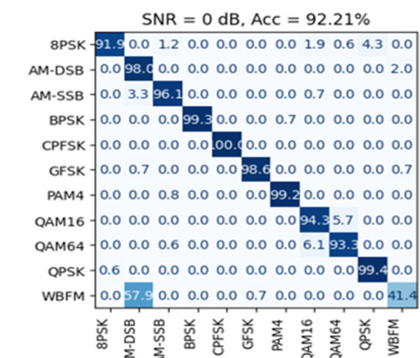
THE PAPER · FIG. 11
Where it still fails, at 0 dB
Test frames labelled 0 dB, about 150 per type (≈1,650). Row: the true type. Column: the classifier's answer. Each row adds up to 100%.
57.9%
of WBFM called AM-DSB: about 85 of ~145 frames
~6%
QAM16 ↔ QAM64, each way: about 9 to 10 frames
91.9%
of 8PSK right: 148 of 161 frames. The rest: 7 → QPSK, 3 → QAM16, 2 → AM-SSB, 1 → QAM64
Figure from El-Haryqy et al. 2025 (CC BY-NC 4.0)
The other seven types are 96 to 100% right at this level.
8
Notes:
Where does it still make mistakes, at 0 dB? This is their figure. About 150 test frames of each type, labelled 0 dB, went in; each row is one true type, and the columns are what the classifier said. Three weak spots. WBFM is called AM-DSB more than half the time: about 85 of some 145 frames. QAM16 and QAM64 are mixed up, about 6 percent each way. And 8PSK: of 161 frames, 148 are right; 7 are called QPSK, its nearest neighbour, and a few go to the QAM types. The other seven types are 96 to 100 percent right.

Slide 9
OUR CHECK
How much better is it, really?
We trained five published models the same way: same data, same split, 3 repeats each.
model | right, all noise levels | right, 10 dB and above
ICRNNA (2025) | 62.2% | 91.5%
LSTM2 (2018) | 61.4% | 91.5%
MCLDNN (2020) | 61.4% | 91.1%
PET-CGDNN (2021) | 61.0% | 90.6%
VT-CNN2 (2016) | 56.1% | 82.0%
First, but only by about one point.
9
Notes:
How much better is it, really? We trained five published models the same way: same data, same split, three repeats each. ICRNNA is first, but only by about one point. At 10 dB and above, the best four are all about 91 percent.

Slide 10
In short
1
A neural network in four steps; step 2, reading in order, does most of the work.
2
It is about one point better than older models, not a big jump.
For us: a solid classifier to build on.
10
Notes:
To sum up. It is a neural network in four steps, and step two, reading in order, does most of the work. And it is about one point better than older models, not a big jump. For us, it is a solid classifier to build on. Thank you. I have more detail on each step if you'd like.

Slide 11
BACKUP
Details, if asked
Each step of the model, the training recipe, their code, and what we checked in their tables.
11
Notes:
Backup slides with the details, if you want to go deeper.

Slide 12
THE PAPER · MODEL
The model at a glance
frame
CNN
BiLSTM
Attention
Dense
output
2 × 128
64 × 128
64 × 256
256
128 → 64
11
size of what comes out
One frame in, eleven probabilities out. The largest is the answer.
Redrawn from their Fig. 2; sizes from their code.
12
Notes:
Here is the whole model. A frame of 2 by 128 goes in. Four blocks process it. Eleven probabilities come out, one per modulation, and the largest is the answer. Below each block I wrote the size of what comes out of it, so you can follow one frame through. I'll now take the blocks one at a time.

Slide 13
THE PAPER · CNN
Block 1: short learned filters
1
64 filters, 3 taps
2 × 128 → 128 × 64
samples →
2
128 filters, 3 taps
→ 128 × 128
one output per sample, per filter
pool: larger of each pair
illustration
3
→ 64 × 128
Like an FIR filter whose taps are learned instead of designed.
Each of the 64 steps sums up about 6 samples: less than one symbol.
13
Notes:
Block one: two convolution layers. A convolution here is a short filter, three samples long, slid along the frame, like an FIR filter whose taps are learned instead of designed. The first layer has 64 such filters, the second 128. So every time step is now described by 128 numbers. Then a pooling step keeps the larger of each pair of neighbours, so 128 time steps become 64. Each of the 64 steps summarizes about 6 samples, less than one symbol.

Slide 14
THE PAPER · BiLSTM
Block 2: reading the steps in order
forwards, with a memory
step 1
step 2
step 3
step …
step 63
step 64
backwards, a second LSTM
2 layers, 128 numbers each way
→ 64 × 256
83%
of the model's numbers are here
After this block, every step knows the whole frame.
14
Notes:
Block two: two bidirectional LSTM layers. An LSTM reads the 64 steps in order, one at a time, and carries a memory from step to step. Bidirectional means a second LSTM reads the same steps backwards. So at every step, the output knows what came before and what comes after: 128 numbers from each direction, 256 in total. This block holds 83 percent of the model's numbers.

Slide 15
THE PAPER · ATTENTION
Block 3: a learned weighted average
score = v · tanh(W₁q + W₂k)
weights = softmax(score)
output = Σ weightₜ · stepₜ
a weight for each of the 64 steps; they add up to 1
“Improved” (from their code):
illustration
a learned scale on the scores · dropout 0.1 on the weights · normalization of the output
64 steps in, one vector of 256 out: the frame's summary.
15
Notes:
Block three: attention. Each of the 64 steps gets a score from a small learned network. A softmax turns the scores into weights that add up to one. The output is the weighted average of the 64 steps: one vector of 256 numbers for the whole frame. The paper calls it improved because of three additions. From their code we now know exactly what they are: a learned scale on the scores, dropout on the weights, and a normalization of the result.

Slide 16
THE PAPER · DENSE
Block 4: the decision
8PSK
AM-DSB
BiLSTM 83%
AM-SSB
BPSK
Attention 8%
CPFSK
Dense 5%
GFSK
PAM4
CNN 3%
QAM16
QAM64
QPSK
WBFM
794,188 numbers in total
256 → 128 → 64 → 11 probabilities; the largest wins (illustration)
Most of the model is the LSTM.
16
Notes:
Block four: the decision. Two ordinary layers, 128 and 64 numbers, and then 11 outputs. A softmax turns them into probabilities, and the largest one is the answer. In total the model has 794 thousand numbers. The pie shows where they are: almost all in the LSTM.

Slide 17
THE PAPER · TABLE 2 AND THEIR CODE
How it is trained
DATA
LOOP
STOPPING
70% learn: 154,000 frames
15% watch: 33,000
15% test: 33,000
batches of 32 frames
4,813 steps per epoch
loss: cross-entropy
Adam, learning rate 0.001
loss flat 5 epochs: rate × 0.2
loss flat 6 epochs: stop
at most 100 epochs
58
where it stopped
Trained once: one split, one run.
17
Notes:
How it is trained. Seventy percent of the frames to learn from, fifteen to watch, fifteen to test. Batches of 32 frames; the loss is cross-entropy; the optimizer is Adam with learning rate 0.001. When the validation loss stops improving for 5 epochs, the learning rate is cut by five. When it stops improving for 6 epochs, training stops and the best weights are restored. The paper's table says 58 epochs. From their code we now know that 58 is where this stopping rule fired, not a number they chose. They trained once.

Slide 18
PART 2 · THEIR CODE
What their code tells us
1
The model is the one in the paper
same layers, 794,188 numbers (paper: 0.79 M)
2
“58 epochs” was not a choice
training stops by itself when it stops improving; for them, at 58
3
They trained it once
one split of the data, one run, one number
One run gives one number: how much would it move?
18
Notes:
What does their code tell us? Three things. First, the model in the code is the model in the paper: same layers, 794 thousand numbers. Second, the 58 epochs in the paper were not a choice: the training stops by itself when it stops improving, and for them that happened at 58. Third, they trained it once: one split of the data, one run, one number. And one run leaves a question: how much would that number move if you ran it again?

Slide 19
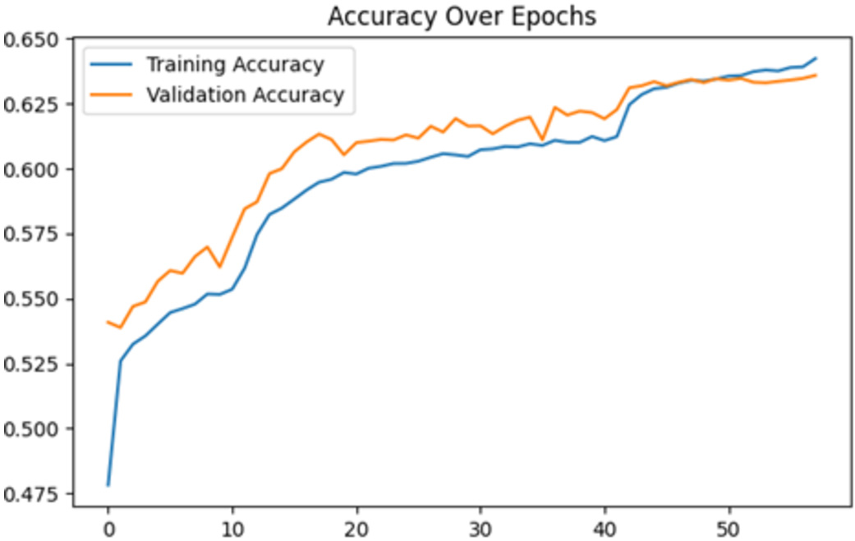
OUR CHECK
What “58 epochs” means
61.75%
our rebuild at a fixed 58 epochs (3 runs)
63.21%
the same, left to run: best at epoch 107
Their Fig. 7: accuracy still rising at 58
Figure from El-Haryqy et al. 2025 (CC BY-NC 4.0)
Their rule stopped on the loss; the accuracy was still climbing.
19
Notes:
One detail about the 58 epochs. Their stopping rule watches the validation loss, and the loss had flattened. But the validation accuracy, in their own figure on the right, is still rising at 58. When I trained our rebuild for a fixed 58 epochs, I got 61.75 percent. Letting it continue, it peaked at epoch 107 at 63.21. So their number is real, but it sits where the accuracy was still climbing.

Slide 20
OUR CHECK
We rebuilt it; their code agrees
Apr 2025
Aug 2026
Sep 2026
paper, no code
their code on GitHub, no weights
our rebuild from the paper alone
63.21%
MATCHED THEIR CODE
MISSED
one pooling step
normalization after each LSTM
dropout on attention weights
size: 794,827 vs 794,188
exact attention form and its learned scale
input normalization
gradient clipping
our rebuild, trained to the end (paper: 63.24%)
Their 63.24% is reproducible from the paper alone.
20
Notes:
Before we knew any code existed, I rebuilt the model from the paper's text alone. Its size matched: 794,827 numbers. In August the authors released their code, and it confirms our reading: one pooling step, normalization after each LSTM, dropout on the attention weights. We missed a few details: the exact form of the attention, the input normalization, and gradient clipping. Trained until it stopped improving, our rebuild reached 63.21 percent, against their 63.24.

Slide 21
OUR CHECK
Three claims their own tables don't support
“Best at low SNR”
Table 5: beaten at −10, −8 and −6 dB
1
“Full model has the highest precision”
Table 6: LSTM alone is higher, 0.768 vs 0.754
2
“MCLDNN: 406 million parameters”
It has 406,199: 0.41 million
3
ICRNNA is about twice MCLDNN's size, not smaller.
21
Notes:
Reading their tables closely, three statements in the text don't match their own numbers. Best at low SNR: in their Table 5, other models are higher at minus 10, minus 8 and minus 6 dB. Highest precision: in Table 6, the LSTM-only model is higher. And MCLDNN is listed with 406 million parameters; it has 406 thousand. So ICRNNA is about twice the size of MCLDNN, not smaller.

Slide 22
OUR CHECK
What the paper doesn't tell us
1
One run
no spread; our seeds vary by up to a point
+9 dB
2
Baselines
retrained on the same split, or copied from their papers?
more signal in QAM16 than in QPSK, both labelled 0 dB (measured in the file)
3
SNR label
taken as the true SNR
A half-point lead from one run may not be real.
22
Notes:
And three things the paper doesn't tell us. It reports one training run, with no spread; across seeds we see up to a point of variation, so a half-point lead may not be real. It doesn't say whether the other models were retrained or copied from their papers. And it treats the SNR label as a true SNR; in this data, at label 0 dB, QAM16 has about 9 dB more signal than QPSK.

