Slide 1


EEG Based Depression Detection using Machine Learning Techniques
Presented By
Md. Hasibul Hasan
Id: 201311067
Dept of CSE, Varendra University
Mst. Taslima Akter
Id: 201311139
Dept of CSE, Varendra University
Md. Yusuf Hasan
Id: 201311094
Dept of CSE, Varendra University
Supervised By
Md. Khademul Islam Molla, PhD
Coordinator
Dept of CSE, Varendra University

Slide 2
Featured Topics
Introduction
Workflow
Data Description
Classification Model
Model Evaluation
Conclusions
Future work
References

Slide 3
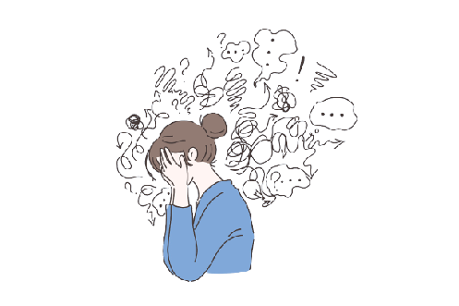
Introduction
Depression is a mental disorder affecting behavior, rooutines, feelings, and physical health.
Electroencephalogram (EEG) measures brain elcectrical activity via electrode on the scalp.
Psychiatrist utilize EEG as a cost-efficient and prevalent method to diagnose depression in patients.

Slide 4
Workflow
Data Description
Feature Extraction
Model
Learning
Model
Classification
Model
Evaluation
Result

Slide 5
Data Description
We use Secondary dataset collected from kaggle [].
There was totally 945 subject available to our dataset.
- 95 are healthy control.
- 199 are depressive disorders.
EG data included 5 min eye closed resting state with 19 channels w

Slide 6
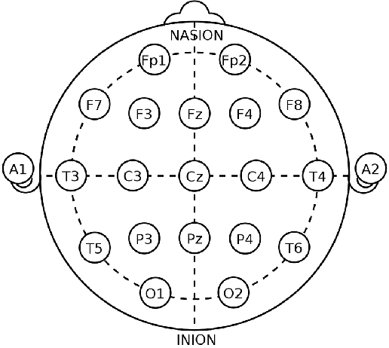
Data Description (cont…)
19 channel used for recording EEG signal.
Symmetrical anterior frontal (Fp1, Fp2)
Frontal (F3, F4, Fz, F7, F8)
Central (C3, C4, Cz)
Parietal (P3, P4, Pz)
Occipital (O1, O2)
Temporal (T3, T4, T5, T6)
Fig: Electrode placement on scalp

Slide 7
Preprocessing
Improving EEG signal quality to remove unwanted artifacts using 4th order Butterworth bandpass filter with filter size of 0.4 Hz - 50 Hz.
Extracting required features.
* Linear features
- Power at different frequency [alpha, beta, delta, theta]
- Amplitude of power signal [mean, median, max, min]
* Nonlinear features
- Spectral entropy
- Singular value deposition
The column for extra information like age, gender, IQ and serial number, and also null entities are removed.

Slide 8
Classification Model
For classification of depression disorder based on the features that were taken from the EEG data, two model were created.
Random Forest Model
XGBoost Model

Slide 9
Classification Model (cont…)
Random Forest
A Random Forest model is a group of decision tree constructed from data sample selected from a training set and a replacement sample known as the bootstrap sample.

Slide 10
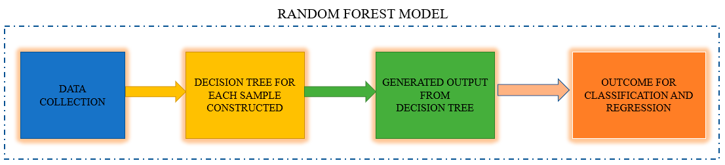
Classification Model (cont…)
Random Forest
Fig: Overview of Random Forest Model

Slide 11
Classification Model (cont…)
XGBoost
A distributed and scalable gradient boosted decision tree ML framework is called Extreme Gradient Boosting (XGBoost). It employs boosting technique, combining multiple weak learner (decision tree) and creates a strong learner.

Slide 12
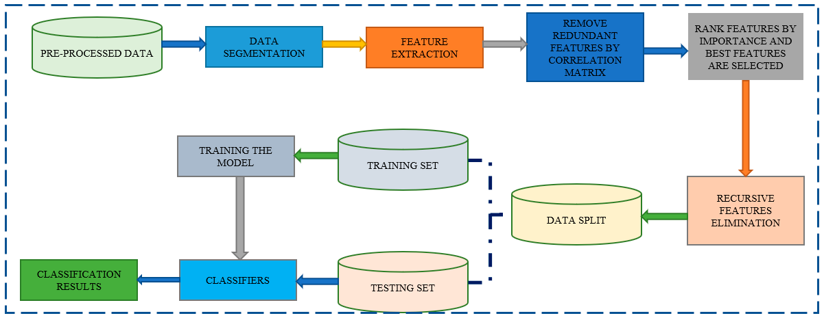
Classification Model (cont…)
XGBoost
Fig: overview of XGBoost Model

Slide 13
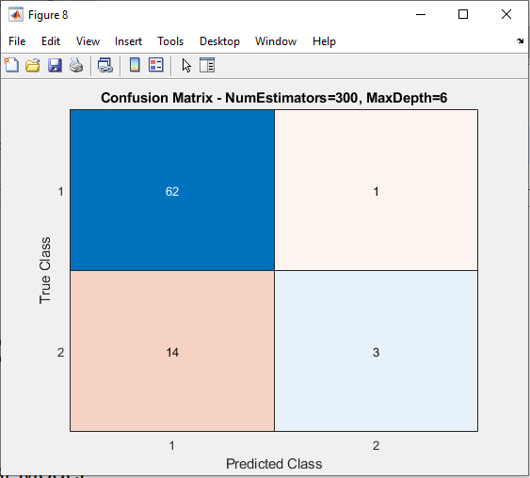
Model Evaluation (cont…)
Random Forest
True Positive (TP): 62
False Negative (FN) : 1
False Positiove (FP): 14
True Negative (TN): 3
Fig: Confusion matrix of Random Forest

Slide 14
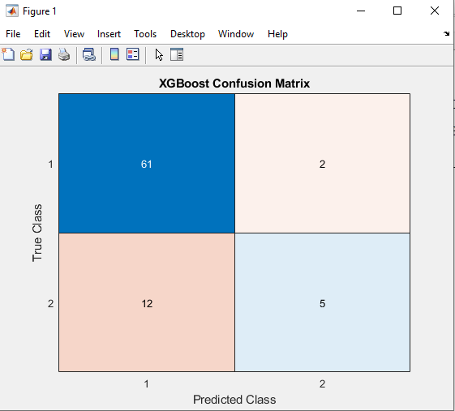
Model Evaluation (cont…)
XGBoost
True Positive (TP): 61
False Negative (FN) : 2
False Positiove (FP): 12
True Negative (TN): 5
Fig: Confusion matrix of XGBoost

Slide 15
Model Evaluation (cont…)
Comparative Analysis
Model | Accuracy | Precision | Recall | F1 Score
Random Forest | 81.25% | 0.95 | 0.98 | 0.96
XGBoost | 82.5% | 0.83 | 0.96 | 0.89

Slide 16
Discussion

Slide 17
Conclusion
We haved looked at:

Slide 18
Future Work
Making the algorithm more efficient to increase accuracy.
Trying different model to train and make a comparative analysis between those.
Evaluating different dataset to check the model performances.

Slide 19
References
Ksibi, A., Zakariah, M., Menzli, L. J., Saidani, O., Almuqren, L., & Hanafieh, R. A. M. (2023). Electroencephalography-based depression detection using multiple machine learning techniques. Diagnostics (Basel, Switzerland), 13(10). https://doi.org/10.3390/diagnostics13101779
Ay, B., Yildirim, O., Talo, M., Baloglu, U. B., Aydin, G., Puthankattil, S. D., & Acharya, U. R. (2019). Automated depression detection using deep representation and sequence learning with EEG signals. Journal of Medical Systems, 43(7), 205. https://doi.org/10.1007/s10916-019-1345-y
Cai, H., Yuan, Z., Gao, Y., Sun, S., Li, N., Tian, F., Xiao, H., Li, J., Yang, Z., Li, X., Zhao, Q., Liu, Z., Yao, Z., Yang, M., Peng, H., Zhu, J., Zhang, X., Gao, G., Zheng, F., … Hu, B. (2022). A multi-modal open dataset for mental-disorder analysis. Scientific Data, 9(1), 178. https://doi.org/10.1038/s41597-022-01211-x

Slide 20
References (cont…)
Mahato, S., & Paul, S. (2019). Electroencephalogram (EEG) signal analysis for diagnosis of major depressive disorder (MDD): A review. In Nanoelectronics, Circuits and Communication Systems (pp. 323–335). Springer Singapore.
Saeedi, A., Saeedi, M., Maghsoudi, A., & Shalbaf, A. (2021). Major depressive disorder diagnosis based on effective connectivity in EEG signals: a convolutional neural network and long short-term memory approach. Cognitive Neurodynamics, 15(2), 239–252. https://doi.org/10.1007/s11571-020-09619-0
Safayari, A., & Bolhasani, H. (2021). Depression diagnosis by deep learning using EEG signals: A systematic review. Medicine in Novel Technology and Devices, 12(100102), 100102. https://doi.org/10.1016/j.medntd.2021.100102

