Slide 1


EEG Based Depression Detection using Machine Learning Techniques
Presented By
Md. Hasibul Hasan
Id: 201311067
Dept of CSE, Varendra University
Mst. Taslima Akter
Id: 201311139
Dept of CSE, Varendra University
Md. Yusuf Hasan
Id: 201311094
Dept of CSE, Varendra University
Supervised By
Md. Khademul Islam Molla, PhD
Coordinator
Dept of CSE, Varendra University

Slide 2
Featured Topics
Introduction
Workflow
Data Description
Features
Model Classification
Model Evaluation
Result
Conclusions
References

Slide 3
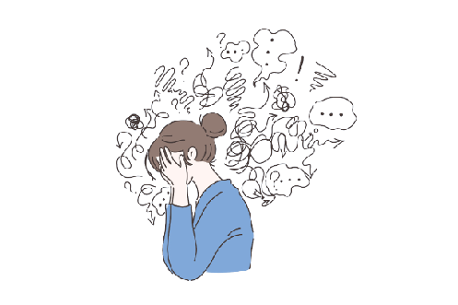
Introduction
Depression is a mental disorder affecting behavior, routines, feelings, and physical health.
Electroencephalogram (EEG) measures brain electrical activity via electrode on the scalp.
Psychiatrist utilize EEG as a cost-efficient and prevalent method to diagnose depression in patients.

Slide 4
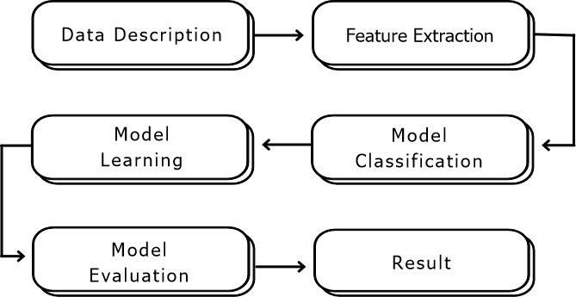
Workflow

Slide 5
Data Description
We used secondary dataset collected from Kaggle.
We got 95 healthy participants and 266 are depressed participants.
5 minutes eye closed resting state EEG data collected from 19 channels with 500 Hz sampling rate.
Power spectral density calculated for 19 channels using 6 frequency band which contain (19*6) = 114 PSD column.
Coherence is measured between every pair of electrodes for each frequency band. Which contain (19*(19-1)/2) = 171 coherence values for each 6 frequency bands containing (171*6) = 1026 coherence columns.

Slide 6
Data Description (cont…)
The dataset contain 6 frequency band
Delta [1-4 Hz]
Theta [4-8 Hz]
Alpha [8-12 Hz]
Beta [12-25 Hz]
High beta [25-30 Hz]
Gamma [30-40 Hz]

Slide 7
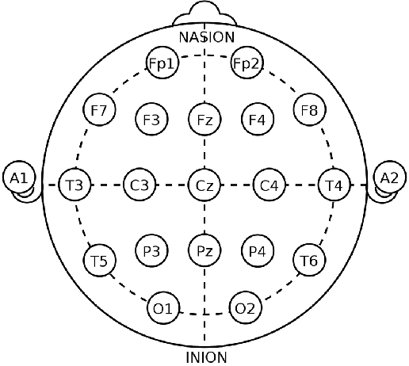
Data Description (cont…)
19 channels used for recording EEG signal.
Symmetrical anterior frontal (Fp1, Fp2)
Frontal (F3, F4, Fz, F7, F8)
Central (C3, C4, Cz)
Parietal (P3, P4, Pz)
Occipital (O1, O2)
Temporal (T3, T4, T5, T6)
Fig: Electrode placement on scalp

Slide 8
Features
Removing unwanted column from dataset. (serial_no, gender, education, and null values).
Specifying only delta, theta, alpha, beta frequency bands columns and use those columns as features for our models.
Encoding specific disorders which represent the target variable for the Machine Learning model.

Slide 9
Data Segmentation
Split the data into two part (train, test).
Assign ratio train 70% and test 30%.

Slide 10
Model Classification
For classification of depression disorder based on the features that were taken from the EEG data, two model were created.
Random Forest Model
XGBoost Model

Slide 11
Model Training
Random Forest
Random Forest model is a supervised Machine Learning algorithm which is used for both regression and classification problems.
In case of classification problem it builds number of decision trees on different samples and takes the majority.

Slide 12
Model Training (cont…)
Data
Random Forest
Split data
Training
Testing
Train Model using parameter
Creating decision treess
Predict using test data
Taking majority
Final Result
Fig: Overview of Random Forest Model

Slide 13
Model Training (cont…)
XGBoost
XGBoost is a distributed and scalable gradient boosted decision tree techniques which is best for classification and regression problem.
Creates decision trees.
Learn from errors and trying to correct errors.
Combining all prediction and given a better result.

Slide 14
Model Training (cont…)
Data
Split data
XGBoost
Training
Testing
Train Model using parameter
Creating decision treess
Classifiers
Classification Result
Fig: Overview of XGBoost Model
Data
Split data
Training
Testing
Train Model using parameter
Creating decision treess
Predict using test data
Combine All predictions
Final Result

Slide 15
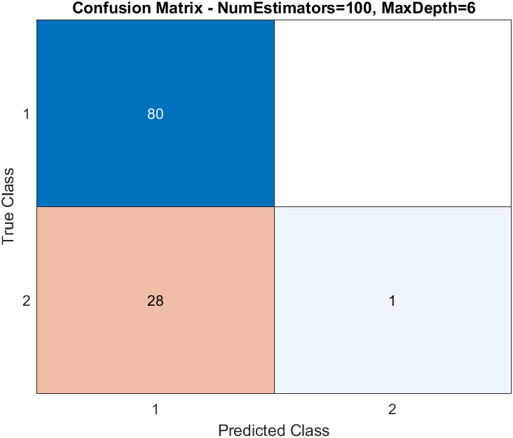
Model Evaluation
Random Forest
True Positive(TP) : 80
True Negative (TN) : 1
False Positive (FP) : 28
False Negative (FN): 0
Fig: Confusion matrix of Random Forest

Slide 16
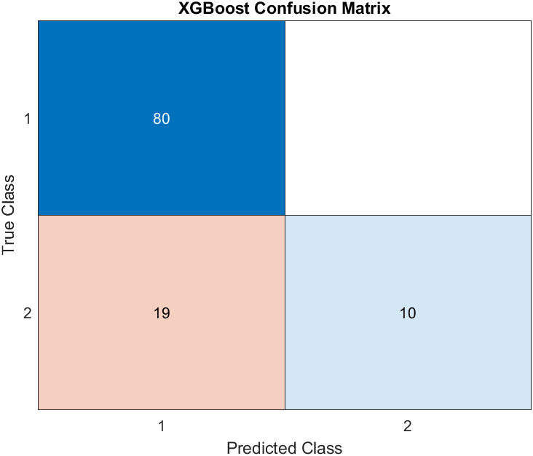
Model Evaluation (cont…)
XGBoost
True Positive(TP) : 80
True Negative (TN) : 10
False Positive (FP) : 19
False Negative (FN): 0
Fig: Confusion matrix of XGBoost

Slide 17
Model Evaluation (cont…)
Model | Accuracy | Precision | Recall | F1 Score
Random Forest | 74.31% | 0.74 | 1.00 | 0.82
XGBoost | 82.57% | 0.81 | 1.00 | 0.89
Fig: Confusion matrix of Random Forest

Slide 18
Model Evaluation (cont…)
Comparative Analysis
Previous Work | Model | Accuracy
[1] | Random Forest | 76%
[1] | XGBoost | 81%
Proposed | Random Forest | 74.31%
Proposed | XGBoost | 82.57%

Slide 19
Discussion
This research consider resting state EEG signal via 19 channels.
Two categories of participants are available here (95 Healthy, and 266 Depressed)
The dataset train via two machine learning techniques (Random forest, and XGBoost).
Comparing XGBoost to Random forest, XGBoost accurate in classifying data with 82.57% accuracy.
The study objective identifying the qualities of label data.

Slide 20
Conclusion
Using the machine learning techniques for mental state detection from EEG signals.
Make the study more productive to diagnosis depression.
The best accuracy we get from this research is 82.57%.

Slide 21
Future Work
Making the algorithm more efficient to increase accuracy.
Trying different model to train and make a comparative analysis between those.
Evaluating different dataset to check the model performances.

Slide 22
References
Mahato, S., & Paul, S. (2019). Electroencephalogram (EEG) signal analysis for diagnosis of major depressive disorder (MDD): A review. In Nanoelectronics, Circuits and Communication Systems (pp. 323–335). Springer Singapore.
Saeedi, A., Saeedi, M., Maghsoudi, A., & Shalbaf, A. (2021). Major depressive disorder diagnosis based on effective connectivity in EEG signals: a convolutional neural network and long short-term memory approach. Cognitive Neurodynamics, 15(2), 239–252. https://doi.org/10.1007/s11571-020-09619-0
Safayari, A., & Bolhasani, H. (2021). Depression diagnosis by deep learning using EEG signals: A systematic review. Medicine in Novel Technology and Devices, 12(100102), 100102. https://doi.org/10.1016/j.medntd.2021.100102

Slide 23
References (cont…)
Ay, B., Yildirim, O., Talo, M., Baloglu, U. B., Aydin, G., Puthankattil, S. D., & Acharya, U. R. (2019). Automated depression detection using deep representation and sequence learning with EEG signals. Journal of Medical Systems, 43(7), 205. https://doi.org/10.1007/s10916-019-1345-y
Cai, H., Yuan, Z., Gao, Y., Sun, S., Li, N., Tian, F., Xiao, H., Li, J., Yang, Z., Li, X., Zhao, Q., Liu, Z., Yao, Z., Yang, M., Peng, H., Zhu, J., Zhang, X., Gao, G., Zheng, F., … Hu, B. (2022). A multi-modal open dataset for mental-disorder analysis. Scientific Data, 9(1), 178. https://doi.org/10.1038/s41597-022-01211-x
Ksibi, A., Zakariah, M., Menzli, L. J., Saidani, O., Almuqren, L., & Hanafieh, R. A. M. (2023). Electroencephalography-based depression detection using multiple machine learning techniques. Diagnostics (Basel, Switzerland), 13(10). https://doi.org/10.3390/diagnostics13101779

