Slide 1
Tweet .. Tweet ???
Final Project CS 523

Slide 2
Architecture
Twitter
Flume
Kafka
Spark Streaming to HBase
Data Representation

Slide 3







Technologies Used

Slide 4
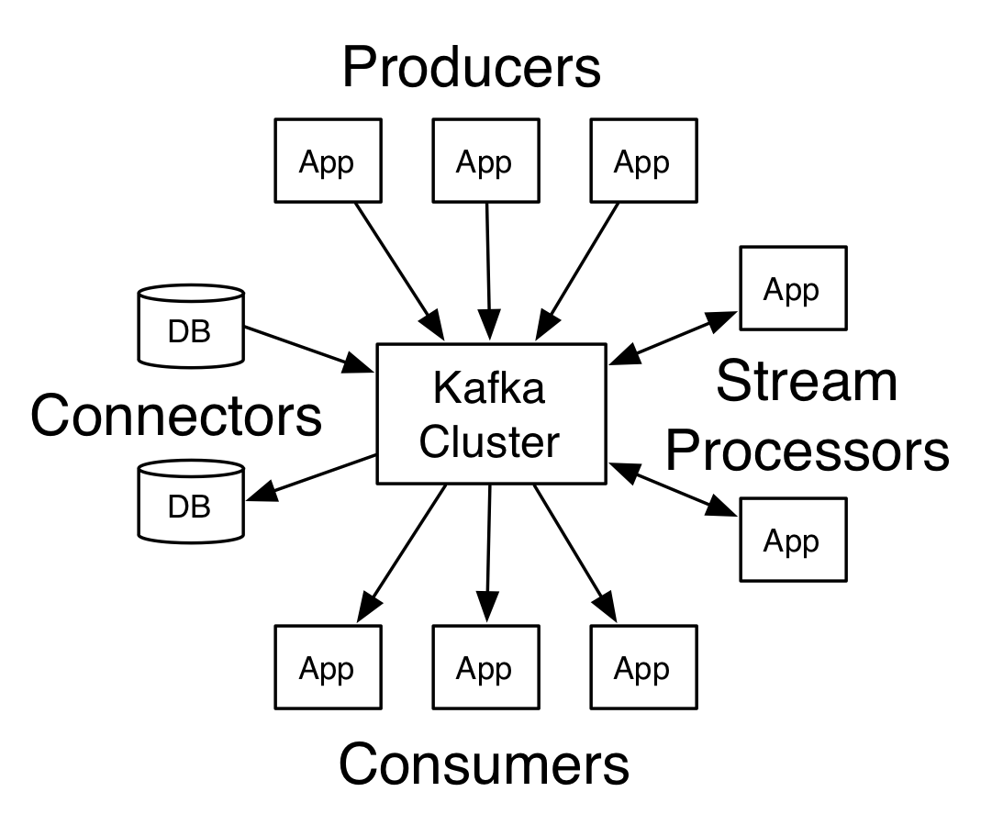
About KAFKA
its streaming platform has the following key capabilities
a message queue or enterprise messaging system
Process streams of records as they occur
Kafka is generally used for two broad classes of application
Building real-time streaming data pipelines that reliably get data between systems or applications
Building real-time streaming applications that transform or react to the streams of data

Slide 5
About KAFKA Cont.
Kafka is run as a cluster on one or more servers that can span multiple datacenters.
The Kafka cluster stores streams of records in categories called topics.
Each record consists of a key, a value, and a timestamp.
Kafka has four core APIs:
The Producer API allows an application to publish a stream of records to one or more Kafka topics.
The Consumer API allows an application to subscribe to one or more topics and process the stream of records produced to them.
The Streams API allows an application to act as a stream processor, consuming an input stream from one or more topics and producing an output stream to one or more output topics, effectively transforming the input streams to output streams.
The Connector API allows building and running reusable producers or consumers that connect Kafka topics to existing applications or data systems. For example, a connector to a relational database might capture every change to a table.

Slide 6
Project in Details
the data source is real stream from Twitter using Twitter4j API the service will receive keywords to crawled data from tweets text.
Data Captured from tweets includes : user Name (screen Name) , location if available ,language , tweet Text ,and hashtag.
Once the Flume Agent started The flume source will be the stream from twitter API implemented class using memory channel all transaction will be transferred to KAFKA sink and this part is direct configuration as follow
TwitterKafkaAgent.sinks.Kafka.type = org.apache.flume.sink.kafka.KafkaSink
TwitterKafkaAgent.sinks.Kafka.topic = Trump
TwitterKafkaAgent.sinks.Kafka.brokerList = localhost:9092
TwitterKafkaAgent.sinks.Kafka.channel = MemChannel
TwitterKafkaAgent.sinks.Kafka.batchSize = 20
PS. In this project scope we can use either Flume or Kafka only so the kafa configured as Echo and queuing cluster without using the portioning and topics features. And used for the course project by trying to linked more than one technology.

Slide 7
Project in Details Cont.
The stream will be catch by the Spark streaming
Saved in Hbase structure
Apply Semantic analysis in another words measure the percentage of how negative or positive your keywords appeared on twitter.
Do some Data Analysis based on languages , location ,hashtag trending.

Slide 8
Symantec Analysis Output Sample

Slide 9
Distribution Based on Language

Slide 10
hashtag

Slide 11
Demo

