Slide 1
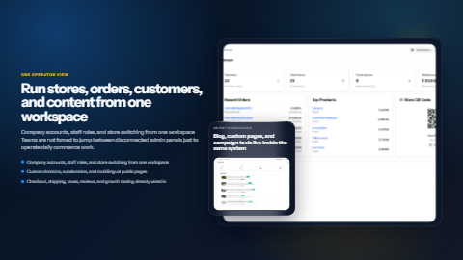
MTJRii
Multi-store commerce infrastructure for launching, operating, and scaling branded online storefronts.
Deck generated from repository documentation and project assets using PptxGenJS. Focus: product breadth, operating model, and technical foundation.
27
10+
22+
payment gateways
store themes
languages
Centralized dashboard for multiple storefronts
AI-assisted content generation and localization
Built-in billing, analytics, blog, and POS support

Slide 2
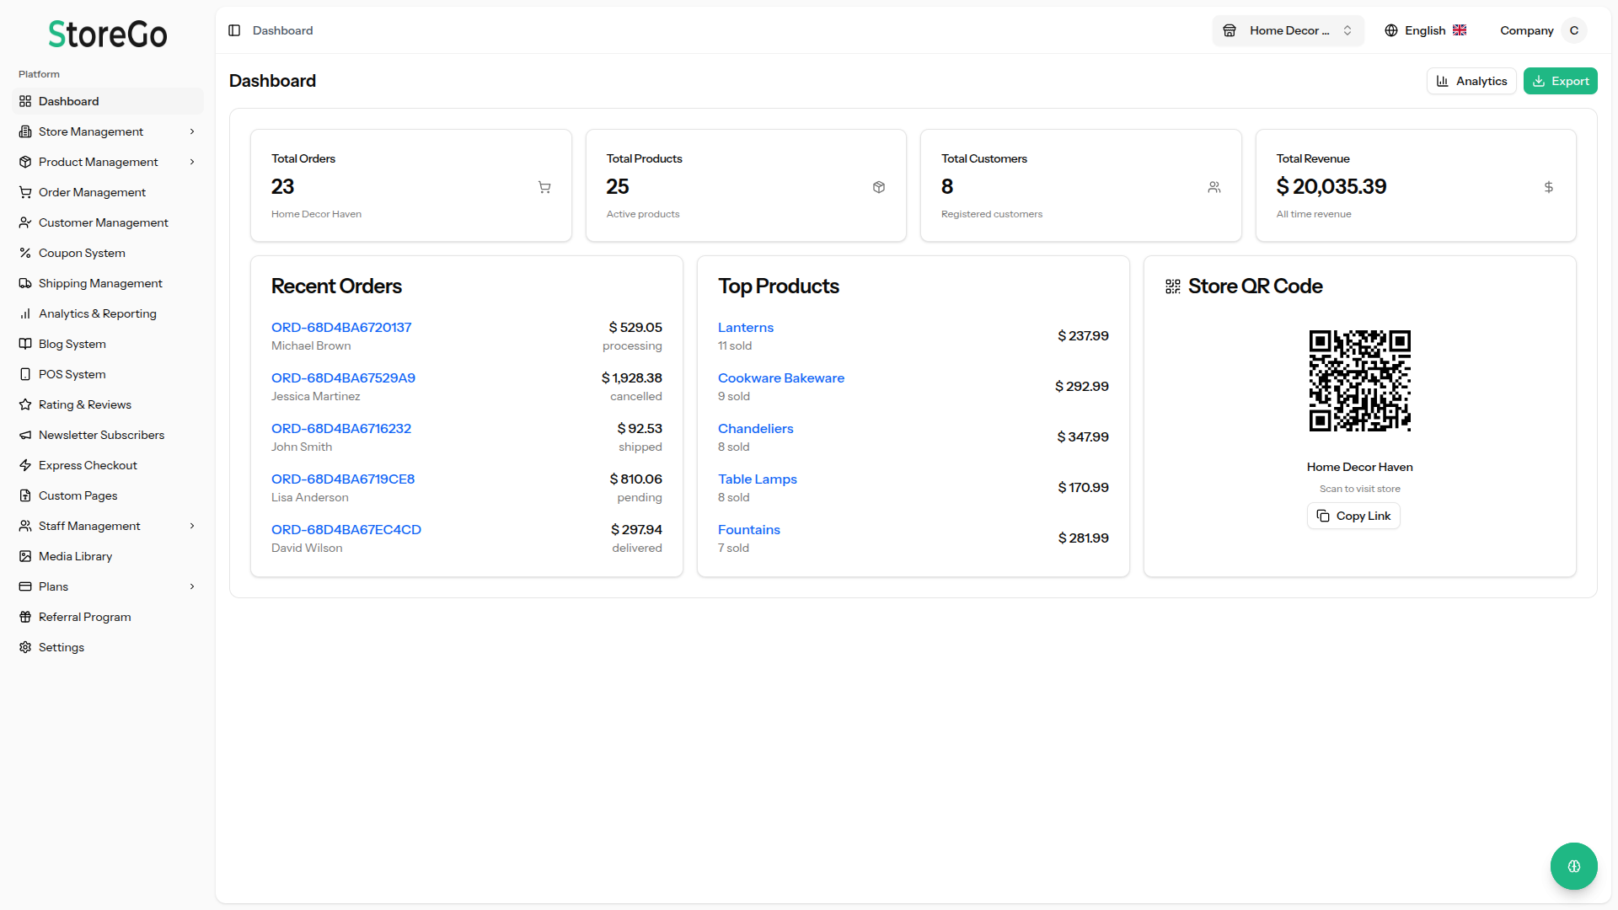
Platform Snapshot
A single admin surface manages many branded stores
The core proposition is SaaS-level centralization without flattening each store’s identity or catalog.
Unlimited
Unified
Flexible
Secure
stores per owner
dashboard control
plan-gated features
custom domains + SSL
Operational model
Why it matters
Store isolation keeps products, orders, and settings independent.
Store switching avoids re-login friction for operators managing several brands.
Plans control caps for products, users, storage, themes, domains, and AI features.
Featured stores and landing-page settings support marketplace-style promotion.
Fits agencies or merchants operating more than one store.
Central governance reduces setup and maintenance cost.
Brand-level flexibility stays visible at the storefront layer.

Slide 3
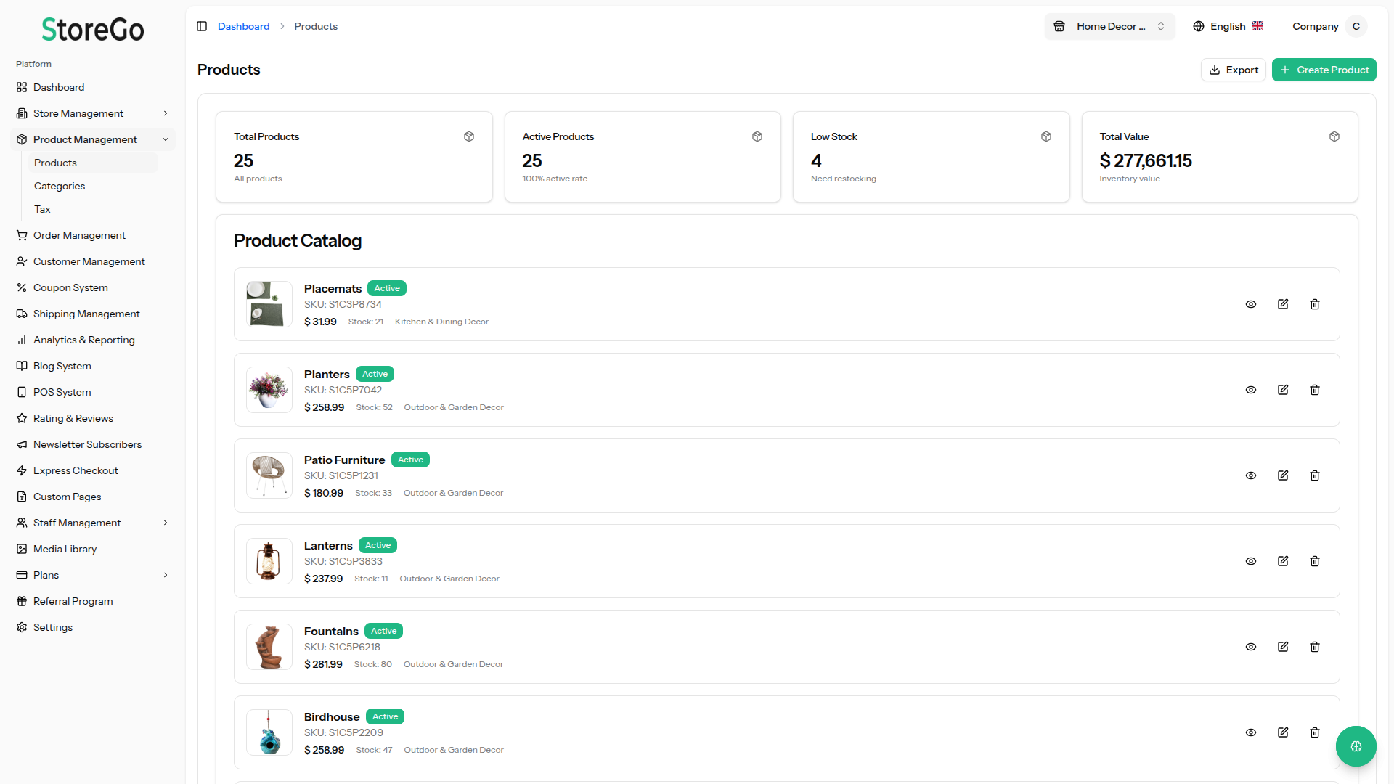
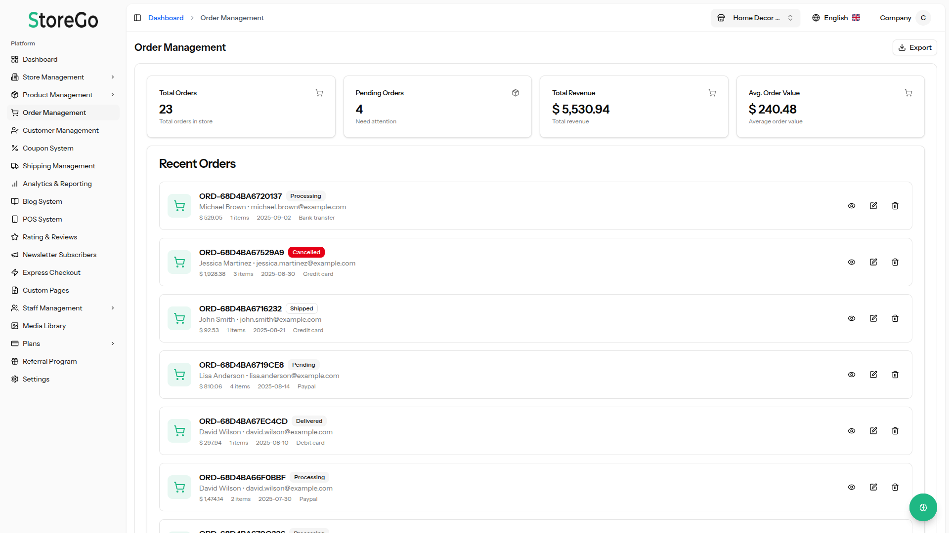
Commerce Operations
Product, inventory, and order flows are first-class
The platform covers the standard merchant operating loop from merchandising through fulfillment.
Included capabilities
Order lifecycle
Product variants, SEO fields, media galleries, tags, and duplication tools.
Real-time inventory tracking with low-stock thresholds and automatic deduction.
Order lifecycle states from pending to delivered, including refunds.
Customer accounts, multiple addresses, order history, and review workflows.
Guest checkout, invoices, exports, and operational notes.
Relative emphasis derived from the repo’s documented feature depth, not runtime telemetry.

Slide 4
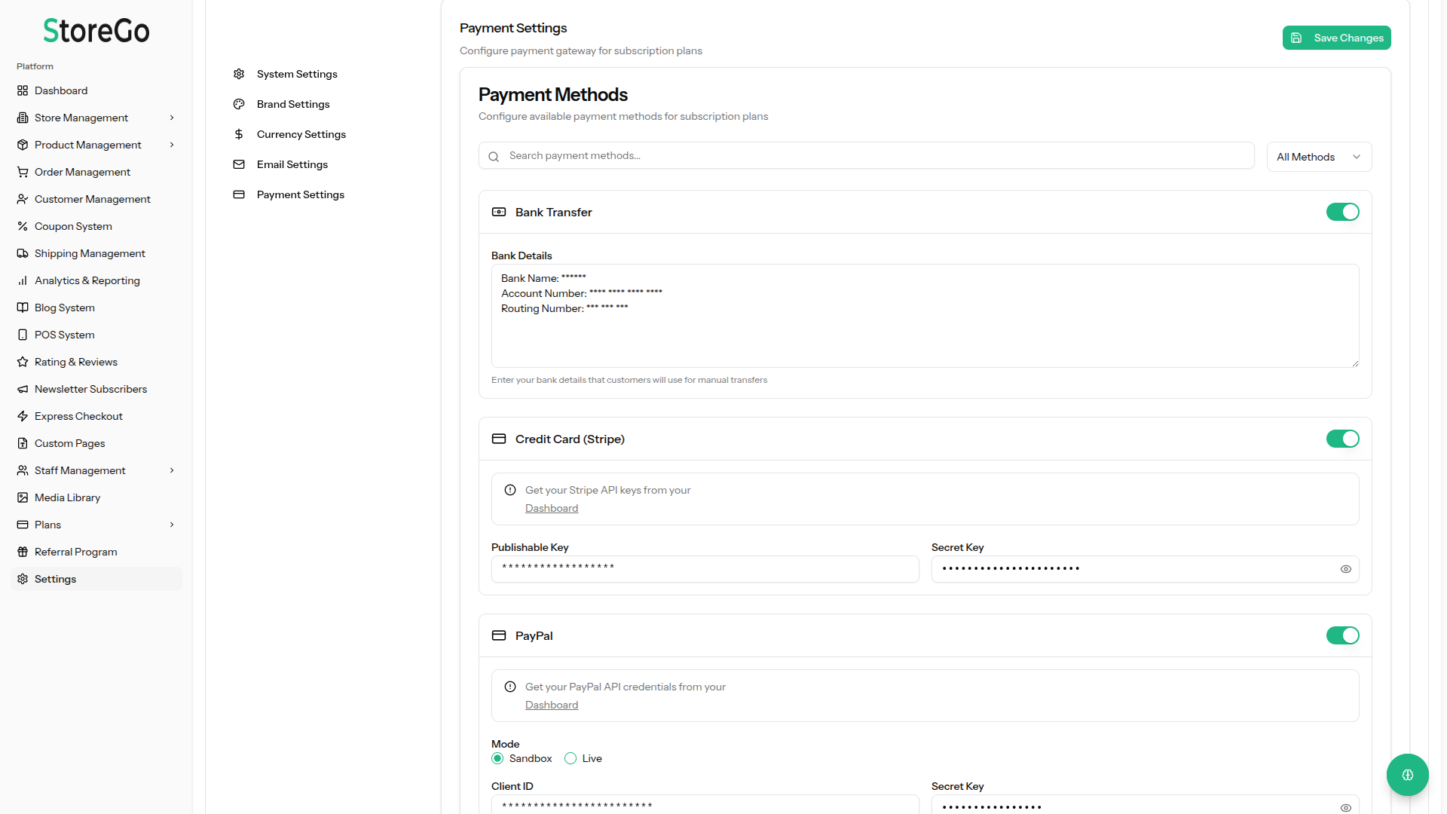
Revenue Stack
Payments, subscriptions, and localization broaden market reach
Documentation highlights both global processors and region-specific gateways, plus multilingual storefront delivery.
Geographic payment coverage
Localization snapshot
22+
10+
AI
languages
themes
content assist
Frontend localization uses i18next and multilingual resource files.
Theme selection, branding, and domain options keep each storefront distinct.
AI-generated content expands merchandising and landing-page throughput.
Subscription controls
Monthly and yearly billing
Trials, coupons, upgrades, downgrades
Feature flags tied to plan limits
27 documented gateways support regional checkout strategies and plan-tier monetization.

Slide 5
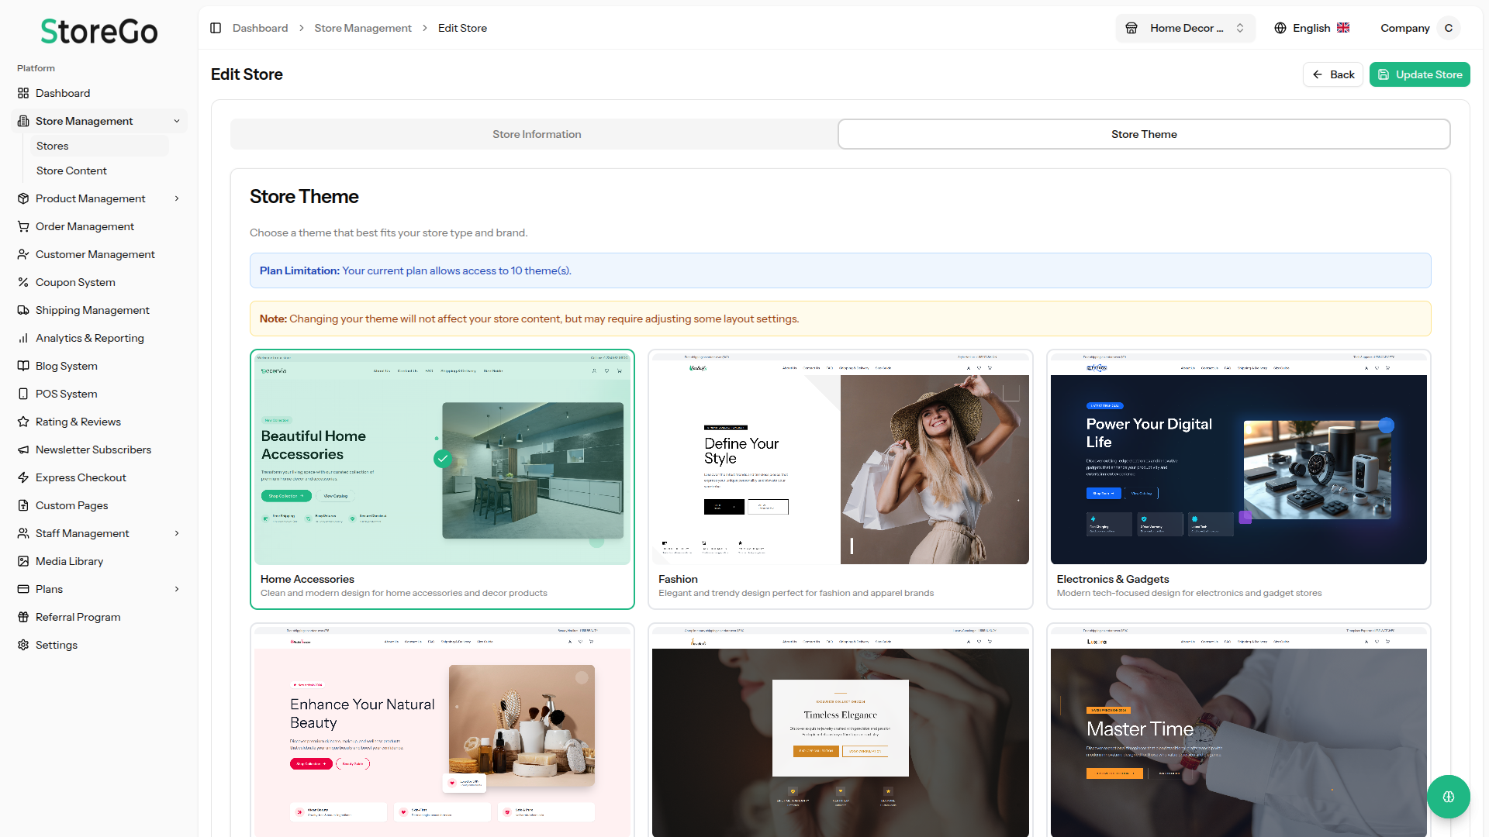
Storefront Layer
Ten-plus themes cover distinct verticals without rebuilding the platform
The theme system is the visible part of the multi-store strategy: different front doors, shared operating core.
Theme catalog
Theme design principles
Home & Accessories
Fashion & Apparel
Electronics & Technology
Beauty & Cosmetics
Jewelry & Accessories
Watches & Timepieces
Furniture & Interior
Cars & Automotive
Baby & Kids
Perfume & Fragrances
Responsive layouts for mobile-first browsing
Custom colors and branding per store
Theme-specific merchandising sections
SEO-aware page structure
Fast-loading image and content presentation
Theme abstraction reduces the cost of entering a new category while keeping the back-office model stable.

Slide 6
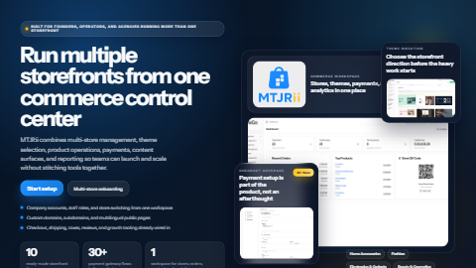
Technical Foundation
Modern full-stack tooling supports the product surface
The repository couples Laravel 12 on the backend with React 19, Inertia.js, TypeScript, and a broad test/configuration surface.
Stack summary
Laravel 12 application structure with migrations, policies, queues, and services.
React 19 + Inertia.js + TypeScript frontend, themed storefront pages, and admin workflows.
Vite build pipeline, Jest and Playwright coverage, plus extensive repo documentation.
Remotion assets indicate a reusable visual/content production layer for product marketing.
Architecture lanes
Laravel core
React admin
Stores
Takeaway: MTJRii is positioned as a broad commerce operating system rather than a narrow storefront template package.

