Slide 1
TSDB For Sensordata
By Yusuf Liu, Blocpower

Slide 2
Outline
Introduction to TSDB
What is TSDB
Why do we need TSDB
Different types of TSDB
Compare and contrast
Between InfluxDB , OpenTSDB and KairosDB, TimescaleDB
A detailed example of InfluxDB
General structure of InfluxDB
Load raw data from Senseware into InfluxDB

Slide 3
What is TSDB?
A time series database (TSDB) is a software system that is optimized for handling time series data, arrays of numbers indexed by time (a datetime or a datetime range).
In our case, the time series data is a log of temperature values over time we can call it a temperature trace, which is our sensor data.

Slide 4
Why do we need TSDB
Traditional relation database management system is not practical for a high transaction volume of time series data and does not support complex logic or business rules.
Queries for historical data, replete with time ranges and time zone conversions are difficult in a relational database.
TSDB supports a number of basic calculations that work on a series as a whole, such as multiplying, adding, or otherwise combining various time series into a new time series.

Slide 5
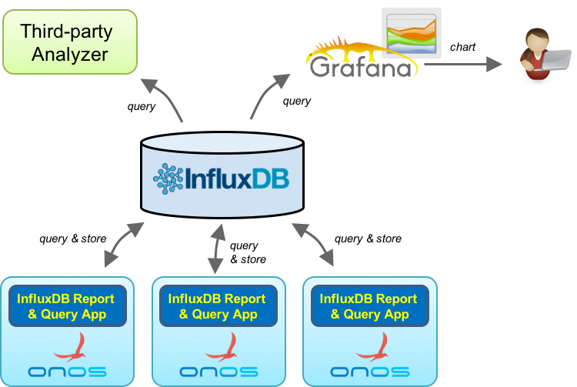
Different types of TSDB InfluxDB
InfluxDB is an open-source TSDB developed by InfluxData. It is written in Go and optimized for fast, high-availability storage and used for time series data in fields such as operations monitoring, application metrics, IoT sensor data, and real-time analytics. It also has support for processing data from Graphite.
This is the first kind of the TSDB, influxDB is a special database that are made to only store time series data.

Slide 6
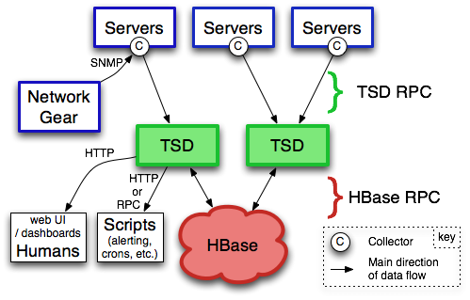
OpenTSDB and KairosDB
OpenTSDB consists of a Time Series Daemon (TSD) as well as set of command line utilities. Interaction with OpenTSDB is primarily achieved by running one or more of the TSDs. Each TSD uses the open source database Hbase to store and retrieve time-series data. Users of the TSD never need to access HBase directly. You can communicate with the TSD via an HTTP API or a simple built-in GUI.
KairosDB is a fork of OpenTSDB used on Cassandra.
So this is the second kinds of TSDB, which is a time series system build on a NoSQL database.

Slide 7
TimescaleDB(IOBeam)
TimescaleDB is an open-source database designed to make SQL scalable for time-series data. It is engineered up from PostgreSQL, providing automatic partitioning across time and space (partitioning key), as well as full SQL support.
So this is the third kind of TSDB, which is a time series system build on a SQL database.

Slide 8
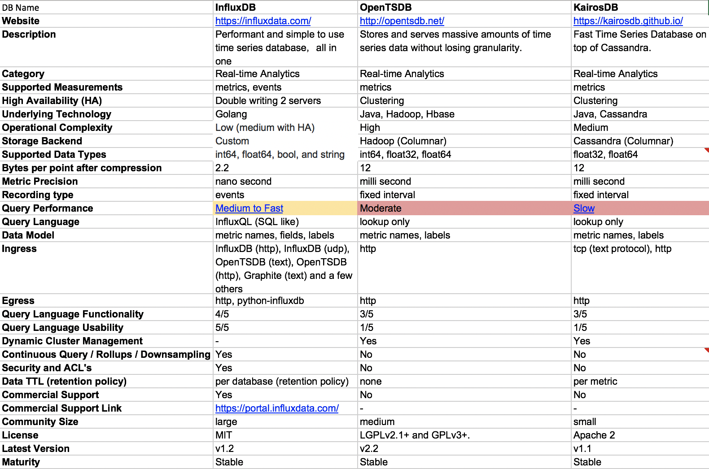
Compare and contrast

Slide 9
A detailed example with InfluxDB
Data in InfluxDB is organized by “time series”, which contain a measured value, like “temperature”.
Time series have zero to many points, one for each discrete sample of the metric. Points consist of time (a timestamp), a measurement (“temperature”)
For example, in our sensor data from Senseware, I created a measurement called ‘temp’ and two tags for that measurement ( ‘location’ & ‘time region’), and each measurement has a value(which is the actual data).

Slide 10
Writing into influxDB
InfluxDB can be directly interact by making requests to the InfluxDB HTTP API or the admin UI.
There is another option for python: InfluxDB-Python is a opensouce client for interacting with InfluxDB.
Lets see an example of reading raw data from excel sheet from senseware and loading it into influxDB with HTTP API.

