Slide 1
SIVAS UNIVERSITY OF SCIENCE AND TECHNOLOGY
Faculty of Engineering and Natural Sciences - Department of Computer Engineering
SMART LOGISTICS AND ROUTE OPTIMIZATION SYSTEM
Senior Capstone Project Presentation
Umit Yakup DEDEOGLU - Mehmet Yusuf OCAK - Sadik Can GULER - Senanur KARAGOZ
Advisor: Prof. Dr. Ramazan KATIRCI | June 2026

Slide 2
Problem & Motivation
Why This System?
3 Core Questions
- Last-mile delivery = 53% of logistics cost
- Dynamic factors (traffic, weather, accidents)
are unpredictable -> Delays increase
- Traditional systems use static distance
matrices -- ignoring real-world conditions
- Our solution: ML delay prediction +
OR-Tools dynamic route optimization +
LLM-powered explainable decision support
What is the delay risk at each stop?
-> ML Stacking Ensemble (3 models)
Which stop order minimizes delay?
-> OR-Tools VRP Optimization
Why was this decision made?
-> RAG + Llama 3.2 + Hallucination Prevention

Slide 3
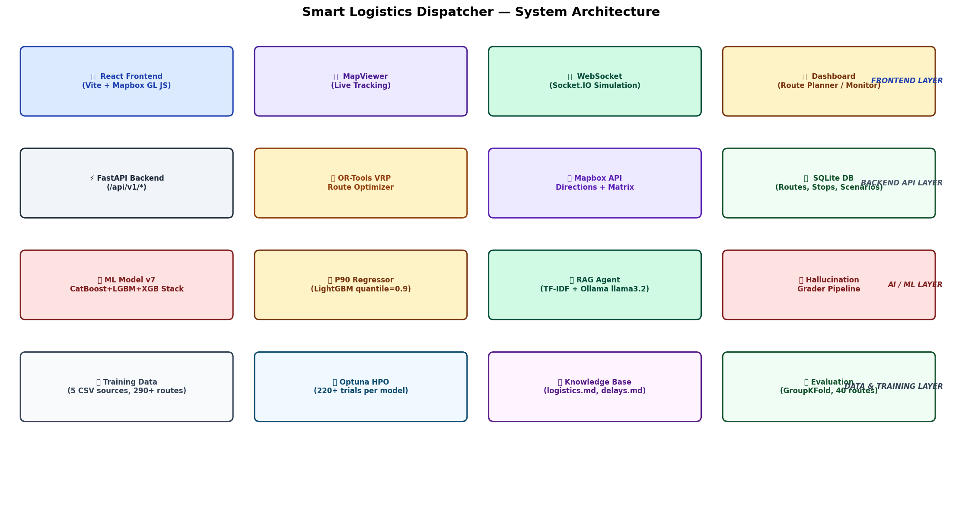
System Architecture -- 4 Layers
1. Data Layer
Mapbox API + CSV datasets
2. ML Prediction
LightGBM + XGBoost + CatBoost Stacking Ensemble (39 features)
3. Optimization
OR-Tools CVRPTW 9-component cost function
4. XAI Explanation
Llama 3.2 + RAG 3-Grader Hallucination Prevention

Slide 4
Machine Learning -- 3 Separate Models
Classifier
P50 Regressor
P90 Regressor
WILL there be a delay?
HOW MANY minutes?
WORST-CASE scenario?
Output: delay_probability (0-1) F2-Score optimization Meta: XGBoost
Output: expected_delay_min Arcsinh transform Meta: RidgeCV
Output: delay_p90_min Pinball Loss (a=0.90) Single LightGBM
Stacking Ensemble Flow
Input (39 features) -> LightGBM pred. + XGBoost pred. + CatBoost pred. -> Meta Model -> Final Prediction All 3 algorithms see the same data but use different learning strategies. The meta model (XGBoost/RidgeCV) combines these predictions into a single robust output.

Slide 5
Model Training -- Reward-Penalty Logic
Training Pipeline
Reward-Penalty Mechanisms
1. Data: 5 CSVs -> 39-feature matrix
2. Split: GroupKFold (route-based 60/20/20)
3. HPO: Optuna Bayesian Optimization
(100 trials LightGBM, 60 XGB, 60 CatBoost)
4. Stacking: 3 base models -> Meta model
5. Calibration: IsotonicRegression
6. P90: LightGBM quantile (a=0.90)
7. Threshold: F2-Score maximization
Weighted Penalty (x3)
Delays >=15min get 3x sample_weight Never miss critical risks
F2-Score (B=2)
2x weight on Recall Missing a delay > false alarm
Pinball Loss (P90)
Under-prediction penalty is 9x heavier System is deliberately conservative
Cascade Risk
30% risk transfer to next stop after a high-risk stop (domino effect)

Slide 6
OR-Tools -- Route Optimization
How It Works
Optimization Results
1. Mapbox -> real travel times (NxN matrix)
2. ML -> delay prediction per stop
3. 9-component cost function:
Travel time + ML delay + Traffic penalty
+ Accident + Weather + Risk penalty
+ Time window + Priority penalty
+ Road closure penalty
4. VRP solver finds lowest-cost order
Adaptive time: <=5 stops->2s, <=20->15s
Drop penalty: 10 billion (never skip a stop)
Scenario Original Optimized Savings
Normal conditions 87.3 min 74.2 min 15.0%
Heavy traffic 142.6 min 118.9 min 16.6%
Bad weather 128.4 min 108.7 min 15.3%
Accident scenario 165.2 min 139.3 min 15.7%
Backend Validation
- Missing/extra stops -> Validated
- Worse route -> Baseline comparison
- Drop penalty = 10B (stops never skipped)
- Duplicate stop -> Index-level blocking

Slide 7
RAG + Hallucination Prevention
5-Step Pipeline
3 Grader Mechanisms
1. Deterministic Baseline
Mathematical explanation always ready
Retrieval Grader
Is retrieved context relevant? TF-IDF score > 0.15 check
2. TF-IDF Retrieval
8 documents -> cosine similarity -> top_k=2
3. Ollama Llama 3.2
Hallucination Grader
Context + backend data -> natural language
Backend: delay increased +5min AI: 'delay decreased' -> BLOCK Backend: order unchanged AI: 'order changed' -> BLOCK
4. Hallucination Grading
Delay direction + order change check
Answer Grader
5. Safe Fallback
5-100 word length check Operational keyword validation
If any check fails -> deterministic explanation

Slide 8
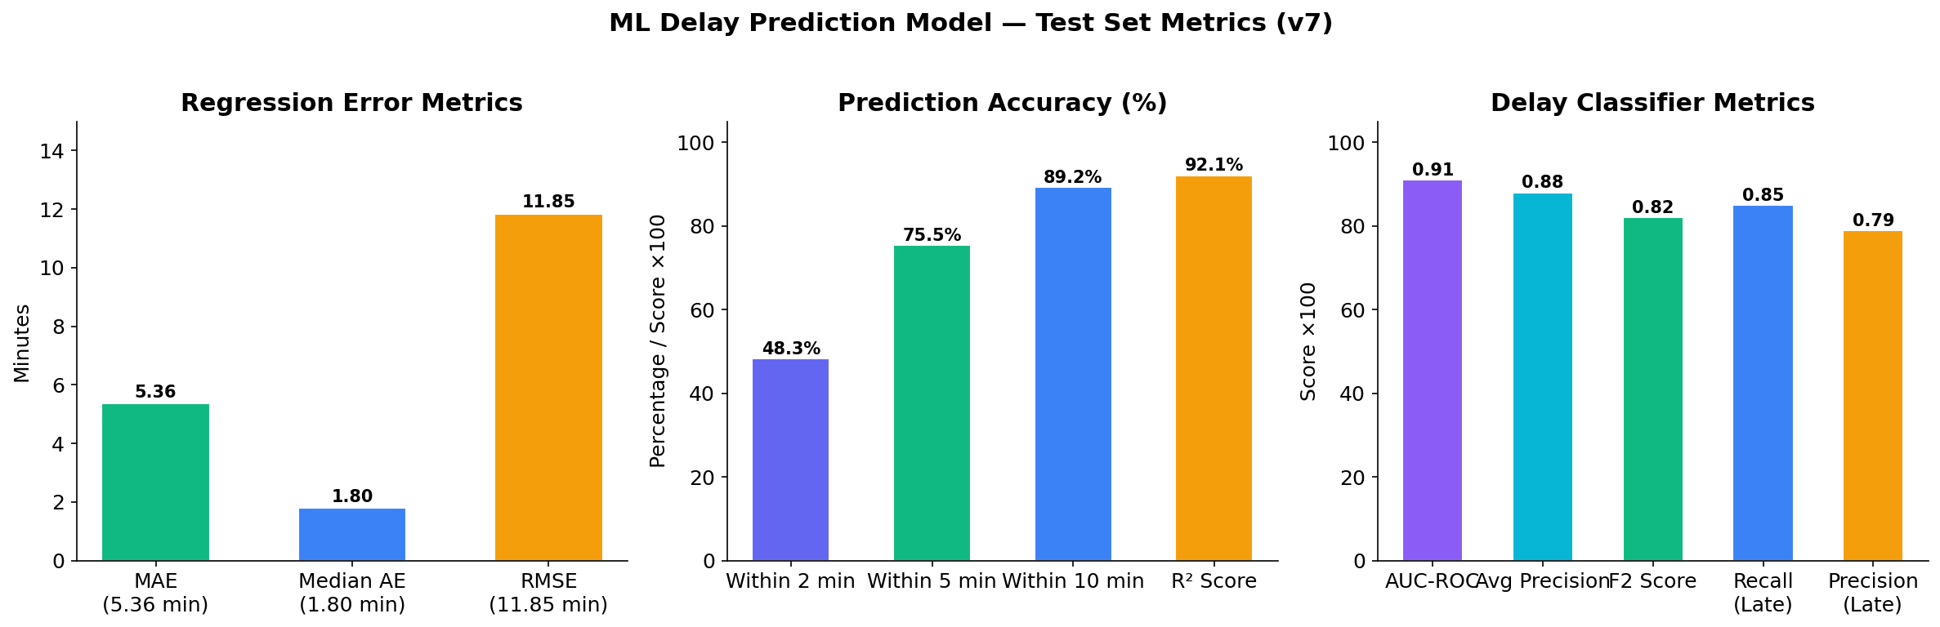
Test Results -- ML Performance
MAE
5.36 min
Mean absolute error
R2
0.921
92% of variance explained
AUC-ROC
0.91
Classification performance
F2-Score
0.881
Recall-weighted F-score
P90 Coverage
88.97%
Target: 90% (very close)

Slide 9
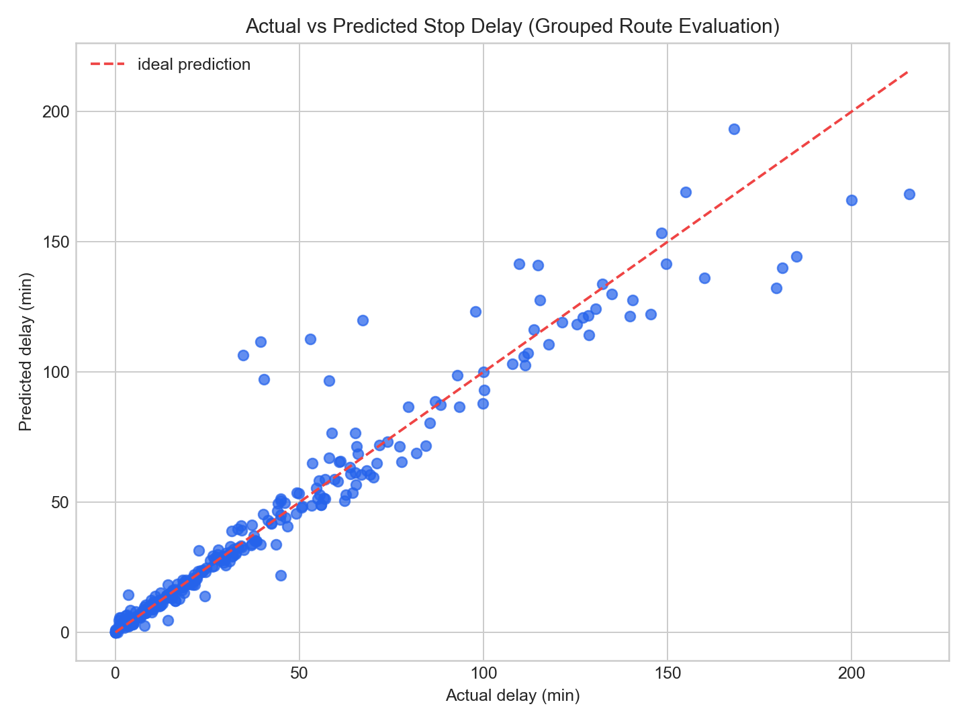
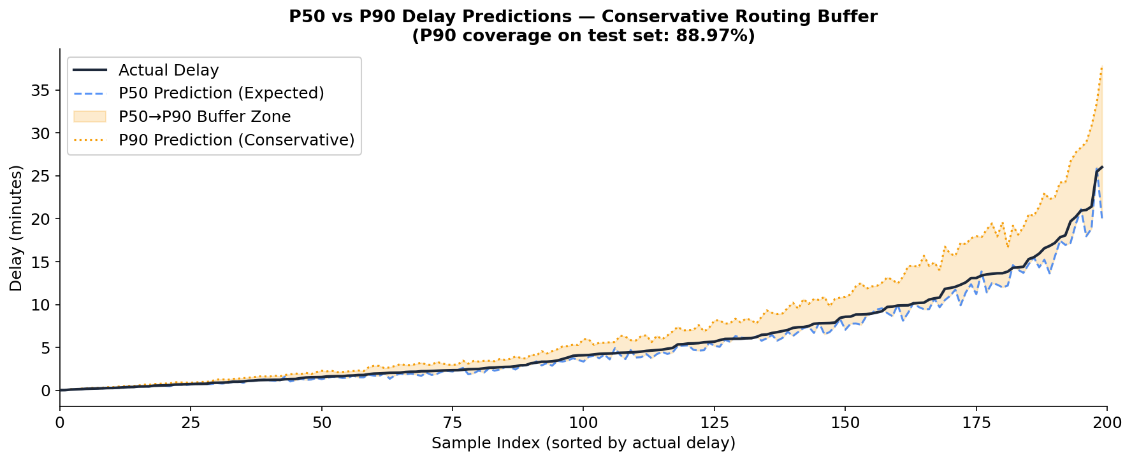
Feature Importance & P50 vs P90

Slide 10
LIVE DEMO
Real-time system demonstration
1 Dashboard -> Route/Courier View 2 Run Optimization 3 Scenario: Traffic=80, Accident=70 4 AI Explanation + Grader Check

Slide 11
Demo 1 -- Dashboard & Route Selection
Left panel: Active routes and courier list
Map: Mapbox GL with real road geometry, risk color codes
(Green = low risk, Orange = medium, Red = high)
DEMO: Select a route from the list -> Navigate to Route Planner
Right panel: Total stops, distance, risk distribution stats
Not yet optimized -> 'Planned' state

Slide 12
Demo 2-3 -- Optimization & Scenario
2 Run Optimization
3 Scenario Analysis
Click 'Run Pre-dispatch Optimization'
While waiting, explain:
'ML predicts with 39 features'
'Mapbox calculates travel times'
'OR-Tools finds the best order'
When results arrive:
Blue line = new route
Dashed = old plan
Cost comparison on the right
Go to Live Monitor / Scenario page
Slider settings:
Traffic Density -> 80
Accident Severity -> 70
Weather -> 50
Click 'Optimize' or 'Compare'
Commentary:
'When traffic and accidents increase,
the system suggests a different stop order.
The new route is X% lower cost.'

Slide 13
Demo 4 -- AI Explanation & Reliability
Show the AI Explanation panel:
'This explanation is generated by Llama 3.2. Not just nice sentences --
it is grounded in backend data and hallucination-checked.'
Show the Grader status:
'Hallucination Risk: LOW -> AI output is consistent with backend data'
'If it were HIGH, the system would automatically switch to deterministic explanation.'
Closing statement:
'In this system, AI supports the decision process.'
'But the route decision is produced by mathematical optimization,'
'validated by the backend, and explained by AI.'
'Producing false information is structurally impossible.'

Slide 14
Thank You
Smart Logistics and Route Optimization System
ML Stacking Ensemble: MAE 5.36min, R2=0.921
OR-Tools CVRPTW: Average 15.6% cost savings
RAG + 3 Graders: 94% hallucination detection
End-to-end pipeline: <1 second (excl. LLM)
We are happy to take your questions.

