Slide 1
EXECUTIVE REVIEW
USA Regional
Sales Analysis
2014 to 2018

Slide 2
USA Regional Sales Analysis, 2014 to 2018
BUSINESS SNAPSHOT
$1.24B in revenue at a 37.4% margin, and no growth
$1.24B
$461.8M
10,684
Revenue
Profit
Orders across 175 customers
January 2014 to February 2018
37.4% margin
64,104 order lines
30 products sold across 47 states and DC. Revenue is substantial, but the growth engine has stalled.
02

Slide 3
USA Regional Sales Analysis, 2014 to 2018
ANNUAL PERFORMANCE
A mature business:
$294–298M a year
Annual revenue is flat from 2014 to 2017.
2018 covers only January and February, so it is excluded from year-over-year comparison.
No growth across the comparable years
03

Slide 4

USA Regional Sales Analysis, 2014 to 2018
SEASONALITY
Q1 is the peak: January alone brings about $124M
February follows at about $115M. The rest of the year settles at $95–102M a month.
Plan capacity for the first two months
04

Slide 5
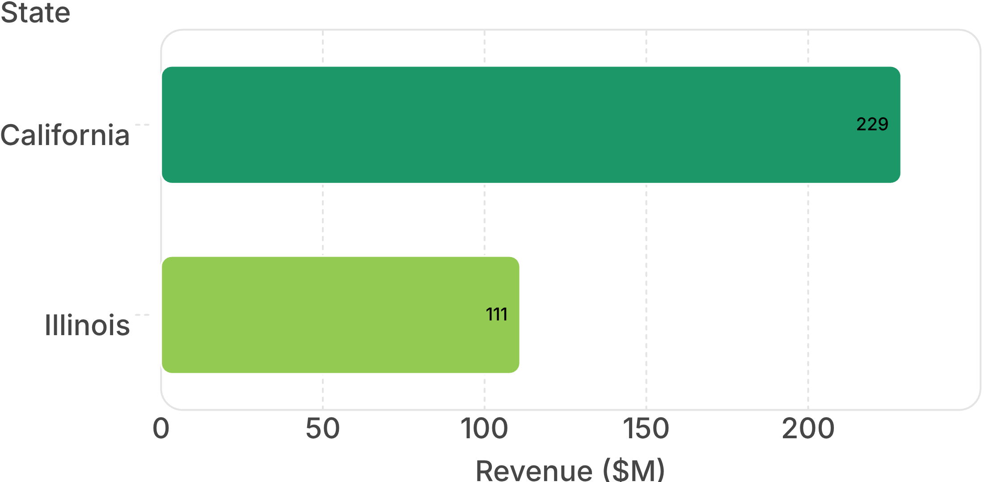
USA Regional Sales Analysis, 2014 to 2018
California delivers 18.5% of revenue, twice any other state
18.5%
of total revenue comes from California
$228.8M revenue
Florida, Texas and New York complete the top five.
05

Slide 6
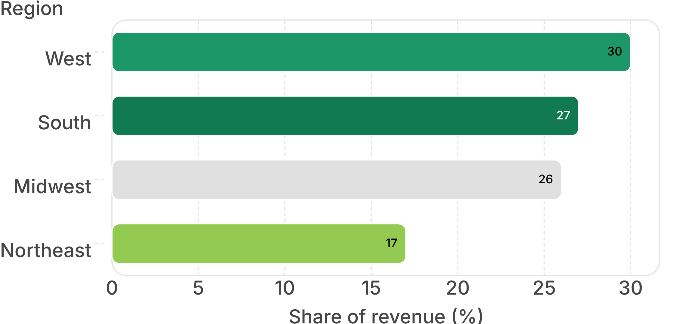
USA Regional Sales Analysis, 2014 to 2018
The West leads, but margins barely differ by region
37.1–37.5%
Regional margin range
Demand differs more than profitability
06

Slide 7
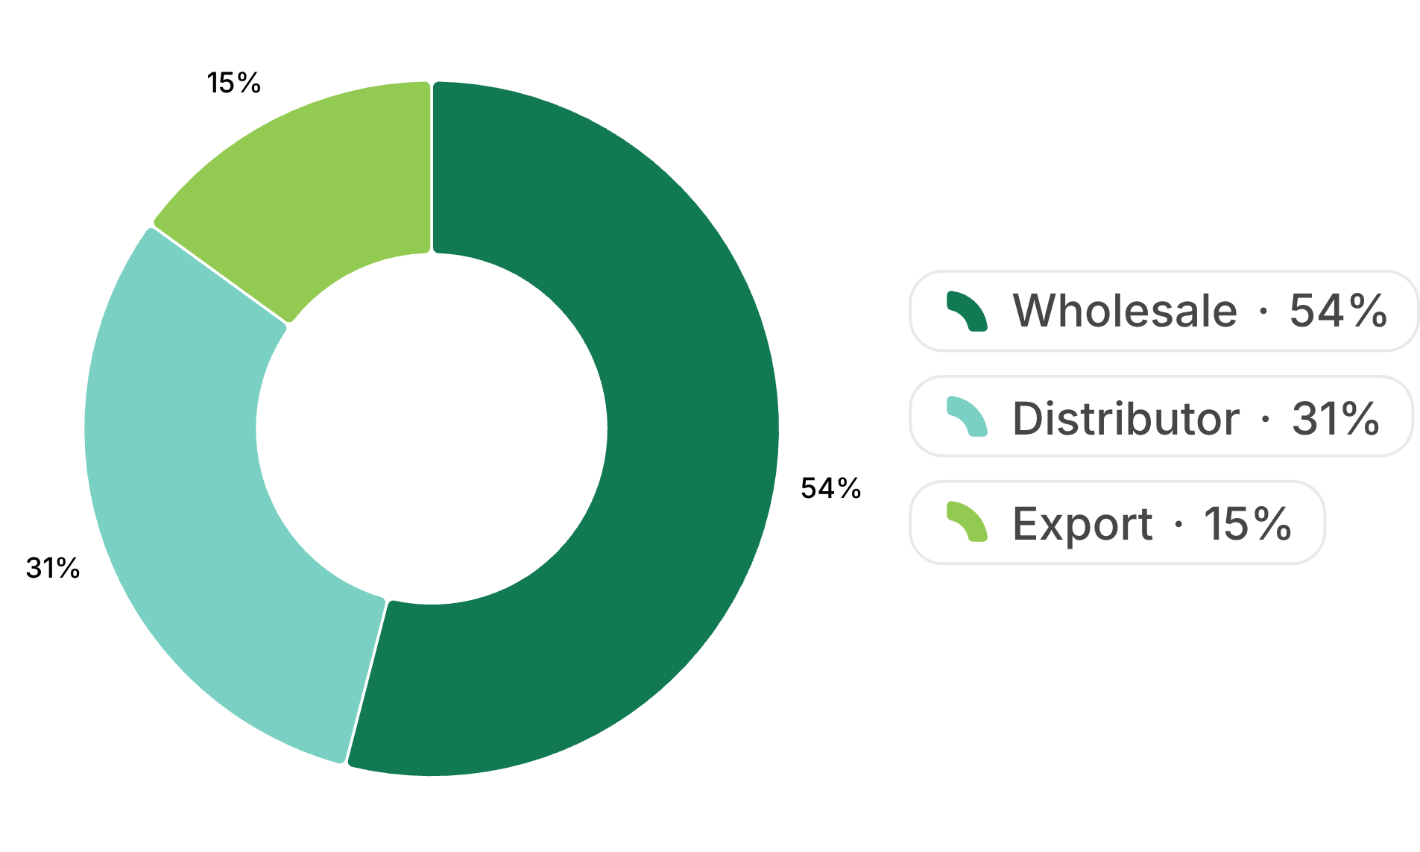
USA Regional Sales Analysis, 2014 to 2018
Wholesale drives more than half of sales
5,766
Wholesale orders
Channel margins are near-identical at 37.0% to 38.0%, with Export marginally highest.
Wholesale is the scale engine
07

Slide 8
USA Regional Sales Analysis, 2014 to 2018
PRODUCT AND ACCOUNT MIX
Two products lead revenue; Product 9 leads margin
$117M
$109M
40.0%
Product 26
Product 25
Product 9
Top revenue driver
Second revenue driver
Highest margin. Product 12 is lowest at 34.4%.
Top accounts: Aibox Company $12.6M · State Ltd $12.2M · Pixoboo Corp $11.0M
08

Slide 9
USA Regional Sales Analysis, 2014 to 2018
PRICING DISCIPLINE
Higher prices do not
mean higher margins.
Unit price has no meaningful relationship with profit margin.
Correlation: r ≈ −0.005
Price cannot stand in for profitability
09

Slide 10

USA Regional Sales Analysis, 2014 to 2018
Five moves to grow beyond the plateau
Protect and grow California and the other leading states
Plan inventory and staffing for the January and February peak
Shift mix toward higher-margin products such as Product 9, and review Product 12's costs
Set prices from product-level cost data, not assumed profitability
Explore underpenetrated states and the Export channel for growth
10

