Slide 1

OptiClass
Integrated University Scheduling and
XAI-Driven Calendar Portal
Ali Berkay Şimşek & Yusuf Yazıcı

Slide 2








The Problem: Thousands of Constraints at Once
All must hold simultaneously
The “common course” trap
Instructor availability
Shared courses must be placed first
Otherwise no valid slots remain later
Late conflict → re-plan everything
Classroom capacity
Semester-based conflicts
Cross-department common courses
Course priority
Why current methods fail
Excel + email / WhatsApp
untracked, not auditable
30 × 80 × 15 × 5 × 10
instructors · courses · classrooms · days · time slots
thousands of combinations — impossible to verify by hand
Black-box automated tools
no “why this slot” → no trust, manual re-checking

Slide 3



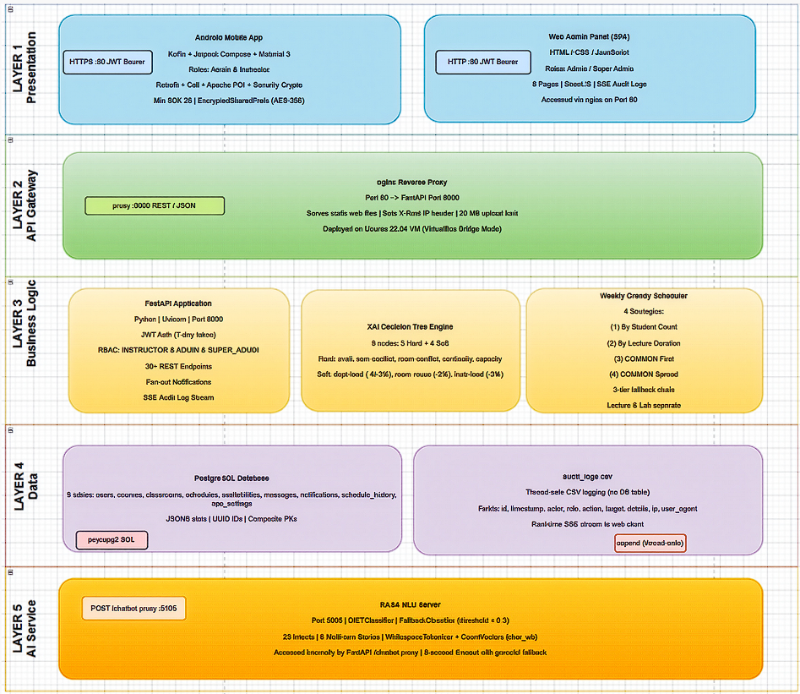


Our Approach: One Integrated System
[ Screenshot: architecture diagram
Android / Web / RASA → FastAPI → PostgreSQL ]
Android App
Web Admin Panel
RASA Chatbot
Kotlin + Jetpack Compose
for instructors
for admin / super admin
24/7 assistant
Shared Backend — FastAPI
JWT authentication · ~50 REST endpoints
PostgreSQL

Slide 4
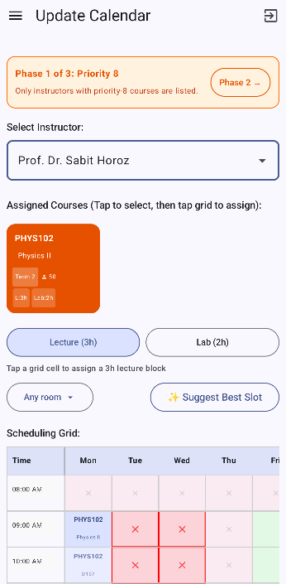

Dynamic Phase System
[ Screenshot: phase banner with
“Go to Phase 2 →” button + calendar grid
with red-X blocked slots ]
Phase 1
Phase 2
Phase N
highest priority
common courses first
unlocks after
admin approval
count derived
from the data
Phase count auto-calculated from priority values
If there is 3 distinct priorities = 3 phases
Next phase unlocks only after approval
One-directional transitions, admin-approved
A controlled, auditable process

Slide 5
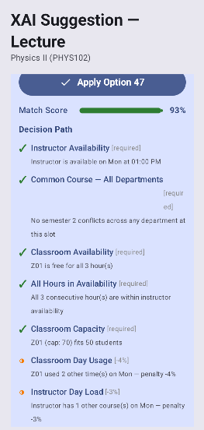
XAI: Explainable Suggestion Engine
9
5 + 4
4
[ Screenshot: accordion UI showing
suggestion score + decision path ]
evaluation nodes
hard constraints
+ soft penalties
auto-schedule
strategies
Suggestion — 92%
instructor available ✓
classroom capacity ✓
daily load −3% ...
Every suggestion = score (%) + step-by-step reasoning
Decision tree covers single slots and full weekly generation

Slide 6
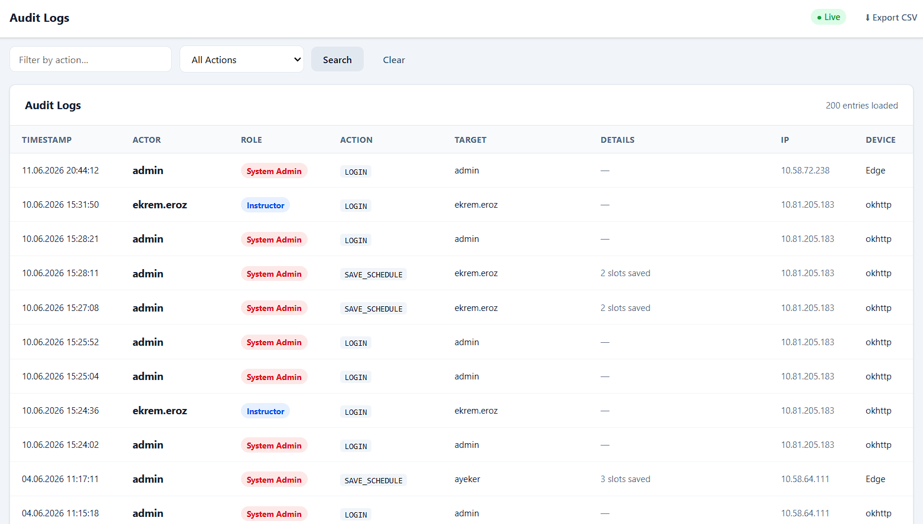



Platform Integration: Web + Chatbot + Audit
Live audit log
Server-Sent Events for super admins · CSV export
[ Screenshot: web dashboard or
live audit log screen ]
RASA NLU chatbot
23 trained intents · 24/7 guidance
Mobile app for instructors
availability submission · messaging · notifications

Slide 7




What Sets Us Apart
“Commercial tools produce a solution. We produce a solution, explain it, and manage the entire process end-to-end.”
Industry tools
1. Dynamic N-phase system
2. XAI decision tree
Fixed rule / phase structures
hard to customize
“Black box” optimization
no explanation of results
Admin-only platforms
little instructor-facing experience
phase count & order derived from data, not hardcoded
score + reasoning for every suggestion → trust
3. Integrated triple platform
4. End-to-end management
Android + Web + chatbot on one backend
availability, messaging, notifications, history

Slide 8

OptiClass schedules the entire university,
explains every decision, and manages
the whole process — on one platform.
Now, let’s see this in action.

