Slide 1
Fundamentals of Data Analytics HW2

Slide 2
Decision Tree Practice
Goal
Understand what decision trees do and the difference between real behavior of classification model and observed data
Description
Construct a decision tree to observe the difference between real ‘right’ data and modeled data
Due: 4/18 Thu. 9am !!!

Slide 3
Flow
Step 1 -
Design features/attributes for your problem and a set of rules to classify data
Step 2 -
Use the data generated in step 1 to build a decision tree
Step 3 -
Compare the rules in the decision tree from step 2 and the rules you used to generate your ‘right’ data
Step 4 -
Discuss anything you can

Slide 4
Simple Example
Question:
Titanic- Who will survive?
Attributes/Features:
艙等(1~3)、性別、年齡、兄弟姊妹數、父母數、小孩數、票價...
Designed Rules:
艙等=1
yes
no
survive
年齡<60
小孩數<2
die
survive
die

Slide 5
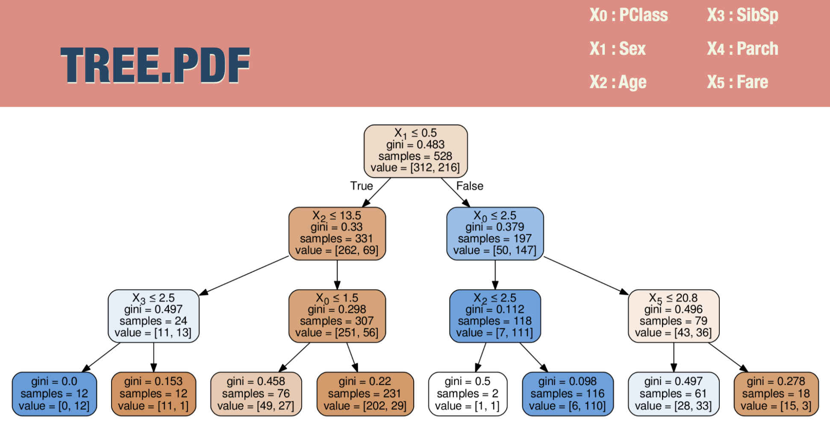

Simple Example -conti.
generate data
compare the rules
index | Pclass | Sex | ... | Survival
1 | 1 | 1 | ... | 1
2 | 1 | 0 | ... | 1
3 | 2 | 1 | ... | 0
4 | 3 | 0 | ... | 0
... | ... | ... | ... | ...
Decision Tree
construct decision tree

Slide 6
Requirement
You should use jupyter / ipython notebook to implement this homework.
Please upload your code, generated data and report to your github.

