Slide 1


Equivariant Geometric Algebra
Course: Deep Learning
Degree: Msci. In AI & Robotics
Yusupha Juwara & Ali Ghasemi
Prof: Silvestri
A.Y. 2023/24

Slide 2
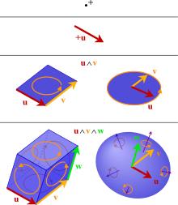
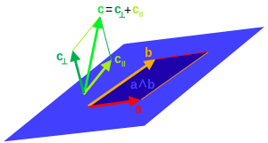
In recent years, two very important and popular research areas in Deep Learning have been:
How can symmetries be encoded using equivariant deep learning?
How can geometric objects be represented through algebraic structures?

Slide 3
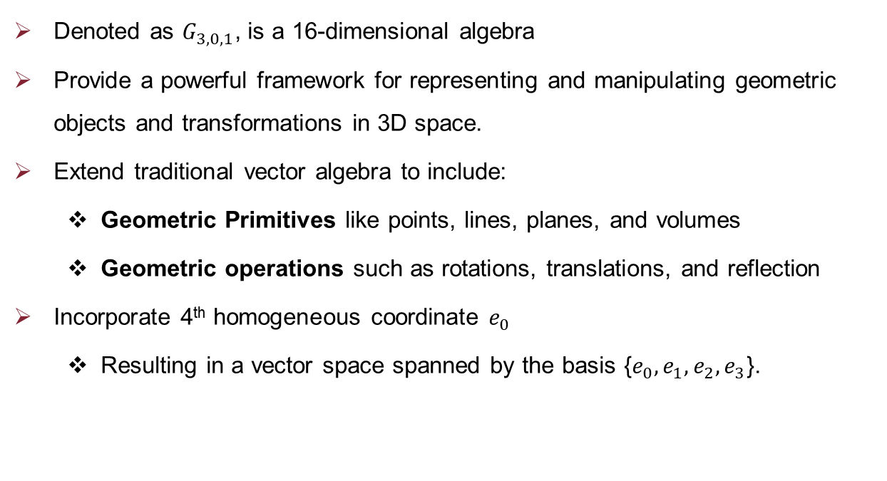
Projective Geometric Algebra
Denoted as $G_{3,0,1}$, is a 16-dimensional algebra
Provide a powerful framework for representing and manipulating geometric objects and transformations in 3D space.
Extend traditional vector algebra to include:
Geometric Primitives like points, lines, planes, and volumes
Geometric operations such as rotations, translations, and reflection
Incorporate 4th homogeneous coordinate $e_{0}$
Resulting in a vector space spanned by the basis {$e_{0}, e_{1}, e_{2}, e_{3}$}.

Slide 4
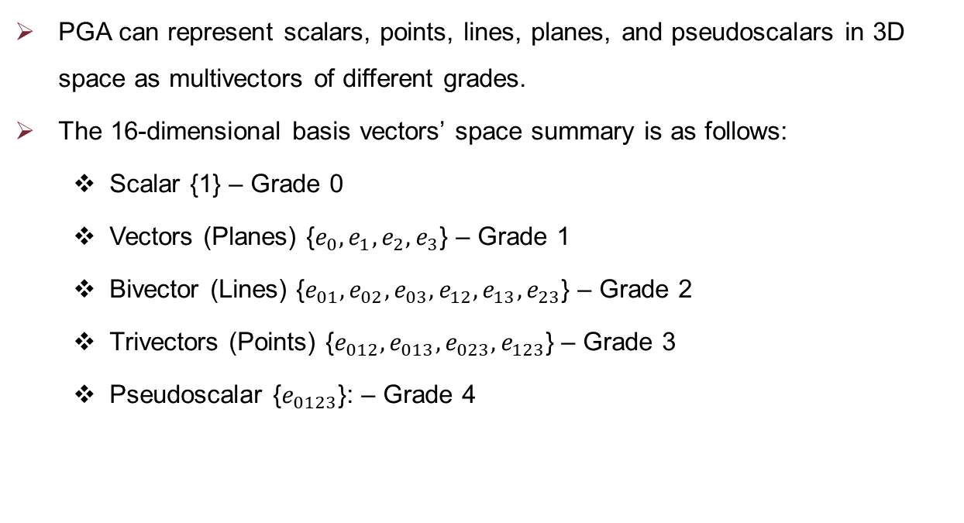
Representation of Geometric Objects
PGA can represent scalars, points, lines, planes, and pseudoscalars in 3D space as multivectors of different grades.
The 16-dimensional basis vectors’ space summary is as follows:
Scalar {1} – Grade 0
Vectors (Planes) {$e_{0}, e_{1}, e_{2}, e_{3}$} – Grade 1
Bivector (Lines) {$e_{01}, e_{02}, e_{03}, e_{12}, e_{13}, e_{23}$} – Grade 2
Trivectors (Points) {$e_{012}, e_{013}, e_{023}, e_{123}$} – Grade 3
Pseudoscalar {$e_{0123}$}: – Grade 4

Slide 5
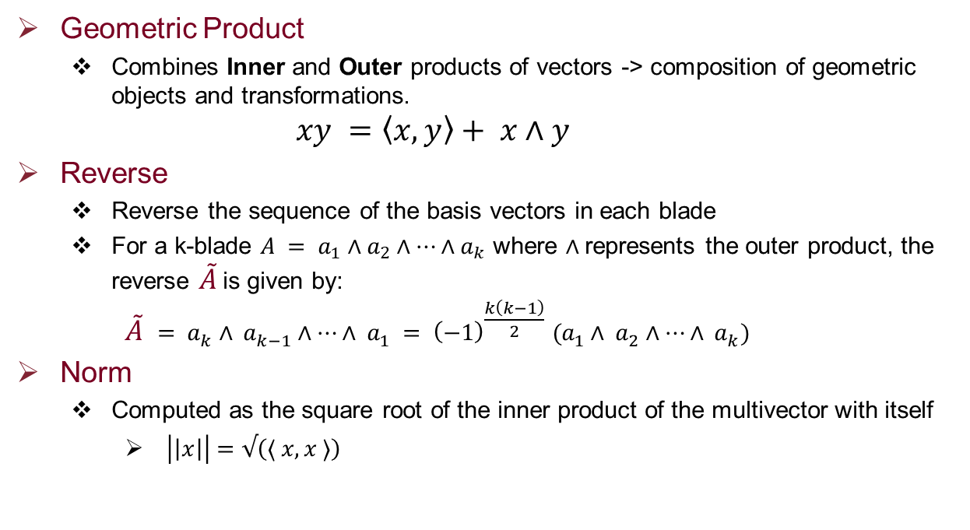
1/3 - Operations
Geometric Product
Combines Inner and Outer products of vectors -> composition of geometric objects and transformations.
$$xy =\left\langle x, y\right\rangle + x∧y$$
Reverse
Reverse the sequence of the basis vectors in each blade
For a k-blade $A = a_{1}∧a_{2}∧⋯∧a_{k}$ where $∧$represents the outer product, the reverse $\tilde{A}$is given by:
$$\tilde{A} = a_{k}∧ a_{k−1}∧⋯∧ a_{1} = {\left(−1\right)}^{\frac{k\left(k−1\right)}{2}} (a_{1}∧ a_{2}∧⋯∧ a_{k})$$
Norm
Computed as the square root of the inner product of the multivector with itself
$\left|\left|x\right|\right|=√\left(⟨ x, x ⟩\right)$

Slide 6
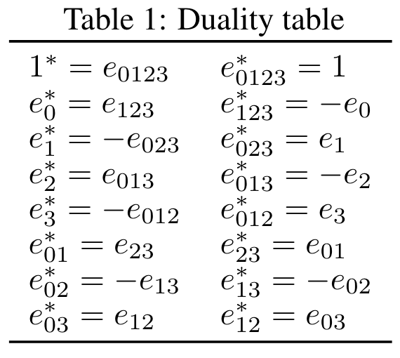
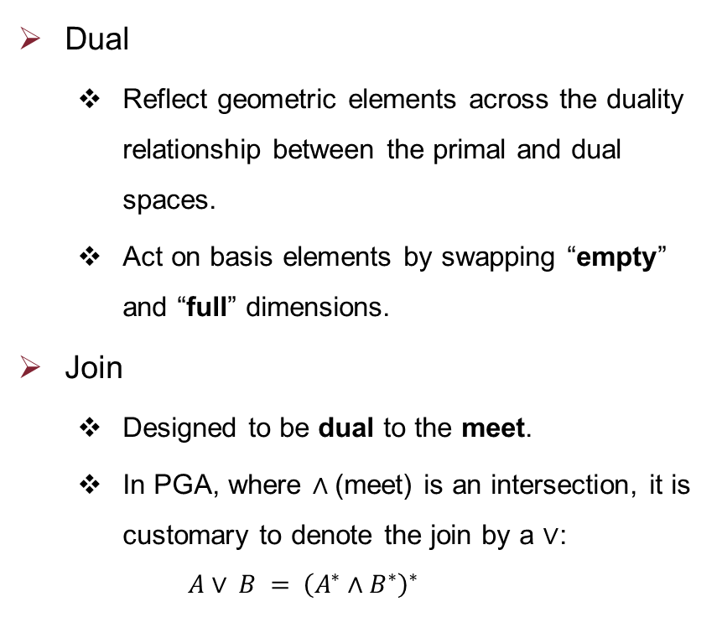
2/3 - Operations
Dual
Reflect geometric elements across the duality relationship between the primal and dual spaces.
Act on basis elements by swapping “empty” and “full” dimensions.
Join
Designed to be dual to the meet.
In PGA, where $∧$(meet) is an intersection, it is customary to denote the join by a $∨$:
$$A∨ B = {\left(A^{∗}∧B^{∗}\right)}^{∗}$$

Slide 7
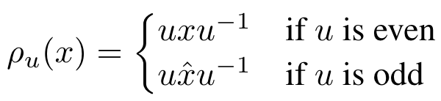
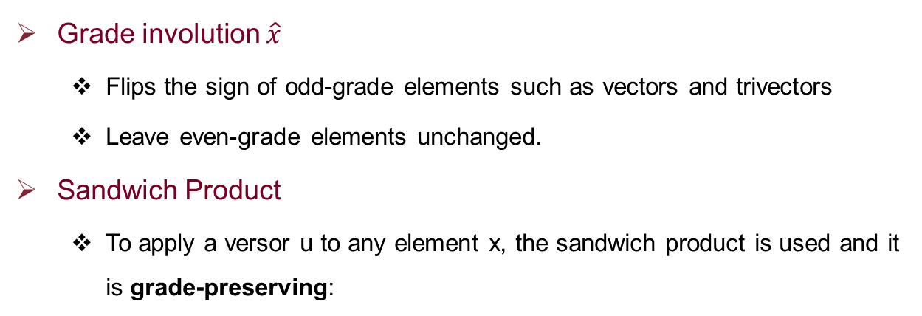
3/3 - Operations
Grade involution $\hat{x}$
Flips the sign of odd-grade elements such as vectors and trivectors
Leave even-grade elements unchanged.
Sandwich Product
To apply a versor u to any element x, the sandwich product is used and it is grade-preserving:

Slide 8
Transformations
Spin transformations:
Closely related to rotations in space & represented by elements called spinors in geometric algebra.
A spinor is a multivector that can be used to represent rotations in any dimension.
Spin transformations preserve the orientation and magnitude of vectors.
They are associated with even-grade multivectors in geometric algebra.
Pin transformations:
Include both rotations and reflections and are represented by pinors.
A pinor is a multivector that can represent both rotations and reflections.
Pin transformations include both spin transformations (rotations) and reflections.
They can be associated with both even and odd-grade multivectors in geometric algebra.

Slide 9
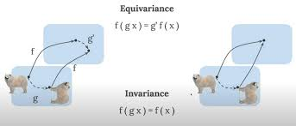
Equivariance Check
Equivariance, in this context, means that applying a transformation before the operation yields the same result as applying the operation and then the transformation.

Slide 10
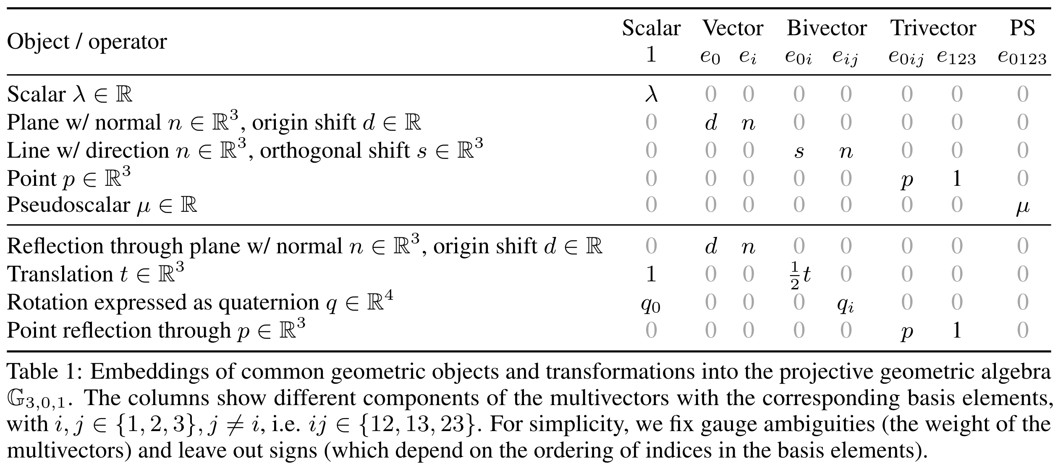
Embedding Table

Slide 11
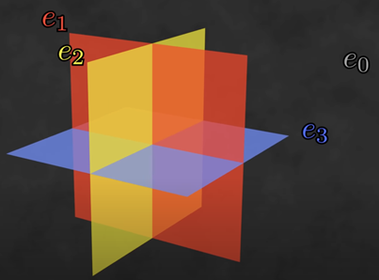
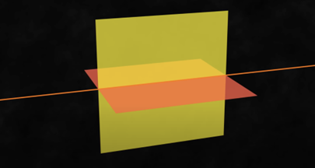
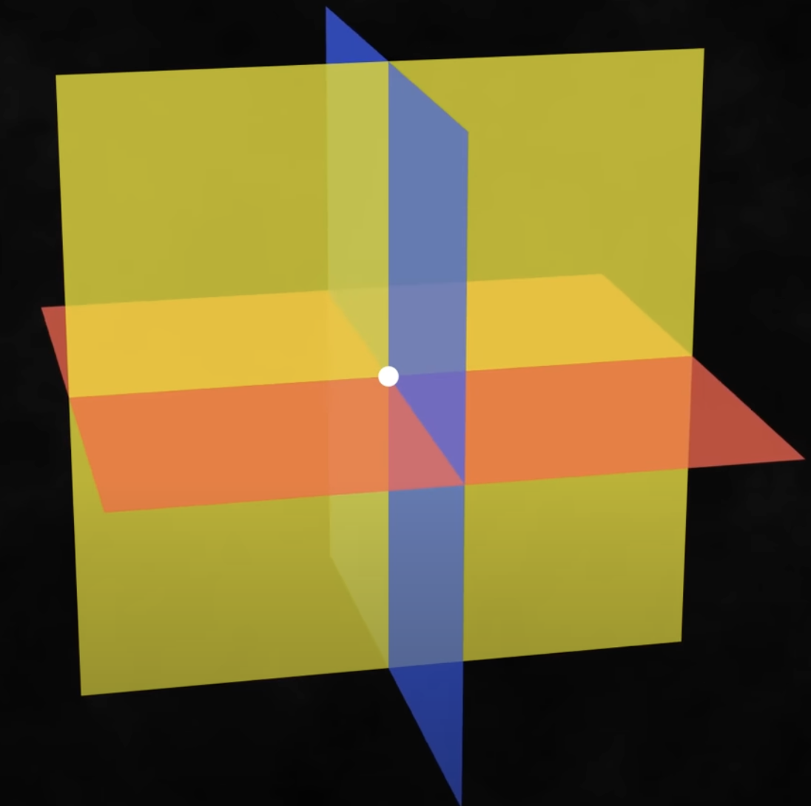
Embedding Figures
3D PGA environment which is equal to the linear space of planes.
Bivectors are considered as lines
Trivectors are points

Slide 12
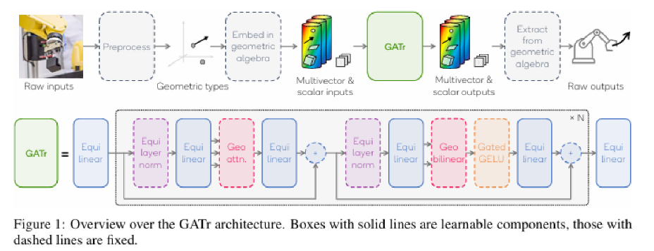
Geometric Algebra Transformer (GATr) Architecture

Slide 13
Components of GATr Architecture

Slide 14
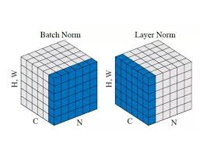
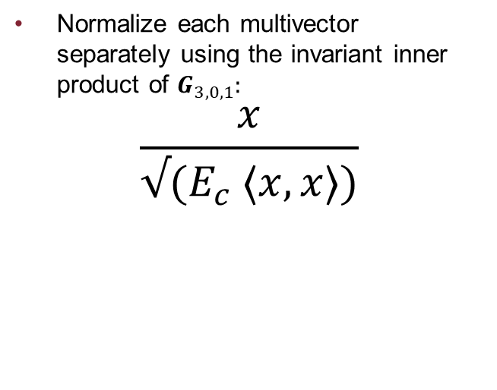
1/5 - Equivariant Layer Norm
Normalize each multivector separately using the invariant inner product of $G_{3,0,1}:$
$$\frac{x}{√(E_{c} ⟨x, x⟩)}$$

Slide 15
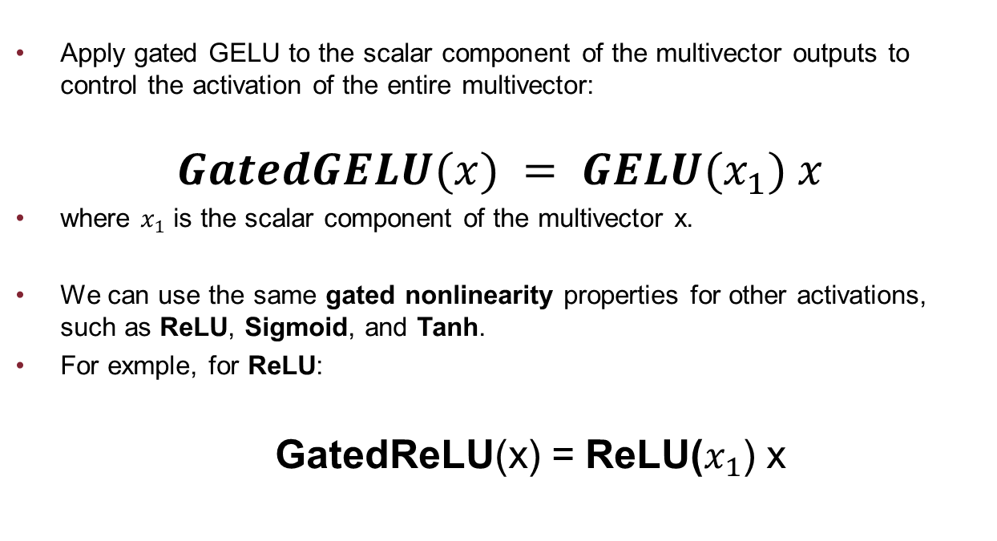
2/5 – Gated Non-linearity
Apply gated GELU to the scalar component of the multivector outputs to control the activation of the entire multivector:
$$GatedGELU(x) = GELU(x_{1}) x$$
where $x_{1}$ is the scalar component of the multivector x.
We can use the same gated nonlinearity properties for other activations, such as ReLU, Sigmoid, and Tanh.
For exmple, for ReLU:
GatedReLU(x) = ReLU($x_{1}$) x

Slide 16
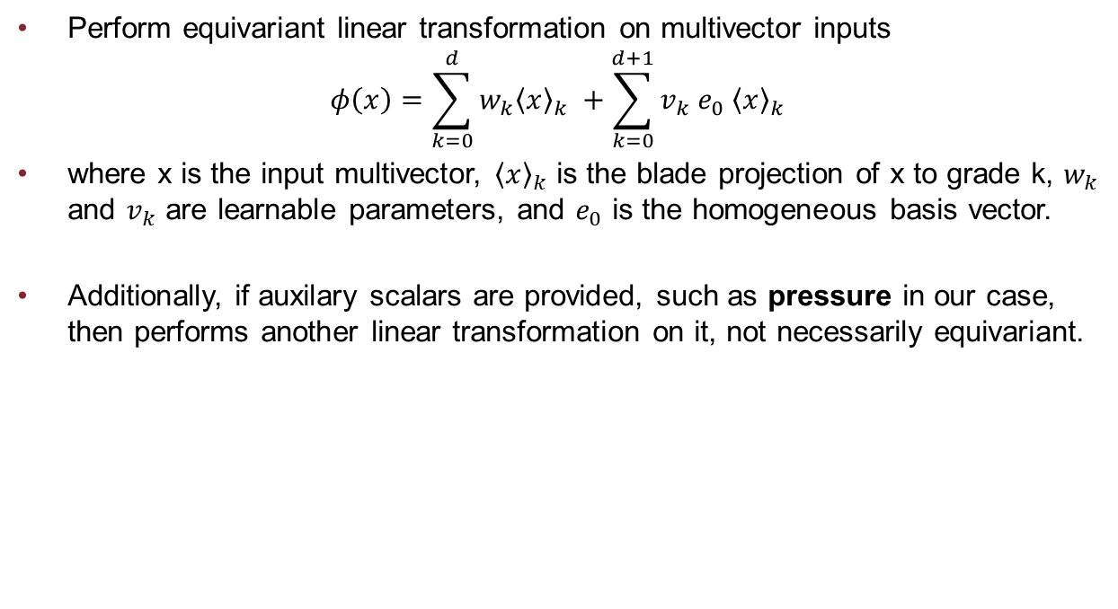
3/5 - Equivariant Linear Transformation
Perform equivariant linear transformation on multivector inputs
$$φ\left(x\right)=\sum_{k=0}^{d}{w_{k}{\left\langle x\right\rangle }_{k}} +\sum_{k=0}^{d+1}{v_{k} e_{0} {\left\langle x\right\rangle }_{k} }$$
where x is the input multivector, ${\left\langle x\right\rangle }_{k}$ is the blade projection of x to grade k, $w_{k}$ and $v_{k}$ are learnable parameters, and $e_{0}$ is the homogeneous basis vector.
Additionally, if auxilary scalars are provided, such as pressure in our case, then performs another linear transformation on it, not necessarily equivariant.

Slide 17

4/5 - Geometric Bilinear Transformation
Perform geometric bilinear operations, that is two operations: geometric product and join:
$$Geometric(x, y; z) = Concatenate_{channel}(xy, EquiJoin(x, y; z))$$
where $EquiJoin(x, y; z) = z_{0123}{\left(x^{∗}∧y^{∗}\right)}^{∗}$, and $z_{0123}$ is the pseudoscalar component of a reference multivector z.

Slide 18

5/5 - Geometric Attention
Represent the geometric attention mechanism, a crucial part of the GATr architecture
Responsible for capturing geometric relationships between multivectors.
$$Attention(q,k,v)\}= \sum_{i}{Softmax_{i}\frac{\sum_{c}{⟨q_{i}, k_{i}⟩}}{√(8n_{c})}}v_{i}$$

Slide 19
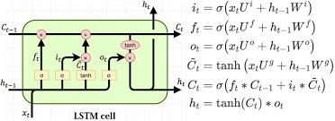
Equivariant LSTM

Slide 20
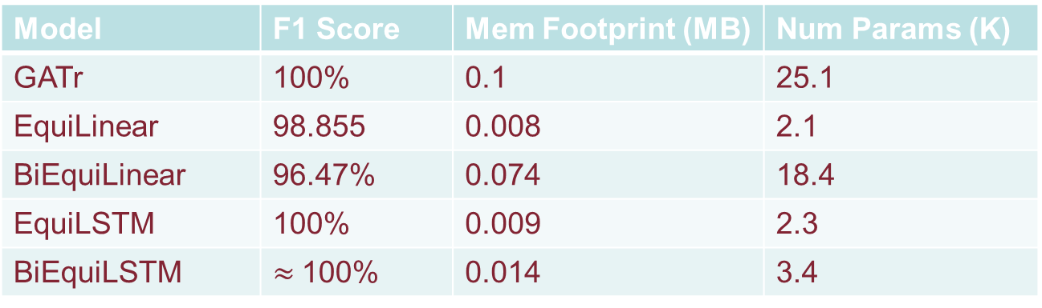
Results
Model | Non-norm data F1 score | Norm data F1 score
SVM | 100% | 98.625%
Log Reg | 100% | 98%
Model | F1 Score | Mem Footprint (MB) | Num Params (K)
GATr | 100% | 0.1 | 25.1
EquiLinear | 98.855 | 0.008 | 2.1
BiEquiLinear | 96.47% | 0.074 | 18.4
EquiLSTM | 100% | 0.009 | 2.3
BiEquiLSTM | $≈$100% | 0.014 | 3.4

Slide 21


