Slide 1


Software Analysis, Design, and Implementation: Enhancing Public Administration Services through Software Solutions
Facoltà di Ingegneria dell’Informazione, Informatica e Statistica
Corso di Laurea in Informatica Applicata e Intelligenza Artificiale
Yusupha Juwara
Supervisor:
Prof. Danilo Avola
Co-Supervisor:
Prof. Luigi Cinque
Prof. Marco Raoul Marini
Prof. Daniele Pannone
A.Y 2022/23

Slide 2


Slide 3

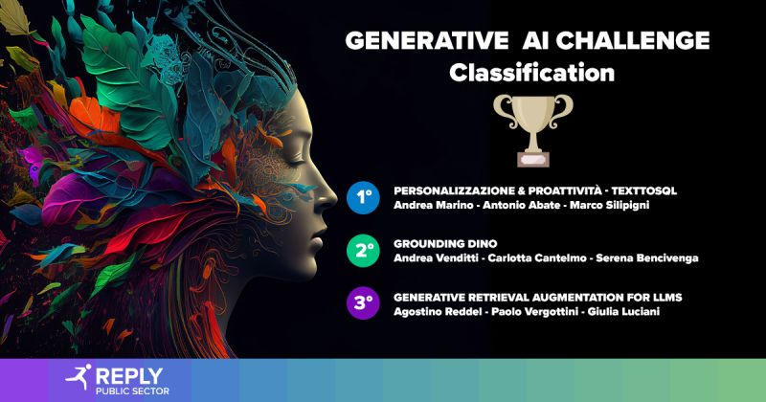
Reply
Whitehall Reply
Italian multinational company
Parent to so many Subsidiaries
Whitehall Reply
Conducts consulting services, Developing solutions/systems, Execution of extensive application projects for Public administration
The company’s specialties encompass:
Big Data & Open Data
Data Broker
Blockchain
Cloud Computing
Public Data Services
Metaverse
Web Application
Artificial Intelligence
Machine Learning
Company Overview stats (2022)
People | 14,300+
Nationalities | 38
Partnerships with Universities | 152
Net Zero Goal | 2030
Revenue (2021) | 1.48 billion
Competitions in AI & ML

Slide 4
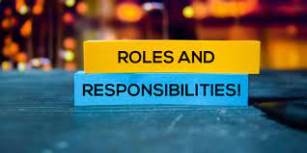

Slide 5
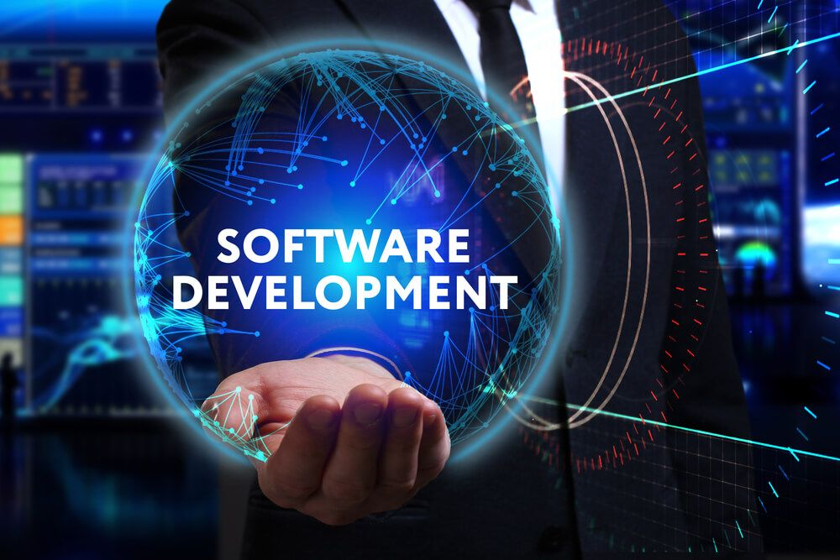

Slide 6
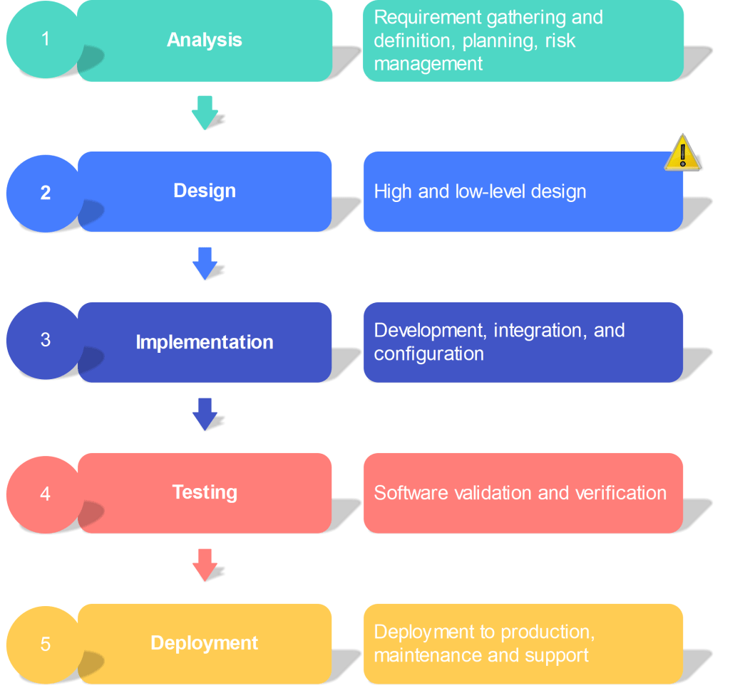
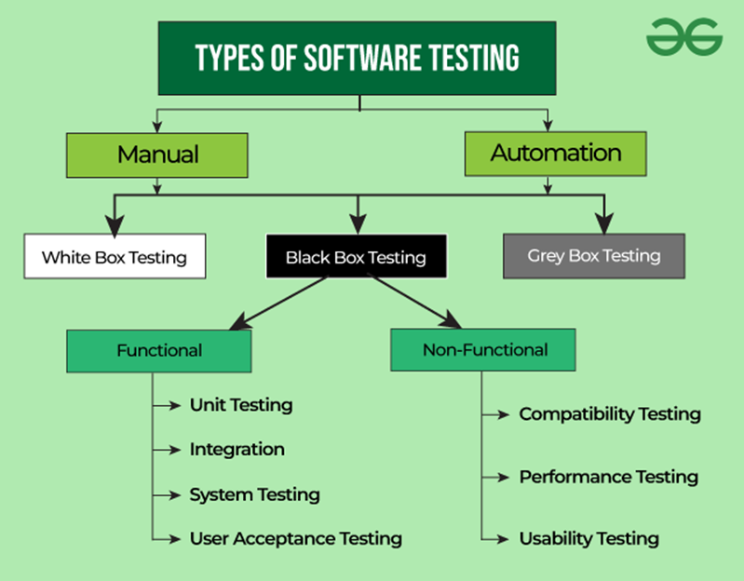


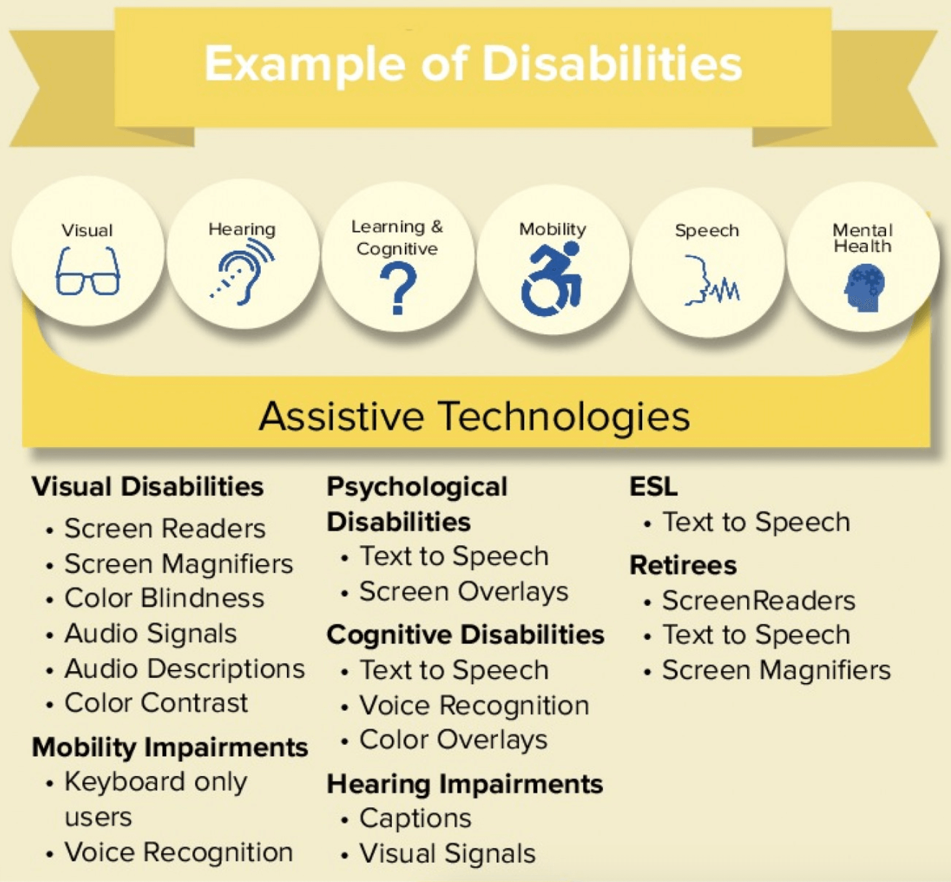
Software Development
Requirements analysis, Software solutions design, and Implementation of very large projects
Test development
Ensuring reliability and quality of software components
New features and functionalities
Multi-Language Support
Accessibility Features for disables

Slide 7
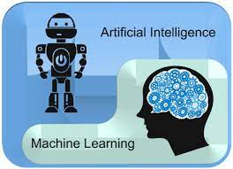
Artificial Intelligence (AI) and Machine Learning (ML)

Slide 8
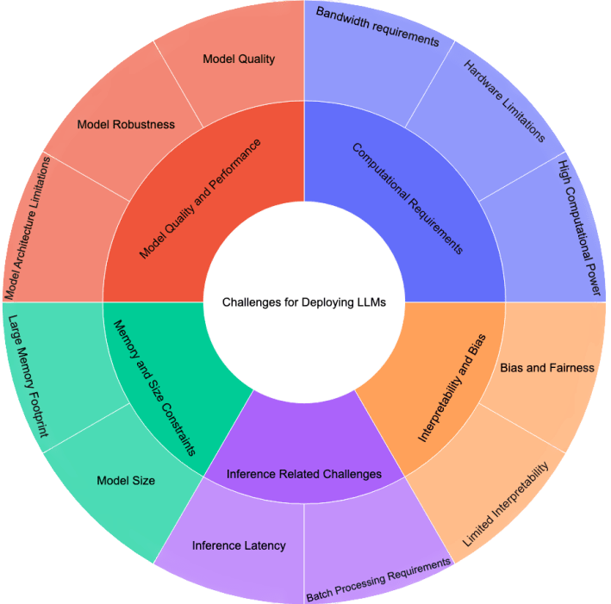
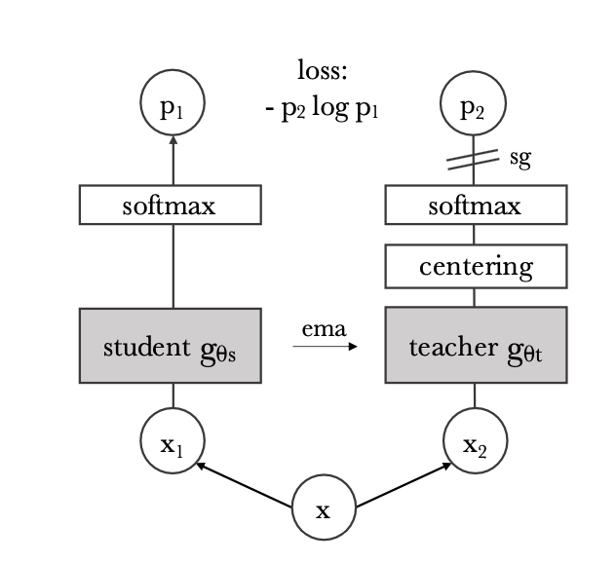
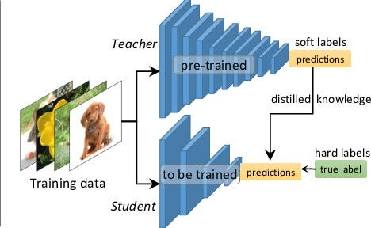
Research
Cutting-edge models and their intricacies
Studying model architectures, algorithms
Grounding Dino → next slides
Knowledge Distillation
Reduces computational requirements
Suitable for deployment on resource-constrained devices
Teacher teaches Student in replicating its decision-making processes
Easily digestible documentation
Knowledge sharing

Slide 9
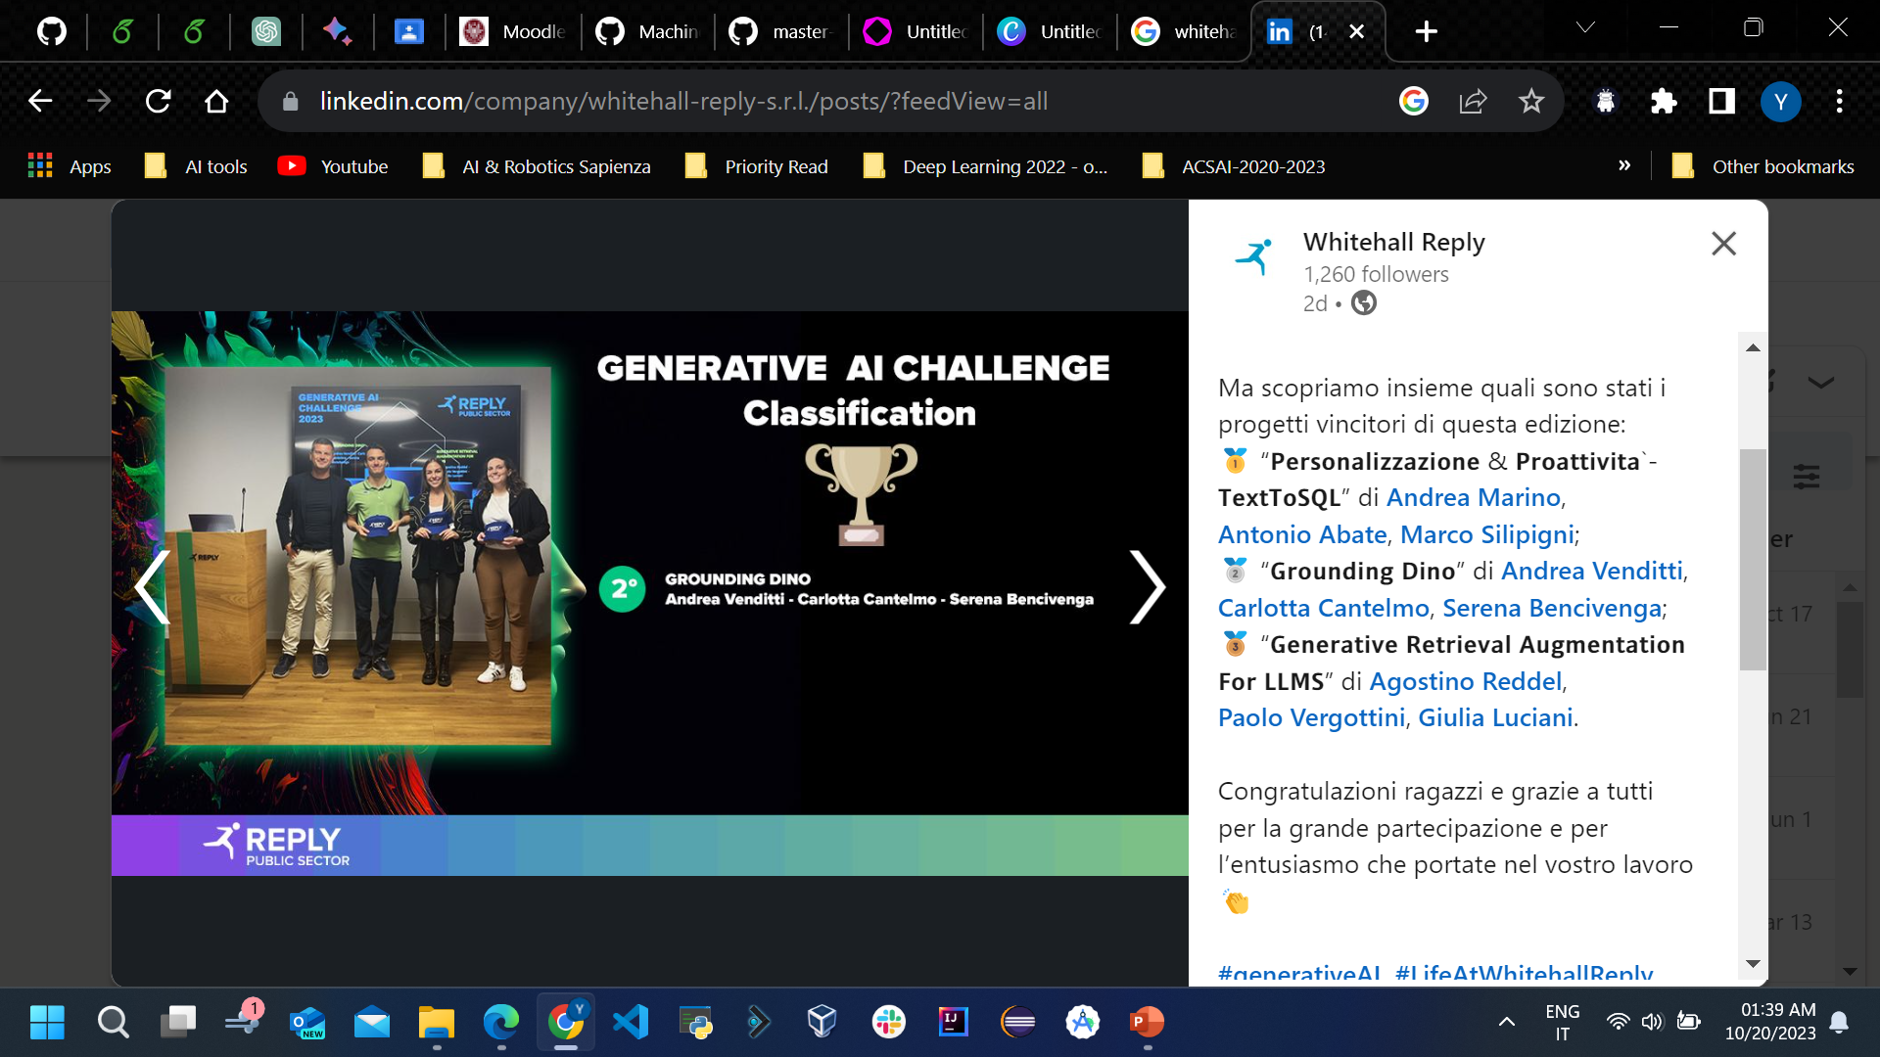
Implementation

Slide 10
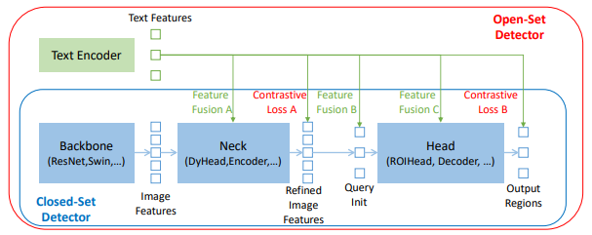
Grounding Dino
Open-set object detector
Referring expression comprehension (REC)
Describing objects with attributes (noun phrases)
Zero-Shot Transfer for Model Generalization
Dual-encoder-single-decoder architecture
Next page
Cross-Modality Feature Fusion
Feature Extraction
Feature Enhancer
Cross-Modality Decoder
Language-Guide Query Selection

Slide 11
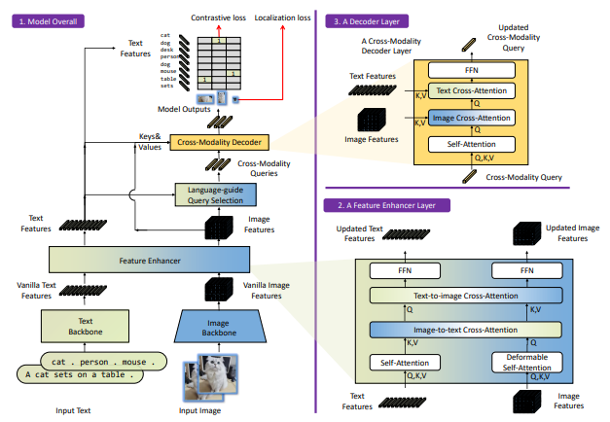
Grounding Dino Architecture
Outputs multiple pairs of object boxes and noun phrases
select cross-modality queries from image features
cross-modality feature fusion

Slide 12
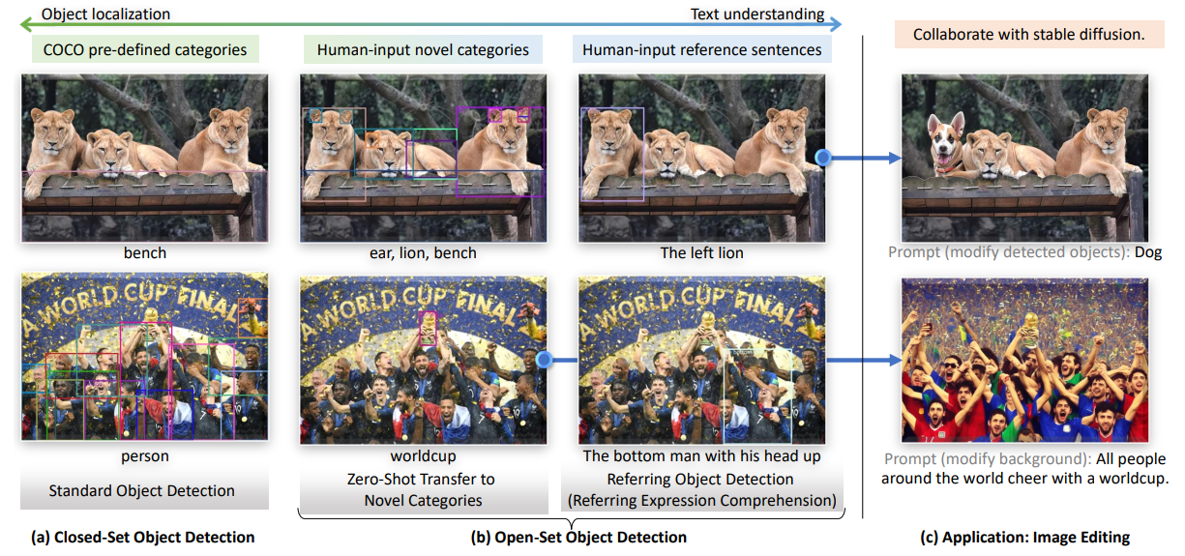
Grounding Dino Example

Slide 13
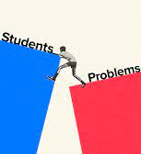
Problems Faced

Slide 14
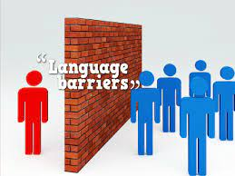

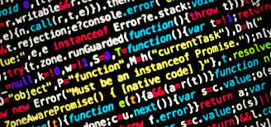
Problems Faced
Language Barrier
Requirement documents, project prototypes → difficulties in comprehending nuances
Understanding technical jargon and intricate project details → hurdle (in the beginning)
Learning On-The-Job
New courses and training modules emerged regularly
Technical certifications → English
Non-technical aspects → Italian (Not Primary Language)
Workplace safety, labor laws, workers’ rights
Understanding Complex Codebases (migrating)
Many dozens -- or even hundreds -- of files
Intricate codebases → require in-depth comprehension
Understanding others’ logic and design choices → Challenging

Slide 15


Slide 16
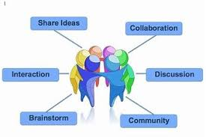

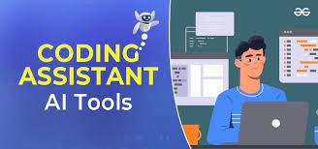
Solutions
Collaborative Learning and Language Proficiency Enhancement
Seek clarification from internship tutor and colleagues → nuances solved
Deep-dive into the Italian language → B2
Multifaceted Learning Approach for On-The-Job Learning
Learning many things at the same time
From language improvement
To understanding non-technical topics
Labor laws and workplace safety → Solved
Leveraging AI Tools for Understanding Complex Code
AI-powered tools → code explanation and clarification

Slide 17
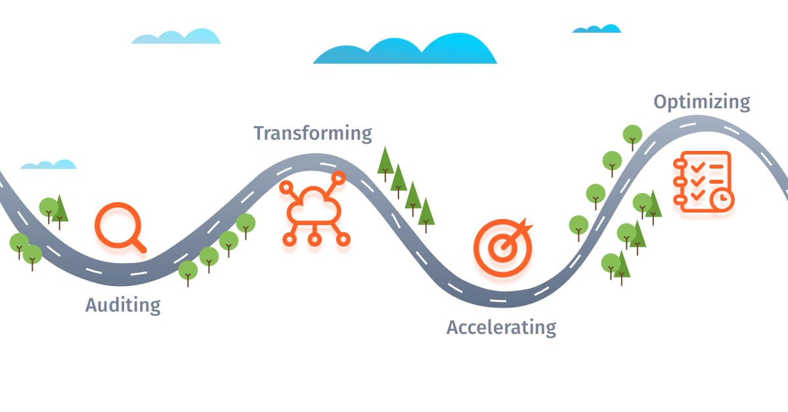
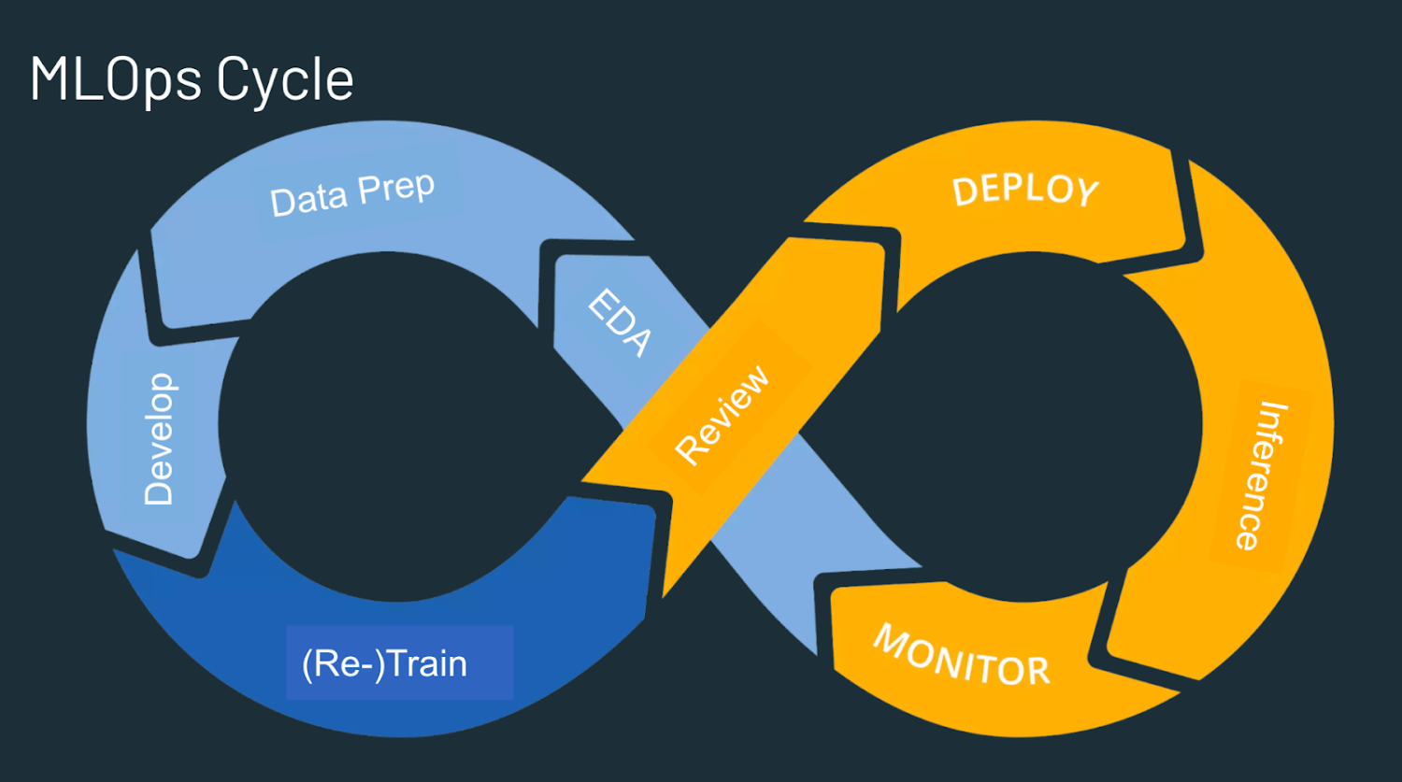
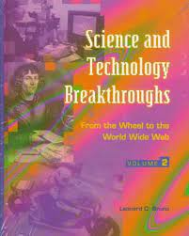
Conclusion
The internship has been a transformative journey
Ranging from very large Software development projects (in public admin)
To cutting-edge AI & ML
To Data Base Management
To Unit & Integration Testing
Future Prospects
MLOps
Design, Development, Deployment to general public
Improve existing algorithms and techniques
AI alignment, Explainability
Novel ideas and methods → breakthroughs in science and technology
Research and Publication → Contribute to open science and open source

Slide 18


