Slide 1
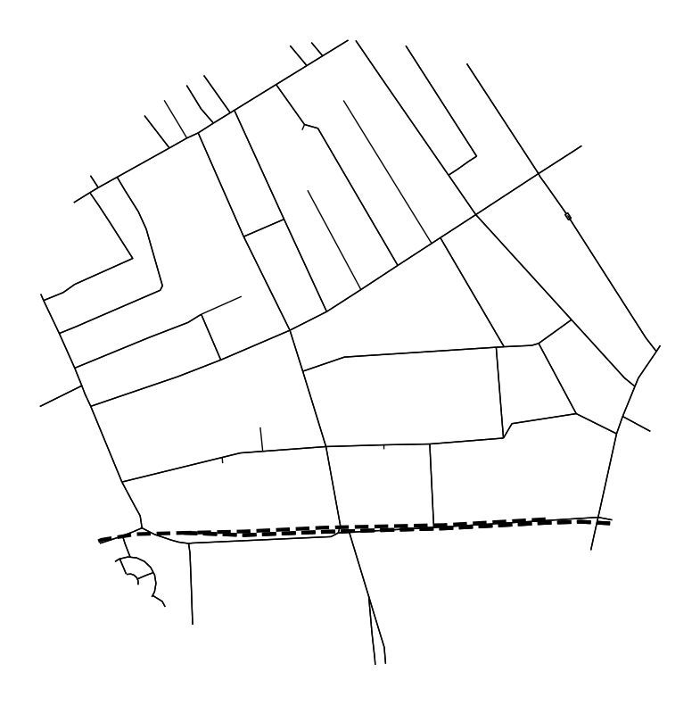
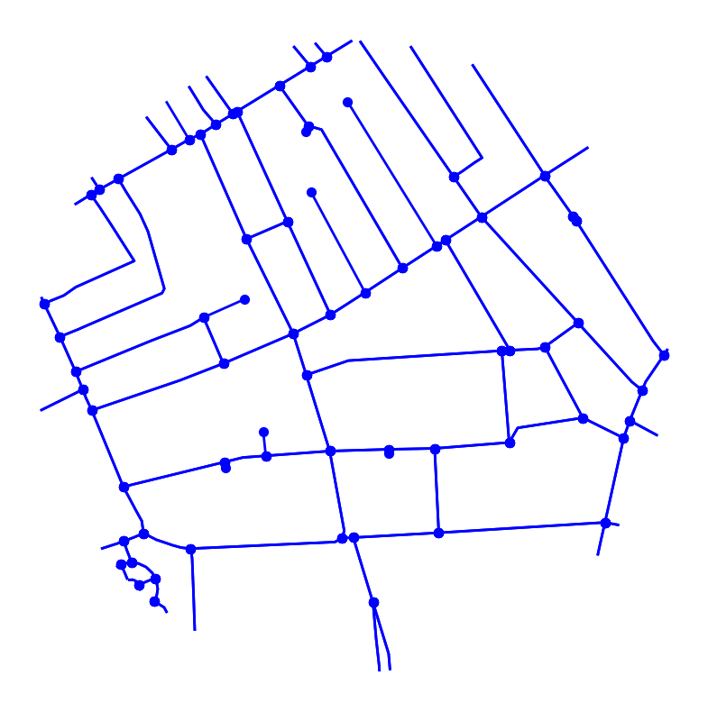
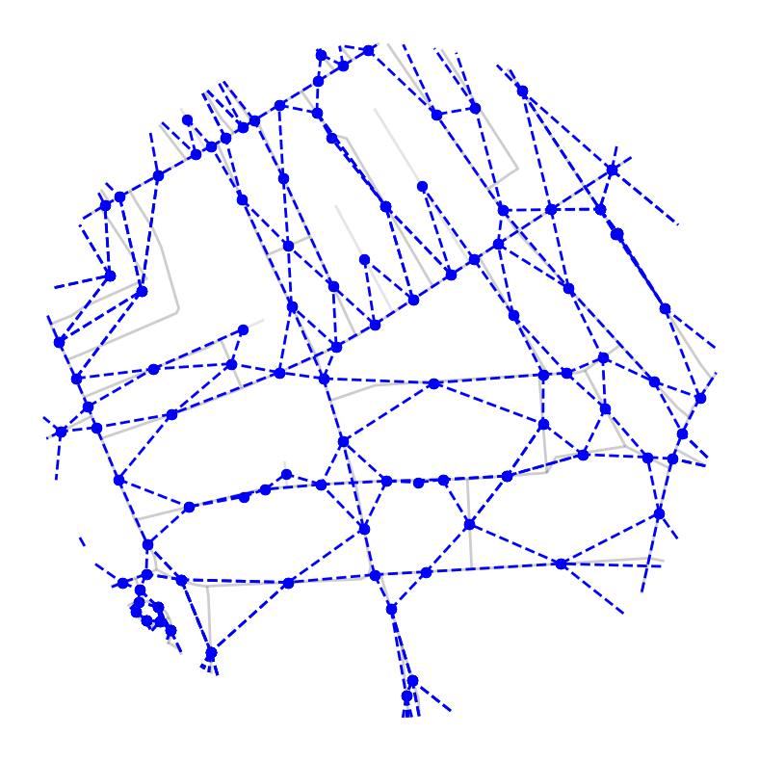
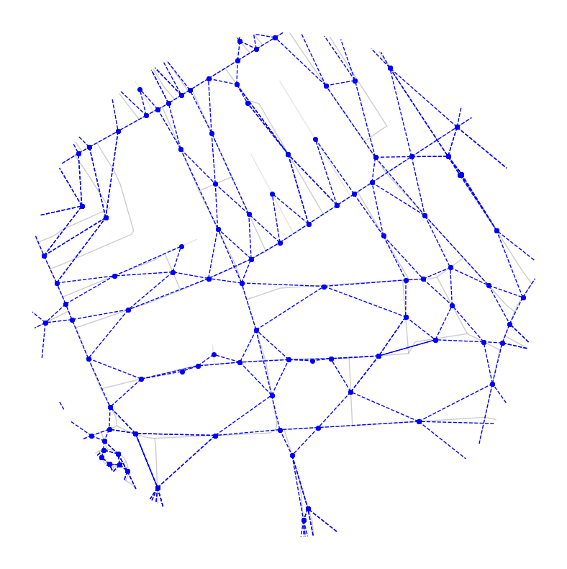
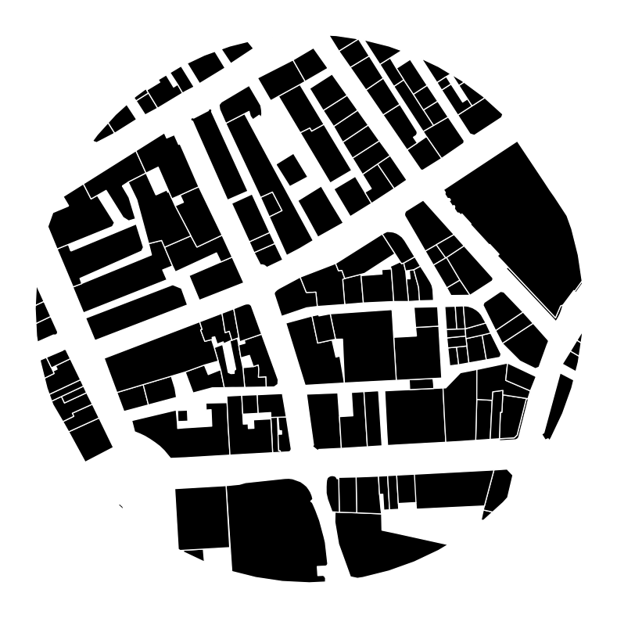
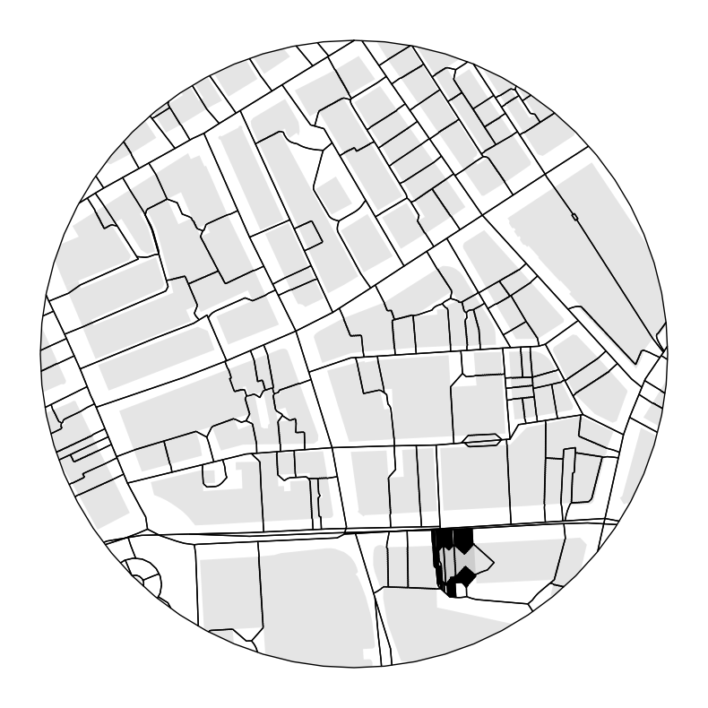
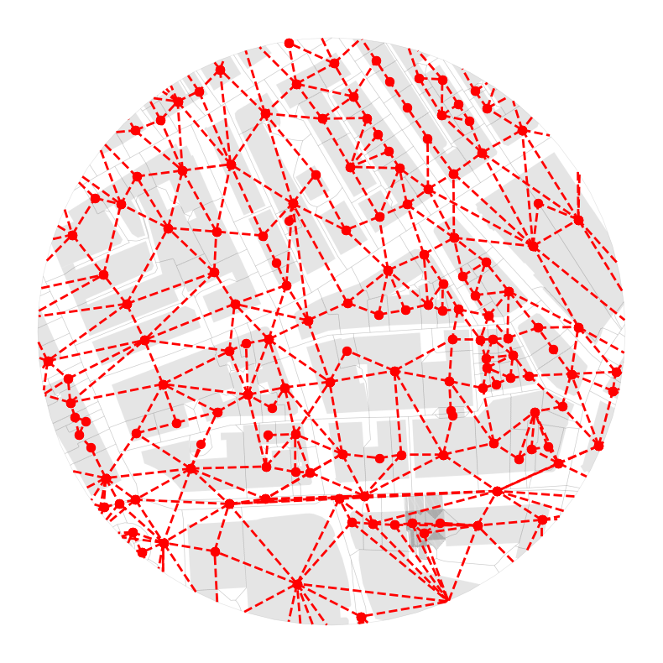
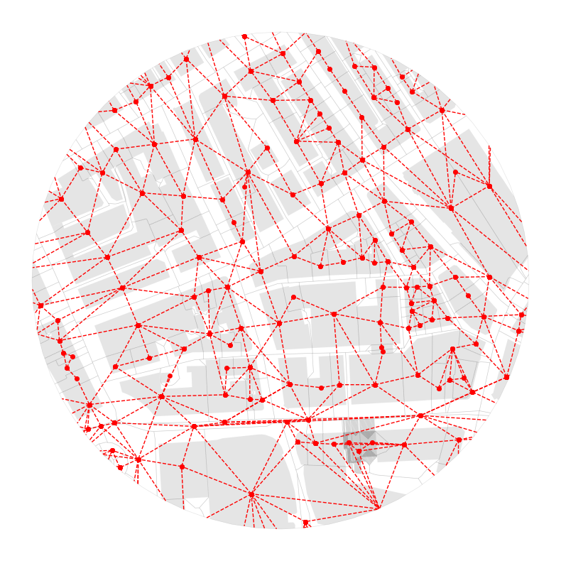
Urban form
characters
Urban function
characters
Barriers
(Streets & railways)
Streets
(node: intersection)
Dual Graph of Streets
(node: street)
Contiguity between
streets and ETCs
Urban form
characters
Urban function
characters
Anchors
(Building footprints)
Enclosed Tessellation Cell
(ETC)
Contiguity Matrix
(node: ETC)

Slide 2
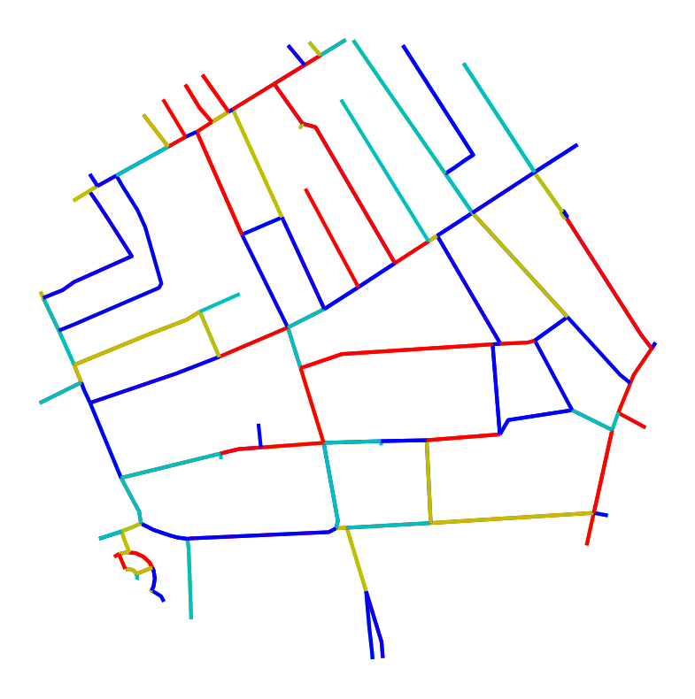
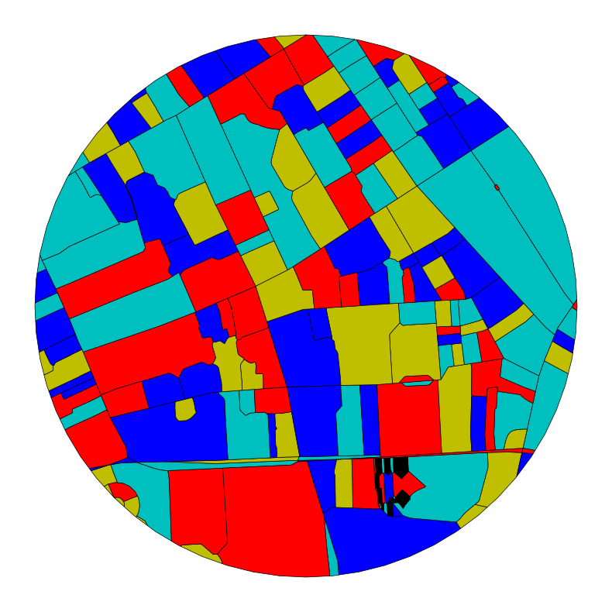


Multi-layers
…
Public → Public
Node-level Encoder
+
Public
spatial signatures
…
Public → Private → Public
Node embeddings
Node-level Encoder
$$Z$$
$$σ(ZZ^{⊤})$$
Node embeddings
Decoder
…
Reconstructed structure
Private → Public → Private
Node-level Encoder
Original graph
+
…
Private
spatial signatures
Private → Private
Node-level Encoder

Slide 3
Year 1 | Year 2 | Year 3
Definition of network representation
Development of open-source library
Updates & enhancements of the open-source library
Data collection & processing
Modeling and development of GNN
Model training & tuning
Interpretation & comparison
Final report

